Slide 1

HOW TO BREAK UP WITH SOMEONE
By: Michael Chang

Slide 2
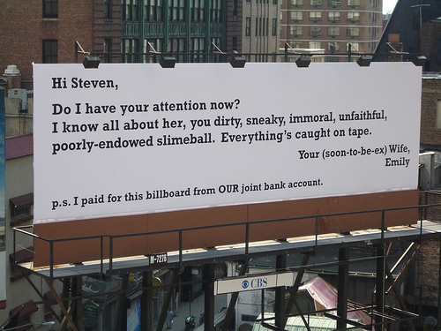
Idea #1
Say it with a Billboard!
Figure out which route/street they take to work every morning and buy billboard space for a week. If you really want to rub it in, buy the space for a month, and make sure it is in an area where they cannot take a detour to work. If you REALLY want to rub it in, then find a hot guy/girl and take a picture of the two of you together and put that on the billboard.

Slide 3
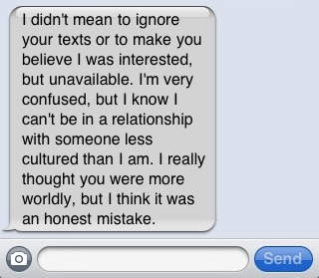
Idea #2
Tell them though a text
Nothing says: “It’s over” more quickly and to the point than a simple text message. No mess, no having to listen to them moan, cry and complain and best of all you can turn off your cell phone to avoid having to hear them whine and moan.

Slide 4
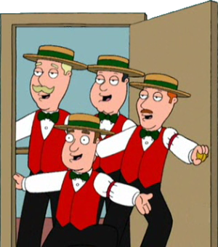
Idea #3
Hire a BarbershoP
Quartet.
Nothing says “I want to break up with you” better than 5 guys showing up on their front doorstep, dressed in white and red striped uniforms with straw top hats singing:
It’s over oveer oveeer oveeeer !!!

Slide 5
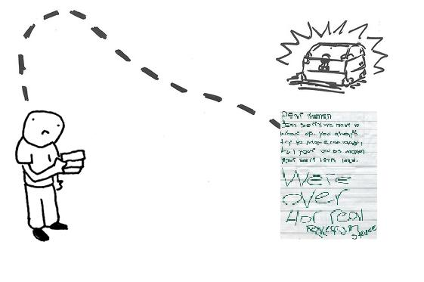
Idea #4
Send them on a treasure hunt.
Pick 5 spots in the area where you live. It could be the mall, the park, the beach, a coffee shop, wherever. Leave a note that leads to the next spot in a hidden area. At the final spot leave the breakup note. If they are not too bright, they will entertain themselves for hours on end before the find the final breakup note.

Slide 6
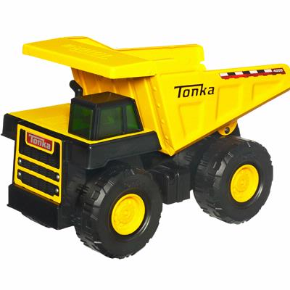

IDEA #5
For the more childish dumpees, give them something tangible to play with - as a replacement for yourself. Wrap up a toy dump truck, Tonka or otherwise. Suggest that they use it to bulldoze the memories of your relationship and clear space for a new life.

Slide 7

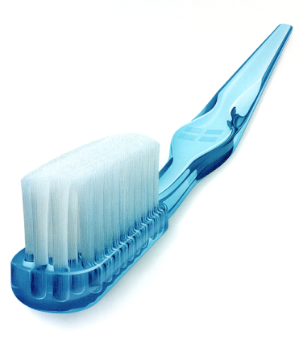
Anthropomorphization.
IDEA #6
Compose a letter ostensibly written by the
dumpee's stuff that still crashes at your
place. Most people who are dating leave some
belongings at their boyfriend's or girlfriend's
house, so you can anthropomorphize these
objects and have them do your break up bidding.
Here's an example:
"Hey, Michael. Psst...it's your blue sweater.
You know, the one you keep at Holly’s place.
Listen, your spare toothbrush and I were
talking in the bathroom the other day, and
rumor has it that Holly will dump you very soon
because she's feeling stifled. Anyway, I don't
want to get hurled out the window, so please
come get me asap. Holly is totally serious!
Anthropomorphism is the attribution of human characteristics to non-human creatures and beings, phenomena, material states and objects or abstract concepts. ... en.wikipedia.org/wiki/Anthropomorphize

Slide 8
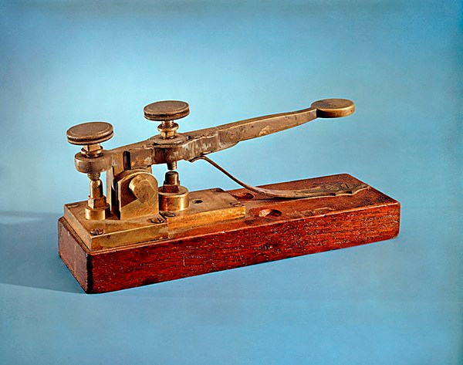
You're dumped - STOP.
IDEA #7
If you were courted in the old
fashioned way, with a series of polite
dates and formal ask-outs, why not
dump the person with an equally old
school gesture - a hand-delivered
telegram! American Telegram still
offers this antiquated service. For an
fee of $39.95 plus $0.89 per word,
you can have a third party deliver the
two-word "You're dumped" message
in a yellow envelope. This grand total
would be $41.73.

Slide 9
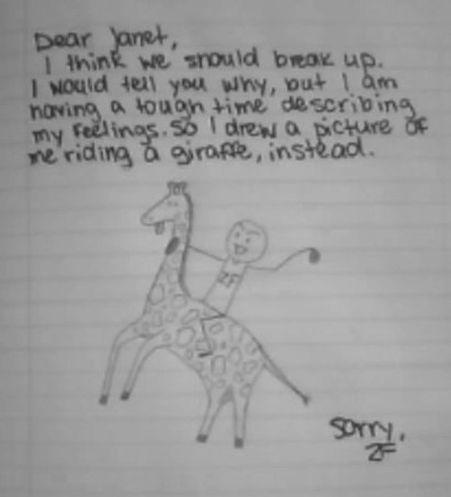
Write a Letter
If your not sure
what to say in
your letter take
this one for
Inspiration.
IDEA #7

Slide 10
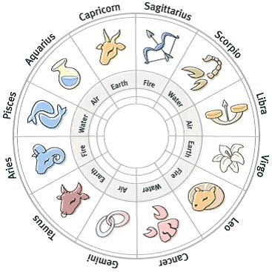
future events
Create a horoscope for him that says "break up with your girlfriend today or she'll make your life hell"
IDEA #8

Slide 11
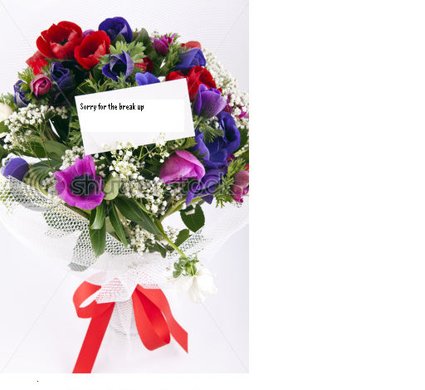
Say it with Flowers!
Send your significant other an
expensive and beautiful bouquet
of flowers to their workplace and
make sure to include a miniature
Dear John letter on the card. The
miles of confusion you create will
be worth having to eat Ramen for
a week to afford this. While
MySpace can be a valuable tool in
humiliating your lover, there's
nothing witty that can be said about
it here.
IDEA #9

Slide 12

My Song to you
Pick out a breakup song. Tell him if you were ever to breakup with him, it would be via this song.
Play him the song.
IDEA #10

