Slide 1
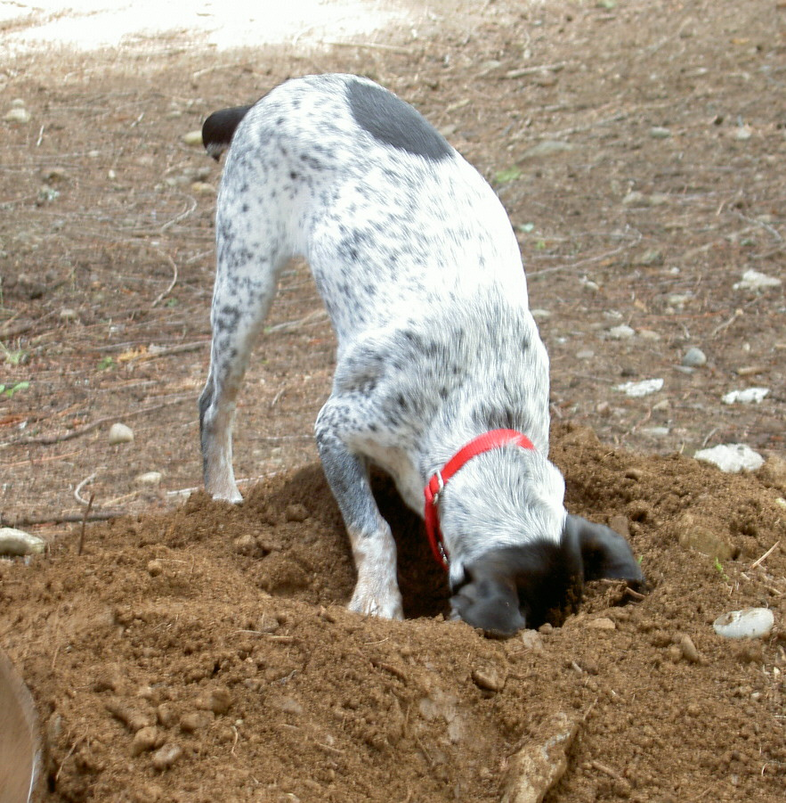

Digging for Data Structures
Anthony Cozzie, Frank Stratton, Hui Xue, Sam King
University of Illinois at Urbana-Champaign
Notes:
Hello, ladies and germs . . .

Slide 2
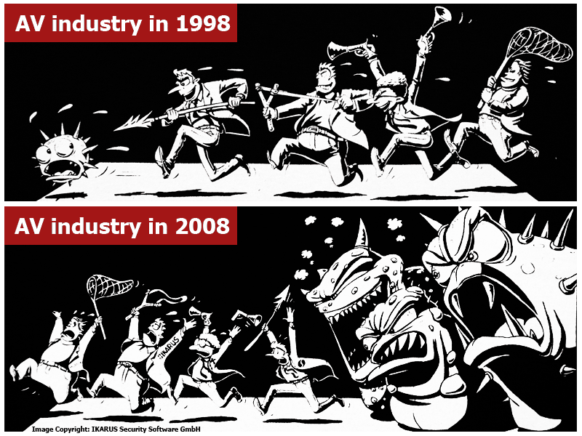
The Current Antivirus Situation
Notes:
AV industry is in trouble. Viruses are getting much stealthier lately. We even have people calling for complete dissolution of the AV industry. Slashdot: “It’s completely wasted money” John Stewart, Cisco Chief Security Officer, 2008. When Slashdot is running articles about how people think your entire industry is worthless, you are in trouble. Microsoft doesn’t have to put up with this. Lots of botnets: example: Srizbi appx. 300K computers and 60 billion spam emails per day. Delivered to user via browser (very convenient since they spam anyway)

Slide 3
Virus Stealth Techniques
Signature checkers are basically grep
Large number of obfuscation techniques
Encryption/packing
Polymorphism (add 2 -> add 17, sub 15)
Opaque predicates and junk bytes
Most of these aren’t even widely used yet!

Slide 4
Observations
All of those techniques obfuscate code
Implies an opportunity for memory-based AV
Obfuscation is very mechanical
But programs are written by people
What we’d like is an AV technique where obfuscation would destroy the human element

Slide 5
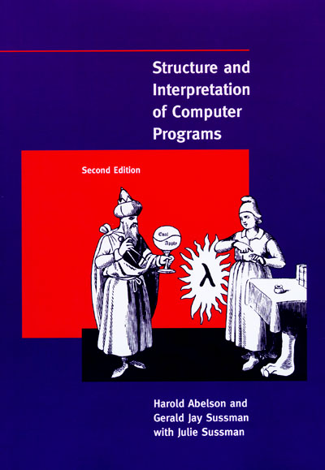
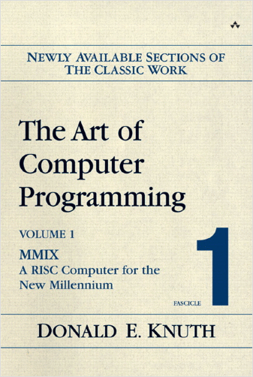
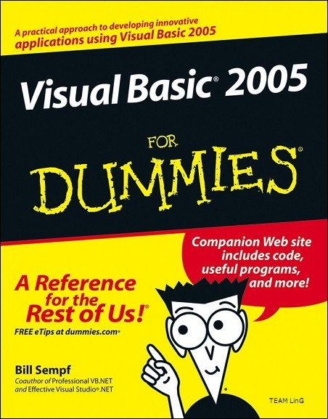
Common Programming Methods
Assumption: all programs use data structures
Notes:
Data structures fulfill all requirements! And we can assume that they are pretty ubiquitous, because just about all programmers are taught to use them!

Slide 6
Data Structure based Antivirus
Detect programs based on their data structures
Emphasis on field types, not actual content
High-level feature detection
Example: encrypting memory will hide data structures
But we expect to find something!

Slide 7
Digging for Data Structures!
08 89 1c 24 89 74 24 04 8b 75 08 8b 5d 0c 8b 56 40 8b 4b
40 8b 42 24 39 41 24 7f 25 7c 2a 8b 42 28 39 41 28 7f 1b
7c 20 8d 43 44 89 45 0c 8d 46 44 89 45 08 8b 1c 24 8b 74
24 04 c9 e9 df 4b 00 24 39 41 24 7f 25 7c 2a 8b 42 00 a2
task_struct char* list<int>
int* char * task_struct
Notes:
But virus writers aren’t nice enough to give us the source code to their programs, so we have to figure out what data structures they use. Digging for Data Structures → resolving the seemingly random bytes of a process image into a list of objects and their types (actually those bytes are part of /bin/ls); idea that programs have a “higher level structure”. Note: works for ALL programs with a static typesystem, not just viruses.

Slide 8
Outline
Detecting Data Structures in Programs
The block type system
Extended example
Accuracy results
Detecting Programs with Data Structures
Why polymorphism is effective
Data structure mixture ratios
Accuracy results
Limitations

Slide 9
The Trick
Problem: image looks random
Trick: build up from the bottom
Convert words into block types
Block types: things we can detect about a machine word of memory
Pointer, zero, bunch of characters
Map block types into atomic types
Atomic type: Anything you’d type in a structure definition: int, int*, char [], struct x*

Slide 10
The Block Type System
 | Data | Zero | Char | Addr
Integer | 0.65 | 0.25
Zero |  | 0.60
String | 0.10 | 0.25 | 0.60
Pointer |  | 0.30 |  | 0.65
Probabilistic mapping between block and atomic types
Unfilled cells are “real small”
Notes:
Columns are block types, rows are atomic types. An almost 1-1 mapping between block and atomic types! Explain typed pointers.

Slide 11
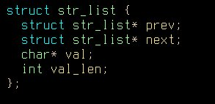
The Key Diagram
A small section of the heap
Laika’s Classification
Address | Value | Char Value | Block
0x650000 | 0x20 | “!” | D
0x650008 | 0x0 | “\0” | 0
0x650010 | 0x650028 | “\FS\0e” | A
0x650018 | 0x650088 | “\^\0e” | A
0x650020 | 0x10 | “\n” | D
0x650028 | 0x650008 | “\BS\0e” | A
0x650030 | 0x650048 | “0\0e” | A
0x650038 | 0x650068 | “h\0e” | A
0x650040 | 0x17 | “\ETB” | D
0x650048 | 0x650028 | “\FS\0\e” | A
0x650050 | 0x0 | “\0” | 0
0x650058 | 0x650068 | “h\0e” | A
0x650060 | 0x17 | “\ETB” | D
0x650068 | 0x6873696620656E6F | “one fish” | S
0x650070 | 0x6966206F7774202C | “, two fi” | S
0x650078 | 0x00646572202C6873 | “sh, red” | S
0x650080 | 0x20 | “!” | D
0x650088 | 0x6C62202C68736966 | “fish, bl” | S
0x650090 | 0x2E68736966206575 | “ue fish.” | S
0x650098 | 0x56700 | “\0g\ENQ” | D
0x6500A0 | 0x40 | “A” | D
unused
Class 1
struct str_list
Composition
Address Array? Blocks
Class 1*
Class 1*
Class 2*
Integer
0x650008 | No | 0AAD
struct str_list
0x650028 | No | AAAD
struct str_list
0x650048 | No | A0AD
char[24]
Class 2
Address Array? Blocks
Composition
0x650068 | Yes; x3 | SSSD
char[17]
String
0x650088 | Yes; x2 | SSDD
Notes:
Explain: how the block types are generated, how we find the objects (pointer targets, how the block type system brings out the similarity, and finally show the typed pointers, talk about “pointer fingerprinting”

Slide 12
There is some math
Lots of quantitative questions:
Should we put object X into Class A or Class B
Should we merge Class A and Class B
We used a standard unsupervised Bayesian classifier – see the paper for details
Provides a single (very large) equation that measures how good a given solution is

Slide 13
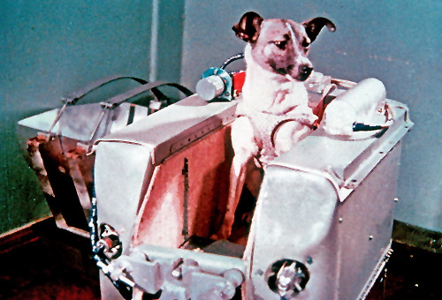
Laika, the first Space Dog
Implemented in Lisp; about 5000 lines
Tries to optimize Bayesian model

Slide 14
Difficulties in Practice
Computationally expensive problem
Only 30% of objects contain pointers
A large number of strings
Typed pointers are necessary
Overly clever programming practices
Unions
Tail accumulator arrays
The X Window Developers in particular used a lot of tail accumulator arrays, and we used a lot of X apps
Notes:
Example is very simple; things get much trickier with real programs. Computational messiness; tail accumulator arrays are where the structure is defined with a variable sized array as the last member; Laika assumes fixed sizes for the classes; a lot of our test apps were GUI programs

Slide 15
Laika’s Accuracy
Ran programs in GDB to get ground truth
7 test programs
Averaged 4000 objects and 50 classes
Measured probability Laika placed objects into the correct classes
p(real|laika), p(laika|real)
Without malloc info: 0.68 and 0.65
With malloc info: 0.80 and 0.70
Notes:
Laika generally does a bit worse on the larger applications; pretty obvious as there are more ways to go wrong. Numbers are for p(real|laika) and then p(laika|real). Note that this is a very harsh measure: double/int. When Laika is only given “objects” its about 5% more accurate. We think this is pretty impressive.

Slide 16
Antivirus!
Notes:
Time to change gears!

Slide 17
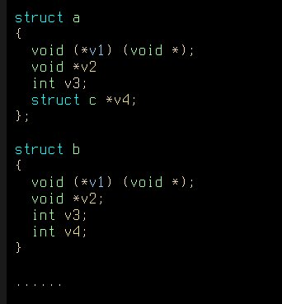
Data structure based classifier
=
Notes:
Emphasis is on the structure, not the data – we ignore the actual field values.

Slide 18
Mixture Ratio I
Program 1
Program; different colors represent objects of different types
Cl
Class 1
Class 2
Laika correctly clusters those types into classes
Notes:
What does Laika do: it looks at programs as a collection of objects, and puts similar objects together

Slide 19
Mixture Ratio II
Program 1
Program 2
Cl
Class 1
Class 2
Class 3
Notes:
Trick: Run two programs at once! Then, look at the results and see how mixed they are! (Red objects occur only in Program 1, Green only in Program 2, but Blue objects are split 50-50)

Slide 20
Mixture Ratio III
Measure how mixed each class is and take weighted average
From Program 1
From Program 2
Cl
Class 1
Class 2
Class 3
Average: 0.85
MR=1.0
MR=0.5
MR=1.0
Notes:
Note how this elegantly reuses the object similarity code we already have – our classifier is only 50 lines of code, which compares pretty favorably with the commercial virus checkers

Slide 21
Is this program a Kraken?
Run it in a sandbox; take a snapshot of its memory image
Download sample Kraken memory image (signature) from repository
Laika analyzes two images as one and measures the mixture ratio
Unknown program is Kraken if the mixture ratio is less than a threshold
Notes:
So, how do we pick the threshold in a rigorous manner?

Slide 22
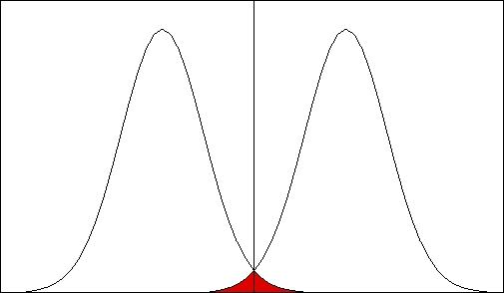
Training
Classified as Virus X
Classified as not Virus X
Distribution of mixture
ratio of other
samples of Virus X
Decision
threshold
Distribution of
mixture ratio of
known good
programs with
Virus X
Probability
Error
Mixture Ratio
Notes:
We have a number, but now we need a threshold for deciding whether these are versions of the same program! Simple maximum-likelihood classifier. Done for each virus separately. Use half of our samples as training data; estimate distribution of mixture ratio, choose threshold for minimum error. It’s easy to get a lot of copies because they are polymorphic ☺

Slide 23
Accuracy
Bot | Bots | Normal Prog. | Errors | Est. Acc. | ClamAV
Agobot | 19 | 27 | 0 | 99.4% | 83%
Kraken | 34 | 27 | 0 | 99.8% | 85%
Storm | 20 | 20 | 0 | 99.9% | 100%
No errors; 100% accuracy on our sample set (~150 tests)
Expected number of errors: 0.33
Notes:
samples/errors: first number is bot samples, second is “clean” samples.

Slide 24
Philosophical Points
Virus detection is an arms race
… and the bad guys always win
Generic virus detection is undecidable
So any virus detector is breakable
Mixture ratio is a very simple first cut; both sides can probably do better
Defense in depth: Laika synergizes very well with existing detectors
Notes:
This is one graduate student’s 5000 lines of code – we can almost certainly do better!

Slide 25
Countermeasures
Simplest Attack: Memory Encryption
XOR all reads and writes with key
Problem: all programs use data structures
Compiler attack: shuffle field orders
Only removes 50% of information
Distribute source code?
Mimicry attack: use structures from Firefox
Defense can try to show that some fields aren’t used

Slide 26
Limitations
High-level structure requires more structure
Very simple programs don’t have it
But, Evil also requires more structure
Computationally expensive
Extra VM; dynamic stuff is never cheap
In the age of multiple cores, do we really care?
Notes:
Spam server, P2P network, etc all require lots of code

Slide 27

Related Work
Semantic Gap
Jones: Antfarm, Geiger
Reverse Engineering
Balakrishnan: Value Set Analysis
Virus detection
Christodorescu: transforming programs into a canonical form; also some syscall detection work
All from Wisconsin
Notes:
Of course we skip this slide ;)

Slide 28
Conclusions
We can find data structures in program images
Humans often use very general tools in similar, restricted ways – “monkey see, monkey do”
High-level features may prove a “sweet spot” for virus detection
Simple data structure based AV is 99.5% accurate
Key statement: “We don’t know what this program is, but we don’t like it”
No panacea, but makes life harder for malware
Notes:
There are all these ways to obfuscate programs, but with high level structure we can add an additional constraint: obfuscations that create programs that still look like they could be written by humans. In the end virus detection is impossible, but we feel Laika raises the bar.

Slide 29

Questions!

Slide 30
Extra: Is Laika really Practical?
Comparison with SystemX is really an economic question
If we can reliably detect viruses using hash signatures, why not?
Ultimately depends a lot on the malware authors
Trends: malware authors are getting better, and hardware is getting cheaper

Slide 31
Extra: Differences between bots
Agobot: highly object oriented, lots of data structures, but lots of variance between instances (source toolkit)
Kraken: didn’t really run; Laika detects on ratio of windows system data structures
Storm: injects itself into a known good process; Laika actually picks services.exe as the virus

