Slide 1

Certification and Technology Update
GASPA
December 2, 2011
Notes:
1

Slide 2

Presenters
Kelli Young
Assistant Director, Certification
Rose Wilson
RT3 Project Coordinator
Chuck McCampbell
CIO

Slide 3


Slide 4
Agenda
Certification Update and HR Hotline
Training and Outreach
Viewing Correspondence Online
New Rules Effective 10/15/11
Upcoming Rule Changes
Upgrade Update / An Online Upgrade Advisor
Leadership and the “Certificate Level”
www.gapsc.com
HiQ
RT3
Notes:
Mention possibility of induction cert to a career cert based on performance.

Slide 5

Certification Facts

Slide 6
Certification Facts
FY11 counts:
Applications received: 40,674 (46,320 in FY10)
Educators newly certified: 10,538 (14,610 in FY10)
Educators renewed: 31,208 (39,851 in FY10)
Total documents processed: 276,145 (328,358 in FY10)
MyPSC accounts at end of FY11: 137,715 (74,231 at end of FY10)
Notes:
What, how and why…
6

Slide 7
Certification Facts

Slide 8
Certhelp Email Volume June - October

Slide 9
Certhelp Email - Topics
Notes:
Type to topic

Slide 10
RESA Assignments

Slide 11
HR Hotline
Effective Monday, December 5th
Available to Georgia authorized School System Personnel
Monday – Friday 7:00 am to 4:30 pm
Dedicated local and long distance number with Voice Mail access
Staffed by two Certification Evaluators
Number will be posted to gapsc.org and available after login
Notes:
A few bullets about why, where and when

Slide 12
Training and Outreach
RESA Assignments
Coming Spring 2012 is our Cert 201 training
Smaller training sessions in distance-learning formats covering topics from understanding gapsc.org and Expresslane to Application procedures
Customized training at RESAs or LEAs by our Training and Outreach Specialists
Notes:
What, how and why…
12

Slide 13
View Correspondence Online
Today, on MyPSC a registered applicant can…
See list of correspondence
Select a correspondence item generated after January 1, 2010, and have it sent to email address
Notes:
A few bullets about why, where and when

Slide 14
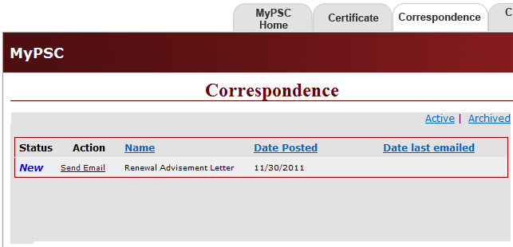
12/01/2011
Send Email

Slide 15
View Correspondence Online
Coming in mid-2012 to MyPSC…
Still see list of correspondence
Still send selected correspondence to their email address
New - view correspondence and print it
Notes:
A few bullets about why, where and when

Slide 16
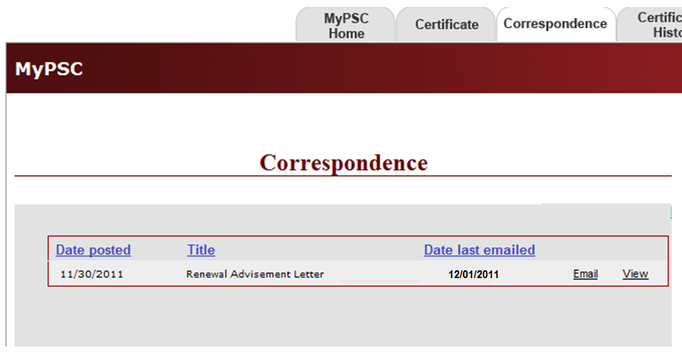
View
Online
Send Email

Slide 17
View Correspondence Online
Coming in mid-2012 to www.gapsc.org...
View correspondence and print it.
Send selected correspondence to the operator’s email address of record or to any other email address.
Notes:
A few bullets about why, where and when

Slide 18
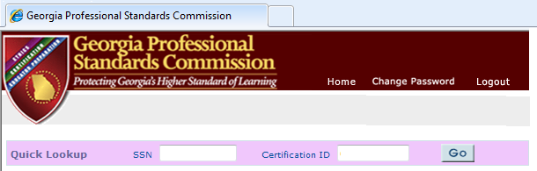
Enter SSN or Cert ID
Click “Go”

Slide 19
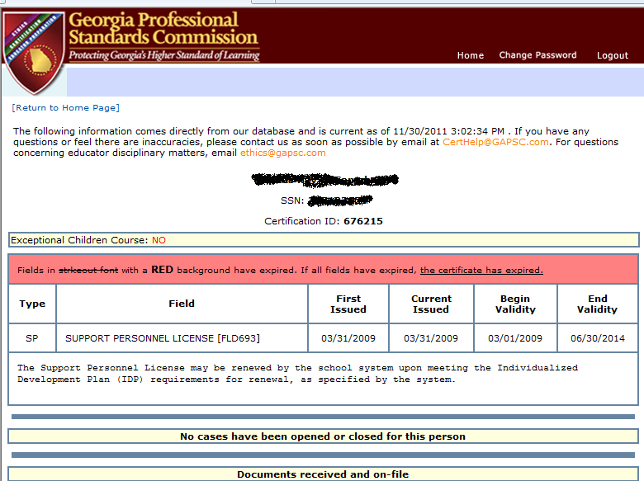

Slide 20
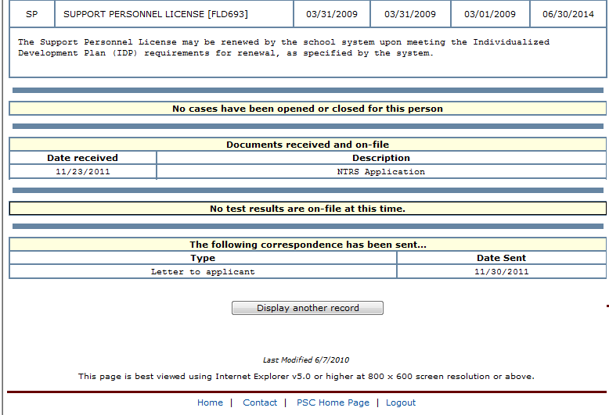

Slide 21
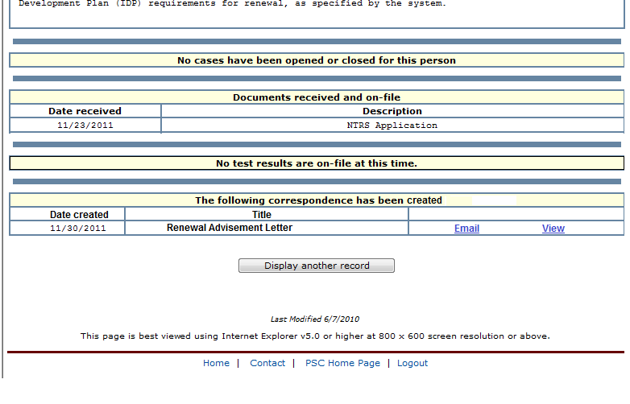

Slide 22
Special Georgia Requirements: Content Test
Effective 10/15/11, Georgia-certified educators who complete out-of-state programs leading to certification must pass the Georgia state-approved content assessment
Educators that hold a Georgia certificate cannot exempt the content assessment by presenting an out-of-state certificate with that state’s content assessment
Initial reciprocity remains
Notes:
What, how and why…
22

Slide 23
Voluntary Deletion of a Certification field
Effective 10/15/11, requests for voluntary deletion of any field that results in an upgrade will also result in the loss of the level associated with the field
The new level assigned will be determined by the rule(s) in effect at the time the previous level was awarded
Notes:
What, how and why…
23

Slide 24
Birth Through Five
Effective 1/15/12, Birth Through Five Certificate (B-5) and
programs changing to Birth Through Kindergarten (B-K)
To be consistent with Educator Preparation program changes
Existing B-5 certificates will remain intact
At time of renewal, GaPSC will change the name
Notes:
A few bullets about why, where and when
24

Slide 25
Rules Effective 1/15/12
Educational Leadership
Removes pre-service coursework language from the cert application process for NPL
Pre-service coursework requirement remains in Ed Prep Program Rule
Clarifies leadership role
Notes:
A few bullets about why, where and when
25

Slide 26
Rules Effective 1/15/12
New Field - Curriculum and Instruction
Service Field
Aligns with Ed Prep Rule
Improvement of teaching skills to impact performance & learning process
(The fields of Instructional Technology and Teacher
Leadership became effective 10/15/11.)
Notes:
A few bullets about why, where and when
26

Slide 27
Upgrades - Certificate Levels and Degrees
Back in the day…
Certificate Level Based on Highest Degree Earned
Degree “Major” Did Not Matter!

Slide 28
Upgrades - What Changed?
Advanced degrees which result in an upgrade…
(1a) must be in a GaPSC field of certification currently held by the educator (In Field),
or
(1b) must result in a new GaPSC field of certification (New Field)
and
(2) Institutions and advanced degrees leading to GA upgrades must meet the same levels of quality as GaPSC approved institutions and programs

Slide 29
What are the options?
Op
 | Infield: Candidate’s field of certification (education or content) | New Field: New certification area in a GaPSC approved certification field
In State | Completion of program at a GaPSC approved education unit OR at a university with a Carnegie Classification of RU/VH Activity or RU/H Activity | Completion of a GaPSC approved program that leads to initial certification at a GaPSC approved education unit AND pass the Georgia state approved content assessment AND complete Georgia requirements AND add the field to certificate.
Out of State | Completion of a program at an institution accredited by NCATE/TEAC/ CAEP OR at a university with a Carnegie Classification of RU/VH Activity or RU/H Activity | Completion of a state approved education program that leads to initial certification at a university either accredited by NCATE/ TEAC / CAEP OR with a Carnegie Classification of RU/VH Activity or RU/H Activity AND pass the Georgia state approved content assessment AND complete Georgia requirements AND add the field to certificate.

Slide 30
Grandfathering Dates for Upgrades
Master’s degree programs:
Enrolled by 7/15/11
Completed by 12/15/14
Specialist degree programs:
Enrolled by 7/15/11
Completed by 12/15/14
Doctoral degree programs:
Enrolled by 7/15/11
Completed by 12/15/16
Enrolled = admitted and actively participating in coursework

Slide 31
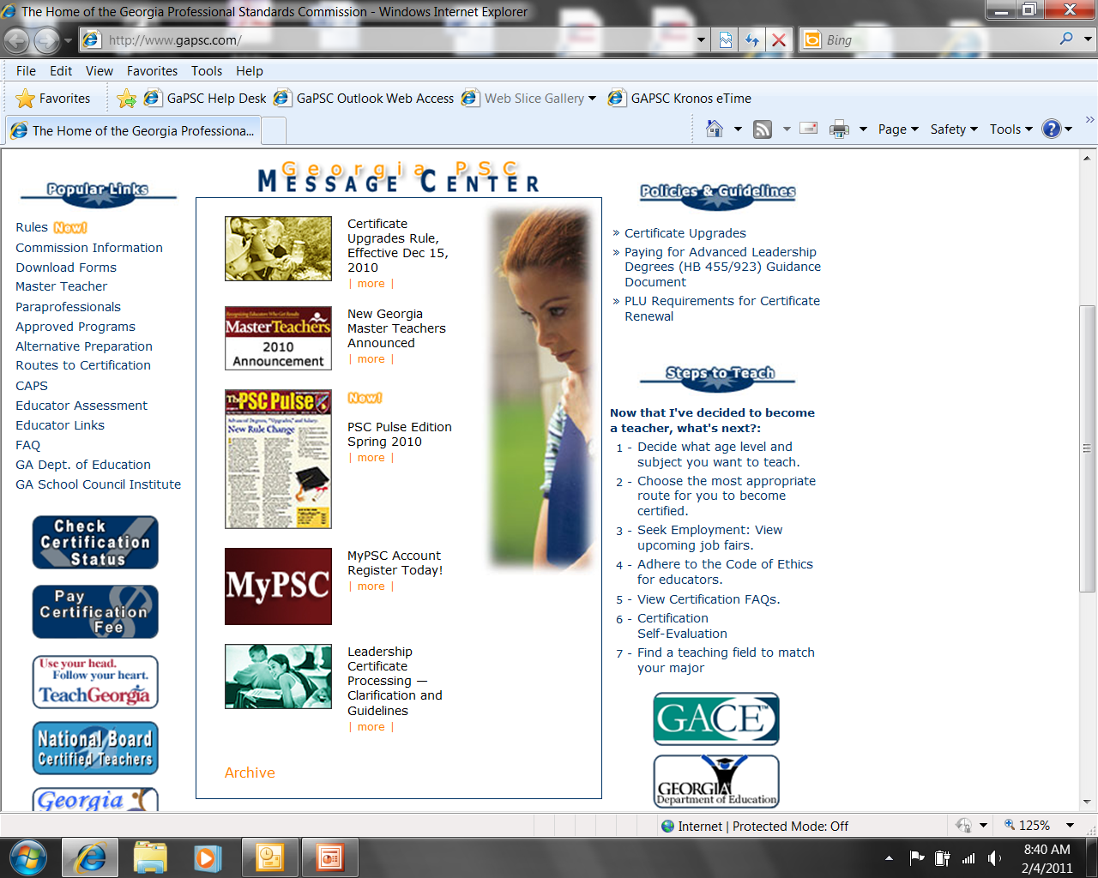

Slide 32
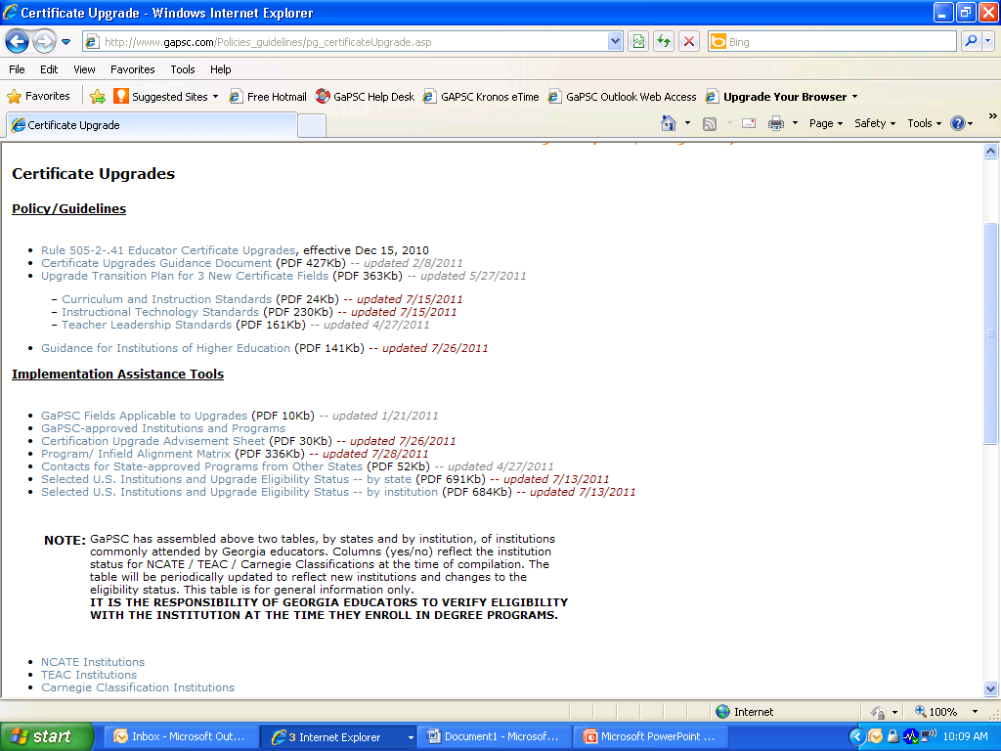
Notes:
Update this!

Slide 33
Implementation Assistance Tools
GaPSC Fields Applicable to Upgrades (PDF 10Kb) -- updated 1/21/2011
GaPSC-approved Institutions and Programs
Certification Upgrade Advisement Sheet (PDF 30Kb) -- updated 7/26/2011
Program/ Infield Alignment Matrix (PDF 336Kb) -- updated 7/28/2011
Contacts for State-approved Programs from Other States (PDF 52Kb) -- updated 4/27/2011
Selected U.S. Institutions and Upgrade Eligibility Status -- by state (PDF 691Kb) -- updated 7/13/2011
Selected U.S. Institutions and Upgrade Eligibility Status -- by institution (PDF 684Kb) -- updated 7/13/2011

Slide 34
Am I Eligible for an Infield Upgrade?
How do I know if I am eligible for an upgrade under the GaPSC Rule 505-2-.41?
You can determine if you are eligible to upgrade by asking yourself two questions.
Question 1: Do I hold a Clear Renewable Teaching, Service, Leadership or Technical Specialist certificate at a Level 4 or higher?
Yes - Proceed to Step 2
No - Educators who hold a Permit or Nonrenewable certificate are NOT eligible to upgrade
Question 2: Will my degree be in-field or out-of field? And will I attend an institution that is in-state or out-of-state?

Slide 35
Program/Infield Alignment Matrix
Certificate field | Approved Infield Program
Agricultural Education (P-12) | Agriculture Education
American Sign Language (P-12) | Foreign Language Education
American Sign Language (P-12) | American Sign Language
Arabic (P-12) | Foreign Language Education
Arabic (P-12) | Arabic
Art (P-12) | Art
Art (P-12) | Art Education

Slide 36
Web-based Upgrade Advisor
Under development now, a web-based “advisor”
Examines an educator’s credentials and determines eligibility for upgrade of level
Integrates existing data sources regarding approved programs to advise about “new field” upgrade
Provides detailed advisory capability about “in-field” upgrades specific to an educator’s credentials
Notes:
Upgrade Advisor Context – verbiage

Slide 37
In-field Upgrade Advisor
Advice about in-field upgrades…
Based on educator’s currently-held credentials
Lists “acceptable” institutions
Lists degrees at each institution that are aligned to an educator’s credential
Notes:
Context – verbiage

Slide 38
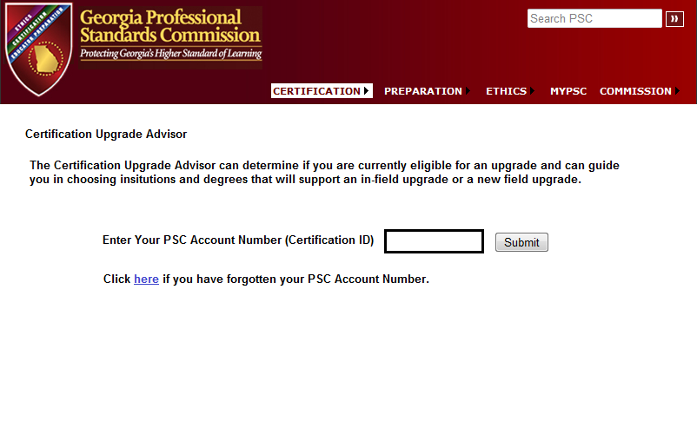
In-field Upgrade Advisor Entry
Notes:
Lead-in screen – collect CertID

Slide 39
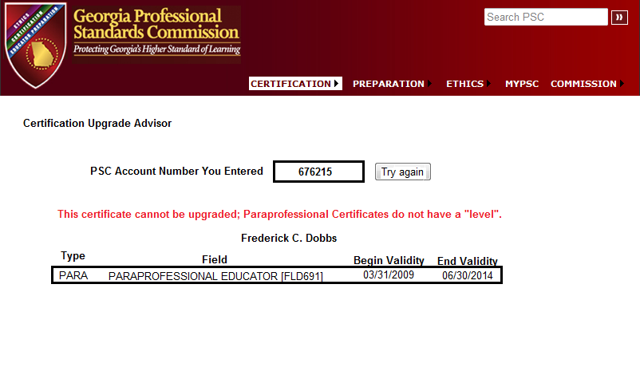
Example – Not Eligible for Upgrade
Notes:
Lead-in screen – Certificate corresponding to CertID; immediate diagnosis if upgrade not possible.

Slide 40
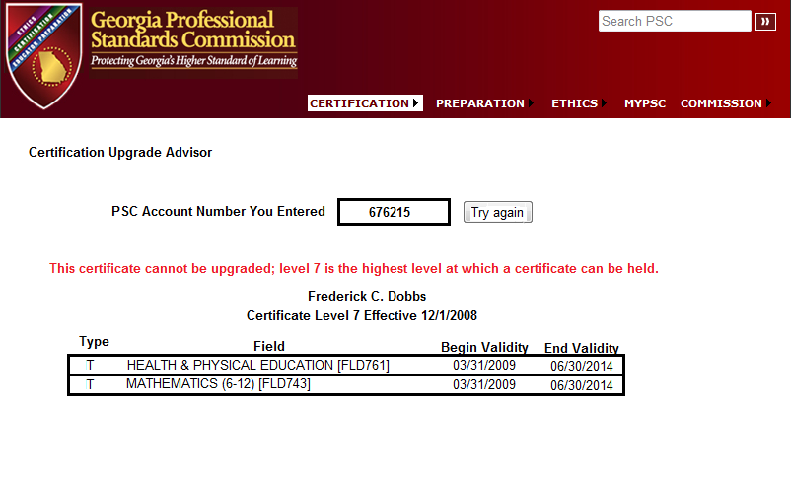
Example – Level 7 is Highest Level!
Notes:
Lead-in screen – Certificate corresponding to CertID; immediate diagnosis if upgrade not possible.

Slide 41
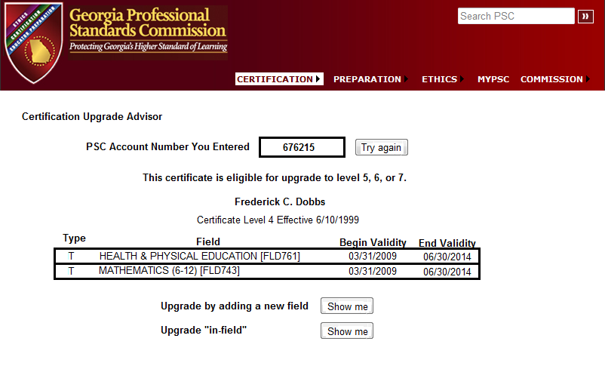
Example – Eligible for Upgrade
Notes:
Lead-in screen – Certificate corresponding to CertID; offer options if upgrade is possible

Slide 42
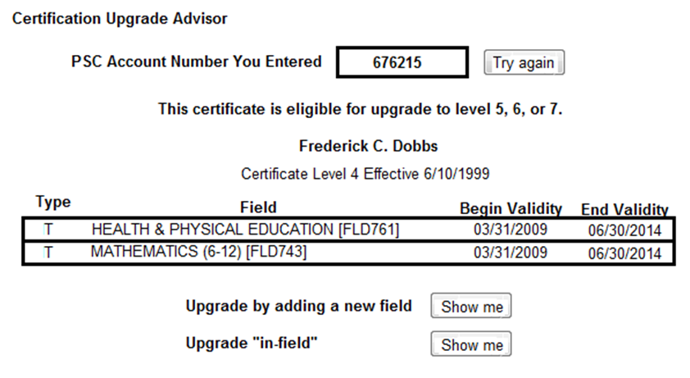
Eligible for Upgrade

Slide 43
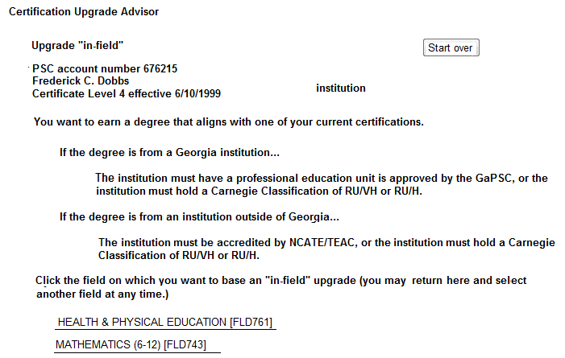
In-field Upgrade Detail
Notes:
In-field upgrade advisor #1; a private, a public, a CofEd degree, a CAS degree

Slide 44
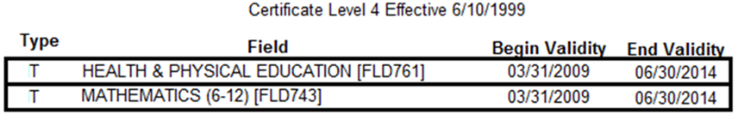
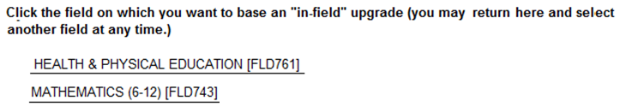
In-field Upgrade Detail
Fred’s Certificate…
Fred’s choices for an in-field upgrade…
Notes:
In-field upgrade advisor #1; a private, a public, a CofEd degree, a CAS degree

Slide 45
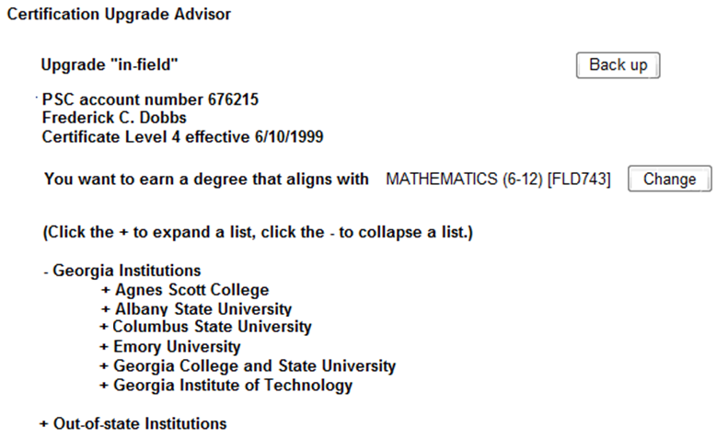
Example – Math Certificate
Notes:
In-field upgrade advisor #2

Slide 46
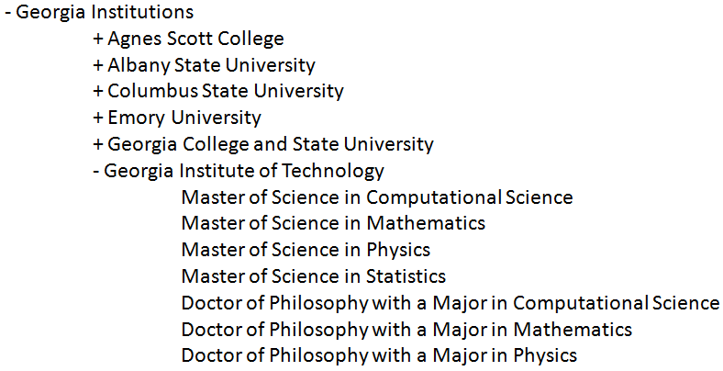
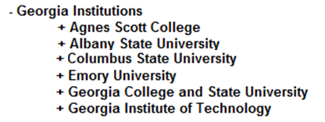
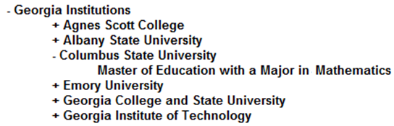
Example – Math Certificate
Notes:
In-field upgrade advisor #2

Slide 47
“Ad hoc” Advice
What does an educator do if...
An institution of interest is not listed?
A degree of interest is not listed?
Notes:
In-field upgrade advisor #3

Slide 48
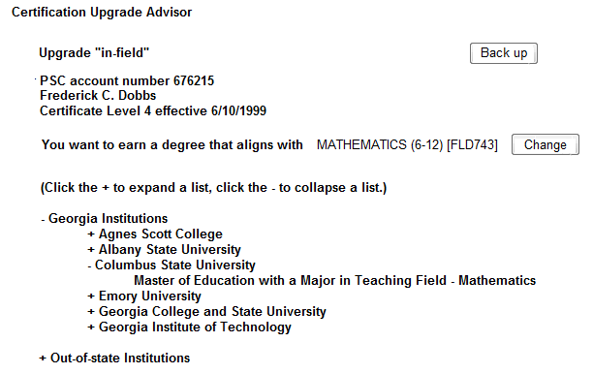
Detail – Link for Ad Hoc Advice Form
Click here to inquire about an institution or degree not listed above.
Notes:
In-field upgrade advisor #3

Slide 49
An Ad hoc Advice Tool
We already have the educator’s name and the certificate field of interest. The educator will enter…
His or her email address
Name of institution
State where institution located
Name of degree
Website address of a page that best describes the degree
We will email back a decision (and add the institution and degree to our matrix.)
Notes:
In-field upgrade advisor #3

Slide 50
Upgrade Advisor Implementation Timeline
December through early February
Build institution/degree/certificate matrix
Late February
Ask IHE’s to review matrix on www.gapsc.org
Early March
Consider any “troublesome” alignments
Mid-March
Go-live on www.gapsc.com
Notes:
Upgrade advisor – how we’re deciding on degree/certificate alignment

Slide 51
Certification Upgrade Review Committee (CURC)
So, Georgia will accept professional out-of-state certificates to establish professional certification. However, the individual will be subject to our Special Georgia Requirements if they did not meet them for the professional out-of-state
certificate.
CURC Members are drawn from:
Institutions of Higher Education (Public and Private)
School System HR Personnel (Various Regions)
GaPSC Education Preparation Staff
GaPSC Certification Staff
Notes:
51
The GAPSC, in collaboration with DOE, is responsible for the implementation of NCLB particularly the “Highly Qualified” teacher program
We utilize data from many sources, our Certification records, the tri-annual CPI reports and the Student Records
Assist schools in ensuring that all students, including the poor and minority students have access and equitable opportunities to highly qualified instruction.
These measures include teachers’ instructional experience, ability to meet the diverse learning needs, and classroom size

Slide 52
CURC Purpose
Review advanced degrees accepted in Georgia to ensure that the intent of the new upgrade rule is met
Various entities collaborate to provide a wide range of perspectives and expertise
Discuss upgrade concerns and appeals to make final degree determinations
Collaborate with the Board of Regents to align degree titles with certification fields
Assure that the criteria used for degree determination is accessible to the public via www.gapsc.com
So, Georgia will accept professional out-of-state certificates to establish professional certification. However, the individual will be subject to our Special Georgia Requirements if they did not meet them for the professional out-of-state
certificate.
Notes:
52
The GAPSC, in collaboration with DOE, is responsible for the implementation of NCLB particularly the “Highly Qualified” teacher program
We utilize data from many sources, our Certification records, the tri-annual CPI reports and the Student Records
Assist schools in ensuring that all students, including the poor and minority students have access and equitable opportunities to highly qualified instruction.
These measures include teachers’ instructional experience, ability to meet the diverse learning needs, and classroom size

Slide 53
Right Now
CURC is formalizing the criteria used to determine infield degrees
Infield degrees are slowly broadening
Majority of educators enrolling in advanced degree programs are selecting:
Curriculum and Instruction
Instructional Technology
Teacher Leadership
Once Georgia institutions become approved for the 3 new fields they will review degrees that were previously completed and either outline additional requirements or recommend for the new field
So, Georgia will accept professional out-of-state certificates to establish professional certification. However, the individual will be subject to our Special Georgia Requirements if they did not meet them for the professional out-of-state
certificate.
Notes:
53
The GAPSC, in collaboration with DOE, is responsible for the implementation of NCLB particularly the “Highly Qualified” teacher program
We utilize data from many sources, our Certification records, the tri-annual CPI reports and the Student Records
Assist schools in ensuring that all students, including the poor and minority students have access and equitable opportunities to highly qualified instruction.
These measures include teachers’ instructional experience, ability to meet the diverse learning needs, and classroom size

Slide 54
Educator Questions About Upgrades
So, Georgia will accept professional out-of-state certificates to establish professional certification. However, the individual will be subject to our Special Georgia Requirements if they did not meet them for the professional out-of-state
certificate.
Does a Teaching and Learning degree qualify for the extended grandfathering period?
Are the out-of-state institutions advertising degrees that meet Georgia’s grandfathering criteria legitimate?
If I get the upgrade on my certificate, will I get paid for my advanced degree if I am not working in the field of my degree?
Are the GaPSC upgrade institution requirements the same as the institution requirements for initial certification?
My degree is not on the GaPSC infield matrix, but I know the degree will help me in my classroom, will GaPSC accept my degree for a certificate upgrade?
Notes:
54
The GAPSC, in collaboration with DOE, is responsible for the implementation of NCLB particularly the “Highly Qualified” teacher program
We utilize data from many sources, our Certification records, the tri-annual CPI reports and the Student Records
Assist schools in ensuring that all students, including the poor and minority students have access and equitable opportunities to highly qualified instruction.
These measures include teachers’ instructional experience, ability to meet the diverse learning needs, and classroom size

Slide 55
Leadership Certification and Degrees
What Happened in 2009?
Lots of folks paid on “unused” Leadership Degrees
Save money!
So… don’t pay for that Leadership Degree if educator not working in a “Leadership Position”
HB455 in 2009, HB923 in 2010
Language changed in O.C.G.A. §20-2-212

Slide 56
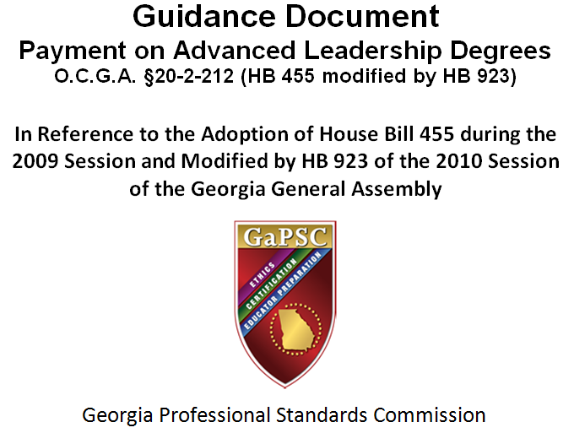
Leadership Certification and Degrees

Slide 57
Leadership Certification and Degrees
“The GaPSC assigns one level (1, 2, 4, 5, 6, or 7) to all certificates held by an educator. Previously, that certificate level (combined with the type of certificate held) automatically determined placement in the appropriate column on the State Salary Schedule. Effective July 1, 2010, placement on the State Salary Schedule for educators earning an advanced leadership degree will now depend on whether the educator is employed in a leadership position as defined by the State Board of Education”
GaPSC Guidance Document

Slide 58
Leadership Certification and Degrees
“The certificate level, which reflects the highest accepted degree held, no longer “automatically” designates salary schedule placement if that degree is a leadership degree earned after July 1, 2010. The bottom line change: 1) LEAs will now have to individually review data on employees holding leadership degrees to determine salary schedule placement rather than automatically using the certificate level; and 2) some educators holding certain advanced leadership degrees will not be paid on that degree level unless they are actually employed in a leadership position.”
GaPSC Guidance Document

Slide 59
Two key points… to take away
“The GaPSC assigns one level (1, 2, 4, 5, 6, or 7) to all certificates held by an educator.”
“LEAs will now have to individually review data on employees holding leadership degrees to determine salary schedule placement rather than automatically using the certificate level.”

Slide 60

Two Key Points… So?
Oh, wow.

Slide 61
Two key points… to reconsider
“The GaPSC assigns one level (1, 2, 4, 5, 6, or 7) to all certificates held by an educator.”
“LEAs will now have to individually review data on employees holding leadership degrees to determine salary schedule placement rather than automatically using the certificate level.”

Slide 62
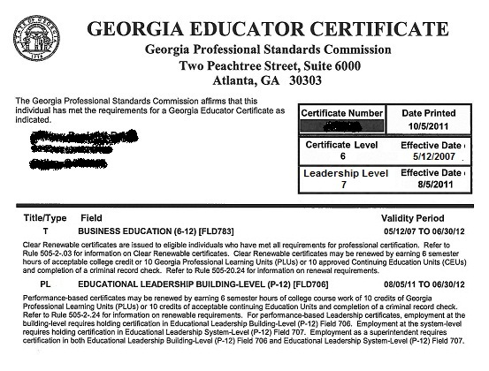
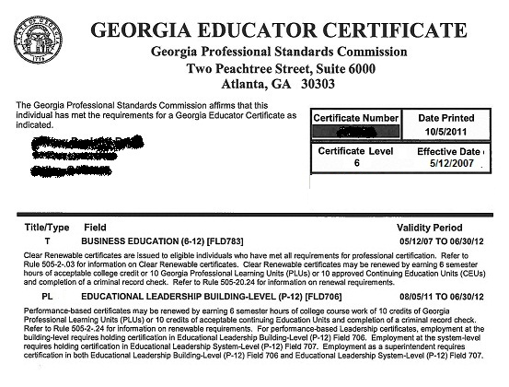
Leadership Certification and Degrees

Slide 63
Leadership “Level”
Only have a Leadership Level if there is a reason to have it…
Leadership degree
Not “grandfathered” (you don’t worry about “grandfathering…”)
Leadership field(s) on certificate

Slide 64
Leadership “Level”
When will we implement the Leadership Level?
The IT work is done
Certification can start using new software next week, Monday, December 5th
You will probably see some Leadership Levels before Christmas weekend

Slide 65
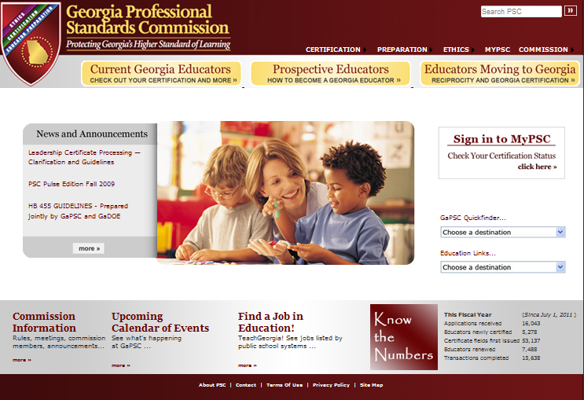
www.gapsc.com
Redesign efforts for www.gapsc.com have been revived.

Slide 66
HiQ
“Tune-up” the screens you use
New reports
Online sign-off process (similar to AYP sign-off)
Go-live January 16th
Major re-write of HiQ will wait until ESEA is reauthorized…

Slide 67
RT3 and GaPSC Technology
Opportunity to significantly update…
Educator Credentialing System
Educator Preparation Information System
GaPSC is also a participant in the Statewide Longitudinal Data System funded through RT3

Slide 68
RT3 Impact on Data Systems & Scope of Work
Educator Credentialing
More data will be collected
More complex rules = more processing time?
Better automation to maintain good turn-around time
Educator Preparation Information System
More data will be collected
Better data collection method to minimize burden on program providers
Better reporting will be needed to utilize the data effectively

Slide 69
Some Effects of Two RT3 Initiatives
Teacher/Leader Evaluations (Effectiveness Measures)
Will Change Rules for Educator’s Certificate Renewal Process
Will Produce More Data for Educator Preparation Program Approval
Induction & Career Ladder
Implications for Educator Certification?
Induction Certificate to Career Teacher Certificate?

Slide 70
Contact Information
Kelli Young
Assistant Director, Certification
k.young@gapsc.com
Rose Wilson
RT3 Project Coordinator
rose.wilson@gapsc.com
Chuck McCampbell
CIO
chuck.mccampbell@gapsc.com

Slide 71
Thank you!
What are your questions?

