Slide 1
Top inventions of 2011 bulletin board idea
Submitted by
Jeremiah Mosteller, RA, WCU

Slide 2
Top

Slide 3
inventions

Slide 4
of 2011

Slide 5
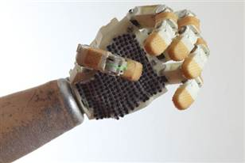
The Stark Hand
Created by Mark Stark, The Stark Hand prototype provides an ingenious, comfortable, and very inexpensive alternative to the hook his friend Dave Vogt had worn all his life. With the new hand, Dave can now catch balls and grip wine glasses.

Slide 6
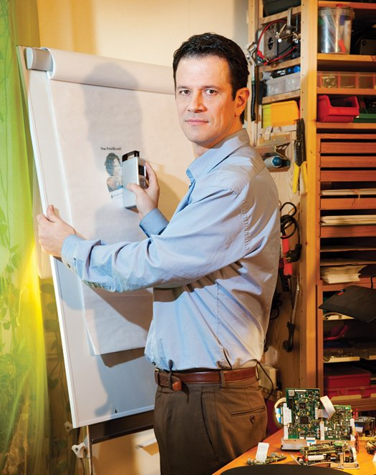
The Print Brush
Weighing in at less than a pound, Alex Breton's Print Brush easily fits in a laptop bag and prints on any flat surface, from wood to fabric to plastic. Alex worked on the project for 11 years. A version with a bonus built-in camera comes out early next year.

Slide 7
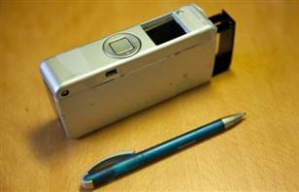
The Print Brush

Slide 8
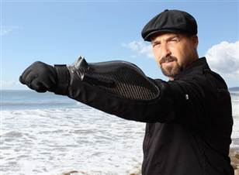
The Body Guard
David Brown designed The BodyGuard, a crime-fighting armored glove, as built-in self protection. The demo model has a camera, a wrist mounted stunner and lots of room for future improvements. The idea came to David while talking to his friend, Kevin Costner.

Slide 9
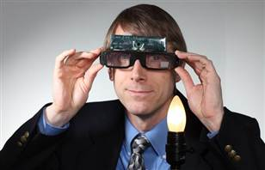
Dynamic Eye Sunglasses
Unlike regular sunglasses, Chris Mullin's glasses block glare instantly with liquid crystal lenses that darken the most where the sun's light is the brightest. A particularly sunny commute inspired Mullin's invention.

Slide 10
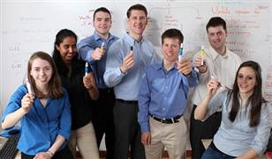
A Prenatal Marker to Screen for Pregnancy Complications
Designed by a college student and his classmates, the Prenatal Screening Kit, or safety pen, helps detect complications in pregnancies at an early stage. The pen will be quite cheap, costing only a third of a cent per use, making it a perfect tool for hospitals in developing nations.

Slide 11
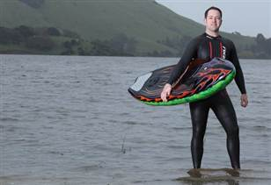
Kymera Motorized Body Board
The lightweight Kymera Body Board is Jason Woods's solution for a timeless problem (for lucky people): how to have fun at the lake without the hassle of lugging a boat around. The latest version of his motorized body board hits speeds of 25 mph.

Slide 12
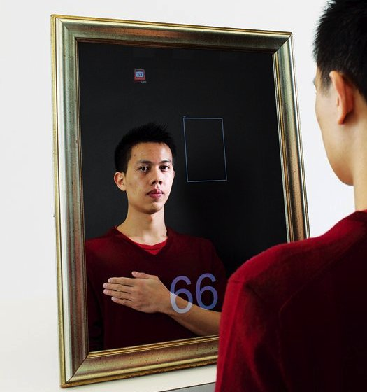
The Medical Mirror
Ming Zher Poh, an electrical- and medical-engineering graduate student at the Massachusetts Institute of Technology is the mastermind that designed the software which allows medics to check for vital signs or help people with a cardiovascular problem to control their health regularly. The patient only needs to stand in front of this special mirror and his heart rate will be displayed on top of his reflection.

Slide 13
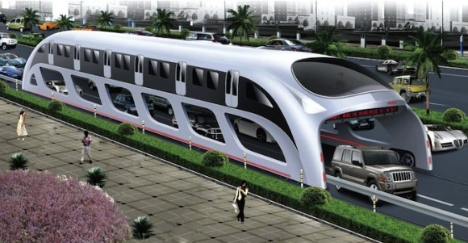
The Straddling Bus
This is the bus of the future, created to ease traffic, in a world which becomes more and more crowded. This bus is as high and as wide as to permit cars to drive under it. The straddling bus is not only functional but also attractive and futuristic. It is economical as well because it uses sun panels placed on the roof. These buses are designed to transport up to 1200 persons and the cost of building one of them, together with the required equipment should be 10 times smaller than that of creating a subway line on the same distance.

Slide 14

Contact Lenses That Change Color To Alert Diabetics of Glucose Levels
There is great news for diabetics. A revolutionary technology has came into being to help them measure blood sugar levels without drawing blood daily. It uses extremely small nanoparticles embedded into the hydrogel lenses. These engineered nanoparticles react with glucose molecules found in tears, causing a chemical reaction that changes their color.

Slide 15
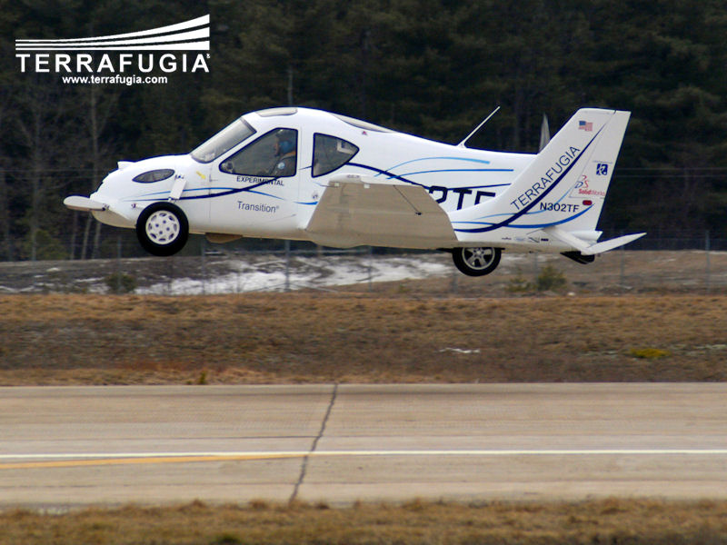
Terrafugia Transition
This is world’s first flying car. It was designed by students, at MIT. Though the concept of the car was invented in 2006, when it was also rewarded, the first aircraft is about to be released, this is year. It seems that it can be used both as an aircraft and as a car, due to the ability of folding its wings. Buy it at a price starting from $ 194,000.

