Slide 1
Masculinity bulletin board and educational program idea
Brian Michael Finn Purdue University

Slide 2



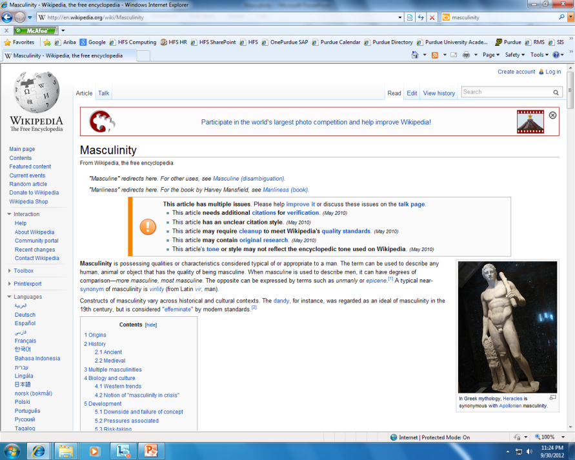


…Topics in the Air…

Slide 3


Recommended Media

Slide 4

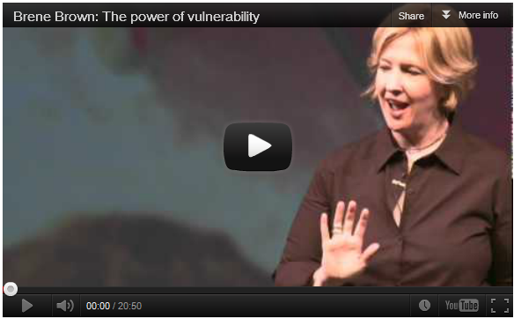
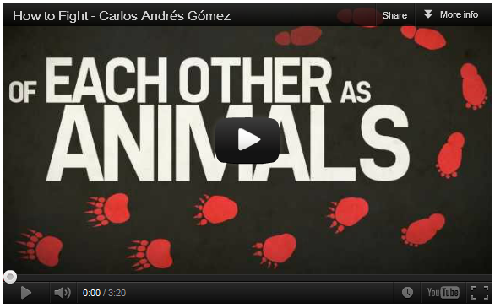
Videos that Speak Volumes
Brene Brown: The power of vulnerability
http://www.ted.com Brene Brown studies human connection -- our ability to empathize, belong, love. In a poignant, funny talk at TEDxHouston, she shares a deep insight from her research, one that sent her on a personal quest to know herself as well as to understand humanity. A talk to share.
How to Fight - Carlos Andrés Gómez
Like many men in our society, Gómez grew up believing that he had to be ready to fight at all times, treat women as objects, and close off his emotional self. It wasn't until he discovered acting that he began to see the true cost of squelching one's emotions—and how aggression dominates everything that young males are taught.

Slide 5


Videos that Speak Volumes
The Moth Presents Anthony Griffith: The Best of Times, The Worst of Times
Anthony Griffith lives in the mountains of California at 5,000 feet elevation in an animal protected community. It's much different from the inner city of Chicago where he used to live, but he still travels doing stand-up. He says that the overwhelming positive response of him telling his story at The Moth has prompted him to write my one man show and pen other short stories now in development.
TEDxIsfeld Bill Pozzobon Breaking the Boys Code of Masculinity
Bill has worked on gender and violence issues with youth and educators for over a decade. In his role as Director of the SafeTeen Boy's Program, he trains the new SafeTeen Agents for Change and co-leads Educator Trainings locally, nationally and internationally. With humour and skill Bill invites the boys and men he works with to step into their full humanity with dignity and courage

Slide 6
Some Major Myths About Sexual Violence
By Ben Atherton-Zeman, 2007 (www.voicesofmen.org)
Myth 1: It’s the victim/survivor’s fault. Because she wore a short skirt, went up to his room, was attracted to him, she deserved to be raped.
Reality Check 1: Rape is never the victim/survivor’s fault. Girls and women get to wear anything they want to – it is never an excuse to rape them. Girls and women get to be attracted to someone, get to go to someone’s room – she should be safe there. Many victims of rape blame themselves for the rape – it’s up to the rest of us to say clearly that it’s never their fault, they’re not alone and that help is available.

Slide 7
Some Major Myths About Sexual Violence
By Ben Atherton-Zeman, 2007 (www.voicesofmen.org)
Myth 2: Victim/survivors are all beautiful young women, who respond to being raped by crying.
Reality Check 2: Rape and sexual assault can happen to women, men, and children. It can happen to straight people, lesbians, gay men, bisexuals and transgender folks. Most rapists are men – but most men do not rape, and can become part of the movement to end sexual violence. Every rape victim/survivor will respond in different ways to their rape – some will seem traumatized, some will seem numb, many will blame themselves. Some will pass judgment on victim/survivors, but we must support them.

Slide 8
Some Major Myths About Sexual Violence
By Ben Atherton-Zeman, 2007 (www.voicesofmen.org)
Myth 3: Rapists are all ugly, leering men on a dark street corner.
Reality Check 3: Rapists, like batterers, can be charming, convincing and “model citizens.” Most rapists’ parents and friends will defend the rapist, and might attack the survivor – challenging “her version” of the story. This myth of rapists helps charming rapists garner sympathy and collusion – any rapist should be held accountable, even if he is a “good guy.”

Slide 9
Some Major Myths About Sexual Violence
Myth 4: A stranger jumping out from behind a bush using physical force is the worst form of rape.
Reality Check 4: Most rapists know their victim – many are trusted friends and family members. Certainly stranger rape is very difficult for the survivor, but when the rapist is someone they know, the trauma can be as bad, or even worse. Many rapists do not use physical force – they use coercion and cajoling, alcohol and drugs. Survivors who succumbed to coercion often blame themselves for letting the person in the door, for drinking, for not saying no more strenuously – again, it is the rapist’s fault, not the survivor’s.

Slide 10
Some Major Myths About Sexual Violence
Myth 5: Sexual assault and rape are usually “he said/she said” communication problems.
Reality Check 5: There are many ways to say “No,” both verbal and nonverbal. Rapists choose to continue despite receiving clear messages that the person they are with is uncomfortable – they choose to try to “make them relax” rather than backing off. Many rapists will testify that the sex was consensual – usually this is the rapist minimizing the extent that they pressured or cajoled the victim/survivor.

Slide 11
Some Major Myths About Sexual Violence
Myth 6: Men can’t be expected to stop when they are aroused.
Reality Check 6: Guys – imagine yourself in high school. You have a girlfriend and you’re at her house, kissing. Her parents suddenly come home. You would stop then! So you can stop when she wants you to.

Slide 12
Some Major Myths About Sexual Violence
Myth 7: Anti-rape advocates are also anti-male.
Reality Check 7: Holding men accountable to our behavior is not anti-male – it is anti-rape. Since most rapists are men, it is our responsibility as a gender to support survivors and speak out against rape. We need to make these issues “men’s issues” and support women who have been taking leadership in this movement for so many years. We need to interrupt rape-supportive behavior such as sexist jokes, pornography, degrading and objectifying images of women, sexism, racism, homophobia, etc. We need to support our local rape crisis center, and groups like Men Can Stop Rape www.mencanstoprape.org. We need to keep raising our voices until this violence stops.

Slide 13
Organizations
Voices of Men
By Ben Atherton-Zeman, benazeman@hotmail.com, www.voicesofmen.org
I pledge to never commit, condone, or remain silent about men’s violence against women.
I pledge to never coerce anyone I know into having sex, or to pressure them into any kind of unwanted physical contact.
I will always seek clear communication instead of assuming consent.
I choose to respect, listen to and seek equality with every person I date, and every person I know.
National Organization for Men Against Sexism: www.nomas.org. Become a dues-paying member, form a chapter.
White Ribbon Campaign, www.whiteribbon.com, based in Canada but works well here, excellent organizer’s manual. Self-adhesive white ribbons can be ordered at www.theribbonlady.com.
Men Can Stop Rape: www.mencanstoprape.org, has an excellent e-newsletter and an “Anti-Rape Man” comic. The “Strength Campaign” posters used in the play are available here.
Men Against Violence is a Yahoo Group of more than 250 people – send an email requesting to join to menagainstviolence@yahoogroups.com.
National Association of Men and Women Committed to Ending Violence Against Women: www.acalltomen.org
National Coalition Against Domestic Violence holds national conferences every two years: www.ncadv.org
Family Violence Prevention Fund: www.endabuse.org, has television PSAs that you can get for your town.
National Resource Center on Domestic Violence: www.nrcdv.org, or call them at 800-537-2238 for info.

Slide 14
Organizations - Continued
Men Against Sexual Violence: a project of PA Coalition Against Rape. www.menagainstsexualviolence.org
Faith-Trust Institute: http://www.cpsdv.org/, faith-based responses to domestic violence, sexual assault, etc.
National Organization for Women has chapters in every state and welcomes males: www.now.org
The Girls, Women and Media Project promotes more positive images of girls and women in the media. www.mediaandwomen.org - they also promote media literacy and citizen activism.
Dads and Daughters: www.dadsanddaughters.org, feminist man Joe Kelly cares about his daughters so much that he wants to help create a world free of violence for them. You don’t have to be a dad of a daughter.
HomeFront Calgary: Canadian group working to stop violence against women – www.homefrontcalgary.com.
Men’s Initiative for Jane Doe, Inc.: Massachusetts statewide clearing house and networking resource for men working to end violence against women, facilitating collaborations between men's associations, rape crisis centers and resources for domestic violence intervention. www.mijd.org.
Gloucester Men Against Domestic Abuse: www.strongmendontbully.com, mentioned in the play.
Jackson Katz: www.jacksonkatz.com, outstanding public speaker on this issue. His video, “Tough Guise” is excerpted in the beginning of the play – it’s worth purchasing at www.mediaed.org.
Jean Kilbourne: www.jeankilbourne.com. She is a phenomenal and award-winning speaker and writer - her “Killing Us Softly 3,” about advertising images of women, is also available at www.mediaed.org.
Your local rape crisis center or domestic violence program: look in the phone book or call the National Domestic Violence Hotline to get contact info: 1-800-799-SAFE (7233). The National Sexual Assault Hotline from RAINN is 1-800-656-HOPE.

Slide 15
Note from the author and from the editor
This document can be printed or edited for a bulletin or bulletin board.
Best,
Brian
Brian Michael Finn Purdue University
Note from the editor: This power point can also be edited for use as an on-line or vibrant-in-person educational program. It has the potential to generate interesting and dynamic conversations.

