Slide 1
Chesapeake Bay Program Data Hub
Requirements Gathering
January 16, 2013
Notes:
Webinar Link: https://www3.gotomeeting.com/join/171053678
Conference dial-in number: (530) 881-1400; Participant access code: 192125

Slide 2

Agenda
Part I: Introduction
Part II: Data Hub Business Processes
Part III: Validation of Functional Issues We’ve Heard
Part IV: Questions, Closing Statements and Next Steps

Slide 3
Introduction
Quick Overview of the Goals for Today’s Session
Attendance Check/Roll Call

Slide 4


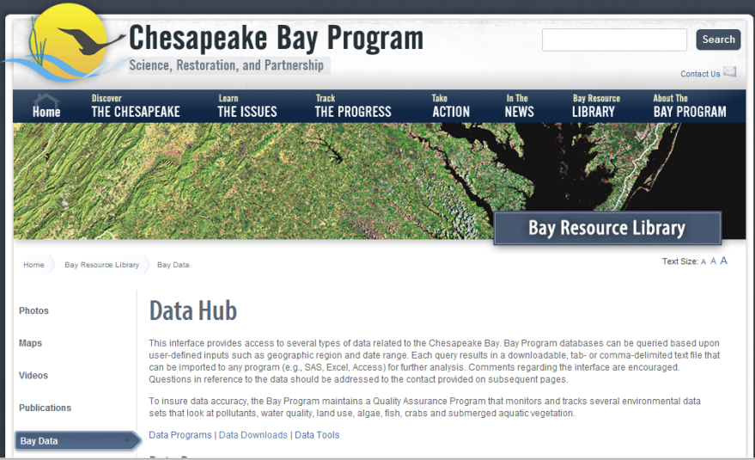


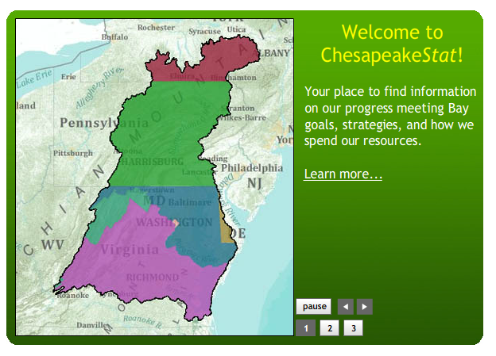
Overview
3,000 Foot View
Retrieve
Integrate
Visualize
Understand
Data Enterprise
Data Hub
Providers
http://www.chesapeakebay.net/data
$$
data
SOA
MOA
SLA
GG
transform standards
metadata
data
Catalog
Discover
http://catalog.chesapeakebay.net/
Chesapeake Stat/Web Mapping Applications
Catalog
Visualization
Entry

Slide 5
Roundtable Discussion
Part II: Data Hub Business Processes
What data do you currently access from the Data Hub?
Are there data sets you wish were included in the Data Hub that are not there?
Is your work typically in the same geographic area? How is that defined?
Process for accessing and using the data that you access from the Data Hub
How often do you typically extract data from the Data Hub?
What output format do you typically choose? Is this the best format for you?
How do you use the data once you’ve downloaded it?
What types of analyses do you typically perform with the data?
Do you do a lot of processing, transformation or aggregation of the data?
Do you use the data typically in one software program or in multiple tools (SAS, GIS, other) once you’ve obtained it?
Does the current system require you to do multiple downloads to get all the information you need?
Do you use other sites or programs to extract all of the data you need for the CBP region?
Notes:
Survey-related information:

Slide 6
Roundtable Discussion
Part II: Data Hub Business Processes
What are the major drawbacks that you see in the current system?
Do you typically have to request help in order to access the data you need?
How are your needs for accessing & using data met or not met via the Data Hub?
What are your barriers (if any) to using the Data Hub?
Are there other data extraction sites that you like, and what do you like about them?
Notes:
Survey-related information:

Slide 7
Roundtable Discussion
Part III: Validation of Functional Issues
The 5 year down load limit is too restrictive, should not require the use of calendar pop-up, and should provide additional ways to select data by date- e.g. seasonal - summer (July-Sept)
The Data Hub should offer an option for transposed data output, including an option for standard GIS outputs.
XML output is not popular and/or is confusing; people generally seem comfortable with CSV outputs but find the current CSV choices clunky
Users must already understand the query parameters and the stations they are looking for. Needs simplification for those who may not know where certain stations or HUCs are.
Would like to use a map-based approach for the area selection capability to allow users to visually select either individual stations or a portion/segment of the watershed, as well as other ways to query the database other than by station and parameter, such as an easy dropdown menu for parameters.
Would like to see options to query by program, project, or state/agency level.
Notes:
First is there anything missing and second, can they help us prioritize these? We may not be able to address all of the functional issues so we are looking to see what will get the most value.
Survey-related information:

Slide 8
Roundtable Discussion
Part III: Validation of Functional Issues: Data
Bay data link needs to be changed to Bay and Watershed or something to reflect that it serves both tidal, non-tidal and land based data.
The MD-MBSS raw data access issue: users should be able to get all the non-tidal benthic stream data in one place.
Some users require access to raw data and some will access summarized or interpreted data. The Data Hub should provide users with access to both.
HUC11 references need to be corrected to the new definitive HUC12.
We need to fix the SAS import problems associated with historic data holding we offer on web; there are too many decimal places in data.
The data should include relevant documentation with downloaded data. Some kind of zip package maybe.
Restore connection between indicators and the bay resource library
http://www.chesapeakebay.net/data
Notes:
Survey-related information:

Slide 9
Roundtable Discussion
Part III: Validation of Functional Issues: General Look & Feel
The “New” data base interface is unattractive and not intuitive with respect to how the data documentation is laid out.
Users found the new interface frustrating because when it was rolled out it was not fully functioning.
Dead links to partner web sites need to be corrected
The new CBP web page should make the Data Hub more prominent; it is currently too buried.
A component such as a “how to” pop-up window that can guide a novice user through the download process would be helpful.
Are there any other main concerns that we have not captured?
http://www.chesapeakebay.net/data
Notes:
Survey-related information:

Slide 10

Summary & Next Steps
Thank you for Your Time Today!
Quick Recap
Your Questions
Next Steps
Contact: Burch.brian@epa.gov
Notes:
Major items we’ve heard; if there are any major items I’ve missed, now is the time.

