Slide 1
Coalition Update for Citizens Advisory Committee
Choose Clean Water Coalition
Hilary Harp Falk
June 1, 2012

Slide 2
Coalition Membership is as Diverse as the Region We Serve
We’re more than 230 organizations–national to regional to the most local of levels – located throughout our six states and DC.
Our groups include:
Conservation, Restoration, Water Monitoring, Sportsmen, Environmental, Faith-Based, Planning, Economic Development, Land Trusts

Slide 3
Our Steering Committee
Anacostia Watershed Society
Audubon Naturalist Society
Chesapeake Bay Foundation
Clean Water Action
Delaware Nature Society
Environment Maryland
James River Association
National Aquarium of Baltimore
National Parks Conservation Association
Natural Resources Defense Council
National Wildlife Federation
Piedmont Environmental Council
PennFuture
Potomac Conservancy
Virginia Conservation Network
West Virginia Rivers Coalition

Slide 4
Our Vision for the Future
Vibrant, clean rivers and streams in all communities in the Chesapeake region.

Slide 5
Coalition Mission
To serve as a strong, united, effective advocate for restoring the thousands of streams and rivers flowing to the Chesapeake Bay by coordinating policy, message, actions and accountability for clean-up success at the federal, state and local levels.

Slide 6
CCWC 2012 Priorities
Ensuring effective implementation of the Chesapeake Bay watershed-wide pollution diet
Improving policies that stop polluted runoff in urban areas
Protecting communities from water pollution created by gas drilling
Defending against Congressional or Administration attempts to weaken or eliminate attempts to weaken efforts for Chesapeake Bay watershed restoration and protection

Slide 7
Threats to Chesapeake Bay Clean-up
Weak watershed implementation plans
Legal threats that would stop or delay implementation of the pollution diet
Reduction in financial resources for WIP implementation
Congressional attacks on the Clean Water Act and pollution diet

Slide 8
What Will Work
Local waters messaging
Collaboration
Building infrastructure in key Congressional districts
Success stories
Benefits of pollution diet implementation

Slide 9
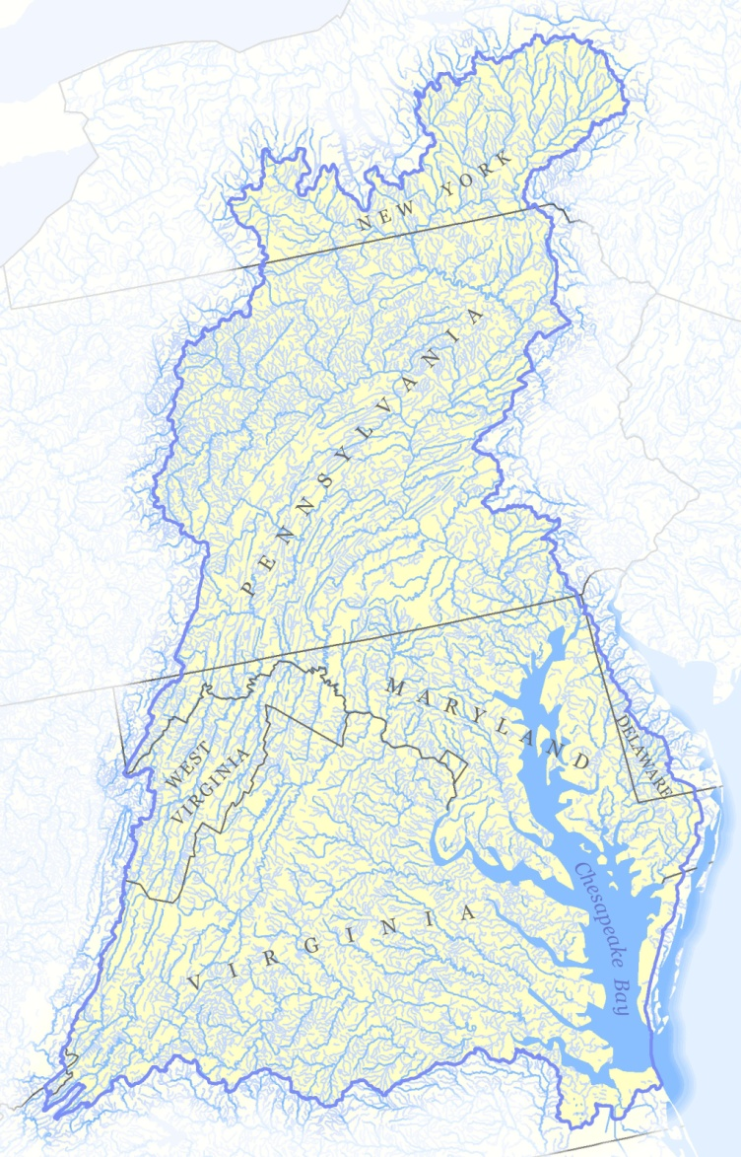
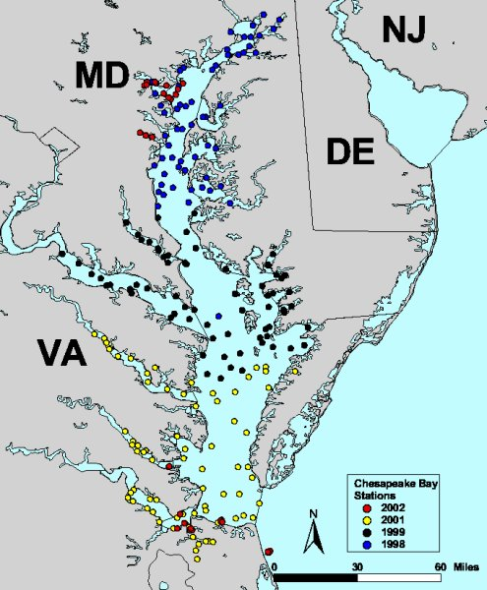
Change Our View
Vs.

Slide 10
Water Is A Local Issue
Strong messaging can build support for the implementation of the pollution diet and defend against threats to weaken efforts for restoration and protection.

Slide 11
Know the Power of Story
Studies prove that emotional stories are far more likely to inspire action.
While much hay is made of questioning science and statistics, it’s harder to question the story of what you saw or experienced – find people who can bring flooding, jobs, pollution, etc. to life.

Slide 12
Make the Pollution Diet Local
Our local waters. Be specific: name rivers and streams.
Our health. Talk about the sources of our drinking water. Talk about being able to eat the fish, safely swim.
Our economy. The tourism, fishing and recreational industries are vital to local economies.
Our local needs. Each locality has an opportunity this year to decide how we will clean up and protect our waterways over the next twenty years.
Our lands. How we use the land, what we build on it, and how we build, are decisions about what we’re going to allow into our rivers and streams.
Our responsibility. Everyone is responsible for the pollution they allow into the water, and for the impact that has on everyone else.

Slide 13
Coalition’s Strength Is In Sharing
“In today’s environment, hoarding knowledge ultimately erodes your power. If you know something very important, the way to get power is by actually sharing it.”
-Joseph Badaracco
Harvard Business School

Slide 14
Creating Opportunities for Enhanced Collaboration
State Leads
Listservs and workgroups
Annual Choose Clean Water Conference
Communications Tools
Coordinating Federal Policy
Notes:
Sharepoint – collaborative software

Slide 15
State Leads
Virginia – Virginia Conservation Network
Maryland – 1000 Friends of Maryland
Pennsylvania – PennFuture
West Virginia – West Virginia Rivers Coalition

Slide 16
Virginia
Through direct engagement with localities in Virginia, Coalition member organizations we were able to help guide and focus the responses local government submitted to the state.
The “Communities for Clean Water” workshops hosted by the Virginia Coalition for local government staff opened the door and allowed Coalition partners to continue to engage and support critical implementation efforts.

Slide 17
Virginia
Conservation Concepts, our local government technical contractor in Virginia, facilitated the George Washington Planning District submission, and through our conference calls, shared many of the strategies with other Coalition members working with localities.
Through his involvement, the Shenandoah Riverkeeper was able to positively influence Rockingham County’s submission. This significantly altered their tone from a negative one that attacked the pollution diet, into a positive and valuable tool we will be able to use in advocating for funding agriculture best practices.

Slide 18
Virginia
By the end of February 2012 when the local information was due to the state, the tide had turned and participation in the process gained momentum.
Only 5% of localities did not respond at all, and 75% responded with clear strategies to implement reductions in their region.

Slide 19
Maryland
Maryland Coalition members released 24 “barometers,” one for each county and Baltimore City.
These public-friendly documents rated the quality of local plans and identified next steps.
The barometers received significant local press coverage and resulted in local partners across the state being contacted and invited to join the WIP team. This was most striking in Wicomico County, where the county team had been closed to outside participants.

Slide 20
Maryland
Coalition members generated roughly 1,300 standard comments as well as more technical comment letters from coalition partners.
Coalition letter had 36 coalition members sign on, including groups that had previously not engaged in the issue.
Effort showed broad public support for the WIP, empowering Maryland’s Department of the Environment to defend the plan and the process. It also clearly showed the state that there are critical deficiencies in their plan, starting an important dialogue on reform.

Slide 21
Pennsylvania
Coordinated a sign-on letter to Governor highlighting the importance of the Phase II WIP and the critical components.
Coordinated a sign-on letter encouraging each of PA’s counties within the Bay watershed to work to submit local plans for the Phase II WIP and attend the upcoming DEP meeting about the process. Letter highlighted “community success stories.”
This communication helped to raise awareness at the local government level about the Phase II WIP process and reinforce the importance of the upcoming DEP meeting to discuss county-level plans, local efforts and program gaps.

Slide 22
Delaware
Comments submitted to Delaware’s Department of Natural Resources and Environmental Control which provided recommendations, questions, and comments to the state plan. These questions and recommendations were addressed and incorporated into the final Plan.
Chesapeake Bay Outreach Coordinator put together a presentation focused on the importance of “Choosing Clean Water.”
Presentations to town councils, master gardener clubs, 4H leaders, and service groups in the state using a conversational approach and local waters frame, provided much needed grassroots understanding of the pollution diet’s role in protecting Delaware’s waters.

Slide 23
West Virginia
West Virginia River Coalition’s goal was submission of a stronger Phase Two Plan by the state and a greater level of local engagement in the planning and submission process.

Slide 24
Coalition Workgroups
TMDL
Shale
Stormwater

Slide 25
TMDL Workgroup
Brings together policy and technical experts on the TMDL -pollution diet - to identify the most critical actions to support implementation. The workgroup also authors and edits letters to the EPA and states with policy recommendations.
The workgroup is focused this year on accountability and ensuring the 2-year milestone process, where the states have set restoration goals, is transparent, accountable and successful.
Experts from this group have also been working on draft Coalition principles for nutrient trading which will be available this summer.

Slide 26
Stormwater Workgroup
Brings together policy and technical experts on stormwater issues to help reduce the largest increasing source of nutrient pollution in the Chesapeake Bay watershed.
Workgroup experts vary in focus from national, regional and down to the state and local level.
Coalition weighs in on at the national level, eg.,for a strong national stormwater rule; at the regional level, eg.,urging EPA to utilized a standardized criteria to evaluate and enforce the stormwater components of Watershed Implementation Plan; and at the state and local level, where Coalition assessed and made recommendations on specific components of states’ Watershed Implementation Plans.

Slide 27
Stormwater Workgroup
During the past year, the Workgroup has:
Submitted early comments to EPA urging the promulgation of a strong national rule on stormwater
Established and adopted a set of Principles Linking Smart Growth and Stormwater entitled Smart Growth, Clean Water, and Sustainable, Competitive Economic Development
Assessed and analyzed the stormwater components of each states’ Phase II Watershed Implementation Plan and made recommendations to EPA and the states on how to strengthen them.

Slide 28
Shale Workgroup
While still waiting for a response from the Forest Service, the Coalition was able to quickly engage in support of a horizontal drilling ban in the George Washington National Forest with a sign on letter of 75 groups.
Coalition members mobilized to generate 50,000 comments on the issue.

Slide 29
3rd Annual CCW Conference
June 4-6, 2012
Lancaster, PA
Clean Water Starts Here
Focus on success stories
Field trips to see success stories

Slide 30
Communications Tools
Toolbox materials coming soon
Communications Workgroup
New CCWC website

Slide 31
Federal Policy
Executive branch – ensure that the president’s annual budget contains the proposed funding needed to keep the restoration effort on track.
Legislative branch – protect the Clean Water Act – budget and partisan politics will target Chesapeake restoration funds and programs – especially the regulatory approach through the EPA’s efforts with the Bay pollution diet.

Slide 32
Coordinating Federal Policy – Overcoming Congressional Attacks
Appropriations "rider" offered by Congressman Bob Goodlatte in February 2011 to stop EPA from spending any money on the TMDL
H.R. 4153 was introduced by Bob Goodlatte (R-VA) and Tim Holden (D-PA) to amend the Clean Water Act to specifically take away EPA's ability to develop and implement an enforceable TMDL for the Chesapeake Bay watershed.

Slide 33
Coordinating Federal Policy – Overcoming Congressional Attacks
Appropriations "rider" offered by Congressman Bob Goodlatte in February 2011 to stop EPA from spending any money on the TMDL
H.R. 4153 was introduced by Bob Goodlatte (R-VA) and Tim Holden (D-PA) to amend the Clean Water Act to specifically take away EPA's ability to develop and implement an enforceable TMDL for the Chesapeake Bay watershed.

Slide 34
Farm Bill 2012?
Senate – Marked up in April, “Regional Conservation Partnership” with priority areas
House – Mark-up a bill on June 19, not looking good
Crystal ball – Unlikely by September 30th (but could happen in lame duck…) likely to depend on the election
Best case scenario – extension!

Slide 35
Federal Policy - Appropriations
Program | Enacted for FY2012 | President Request FY2013 | Coalition’s Request | House | Senate | Final FY 2013
EPA Chesapeake Bay Program | $57.371 million | $72.371 million | $72.371 million
Clean Water SRF (EPA) | $1.4688 billion | $1.175 billion | $2.1 billion
USDA EQIP | $1.408 billion (estimate) | $1.403 billion | $1.403 billion
USDA Chesapeake Bay Watershed Initiative (2008 Farm Bill) | $50 million | $50 million | $50 million
USDA Forest Service- Chesapeake Forests | $0.9 million | $0.9 million | $0.9 million
USGS Chesapeake Bay Studies | $7.63 million | $9.849 million | $9.849 million
NPS Chesapeake Regional programs | $2.981 million | $3.005 million | $3.005 million
Chesapeake Bay Activities (FWS) |  | $3.5 million | $3.5 million
Interagency Initiative: (Interagency R&D Initiative on Hydraulic Fracturing)
U.S. EPA |  | $14 million | $14 million
U.S.G.S. |  | $19 million | $19 million
Dept. of Energy |  | $12 million | $12 million | $10 million | $12 million

Slide 36
Coalition Staff
Hilary Harp Falk, Program Director
email: falkh@nwf.org
phone: 443-759-3406
Deb Kleiner, Communications Manager
NEW: Tanya Dierolf, Field Manager
Peter Marx, Federal Affairs

