Slide 1
Microexpressions
Based on the Studies of Paul Eckman
LIE TO ME

Slide 2
About Paul Eckman
Paul Ekman was an undergraduate at the University of Chicago and New York University. He received his Ph.D. in clinical psychology at Adelphi University (1958), after a one year internship at the Langley Porter Neuropsychiatric Institute. After two years as a Clinical Psychology Officer in the U.S. Army, he returned to Langley Porter where he worked from 1960 to 2004. His research on facial expression and body movement began in 1954, as the subject of his Master’s thesis in 1955. His first publication was in 1957. In his early work, his approach to nonverbal behavior showed his training in personality. Over the next decade, a social psychological and cross-cultural emphasis characterized his work, with a growing interest in an evolutionary and semiotic frame of reference. In addition to his basic research on emotion and its expression, he has studies deceit for the last thirty years.

Slide 3
Your Face
A microexpression is a brief, involuntary facial expression shown on the face of humans according to emotions experienced. They usually occur in high-stakes situations, where people have something to lose or gain. Unlike regular facial expressions, it is difficult to fake microexpressions. Microexpressions express the seven universal emotions: disgust, anger, fear, sadness, happiness, surprise, and contempt. They are very brief in duration, lasting only 1/15 to 1/25 of a second.

Slide 4
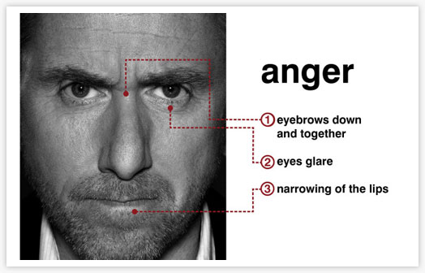

Slide 5
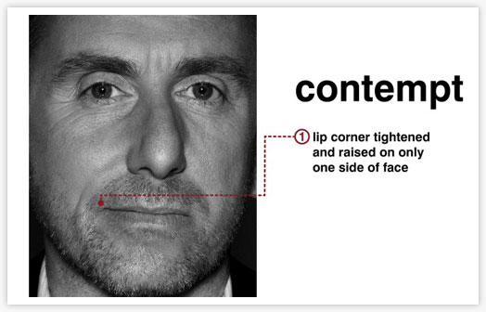

Slide 6
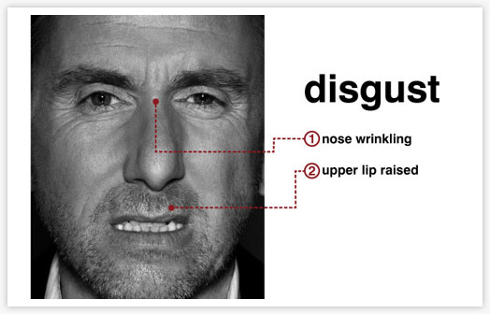

Slide 7
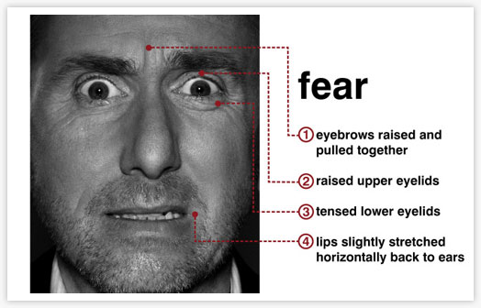

Slide 8
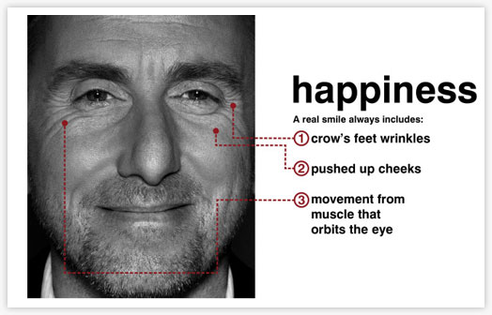

Slide 9
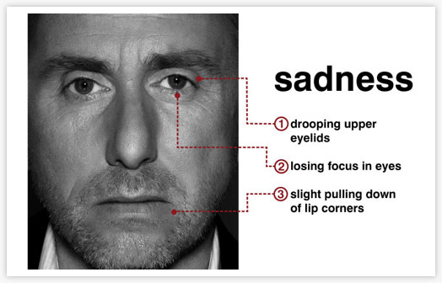

Slide 10
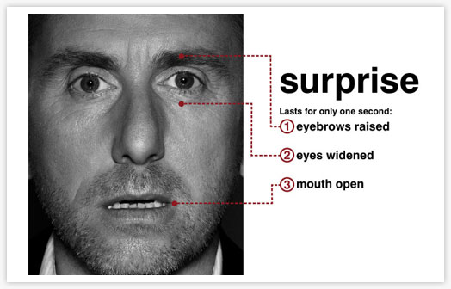

Slide 11
The Truth Is Written All Over Our Faces
Remember, these expressions can’t be controlled, and will show up on your face within a split second.
Because of this, it is possible to read what you are really thinking, and therefore be able to tell whether or not you are lying.

Slide 12
METT
When people deliberately try to conceal their emotions (or unconciously repress their emotions), a very brief–1/15 to 1/25 of a second– facial expression often occurs, invisible to nearly everyone who has not trained with METT: the micro-expression training tool. Training with METT enables you to better spot lies, put people at ease and be liked by others, and be more successful in sales.

Slide 13
Despite efforts to conceal any sign of emotion that is felt, leakage may occur in very small hard to recognize fragmants of expression. These tiny changes also can occur when an emotion is just beginning, often before the person knows they are about to act emotionally. METT can train people to “see” these important signals.

Slide 14
Micro expressions tell you that the emotion is concealed. But they do NOT tell you how or why it was concealed. They may be the result of a conscious, deliberate choice in which the person knows how he/she is feeling but does not want anyone else to know. Or, as a result of repression, in which the person does not know how he/she is feeling and has been blocked from their consciousness.

Slide 15
“Lie to Me”
Lie to Me is an American television series. In the show, Dr. Cal Lightman (Tim Roth) and his colleagues in The Lightman Group accept assignments from third parties (commonly local and federal law enforcement), and assist in investigations, reaching the truth through applied psychology: interpreting microexpressions, through the Facial Action Coding System, and body language.

Slide 16
FACS (Facial Action Coding System)
FACS is a research tool useful for measuring any facial expression a human being can make. As you may or may not already know, FACS is an anatomically-based system for exhaustively describing all observable facial movement. Each observable component of facial movement is called an action unit or AU. All facial expressions can be decomposed into their constituent AUs.

Slide 17
F.A.C.E (Facial Expression.Awareness.Compassion.Emotions.)
F.A.C.E. provides information about how to learn to recognize signs of emotion in the face. The Micro Expression Training Tool (METT) teaches recognition of concealed emotions through two kinds of training. This first kind of training is in slowed motion. It compares and contrasts the emotions that are most often confused with each other – anger and disgust, fear and surprise, fear and sadness, — with a commentary about just how each pair of emotions differ, which can be used at this slow speed to benefit people with aspergers or autism.

Slide 18
SETT
The Subtle Expression Training Tool (SETT) teaches recognition of very small, micro signs of emotion. These are very tiny expressions, sometimes registering in only part of the face, or when the expression is shown across the entire face, but is very small. Subtle expressions occur for many reasons. The emotion experienced may be very slight; they also occur when an emotion is just beginning, becoming larger if it is felt strongly. Mini expressions also may occur when strong emotions are felt but are being actively suppressed and all that leaks out is a fragment of the full expression. Dr. Ekman developed this training tool which increases people’s ability to spot these tiny signals.

Slide 19
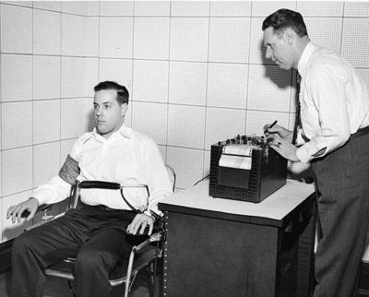
LIE TO ME

Slide 20
Submitted by Janine A. Carbone, Rochester Institute of Technology

