Slide 1
Are you Being Safe on Facebook?
Resident Assistant Michael Prestin
UW-River Falls

Slide 2

Are You Being Safe on

Slide 3
Check Out These 11 Simple Steps
To be safer on Facebook!

Slide 4
Set the security settings on your profile to "Only my friends.
Set the security settings on your profile to "Only my friends."
By doing this, you will be able to have control who has access to your information and pictures.
For certain pictures, you can also select certain friends that you do or do not want them to see.
.

Slide 5
2. Be sure to set your privacy settings.
Always monitor pictures that other people put of you and tag you on. You can see the tagged pictures of you by going to your profile and under your profile picture it should say "Photos of You" and the number of tagged pictures. Click on that, and look through the pictures. You should be able to un-tag any unappealing photos of you, but people still have the ability to see it.
Don't hesitate for a second to "un-tag" yourself from pictures that you do not approve of. Simply click "remove tag" next to the name in the list of people in the picture.
Also if you think that the particular picture could put you in a compromising situation, consult whoever put it up and ask him or her to remove it immediately. If they are your so called pals they should comply with your request

Slide 6
3. Do not post pictures of yourself under the influence of any type of substance.
This refers to pictures such as: Dancing-on-the-bar pictures or candid shots of the last time you got hammered with your pals on happy hour. Don't be caught with drugs, especially if you're underage because anyone can just print out the picture and show it to your parents.

Slide 7
4. Be cautious of the statuses, photos, videos, etc. you post if your coworkers, colleagues, or even your boss is friends with you.
If possible, avoid sending out or accepting friend requests from those who know you from work, especially your boss. Granting them full access to view your personal life will only have negative effects on your job.

Slide 8
5. Avoid putting your phone number, mailing address, children's or pet's names in your profile. People often use words such as pet's names or numbers as passwords, so it is not recommended to publish them on-line.

Slide 9
6. Never post information regarding an upcoming vacation or trip as your status.
Doing so is just asking for your house to be robbed.
If you must post photos and every detail of your two-week trip to France, do so after you return home, not before or during your vacation.

Slide 10
7. Change your password every so often. Don't make your password something obvious such as your birthday or mother's maiden name. Try to have at least one capital letter, one lowercase letter, two numbers, and a symbol. The longer and more complicated the password, the safer you are from getting your account hacked. Always remember to log out after you're finished with Facebook, especially on a shared computer.

Slide 11
8. Don't confuse Facebook with an on-line dating site.
The purpose of Facebook is to connect you with people you know.
Making you profile public means you're sharing your information with everyone, even though you don't know them, a risk that you wouldn't want to take.

Slide 12
9. Be careful who you friend. Be careful who you friend. Don't friend anyone out of your state/country unless you know them pretty well. Only friend people you know. You can add mutual friends that you don't know if you want to, though not recommended. Only friend people that you at least know their favorite color, siblings name, pets name, or something like that. Make sure they are the correct person by looking through their pictures. If they are not familiar, then remove them as a friend by getting to your friend list. Block anyone that seems to threaten or harass you.

Slide 13
10. Before clicking on a link from Facebook, always remember to check the address bar, which should always display "www.facebook.com/" and nothing else like "www.facebook33.tk" or "www.facebook1.php", etc. which is a giveaway of a phisher.
It can steal your e-mail and password, as well as post spam links to your friends' Walls.

Slide 14
11. Take advantage of online Social Network Monitoring services.
No matter how active you are, going through your children's posts, messages, photos, videos, comments is impossible. Remember: children have no right to privacy from their parents, but you don't necessarily need to view every post they make unless you have reason to be suspicious. You should have their passwords so you can see if they are getting into dangerous situations or are exhibiting inappropriate speech or behavior. You can, though, respect your children's individuality and take advantage of online Monitoring services. These services inform you on what you need to know in an easy to use platform. Some of these services offer monitoring for Facebook, MySpace, Twitter and cell phones; becoming your social shield against predators, Cyber-bullies, Reputation issues.
As a college student, be aware of your rights as an adult. If a parent or guardian is monitoring your social networking and you want to limit that access, talk about it with them and change the settings that allow monitoring.

Slide 15
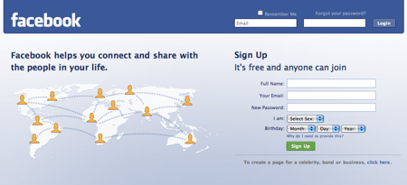
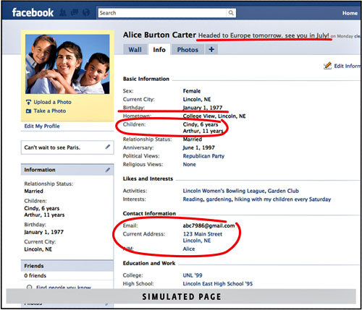

Slide 16
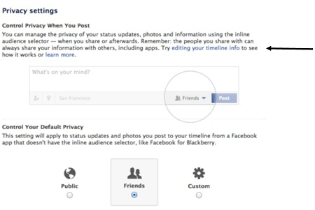

Slide 17
Sources
http://www.wikihow.com/Keep-Safe-on-Facebook

