Slide 1
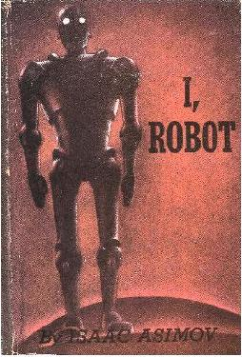
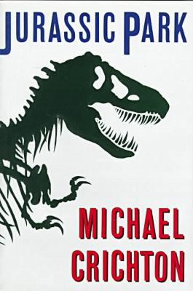
More Recent Work
Since the days of Verne and Wells, science fiction writers have explored the implications of artificial intelligence and genetic engineering …

Slide 2
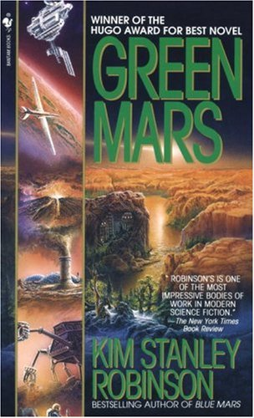
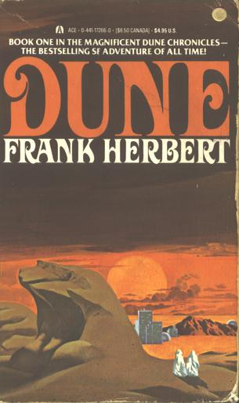
More Recent Work
Ecology and terraforming …

Slide 3
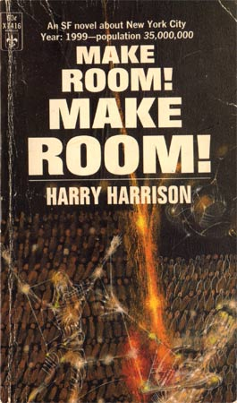

More Recent Work
Overpopulation ...

Slide 4
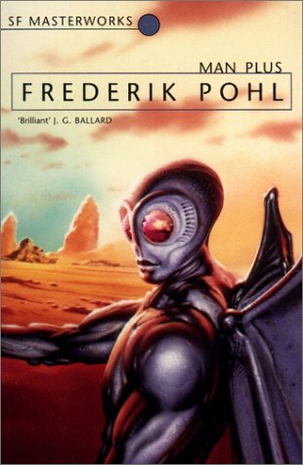

More Recent Work
and the transformation of human nature through advanced biotechnology

Slide 5
More Recent Work
A number of political theorists have suggested that government grows by using crises and emergencies as an excuse to expand its powers
After the crisis is over the increased powers rarely return to their pre-crisis level

Slide 6

More Recent Work
George Lucas dramatised the same idea in his second Star Wars trilogy

Slide 7

Nanotech in Science Fiction
The potential benefits and hazards of nanotechnology have featured prominently in science fiction as well
Michael Crichton’s Prey, for example, dramatises the “grey goo” scenario of nanobots running amuck, gobbling up everything in sight

Slide 8
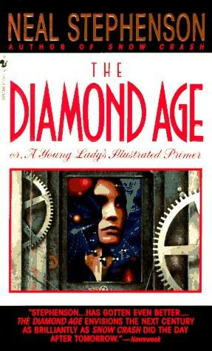
Nanotech in Science Fiction
Neal Stephenson’s The Diamond Age depicts a world in which nanotechnology has given us amazing powers, including the ability to grow entire islands and cities out of crystal
The downside is that only the upper classes benefit from this technology while ordinary people live in squalor
The plot turns on a poor child’s accidental discovery of a rich child’s abandoned interactive nano-powered “illustrated primer”

Slide 9
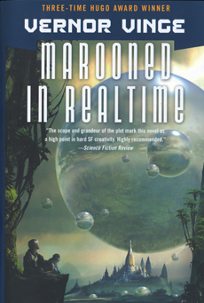
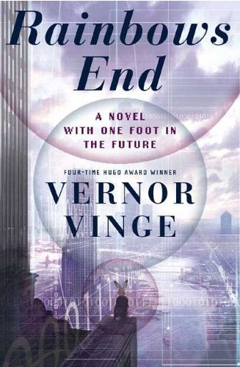
Nanotech in Science Fiction
Vernor Vinge’s novels deal with the concept of the “Singularity,” a hypothetical point in our supposedly very near future where the advance of nanotechnology, biotechnology, and artificial intelligence will transform the human race into superhuman beings beyond our present comprehension

Slide 10
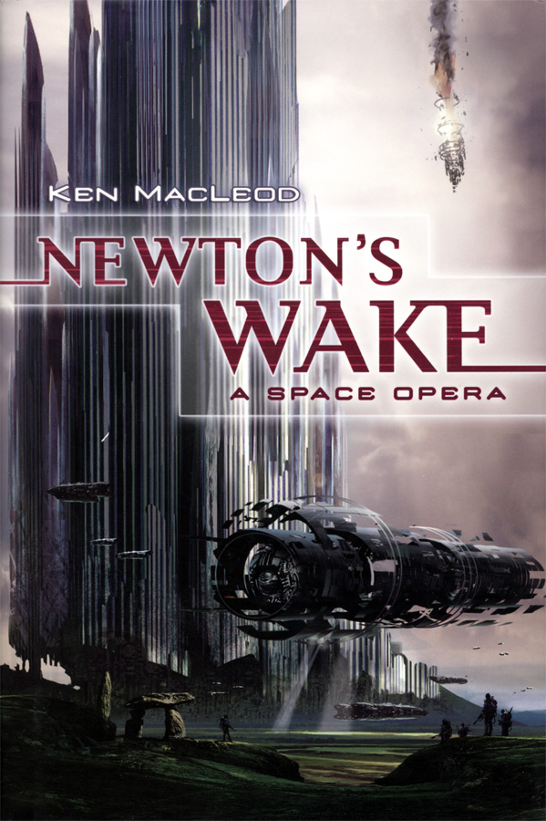
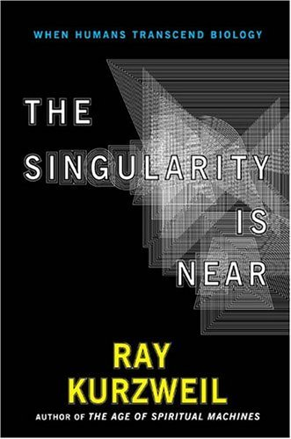
Nanotech in Science Fiction
This “Singularity” idea, which originated in Vinge’s science fiction novels, is now being embraced not only by other science fiction writers but also by nonfiction futurists such as Ray Kurzweil

Slide 11
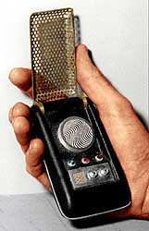
Prediction or Influence?
The personal communicators in the 1966 Star Trek look a lot like today’s cell phones
But is that because they predicted them?

Slide 12
Prediction or Influence?
Or is it because the people who created cell phones were influenced by Star Trek?

Slide 13
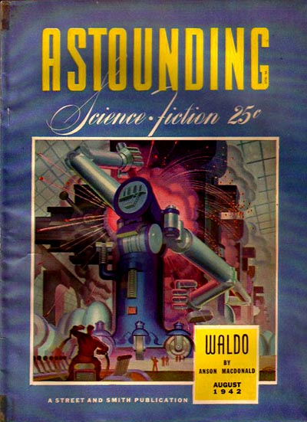
Prediction or Influence?
In his 1942 short story “Waldo,” Robert Heinlein predicted the use of remote manipulators

Slide 14
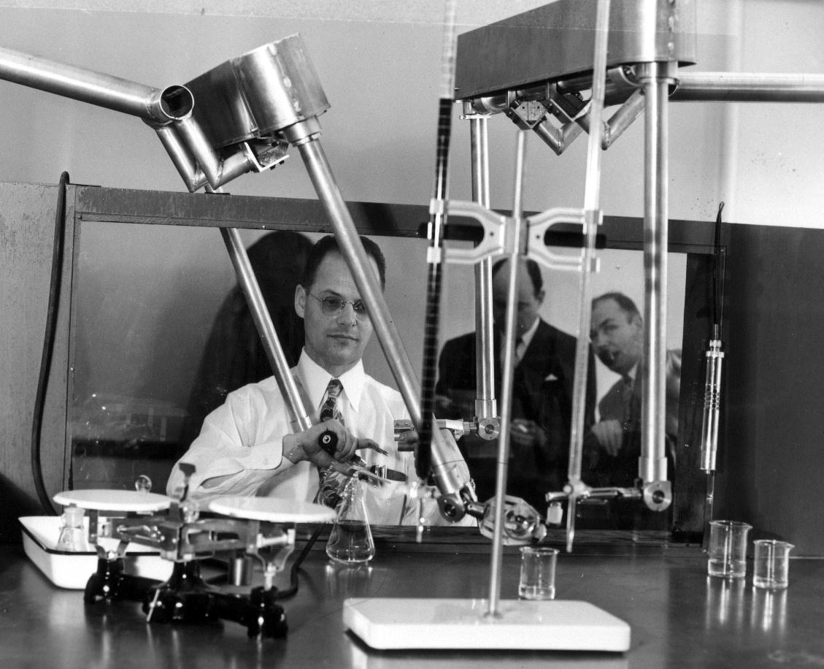
Prediction or Influence?
When they were finally invented in real life, they were called “Waldoes,” in honour of Heinlein’s story

Slide 15
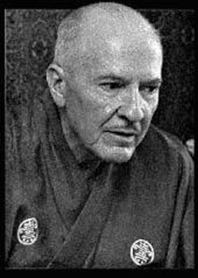
Prediction or Influence?
“This machine ... has access to the Congressional Library St. Louis Annex, does it not?”
“Certainly. Hooked into the Interlibrary Net, rather, though you can restrict a query to one library.”
– conversation from Heinlein’s I Will Fear No Evil (1970)

Slide 16
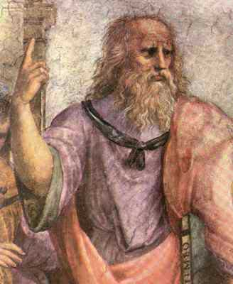
Science Fiction and Philosophy
How are they similar?
Both concern themselves with the possible, not just the actual
Both project possible states of affairs and either invite us to realise them or warn us to avoid them

Slide 17
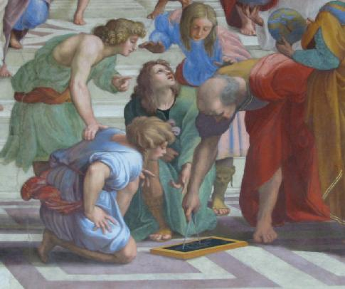
Science Fiction and Philosophy
How are they different?
Philosophy proceeds by
logical argument
It starts from premises
you already accept, and
attempts to show how
those premises logically
commit you to conclusions you don’t yet accept

Slide 18
Science Fiction and Philosophy
Hence in philosophy it never makes sense to dismiss a philosophical argument as “subjective” or “just someone’s opinion”
Whether or not you do accept the premises is a fact
Whether or not those premises logically entail the conclusion is also a fact

Slide 19
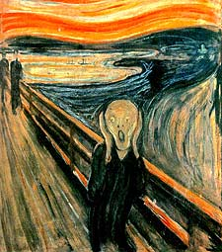
Science Fiction and Philosophy
Once you accept the premises of a logically valid argument, you cannot reject the conclusion without contradicting yourself
Socrates: “What is more shameful than to be in disagreement with oneself?”

Slide 20
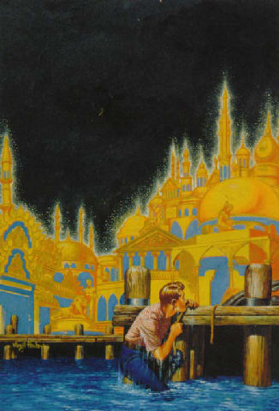
Science Fiction and Philosophy
Science fiction, by contrast, doesn’t necessarily deal with proofs and arguments (though these may occur incidentally)
It projects possibilities vividly so that we can feel what they would be like, and engages our emotions for or against them
But doesn’t philosophy do this too, through its use of thought-experiments?

Slide 21
Science Fiction and Philosophy
An important similarity between science fiction and philosophy is that they can both convince us that some possible future is worth pursuing (or avoiding) by drawing on beliefs and emotional reactions already latent within us

