Slide 1
Black History Month Jeopardy! Bulletin Board & Programming Idea
Submitted by Tamarah Roumayah Resident Advisor
Wayne State University, Detroit, MI

Slide 2
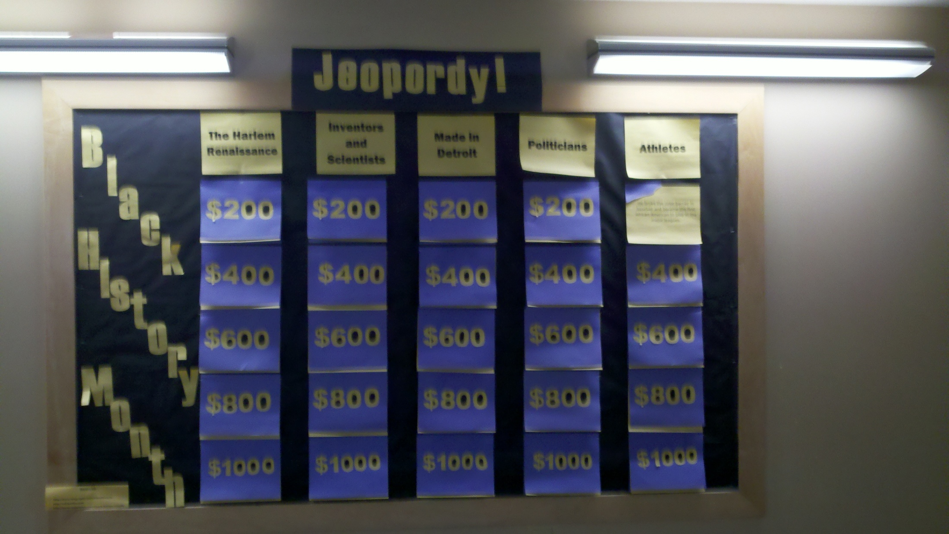

Slide 3
Politicians
Condoleezza Rice
She was the first African American woman to serve as United States Secretary of State, and the first African American and the first woman to serve as the President’s National Security Advisor.
Carol Braun
In 1993, this Illinois native became (and still is, to date) the first African American woman elected to the United States Senate.
Benjamin Oliver Davis
In 1998, he became the first African American general in the United States Army.
Thurgood Marshall
In 1967, he became the first African American U.S. Supreme Court Justice.
Susan Rice
This foreign policy advisor became the first African American woman to serve as an ambassador to the United Nations.

Slide 4
Made in Detroit
Motown Records
Founded by Barry Gordy in 1959, this company became one of the most successful black-owned companies in the nation, and cultivated the careers of music greats such as Diana Ross and Michael Jackson.
1967 riots
This event lasted five days and left 43 dead and 467 injured; it is reputed to have deepened the divide between whites and blacks in Detroit, instigate a frantic spike in “white flight” out of the city, and created extremist groups within each racial group.
Coleman Young
In 1974, he was elected as the first black mayor of Detroit.
Rosa Parks
This Detroit native refused to give up her bus seat to a white passenger in Alabama, which spurred a nation-wide effort to end segregation of public facilities.
Martin Luther King, Jr.
He delivered his “I Have a Dream” speech first in Detroit, before taking it to Washington.

Slide 5
Inventors & Scientists
Guion Bluford
After completing the STS-8 mission aboard the Challenger, this engineer and astronaut became the first black man in space.
Otis Boykin
He invented electronic control devices for guided missiles, IBM computers, and the control unit for pacemakers.
Joycelyn Elders
In 1993, she became both the first African-American and the first woman to serve as Surgeon General, and is famous for her controversial views on masturbation, stating “[Masturbation] is a part of human sexuality, and perhaps it should be taught”.
Lonnie Johnson
He invented the “SuperSoaker” in 1989.
Daniel Williams
He is credited with performing the first open heart surgery on July 9, 1853.

Slide 6
The Harlem Renaissance
W.E.B. Du Bois
This writer and sociologist was co-founder of the NAACP, and was one of the most famous social activists during the Harlem Renaissance.
Harlem, New York City, NY
This was the birthplace of the Harlem Renaissance, which was called a literary and intellectual flowering that fostered a new black cultural identity in the 1920s and 1930s.
Langston Hughes
Credited as one of the founding fathers of the Harlem Renaissance, this playwright/poet/novelist became famous for his first published poem, “The Negro Speaks of Rivers”.
Opportunity Magazine
This official publication of the National Urban League employed Harlem Renaissance writers and editors, published poems and short stories by African Americans, and promoted African American literature.
The Apollo Theatre
This theatre rose to prominence during the Harlem Renaissance, during which time it was reputed to only hire black entertainers; of these were James Brown, Ella Fitzgerald, and Billie Holiday.

Slide 7
Athletes
Florence “Flo-Jo” Griffith-Joyner
This Olympic track star won three gold medals and two silver medals, and still holds world records in 100-meter and 200-meter races, which were set in 1988.
Muhammad Ali
Also a social activist and philanthropist, he was the first boxer to win the world heavyweight championship three times.
Jackie Robinson
He broke the color barrier in baseball and became the first African American to play in the major leagues.
Lynette Woodard
Following her careers in college and professional basketball, she became the first female member of the Harlem Globetrotters in 1985.
Charlie Sifford
In 1961, he broke the color barrier in golf when he became the first African American to play in the PGA tour.

Slide 8
Sources
http://www.biography.com/blackhistory/
http://wikipedia.com
http://www.infoplease.com/black-history-month/

