Slide 1

Crowley Latin American Services LLC presenta:
El Impacto de la transportacion y
logística
en la carga refrigerada
http://www.youtube.com/watch?feature=player_detailpage&v=lDP5sb1jhk8

Slide 2



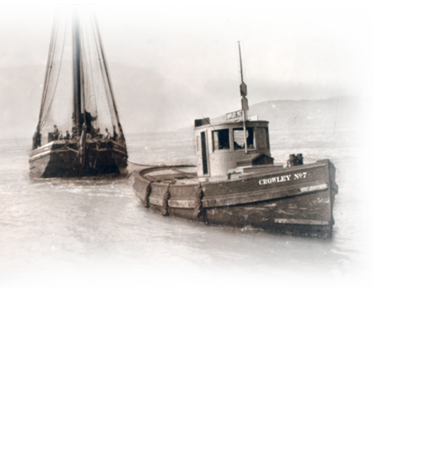
50 years providing a world-class service in Central America

Slide 3

“Throughout our 119-year history, the people of Crowley have recognized the importance of safety and security in our operations, to our customers and to our employees. We also have been committed to the utmost levels of security within a broader national and global context.”
Our mission is to be a leader in our markets by providing world class services that ensure long –term company durability.
Thomas B. Crowley Jr.
Chairman, President and CEO

Slide 4
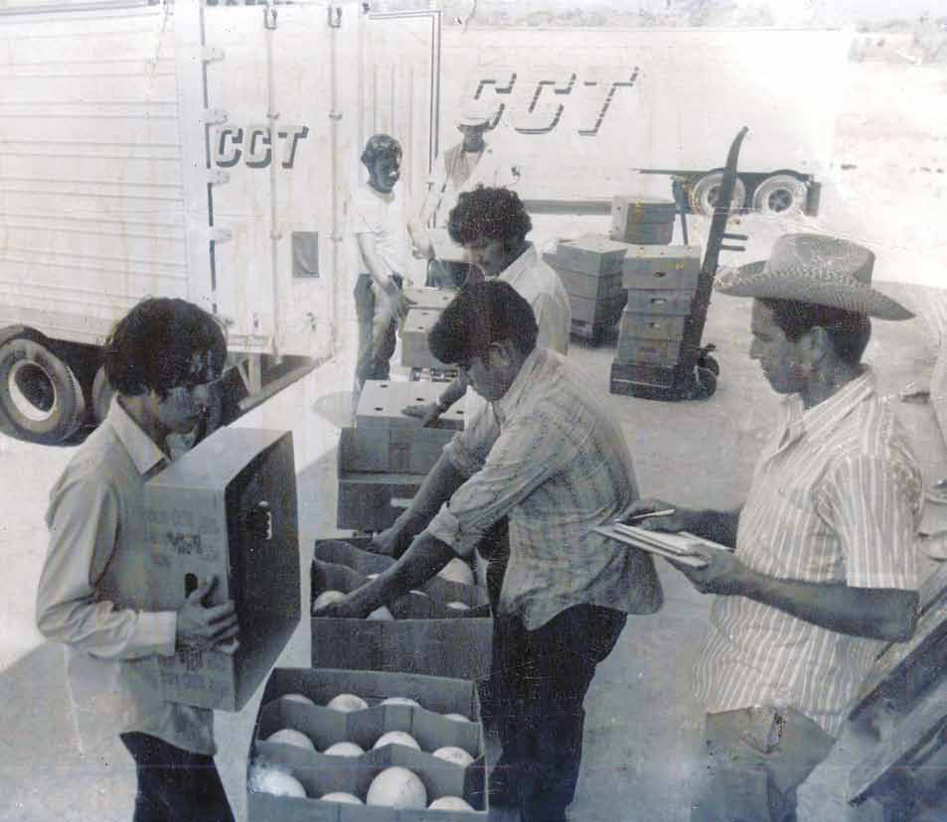
CELEBRATING 50 YEARS OF LEADERSHIP, GROWTH AND SUSTAINABILITY
2011 marks the 50th anniversary of ocean cargo transportation service between the U.S. and Central America for Crowley and predecessor company Coordinated Caribbean Transport (CCT). Since 1961, Crowley has helped the region blossom into the shipping hub that it is today, and has contributed to the development of Central America’s economy, culture and ports. Crowley now reflects on its history of faithful service to the people of Central America while also looking forward to the next 50 years of growth and opportunity.

Slide 5


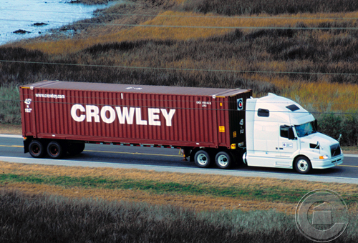
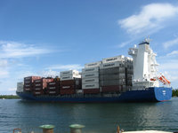
Crowley Services Today
Liner Shipping Services
Worldwide Logistics
Energy Support Services
Contract Towing & Transportation
Ocean Towing & Transportation
Ship Assist & Escort Services
Petroleum/Chemical Transport
Fuel Sales and Distribution
Salvage & Emergency Response
Ship Management
Vessel Construction/Naval Architecture

Slide 6
Liner Shipping Services
Crowley is the leading ocean cargo carrier between the United States and Puerto Rico, the Caribbean, Bahamas, Central America and Dominican Republic.
Services include regularly scheduled liner operations for cargo shipped in containers and/or trailers; rolling stock such as cars, trucks, buses and construction equipment; and break-bulk, heavy lift and over-dimensional items via Crowley’s extensive fleet of specialized equipment and vessels.
With its frequents, fast service, Crowley can provide unmatched Speed to Market within the U.S., Central and Caribbean Region.

Slide 7
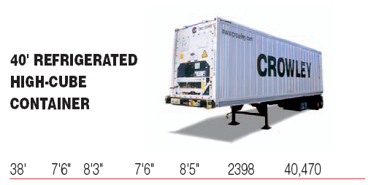
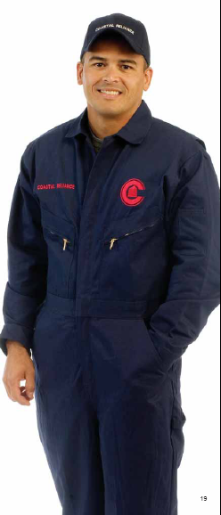
Reefer Units
Crowley has the most modern refrigerated container fleet in the industry in Thermo King and Carrier
Because each unit is capable of maintaining temperatures to within
plus or minus one-half degree Fahrenheit even in 122-degree
ambient temperatures, you can ship with confidence.
Hand-held computers allow our operators to access advanced
microprocessors for diagnostic checks, and download all transit data.
An extensive pre-trip function performs the industries most accurate
performance check.
As produce farmers across the Americas gear up for the peak winter produce season, Crowley has added 400 new refrigerated containers to its fleet to accommodate their
needs.
This state-of-the art equipment feature the most efficient and environmentally friendly technology, to ensure Crowley and customers reduce their environmental footprint.
Today, the company owns and leases more than 44,000 pieces of specialized equipment, including more than 20,394 chassis, 18,280 dry containers and more than 3,000
refrigerated containers—all of which come in a variety of sizes and are
strategically located throughout the United States, Central America and the Caribbean.

Slide 8
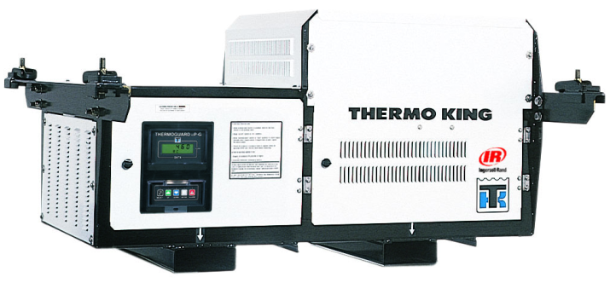
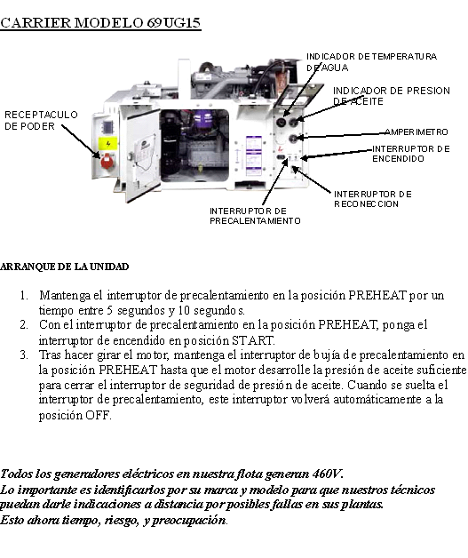
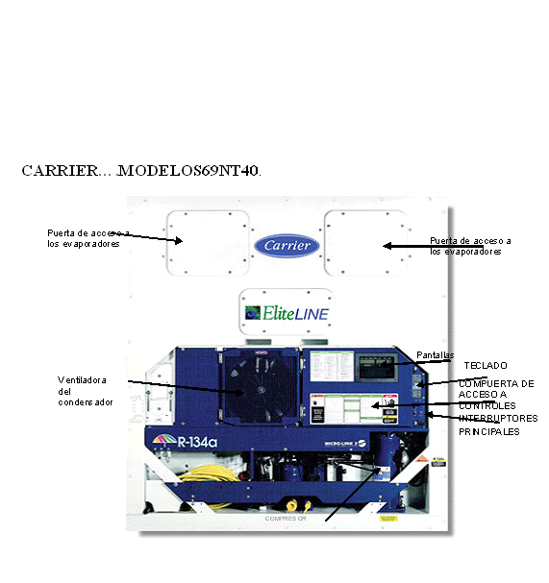
People Who Know
“From having the most modern refrigerated container fleet in the
Industry the most knowledgeable employees, you can ship with confidence”

Slide 9


Refrigerated (Reefer) Cargo Shipping
for Perishables
Crowley People who know refrigerated cargo. Having the right reefer equipment is only part
of the equation when it comes to shipping
perishables successfully. The true difference lies
in the expertise and helpfulness of
the Crowley staff. Our reefer cargo experts are
here to recommend the right equipment,
explain packing techniques to achieve proper
air circulation within the container,
and monitor and track your shipment during
the entire move.
We perform computerized pre-trip diagnostics
tests and cover a 22-item detailed checklist to
ensure that each and every one of our containers
is in top condition for packing.
While shipments are in transit, we maintain
temperature levels.
Power packs and backup power
sources are continually monitored via satellite.
Each piece of equipment undergoes
a yearly scheduled preventive maintenance
service check.

Slide 10


Don't trust your perishables to just anyone.
At Crowley, we understand there's no margin for
error when shipping perishable commodities
whether they be frozen, chilled or simply
temperature controlled in an insulated container.
That's why we combine state-of-the-art reefer
equipment with experts in the field to provide you
with the most reliable refrigerated cargo
transportation services available today between
the United States and Puerto Rico,
the Caribbean, Bahamas, Central America,
Dominican Republic, Haiti and Cuba.
So whether your shipping produce, beef, chicken,
seafood, ice cream, pharmaceuticals, or anything
in between, go with people who know - Crowley.

Slide 11


Slide 12
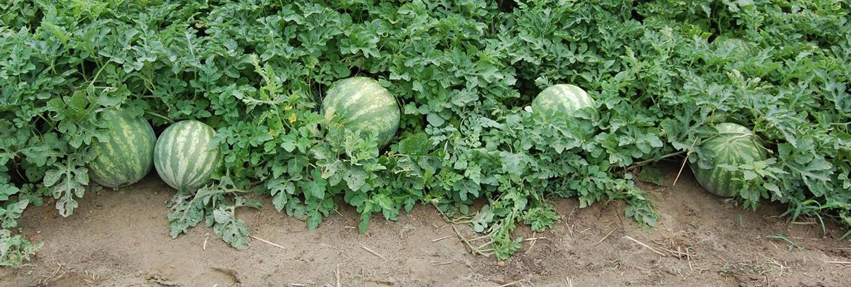
Import Customs Clearance
Customized Brokers is a world leader in helping goods clear U.S. Customs as efficiently as possible. We place an emphasis on time-sensitive goods like fresh and frozen produce. To provide our customers with the best, most comprehensive service, we maintain a presence at airports and ports throughout the U.S.
We have built a strong knowledge of compliance and strong relationships with CBP, USDA and FDA to allow us to expedite our customers' shipments. We also handle documentation, such as FDA Prior Notice and ISF filings to ensure your goods are cleared on time.
On top of that, our partnerships with carriers and service providers ensure that your goods are processed and delivered quickly with excellent service. We operate around the clock, seven days a week. There is always a representative available to expedite releases or answer any questions customers may have.

Slide 13

Overview
Customized Brokers is a leader in the customs clearance of produce into the United States.
Our strong knowledge of compliance and our excellent relationship with CBP, USDA and FDA allow us to expedite our customer’s shipments.
We have developed a strong partnership with all carriers and service providers, ensuring expeditious process and excellent service.
We operate around the clock, seven days a week. There is always a representative available to expedite releases or answer any questions customers may have.

Slide 14







Customs Broker Services
We provide 24/7 service
CBP/AQI clearances
Fumigation Coordination
FDA Prior Notices
FDA Foreign Facility Registration
Act as FDA Foreign Facility US Agent
Importer Security Filing 10+2
IT's /T&E's issued upon request
Yearly Customs Bonds issued and renewed
Transportation Coordination
Reconciliations
Consulting
Cargo Insurance

Slide 15
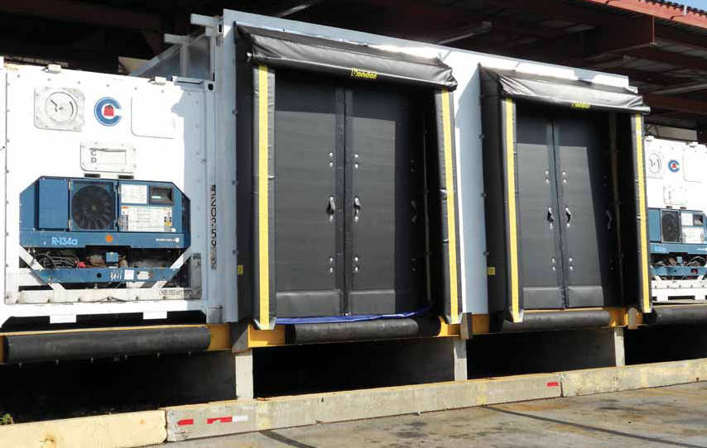
If Pests are Bugging Your Imported Produce in Port Everglades,Florida, Then Bring Them Here
Crowley’s custom-built Highly Mobile Actionable Pest (HMAP) Refrigerated
Chamber in Port Everglades allows your containers to be prepared for fumigation in a chilled environment, saving your valuable cargo and eliminating the need to export the load back to the country of origin.
The (HMAP) Refrigerated Chamber is the only one of its kind in Port Everglades, and it exceeds the requirements established by the U.S. Department of Agriculture’s Animal and Plant Health Inspection Service and applies to international cargo shipments that have been determined by Plant Protection and Quarantine identifiers to be infested with highly mobile actionable pests.

Slide 16
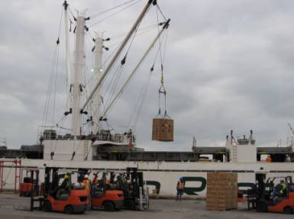
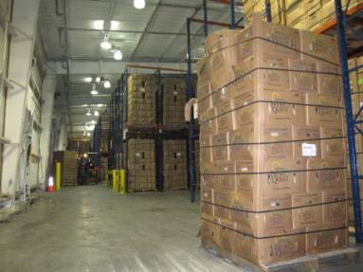
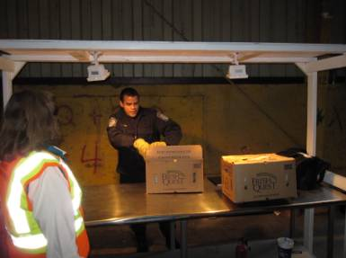
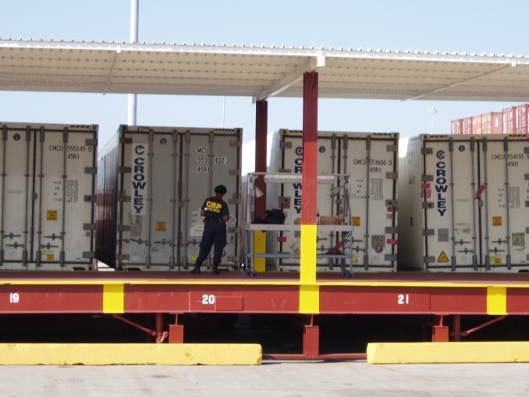
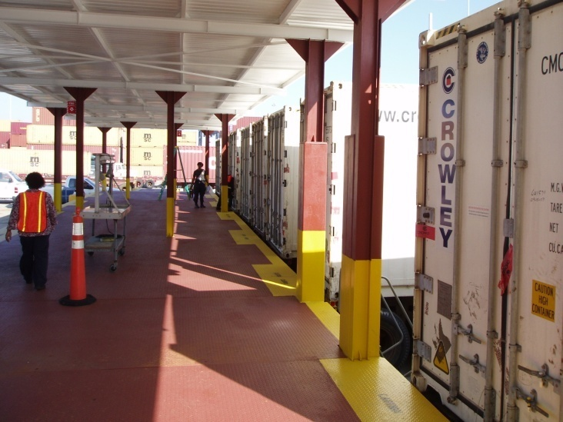

Port Operations Procedures
Vessel Discharge
USDA Inspection

Slide 17

CBP/AQI - USDA
Agriculture is responsible for verifying documentation (Phytosanitary certificates and/ others) and inspecting produce for admissibility. Agriculture Quarantine works under the direction of CBP.
USDA handles pest identification and fumigation
USDA has personnel in some countries (like Chile and Peru). Certain produce from those countries could arrive “pre-cleared”.
Importers of fresh produce are required to have USDA import permits
All costs for CBP/AQ inspections are for the account of the importer. These may include fumigation, re-exportation or destruction)
Notes:
Fruits and Vegetables Import Requirements (FAVIR)
The FAVIR database allows customers to search for authorized fruits and vegetables by commodity or country, and quickly and easily determine the general requirements for their importation into the United States. This database will include emergency pest notifications to alert users if there is a change in the import status of a commodity or country. It also allows APHIS officials and the Department of Homeland Security’s Customs and Border Protection (CBP) agricultural inspectors to quickly determine whether or not a commodity is authorized entry into the United States, as well as the general requirements for importation. FAVIR allows easy access to information pertaining to the importation of fruits and vegetables.
USDA requires a written permit for importing fresh and/or frozen fruits and vegetables (including fresh herbs and sprouts) for consumption from all foreign sources into the United States and its territories.
Example: asparagus Consignments may or may not be precleared. If they are precleared, the consignment must be accompanied by a PPQ Form
203 signed by the APHIS inspector on site in Peru to validate foreign site preclearance. Precleared asparagus does not need
to be treated upon arrival or at the port of entry (it was treated in Peru). If the consignment was not precleared, REQUIRE
T-101-b. HOLD consignment and CONTACT PPQ through proper channels.
Asparagus
Pest: External feeders such as Noctuidae spp., Thrips spp.
(except Scirtothrips dorsalis from Thailand), Copitarsia spp.
Treatment: T101-b-1 MB (“Q” label only) at NAP—tarpaulin or
chamber
Costa Rica: Yam (tuber), T101-f-3 14

Slide 18

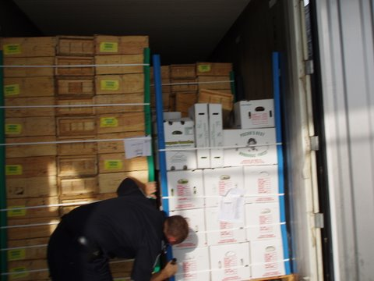
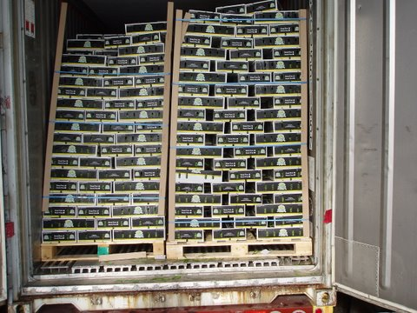
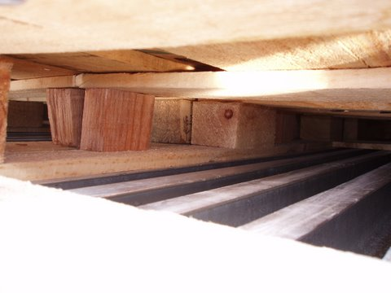
Wood Packing Material (WPM) Requirements
The regulation became effective on September 16, 2005, states that any WPM that arrives in the U.S. must comply with treatment and marking requirements. If WPM arrives in the US and is untreated and non-compliant to this new regulation, the materials will be immediately exported at the cost and responsibility of the importer.

Slide 19

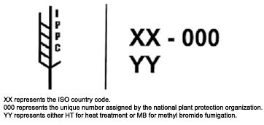
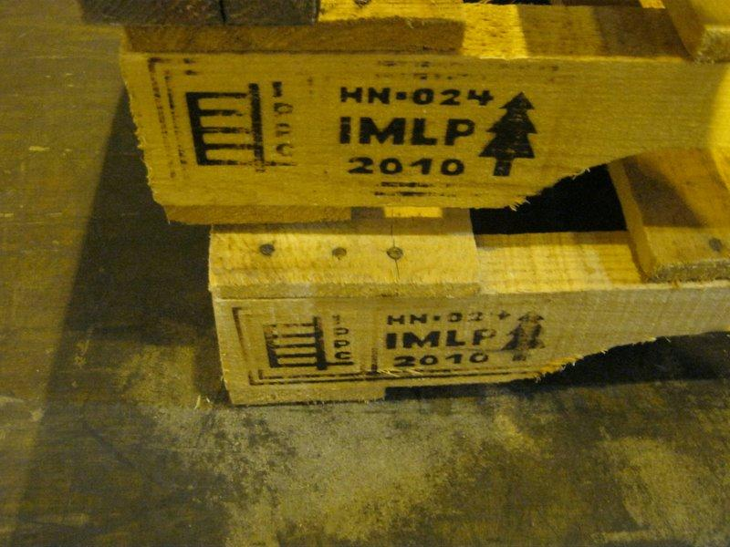
WPM marking issues

Slide 20
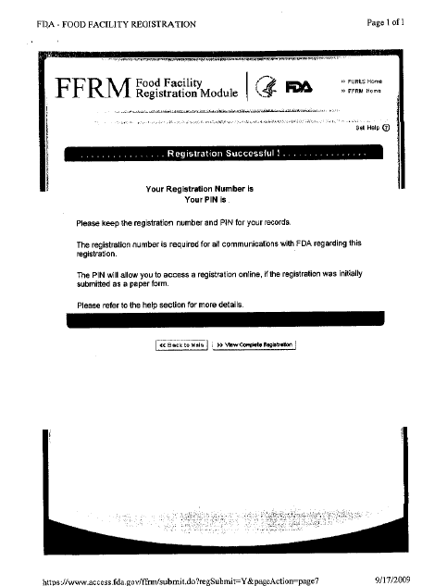




FDA
FDA Food Facility Registration
www.FDA.gov
Food and Drug Administration conducts random sampling of produce to check for pesticide residue and microorganisms
Basic information is transmitted to FDA . Electronic response is received:
Release without sampling
Request sampling
Notes:
Prior Notice of Imported Food Under the Public Health Security and Bioterrorism Preparedness and Response Act of 2002, Federal Register, November 7, 2008
Crossing Location = Port of Arrival for Prior Notice; may or may not be the port where entry is made for CBP purposes.
FDA Country of Production (Originating Country)
For food in its natural state -- the country where the article of food was grown or collected, including harvested and readied for shipment to the U.S.
For wild fish or seafood caught or harvested outside the waters of the U.S. by a vessel that is not registered in the U.S.: the country in which t
he vessel is registered
For an article of food that was grown in a U.S. Territory: the U.S.
What Food Imports are Subject to Prior Notice?
Unless excepted, all food for humans and animals that is imported or offered for import into the United States for use, storage, or distribution in the U.S., including:
Food for gifts and trade
Quality assurance/quality control samples
Food for future export
Food for transshipment through the U.S. to another country
Food for use in a U.S. Foreign Trade Zone (FTZ)
Food sent by mail
Food sent by express couriers
Who is Authorized to Provide Prior Notice?
"Submitter" can be any person with knowledge of the required information
"Transmitter" is a person who transmits the required information to FDA for the submitter
How Far in Advance Can I submit Prior Notice?
Maximum time frames for submitting PN:
Increased time frames from the IFR
Dependent on mode of submission:
- Via ABI/ACS: Submit PN no more than
30-calendar days before arrival
- Via PNSI: Submit PN no more than 15-calendar days before arrival
Does not apply to food arriving by international mail (must submit PN before food is sent to U.S.)
- When Is My Prior Notice Due?
Arrival by land via road: PN must be given no less than 2 hours before the food arrives at the port of arrival
Arrival by air and land via rail: PN must be given no less than 4 hours before the food arrives at the port of arrival
Arrival by water: PN must be given no less than 8 hours before the food arrives at the port of arrival
What Happens to Food Without Adequate Prior Notice?
No or inaccurate prior notice - food is subject to refusal
Untimely prior notice - food is subject to refusal, unless FDA has already reviewed the notice and notified CBP of its response
What Happens to Food Without Adequate Prior Notice?
If refused, food must be held at the port of entry, unless:
CBP concurrence is obtained for export and food immediately is exported from the port of arrival under CBP supervision; or
Directed to another location by CBP or FDA
Must notify FDA of hold location
FDA and CBP are not liable for transportation, storage or other expenses resulting from any hold
- Consequences of Failure to Submit Adequate Prior Notice
Prohibited act to import or offer for import food without providing prior notice:
FDA can bring a civil or criminal action in federal court
FDA can seek to debar persons under section 306 of the Bioterrorism Act
- Minimum time frames for submitting PN – retains the IFR time frames: no less than
- 8 hours (for food arriving by water),
- 4 hours (for food arriving by air or land/rail), and
- 2 hours (for food arriving by land/road) before the food arrives at the port of arrival
-
-

Slide 21
FDA
When microbiologic contamination is found the importation of related products is affected.
Examples of closed markets and corresponding losses in USD:
Honduras cantaloupe in 2008 - 8 Millions
Salmonella Litchfield – 51 cases reported
Mexico tomatoes in 2008 - 90 Millions
Guatemala raspberry in 1999 – 36 Millions
Cyclosporiasis (feces-contaminated fresh
produce and water) – 2800 cases reported
Mexico cantaloupes in 2000-03 – 58 Millions
Salmonella pomona – 155 cases reported
Mexico scallions in 2003 – 10.5 Millions
Source: OIRSA.ORG prevention of biological contamination
Notes:
Prior Notice of Imported Food Under the Public Health Security and Bioterrorism Preparedness and Response Act of 2002, Federal Register, November 7, 2008
Crossing Location = Port of Arrival for Prior Notice; may or may not be the port where entry is made for CBP purposes.
FDA Country of Production (Originating Country)
For food in its natural state -- the country where the article of food was grown or collected, including harvested and readied for shipment to the U.S.
For wild fish or seafood caught or harvested outside the waters of the U.S. by a vessel that is not registered in the U.S.: the country in which t
he vessel is registered
For an article of food that was grown in a U.S. Territory: the U.S.
What Food Imports are Subject to Prior Notice?
Unless excepted, all food for humans and animals that is imported or offered for import into the United States for use, storage, or distribution in the U.S., including:
Food for gifts and trade
Quality assurance/quality control samples
Food for future export
Food for transshipment through the U.S. to another country
Food for use in a U.S. Foreign Trade Zone (FTZ)
Food sent by mail
Food sent by express couriers
Who is Authorized to Provide Prior Notice?
"Submitter" can be any person with knowledge of the required information
"Transmitter" is a person who transmits the required information to FDA for the submitter
How Far in Advance Can I submit Prior Notice?
Maximum time frames for submitting PN:
Increased time frames from the IFR
Dependent on mode of submission:
- Via ABI/ACS: Submit PN no more than
30-calendar days before arrival
- Via PNSI: Submit PN no more than 15-calendar days before arrival
Does not apply to food arriving by international mail (must submit PN before food is sent to U.S.)
- When Is My Prior Notice Due?
Arrival by land via road: PN must be given no less than 2 hours before the food arrives at the port of arrival
Arrival by air and land via rail: PN must be given no less than 4 hours before the food arrives at the port of arrival
Arrival by water: PN must be given no less than 8 hours before the food arrives at the port of arrival
What Happens to Food Without Adequate Prior Notice?
No or inaccurate prior notice - food is subject to refusal
Untimely prior notice - food is subject to refusal, unless FDA has already reviewed the notice and notified CBP of its response
What Happens to Food Without Adequate Prior Notice?
If refused, food must be held at the port of entry, unless:
CBP concurrence is obtained for export and food immediately is exported from the port of arrival under CBP supervision; or
Directed to another location by CBP or FDA
Must notify FDA of hold location
FDA and CBP are not liable for transportation, storage or other expenses resulting from any hold
- Consequences of Failure to Submit Adequate Prior Notice
Prohibited act to import or offer for import food without providing prior notice:
FDA can bring a civil or criminal action in federal court
FDA can seek to debar persons under section 306 of the Bioterrorism Act
- Minimum time frames for submitting PN – retains the IFR time frames: no less than
- 8 hours (for food arriving by water),
- 4 hours (for food arriving by air or land/rail), and
- 2 hours (for food arriving by land/road) before the food arrives at the port of arrival
-
-

Slide 22
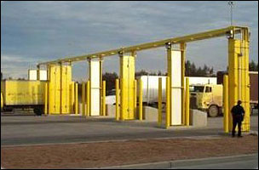
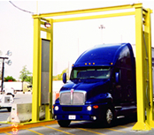
CBP Mandated RPM inspections
Since 2007, CBP PEV has mandated that all ocean containers be screened by an RPM (Radiation Portal Monitor) prior to entering the commerce of the United States. In 2011 CBP expanded the role of the RPMs to include all foreign cargo including bulk, break-bulk, loose, and roll-on/roll-off (ro-ro) commodities.

Slide 23
Fumigation Procedures
There are two types of fumigation, automatic fumigation and USDA ordered fumigation.
Automatic fumigation is done when USDA makes it a condition of entry for a specific commodity.
USDA ordered fumigation is done when the USDA inspector finds a bug/pest during the routine PQ inspection done after cargo arrives.
When a container has to be fumigated, USDA will issue an Emergency Action Notification (523) and a chain of custody.
The EAN must be signed and sent back to USDA with the action marked that will be taken.
Fumigation request is then sent to the fumigation site along with the
emergency action notification.
Temperature instructions are sent to the line if ocean container.
Trucker is contacted to have trailer loaded and sealed by USDA if air cargo.
When container/trailer arrive at the fumigation site USDA will remove the fumigation seal.

Slide 24

Compatibility Group Specifications
Group 1: Fruits & Vegetables (32-36F) 90-95% humidity. Many products in this group produce ethylene. Citrus treated with biphenyl may give odors to other products.
Group 2: Fruits & Vegetables (32-36F) 95-100% humidity. Many products in this group are sensitive to ethylene. These products can be top-iced.
Group 3: Fruits & Vegetables (32-36F) 65-75% humidity. Moisture will damage these products.
Group 4: Fruits & Vegetables (40F) 90-95% humidity. Citrus treated with biphenyl may give odors to other products. Can be top-iced.
Group 5: Fruits & Vegetables (50F) 85-90% humidity. Many of these products produce ethylene and are also sensitive to chilling injury.
Group 6: Fruits & Vegetables (55-60F) 85-90% humidity. Many of these products produce ethylene and are also sensitive to chilling injury. Citrus treated with biphenyl may give odors to other products.
Group 7: Fruits & Vegetables (65-70F) 85-90& humidity. Separate from pears & tomatoes due to ethylene sensitivity.

Slide 25
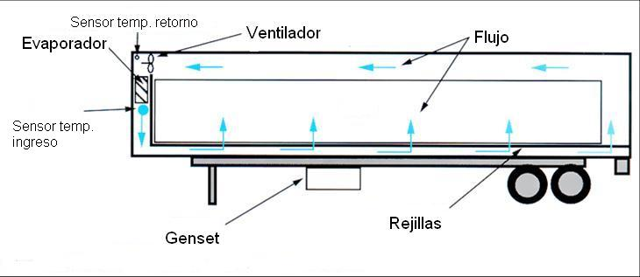
Air Flow

Slide 26
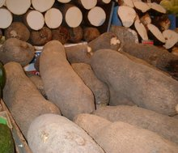
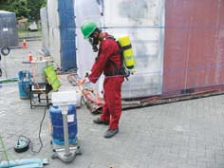

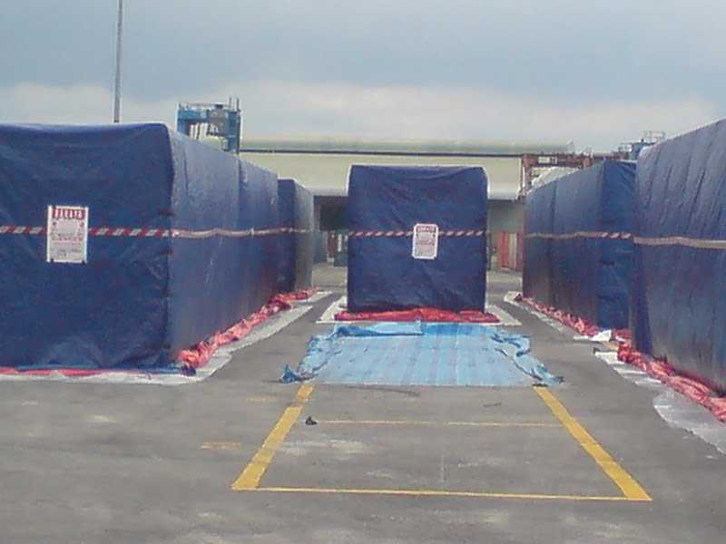
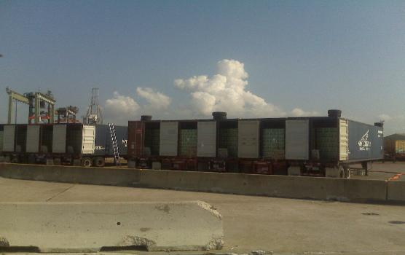
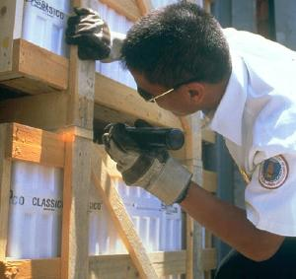
Fumigation Procedures
Once fumigation and aeration are completed driver can deliver to customers warehouse.

Slide 27
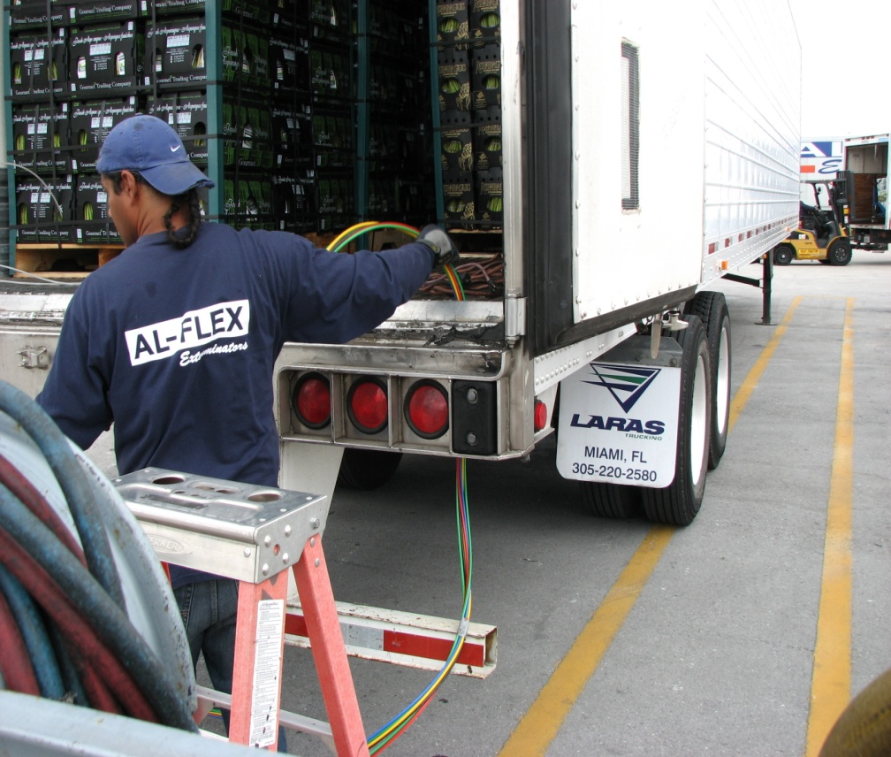
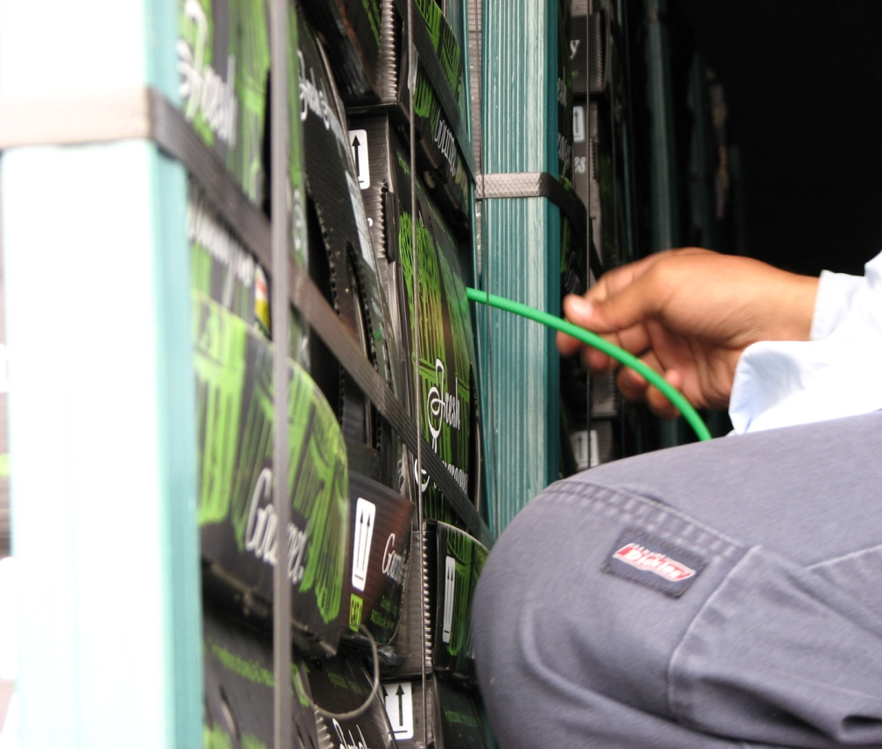
Fumigation personnel placing monitoring lines prior to fumigation.
Placing lines in specific locations inside the perishable box.

Slide 28
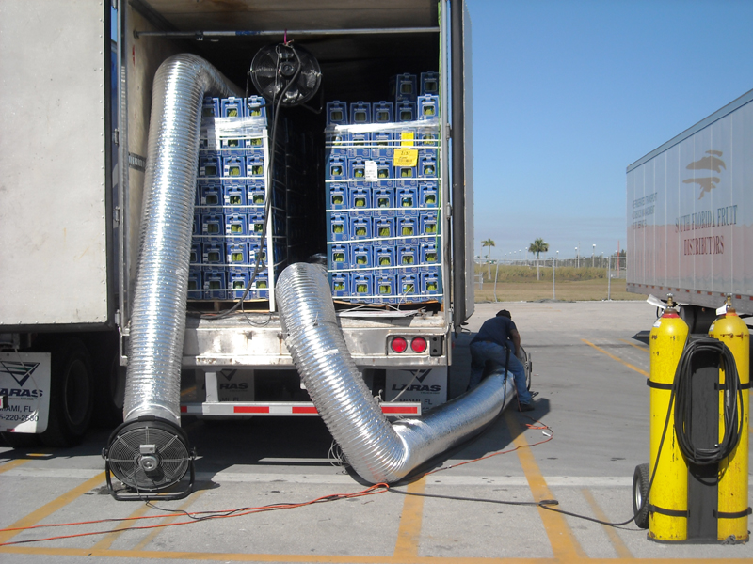
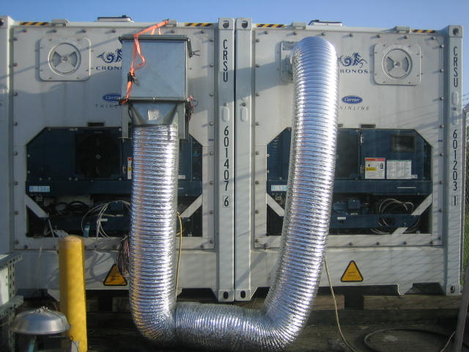
Proposed new recycling concept which transfers fumigants from existing fumigation container directly to the next container.
Traditional tarp-less aeration method.

Slide 29
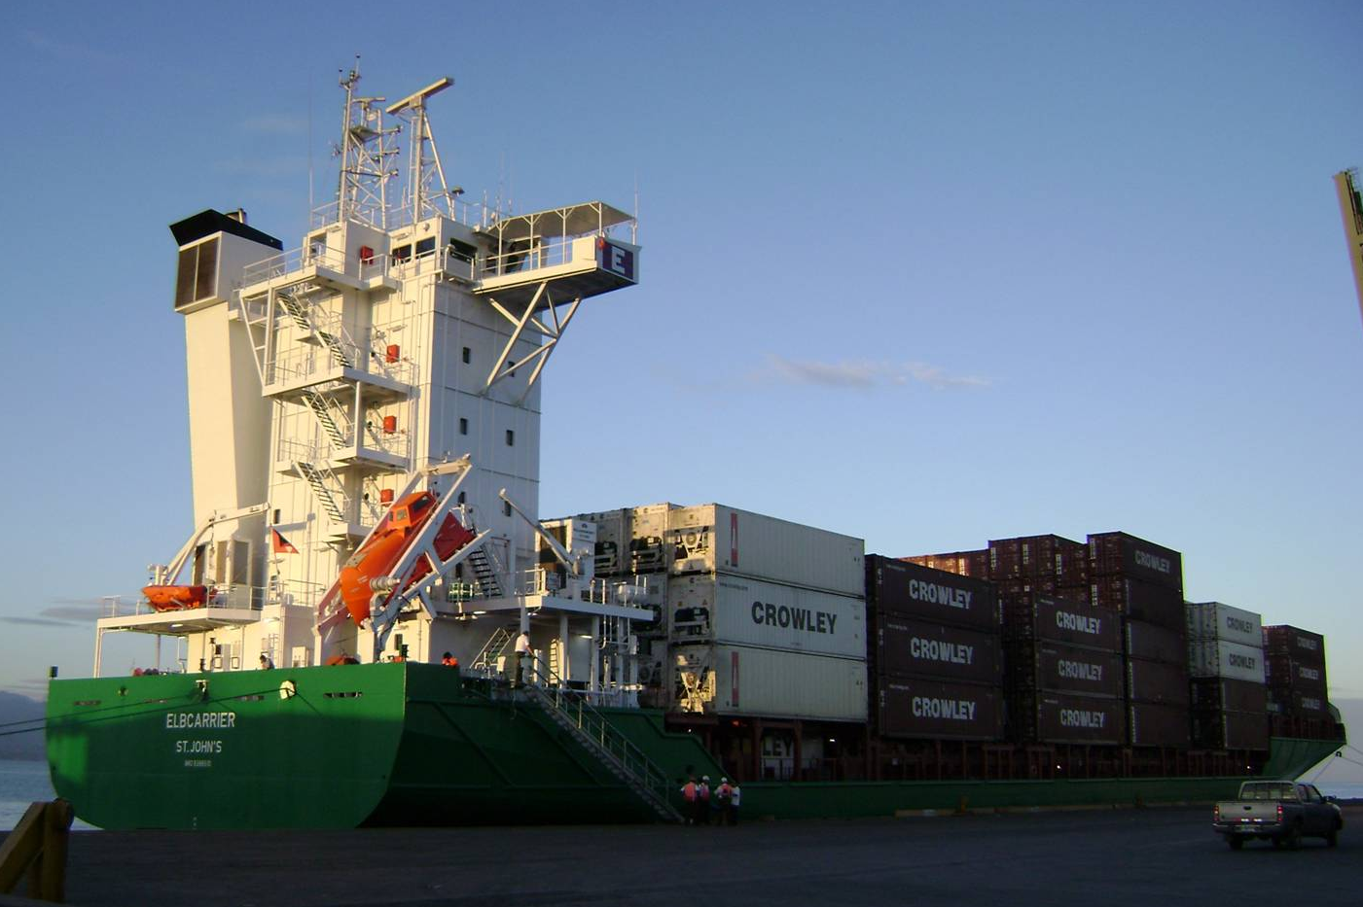
Ready to ship?

Slide 30

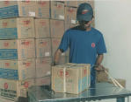
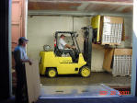

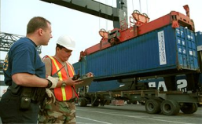



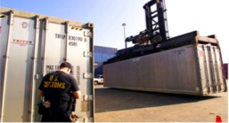
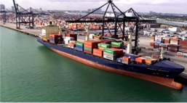
The Chain of Integrity “End to End” Transport of cargo origin to Final Destination
Production
Packing
Loading
Internal
Transportation
Preloading
Inspection
Loading the transport
1
2
3
CSI
5
10
9
8
7
6
Merchandise
Receipt
Internal
Transportation to final
Destination
Inspection
Receipt
Destination Port
International
Transportation

Slide 31
When Customers are ready to ship
Documents Required:
Commercial Invoice in English
Packing List
ISF form (ocean)
Certificate of Origin
Phitosanitary Certificates
FDA registration number should be included on Commercial Invoice
Bill of Lading or Air Way Bill
FDA packing information
Notes:
Phytosanitary Certifica:
to reduce the risk of inadvertent entry of pests and diseases that could harm agriculture, public health, navigation, irrigation, natural resources, or the environment. This data product identifies which countries, under APHIS phytosanitary rules, are eligible to export to the United States the fresh fruits and vegetables that are most important in the American diet.

Slide 32
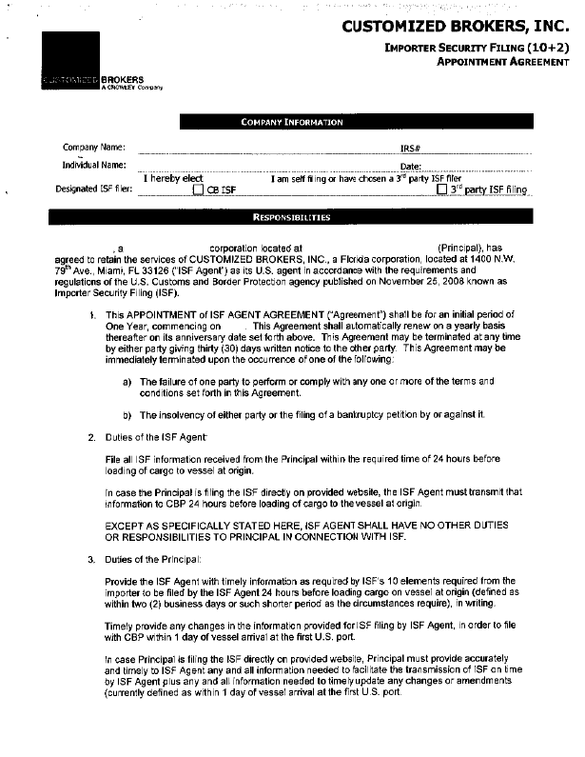
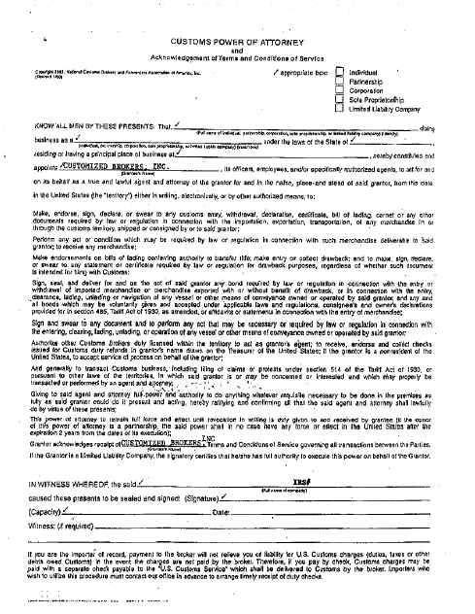
First time importers
Importer Profile
Power of Attorney
Bond
ISF agreement (if ocean)
USDA Import permits (per country and commodity)
Credit application

Slide 33




Internet Bill of Lading Releases
Customers who use this feature will save travel and courier costs.
Bills of Lading will be sent via the Internet.
Crowley can send draft copies right to customers' desktops, allowing them to review the documents prior to release. We can transmit original Bills of Lading, non-negotiable and invoice copies of the Bills of Lading that shippers authorize us to print at their locations.
“10+2” Program

Slide 34
Expedite, Follow up, Deliver
Traffic Procedure
Pending documentation (commercial invoice, Bill of Lading and originals) is sent to our office by the shipper or the consignee and is matched with the ISF confirmation and arrival notice
Data entry processes the entry along with the FDA prior notice if needed.
Once all the information is gathered the coordinator sends out a notification with all pertinent information to customer.
The coordinator will continue to check on the arrival of the vessel until the date it arrives and will update customer each day until arrival.
When cargo arrives the coordinator will confirm PQ exam schedule and update customer. At this time the coordinator will also find out about any other inspections required and advise the customer if not already done.
Once container has been inspected by all government agencies requesting to inspect container and released in AMS, coordinator will update customer and schedule delivery.

Slide 35

CONTACT INFORMATION
Contact Information:
CROWLEY
Shras@crowley.com
(504) 2564-7100
Customized Brokers a Crowley Company
1400 N.W. 79th Avenue
Miami, Florida 33126
(305) 471 8989
Ocean@customizedbrokers.net
ISF@customizedbrokers.net
Air@customizedbrokers.net
Exports@customizedbrokers.net
Info@customizedbrokers.net
Notes:
Looking to have a central point for Sales and Customer Service

Slide 36



Thanks

