Slide 1
Memorial Day
History and Background

Slide 2
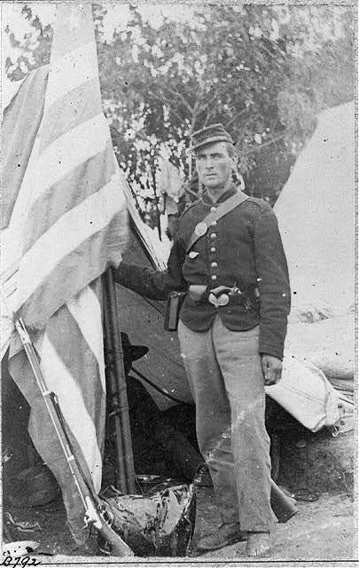
Civil War
Also called the War Between the States
War began April 12, 1861
President Abraham Lincoln issued the Emancipation Proclamation in September 1862 freeing all slaves
War ended when General Robert E. Lee surrendered on April 9,1865
Approximately 620,000 soldiers died during the war
Courtesy of the Library of Congress
http://memory.loc.gov/master/pnp/cph/3b10000/3b17000/3b17700/3b17751u.tif

Slide 3
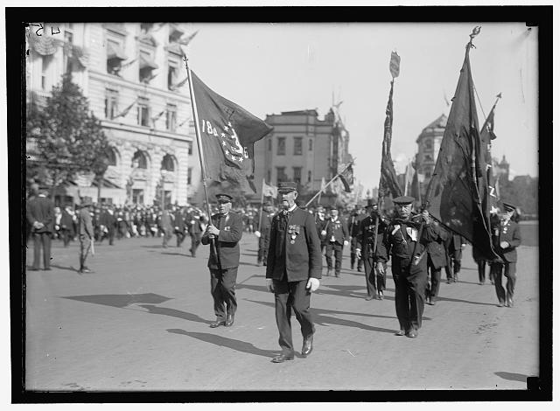
Decoration Day
Major General John Logan issued General Order 11 on May 30, 1868
The order called for decorating graves of those that died in the Civil War with flowers
The holiday continued to grow and be celebrated throughout the nation
After World War I, the holiday was expanded to include all service members that had died in all the wars and conflicts of our nation
Courtesy of the Library of Congress
http://memory.loc.gov/service/pnp/hec/06300/06301v.jpg

Slide 4
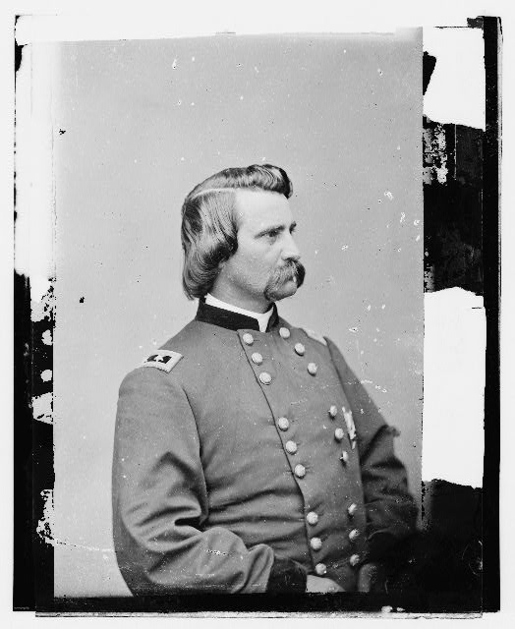
Quote
“We should guard their graves with sacred vigilance. ... Let pleasant paths invite the coming and going of reverent visitors and fond mourners. Let no neglect, no ravages of time, testify to the present or to the coming generations that we have forgotten as a people the cost of a free and undivided republic.”
Major General John Logan
Grand Army of the Republic
May 5, 1868
Courtesy of the Library of Congress
http://memory.loc.gov/service/pnp/cwpbh/01200/01220v.jpg

Slide 5
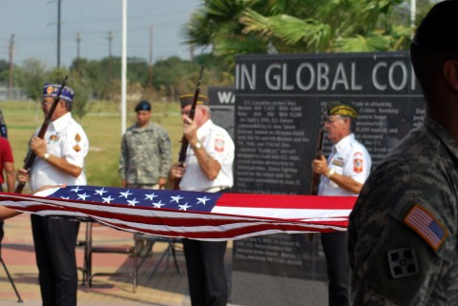
Memorial Day
Celebrated on May 30th until Congress declared it a national holiday in 1971
Memorial Day was then set to be held on the last Monday in May
Congress passed the National Moment of Remembrance Act in 2000 which encourages all Americans to pause for a minute of silence at 3pm on Memorial Day to remember and honor those that died in service to our country
Courtesy of the Veterans War Memorial Foundation of Texas
http://www.mcallen.net/veterans/default.aspx

Slide 6
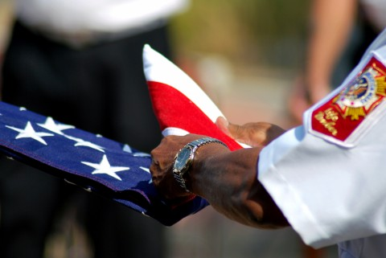
Memorial Day Traditions
Visiting cemeteries and placing small American flags on each veterans gravesite
Displaying the U.S. flag at half-staff until noon
A moment of silence at 3 pm local time to remember and honor the fallen
Memorial Day Parades
Wearing of poppy flowers
Courtesy of the Veterans War Memorial Foundation of Texas
http://www.mcallen.net/veterans/default.aspx

Slide 7
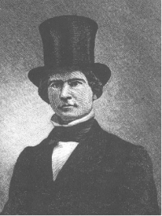
Poem
“The muffled drum's sad roll has beat
The soldier's last Tattoo;
No more on life's parade shall meet
That brave and fallen few.
On Fame's eternal camping ground
Their silent tents are spread,
And glory guards, with solemn round
The bivouac of the dead.”
"THE BIVOUAC OF THE DEAD"
by Theodore O'Hara, 1847
Courtesy of the U.S. Department of Veterans Affairs
http://www.cem.va.gov/images/ohara.jpg

Slide 8
References
United States Department of Veterans Affairs - Memorial Day Background
http://www1.va.gov/opa/speceven/memday/history.asp
Memorial Day History
http://www.usmemorialday.org/backgrnd.html

