Slide 1
All Our Ovaries Ovarian Health Bulletin Board
Submitted by Abby Hargreaves, RA, Hollins University

Slide 2
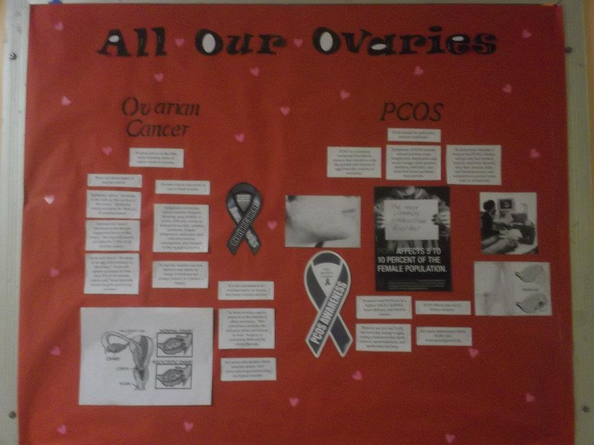

Slide 3
Ovarian Cancer
Ovarian cancer is the fifth most common cause of cancer death in women.
For more information about ovarian cancer, visit www.cancer.gov/cancertopics/types/ovarian.
Ovarian cancer can occur in one or both ovaries.

Slide 4
There are three types of ovarian cancer.
Epithelial cancer “develops in the cells on the surface of the ovary.” Epithelial cancer accounts for 90% of all ovarian cancer.
Germ cell cancer “develops in an egg cell produced in the ovary.” Germ cell cancer accounts for less than 5% of all ovarian cancer and “most typically occurs in girls and young women.”
Stromal cell cancer “develops in the deeper supportive tissue of the ovary.” Stromal Cell cancer accounts for 5-8% of all ovarian cancer.
For more information about ovarian cancer, visit www.cancer.gov/cancertopics/types/ovarian.

Slide 5
Symptoms of ovarian cancer include:
frequent bloating
pain in belly or pelvis
difficulty eating or feeling full quickly
urinary problems
fatigue
indigestion
back pain
pain with intercourse
Constipation
changes in the menstrual cycles

Slide 6
Doctors Test for and Treat Ovarian Cancer…
To test for ovarian cancers…
To treat ovarian cancer…
To test for ovarian cancers, doctors may check for lumps (which are not always cancer) or conduct a biopsy.
For more information about ovarian cancer, visit www.cancer.gov/cancertopics/types/ovarian.
To treat ovarian cancer, removal of the ovaries is often necessary. This sometimes includes the fallopian tubes and uterus as well. Surgery is commonly followed by chemotherapy.
It is not uncommon for ovarian cancer to return, but many women survive.

Slide 7
Polycystic Ovarian Syndrome (PCOS)
PCOS stands for polycystic ovarian syndrome.
PCOS effects one out of fifteen women.
PCOS “is a common hormonal disorder in women that interferes with the growth and release of eggs from the ovaries, or ovulation.”

Slide 8
Polycystic Ovarian Syndrome
Symptoms of PCOS
To Diagnose PCOS…
missed periods
acne,
weight gain
depression and mood swings
male-pattern baldness
infertility
abnormal facial and body hair growth
To determine whether a woman has PCOS, a doctor will:
go over her medical history;
check her thyroid,
Check her skin,
Check her hair,
Check her breasts, belly, and blood pressure
Perform a pelvic exam and/or ultrasound

Slide 9
Polycystic Ovarian Syndrome
Women with PCOS are at a higher risk for diabetes, heart disease, and uterine cancer.
For more information about PCOS, visit www.pcosupport.org.
There is no cure for PCOS, but exercise, losing weight, eating a balanced diet, birth control, spironolactone, and metformin can help.

Slide 10
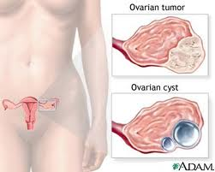

Slide 11
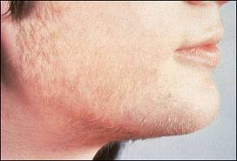

Slide 12
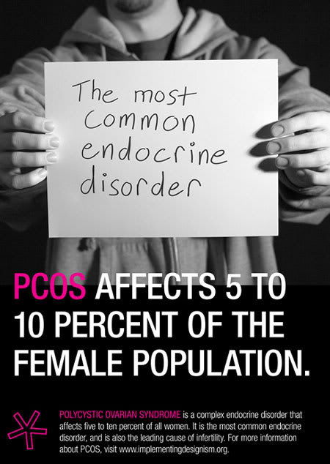

Slide 13


Slide 14
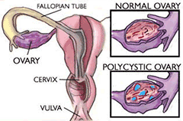

Slide 15


Slide 16
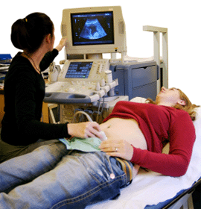

Slide 17
Resources
Ovarian Cancer
Polycystic Ovarian Cancer
For more information about ovarian cancer, visit www.cancer.gov/cancertopics/types/ovarian.
For more information about PCOS, visit www.pcosupport.org.

