Slide 1
The Art of Napping
Emily Kooistra, Resident Assistant
Penn State- Berks

Slide 2
Notes from the author
Supplies to make the board:
Foam poster board, 300 cotton balls, scrapbooking paper, yarn, GLUE, glitter glue, sparkly ribbon, cloud bulletin board paper, felt

Slide 3
Steps to make the bulletin board
-for the border of the board, I used glitter ribbon and stapled that to the edge.
-the lettering is made from glitter scrapbook paper, and I used a machine to cut each letter for me. After all the letters were cut, I outlined it in glitter glue, so it would "pop" a little more.
- to make the several clouds, I used foam poster board as the backing. My first cloud I made it "cloud like", however, it gets really hard to cut out the little puffs on the side. For the rest of the clouds, I just cut circle/oval shapes. When putting on the cotton balls, I got two sizes, 200 Jumbo cotton balls, and 100 regular ones. It was easy to glue them on, the smaller ones filled the gaps between the jumbo cotton balls.
-I poked holes on the tops of the clouds, and threaded the yarn. (TIP: wrap tape on the tip of the yarn that you are threading, it frays easily and the tape helps keep the point). I hung it using thumb tacks, it would be too heavy for tape to hold it.
-To make the cluster of clouds on the bottom left, I made four clouds. I put two on the bottom, putting space between. I placed the third one on top, balancing on both. The fourth one, I glued one edge of it to the third (top) cloud, and I made a trapezoid and used that to support the side that wasn't glued to the cluster. I taped each side of the trapezoid to the cloud and the board.
-The sleeping person on the board is me, I took a picture of myself "sleeping" and cut it out. I took a piece of felt and stapled it to the board so it looks like a blanket.

Slide 4
Notes from the author
I wrote my information on pieces of scrapbook paper (I used scrapbook paper because it always has fun patterns), and simply glued it onto each cloud.
TIP, the large cloud above me sleeping, is titled: Things to Sleep On, and is fun facts about napping.

Slide 5
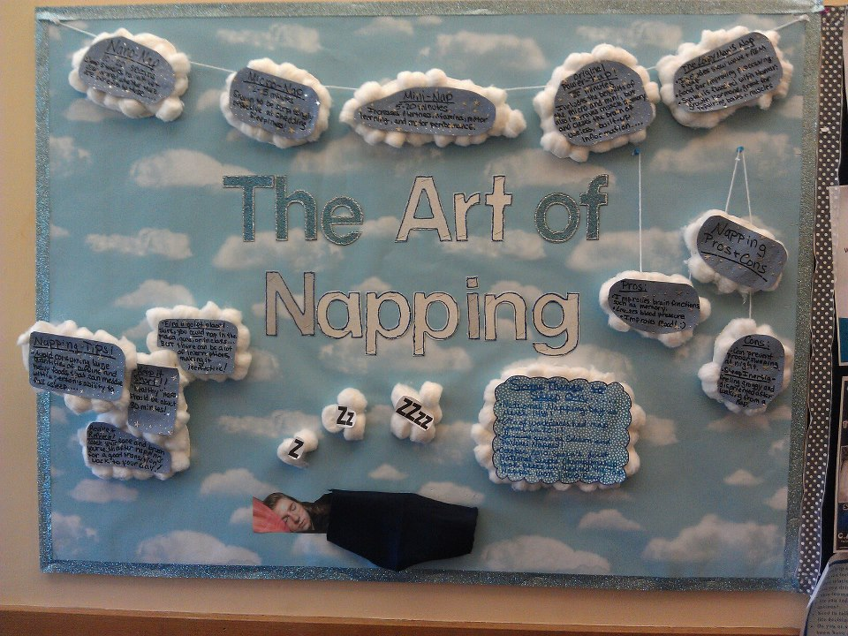

Slide 6
Resource for the Napping Content
The content for this board came form the following resource:
http://www.mindbodygreen.com/0-3423/What-You-Need-to-Know-About-Napping-Infographic.html

