Slide 1
SQL Server Security Granting, Controlling, and Auditing DATABASE ACCESS
March 17, 2011

Slide 2
Mike Fal
Working with SQL Server since MSSQL 7.
Experience with different industries and auditing.
Currently supporting 100+ servers with varying requirements.
New blog – www.mikefal.net
Twitter - @Mike_Fal

Slide 3
The importance of security
Primary goal – Protecting the data!
Security – Tools that control access to the data.
Risk – Can someone gain unauthorized access? How likely is it?

Slide 4
Scope
How do we manage access?
Authentication types
Server roles
Database roles
How can we audit login access?
Views
Queries

Slide 5
Getting Access
How do we control database logins?

Slide 6
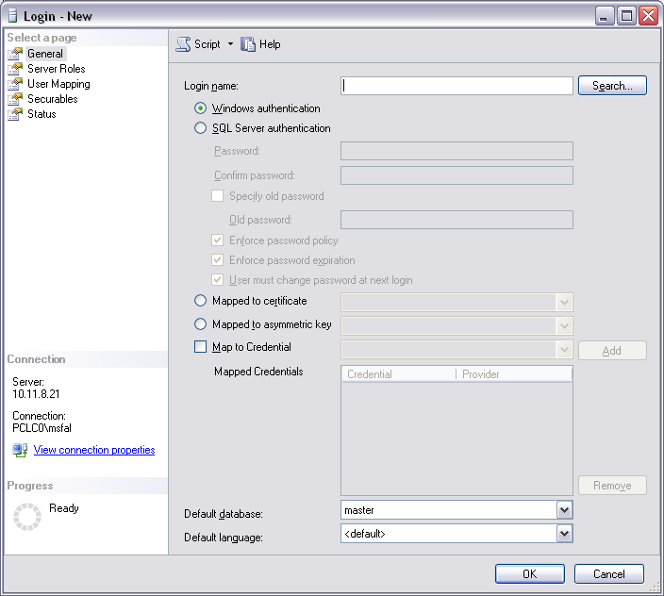
Authentication Types
Windows pass-through
Uses Active Directory accounts
Passwords controlled by domain policy
Direct Database Login
Accounts used only by SQL Server.
Passwords controlled by local computer policy
Can override policy and expiration enforcement

Slide 7
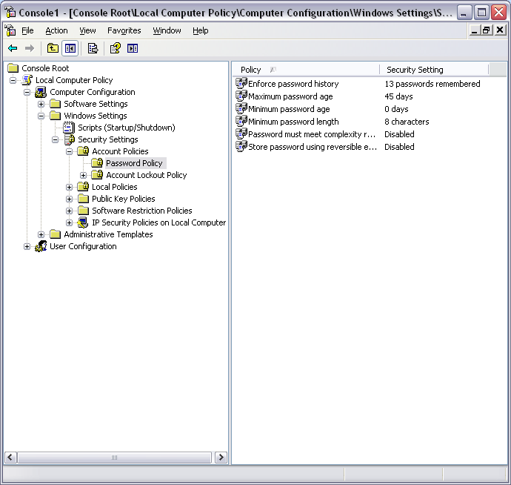
Editing Password Policies
Local Policy Editor
Administrative tools ->
Local Security Policy

Slide 8
Password Policies
What is a strong password?
http://en.wikipedia.org/wiki/Password_strength
“The strength of a password is a function of length, complexity, and unpredictability.”
http://www.us-cert.gov/cas/tips/ST04-002.html
Don't use passwords that are based on personal information that can be easily accessed or guessed.
Don't use words that can be found in any dictionary of any language.
Develop a mnemonic for remembering complex passwords.
Use both lowercase and capital letters.
Use a combination of letters, numbers, and special characters.

Slide 9
Creating a User
Use the GUI: Security->Users->Right Click, New User…
T-SQL:
CREATE LOGIN <login name> FROM WINDOWS
CREATE LOGIN <login name> WITH PASSWORD ‘<password>’

Slide 10
Query Logins
Use sys.server_principals and sys.sql_logins views
select
sp.name,
sp.type_desc,
sp.default_database_name,
sl.is_policy_checked,
sl.is_expiration_checked
from sys.server_principals sp
left join sys.sql_logins sl on (sp.principal_id = sl.principal_id)
where sp.type not in ('R','C')
order by name

Slide 11
Controlling Access
How do you stop the monkey business?

Slide 12
Managing Access
Understand your business needs.
Keep access as restrictive as possible.
GRANT <permission> ON <object> TO <principal>
WITH GRANT option allows the account to grant permission to other principals

Slide 13
Access Levels
Server Level
Start/stop services
Grant access
Create databases
Perform bulk operations
Database Level
Query and modify data
Create objects

Slide 14
Server Roles
SYSADMIN – Perform any action on the server.
SECURITYADMIN – Manage server level permissions.
SERVERADMIN – Manage server configurations and start/stop services.
PROCESSADMIN – Kill processes running on the instance.
SETUPADMIN – Add/remove linked servers.
BULKADMIN – Able to run BULK INSERT and execute bulk operations.
DISKADMIN – Manage server disk files.
DBCREATOR – Create, alter, drop, and restore databases.
PUBLIC – Generic role that all users are a member of.
http://msdn.microsoft.com/en-us/library/ms188659.aspx

Slide 15
Server Roles
Access can be granted via individual GRANTs or roles.
SYSADMIN and SECURITYADMIN are the critical server roles.
SQL 11 allows you to make custom server roles.
Add logins to roles either by GUI or sp_addsrvrolemember
select
r.name [Server Role],
u.name [Login],
u.type_desc [User Type]
from (select name,principal_id
from sys.server_principals where type = 'R') r
join sys.server_role_members rm
on (r.principal_id = rm.role_principal_id)
join (select name,type_desc,principal_id
from sys.server_principals where type != 'R') u
on (rm.member_principal_id = u.principal_id)

Slide 16
Database Roles
DB_OWNER - Perform all activities on the database.
DB_SECURITYADMIN – Manages role membership and permissions on the database.
DB_ACCESSADMIN – Manages login access to the database.
DB_BACKUPOPERATOR – Can backup the database.
DB_DDLADMIN – Able to run any DDL command.
DB_DATAWRITER – Able to modify data in all user tables.
DB_DATAREADER – Able to read data in all user tables.
DB_DENYDATAWRITER – Denied the ability to modify data in all user tables.
DB_DENYDATAREADER – Denied the ability to modify data in all user tables.

Slide 17
Database Roles
Access can be granted via individual GRANTs or roles.
Custom roles can be created within a database.
Add users to roles using GUI or sp_addrolemember.
select
r.name role_name,
u.name db_login,
u.type_desc
from (select name,principal_id
from sys.database_principals where type = 'R') r
join sys.database_role_members rm
on (r.principal_id = rm.role_principal_id)
join (select name,type_desc,principal_id
from sys.database_principals where type != 'R') u
on (rm.member_principal_id = u.principal_id )

Slide 18
Auditing
Monitoring user access

Slide 19
General Practices
Create some basic reports – Excel or Reporting Services.
Watch out for escalating permissions (DBO and SA versus other roles).
Nested permissions:
AD groups and changing members
xp_logininfo

Slide 20
Auditing Role Access
Server and Database Role queries.
sys.server_principals and sys.server_role_members for Server Roles
sys.database_principals and sys. database_role_members for Database Roles

Slide 21
Auditing Specific Access
sys.database_permissions to show individual object grants
select
pr.name,
pe.type,
o.name,
o.type_desc,
pe.permission_name,
state_desc
from
sys.database_principals pr
join sys.database_permissions pe on (pr.principal_id = pe.grantee_principal_id)
join sys.objects o on (pe.major_id = o.object_id)
where
pe.state in ('W','G')
and o.type = 'U'
order by pr.name

Slide 22
Summary
Types of authentication – Windows pass through and Direct Database Login.
Roles – Tools to manage access
Auditing – Perform regular reviews of your security

Slide 23
Questions
HUH?
www.mikefal.net
@Mike_Fal

