Slide 1
Get More Out of Google: Tips & Tricks for Research
Joseph Hadley
Resident Advisor
The University of Michigan – Ann Arbor

Slide 2
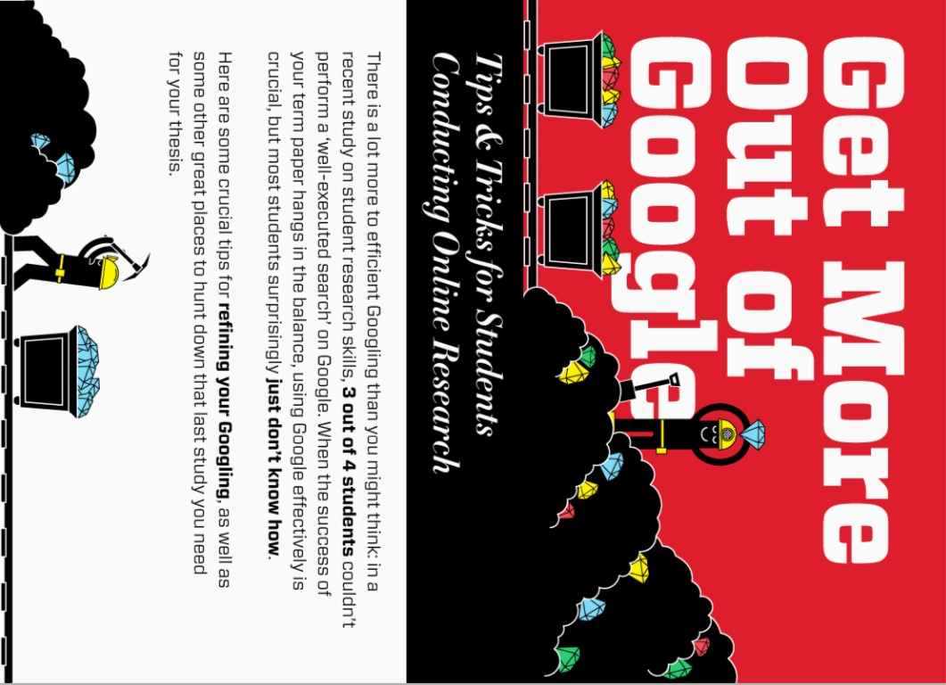

Slide 3
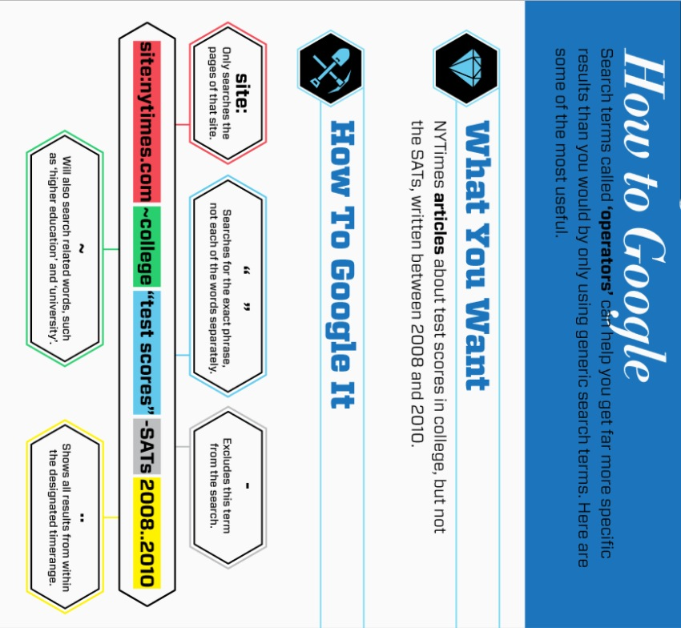

Slide 4
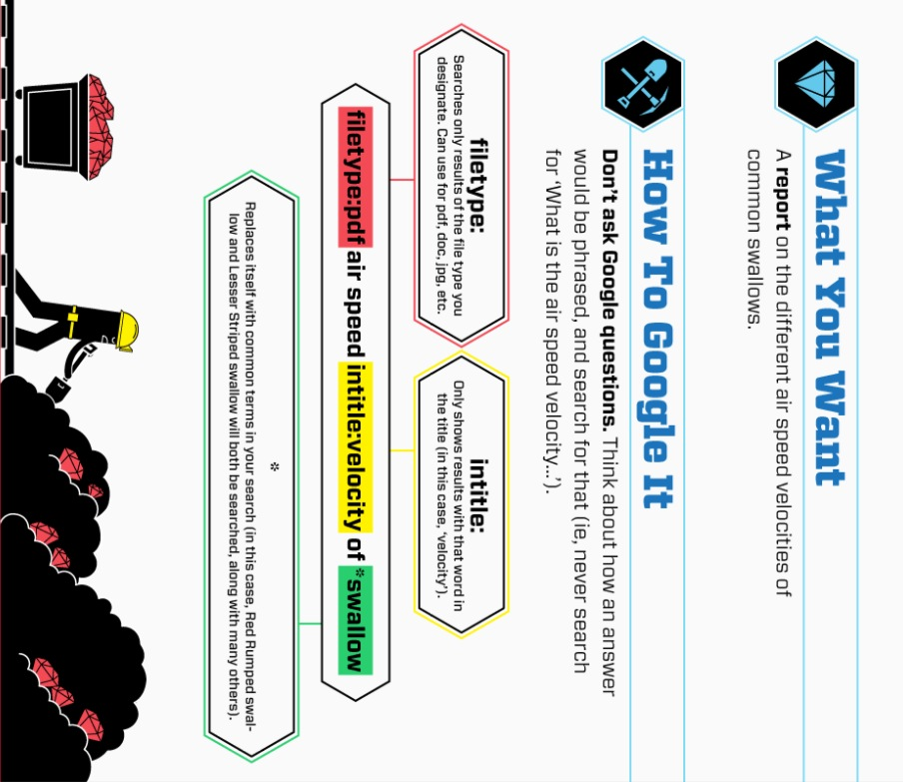

Slide 5
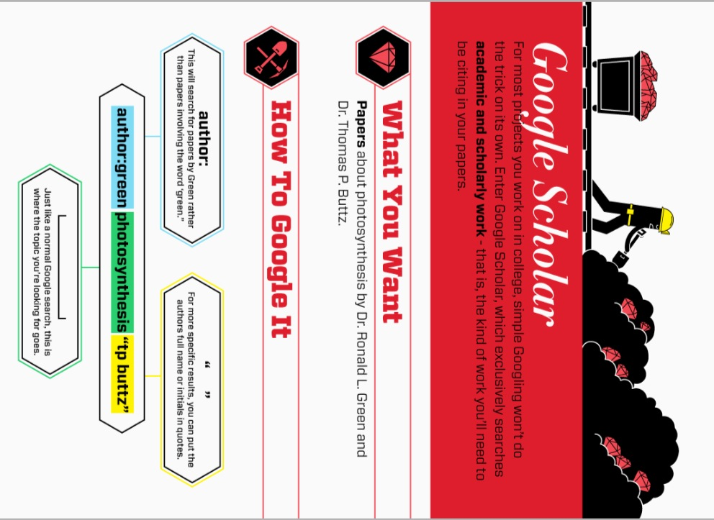

Slide 6
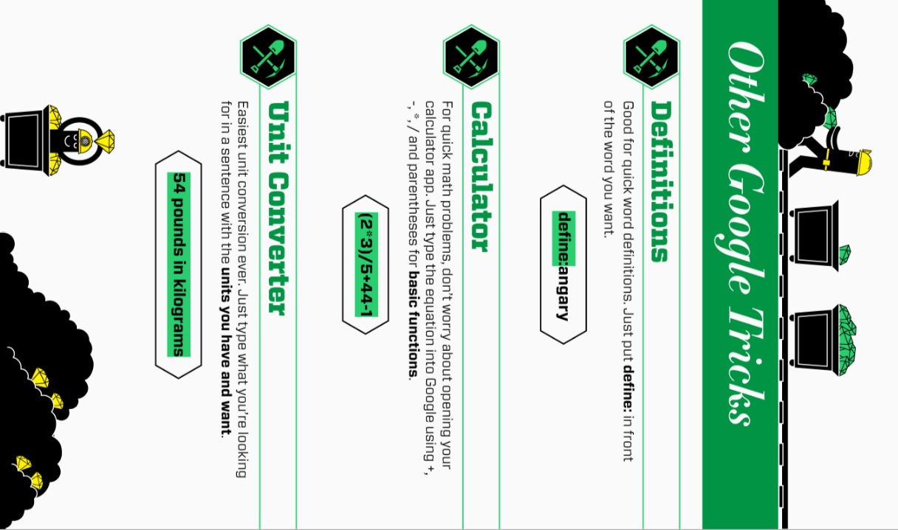

Slide 7
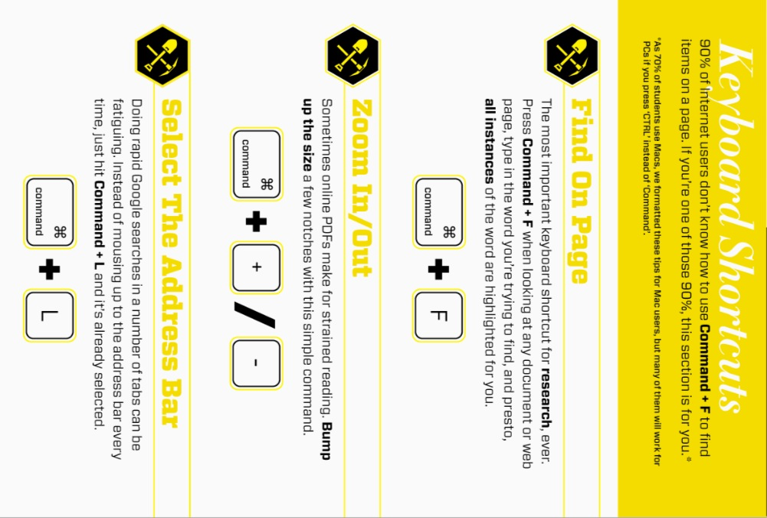

Slide 8
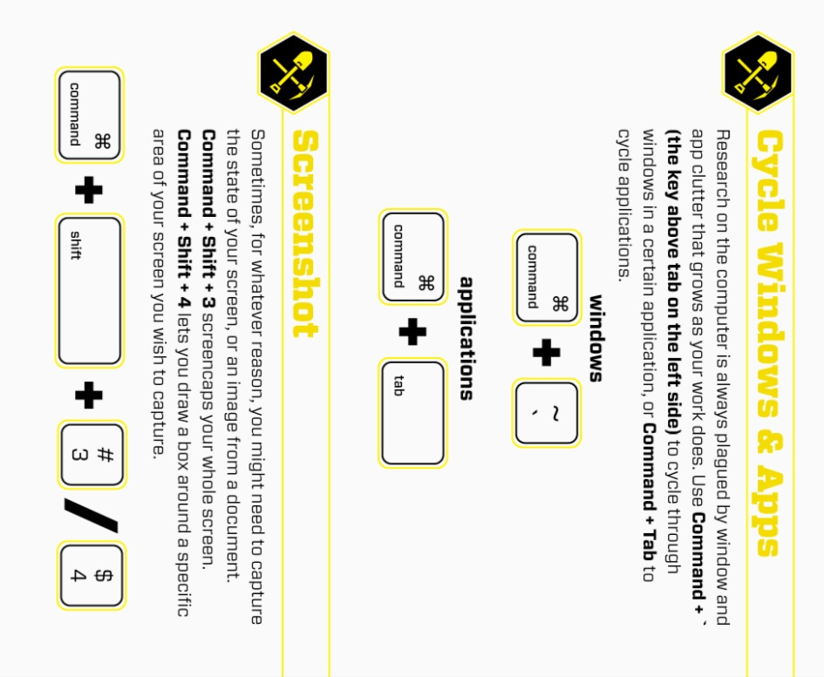

Slide 9
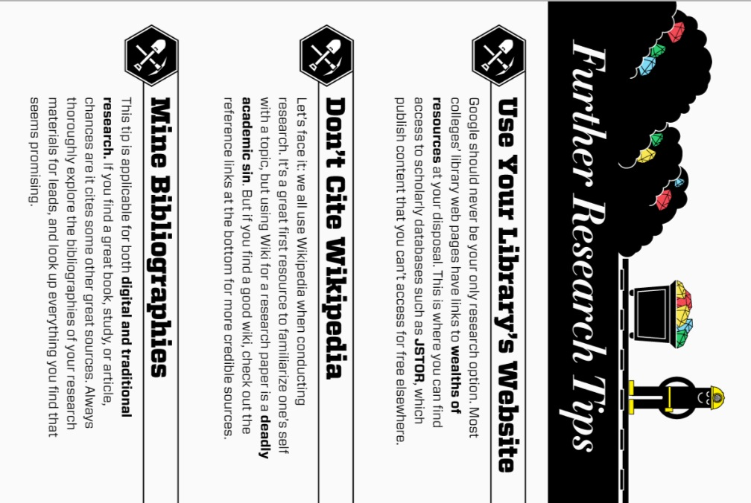

Slide 10
Notes from & about the author
Here's a bulletin board I made with an infographic showing how to better utilize google search.
I hope you and other RA's can benefit from it!
This bulletin board was created by
Joseph Hadley, Resident Advisor at the University of Michigan – Ann Arbor

