Slide 1
Towards a Semantic Wikipedia: WikiData
Project proposal overview
Denny Vrandečić, Daniel Kinzler
SMWcon, Berlin, September 22, 2011

Slide 2
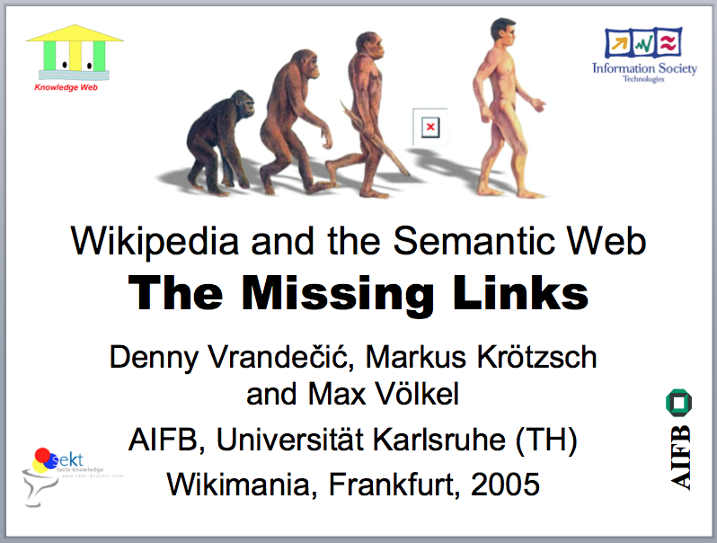
Wikimania 2005

Slide 3
Wikidata

Slide 4
WikiData
What
Why
How

Slide 5
WHAT

Slide 6
i
shortipedia
Second-hand facts. For free.

Slide 7
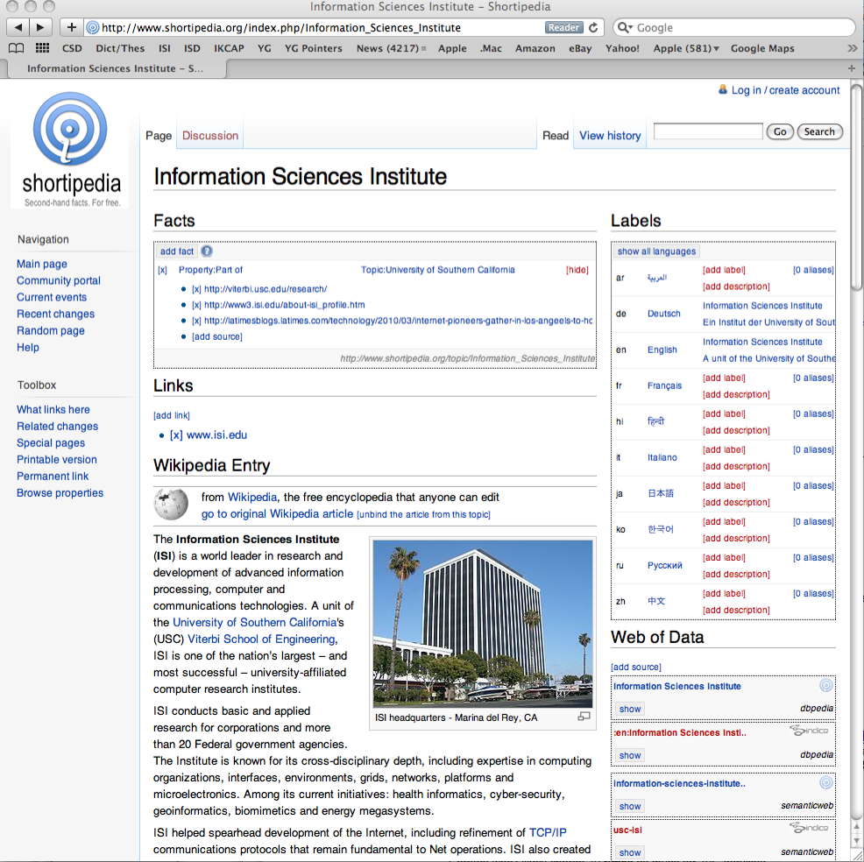

Slide 8
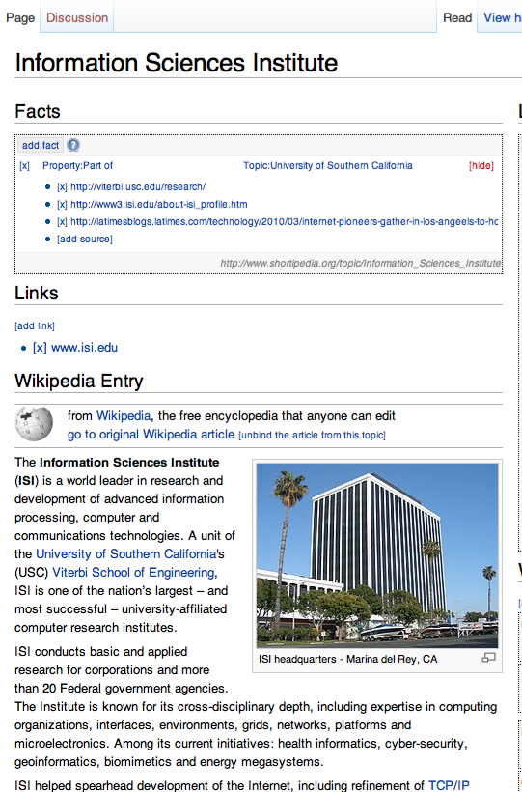
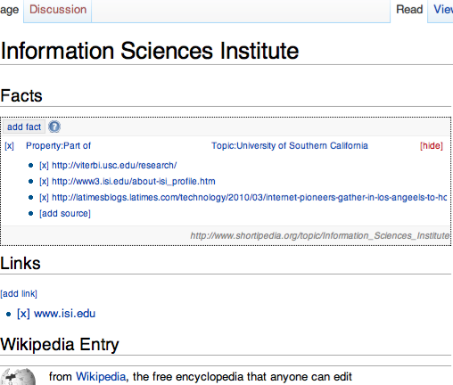

Slide 9
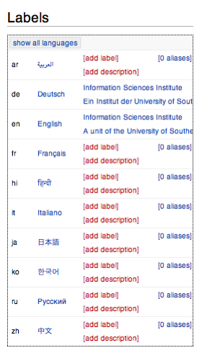

Slide 10



Seattle
edit
From Wikidata
The biggest city in Washington state
Also known as: Seattle, WA
edit
Main page
Contents
Access the API
Random page
Donate to Wikidata
Interaction
Help
About Wikidata
Community portal
Recent changes
Languages
Catalá
Cesky
Dansk
Deutsch
Eesti
Español
Esperanto
Français
Hrvatski
Italiano
Complete list
edit | x
State | Washington | [3 sources]
Country | USA | [2 sources]
Population | 608,660 | [1 source]
 | 600,000 | [2 sources]
 | [other values]
Area code | 206 | [2 sources]
Mayor | Michael McGi| | [0 sources]
Demonym | Seattleite | [1 source]
Area | 369.2 km” | [2 sources]
Coordinates |  | [3 sources]
[new fact]
Michael McGillicutty
American professional wrestler
Michael McGimpsey
North Irish politician
Michael McGinn
US lawyer and politician
Michael McGinlay
Irish footballer
Michael McGinn
Scottish playwright

Slide 11
Project plan: 3 phases
Phase 1: Interwiki links
Phase 2: Infobox augmentation
Phase 3: Inline queries

Slide 12
Phase 1: Interwiki links
Current: every language links to every other
In Wikidata: create one page for each entity, list representations in each language
Also have labels, aliases, and short descriptions
Maybe external identifiers too?
In Wikipedias: pull Interwiki links from Wikidata and display upon using magic word

Slide 13
Phase 2: Infobox augmentation
Current: each article calls an infobox with values
In Wikidata: centralize the values
In Wikipedias: just call the infobox and populate it with values from Wikidata
For each value, give the possibility to add sources
Just like in Shortipedia
All still highly scalable (only lookups)

Slide 14
Phase 3: Inline queries
Enable inline queries in Wikipedias
With several formats

Slide 15
Why

Slide 16
WikiData: Goals
Provide a database of the world’s knowledge that anyone can edit
Collect references and quotes for millions of data items
Engage a sustainable community that collects data from everywhere in a machine-readable way
Increase the quality and lower the maintenance costs of Wikipedia and related projects
Deliver software and community best practices enabling others to engage in projects of data collection and provisioning

Slide 17
Database of the world’s knowledge that anyone can edit
Facts about millions of entities
Collaboratively edited and maintained database
Read-write access for humans and bots
Data can be reused anywhere
Common vocabulary of entities for the Web

Slide 18
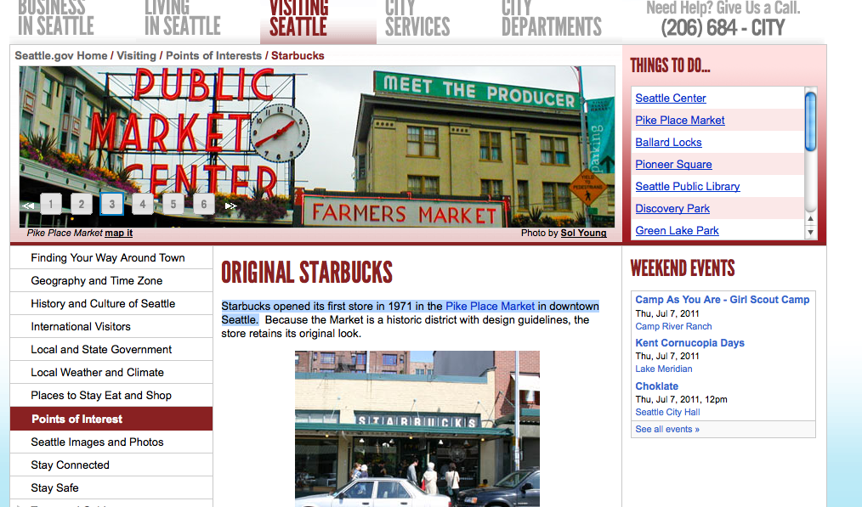
Annotations of text with facts all over the Web
Every single fact can be given a reference to text on the Web
Incentive: maintaining the validity of the references
Can be used for training and validating text understanding in several languages
Can be automatically learned from reading the text and validated by humans
Starbucks
Seattle
Founded in

Slide 19
Sustainable community with clear incentives
Additional extrinsic motivation through improving Wikipedia
Build on interest of working Wikipedia communities
Some tasks accessible to game mechanisms and ‘casual encyclopeding’
Heterogeneous tasks available for contributors

Slide 20
Increase the quality and lower the maintenance costs of Wikipedia
WikiData replaces a lot of manual or bot effort
Centralizing interwiki link decreases current quadratic costs to linear
Centralizing infobox maintenance decreases current linear costs to constant
Centralizing infobox maintenance also decouples language capabilities from data maintenance
Make Wikipedia more attractive by including more data and visualizations
Removes argument ‘who will maintain this visualization?’
Enable automatic creation of millions of stubs in more than 100 languages

Slide 21
Provide software, experience, and example for similar projects
WikiData will not be the only data gathering community
Provide software used on WikiData
Share experience about managing such a project
Encourage other communities to create new bold projects for knowledge acquisition
in research
in enterprises
in culture
in hobbies

Slide 22
How

Slide 23
Software architecture
App
Browser
Browser
App
Browser
WikiData client
WikiData extension
External
website
Semantic MediaWiki
MediaWiki
Data backend
MediaWiki
Wikimedia Foundation infrastructure

Slide 24
Technical differences to SMW
Annotate statements
With sources
With context (most important, time)
No free text
Save directly as structure instead of wikitext
Probably save JSON first instead of wikitext content
Back end to save and scalable query the data

Slide 25
Clear incentives structure per phase / task
Phase 1: Interwiki links
Wikipedians are not creating abstract entites
Replace current quadratic cost interwiki system with linear cost
Phase 2: Infoboxes
Wikipedians do not gather data aimlessly
Replacing current (horrible!) templates in many articles
Increase consistency, decrease maintenance costs
Provide sources for all facts in order to ensure quality
Informative stubs for 100,000s of articles in over 100 languages
Phase 3: Inline queries
Enable attractive visualizations of data
Not only in Wikipedia, but anywhere!
Gather data for specific sets of interest

Slide 26
Thank you! Questions and discussions
http://meta.wikipedia.org/wiki/New_Wikidata

