Slide 1


On Flow Authority Discovery in Social Networks
Charu C. Aggarwal
IBM T.J. Watson Research
Center, Hawthorne,
New York
charu@us.ibm.com
Arijit Khan, Xifeng Yan
Computer Science
University of California,
Santa Barbara
{arijitkhan, xyan}@cs.ucsb.edu

Slide 2

Motivation
Online Marketing via “word-of-mouth” recommendations.
Find a small subset of influential individuals in a social network, such that they can influence the largest number of people in the network.

Slide 3


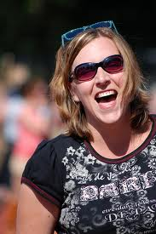



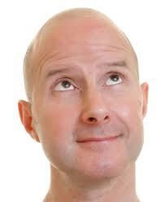

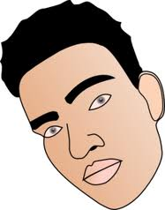
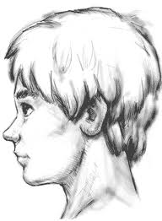


Motivation
Fast and widespread information cascade, i.e., with the use of Facebook and Twitter, the event “2011 Egyptian Protest” quickly reached to the protestors worldwide.
Influence Propagation in Social Network

Slide 4
Roadmap
Problem Formulation
Related Work
Algorithm
Ranked Replace
Bayes Traceback
Restricted Source and Targets
Experimental Results
Conclusion

Slide 5
Problem Formulation
Directed Graph G (V, E, P).
P : E → {0,1}; probability of information cascade through a directed edge.
Let p_{ij} be the probability of information cascade along directed edge e_{ij}. Then, P = [p_{ij}].
If r_{i} be the probability that a given node i contains an information, then it eventually transmits the information to adjacent node j with probability (r_{i} ˟ p_{ij}).
p_{ij}
1-p_{ij}
r_{i}
r_{i}
1-r_{i}
i
j
i
j
i
j
Influence Cascade Model

Slide 6




Problem Definition
Let be the steady state probability that node i assimilates the information.
S is the initial set of seed nodes, where the information was exposed.
p_{li}
Influence Cascade Model
Problem Definition:
Given the budget constraint k, determine the set S of k nodes which maximizes the total aggregate flow

Slide 7
Roadmap
Problem Formulation
Related Work
Algorithm
- Ranked Replace
- Bayes Traceback
Restricted Source and Targets
Experimental Results
Conclusion

Slide 8
Related Work
Kempe, Kleinberg, Tardos . KDD ‘03:
Linear Threshold Model –
A node gets activated at time t if more than a certain fraction of its neighbors were active at time t-1.
Independent Cascade Model
Each newly active node i gets a single chance to activate its inactive neighbor node j and succeed with probability p_{ij}.
Greedily select the best possible seed node given the already selected seed nodes.
Chen, Wang, Yang. KDD ‘09:
Degree Discount Independent Cascade Model.
Wang, Kong, Song, Xie. KDD ‘10:
Community Based Greedy Algorithm for Influential Nodes Detection.
Lappas, Terzi, Gunopulos, Mannila. KDD ‘10:
K-effectors that maximizes influence on a given set of nodes and minimizes the influence outside the set.

Slide 9
Roadmap
Problem Formulation
Related Work
Algorithm
- Ranked Replace
- Bayes Traceback
Restricted Source and Targets
Experimental Results
Conclusion

Slide 10
Ranked Replace Algorithm
Iterative and heuristic technique.
Initialization:
- Calculate the steady state flow (SSF) by each node u in V, which is defined as the aggregate flow generated by node u individually.
SSF(u) = ; when S = {u}.
- Sort all nodes in V in descending order of their steady state flow.
Preliminary Seed Selection:
- Select the k nodes with highest SSF values as the preliminary seed nodes in S.

Slide 11
Ranked Replace Algorithm (Continued)
Iterative Improvement of Seed Nodes:
- Replace some node in S with a node in (V-S), if that increases the total aggregate flow.
- The seed nodes in S are replaced in increasing order of their SSF values.
- The nodes from (V-S) are selected in decreasing order of their SSF values.
- If r successive attempts of replacement do not increase the aggregate flow, terminate and return S.
SSF
SSF
S
V-S

Slide 12
Problem with Ranked Replace
Each iteration of Ranked Replace technique requires a lot of computation O(t.|E|); where t is the number of iterations required to get steady state probabilities.
Number of iterations required for convergence of Ranked Replace can be very large O(|V|).
Slow !!!

Slide 13
Bayes Traceback Algorithm
An information is viewed as a packet.
The packet at a node j is inherited from one of its incoming nodes i with probability proportional to p_{ij} following a random walk.
There is a single information packet, which is (stochastically) present only at one node at a time.
0.2
0.2
S
0.1
0.5
0.3
0.2
Expose the information packet to one of the k seed nodes.
0.5
The token will visit the nodes in the network following random walk. Thus, it can visit a node multiple times.
Bayes Traceback Model

Slide 14
Bayes Traceback Model (Continued)
Transient State – Each node in the graph has equal probability of having the packet.
The even spread of information may not be possible in steady-state, however our goal is to create an evenly spread probability distribution as an intermediate transient after a small number of iterations following the random walk.
Identify k seed nodes, so that an intermediate transient state is reached as quickly as possible.
Intuitively, these k nodes correspond to the seed nodes which result in maximum aggregate flow in the network.

Slide 15
Bayes Traceback Algorithm
Starting from the transient state at t=0, trace back the previous states using Bayes Algorithm.
Q^{-t}(i) = probability that node i has the information packet at time t.
At each iteration, delete a fraction of nodes with low probabilities of having the information packet. Iterate until end up with k nodes.
A
Q^{-t}(B)=0.5 Q^{-t}(C)=0.3
Q^{-(t+1)}(A)
= 0.5*0.3/(0.3+0.4+0.5) + 0.3*1.0/(1.0+0.2)
= 0.38
0.3
1.0
B
0.5
C
0.3
0.4
0.5
0.2
Bayes Traceback Method

Slide 16
Running Time of Bayes Traceback
Each iteration of Bayes Traceback has complexity O(|E|).
If we delete f fraction of the remaining nodes in each iteration, the number of iterations required by Bayes Traceback method is given by log(n/k)/log(1/(1-f)) .
Fast !!!

Slide 17
Roadmap
Problem Formulation
Related Work
Algorithm
- Ranked Replace
- Bayes Traceback
Restricted Source and Targets
Experimental Results
Conclusion

Slide 18
Restricted Source and Targets
Restricted Targets: maximize the flow in a given set of target nodes, although the entire graph structure can be used.
Restricted Source: The initial k seed nodes can be selected only among a given set of candidate nodes.
Solutions to both problems are straightforward for Ranked Replace algorithm.
For Restricted source problem in Bayes Traceback method, delete nodes until k nodes are left from the given set of candidate nodes.

Slide 19
Restricted Source and Targets (Continued)
For Restricted target problem in Bayes Traceback method, the target nodes are considered as sink nodes; i.e., we do not propagate the flow from target node to non-target node, but we propagate flow from non-target to target sets.
A
Q^{-t}(B)=0.5 Q^{-t}(C)=0.3
Q^{-(t+1)}(A)
= 0.5*0.3/(0.3+0.4+0.5) + 0.3*1.0/(1.0+0.2)
= 0.1
0.3
1.0
B
0.5
C
0.3
0.4
0.5
0.2
Bayes Traceback with Restricted Target

Slide 20
Roadmap
Problem Formulation
Algorithm
- Ranked Replace
- Bayes Traceback
Restricted Source and Targets
Experimental Results
Conclusion

Slide 21
Experimental Results
Data Sets:
Top-5 Flow Authorities in DBLP:
 | # of Node | # of Edges
Last.FM | 818,800 | 3,340,954
DBLP | 684,911 | 7,764,604
Twitter | 1,194,092 | 6,450,193
Ranked Replace | Bayes Traceback | Peer Influence | Degree Discount IC
Wen Gao | Wen Gao | Luigi Fortuna | Wei Li
Francky Catthor | Philip S Yu | Dipanwita R. C. | Wei Wang
Philip S Yu | M T Kandemir | Timothy Sullivan | Li Zhang
M T Kandemir | Francky Catthor | Wei Li | Ian T Foster
A L S Vincentelli | A L S Vincentelli | S C Lin | Wei Zhang

Slide 22
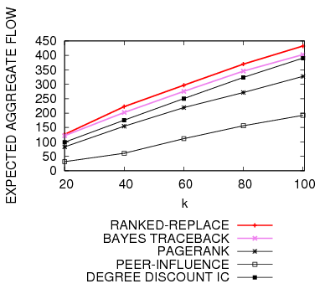
Effectiveness Results
k = # flow authority nodes
Effectiveness Results (DBLP)

Slide 23
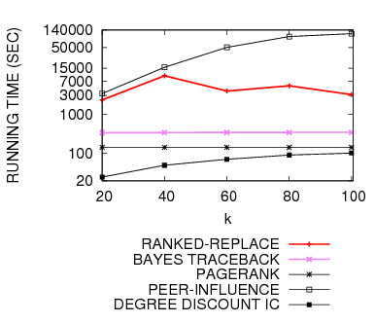
Efficiency Results
k = # flow authority nodes
Efficiency Results (DBLP)

Slide 24
Roadmap
Problem Formulation
Related Work
Algorithm
- Ranked Replace
- Bayes Traceback
Restricted Source and Targets
Experimental Results
Conclusion

Slide 25
Conclusion
Novel algorithms for the determination of optimal flow authorities in social networks.
Empirically outperform the existing algorithms for optimal flow authority detection in graphs.
Can be easily extended to the restricted source and target set problems.
How to modify the algorithms in the presence of negative information flows?

Slide 26
Thank You!!!
Questions?

