Slide 1
Mythbusters Debunking Common SharePoint Farm Misconceptions
ITP361
Spencer Harbar

Slide 2
Spencer Harbar, MVP, MCSD.NET, MCAD, MCSE, APM
www.harbar.net
Enterprise Architect working with some of Microsoft’s largest customers deploying Office SharePoint Server 2007.
15 years in Enterprise IT
ISPA Board Member

Slide 3
Agenda
Common SharePoint Myths
Farm Topologies
Shared Service Providers
Authentication
Global Deployments
High Availability
SharePoint “Magic Numbers”
Interactive session

Slide 4
Farm Topologies

Slide 5
Farm Topologies (Roles)
“Web Front End” (WFE)
Terminology hangover from previous version
WSS Web Application Service
Functional Decomposition of:
Search Index & Search Query
Excel Services
InfoPath Forms Services
Document Conversions
Content Deployment

Slide 6
Farm Topologies
“No Topology Restrictions”
No enforced restrictions
Plenty of real world restrictions, for example
Number of “WFE”s
Number of Web Applications
Topology Models remain appropriate
“Load balancing” of:
Search Query Servers
Excel Calculation Services

Slide 7
FARM TOPOLOGIES
Overview of functional decomposition, fundamental to planning farm topologies.

Slide 8
Shared Services

Slide 9
Shared Service Providers (SSPs)
“SSPs are implemented as Web Applications”
Many elements make up a SSP
Web Application is for administration only
“SSP Admin can be provisioned on dedicated servers”
It’s a Web Application!
Therefore deployed to every “WFE”

Slide 10





Shared Service Providers (SSPs)
Office Server
Web Services (IIS)
SSP DB
SSP Search DB
SharedServices1 (Web App)
Content DB
My Site Host (Web App)
Search Index

Slide 11
Shared service providers
Overview of SSP elements, fundamental to understanding intra farm server communications.

Slide 12
Authentication

Slide 13
Authentication
“Kerberos makes SharePoint faster”
It avoids Secure Channel (NTLM) bottlenecks
Performance benefit generally for long user sessions
Environment Specific
“One DC for every three WFEs”
Old wives tale
It depends upon your authentication scenario
Placement of DCs is far more important

Slide 14
Global Deployments & High Availability

Slide 15
Global Deployments
“SharePoint can’t do geo-distribution”
Plenty of options
Consider carefully why you may need them
SharePoint Online
“SharePoint doesn’t work over the WAN”
A slow WAN link problem is a slow WAN link problem!
Not a SharePoint problem

Slide 16
High Availability
“Web Gardens give you better performance”
Don’t use them (yet!)
“A single Farm can host 100s of Web Applications”
~10 Web Applications per Farm is reasonable
SharePoint loves RAM
Request Routing or DNS increases operational service burden considerably

Slide 17
High Availability
“Web Apps can be deployed to specific servers in a Farm”
Request Routing or DNS increases operational service burden considerably
There is nothing wrong with multiple farms

Slide 18
“SharePoint can’t scale”
average daily load throughput of:
~5 million TIFF images
~1.9 million Microsoft Office documents.
40+ million content items were loaded into SharePoint in only 13 days
Average content database size of:
200.65 GB for Divisional Site Collections
137.60 GB for departmental site collections
539 GB for the search database
Over 5TB content storage with capacity for double

Slide 19
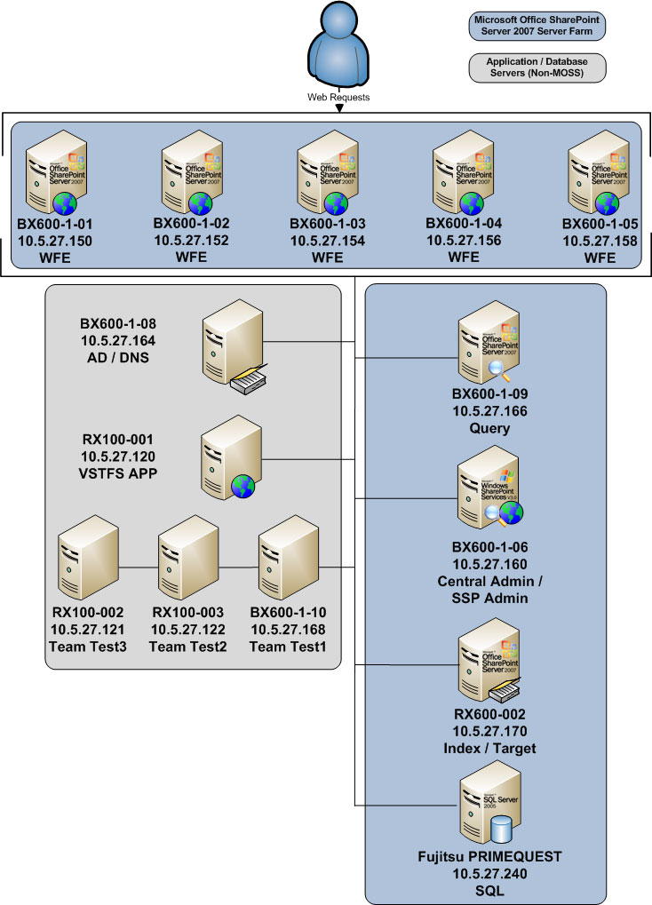
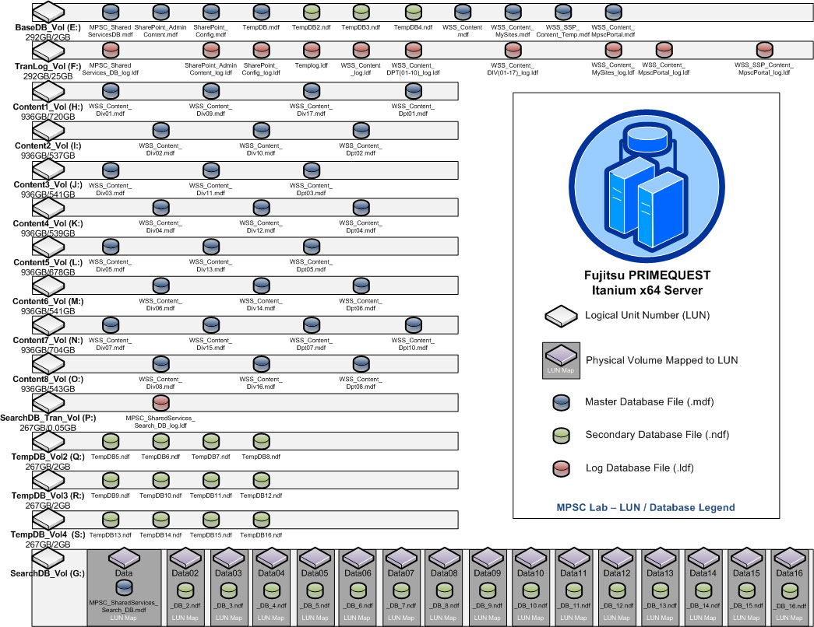
“SharePoint can’t scale”

Slide 20
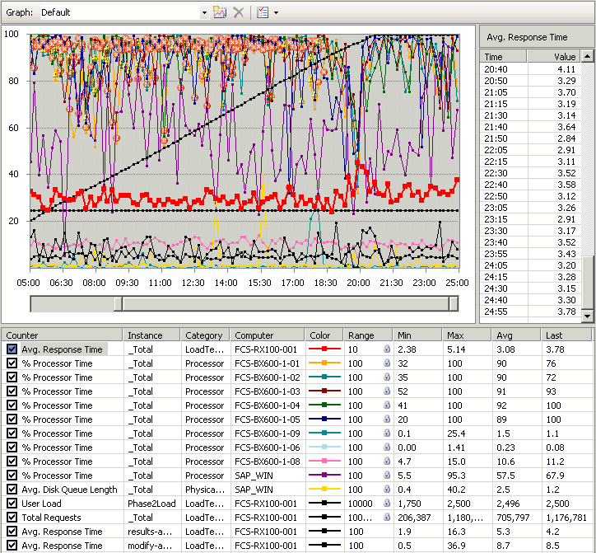
“SharePoint can’t scale”
Place picture or screen shot here
technet.microsoft.com/en-us/library/cc262067.aspx

Slide 21
SharePoint “Magic Numbers”

Slide 22
SharePoint “Magic Numbers”
“How many XXXX can I have in my SharePoint?”
Plan for Software Boundaries (TechNet)
technet.microsoft.com/en-us/library/cc262787.aspx

Slide 23
SharePoint “Magic Numbers”
There are only guidelines for acceptable performance
Such guidelines are based upon test scenarios
1 thru 1 Database Server
1 thru 8 Web Servers
Team Sites (55%), Doc Workspace (20%), Meeting Workspace (10%), Blog (10%), Wiki (5%)
Other scenarios coming soon
Often refined based on customer deployments

Slide 24
Logical Architecture "Magic Numbers"
Logical architecture object | Guidelines for acceptable performance
Shared Services Provider (SSP) | 3 per farm (20 per farm maximum)
Zone | 5* per farm
Web application | 99 per SSP
Internet Information Services (IIS) application pool | 8 per Web server
Site collection | 50,000 per Web application
Content database | 100 per Web application
Site collection | 50,000 per database

Slide 25
Example “Magic Numbers”
Site object | Guidelines for acceptable performance | Scope of impact when performance degrades
Site collection | 50,000 per content database | Farm
Site collection | 150,000 per Web application | Farm
Web site | 250,000 per site collection | Site collection
Subsite | 2,000 per Web site | Site view
Document | 5 million per library | Library
Item | 2,000 per view | List view
Document file size | 50MB (2GB max*) | Library, file save performance
List | 2,000 per Web site | List view
Field type | 256 per list | List view
Column | 2,000 per document library 4,096 per list | Library and list view
Web Part | 50 per page | Page
Managed path | 20 per Web application | Web application

Slide 26
There are NO magic numbers!
Successful Solutions Architecture is basically two things:
Compromise
Reduction of Complexity
Evaluate solution holistically ensuring adequate compromises.
Test and monitor as you build and deploy your solution.
Re-design the solution to ensure that you do not exceed capacity guidelines.
Test, test, test!

Slide 27


Thank you for attending!
Post conference DVD with all slide decks
Sponsored by

