Slide 1


Rum Run
Entering the European market with Tres Hombres Rum
Presented by Garrett O. Koolman
August 29 2011

Slide 2

International Shipping Today
International Shipping CO2 emissions were 2.7% of the total global emissions or 870 million tons in 2007. In 2010 this numbers has reached 1 Giga-tons of CO2 emissions.
If unchanged, it is estimated that International shipping will reach 18% of global CO2 emissions by 2050.
Scientist have yet to predict the consequences to the environment and the world as we know it, if the situation is left unchanged.
*Source: IPPC, Climate Change 2007 & IMO GHG Study 2009, Oceana Europe 2011.

Slide 3
9 of the biggest Global contributors to Co2 emissions
*Source:Rightship-Calculating and Comparing CO2 Emissions from Ships-Existing & New, Report February 2011

Slide 4
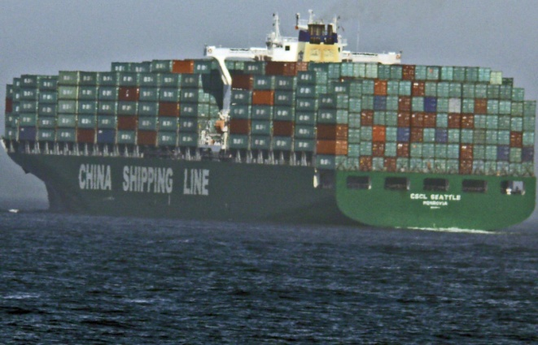
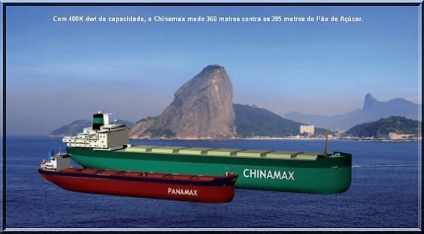
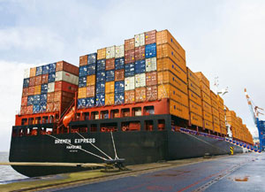
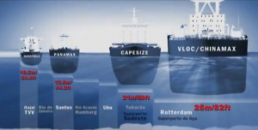
Adapting & Accommodating…
Global Merchandise export in 2009 valued at $12.5 Trillion was expected to grow with 9.5% in 2010
ChinaMax VLOC of 400,000 tons entered the market in 2011
50,054 ships make up the global fleet
28 M/82ft deep ports required to accommodate the ChinaMax
*Source: WTO 2010 World Trade report, EBX ChinaMax and Super-Port announcement & Marisec World Trade Shipping 2010

Slide 5
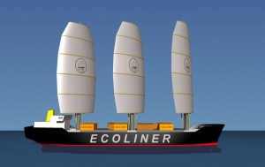
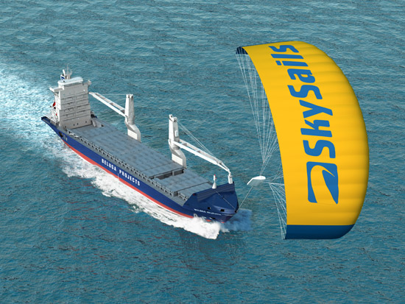
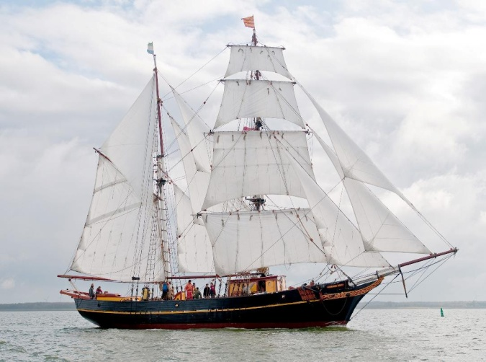
Practical Solutions
Change the way we power shipping vessels in order to curb these high levels of carbon emissions released when burning fossil fuels by harnessing wind energy.
Prototype: Ecoliner Fairwinds 8000 ton deadweight and reduce emissions by 50%
German Based, SkySails 320 m² Electric Kite replaces 2 MW propulsion power
Tres Hombres 126 ton carbon neutral Cargo Sail Ship

Slide 6
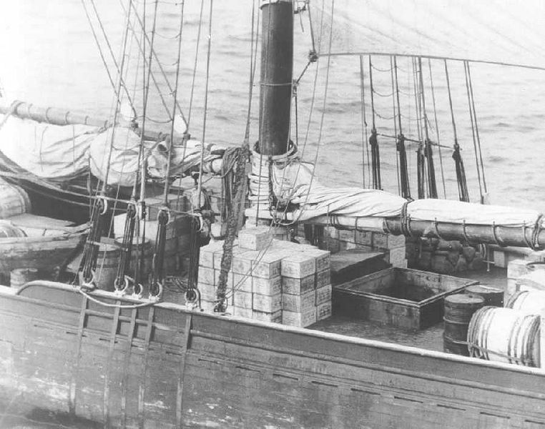
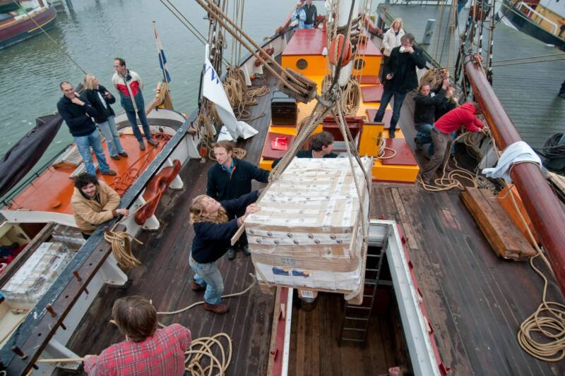
Rum Running
“Is the illegal business of transporting (smuggling) alcoholic beverages over water where such transportation is forbidden by law. Smuggling is usually done to circumvent taxation or prohibition laws within a particular jurisdiction.”
Rum Runner schooner Kirk and Sweeny during the 1920’s
(Illegal)
Rum Runner schooner Tres Hombres , 2010
(Legal)

Slide 7




Sustainability principles
Max Havelaar Fair Trade
EU Organic (Biologisch)
Reduced Carbon emission Transportation of goods
Eco-Friendly “Green” Production Process

Slide 8
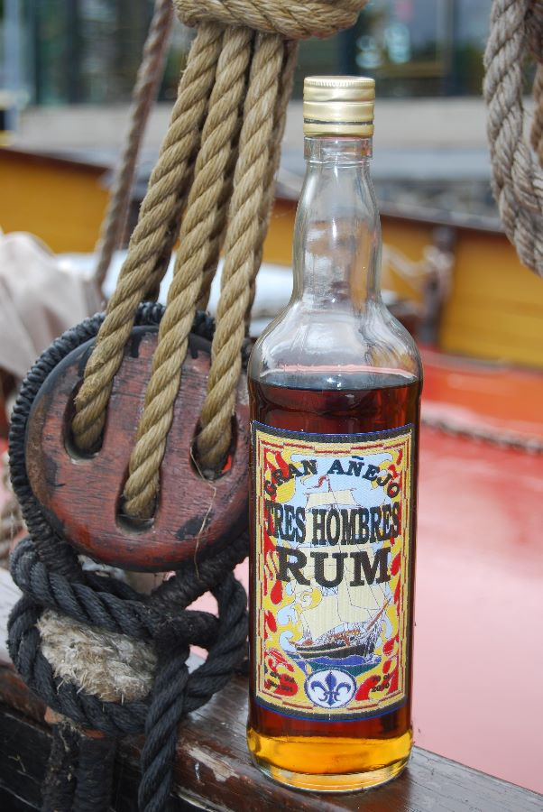
The Message The Vehicle
The “Flagship” -Product and Brand
The Fair Transport label ads aggregated value for products and companies

Slide 9
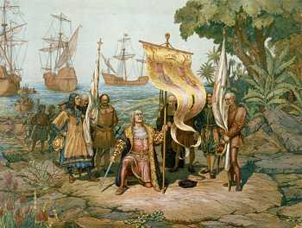
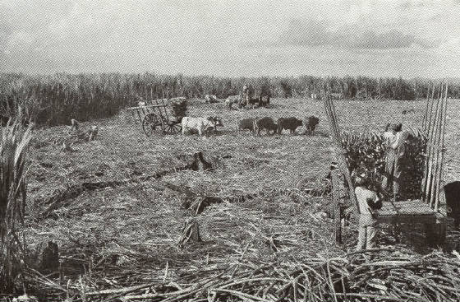
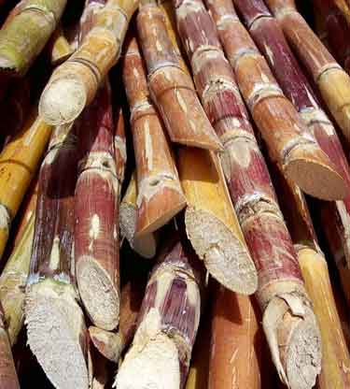
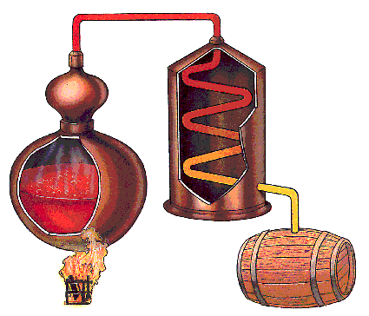
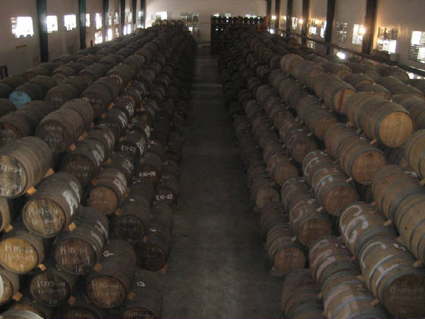
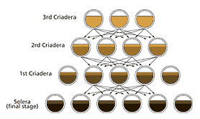
A brief history of Rum
Rum dates back to Christopher Columbus’ 2nd voyage in 1493 to Hispaniola
Rum is distilled from molasses or sugar cane juice
Rum can be distilled in Copper pot stills or Continuous “Coffey” stills.
Rum goes by the name: Rum, Ron or Rhum
First rum to be exported to Europe was in 1793 , exported to Spain.
Rum comes in three general categories:
White (Silver)rum, Dark /Aged(Gold) rum or Flavored & Spiced rum.
Rum is Aged in used oak barrels
Rum is blended using traditional or Solera blending process
Solera blending process

Slide 10
The Global Rum market
Rum’s global market share was 12% of the total spirits industry in volume in 2009.
The forecast of the rum category for 2010-2014 is 3.5% CAGR
Key players in the rum industry: Bacardi ltd., Diageo Plc., The Edrington Group, Pernod Ricard S.A. & Fortune Brands.
Top Four Global Rum Brands | Volume in 9 liter cases as of 2010
1.Bacardi Rum | 18,748,600
2.Captain Morgan Rum | 8,898,000
3.Brugal Rum | 4,234,900
4.Havana Club Rum | 3,710,500
*Source: IWSR 2011 Top 50 international spirits brands

Slide 11
European Markets explored for the entry of Tres Hombres Rum
Rum market overview of The Netherlands, Germany and Belgium
Country & Year | Value (in million) | Volume (in hectoliters) | White rum market share | Dark rum market share | Value CAGR
The Netherlands 2009 | € 155.2 | 54,945 | 90.7% | 9.3% | 3.7% (2004-2009)
2014 | € 191.9 | 63,000 |  |  | 4.2% (2009-2014)
Germany 2009 | € 903.4 | 323,000 | 56.6% | 43.4% | 1,9% (2004-2009)
2014 | € 861 | 301,000 |  |  | -1% (2009-2014)
Belgium 2009 | € 51.2 | 25,000 | 66.9% | 33.1% | 2.5% (2004-2009)
2014 | € 57.6 | 28,000 |  |  | 2.4% (2009-2014)
*Source: Datamonitor Rum in The Netherlands, Rum in Germany, Rum in Belgium to 2014 Report, January 2011

Slide 12
The Chosen Market = The Netherlands
Downward trend in spirit consumption
26 different spirits categories
31.6% of spirits consumed are domestic spirits in the category Jenver and Beerenburg
Upward trend in rum consumption
Underdeveloped dark rum market 9.3%
CAGR in value up to 2014 of 4.2%
*Source:PDCG, kerncijfers 2009 & De Slijterij Vakblad 2009

Slide 13
Survey 1 the Opinion Leaders
Slow steady growth in the rum category.
Consumers are very price sensitive when purchasing rum, especially for mixing.
Average price for aged (dark) rum was € 27.00.
8 year old Dominican rums’ prices range between € 17.95- € 26.00.
The average margin added on cost price, ranged between 20%-50%.
Success factor for new entrants was price-to-quality ratio.
Sustainable transport at low financial impact on cost prices would have a place in the spirits industry.
Tres Hombres Rum need to integrate brand messaging in the presentation of the end product.
The product presentation needs to be improved and cost price was high.

Slide 14
Survey 2 the rum consumers
27.2% of participants preferred spirit category was rum.
The age concentration of participants who preferred rum was between the ages 18-45.
38% of participants said to prefer gold or dark rum.
The three most important criteria when choosing a new rum product:
1. taste
2. brand
3. price
68% of the participants spend on average between €10.00-€ 25.00 on rum.
Preferred sustainability principle in regards to spirits was Fair Trade followed by Eco-friendly production and in third Reduced carbon foot print.

Slide 15
58.5% of participants said that sustainability in regards to transport of spirits was important to them.
93.6% of participants who would pay extra for reduced carbon foot print, would pay a maximum of € 7.50 additionally.

Slide 16
Applying the Marketing Mix (The 5 P’s)
The Management Problem = Marketing Problem.
Marketing Mix
1.Product
2.Price
3.Promotion
4.People
5.Place

Slide 17
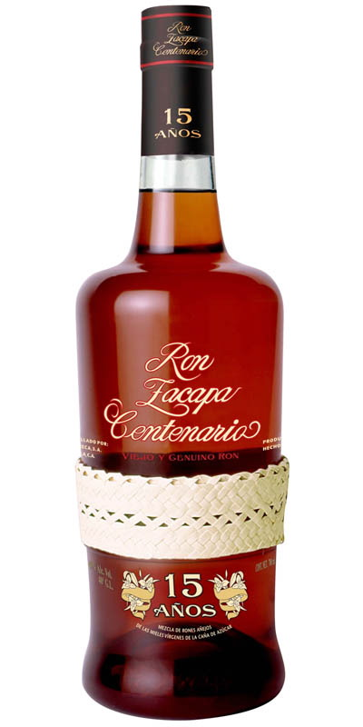
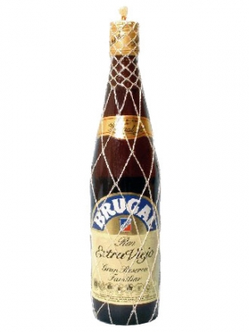
1. The Product
Maintain the same distiller to guaranty consistency in quality and taste.
2. Produce labels and procure cork seals in Europe to guaranty high quality and to enhance the product presentation.
3. Attach a small label (booklet) around the neck of the bottle containing product story and brand message.
Branded as the most sustainably transported rum in the world
Unique characteristic is that it is aged at 2,300 m altitude above the clouds in Guatemala
Branded as the typical Dominican rum in style and flavor

Slide 18
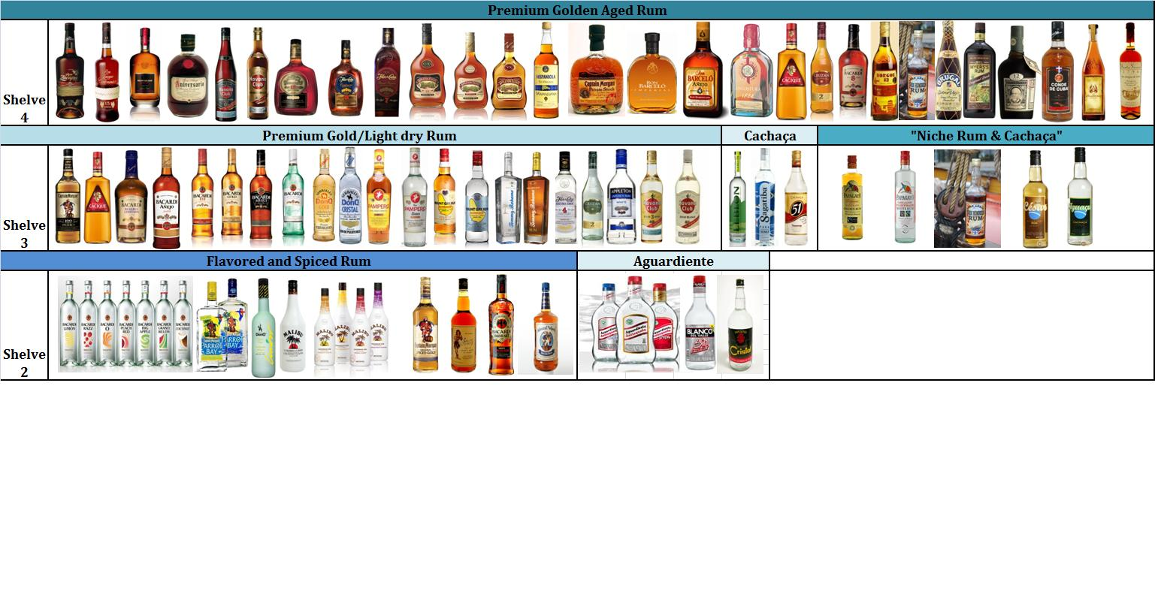
Do you stand out in A crowd?
Rum and Sugar-based spirits from the Caribbean and Latin America currently available in European markets.

Slide 19
2.The Price
The Average price of the biggest competitors in the dark rum market in
The Netherlands
Holding Company | Golden and Dark rum brand | Average Retail Price
Bacardi Limited | Bacardi Black | € 15.49/70cl.
 | Bacardi Oro | € 21.99/70cl
 | Bacardi Reserva | € 22.99/70cl.
 | Bacardi 8 Años | €24.95/70cl.
Diageo | Captain Morgan Black | € 19.99 /70cl.
 | Ron Cacique Añejo Superior | € 21.95/70cl.
 | Ron Pampero Especial | € 24.99/70cl.
 | Ron Zacapa Solera 23 | € 49.95/70cl.
 | Ron Zacapa Solera Reserva15 | € 39.95/70cl.
Pernod Ricard | Havana Club Especial | € 19.95/70cl.
 | Havana Club 7 Años | €27.45/70cl.
The Edrington Group | Brugal Añejo | € 22.99/70cl.
 | Brugal Carta Dorada | €19.95/70cl.
 | Brugal Extra Viejo | €24.99/70cl.
Rémy Cointreau Group | Mount Gay Rum | €15.95/70cl.
Suriname Alcoholic Beverages NV | Borgoe 82 | € 16.50/70cl.
 | Borgoe Extra | € 21.99/70cl.
 | Borgoe 8 Jaar | € 31.95/70cl.

Slide 20
Retail prices Competing products in the “Niche Spirits” segment
Brand of Niche Sustainable Spirits | Retail Price
1.Papagayo Organic Fair Trade Rum White | € 20.95
2.Papagayo Organic Fair Trade Rum Gold | € 23.70
3.Highland Harvest Organic Scotch Whisky | € 28.75
4.Erhmanns Fair Vodka | € 33.69
5.Tres Hombres Fair Transport Rum | € 39.95
6.Cesar Colussi Iguacu Fair Trade Cachaça | €52.00
7.Cesar Colussi Cesar Bio Fair Trade Rum | €57.50
Price determines classification
2. Price-to-quality ratio is extremely important for new brands.
3. Current price of Tres Hombres Rum is 100% higher than Rum Hispaniola Gran Añejo from Mardi S.A. current retail value € 19.50.

Slide 21
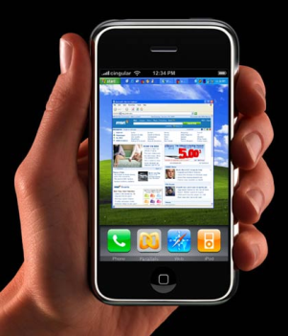
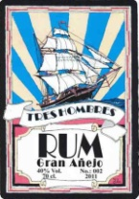

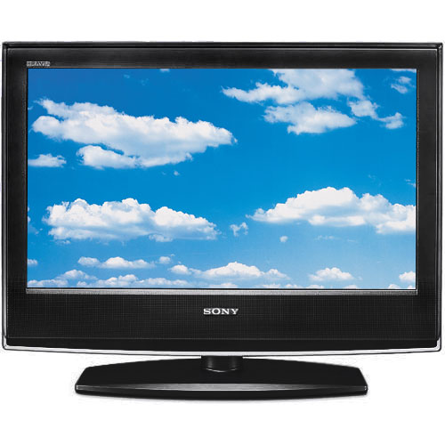

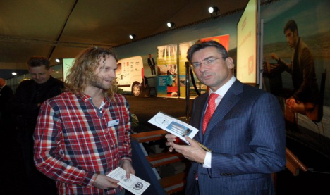






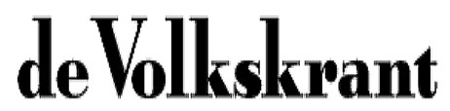
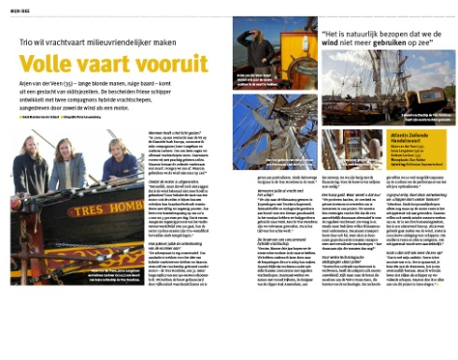

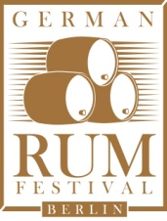
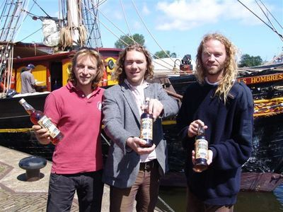
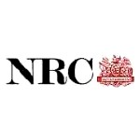
3. Promotion

Slide 22
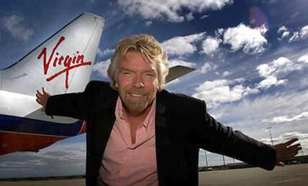
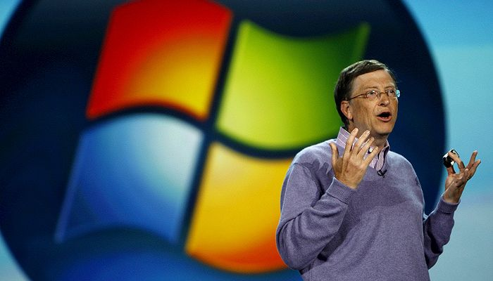
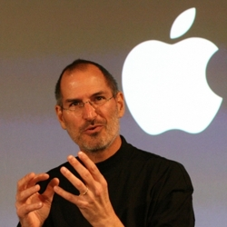
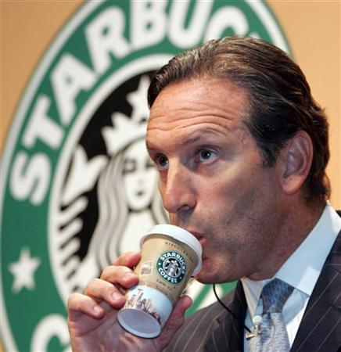
4. The People
Putting a face on a brand is critical for making products relatable to end consumers, putting three is a triple play
Sir. Richard Branson
Bill Gates
Steve Jobs
Howard Schultz

Slide 23
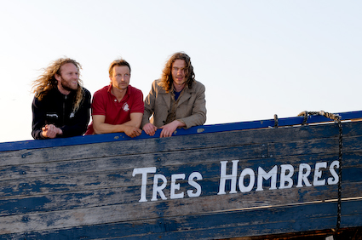
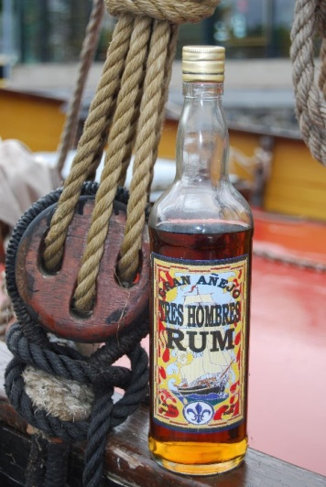
Live the brand & walk the market
Connecting the end consumers with the people behind the brand is critical to brand building and brand name recognition.

Slide 24
5. Place (Distribution)
Sales revenue for the Dutch retail liquor store market in million Euro
Year | Retail Liquor Stores Chains | Independent Liquor Stores | Total Revenue
2007 | 555.1 | 437.1 | 992.2
2008 | 587.6 | 440.2 | 1,027.8
2009 | 621.7 | 441.4 | 1,063.1
2010 | 605.6 | 397.5 | 1,003.1
Independent retail liquor stores offer flexibility for independent labels like Tres Hombres Rum.
Higher level of personal involvement and interaction of owners with consumers.
Promotional opportunity are much easier to realize in contrast to highly structured retail chains with national campaigns.
Securing prime shelf space real-estate (Category Management) has less red tape.
*Source: AC Nielsen

Slide 25
Exclusivity is key for new brands
Liquor Store count per province in The Netherlands
Drente | 110 | Noord-Brabant | 329
Felvoland | 51 | Noord-Holland | 497
Friesland | 157 | Overijsel | 191
Gelderland | 360 | Utrecht | 191
Groningen | 113 | Zeeland | 89
Limburg | 125 | Zuid-Holland | 551
Offer exclusivity contracts in densely populated and highly saturated liquor store markets.
Supply directly to retailers in order to shorten the supply chain and reduce cost on a low product supply.
Support exclusivity contracts with independent retailers through promotional activities and social media activities.
1 liquor store for every 6,013 Dutch inhabitant.
*Source:HBD o.b.v. CBS en Locatus 2010

Slide 26
To Summarize
Build the Brand
1.Focus on the Product
2.Price-to-quality ratio
3.Multi-channel promotional activity
4.Be the face and live the brand
5.Champion Independent liquor store retailers

Slide 27
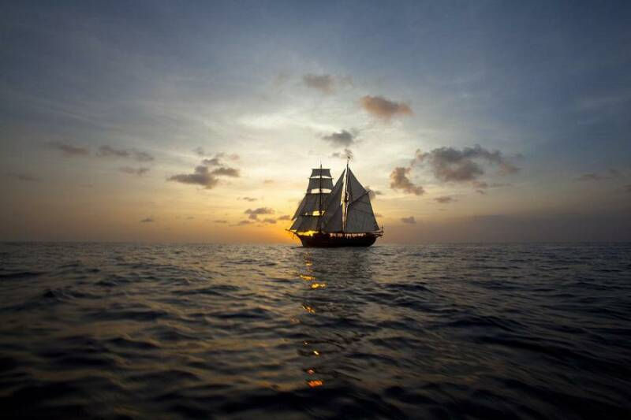
“A sustainable planet keeps the Sugar grass growing and the Rum flowing!” -Garrett O. Koolman, 2011
Thank You

