Slide 1
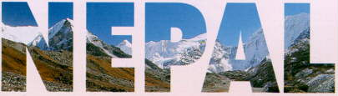
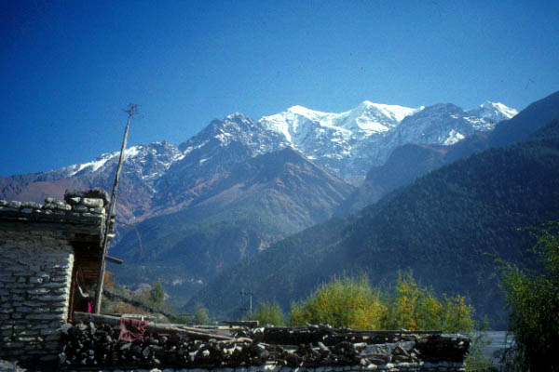
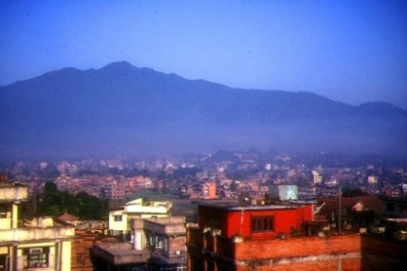
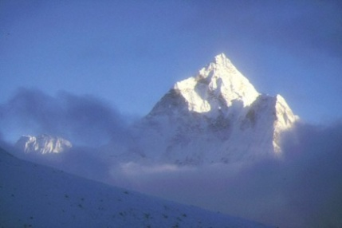
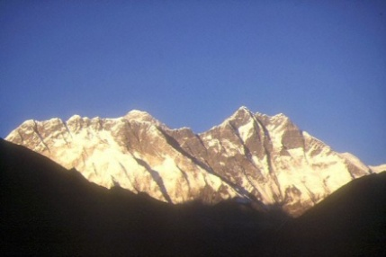
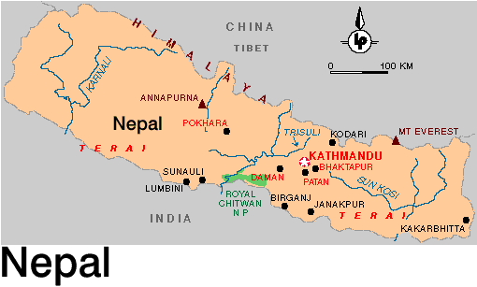
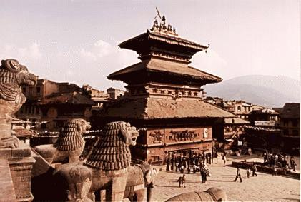
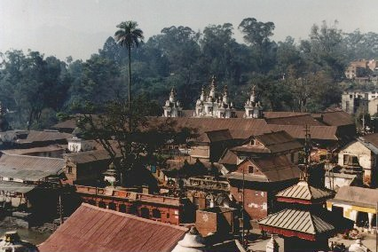
Umesh Prasad Dhakal
Executive Director
Nepal Red Cross Society

Slide 2
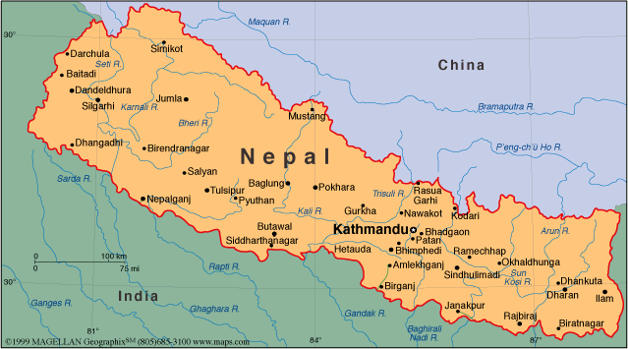
Country Context
Total population: 23,151,423 with annual population growth rate at 2.25 [CBS, 2001]
Most natural hazard prone; flood, earthquake, fires, landslides, extended dry spell & health risks resulting to epidemics
Nepal is disaster prone country due to;
rugged & fragile geomorphic condition
variable climate conditions
increasing population
poor economic conditions
unplanned settlements

Slide 3
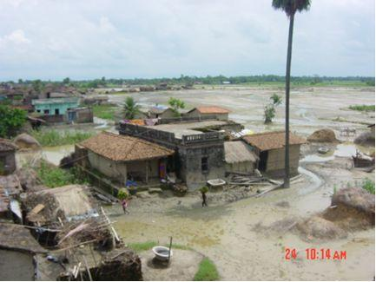
Disaster Risk Profile
Nepal is ranked as 11th most risk country in world in terms of relative vulnerability to earthquake & 30th with respect to flood [UNDP/BCPR, 2004]
Nepal remains as one of the global hot-spots for natural disaster [World Bank, 2005]
Entire country falls in high earthquake intensity belt-high seismic scale of MMI IX & X for the generally accepted recurrence period [global seismicity hazard assessment program]
In the risk of climate change & its consequences

Slide 4
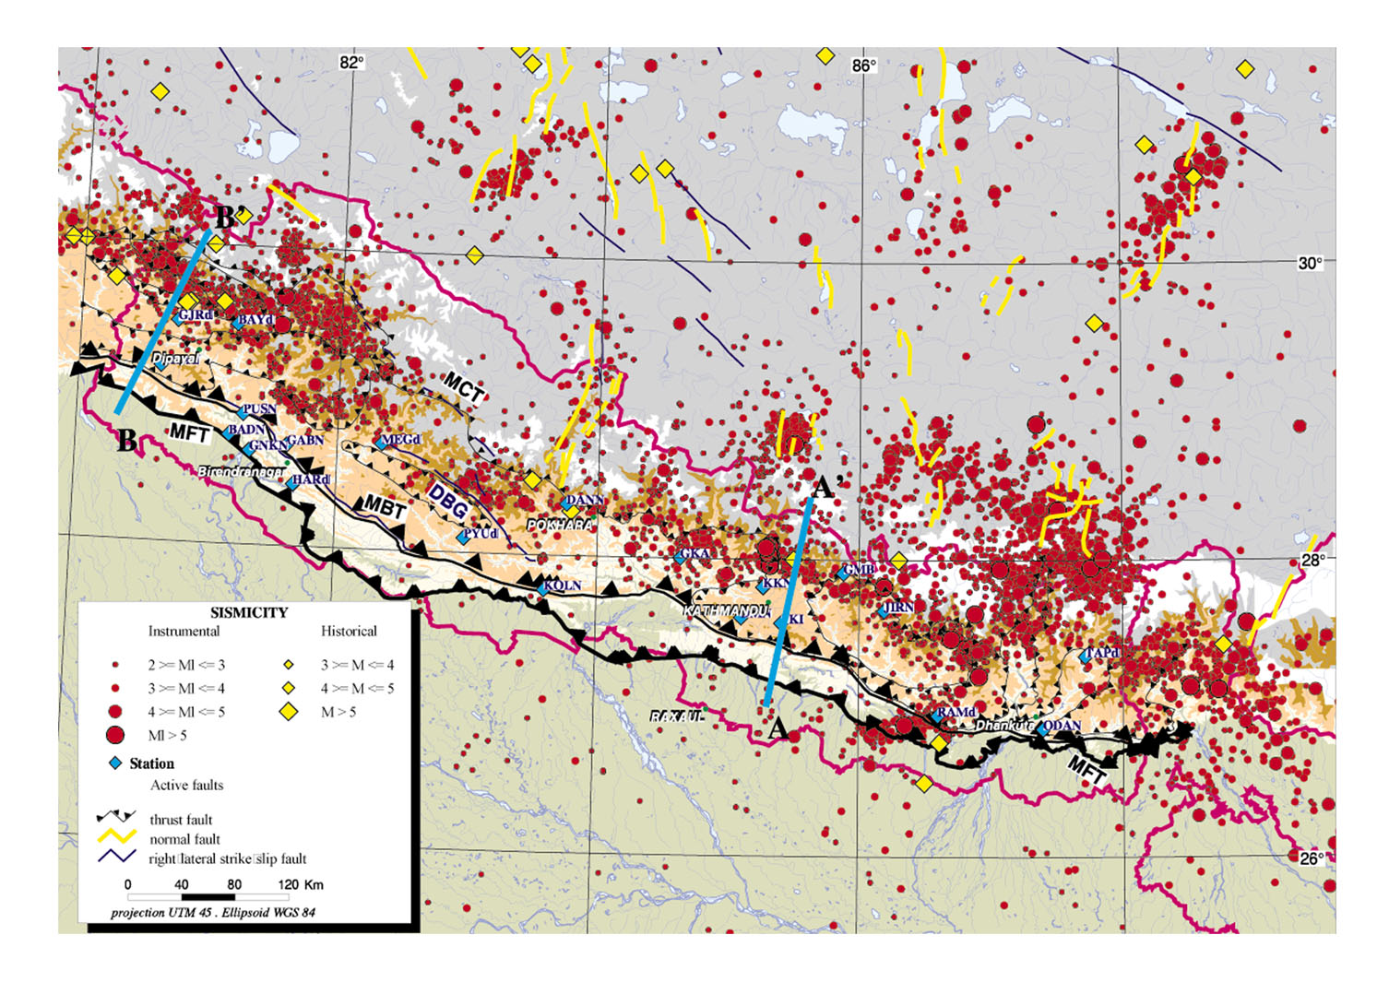
The Disaster Situation
Earthquake is a major potential hazard to reckon with –
the country is located on an active seismic belt
the exponential urbanization trend over the past decade with general disregard of earthquake
Kathmandu valley (3 districts and 5 Municipalities) is at the high risk of earthquake

Slide 5
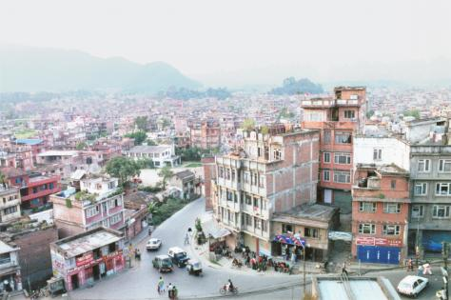
Urbanization in Nepal: Some Facts & Figures
Urban population: about 17 % of total population
In 1981, Nepal was one of the least urbanized city with 6.3% of the population residing in urban centers
The existing urban centers are neither well developed nor well connected in terms of geographical distributions.
in 25 years of time, proportion of rural & urban population will be half/half
Sources: Library of congress country study; CIA World Fact Book

Slide 6
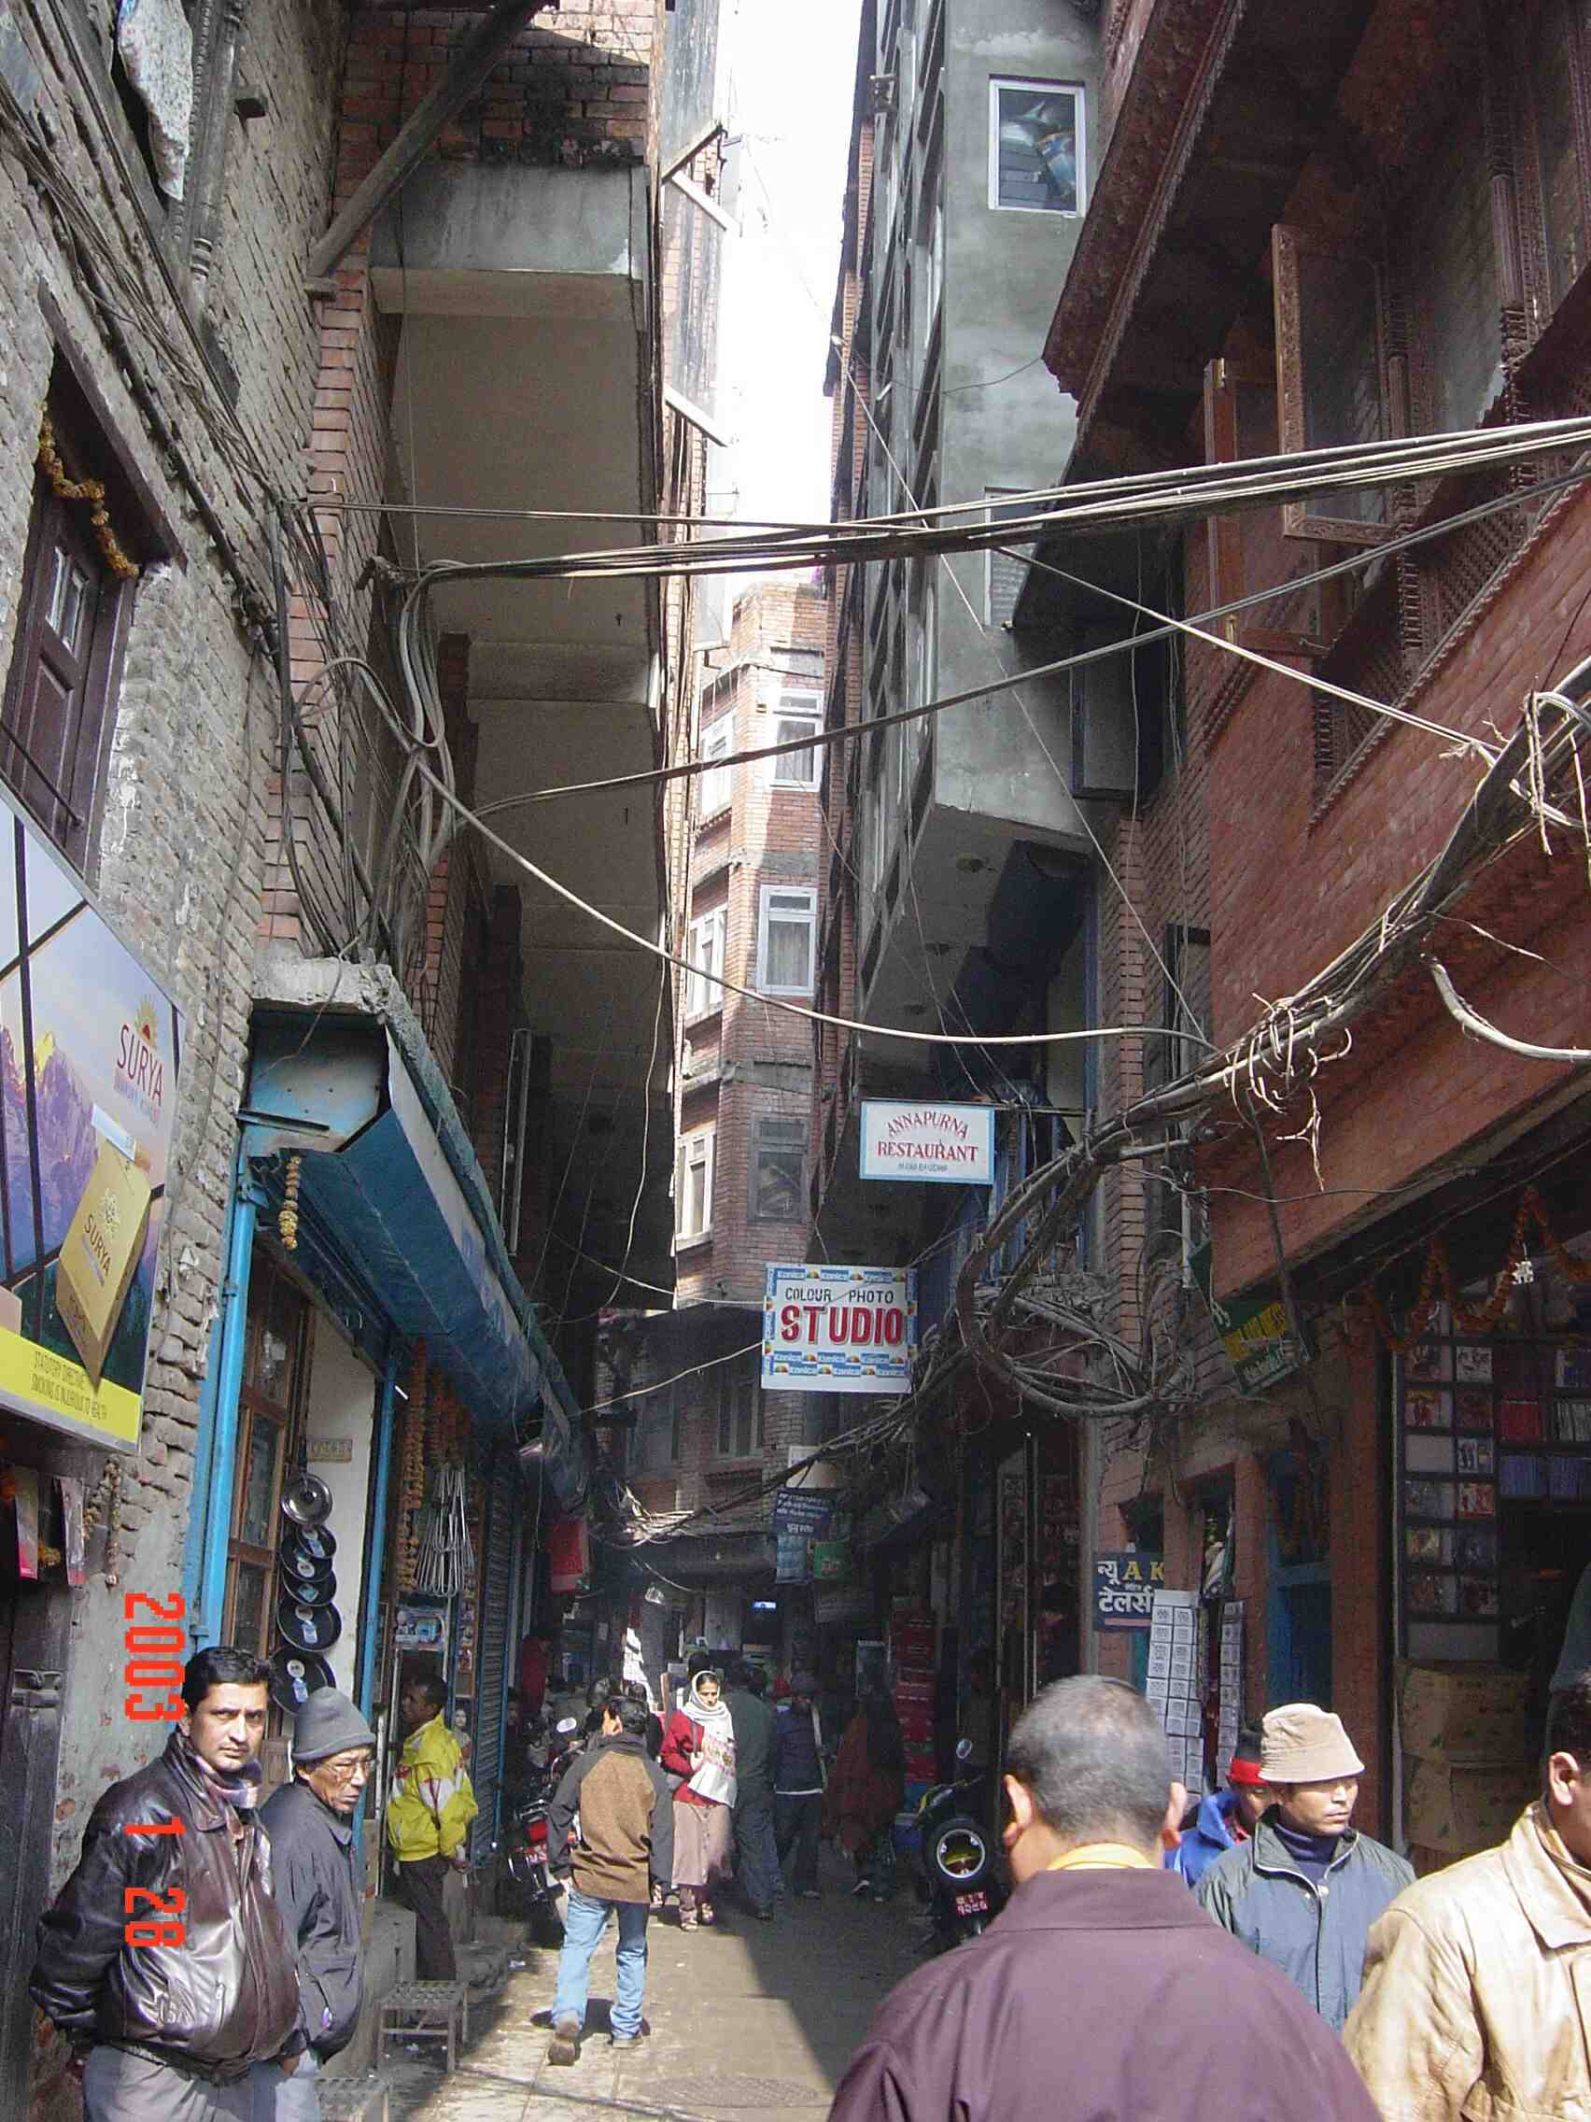
Disaster Risk: Kathmandu Valley Scenario
Earthquakes may pose greater impact in the valley due to:
Rapid urbanization
Fast growing population
Haphazard housing & settlement patterns
Lack of enforcement of building code
Humanitarian response will be affected due to:
Weak & poor infrastructure
Lack of communication facilities
Poor WATSAN facilities
Poor transportation facilities

Slide 7
Disaster Risk: Kathmandu Valley Scenario
KVERP/NSET [intensity IX], SEDM, JICA [intensity VII] together with Nepal Government study made in 2002 predicts the results of an earthquake in the Kathmandu Valley, resulting in varying scenarios for disaster impact & aftermath [intensity IX]
Up to 40,000 dead Up to 95,000 injured Up to 900,000 homeless 60% of buildings destroyed Only two or three of the 14 hospitals in the valley with an in-patient capacity of thirty or more still functional 95% of water pipes & 50% of pumping stations & treatment plants seriously affected; water supply disrupted for several months | 60% of telephones unusable for up to a month 40% of electricity lines and all sub-stations non-functional for a month 50% of bridges & many narrow roads unusable because of damage & debris Kathmandu international airport isolated by collapse of access roads & bridges; runway partially or totally unusable.

Slide 8
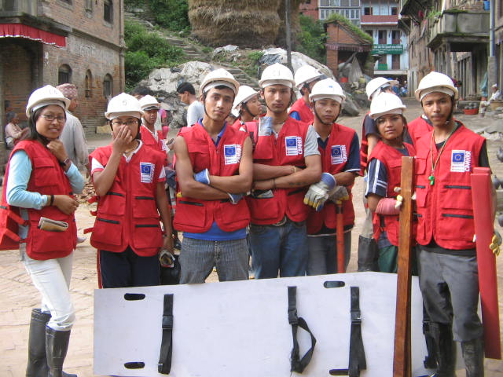
NRCS Efforts
Institutionalizing community preparedness for emergency response through community based earthquake preparedness & school based earthquake preparedness programs as basis to reduce the risk of earthquake in Kathmandu valley;
Community mobilization/coordination & networking
strengthening individual, household & community level preparedness
developing plans & implementing risk reduction interventions
Preparedness at organizational & community level
Development of an earthquake contingency plan-to ensure rapid, appropriate & effective NRCS response to a major earthquake centered in the Kathmandu valley, making optimum use of all available RCRC resources within Nepal & beyond [http://www.nrcs.org]

Slide 9
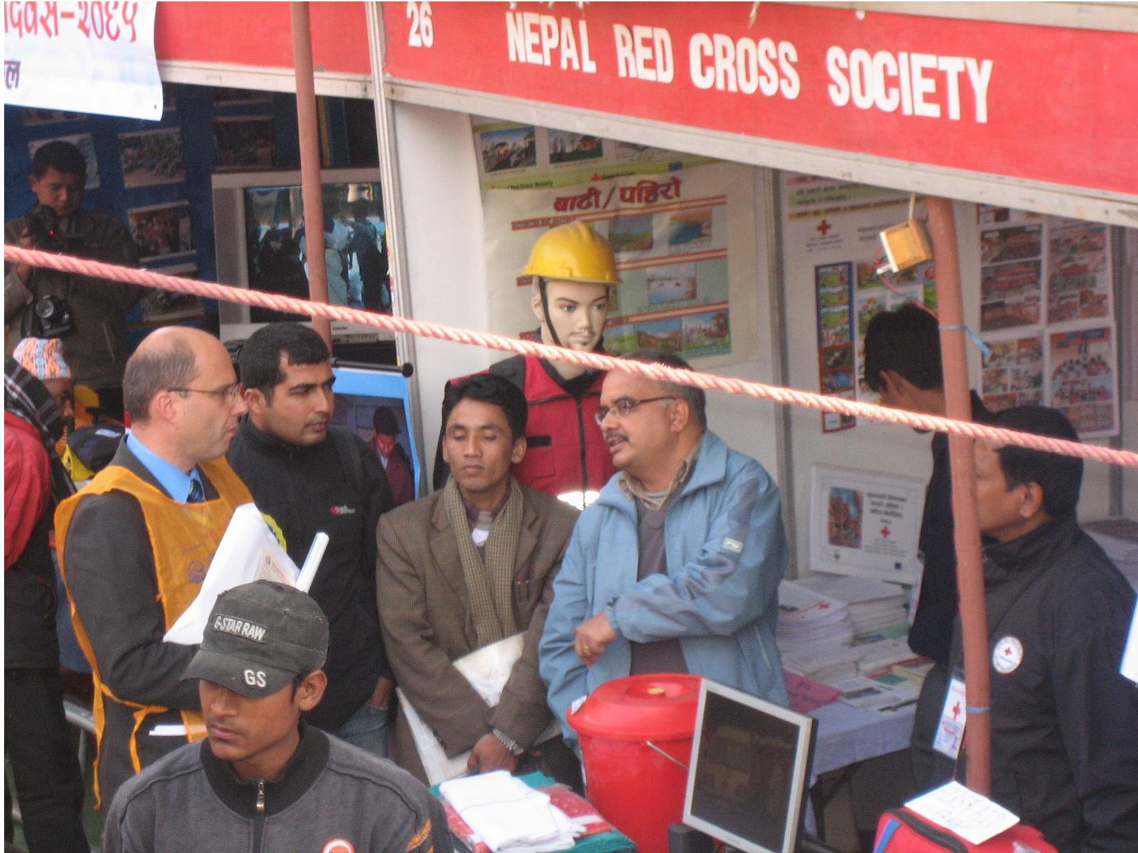
NRCS Efforts
Implementing resilient cities in south Asia project in support of IFRC
Implementation of Urban Sanitation Project & other CBDRR interventions
Coherent DM framework- compatible with government, IFRC & HFA
Development of tools & resources
Cross-country sharing of experiences
Member of regional & global networks: GA DRR & Regional DM Working Group.

Slide 10
Nepal Government Initiatives
The government has recently adopted Disaster Risk Management Strategy-2009 guided by the 10th Five-year Development Plan [2002-2007] & also the Interim National Development Plan [2008-2010] of the government & also reflecting the global strategies- Hyogo Framework for Action 2005-2015.
The government has recently established National Platform for Disaster Risk reduction-2009 & is dedicated to share & exchange the information related to National DRR Platform on HFA implementation in Nepal
International consortium of ADB, IFRC, UNOCHA, UNISDR & the World Bank formed in 2009 supported government to develop long term DRR Action Plan
Implementation of codes related with building construction in selected areas
Observing National earthquake day- as point to recall destruction of 1934 earthquake in Nepal & awareness for country population
National DM Act drafted & under approval process.
Establishment of focal desks in PM Office, NPC & Key Ministries.

