Slide 1
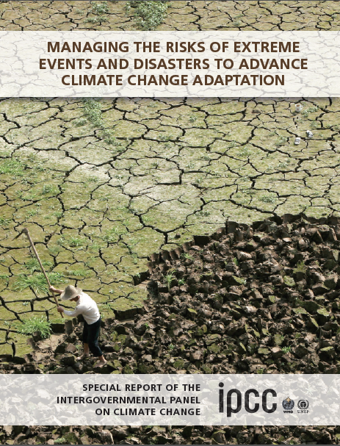

Managing the Risks of Extreme Events
and Disasters to Advance
Climate Change Adaptation
Special Report of the
Intergovernmental Panel on Climate Change
Prof. Wadid ERIAN
DIRECTOR, Land and Water Uses Division
LAS ACSAD
Lead Author in IPCC - SREX , WGII
Member in UNISDR GAR Advisory Board
Advisor World Bank
The IPCC was established by the United Nations Environment Programme (UNEP) and the World Meteorological Organization (WMO) to provide the world with a comprehensive assessment of the current state of knowledge of climate change and its potential environmental and socioeconomic impacts.

Slide 2
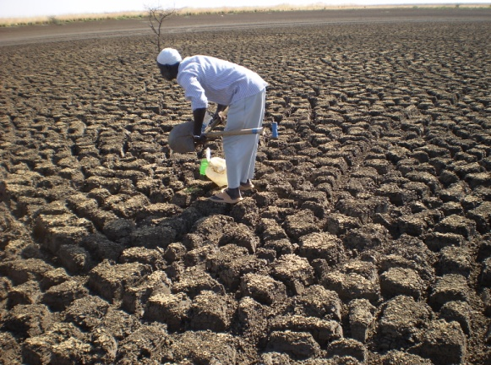
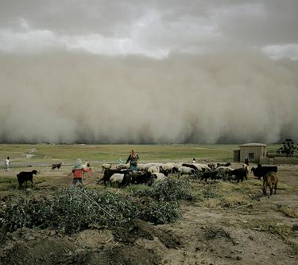
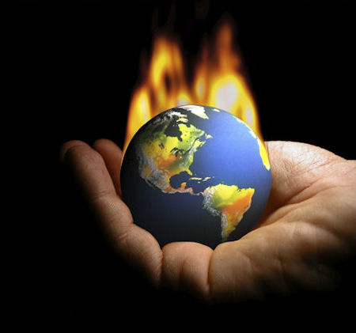
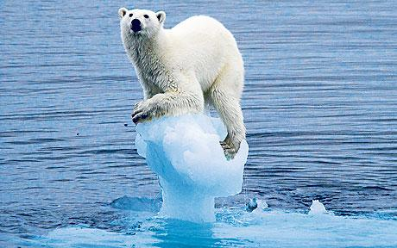
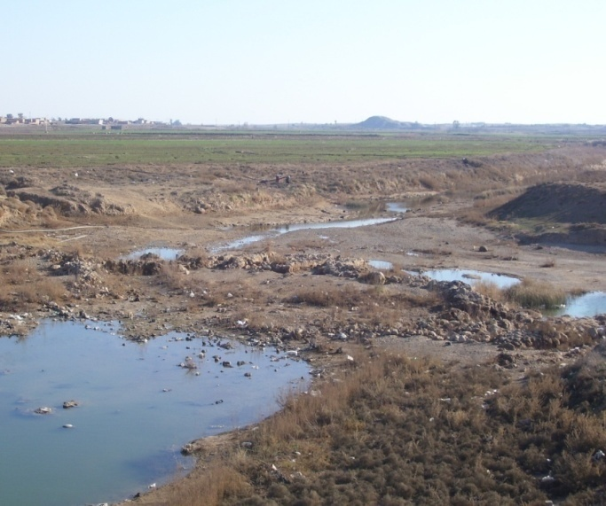
Why We Need The Special Report?
Extreme weather and climate events,
interacting with:
exposed and vulnerable human and natural systems, can lead to disasters.
This Special Report
explores the challenge of understanding and managing the risks of climate extremes to advance climate change adaptation.

Slide 3
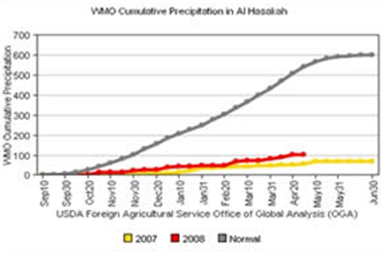
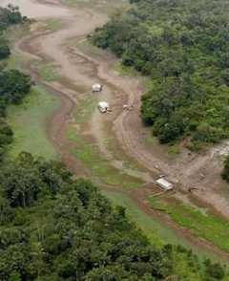
Chapter 1 Climate Change: New Dimensions in Disaster Risk, Exposure, Vulnerability, and Resilience
Chapter 2 Determinants of Risk: Exposure and Vulnerability
Chapter 3 Changes in Climate Extremes and their Impacts on the Natural Physical Environment
Chapter 4 Changes in Impacts of Climate Extremes: Human Systems and Ecosystems
Chapter 5 Managing the Risks from Climate Extremes at the Local Level
Chapter 6 National Systems for Managing the Risks from Climate Extremes and Disasters
Chapter 7 Managing the Risks: International Level and Integration across Scales
Chapter 8 Toward a Sustainable and Resilient Future
Chapter 9 Case Studies
A period of abnormally dry weather long enough to cause a serious hydrological imbalance.
Glossary of Terms
Precipitation deficit is defined as a METEOROLOGICAL DROUGHT.
Drought is a relative term shortage of precipitation related to particular activity
during the growing season affects yield - SOIL MOISTURE DROUGHT, or
AGRICULTURAL DROUGHT,
Storage changes in soil moisture and groundwater are also affected by increases in actual evapotranspiration in addition to reductions in precipitation.
Drought:
A MEGADROUGHT
is drought, lasting much longer than normal, usually a decade or more.
during the runoff season affects water supplies –
HYDROLOGICAL DROUGHT.

Slide 4
This volume, Managing the Risks of Extreme Events and Disasters to Advance Climate Change Adaptation, is a Special Report of the Intergovernmental Panel on Climate Change (IPCC).
The report is a collaborative effort of Working Group I (WGI) and Working Group II (WGII).
The IPCC leadership team for this report also has responsibility for the IPCC Fifth Assessment Report (AR5), scheduled for completion in 2013 and 2014.
The IPCC’s
Fifth Assessment
Report (AR5)
Completion dates
Working Group I
23 - 26 September 2013
Working Group II
25 - 29 March 2014
Working Group III
7 - 12 April 2014

Slide 5
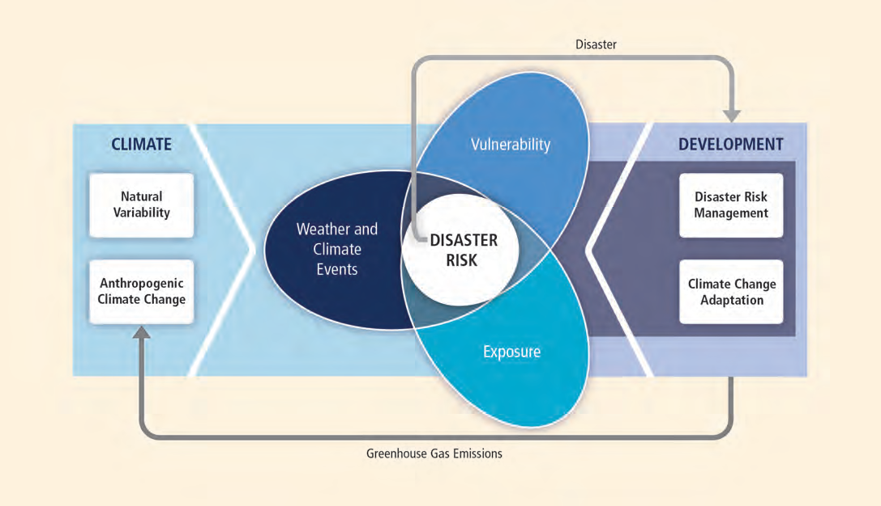
The character and severity of impacts from climate extremes depend not only on the extremes themselves but also on exposure and vulnerability.
Adverse impacts are considered disasters when they produce widespread damage and cause severe alterations in the normal functioning of communities or societies.
Climate extremes, exposure, and vulnerability are influenced by a wide range of factors, including anthropogenic climate change, natural climate variability, and socioeconomic development

Slide 6
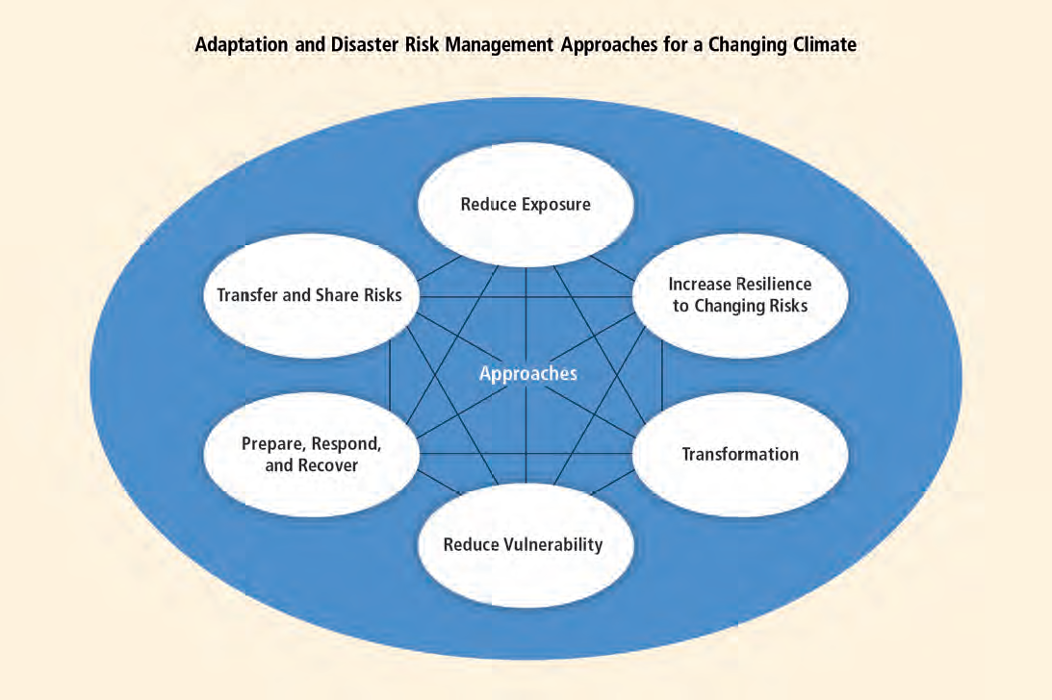
Disaster risk management and adaptation to climate change focus on reducing exposure and vulnerability and increasing resilience to the potential adverse impacts of climate extremes, even though risks cannot fully be eliminated
This report assesses a wide range of complementary adaptation and disaster risk management approaches that can reduce the risks of climate extremes and disasters and increase resilience to remaining risks as they change over time. These approaches can be overlapping and can be pursued simultaneously

Slide 7
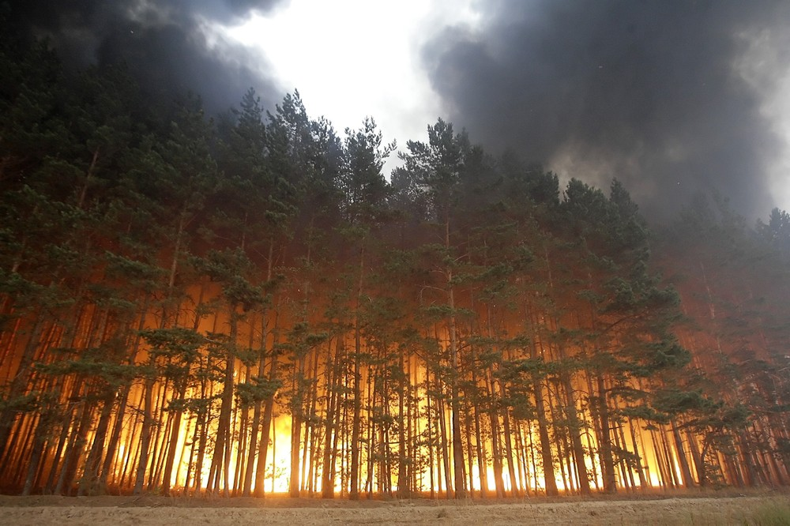
Future Climate Extremes, Impacts, and Disaster Losses

Slide 8
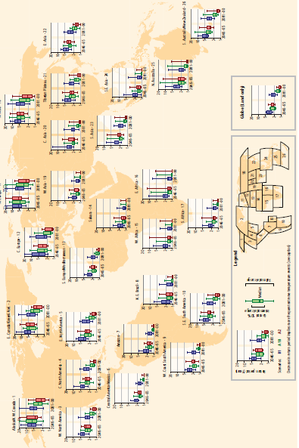
Confidence in projecting changes in the direction and magnitude of climate extremes depends on many factors, including the type of extreme, the region and season, the amount and quality of observational data, the level of understanding of the underlying processes, and the reliability of their simulation in models.
Projected return periods for the maximum daily temperature that was exceeded on average once during a 20-year period in the late 20th century (1981–2000). A decrease in return period implies more frequent extreme temperature events (i.e., less time between events on average).

Slide 9
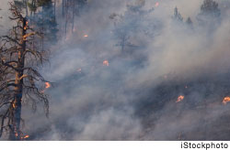
Models project substantial warming in temperature extremes by the end of the 21st century. increase by about 1°C to 3°C by the mid-21st century and by about 2°C to 5°C by the late 21st century, depending on the region and emissions scenario

Slide 10
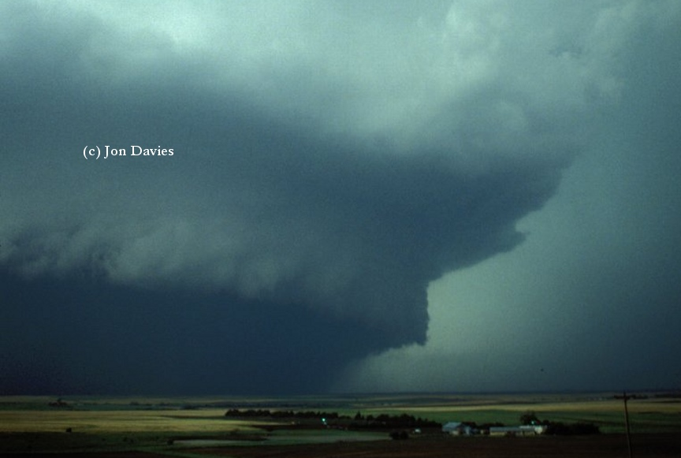
It is likely that the frequency of heavy precipitation or the proportion of total rainfall from heavy falls will increase in the 21st century over many areas of the globe.
This is particularly the case in the high latitudes and tropical regions, and in winter in the northern mid-latitudes. Heavy rainfalls associated with tropical cyclones are likely
to increase with continued warming.
There is medium confidence that, in some regions, increases in heavy precipitation will occur despite projected decreases in total precipitation

Slide 11
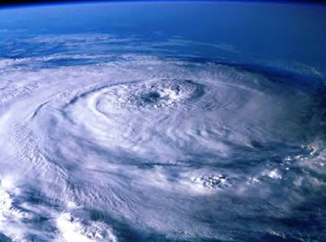
There is medium confidence that there will be a reduction in the number of extra_ tropical cyclones averaged over each hemisphere.
While there is low confidence in the detailed geographical projections of extra_ tropical cyclone activity,

Slide 12
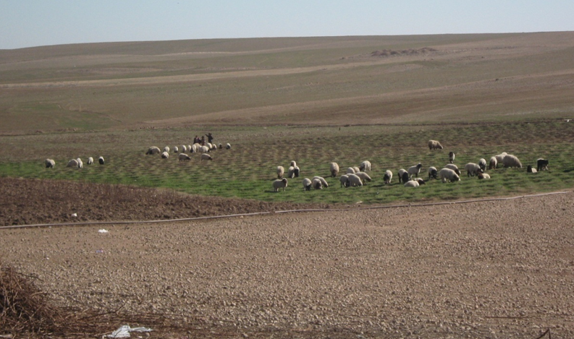
There is medium confidence that droughts will intensify in the 21st century in some seasons and areas, due to reduced precipitation and/or increased evapotranspiration.
This applies to regions including southern Europe and the Mediterranean region, central Europe, central North America, Central America and Mexico, northeast Brazil, and southern Africa. Elsewhere there is overall low confidence because of inconsistent projections of drought changes (dependent both on model and dryness index). Definitional issues, lack of observational data, and the inability of models to include all the factors that influence droughts preclude stronger confidence than medium in drought projections.

Slide 13
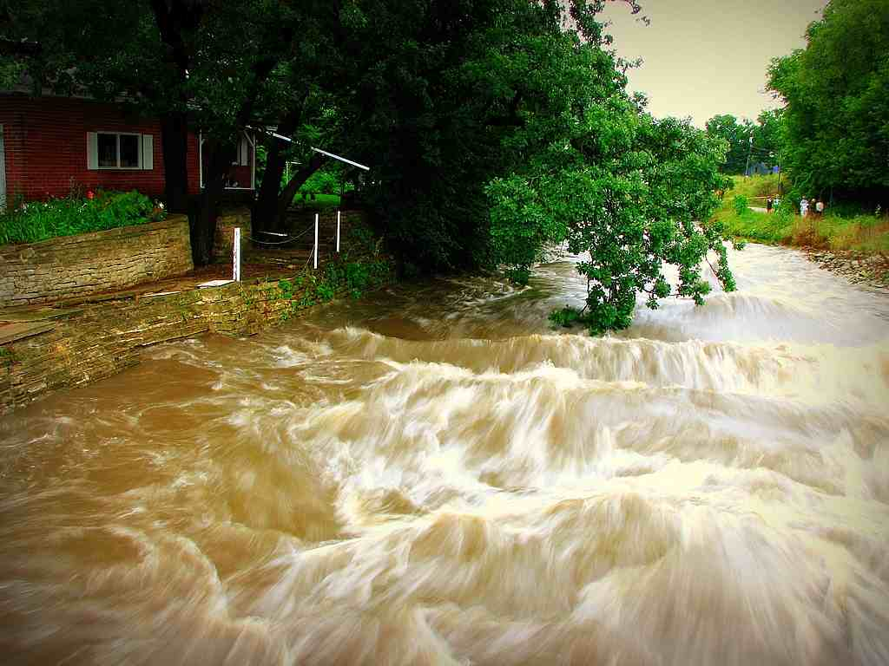
Projected precipitation and temperature changes imply possible changes in floods, although overall there is low confidence in projections of changes in fluvial floods.
Confidence is low due to limited evidence and because the causes of regional changes are complex, although there are exceptions to this statement.
There is medium confidence (based on physical reasoning) that projected increases in heavy rainfall would contribute to increases in local flooding in some catchments or regions.

Slide 14
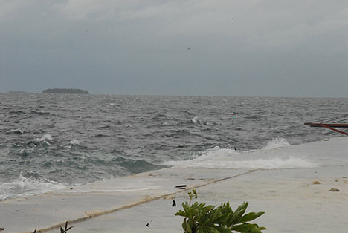
It is very likely that mean sea level rise will contribute to upward trends in extreme coastal high water levels in the future.
There is high confidence that locations currently experiencing adverse impacts such as coastal erosion and inundation will continue to do so in the future due to increasing sea levels, all other contributing factors being equal.
The very likely contribution of mean sea level rise to increased extreme coastal high water levels, coupled with the likely increase in tropical cyclone maximum wind speed, is a specific issue for tropical small island states.

Slide 15
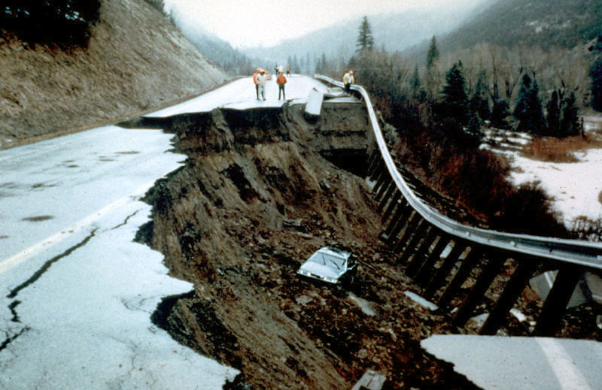
There is high confidence that changes in heat waves, glacial retreat, and/or permafrost degradation will affect high mountain phenomena such as slope instabilities, movements of mass, and glacial lake outburst floods.
There is also high confidence that changes in heavy precipitation will affect landslides in some regions

Slide 16
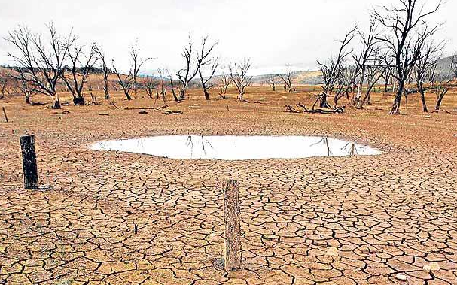
There is low confidence in projections of changes in large-scale patterns of natural climate variability.
Confidence is low in projections of changes in monsoons (rainfall, circulation) because there is little consensus in climate models regarding the sign of future change in the monsoons. Model projections of changes in El Niño–Southern Oscillation variability and the frequency of El Niño episodes are not consistent, and so there is low confidence in projections of changes in this phenomenon.

Slide 17
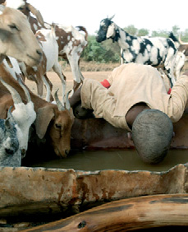
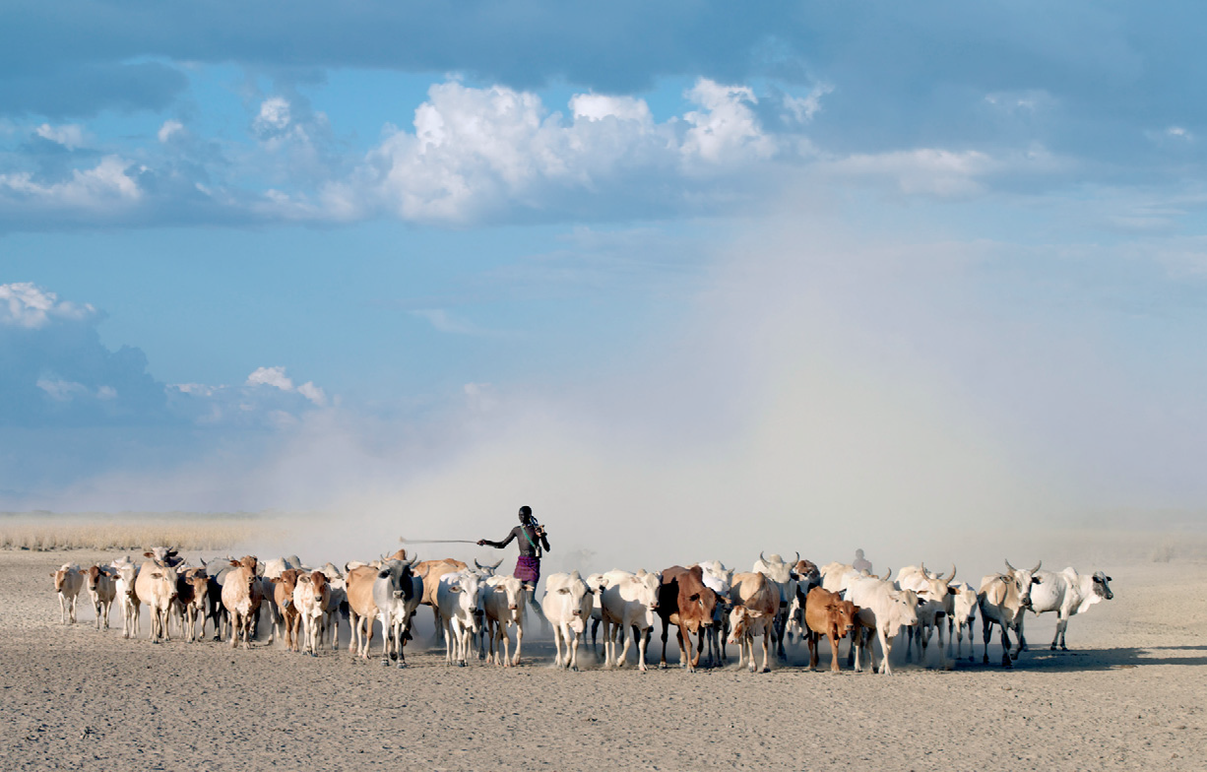
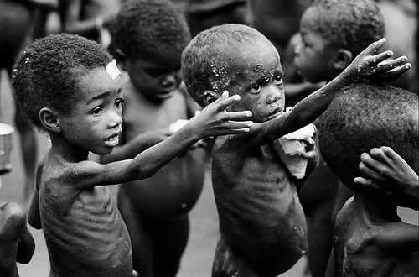
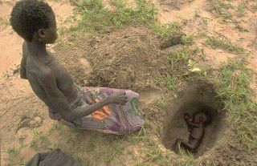
Human Impacts and Disaster Losses

Slide 18
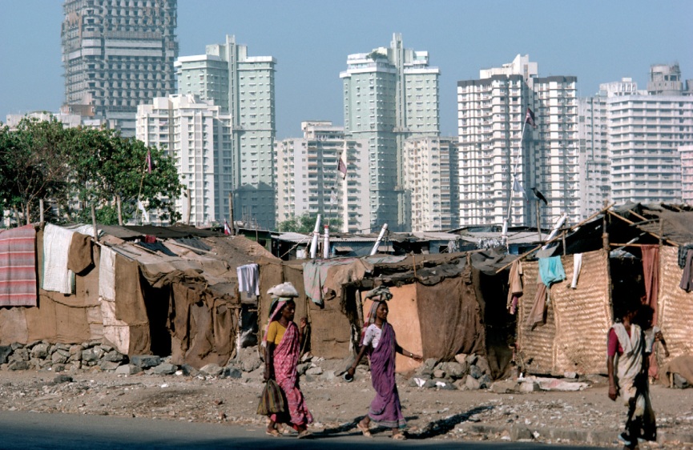
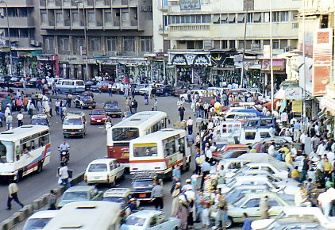
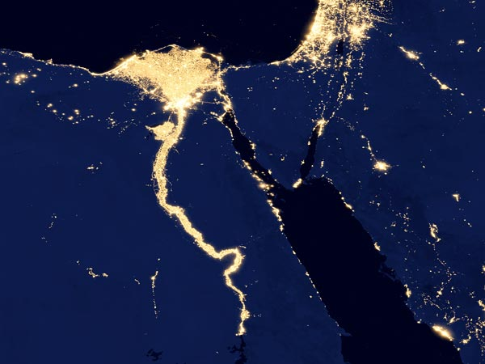
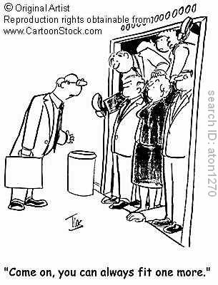
In many regions, the main drivers of future increases in economic losses due to some climate extremes will be socioeconomic in nature
(medium confidence, based on medium agreement, limited evidence)
Climate extremes are only one of the factors that affect risks, but few studies have specifically quantified the effects of changes in population, exposure of people and assets, and vulnerability as determinants of loss. However, the few studies available generally underline the important role of projected changes (increases) in population and capital at risk.

Slide 19
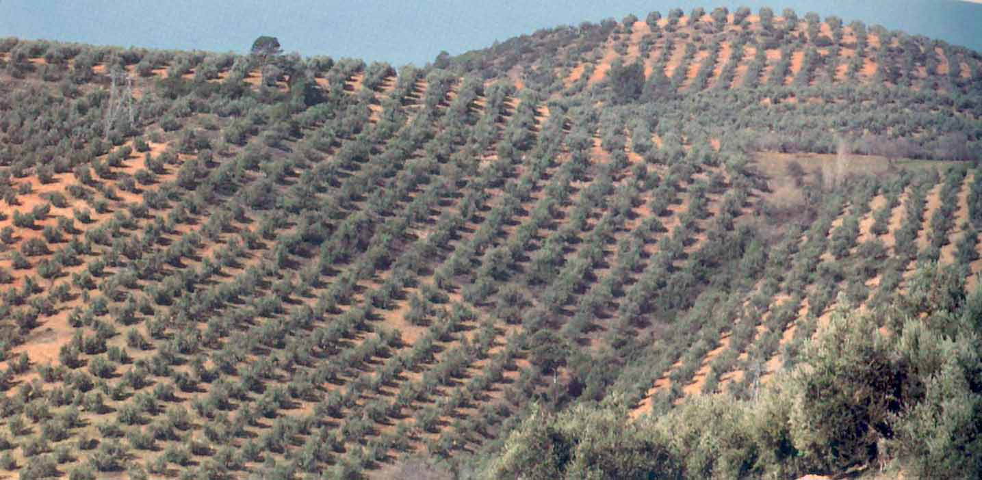
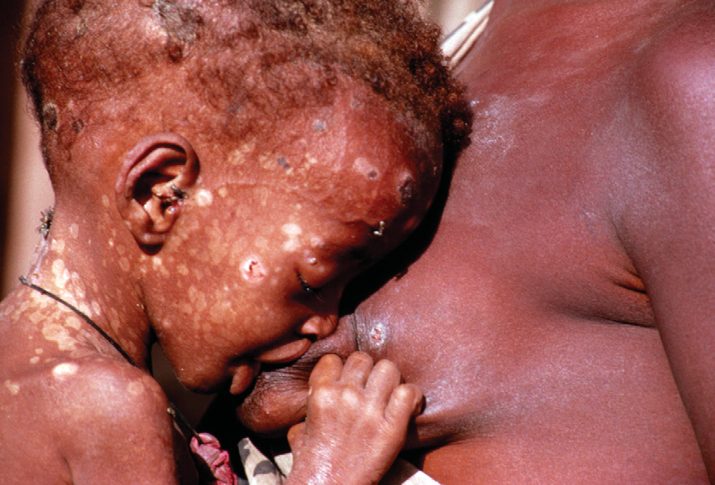
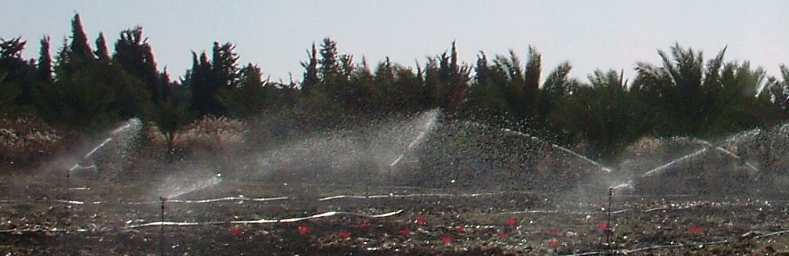
Managing Changing Risks of Climate Extremes and Disasters

Slide 20

EUROPE AND MEDITERRANEAN
Temp. max | High confidence: Likely increase in WD and likely decrease in CD in most of the region. Some regional and temporal variations in significance of trends. Likely strongest and most significant trends in the Iberian Peninsula and Southern France (Medium confidence: Smaller or less significant trends in S.E. Europe and Italy due to change point in trends at the end of the 1970s / beginning of 1980s; sometimes linked with changes in sign of trends; strongest WD increase since
Temp.min | High confidence: Likely increase in WN and likely decrease in CN in most of the region. Some regional variations in significance of trends. Very likely overall increase in WN and very likely overall decrease in CN in S.W. Europe and W. Mediterranean; likely strongest signals in Spain and Southern France. Likely overall tendency for increase in WN and likely overall tendency for decrease in CN in S.E. Europe and E. Mediterranean
Heat Waves/Warm Spells | High confidence: Likely overall increase in HW in summer (JJA). Significant increase in max HW duration since 1880 in Iberian Peninsula and west Central Europe in JJA. Significant increase in max HW duration in Tuscany (Italy). Significant increase in HW indices in Turkey and to a smaller extent in S.E. Europe and Turkey in JJA. Less significant signal in HW indices in S.E. Europe due to presence of change point in trends.
Heavy Precipitation | Low confidence: Inconsistent trends within domain and across studies. Medium confidence: Overall increase in dryness (SMA, PDSI, CDD), but partial dependence on index and time period.
Dryness | Medium confidence: Overall increase in dryness (SMA, PDSI, CDD), but partial dependence on index and time period.

Slide 21


Actions that range from incremental steps to transformational changes are essential for reducing risk from climate extremes (high agreement, robust evidence).
Incremental steps aim to improve efficiency within existing technological, governance, and value systems,
whereas transformation may involve alterations of fundamental attributes of those systems.
Transformations, where they are required, are also facilitated through increased emphasis on adaptive management and learning.
Where vulnerability is high and adaptive capacity low, changes in climate extremes can make it difficult for systems to adapt sustainably without transformational changes. Vulnerability is often concentrated in lower-income countries or groups, although higher-income countries or groups can also be vulnerable to climate
extremes
COP18 – Sustainability in Action
Doha’s Tornado Tower, a landmark example of a Siemens Total Building Solution, is lit up in green using energy efficient LED lights for the duration of COP18.

Slide 22
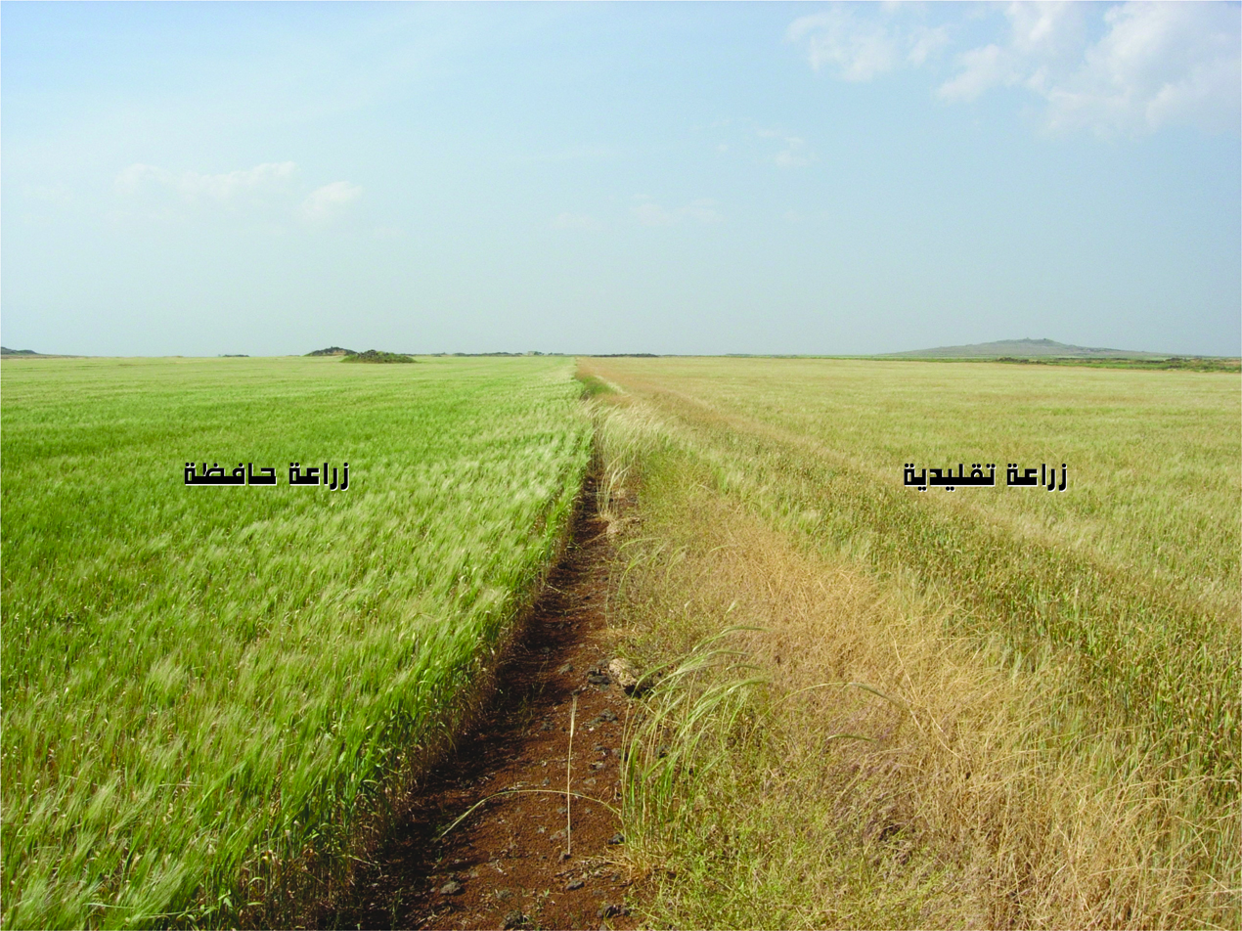
Social, economic, and environmental sustainability can be enhanced by disaster risk management and adaptation approaches.
A prerequisite for sustainability in the context of climate change is addressing the underlying causes of vulnerability, including the structural inequalities that create and sustain poverty and constrain access to resources (medium agreement, robust evidence).
This involves integrating disaster risk management and adaptation into all social, economic, and environmental policy domains.

Slide 23
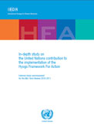
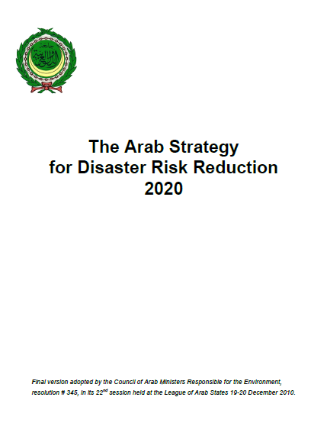
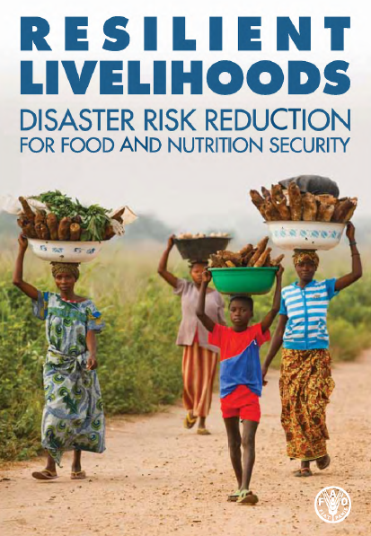
The most effective adaptation and disaster risk reduction actions are those that offer development benefits in the relatively near term, as well as reductions in vulnerability over the longer term (high agreement, medium evidence).
There are tradeoffs between current decisions and long-term goals linked to diverse values, interests, and priorities for the future.
Short- and long-term perspectives on disaster risk management and adaptation to climate change thus can be difficult to reconcile.
Such reconciliation involves overcoming the disconnect between local risk management practices and national institutional and legal frameworks, policy, and planning.

Slide 24
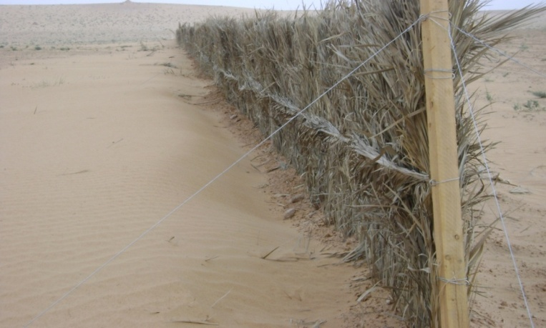
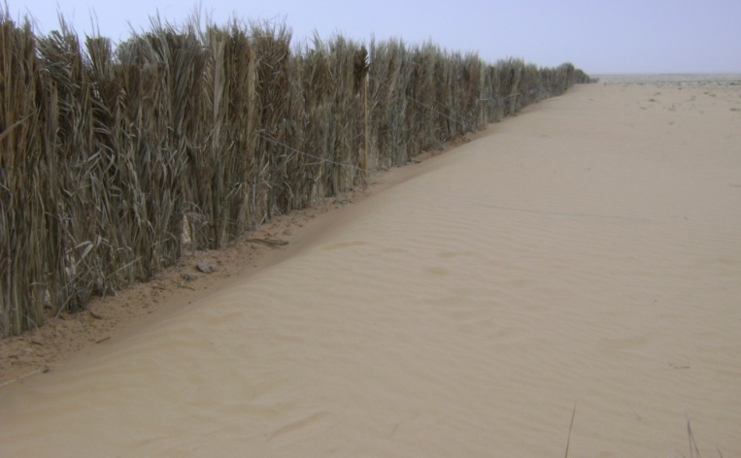
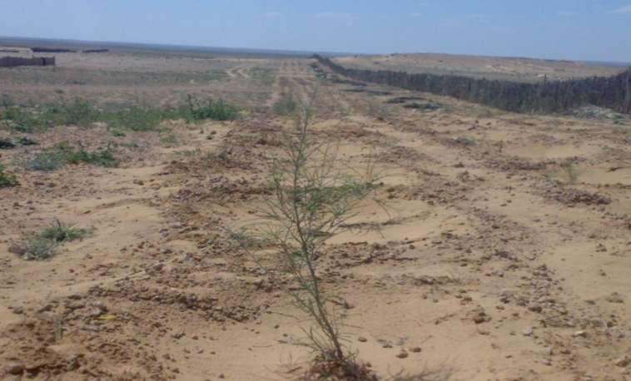
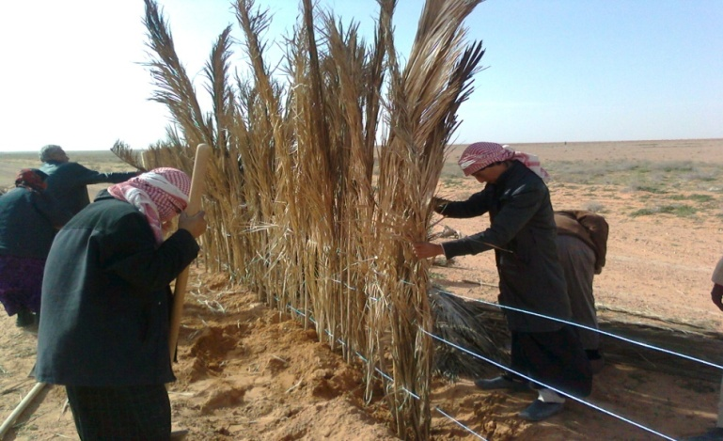
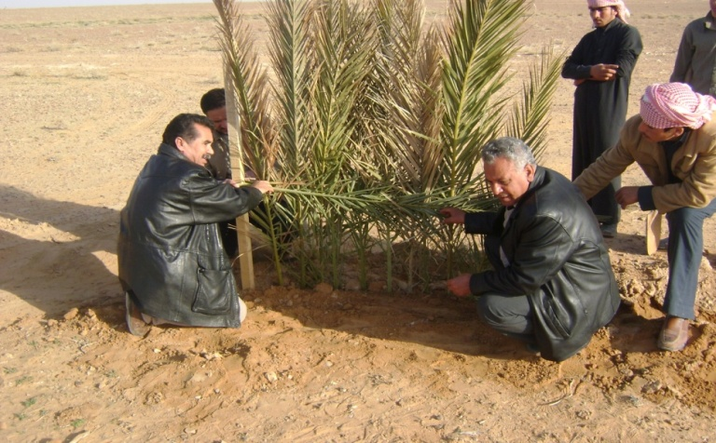
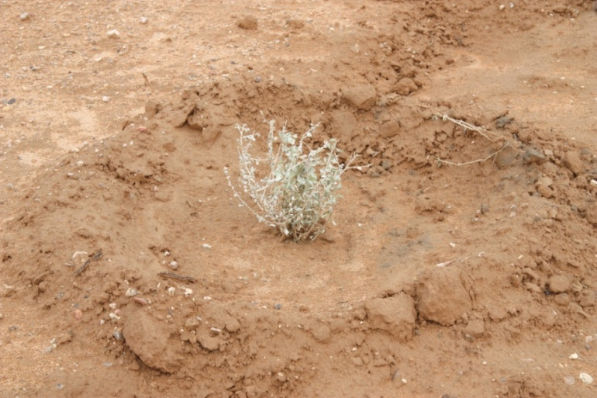
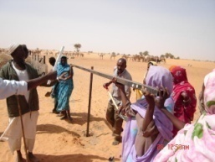
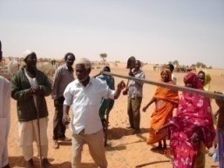
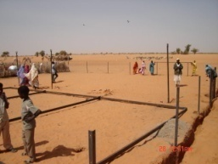
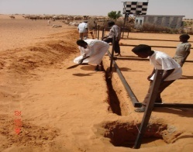
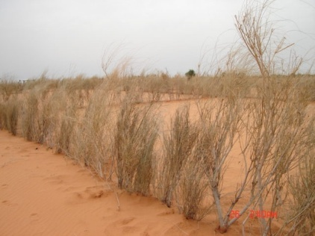
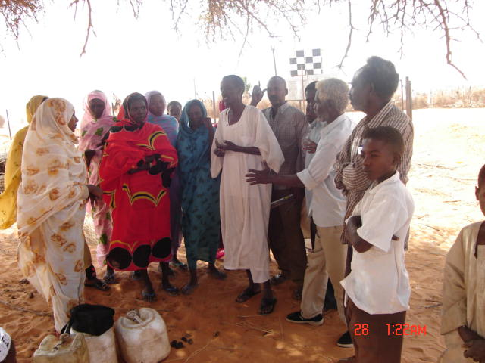
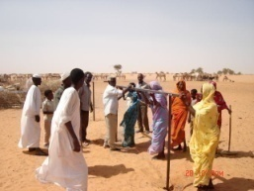
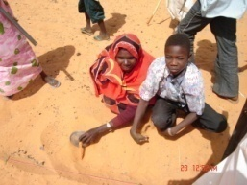
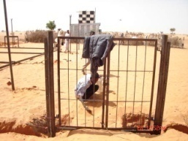











Progress toward resilient and sustainable development in the context of changing climate extremes can benefit from questioning assumptions and paradigms and stimulating innovation to encourage new patterns of response (medium agreement, robust evidence).
Successfully addressing disaster risk, climate change, and other stressors often involves embracing broad participation in strategy development, the capacity to combine multiple perspectives, and contrasting ways of organizing social relations.

Slide 25




The interactions among climate change mitigation, adaptation, and disaster risk management may have a major influence on resilient and sustainable pathways (high agreement, limited evidence).
Interactions between the goals of mitigation and adaptation in particular will play out locally, but have global consequences.
Fossil energy
The production of fossil fuels has played an important economic role in the region for decades, and there’s much to gain from efficient use of fossil resources.

Slide 26

There are many approaches and pathways to a sustainable and resilient future.
However, limits to resilience are faced when thresholds or tipping points associated with social and/or natural systems are exceeded, posing severe challenges for adaptation.
Choices and outcomes for adaptive actions to climate events must reflect divergent capacities and resources and multiple interacting processes. Actions are framed by tradeoffs between competing prioritized values and objectives, and different visions of development that can change over time. .
Iterative approaches allow development pathways to integrate risk management so that diverse policy solutions can be considered, as risk and its measurement, perception, and understanding evolve over time

Slide 27
Case Studies
9.2.1. European Heat Waves of 2003 and 2006
9.2.2. Response to Disaster Induced by Hot Weather and Wildfires
9.2.3. Managing the Adverse Consequences of Drought
9.2.4. Recent Dzud Disasters in Mongolia
9.2.5. Cyclones: Enabling Policies and Responsive Institutions for Community Action
9.2.6. Managing the Adverse Consequences of Floods
9.2.7. Disastrous Epidemic Disease: The Case of Cholera
9.2.8. Coastal Megacities: The Case of Mumbai
9.2.9. Small Island Developing States: The Challenge of Adaptation
9.2.10. Changing Cold Climate Vulnerabilities: Northern Canada
9.2.11. Early Warning Systems: Adapting to Reduce Impacts
9.2.12. Effective Legislation for Multilevel Governance of Disaster Risk Reduction and Adaptation
9.2.13. Risk Transfer: The Role of Insurance and Other Instruments in Disaster Risk Management and Climate Change Adaptation in Developing Countries
9.2.14. Education, Training, and Public Awareness Initiatives for Disaster Risk Reduction and Adaptation

Slide 28
Thank You
Dr. Wadid Fawzi Erian wadiderian @gmail.com +201276257444

