Slide 1
Analyzing an Image using MAC Systems Sleuth kit version 3.2.0 & Autopsy 2.24
Page 325 from “Guide to Computer Forensics and Investigations 4th edition”

Slide 2
MAC Forensic Tools
Sleuth Kit – base program for Unix investigations. Uses a command-line interface.
Autopsy – Graphical User Interface (GUI) that “sits on top” of Sleuth Kit command-line interface. Allows access to Sleuth Kit functions via a GUI.

Slide 3
Boot your MAC
Select number 2 on your KVM Switch
Press the power button on the MAC
Login in to the ‘student’ account
Password: $tudent1

Slide 4
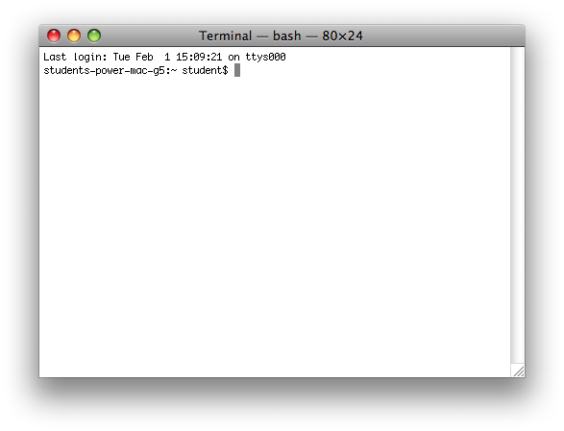
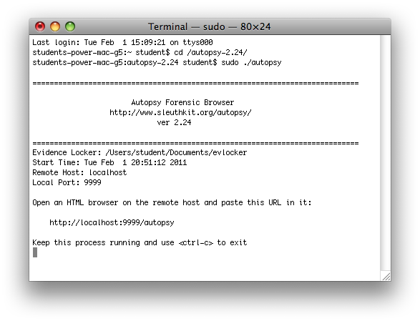
Starting Autopsy
At Terminal change the working directory by typing “cd /autopsy-2.24/” without the quotes
Now type “sudo ./autopsy” and enter the Student password
Be sure to add spaces after cd and sudo
Right-click on ‘http://localhost:9999/autopsy’ and select Open URL

Slide 5
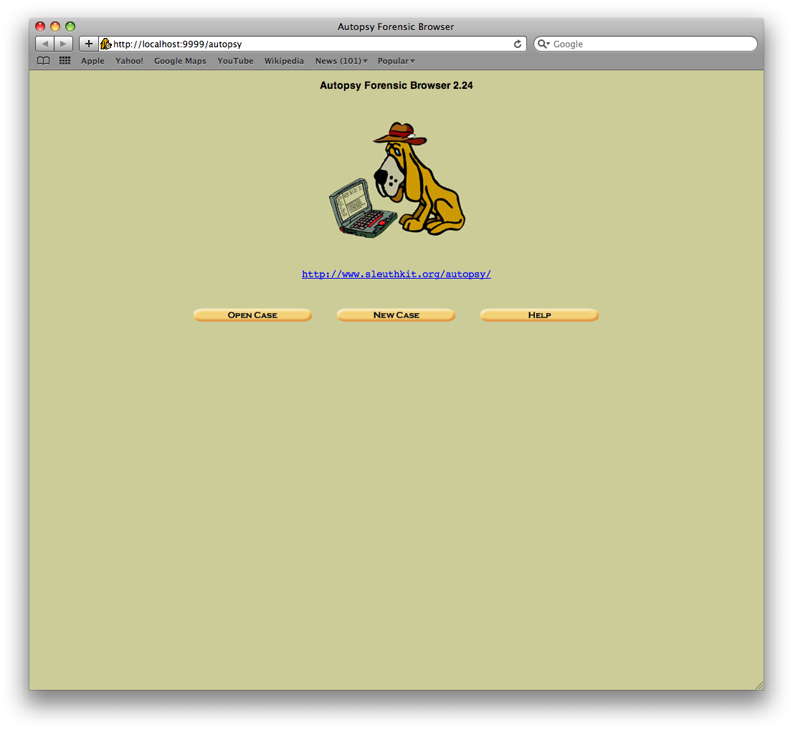
Autopsy Forensic Browser
Click on New Case

Slide 6
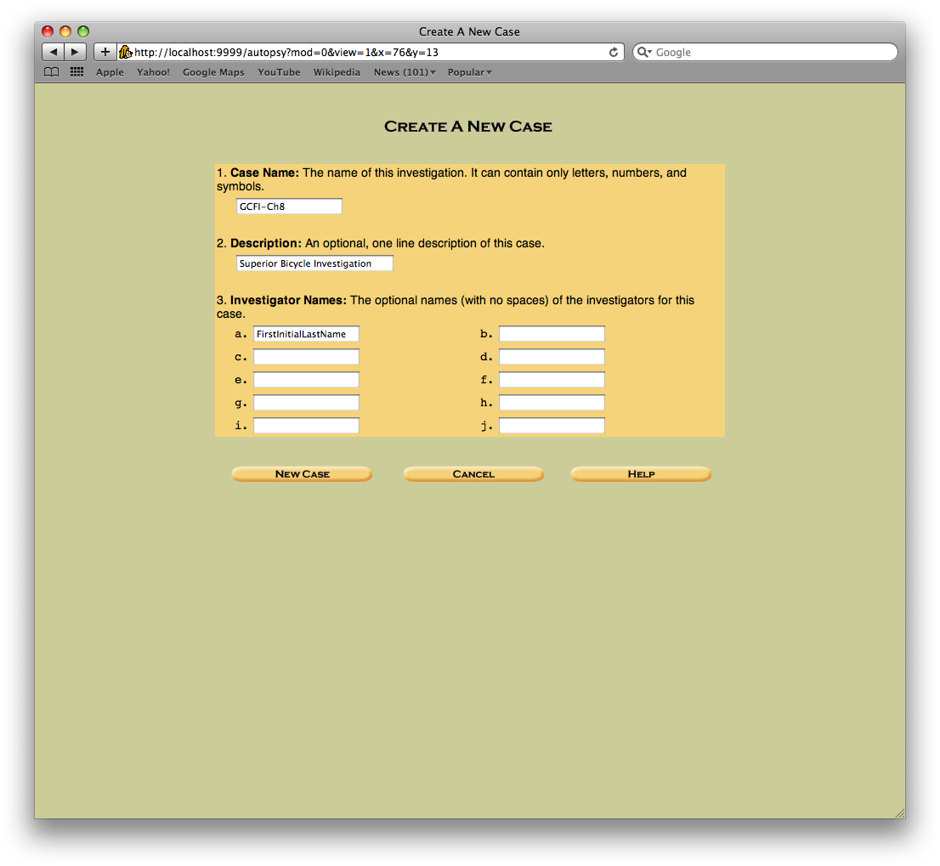
Creating a new case
Enter the following information:
Case name: GCFI-CH8
Description: Superior Bicycle Investigation
Investigator Names:
a. ‘Your Name’
Click New Case

Slide 7
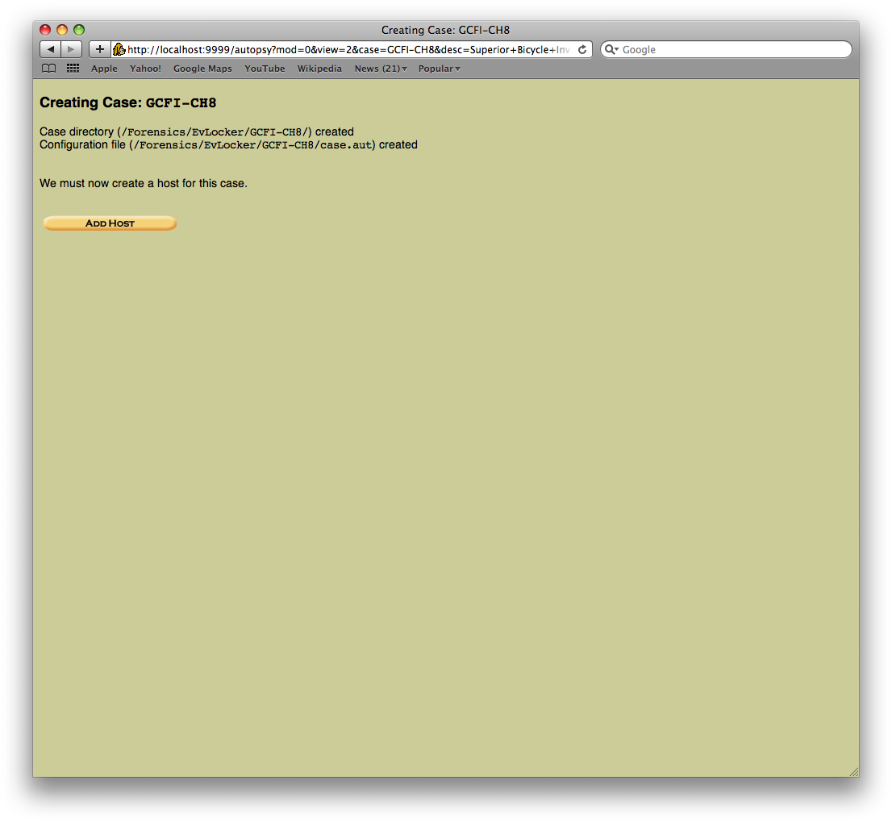
Creating a New Case
Click ‘Add Host’

Slide 8
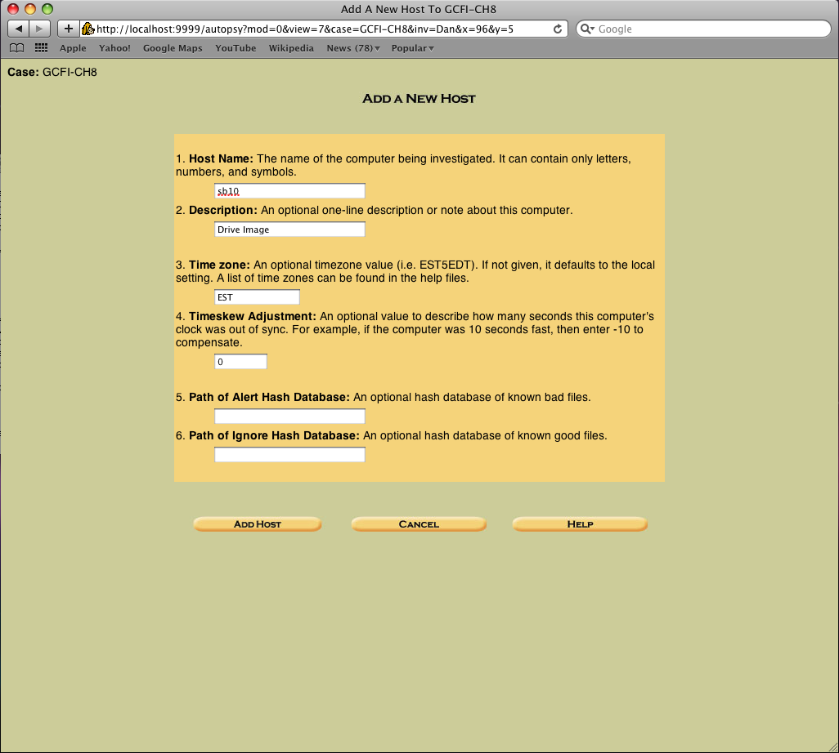
Creating a New Case
Enter the following information:
Host Name: sb10
Description: Drive Image
Time zone: EST
Timeskew: 0
Click Add Host

Slide 9
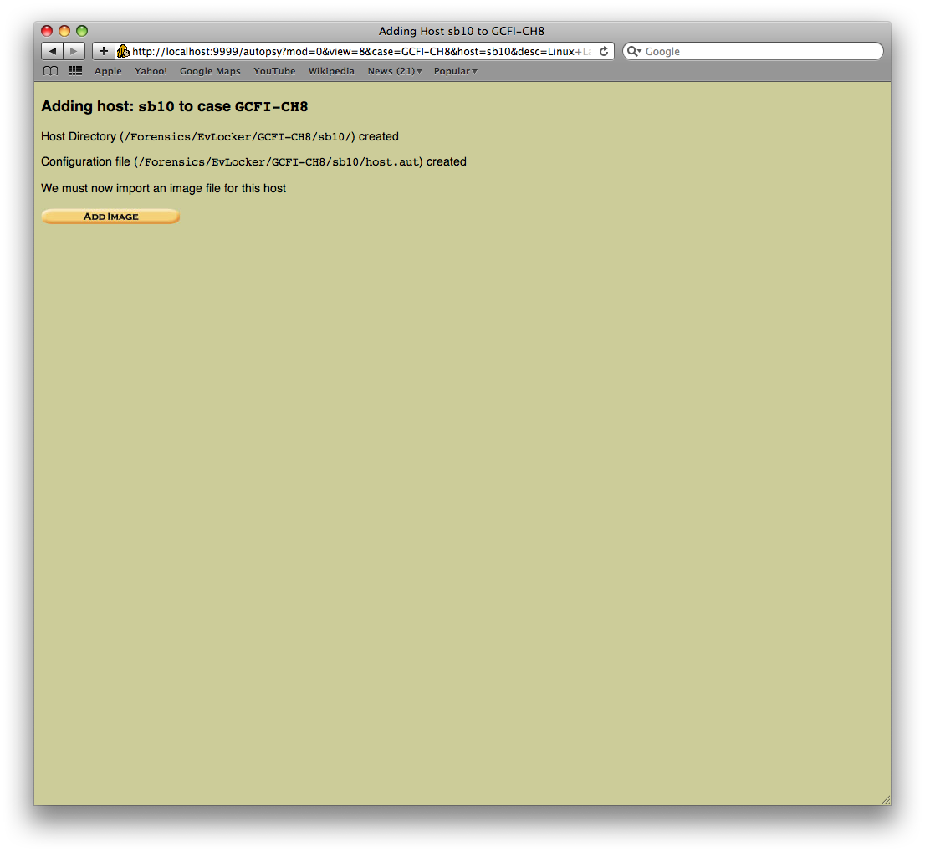
Creating a New Case
click Add Image

Slide 10
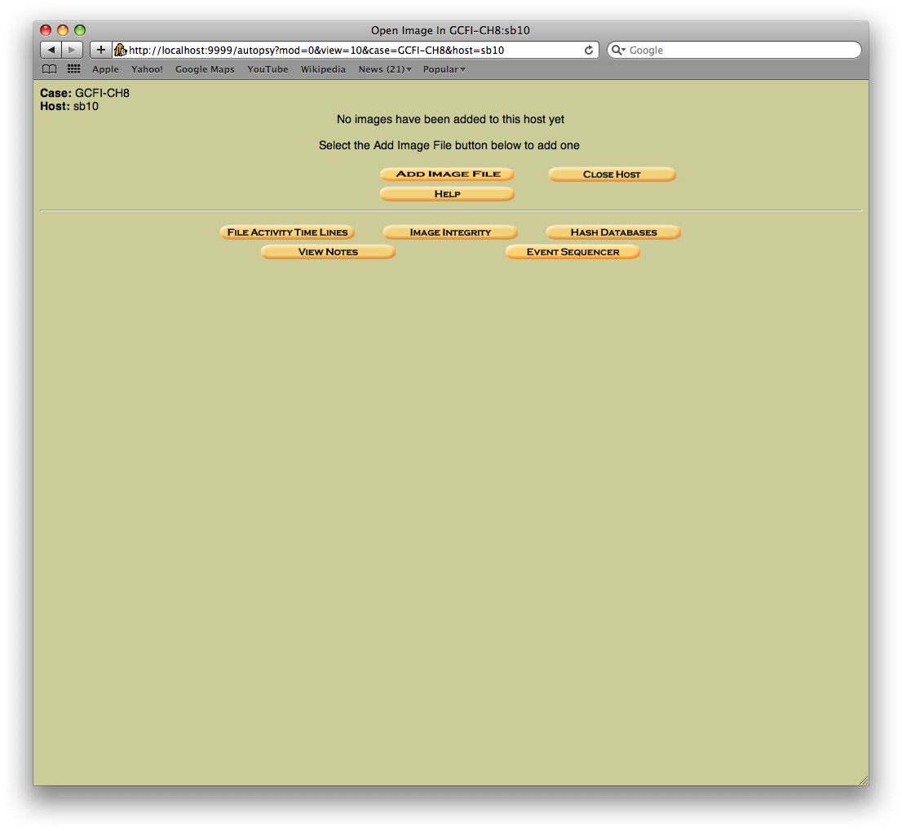
Adding an Image
click Add Image File

Slide 11
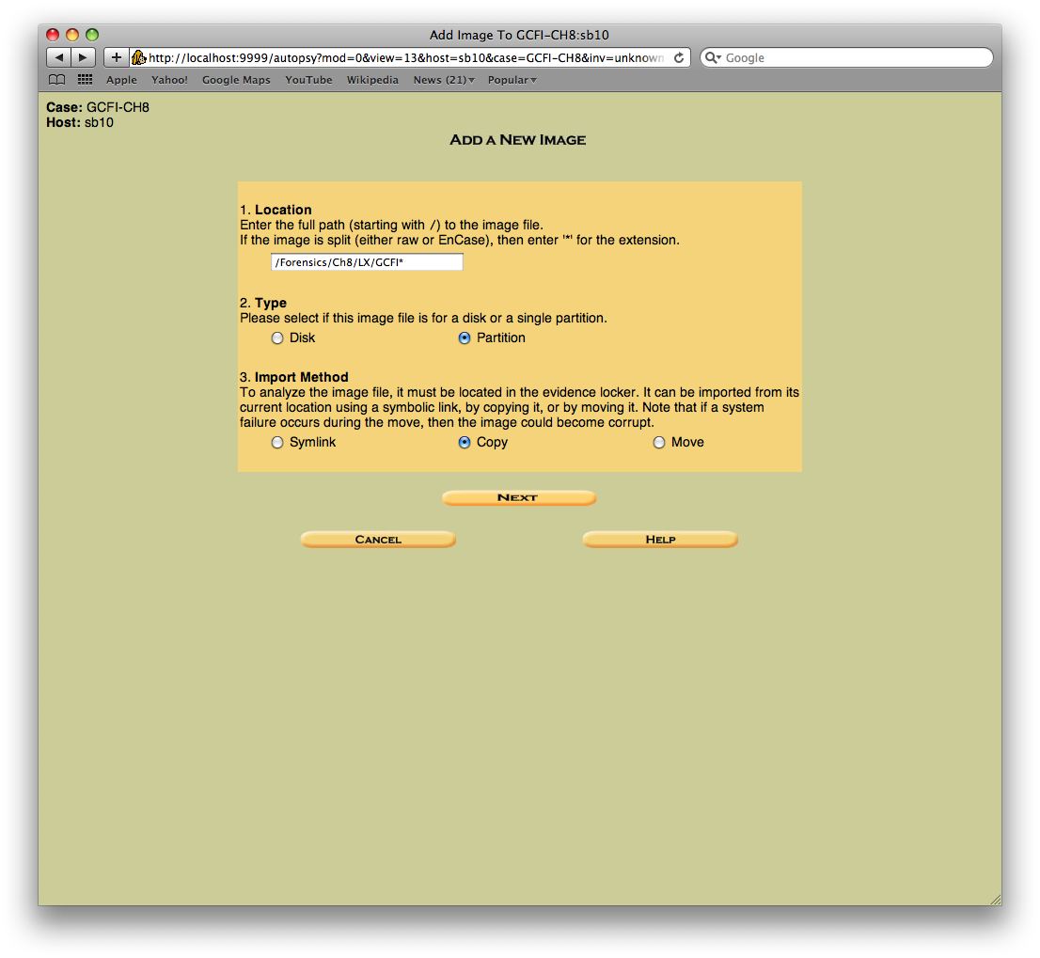
Adding a New Image
CaSe SeNsItIvE
Location: /Forensics/CH8/
LX/GCFI*
(entries are case sensitive)
Type: Partiton
Import Method: Copy
click Next

Slide 12
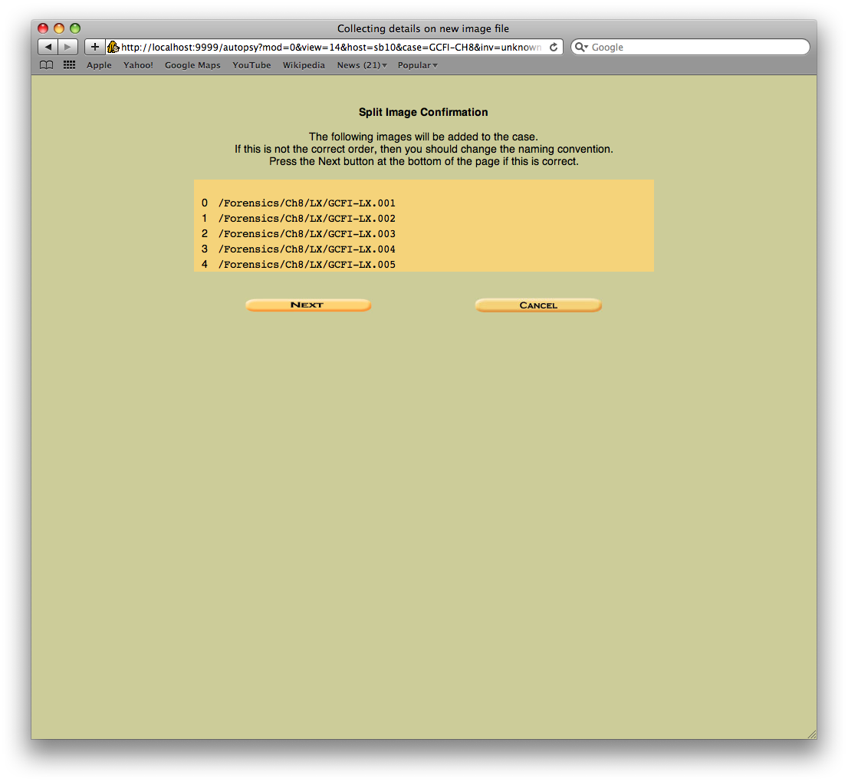
Adding a New Image
Make sure the image files are in the correct order
Click next

Slide 13
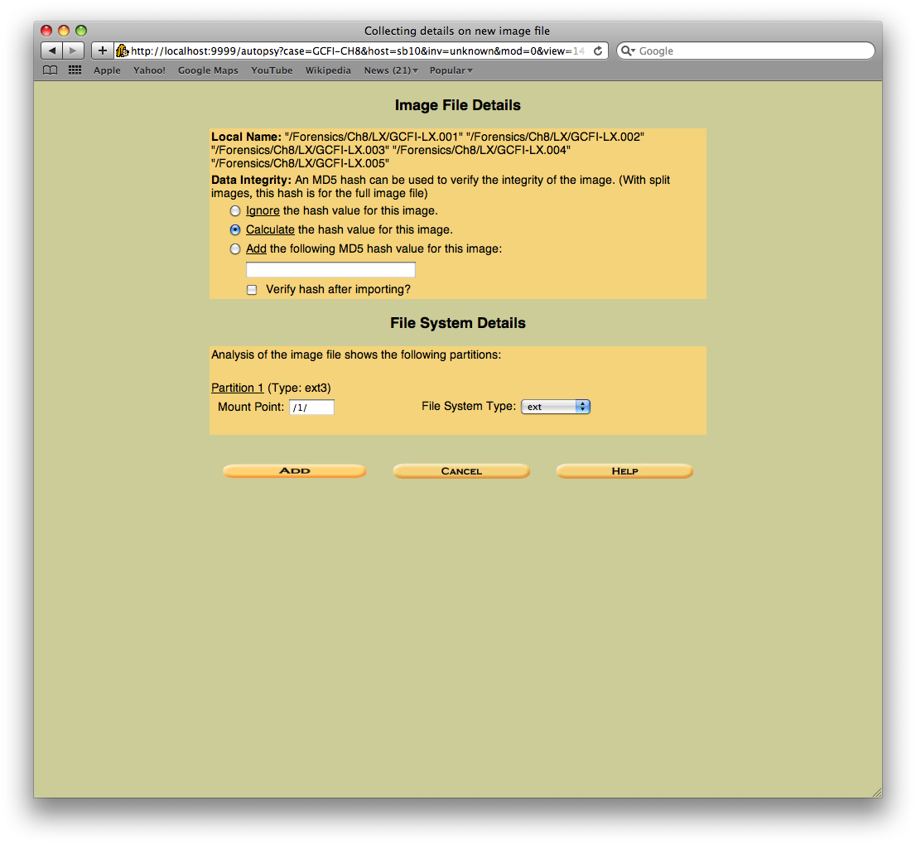
Calculating Hash Values
Click the Calculate the hash value for this image
Click Add
This will take a few minutes…so don’t keep clicking the Add button

Slide 14
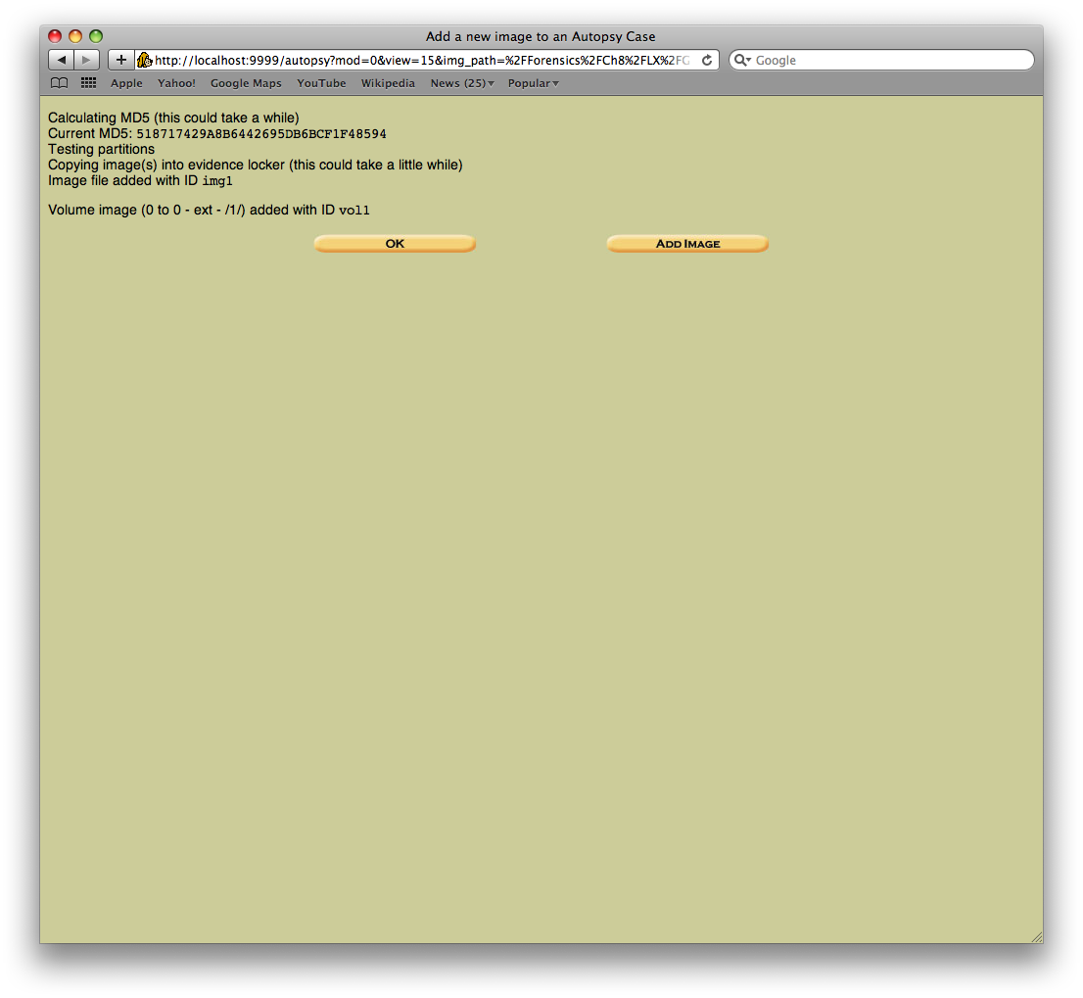
Adding a New Image
Notice the blue bar in the URL, this means it is calculating the hash value
Verify your hash value matches the value in the slide
After MD5 is calculated, click ok

Slide 15
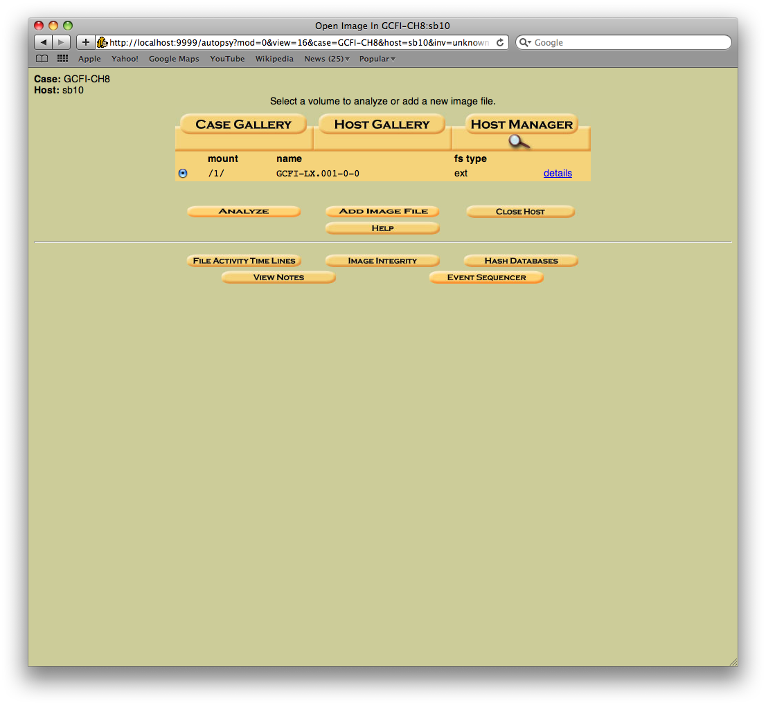
Analyzing the Image
Click Analyze

Slide 16
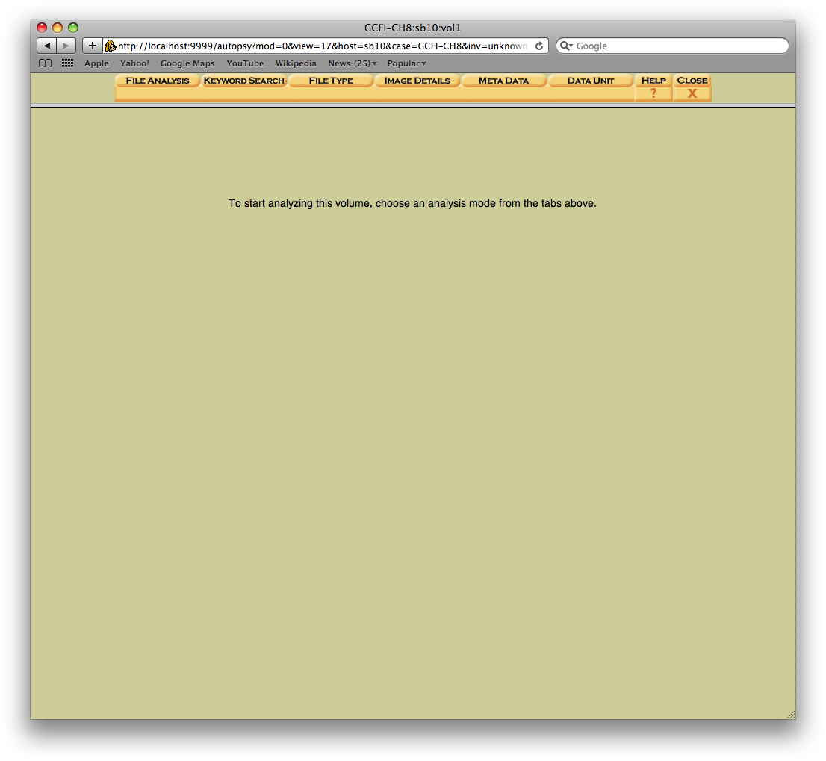
Keyword Search
Click on Keyword search

Slide 17
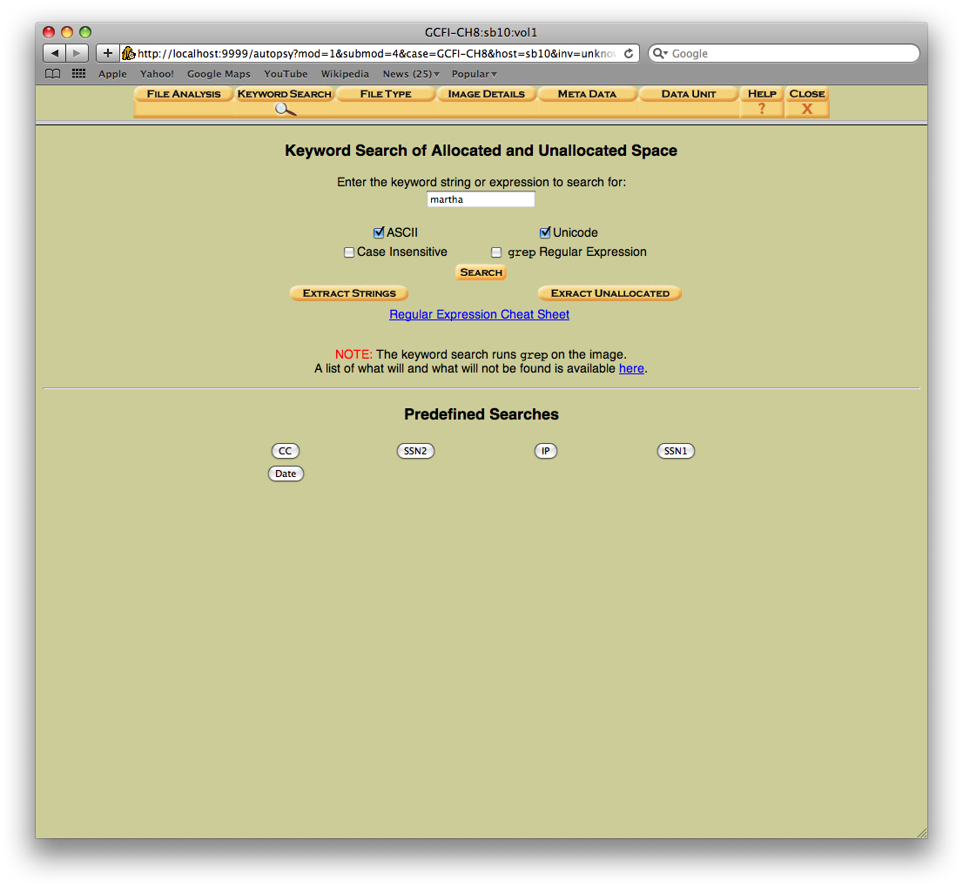
Keywords
Note the Magnifying glass under key word search. This is where you currently are
Type “martha” in the search box
Click Search
You will not see a status so be patient and don’t mash buttons

Slide 18
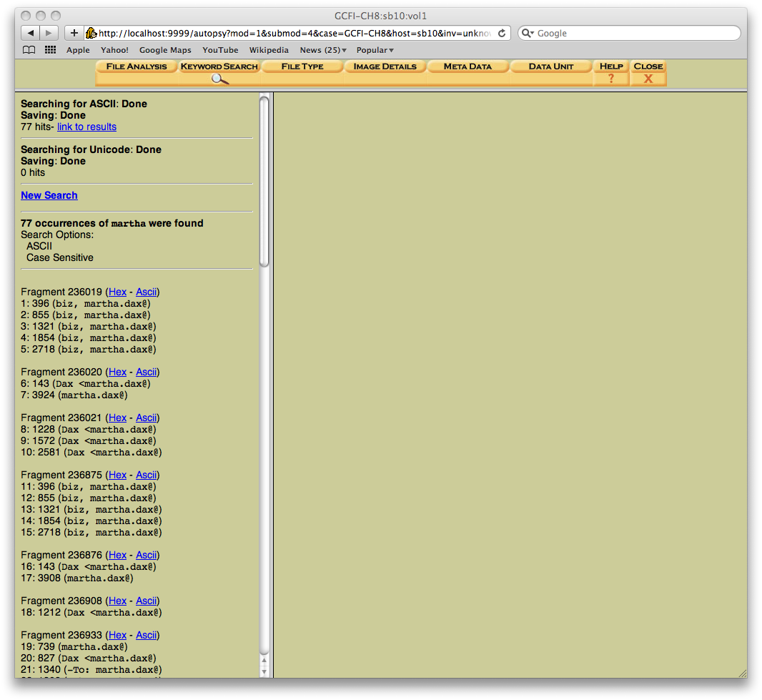
Keyword Search
If case sensitive was selected typing “Martha” or “martha” would give you different results
This search takes about 6 minutes
Click link to results

Slide 19
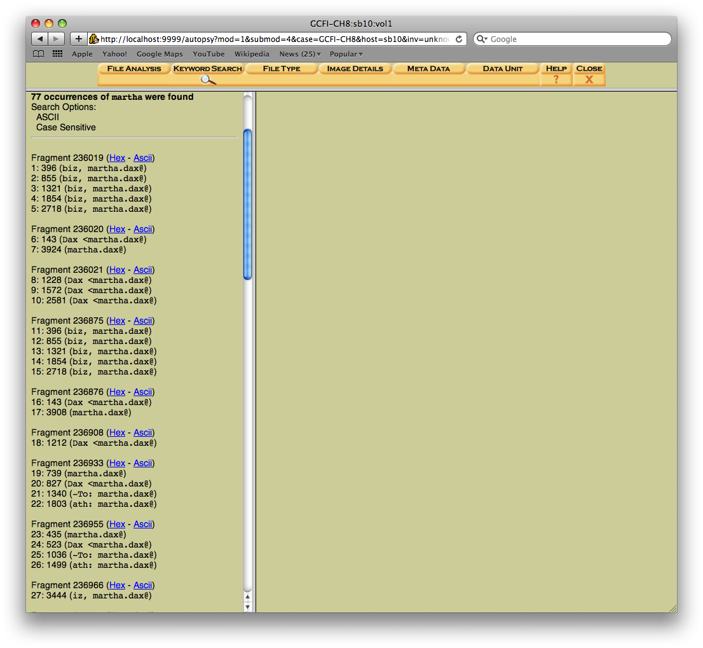
Viewing Keyword Search
Look for Fragment 236019, click on ASCII
Review other fragments using the “ASCII” & “Hex” links next to each fragment

Slide 20
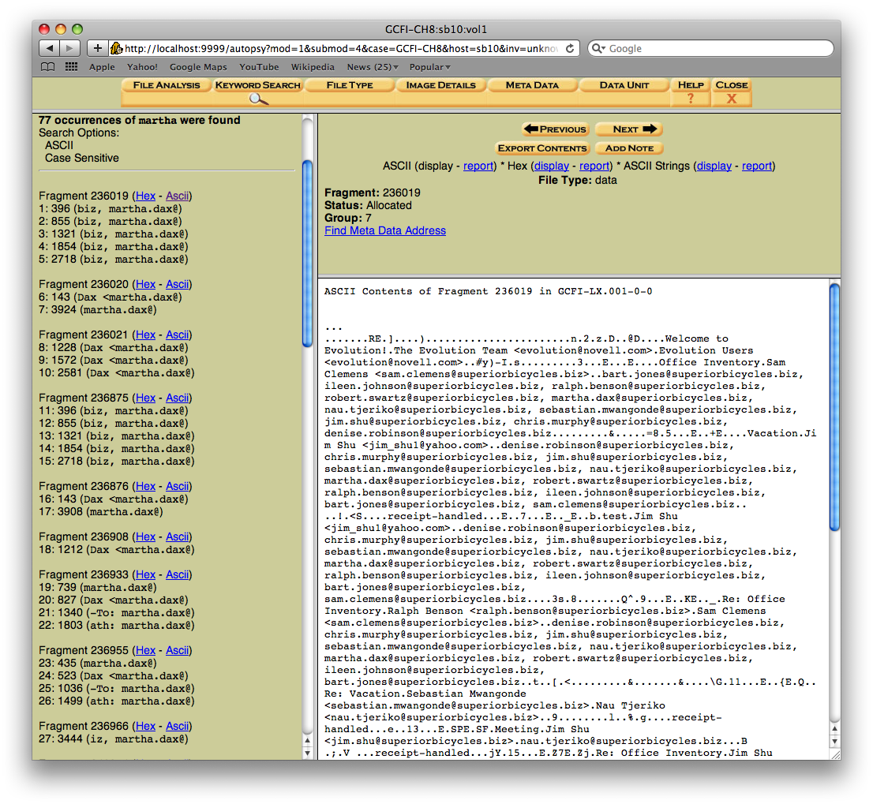
Viewing Keyword Search
Contents of a fragment can be exported for reports via clicking “Export contents”
Notes about each fragment can be taken by clicking the “Add Note”

Slide 21
Viewing Keyword Search
We now want to return to the Select a volume to analyze time lines
Click Close to navigate back

Slide 22
Timelines
Click File Activity Time Lines button

Slide 23
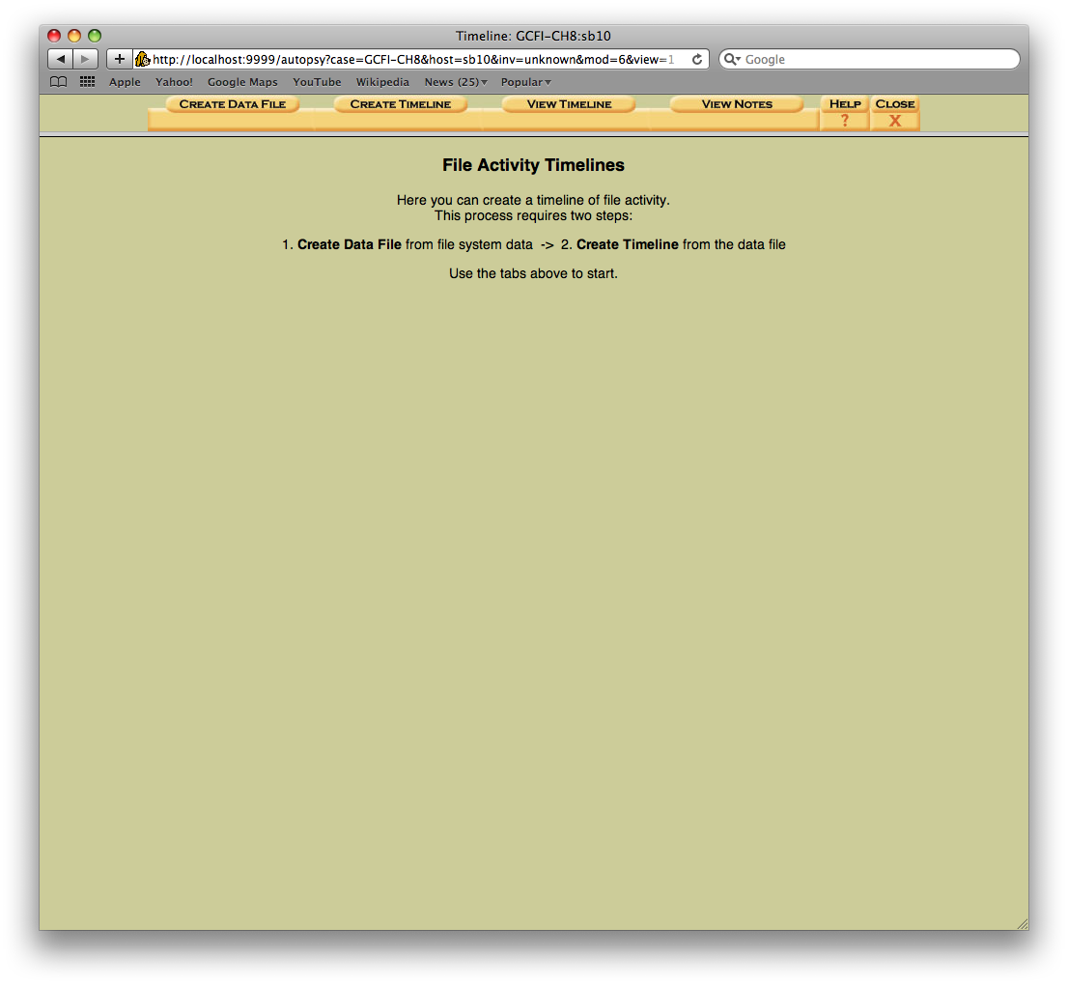
Creating a Data File
Click Create Data File

Slide 24
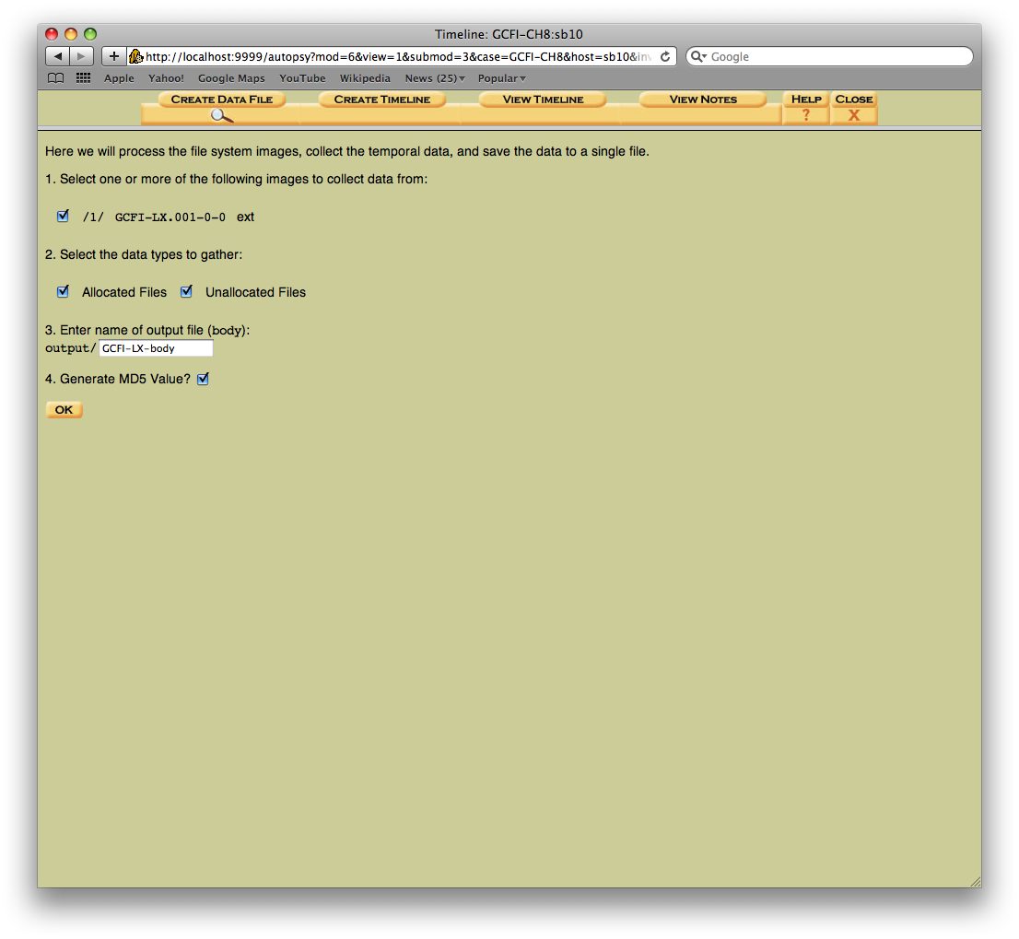
Creating a Data File
Select /1/ GCFI-LX.001-0-0
Type in GCFI-LX-body for the name of output file
Click OK
This will take about 30 seconds to complete

Slide 25
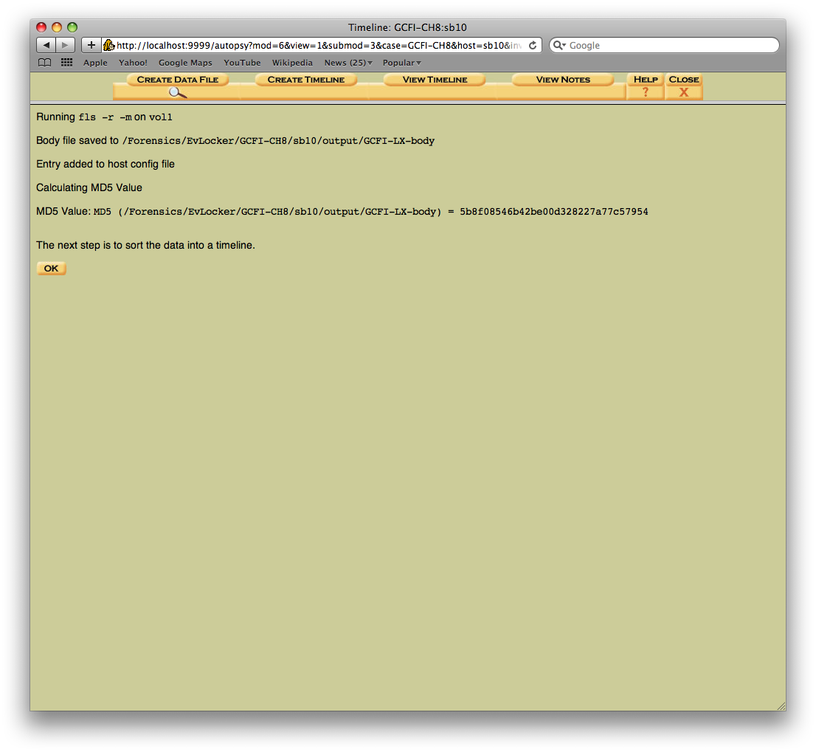
Creating a Data File
Click OK again

Slide 26
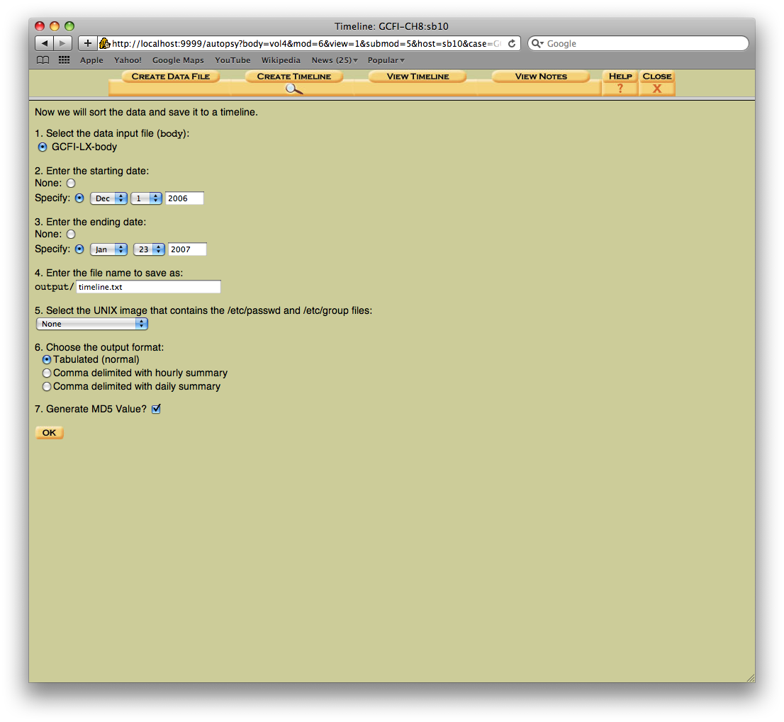
Creating a Timeline
Select GCFI-LX-body
For starting date click specify and select Dec 1, 2006
For ending date click specify and select Jan 23, 2007
Click OK

Slide 27
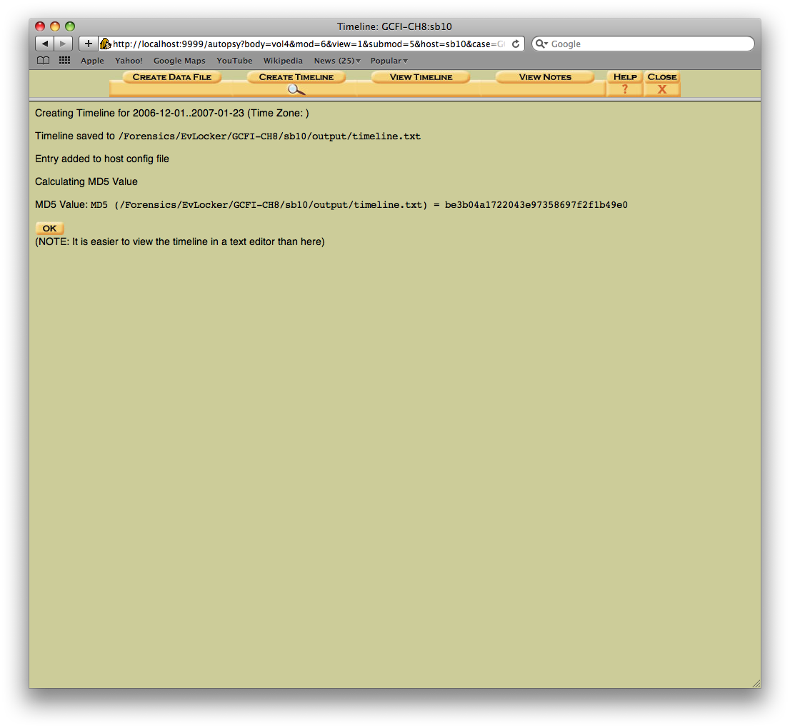
Creating a Timeline
The timeline will also take about 30 seconds to generate
When the timeline is complete click OK

Slide 28
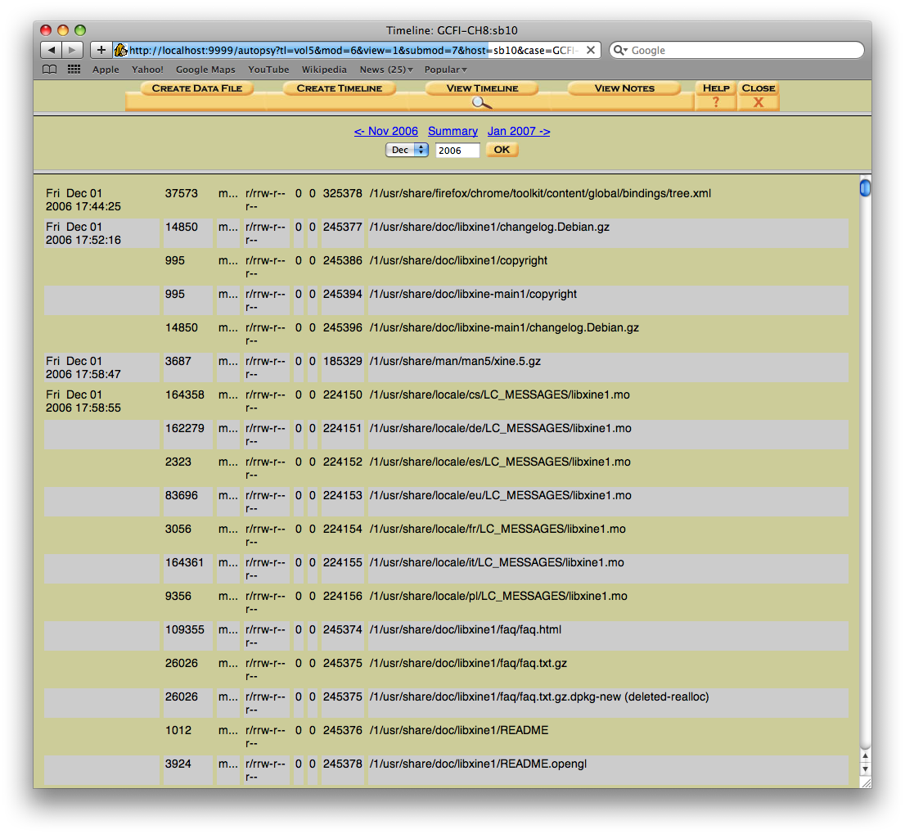
Viewing a Timeline
Use the navigation buttons under the menus to select the dates to view
You can also navigate to the text file by opening CIS POD, Forensics, EvLocker, GCFI-CH8, sb10, output and selecting timeline.txt

Slide 29
Closing Sleuth Kit
Click the red x in the upper left corner of the browser
Click inside the Terminal window and use ‘ctrl -c’ to exit the process
You can then click the red x in the upper left corner to close Terminal

