Slide 1
Sit Down in Teams of 2
Each team has their own:
Laptop computer
LEGO NXT robot
USB cable
Light paper on the table to test the robot
Notes:
1
1

Slide 2

Bottle Robo Sumo
with Lego NXT & RobotC
Summer 2012
Dr. Chris Cartwright
Co-Developed by Dr. CJ Chung and Dr. Kurt Meister
Lawrence Technological University

Slide 3
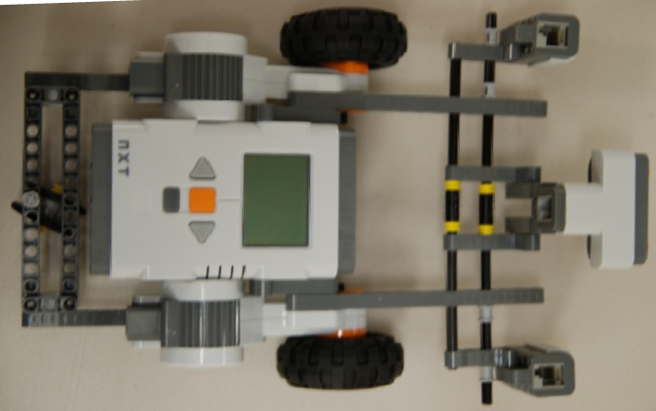
LEGO NXT is an Autonomous robot
Left Motor with Rotation Sensor
Left Light Sensor
Computer
Sonar Sensor
Right Motor with Rotation Sensor
Right Light Sensor
Notes:
3
3

Slide 4
First Program
Your first task is to make the robot
Go forward on the light paper
Until it gets to the edge of the paper
And Stop
Notes:
4
4

Slide 5
How does the robot know it is at the edge of the paper?
Light sensors (which are pointed down)
Turn on a red light
Tell the computer how bright a light they are seeing reflected back
Function of the color of the surface and how far the surface is from the light sensors
Notes:
5
5

Slide 6
Let’s Try It!
Open the program Go.c
Connect your robot to the laptop
Turn on the robot
Notes:
6
6

Slide 7
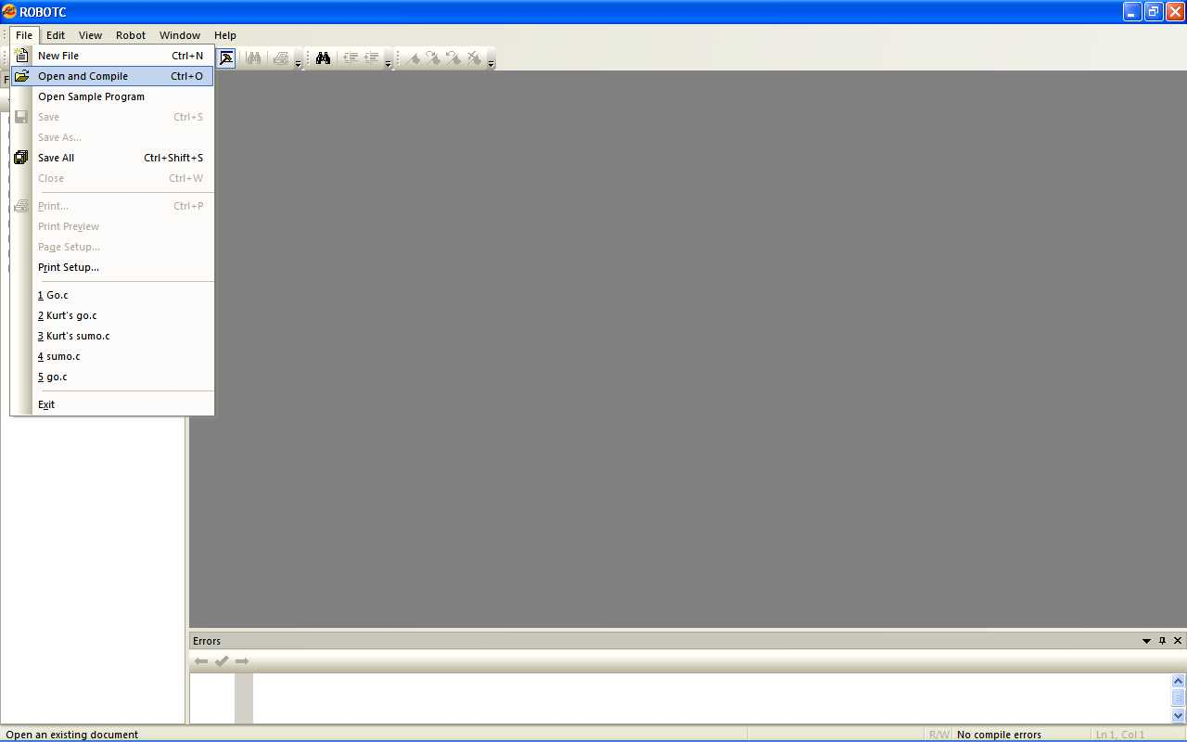
Open a Program
Notes:
7

Slide 8
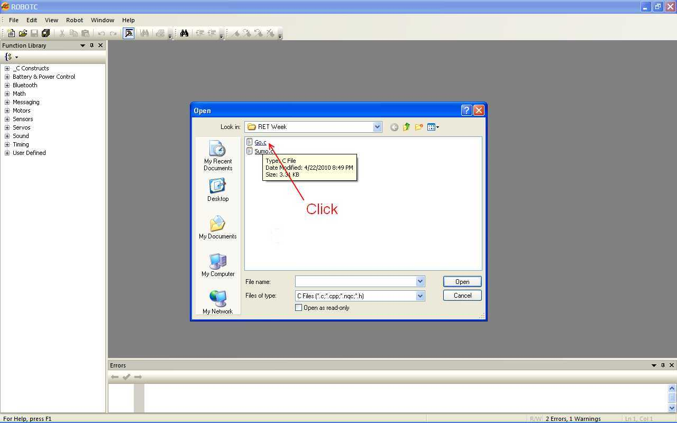
Open Go.c
Notes:
8

Slide 9
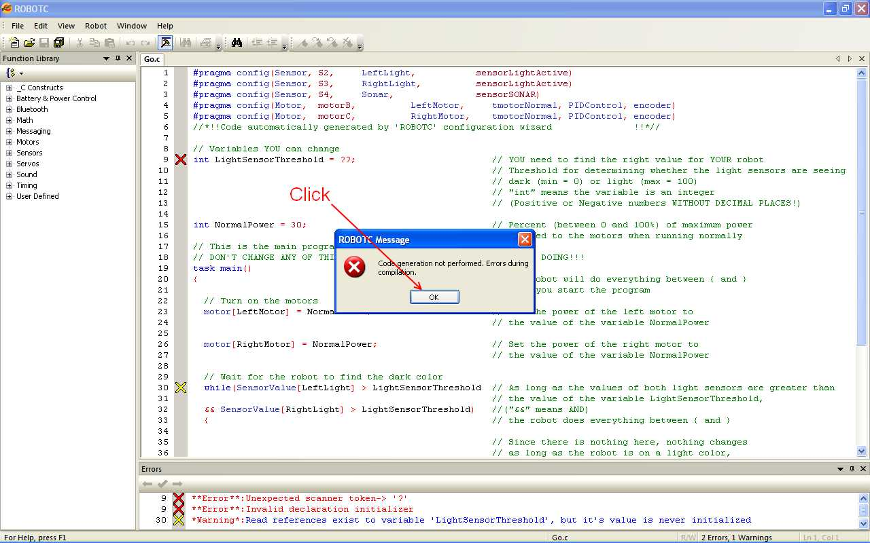
Ignore the Error Message
Notes:
9

Slide 10
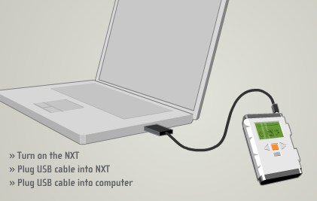
How to Connect Your Robot to Your Laptop
Notes:
10
10

Slide 11
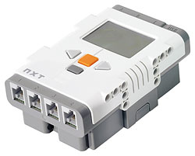
NXT Computer
Switch programs
Turn on and ENTER
Emergency Stop, BACK and turn off
Notes:
11
11

Slide 12
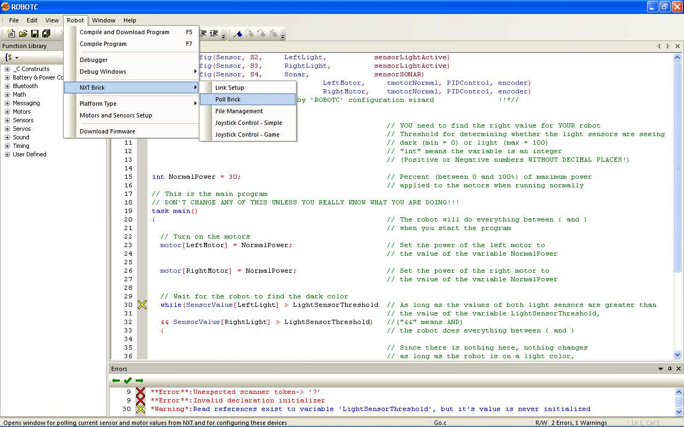
Poll the Robot’s Sensors
Notes:
12

Slide 13
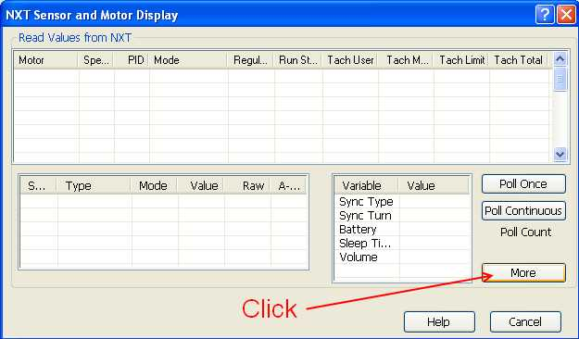
View More Information
Notes:
13

Slide 14
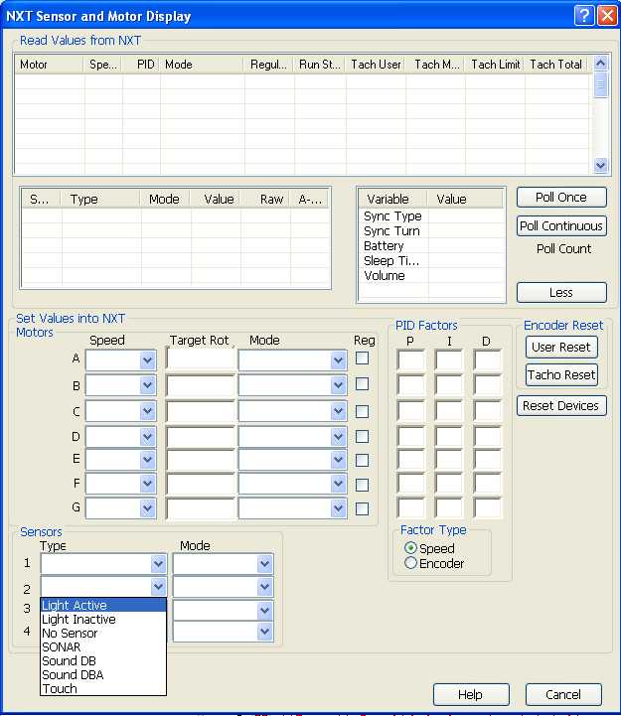
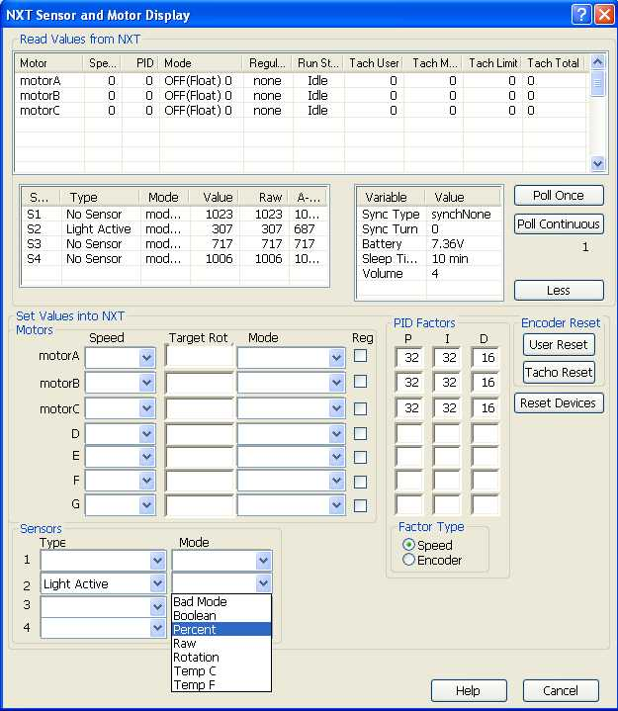
Setting Up the Light Sensors
Do the same thing for Sensor 3
Notes:
14

Slide 15
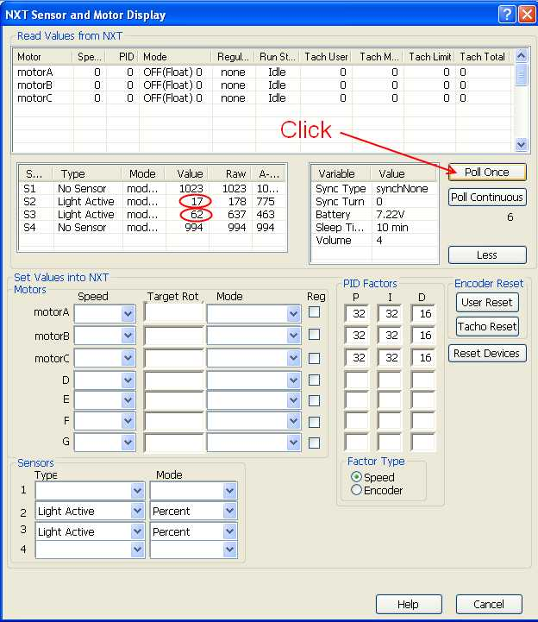
Let’s See What the Robot Sees
Put one light sensor over the light paper
Put the other light sensor over the edge of the table
Notes:
15

Slide 16
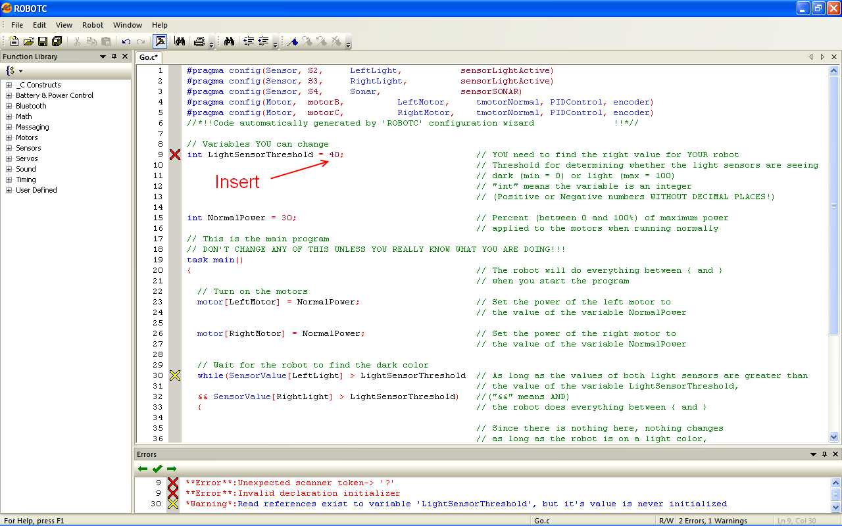
Use the Midpoint of Those Values to Decide What is Light and Dark
Insert the midpoint in Line 9 where the question marks are
Notes:
16

Slide 17
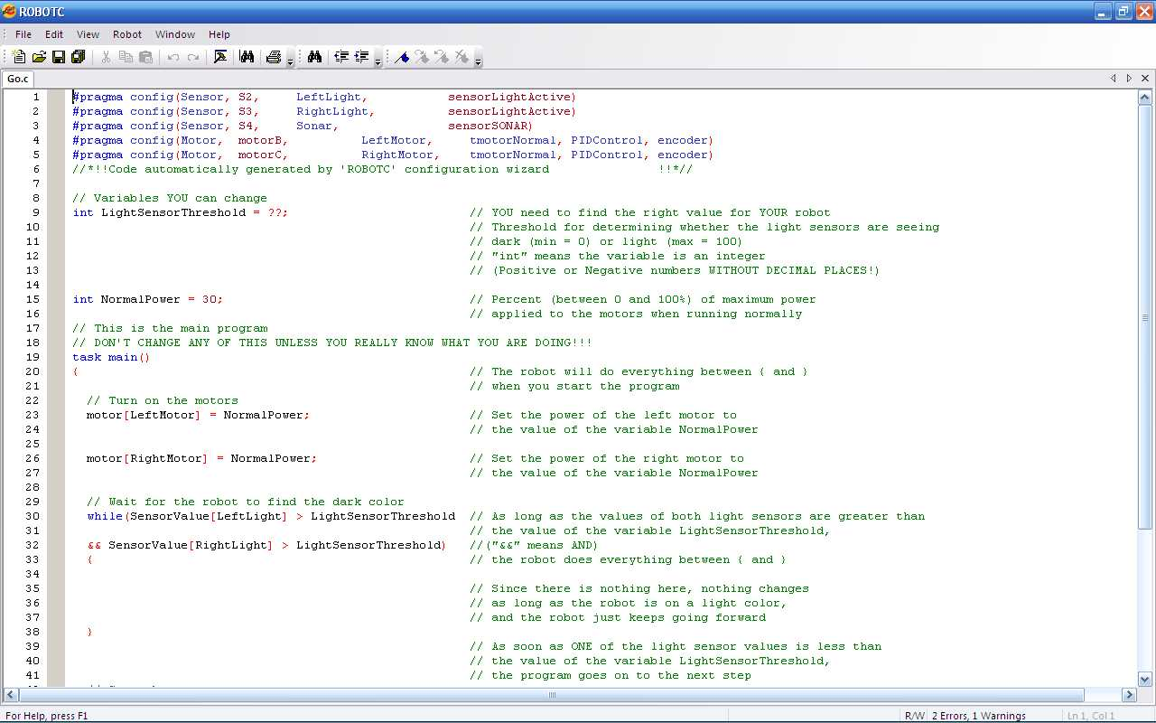
Let’s See What the Program Does
Notes:
17
Switch to ROBOTC and explain the program
17

Slide 18
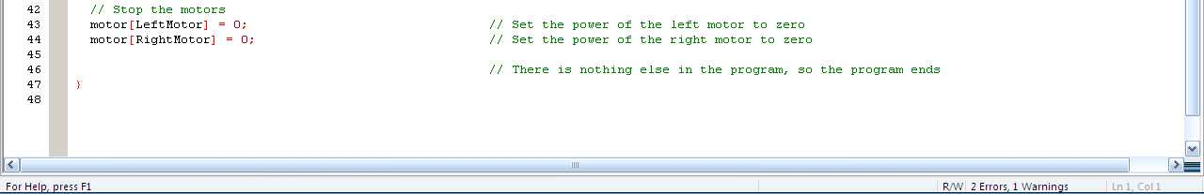

Slide 19
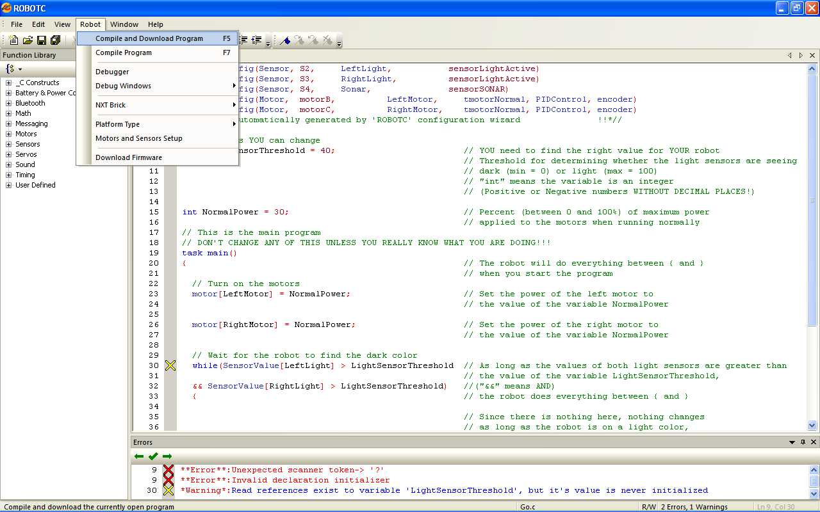
Download Go.c to the Robot
Notes:
19
Switch to ROBOTC and explain the program
19

Slide 20
Run the Program
Press the Orange Button 3 times
You should see Run on the display
Don't cheat and run the program from your laptop
Put the robot on the folder
Press the Orange Button one more time to run the program
Notes:
20

Slide 21
Did Your Robot Stop at the Edge?
If so, GREAT
Try adjusting the variable NormalPower and see what happens
If not,
Try running the program again while Polling the Brick CONTINUOUSLY and adjust the values
Notes:
21

Slide 22
RoboSumo
Now, you are ready to play RoboSumo
Just like sumo
One robot has to push the other off the table
Without it going off the table
Notes:
22
22

Slide 23
How Does the Robot Know Where the Other Robots Are?
Just like a bat, the Sonar Sensor sends out sound waves
By measuring how long it takes for the sound waves to be reflected back
It knows how far away something is
It does NOT know what that “something” is
If YOU are the closest thing in front of the robot, it will find YOU!!!
Notes:
23
23

Slide 24
How Does the Robot Know Where the Edge of the Table Is?
We’ll use Light Sensors the same way we did to find the difference between the light paper and the dark table
Now, the robot is just looking for the difference between the light table and the dark edge
Much less light is reflected back past the edge of the table
Notes:
24
24

Slide 25
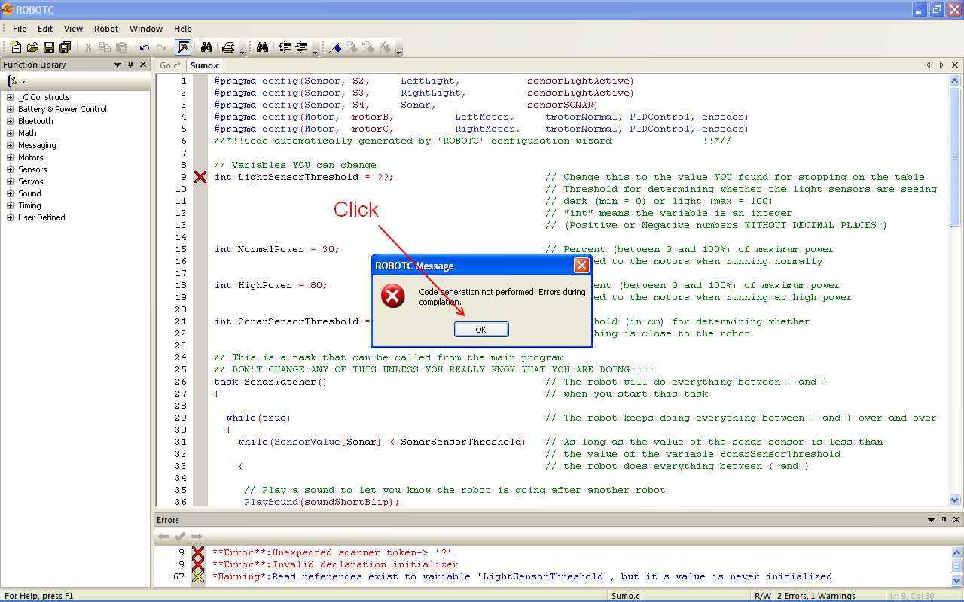
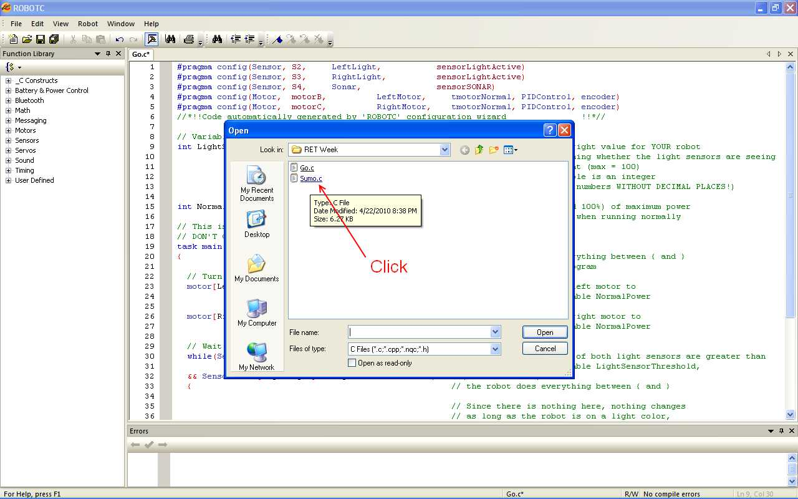
Open the Program Sumo.c
Notes:
25
25

Slide 26
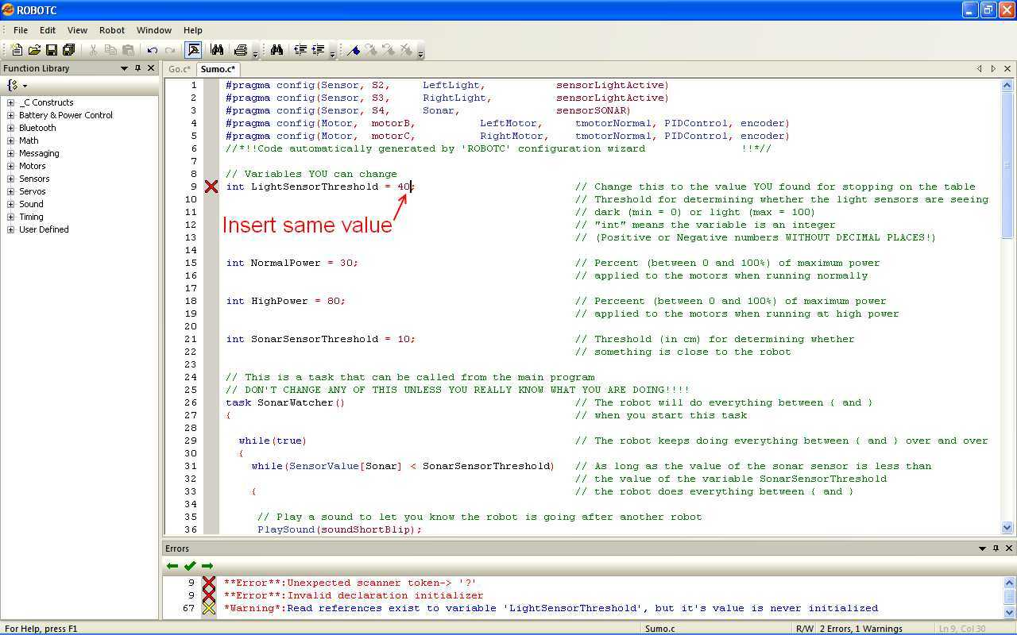
Change the LightSensorThreshold
Insert the same value for LightSensorThreshold you used for Go.c
Notes:
26

Slide 27
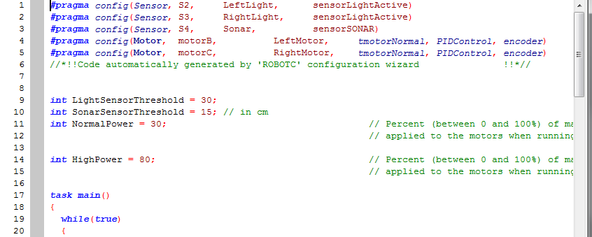
Let’s See What the Program Does
Notes:
27
Switch to ROBOTC and explain the program
27

Slide 28
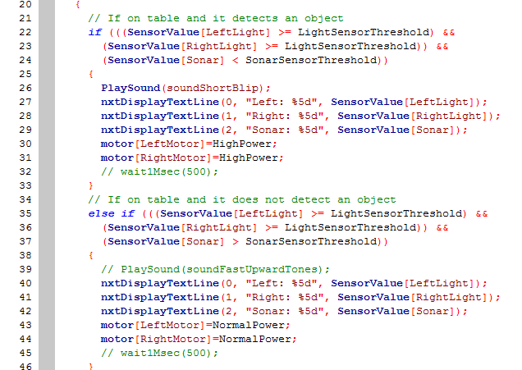

Slide 29
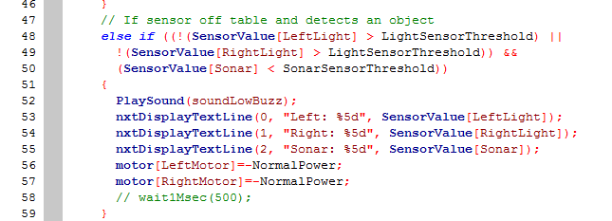

Slide 30
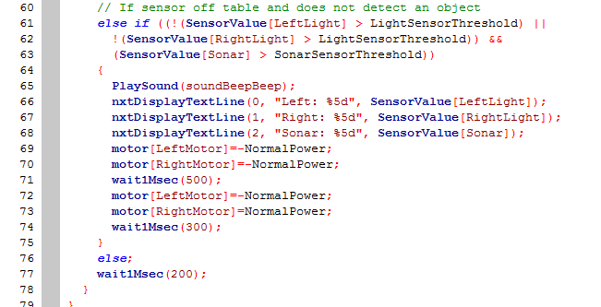

Slide 31
Other Variables to Adjust
If you’re daring, you can adjust some of the other variables
SonarSensorThreshold
NormalMotorPower
HighMotorPower
Notes:
31
31

Slide 32
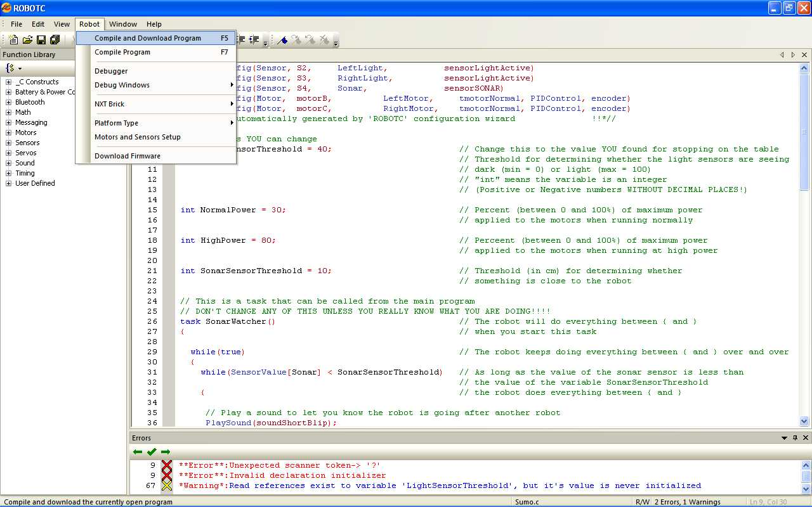
Download Sumo.c
Notes:
32
32

Slide 33
Mini Sumo Competitions
If your team is ready to compete, bring your robot to the sumo tables
The display on your NXT should show sumo.c
When I say “go”, press the orange button to run your program
If we have time, the last surviving robot from each table will have a final match
Notes:
33
33

Slide 34
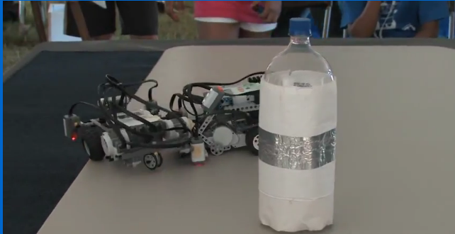
Bottle Robo Sumo
The goal is to be the first robot to find the bottle and push it off the table OR
Have your robot push the opponent off the table

Slide 35
Necessary Strategy for bottle sumo
Instead of just moving forward, how could we have the robot search for the bottle (or an opponent)?

Slide 36
Finding Objects using Sonar Sensor
The Ultrasonic sensor uses sound waves to locate objects and determine how far they are from the robot, just like a bat!
However, it sees things in a wide angle, just like your eyes
Its “field of vision” is about 45 degrees to either side
That means it “sees” things that are not directly in front of the robot

Slide 37
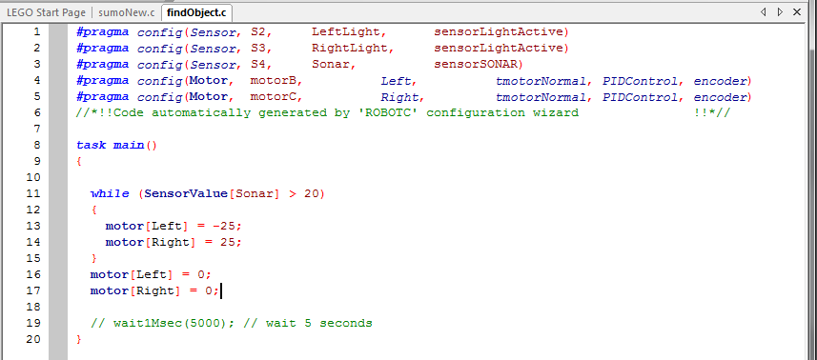
FindObject.c

Slide 38
Problems?
Did the robot find YOU instead of the bottle?
Did the robot spin too far (slow down the power)?
Did the robot stop too soon (remember field of vision)?

Slide 39
Some ideas to make a complete Bottle Robo Sumo program
Usually the bottle will be located in front of the robots as shown below:
Start with left x degree spin-search and right 2x degree spin-search, where x is less than 90 degrees
Whenever, it backs up, do the similar spin-search
B
R1
R2

Slide 40
Bottle Robo Sumo Opportunities
US Open in Nov 2012
Robot Olympic in South Korea, Dec 2012
Robot Olympic in Colorado, USA, Dec 2013
…

Slide 41
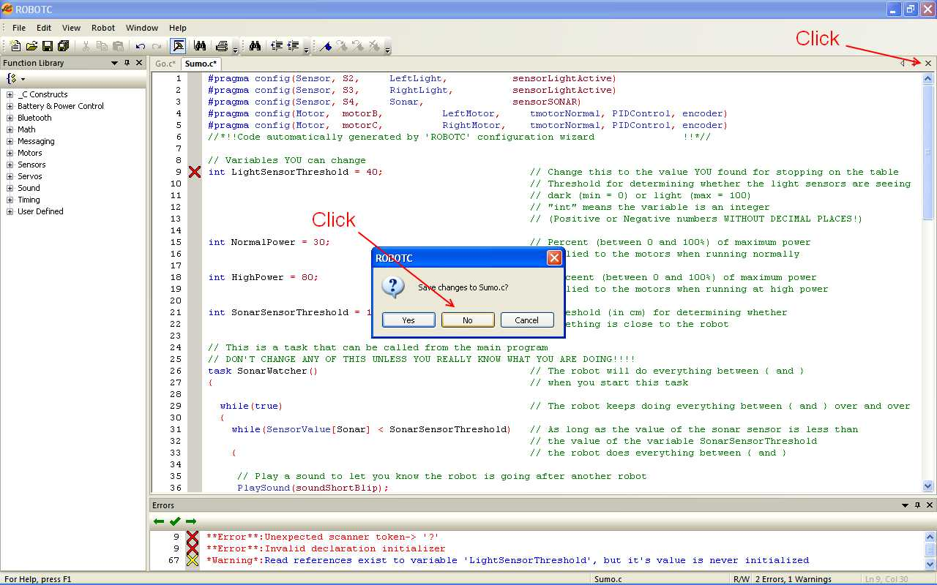
Assistants Will Close Your Programs
Close Go.c, Sumo.c, FindObject.c
Do NOT save changes
Notes:
41
41

Slide 42
Between Groups
Make sure correct NXT is matched with laptop
Check the battery level on the NXTs
Replace the battery pack if less than ½ charged
Put the old battery pack on the charger
Make sure students didn't save programs
If so, open copy and save as
Help the students assemble in teams of 2
Notes:
42

