Slide 1
RIPE 66
Dublin, 13th – 17th May

Slide 2

Celebrating 15 years: 1997 - 2012

Slide 3
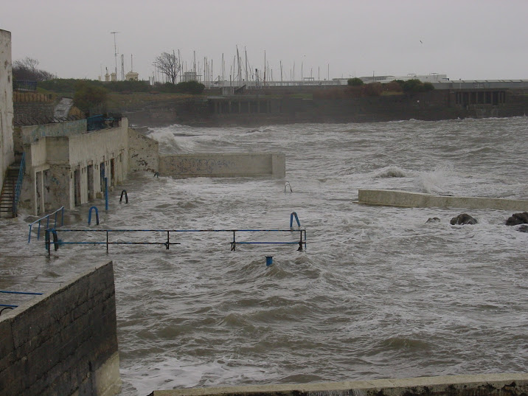

Slide 4
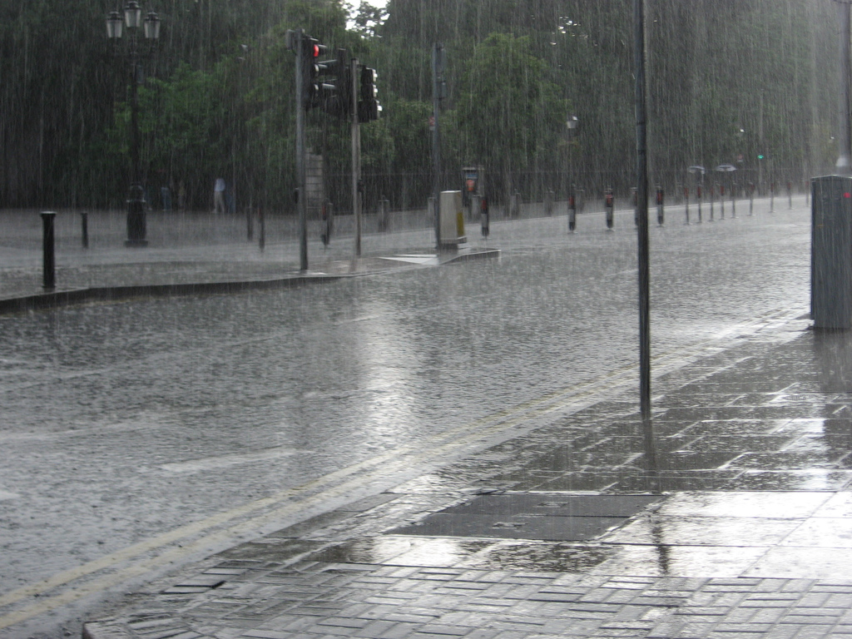

Slide 5
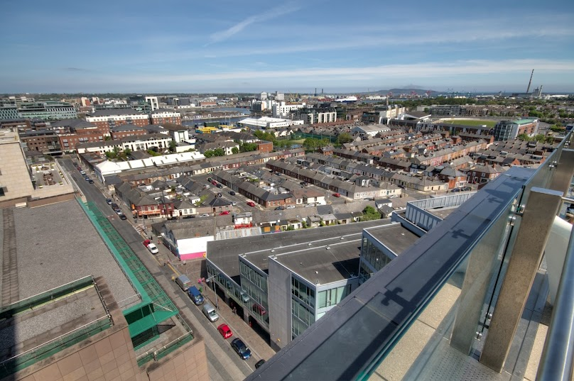

Slide 6
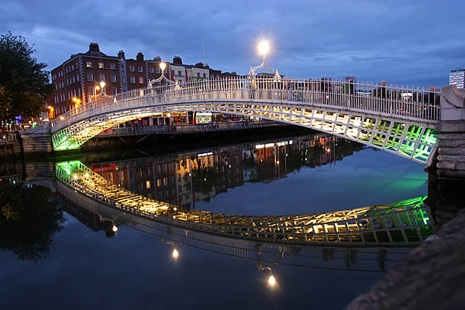

Slide 7
Céad Míle Fáilte!
(You bring the IP Addresses, we’ll bring the beer.)

