Slide 1
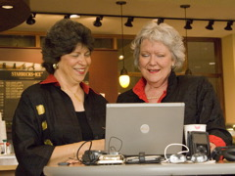
SKYPE: Using it outside of school & during the school day
Dr. Barrie Jo Price
And
Dr. Anna C. McFadden

Slide 2

www.emTech.net
Barrie Jo Price, bjprice@ches.ua.edu SKYPE: barrie.jo.price
Anna McFadden, amcfadde@emTech.net SKYPE: amcfadde

Slide 3
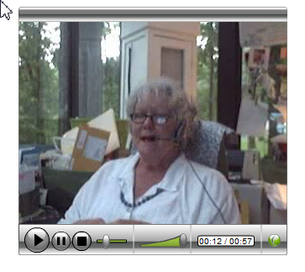
SKYPE: VoIP
What is SKYPE?

Slide 4



PERSONAL SKYPE

Slide 5
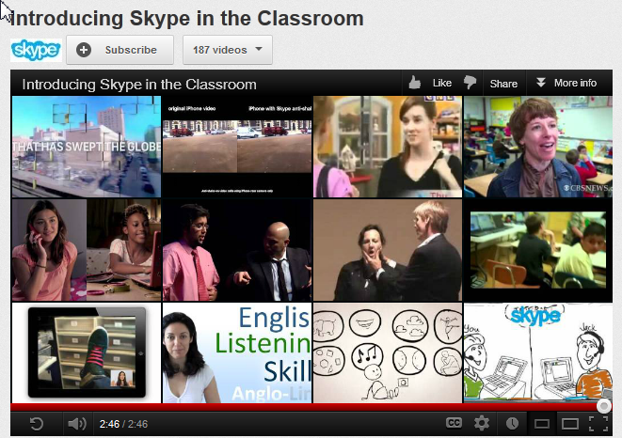
SKYPE in TEACHING & LEARNING

Slide 6
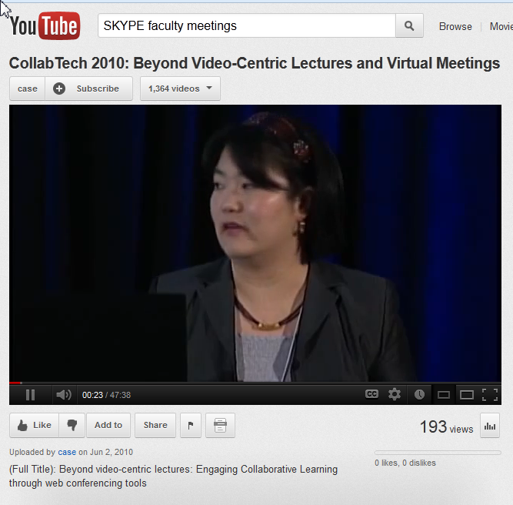
This is a 47 minute video at a 2010 conference on engaging collaborative learning: Collaborative Technology 2010 – Beyond Video-centric Lectures and Virtual Meetings - http://www.youtube.com/watch?v=JaKYHLf-zAw

Slide 7
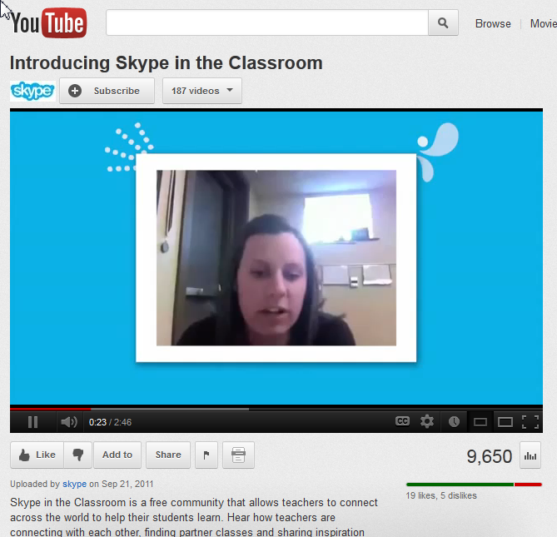
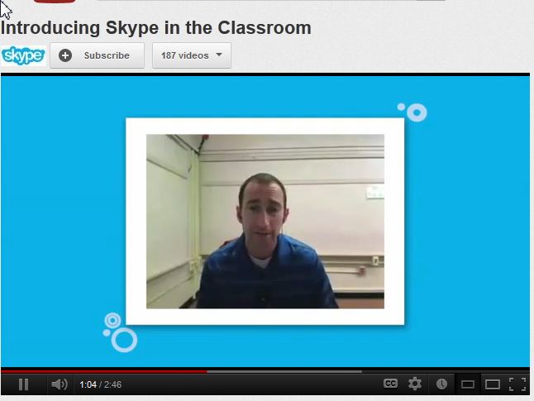
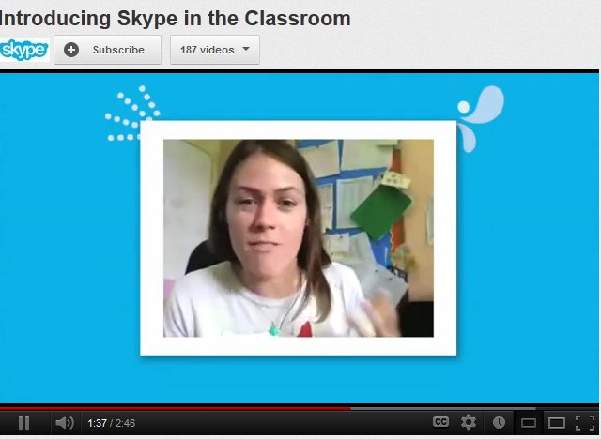
SKYPE in TEACHING AND LEARNING

Slide 8


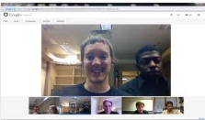
SKYPE for Meetings

Slide 9
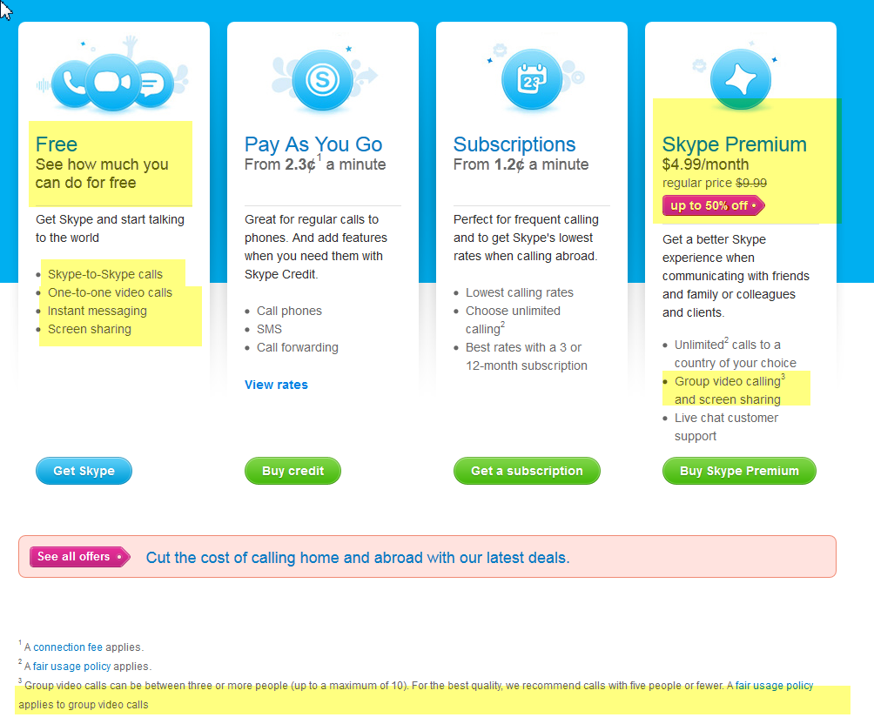

Slide 10
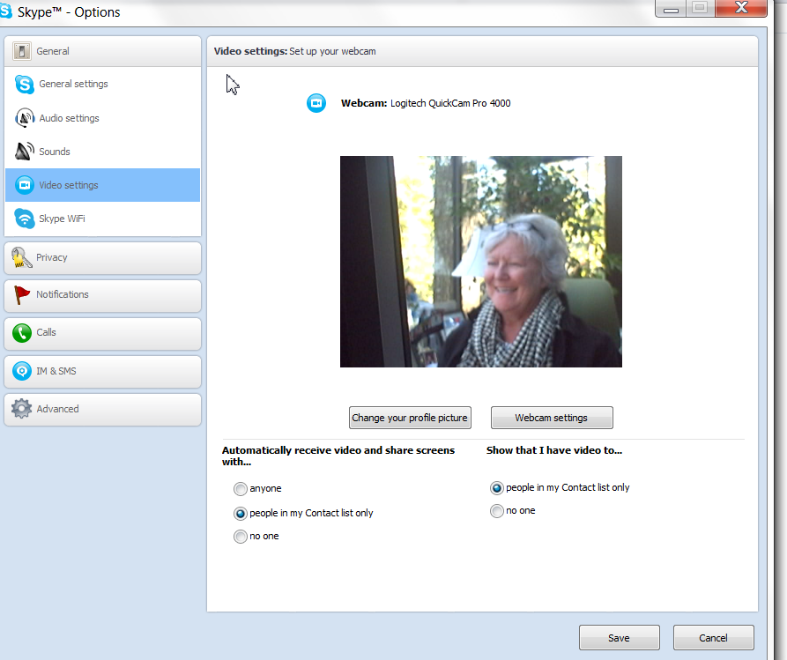
SKYPE
Meeting tools
Chat feature & WORD
Voice Recorder Apps

Slide 11
SKYPE & STUDENTS
Homework
Meet in groups & record
Turn in recording (mp3) and transcript
Collaborations
Interviews
Language Instruction
Position Papers, White Papers

Slide 12
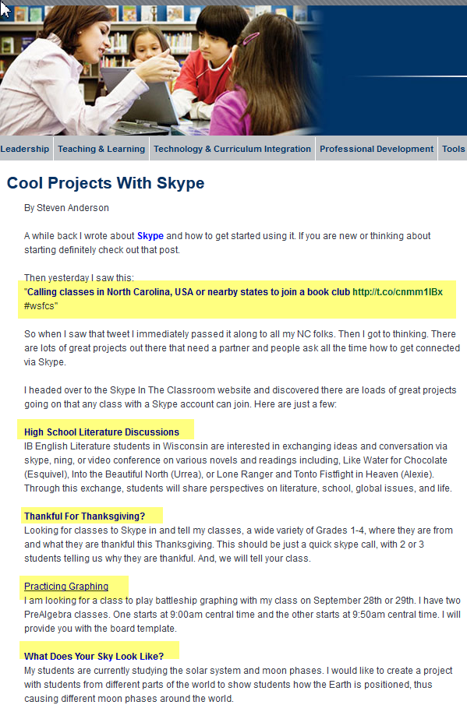

From
http://www.guide2digitallearning.com/tools_technologies/cool_projects_skype

Slide 13
SKYPE Outside of School
Virtual Advising (Penn State, for example)
http://dus.psu.edu/mentor/2011/12/skype-students/
Students at Home Ill
http://schoolsofthought.blogs.cnn.com/2012/10/23/homebound-student-learns-via-skype/

Slide 14
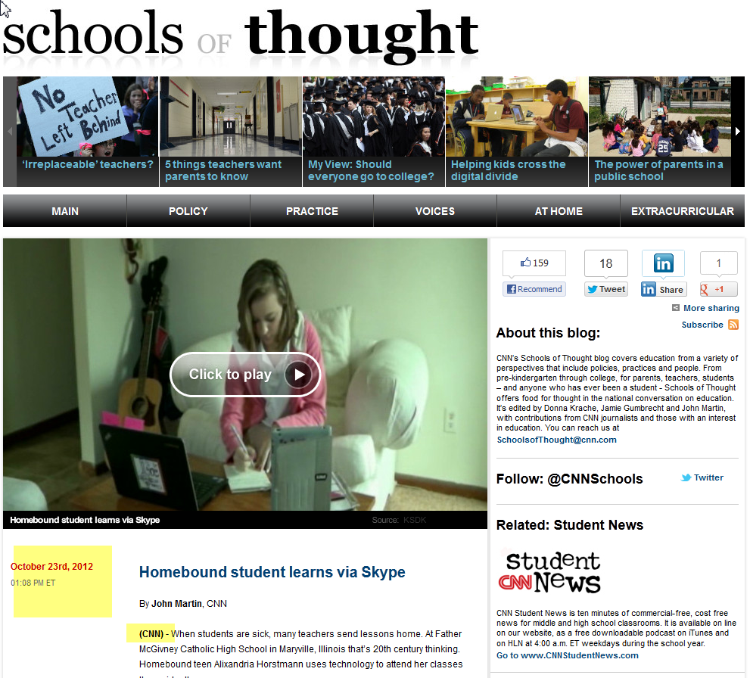

Slide 15
SKYPE
Inside or outside of school
Teachers or students
Professional activities or instructional activities
Tools and skills already exist within the population of students and, typically, teachers

Slide 17
www.emTech.net
Barrie Jo Price, bjprice@ches.ua.edu SKYPE: barrie.jo.price
Anna McFadden, amcfadde@emTech.net SKYPE: amcfadde

