Slide 1


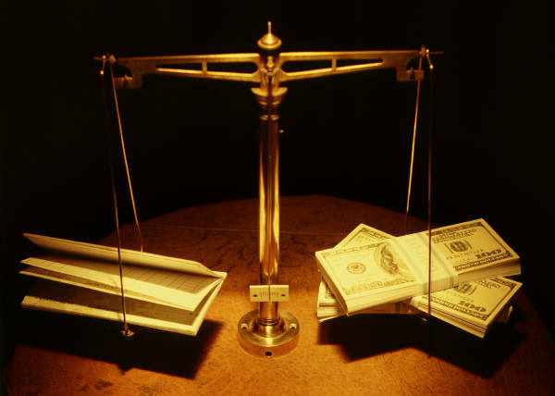
A Webinar on:
An Introduction to Ethics in Meteorology
Presenter:
Gerald J. Mulvey, Ph.D.,
CCM #571
Research
Government
Commercial
Legal

Slide 2


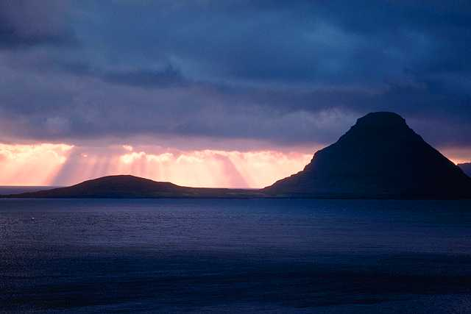
Agenda
Purpose
Background
Ethics in Meteorological Academia & Research
Ethics in Government Meteorology
Ethics in Commercial Meteorology
Ethics in Forensic Meteorology
Summary
References

Slide 3
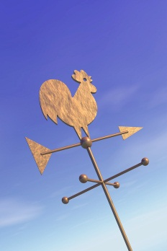
Background
Purpose: Introduce Meteorologists to ethical principles common to:
American Meteorological Society (AMS)
Weather Modification Association (WMA)
National Council of Industrial Meteorologists (NCIM)
National Weather Association (NWA)
Weather impacts the lives of people around the globe, in work and play, in health and safety, in commerce and industry, and in finance and law . With such a wide spread and intimate impacts the practitioners of meteorology daily face a significant challenge to conduct their affairs with high ethical standards.

Slide 4
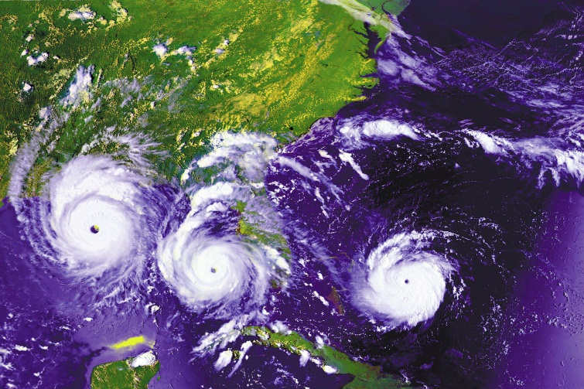
Common Elements
Fair representation of capabilities
Accurate representation of the “state-of-the-science”
Provision of fair value for compensation
Forum for addressing discrepancies in representation or conduct for meteorologists

Slide 5
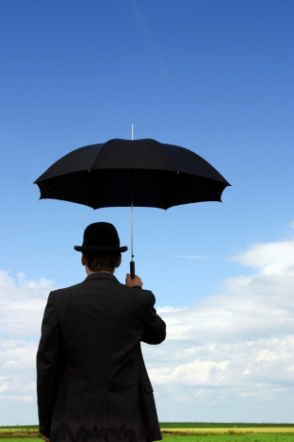
Cross Comparison Of Ethical Principals
Ethical Element | AMS | NCIM | WMA | NWA
Credentials | Certificate holders | X | Certificate holders | Seal holders
State of science | X | X | X | Seal holders
Capabilities | Certificate holders | X | X | Seal holders
Written Standards | X | X | X | X
Sanction Mechanism |  |  | Certificate holders
Notes:
References:
American Meteorological Society Constitution (http://www.ametsoc.org/aboutams/organizationpdfs/constitution.pdf)
Weather Modification Association, Weather Modification Ethics & Standards (http://www.weathermodification.org/standards_ethics.php)
National Council of Industrial Meteorologist, Code of Ethics of The National Council of Industrial Meteorologist (http://www.ncim.org/pdfs/CODE_OF_ETHICS.pdf)
National Weather Association (http://www.nwas.org/seal/seal-proc-updated.pdf and http://www.nwas.org/bylaws.php)

Slide 6
Academia / Research: An example
10/15/2012
6
Research and Openness
A prestigious university has conducting research on climate change
They have compiled a unique data set from which they have drawn their conclusions which has impacted national and global politics
The university has received requests to release the data set for others to review. If they do this they will miss the opportunity to publish research
articles based on the data they have
meticulously compiles and quality controlled
Notes:
Approximately 1000 e-mails from the Climatic Research Unit (CRU) of the University of East Anglia (UEA) were stolen and made public without authorization. The e-mails seemed to place in doubt the unbiased nature of the scientific opinion of a group of researchers at the University of East Anglia.
After an investigation of the implications of the e-mails by several panels, the scientists were cleared of manipulation of their data to support preconceived ideas on global warming. Independent reviews exonerated the CRU of specific allegations made against the rigor and honesty of CRU scientists. The independent review commissioned by the UEA did find that there had been a consistent pattern of failing to display the proper degree of openness, both on the part of the CRU scientists and on the part of the UEA, who failed to recognize not only the significance of statutory requirements but also the risk to the reputation of the University and, to the credibility of UK climate science. This report also describes multiple recommendations to prevent this kind of backlash from recurring.
References:
Climate change cover-up? You better believe it, 2009, D. Biello Nov 24, 2009 Observations, Scientific American Blog
The Year Climate Science was Redefined, 2010, M. Hulme, The Guardian, 16 November
British Panel Clears Scientists, 2010, J. Gillis, The New York Times, July 7
Scientists Respond to Climategate E-Mail Controversy, 2009 D. Biello, Scientific American, December 4
What East Anglia’s E-Mail Really Tell Us about Climate Change, 2009, P. Kelemen, Popular Mechanics, December 18
The Independent Climate Change E-mails Review, July 2010, Muir Russell, Geoffrey Boulton, Peter Clarke, David Eyton and James Norton, Commissioned by University of East Anglia, p 160. (Available at: http://www.cce-review.org/pdf/FINAL%20REPORT.pdf)
6

Slide 7

Academia / Research: An example
An Approach
In a publish or perish academic world letting others access your data before all publication options are exhausted could mean lost recognition
While scientific courtesy usually allows the developer/collector of data first access to the data and publication of results, release of data for peer and general review should be done in a timely fashion
Withholding data from public review allows others to criticize researcher’s results and their data as unsubstantiated or bogus
10/15/2012
7
Questions
Is it fair that others publish articles based on their data before they have covered all the publication options?
Doesn’t the scientific method rely on independent data review and duplication of experiments to validate conclusions?
How could the data be released?
Notes:
Climatic Research Unit (CRU) of the University of East Anglia (UEA) was engaged in climate change research. They published a report describing the results of their analysis but did not make the data available. Approximately 1000 e-mails from the Climatic Research Unit were stolen and made public without authorization. The e-mails seemed to place in doubt the unbiased nature of the scientific opinion of a group of researchers at the University of East Anglia.
After an investigation of the implications of the e-mails by several panels, the scientists were cleared of manipulation of their data to support preconceived ideas on global warming. Independent reviews exonerated the CRU of specific allegations made against the rigor and honesty of CRU scientists. The independent review commissioned by the UEA did find that there had been a consistent pattern of failing to display the proper degree of openness, both on the part of the CRU scientists and on the part of the UEA, who failed to recognize not only the significance of statutory requirements but also the risk to the reputation of the University and, to the credibility of UK climate science. This report also describes multiple recommendations to prevent this kind of backlash from recurring. . Several recommendations among them were:
A recognition that challenges to scientific work can be based on non-traditional methods offering false conclusions and alternative hypotheses for peer review and publication. The “blogosphere” and non traditional scientific dialogue provides an opportunity for unmoderated comment to stand alongside peer reviewed publications; for presentations or lectures at learned conferences to be challenged without inhibition; and for highly personalized critiques of individuals and their work to be promulgated without hindrance.
The existence of the “blogosphere” demands openness and access to data. A failure to recognize this and to act appropriately, can lead to immense reputational damage by feeding allegations of cover up.
All scientists must learn to communicate their work in ways that the public can access and understand.
The impact of this incident was a strengthening of mistrust of scientists and their conclusions. Despite the independent assessments (see: references) and reports of the media (Guardian, Scientific American, The New York Times, and Popular Mechanics) clearing the researchers of data manipulation, the damage was already done (see: references) and opponents of the conclusions of the study used the controversy to cast doubt on the veracity of the report. The publication of the e-mails weeks before the 15th Conference of the Parties in Copenhagen (U.N. summit on global warming) was politically explosive.
References:
Climate change cover-up? You better believe it, 2009, D. Biello Nov 24, 2009 Observations, Scientific American Blog
The Year Climate Science was Redefined, 2010, M. Hulme, The Guardian, 16 November
British Panel Clears Scientists, 2010, J. Gillis, The New York Times, July 7
Scientists Respond to Climategate E-Mail Controversy, 2009 D. Biello, Scientific American, December 4
What East Anglia’s E-Mail Really Tell Us about Climate Change, 2009, P. Kelemen, Popular Mechanics, December 18
The Independent Climate Change E-mails Review, July 2010, Muir Russell, Geoffrey Boulton, Peter Clarke, David Eyton and James Norton, Commissioned by University of East Anglia, p 160. (Available at: http://www.cce-review.org/pdf/FINAL%20REPORT.pdf)
7

Slide 8
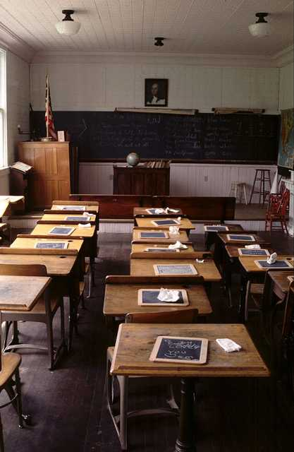
Academia / Research
Ethical Challenges:
Use of valid data
Providing access for open reviews
Assigning credit for work to the performers
Encouraging scientific debate of theories and interpretations while avoiding personal attacks

Slide 9

Academia / Research
Ethical Challenges:
Use of valid data
Is the data good enough ? (publications, next grant pressures)
Providing access for open reviews
Decision to release the data
Assigning credit for work to the performers
Who contributed and who did not
Encouraging scientific debate of theories and interpretations while avoiding personal attacks
Science is a process of ongoing challenge and testing of theories

Slide 10
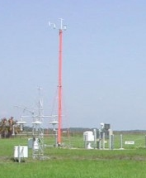
Government: An example
Since the installer is looking for people and you are looking for a new opportunity you are thinking about approaching them about the possibility of working for them on the analysis contract
10/15/2012
10
Influence and Employment
You are a manager for a contract with the a fast growing company to install meteorological instrumentation.
There is a potential contract to analyze the data, but you are not in line to manage it.
It is towards the end of the contract and you are doing the evaluation of the installer

Slide 11

Government: An example
10/15/2012
11
Questions
How would your supervisor view exploring job opportunities with the company?
How would it influence your evaluation of their performance on the existing contract?
Would this be legal?
An Approach
Back away from any interaction with the company about job opportunities
If you really want to work the data analysis project, you need to distance yourself from the company and the government for at least a year. A better option would be not to seek employment with that company
You risk your reputation, current job and potential legal action
Notes:
This case was actual occurred a Commerce Department Employee conflict of interest with updating automated weather forecasting systems. The employee was tasked to review the performance of a company, which had contracted with the Commerce Department to update automated weather forecasting systems. He was found guilty of have been negotiating for a position with that same company while reviewing their performance. (Federal criminal statute, 18 U.S.C. 208) (ref. 7). Here the employees’ creditability for a fair performance assessment was seriously questioned and he was in fact convicted of a Federal crime.
The meteorological instrumentation industry and the number of organizations employing meteorologists in general are not very large. Job opportunities are limited because of this. Those in positions of responsibility for procurement and contract oversight must be sensitive to the responsibilities of their posts. Obligations of one’s current employment position may rule out pursuit of a new position even if it is the best suited for ones circumstance. Acknowledging these ethical obligations and acting accordingly will prevent suspicion, reproach, and potentially criminal investigation of ones actions. This action will benefit both the individual involved as well as the organizations.
Encyclopedia of Ethical Failure, (2007) Department of Defense, Office of General Counsel, Standards of Conduct Office,
September 2007
Update on Federal Criminal Conflict of Interest Statutes, (2006), E. Lazarus , Pass It On, Government and Public Sector Lawyers Division, American Bar Association, Spring 2006, Vol.15, No.3
11

Slide 12
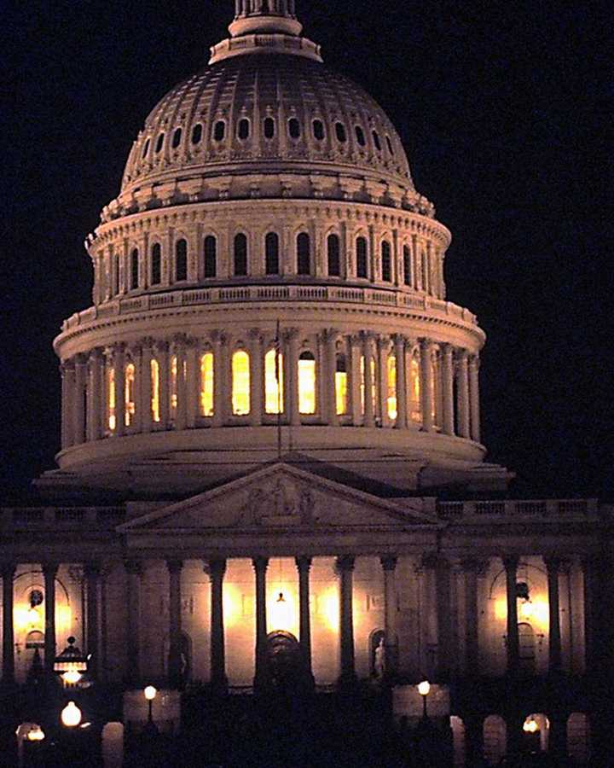
Government
Ethical Challenges:
Avoiding conflicts of interest
Providing unbiased scientific results in a timely manner
Placing the good of the “people” above personal or organizational credit

Slide 13
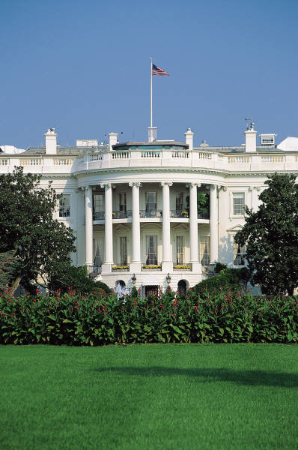
Government
Ethical Challenges:
Avoiding conflicts of interest
Personal friends and competitors how should they be treated?
Providing unbiased scientific results in a timely manner
Can the timing of the release of data or analysis influence credibility of results
Placing the good of the “people” above personal
or organizational credit
First obligation is the safety and welfare of the people

Slide 14
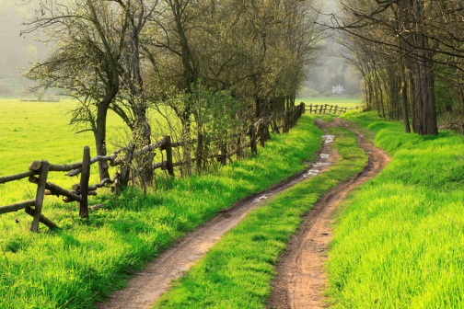
Commercial: An example
10/15/2012
14
Road Construction Project
Location foreign country with few Class A observation stations
National Military have additional stations, but do not seem inclined to release the data
Local university professor claims to have the military data
Professor will “process” the data for you under a research grant
What do you do?
Notes:
An example of one dilemma can be illustrated by the following case of the Roadway Construction Project.
You have been hired by an international engineering firm to provide the design team with localized climatological information on precipitation (type, rates, total storm amounts) and wind (speed and direction) along several potential road development corridors in a developing country. To get this consulting job you took an aggressive stance with price and need to finish your in-country wok as soon as possible. While the broad scale climatological data is available (major cities and airports) the local climatological data and recent local meteorological measurement data along the potential road corridors is available only at selective universities and through the military. You approached the Army Major in charge of the data collection and processing only to learn that the data you want while it has been collected and processed is considered sensitive due to the proximity of unnamed military facilities and thus not available to foreigners. You then approached the university professor in charge of collecting and processing similar data civil uses. You are told that this local data is only stored in a “raw” format. The professor suggests that he and his graduate student can process the data into a suitable format for you. They are very willing to give you a “proposal” to perform this work. As a bonus that imply they have a special relationship with the Army Major in charge of the military data collection and can also access this information for processing to format the data at a modest cost. The professor assures you that the “military” data is not sensitive and he can be easily sent to you when the processing is completed back to the U.S. via e-mail. What do you do?
Give a grant to the university professor to “process” the civil data and extrapolate it to the full extent of the corridors.
Provide additional funding to the university professor to recover the “military” data.
Negotiate with the Army Major to acquire the military data so the full extent of the roadway corridor is covered.
Report to the Engineering firm the data along the full extent of the corridors cannot be obtained but you will use best practices to extrapolate the required parameters.
Should you hire a local consultant to help clarify the legal status of the data and just what the Army Major said.
Summary
The question is trust. Can you really trust the university professor? Was the Army Major truthful or looking for a bribe? Is there any civilian and military data? Will any data you get be reliable or just extrapolations from major stations?
14

Slide 15
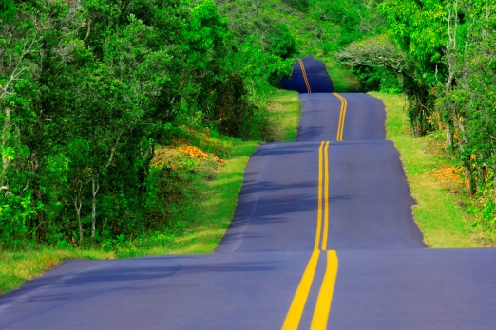
Commercial: An example
Questions:
Does the professor have that data and the right to release it?
Did you understand the military position correctly?
What will happen to the university professor?
An Approach:
Approach the military commander carefully to see if there was a misunderstanding
Don’t compromise the professor position.
Inform your client
Don’t utilize the professor unless the data is clearly “real” and is legitimately available for use
10/15/2012
15
Notes:
An example of one dilemma can be illustrated by the following case of the Roadway Construction Project.
You have been hired by an international engineering firm to provide the design team with localized climatological information on precipitation (type, rates, total storm amounts) and wind (speed and direction) along several potential road development corridors in a developing country. To get this consulting job you took an aggressive stance with price and need to finish your in-country wok as soon as possible. While the broad scale climatological data is available (major cities and airports) the local climatological data and recent local meteorological measurement data along the potential road corridors is available only at selective universities and through the military. You approached the Army Major in charge of the data collection and processing only to learn that the data you want while it has been collected and processed is considered sensitive due to the proximity of unnamed military facilities and thus not available to foreigners. You then approached the university professor in charge of collecting and processing similar data civil uses. You are told that this local data is only stored in a “raw” format. The professor suggests that he and his graduate student can process the data into a suitable format for you. They are very willing to give you a “proposal” to perform this work. As a bonus that imply they have a special relationship with the Army Major in charge of the military data collection and can also access this information for processing to format the data at a modest cost. The professor assures you that the “military” data is not sensitive and he can be easily sent to you when the processing is completed back to the U.S. via e-mail. What do you do?
Questions to ask yourself
Give a grant to the university professor to “process” the civil data and extrapolate it to the full extent of the corridors?
Provide additional funding to the university professor to recover the “military” data?
Negotiate with the Army Major to acquire the military data so the full extent of the roadway corridor is covered?
Report to the Engineering firm that the data along the full extent of the corridors cannot be obtained but you will use best practices to extrapolate the required parameters?
Should you hire a local consultant to help clarify the legal status of the data and just what the Army Major said?
Additional Questions
The question is trust. Can you really trust the university professor? Was the Army Major truthful or looking for a bribe? Is there any civilian and military data? Will any data you get be reliable or just extrapolations from major stations?
15

Slide 16
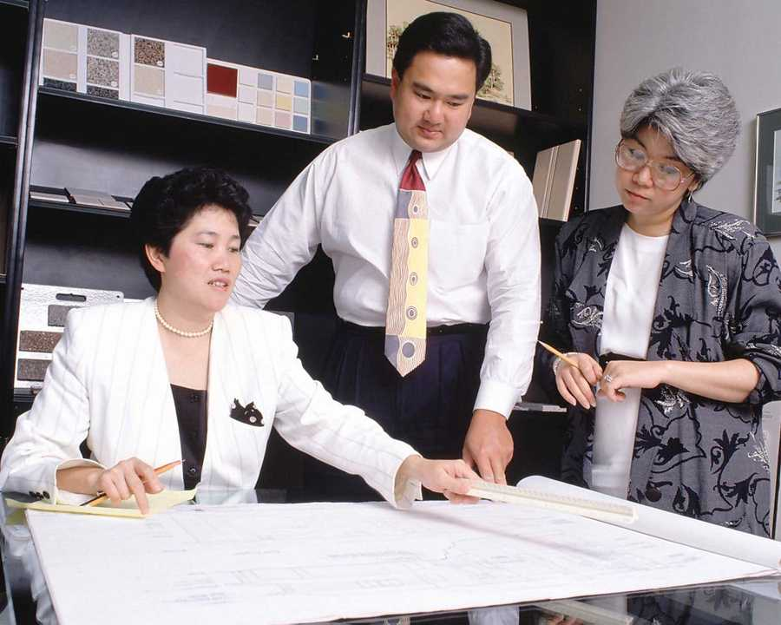
Commercial
Ethical Challenges:
Retaining proprietary secrets while advancing the science
Providing fair value for services
Utilizing established methodologies and identifying unproven ones
Accurate assessment of capabilities

Slide 17
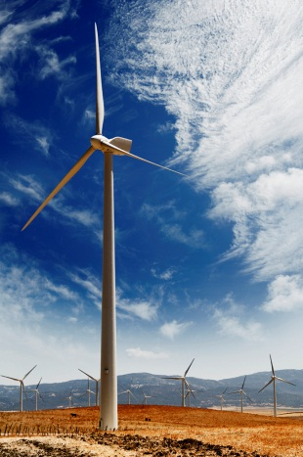
Commercial
Ethical Challenges:
Retaining proprietary secrets while advancing the science
A balance between advancing ones company goals and advancing the science. The release of private data and techniques to the scientific community
Providing fair value for services
Easy answers should not cost hard dollars only hard answers Valid charges and record keeping
Utilizing established methodologies and identifying unproven ones
Techniques that have not been validated and proven, provide only new questions. State of the science approaches
Accurate assessment of capabilities
Avoid overselling capabilities to make a sale can lead to broken contracts, waste, and poor future contract opportunities

Slide 18

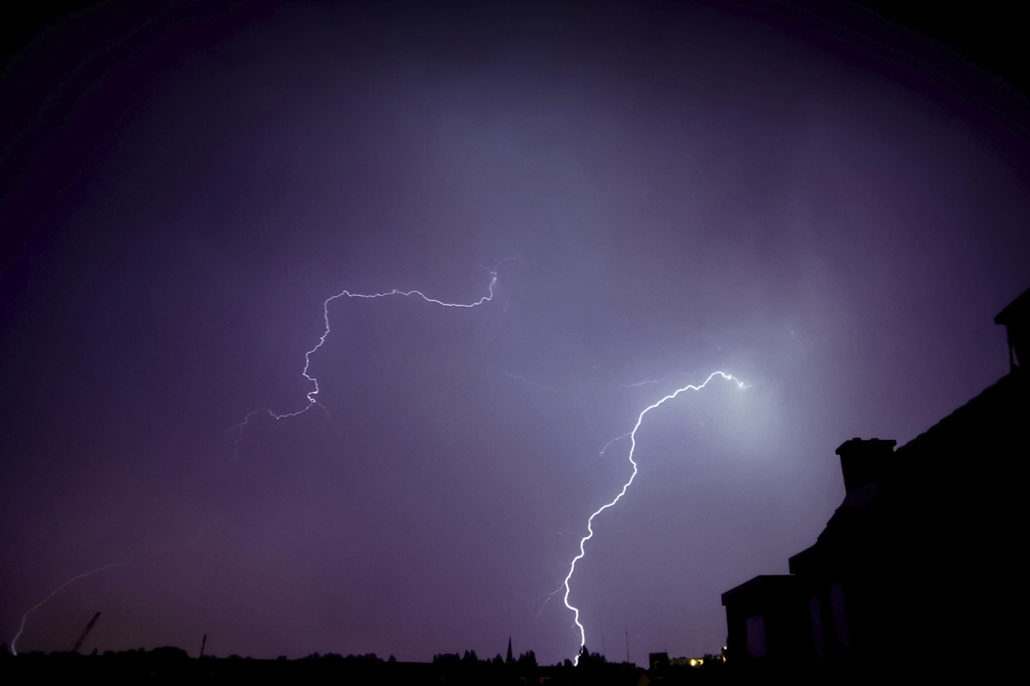

Forensic Meteorology: An example
High profile person is involved in a late night car accident in a rural area that occurred during a frontal passage and is being sued for damages
Radar data is spotty in the area of the accident and the nearest Class A weather station is 10 miles away
A near by weather enthusiast offers data from his personal weather system that has been operating for 5 years to help substantiate the rainfall during the period
10/15/2012
18
Notes:
High profile person is involved in a late night car accident in a rural area that occurred during a frontal passage and is being sued for damages. Because of their position the plaintiff's attorney is asking for a considerable sum of money. Thus, the client is willing to hire an expert (you) to defend his claim that the roadway was not wet and the plaintive was driving recklessly. The plaintive claims that the defendant was driving too fast for conditions and the roadway was covered in water and it was raining hard. Radar data is spotty in the area of the accident and the nearest Class A weather station is 10 miles.
A near by weather enthusiast offers data from his personal weather system that has been operating for 5 years to help substantiate the rainfall during the period.
The question here is do you really need the weather enthusiast data, and is it of any value. Uncontrolled data can be altered easily with no trace. The enthusiast could be a fan of the defendant or the plaintive and could alter the data to support either position.
There are many weather sites owned and operated by individuals who may or may not have any meteorological training. They may offer data for a variety of reasons.
You will need to explore the data and the station just in case the plaintiff's attorney brings it up. But it is basically unreliable unless there are special circumstances.
18

Slide 19
Forensic Meteorology: An example
Questions
What should you do?
Accept the data and use it to fill in for the lack of radar data and the data from distant observation station?
Rely on the official data?
An Approach
Gather all official data (radar, official observations, satellite data and eyewitness/police accounts)
Check for any special data collections (universities field projects, water districts, highway departments, agricultural observational sites, etc.)
Perform your analysis using standard techniques to estimate if it was raining and the rainfall rate
Alert your client to the availability and the difficulties of using it.
Additional considerations reliability of the weather enthusiast, representativeness of his site, personal motivations
10/15/2012
19

Slide 20
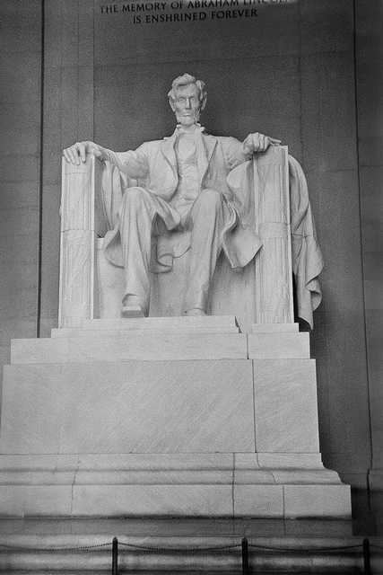
Forensic Meteorology
Ethical Challenges:
Accurate representation of personal capabilities
Accurate representation of “state of the science”
Utilization of quality data and proven techniques
Obligations to hiring attorneys

Slide 21

Forensic Meteorology
Ethical Challenges:
Accurate representation of personal capabilities
If you are an subject matter expert, state so, if you need to study up on a subject set reasonable expectations
Accurate representation of “state of the science”
Science has its limits. Setting expectations early can avoid embarrassment later
Utilization of quality data and proven techniques
Use standard techniques and quality data. Don’t give the opposing expert an opportunity to challenge your understanding of the science or credibility
Obligations to hiring attorneys
Understand your duty to the attorneys and
the courts

Slide 22
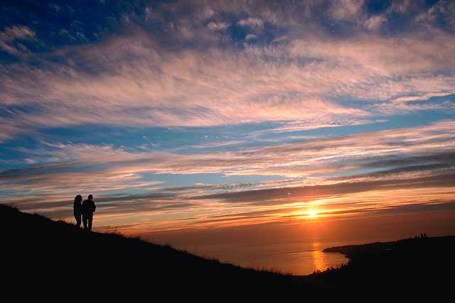
Summary
Common elements tie all meteorologists together
Our professional organizations provide guidance and in some cases self corrective action
It is up to each meteorologist to be aware of ethical dilemmas and to act in the best interest of the profession and science in general

Slide 23

References
National Weather Association (http://www.nwas.org/)
Weather Modification Association (http://www.weathermodification.org)
National Council of Industrial Meteorologists (http://www.ncim.org )
American Meteorological Society (http://ametsoc.org )
Other Readings
Honesty, Ahearne, J., 2011, American Scientists, vol. 99, March April, pp. 120-122
On Being a Scientist: Guide to Responsible Conduct in Research, 2009, Committee on Science, Engineering and Public Policy, National Academy of Sciences, National Academy of Engineering and Institute of Medicine, third edition, Washington, National Academies Press
Some of the images used herein were obtained from The Learning Company’s ClickArt Christian Graphics Deluxe product c 1999 The Learning Company, Inc. and its subsidiaries, 88 Rowland Way, Navato, CA 94945 USA. All rights Reserved

Slide 24


About the Presenter
Gerald Mulvey has a Ph. D. in atmospheric science. He has 30 + years of experience in industry and has coauthored a series of articles on ethics in meteorology which have been published in BAMS or accepted for publication.
Hill, J., and G. Mulvey, AMS Resources and Guidance for Ethics and Professional Conduct, accepted for publication in the Bulletin of the American Meteorological Society 2012
Mulvey, G. and J. Hill, International Business and Meteorology: Special Ethical Dilemmas, accepted for publication in the November 2012 issue of the Bulletin of the American Meteorological Society
Hill, J., and G. Mulvey, 2012, The Ethics of Defining a Meteorologist: Who is a Meteorologist, Bulletin of the American Meteorological Society, Vol. 93, no 7, pp.1080-1082
Hill, J., and G. Mulvey, 2012, Business Ethics for Professional Meteorology: Expectations and Satisfied Customers, Bulletin of the American Meteorological Society, Vol.93, no 6, pp.889-891

