Slide 1
Semantic MediaWiki Tutorial
Markus Krötzsch, Oxford
Denny Vrandečić, KIT
Berlin SMWCon Fall 2011

Slide 2
Overview
Wikis, MediaWiki, and Wikipedia
Semantic MediaWiki (SMW)
Create instance data with in the wiki
self descriptions using existing concepts and newly created concepts
affiliation, interests, etc.
Collaborative ontology design with SMW
Export data
Use http://scratchpad.referata.com for testing
This is introductory – you might want to go to the Developers consultations in the other room

Slide 3
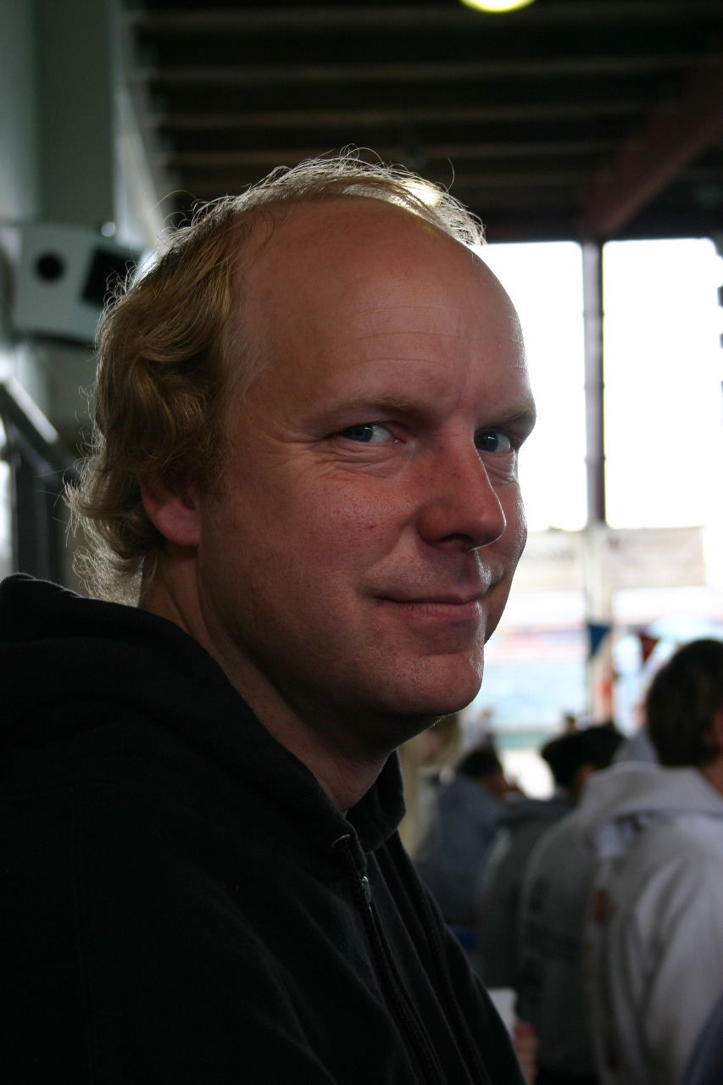
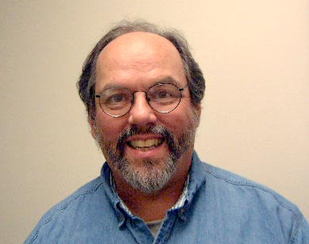
Long, long time ago…
Using Pattern Languages for Object Oriented Programming, OOPSLA87
Notes:
Kent Beck and Ward Cunningham, based on Christopher Alexander

Slide 4





Design Patterns
Many books,
many conferences
on design patterns
Idea: Collecting design patterns
Notes:
Website created 1994
PLOP pattern languages of programming
Ward Cunningham

Slide 5


Design Patterns Web Page
HTML
Simple Syntax
HTML
HTML
Notes:
The first wiki, 1995

Slide 6
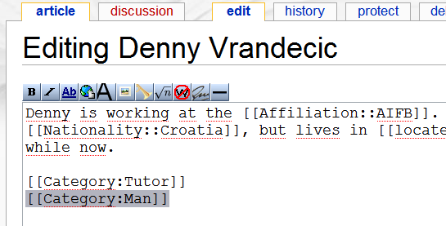
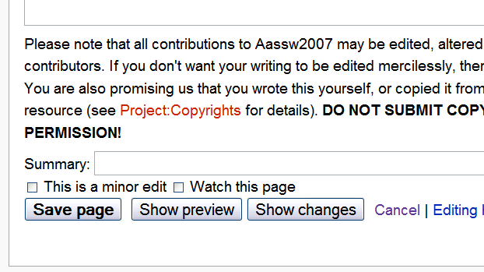
Editing the wiki
Create a new page or go to an existing one
Click on “edit”
Try to add or change text
You can cancel anytime, preview (just for you), or save the changes so that everyone can see them

Slide 7
Quick overview of wiki markup
'''three apostrophes''' will make text bold
''two apostrophes''' will make text italic
[[Text in double square brackets]] will be links to the page named as the text in the brackets
[[Link target|link text]] will display a link that looks like link text but links to link target
The wiki is case sensitve – but not on the first letter of a link
The wiki is Unicode

Slide 8
Namespaces
Each page in the wiki belongs to a namespace
Example namespaces: Talk, Category, Template, Help, File, User, User, etc.
Default namespace is empty (like for articles in Wikipedia)
Some namespaces have special semantics
Semantic MediaWiki introduces further namespaces
Property
Concept

Slide 9
Parser functions / Templates
They are called in wikitext with {{ }}
Template call
{{City}}
Can also have parameters (by name or by position)
{{City|population=200,000}}
{{City|200,000}}
Function call work the same way (but may have a : or #)
{{#expr:20+4}}

Slide 10
edit
wow. I can change the web.
let’s write an encyclopedia!

Slide 11
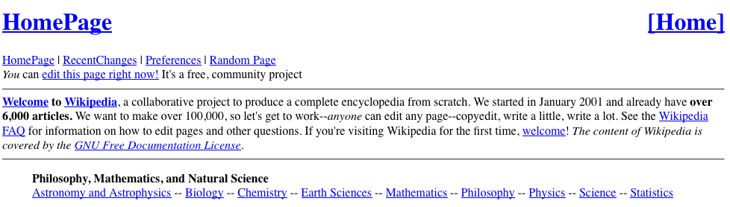

Slide 12
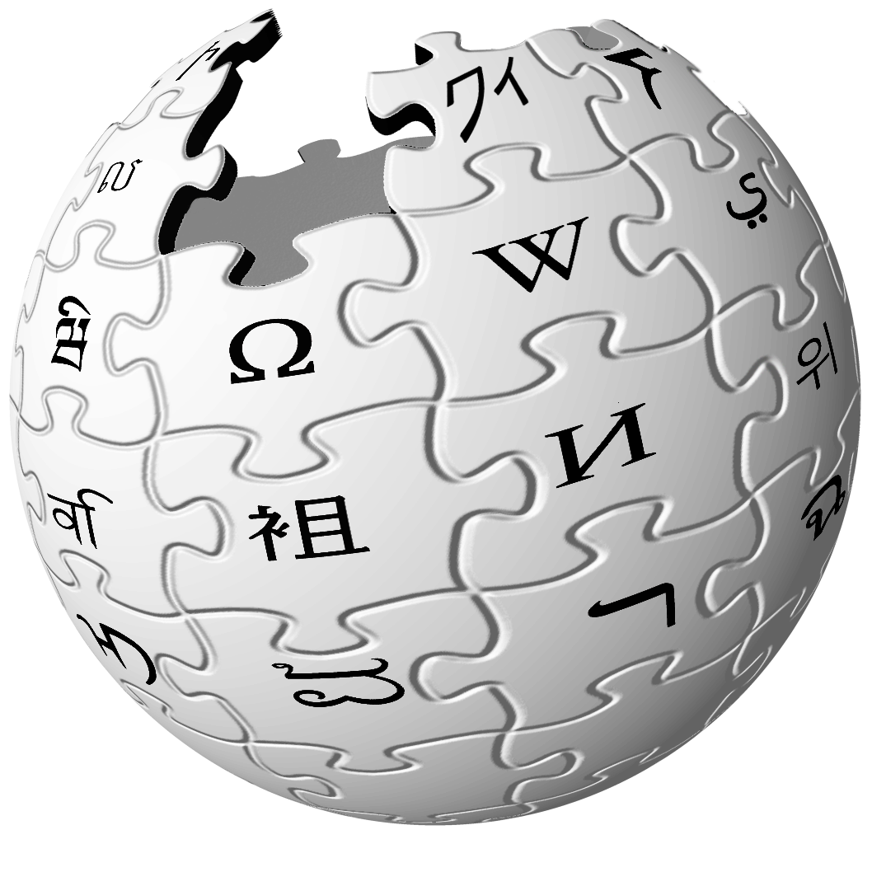
Notes:
12

Slide 13
So far…
Human collaborations can achieve great things
But some things are better left to machines…

Slide 14
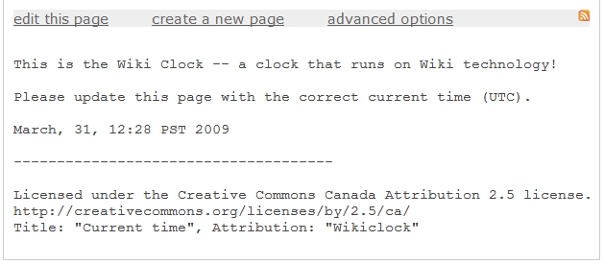
Wiki Clock
http://pageoftext.com/wikiclock

Slide 15

edit
edit
Notes:
So why does Wikipedia work, and wiki clock not?

Slide 16
Universal Access to
All Knowledge
Notes:
We are far less ambitious. (Stolen from Brewster Kahle)

Slide 17
What Wikipedia knows
Wikipedia has articles about…
… all cities
… their populations
… their mayors
So can I ask for a list of the world’s ten largest cities with a female mayor?
Notes:
17

Slide 18
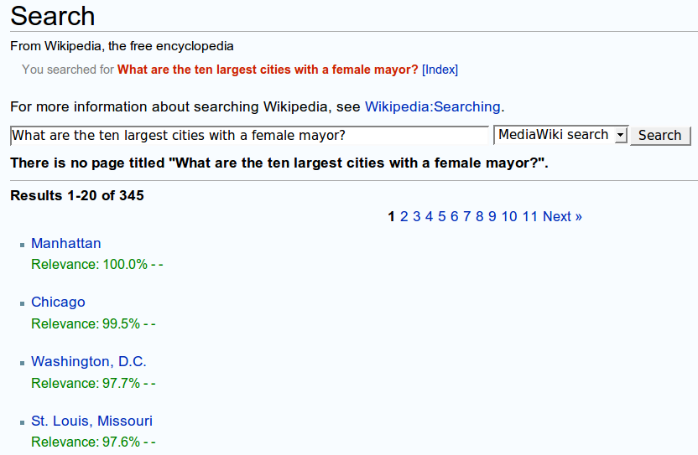
Let’s see what happens…
Notes:
18
All answers are wrong.

Slide 19
Wikipedia’s answer: lists

Slide 21
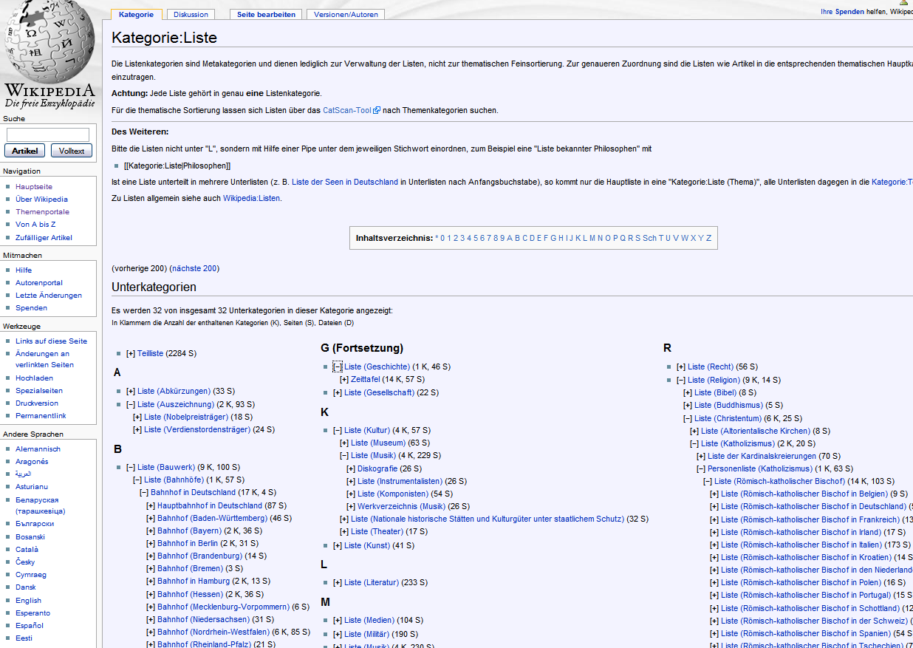

Slide 22
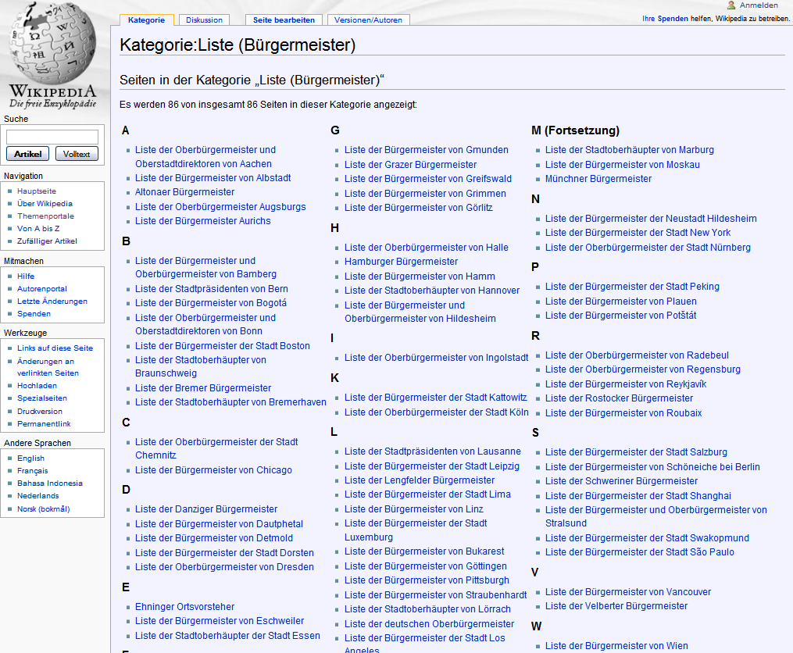

Slide 23
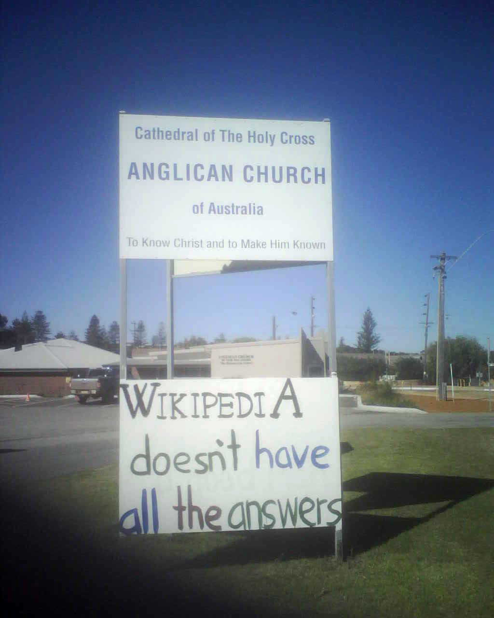

Slide 24
Computer are stupid

Slide 25
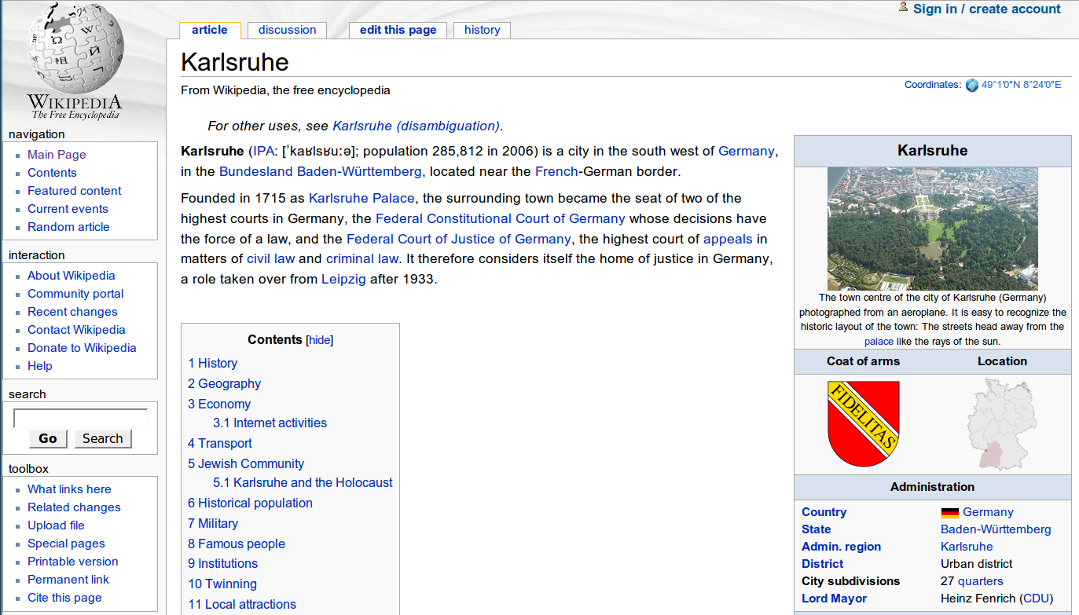
What humans see
Notes:
25

Slide 26
What humans see
Karlsruhe
... has a population of 285,812
... is located in Germany
... was founded in 1715
... has mayor Heinz Fenrich

Slide 27
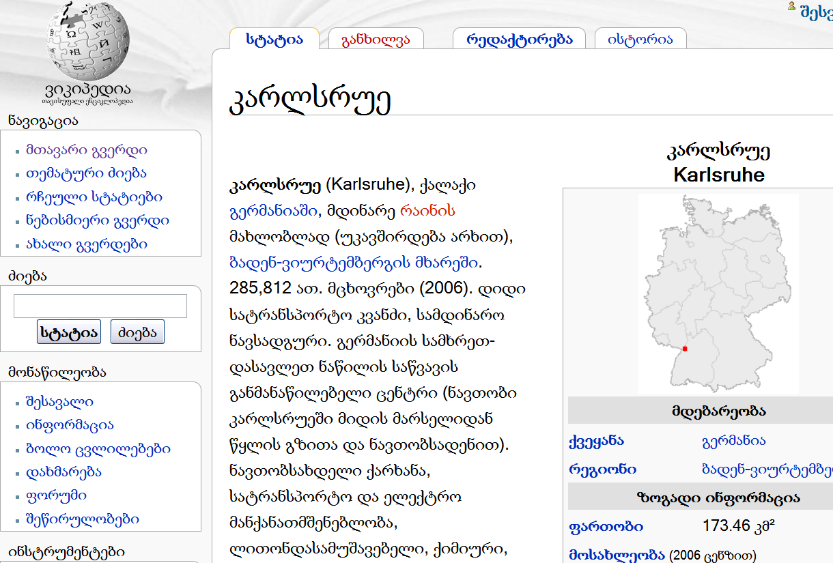
What computers see

Slide 28
What computers see
Karlsruhe
... 285,812
... Germany
... 1715
... Heinz Fenrich

Slide 29
Computer don‘t make connections

Slide 30
Computer need our help

Slide 31
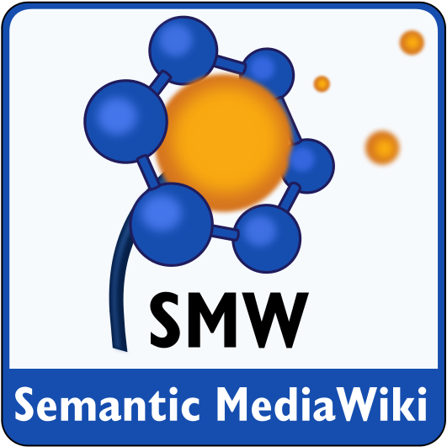

Slide 32
The IDEA

Slide 33
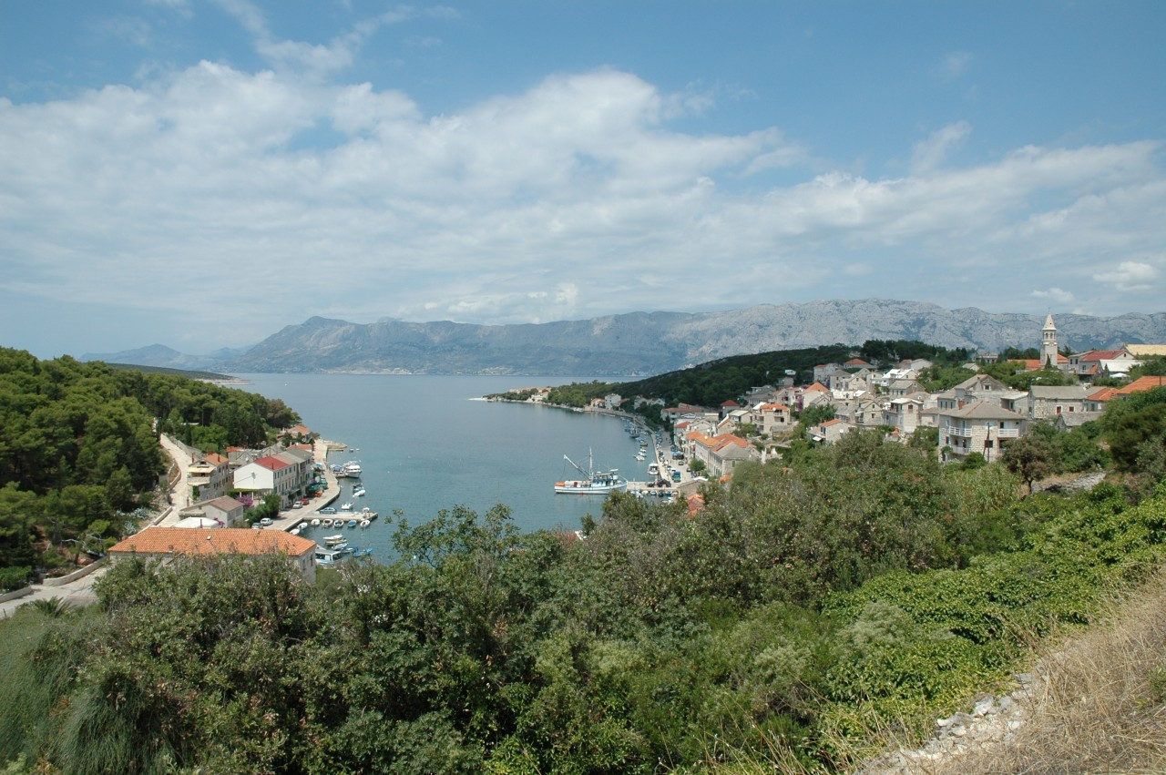

Slide 34
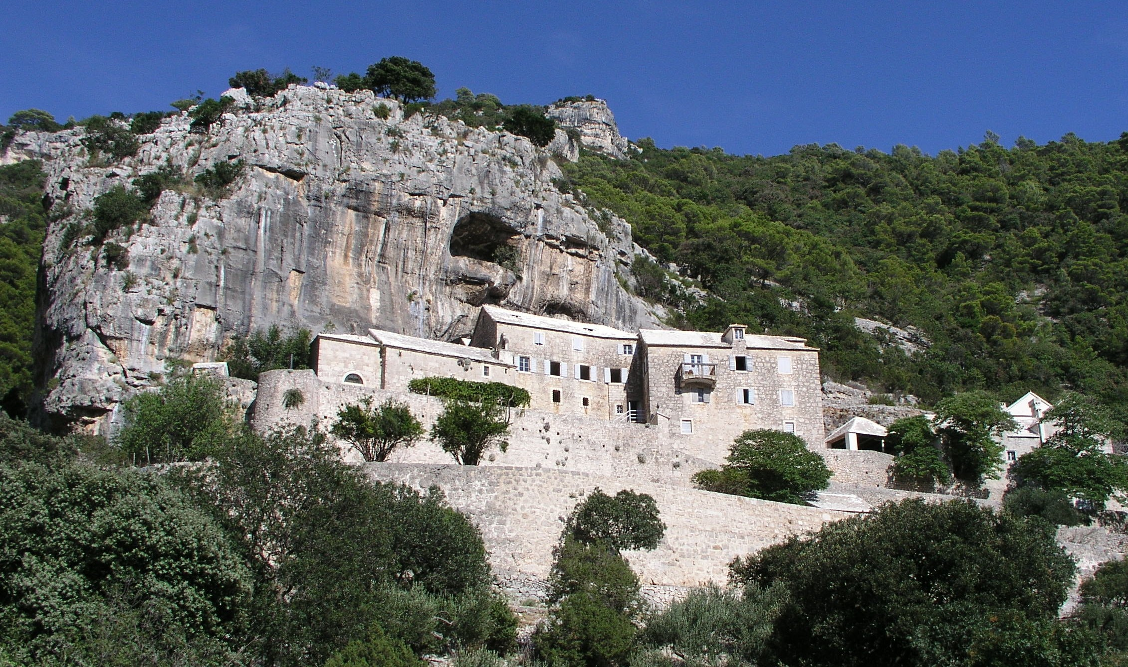

Slide 35
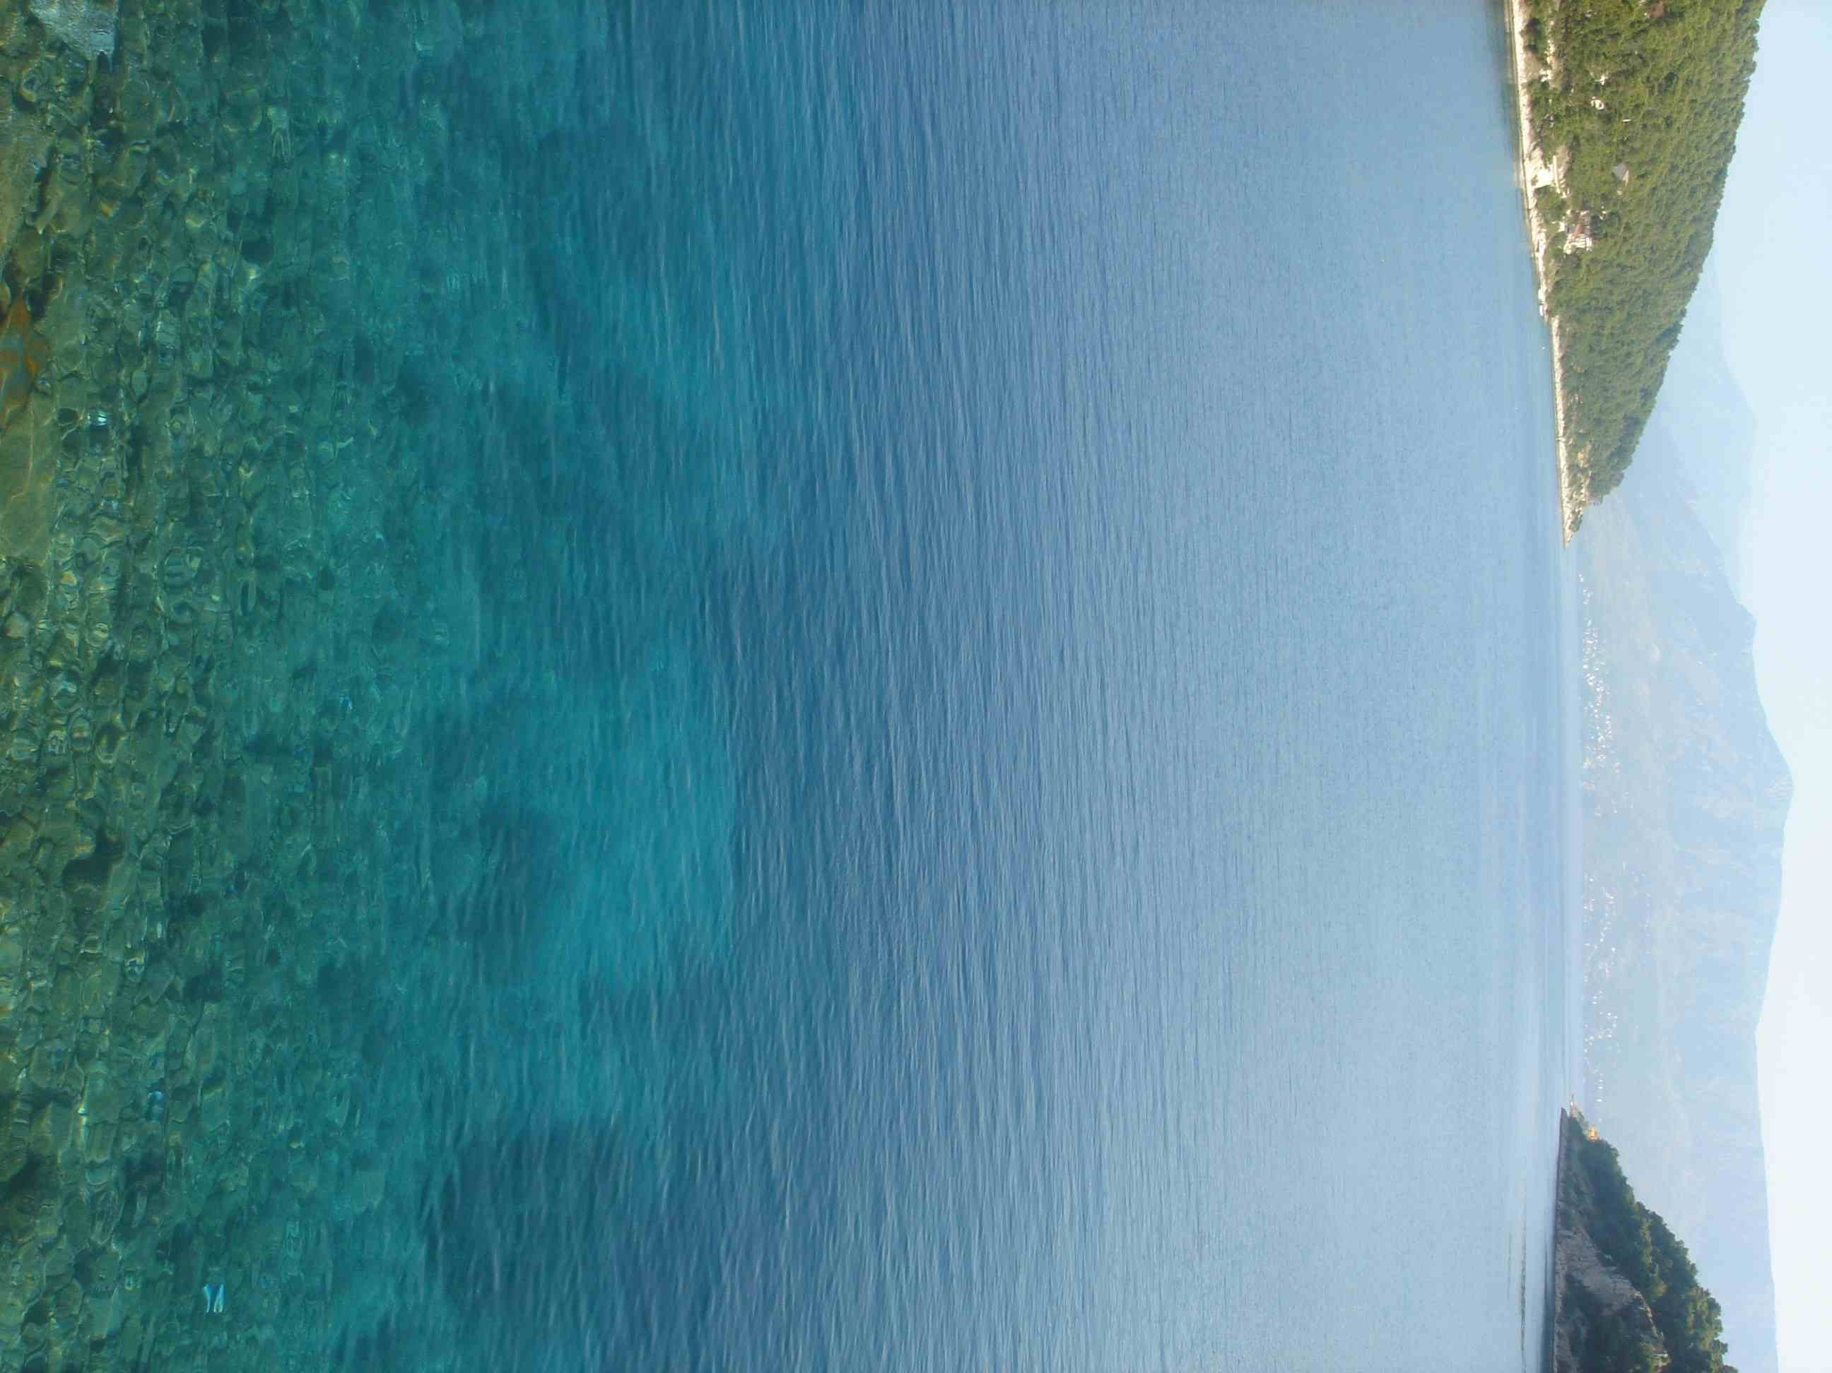

Slide 36
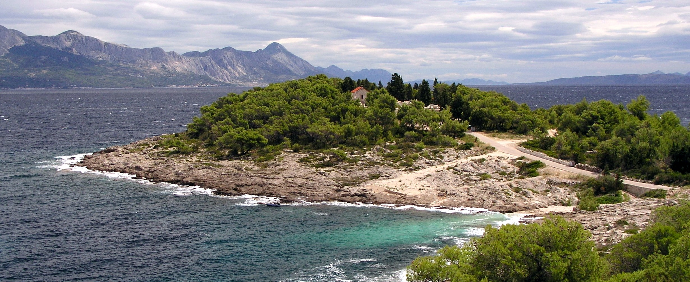

Slide 37
Wikipedia today
Brač is a Croatian island in the Adriatic Sea. The island has a population of 13,000, living in numerous little towns, ranging from the 'main town' Supetar, with more than 2,500 inhabitants, to Novo Selo, where only a dozen people live.
Today, Brač lives mostly on tourism, but fishing and agriculture (especially wine and olives) are very important too, as is selling its precious, white stone (which was used in building Diocletian's Palace in Split, and is built into the White House in Washington, DC, too).
Category: Croatian Island
Notes:
An article in the Wikipedia today. Note that the text has a lot of links to other articles.

Slide 38
How are they linked?
Brač Croatia
Brač Adriatic Sea
Brač Supetar
Brač Novo Selo
Brač tourism
Brač fishing
Brač agriculture
Notes:
But we don’t just know that the articles are somehow connected, we can say more about these connections.

Slide 39
How are they linked?
Brač belongs to Croatia
Brač Adriatic Sea
Brač Supetar
Brač Novo Selo
Brač tourism
Brač fishing
Brač agriculture
Notes:
We can say what type of connection exists between to things.

Slide 40
How are they linked?
Brač belongs to Croatia
Brač located in Adriatic Sea
Brač Supetar
Brač Novo Selo
Brač tourism
Brač fishing
Brač agriculture
Notes:
That the island is “located in” the Adriatic.

Slide 41
How are they linked?
Brač belongs to Croatia
Brač located in Adriatic Sea
Brač has town Supetar
Brač has town Novo Selo
Brač tourism
Brač fishing
Brač agriculture

Slide 42
How are they linked?
Brač belongs to Croatia
Brač located in Adriatic Sea
Brač has town Supetar
Brač has town Novo Selo
Brač lives on tourism
Brač lives on fishing
Brač lives on agriculture

Slide 43
Typed links
Extend wiki with typed links
So the computer “understands” it
Brač is a
[[Croatia]]n island with an area of 396 km².
Brač is a
[[belongs to::Croatia]]n island with an area of [[area::396 km²]].
Brač
Croatia
396 km²
area
belongs
to
Notes:
So here we show the syntax how a typed link can be created.

Slide 44
Karlsruhe
Karlsruhe is a city in
[[Germany]].
[[Country::Germany]].
Country
Germany
Subject | Predicate | Object
Karlsruhe
Country
Germany
Karlsruhe
Mayor
Heinz Fenrich
Heinz Fenrich
Gender
Male
Notes:
44
Instead of having typed links, one could also use templates. The template then defines the semantics.
Templates are already heavily used in many wikis.

Slide 45
Annotating with templates
{{City
|Mayor=Heinz Fenrich
|Population=285812
|Country=Germany
}}
Notes:
Other thing: the stated knowledge can also be reused inside the wiki, in form of inline queries.
This is an example.

Slide 46
Semantic MediaWiki
Extension of MediaWiki
Popular Wiki engine
Powers Wikipedia
Wikis are websites that anyone
can edit
Easy to use
Extends MediaWiki by enabling…
Typed links
Property – Value
Inline queries
New ways to explore the content
Open source and well documented
We will learn how to use Semantic MediaWiki (SMW)

Slide 47
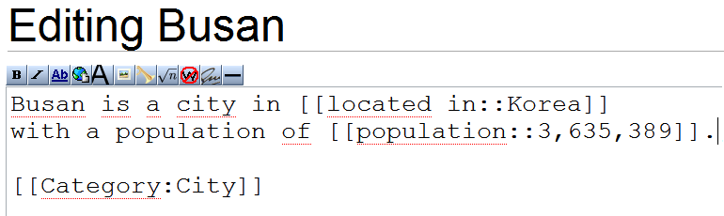
Overview of semantic markup
To add a page P to category C type [[Category:C]] on page P
To make a typed link of type R from page P1 to page P2 type [[R::P2]] on page P1
To state the value V of an attribute A on page P type [[A::V]] on page P
Example:

Slide 48

Data values and types
Attributes like [[birthdate::February 27 1978]] or [[population::3,635,389]] must know the type of the value
This is done by adding [[has type::T]] on the page of the attribute
Available, predefined types:
Page
String
Number
Boolean
Date
Text
Code
Temperature
Telephone number
Record
URL
Email
Annotation URI
Geographic coordinate (S Maps)
Enumeration
Custom units

Slide 49
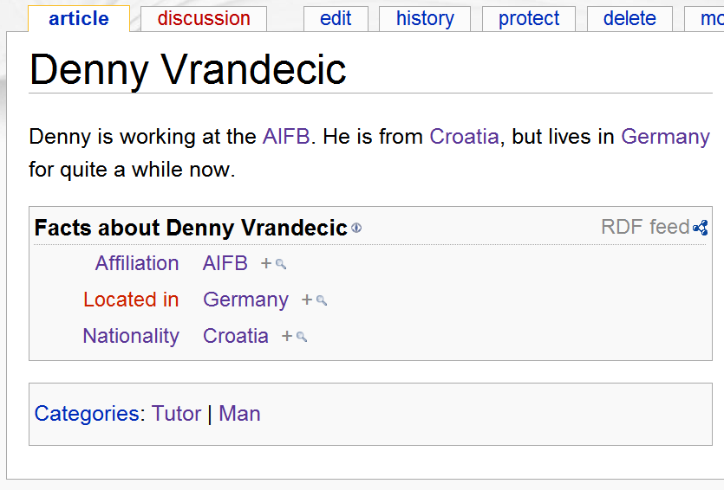
Add your own information
Now add information about yourself
For example: nationality, affiliation, age, birthday, hair color, likes…
Save or preview to see if and how the information has been understood
Blue links mean there is a page about it
Red link means there is no page about it

Slide 50
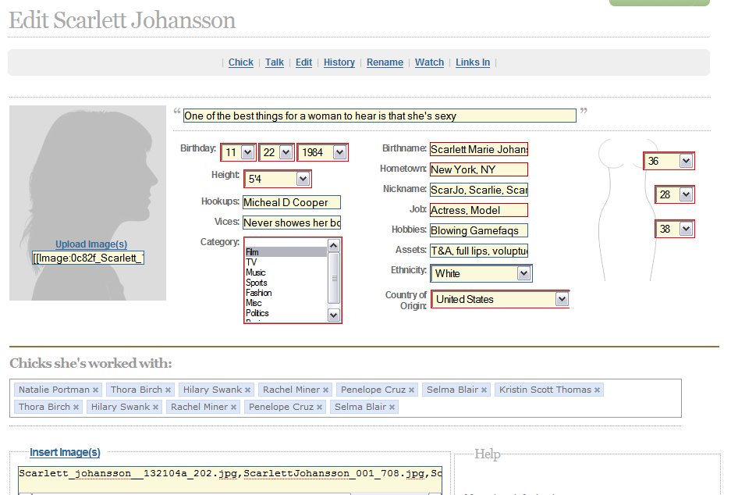
Semantic Forms
Example from http://www.chickipedia.com
Semantic Forms [[developer::Yaron Koren]]
Forms can make the wiki look like a database application, but remain still much more flexible.

Slide 51
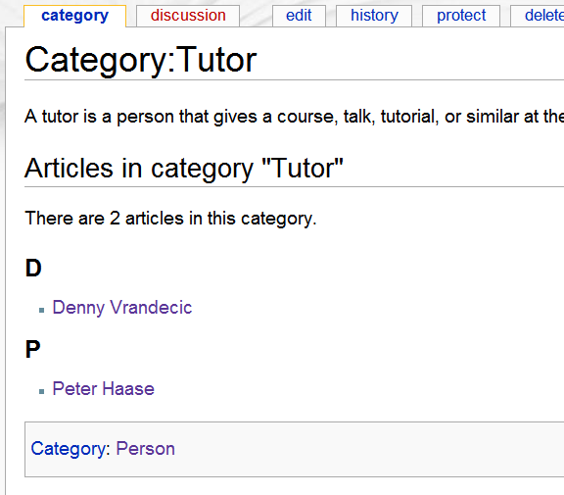
Collaborative ontology engineering
There are pages describing categories and properties
Informal description
Can be discussed
Can be edited
Extensional descript.
List of all instances
But: only direct ones
Supercategories

Slide 52
Social aspects
Task: come up with a vocabulary and the relation between the vocabularies for the whole group, using the wiki
How to decide which properties and categories are important?
How to define the properties or categories?
How to ensure high quality data? What does it mean?
How to control the wiki knowledge base and its growth?
Browse the wiki to see the results and connections

Slide 53
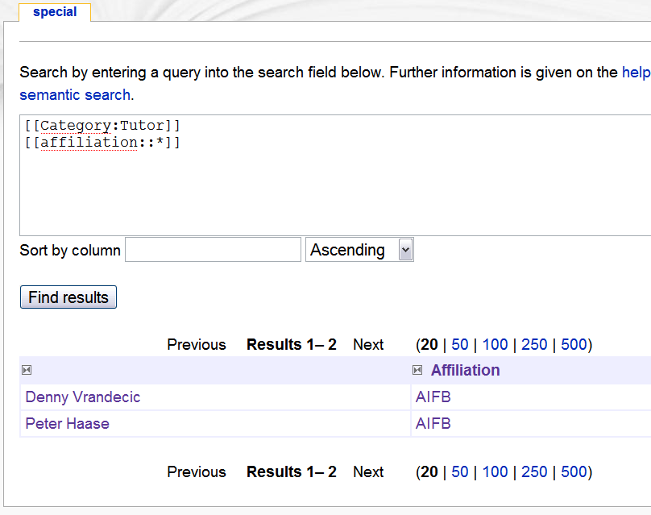
Querying the knowledge
Go to Special:Ask
Enter a query
Queries look like this:
Conditions on a category: [[Category:X]]
Conditions on a property: [[R::X]]
Property conditions can be ranges, [[R::>X]], [[R::<X]]
Property conditions: any value [[R::+]]
Print statements: ?R
Examples follow
See also online docs

Slide 54
Query examples
[[population::>1,000,000]] anything with a population of over a Million
[[located in::Korea]] anything that is located in Korea
[[affiliation::+]] anything that has any stated affiliation
[[Category:Tutor]] all tutors
[[Category:Tutor||Student]] all tutors or students (logical or)
[[Category:Tutor]] [[Category:Student]] everyone who is both

Slide 55
Querying and social aspects
Querying can only be done on aligned vocabularies
If half of the people use “affiliation” and the other half “works for” you cannot query the knowledge easily
Inside SMW, information integration usually happens with social tools, not with technology
Gardening tools can help with aligning vocabularies, but not replace them
Tools that allow you to rename a property throughout the wiki
Or to join two different names

Slide 56
Querying the wiki
{{#ask:
[[Category:City]]
[[Mayor.Gender::Female]]
| sort=Population
}}
Notes:
Other thing: the stated knowledge can also be reused inside the wiki, in form of inline queries.
This is an example.

Slide 57
Querying the wiki
{{#ask:
[[Category:Country]]
[[Continent::North America]]
|?Population
}}
Notes:
Other thing: the stated knowledge can also be reused inside the wiki, in form of inline queries.
This is an example.

Slide 58
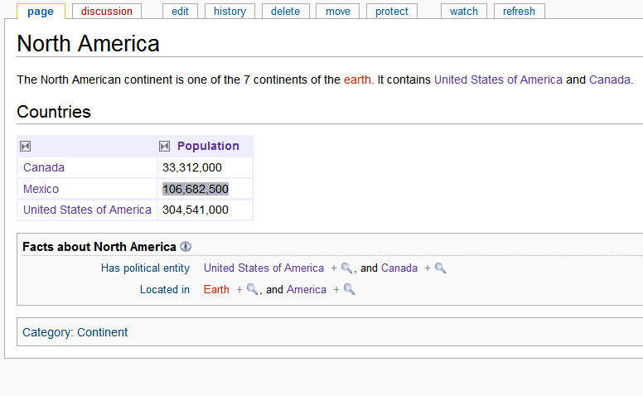
Result rendering
Notes:
Data can be formatted in many different ways. This example takes the population of the North American states.
Here it is displayed as a table.

Slide 59
Querying the wiki
{{#ask:
[[Category:Country]]
[[Continent::North America]]
|?Population
|format=piechart
}}
Notes:
Other thing: the stated knowledge can also be reused inside the wiki, in form of inline queries.
This is an example.

Slide 60
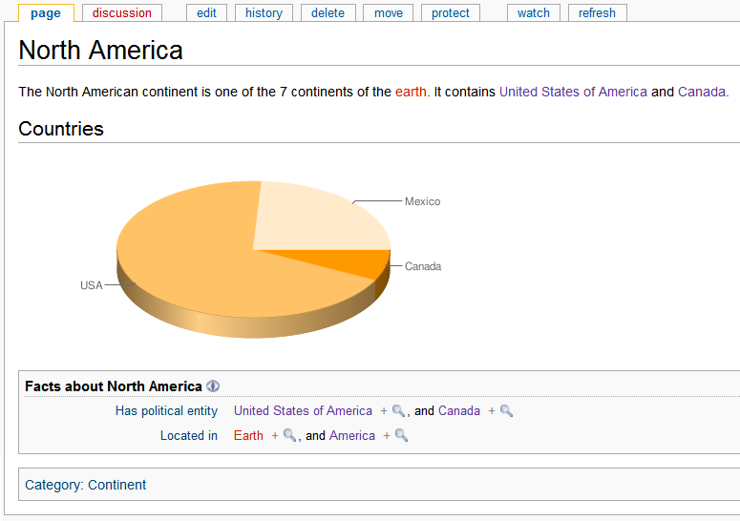
Pie chart
Notes:
As a pie chart

Slide 61
Querying the wiki
{{#ask:
[[Category:Country]]
[[Continent::North America]]
|?Population
|format=barchart
}}
Notes:
Other thing: the stated knowledge can also be reused inside the wiki, in form of inline queries.
This is an example.

Slide 62
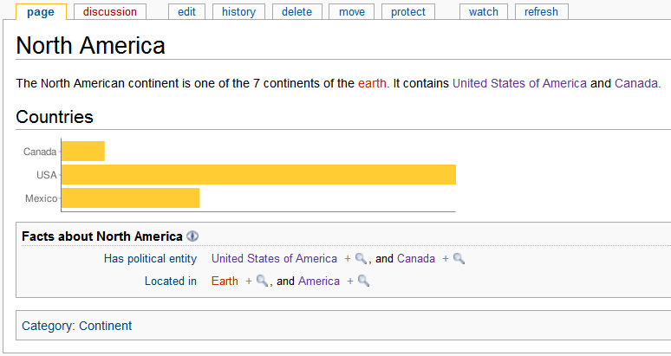
Bar chart
Notes:
As a bar chart.

Slide 63
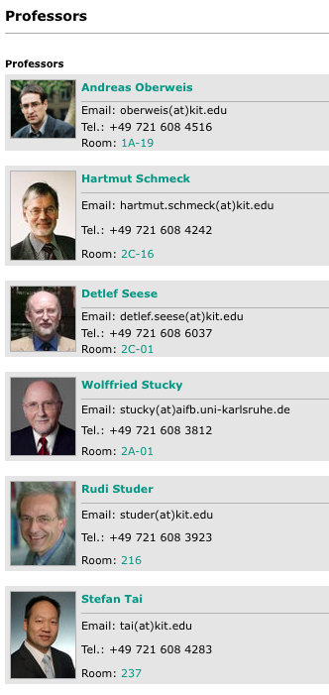
Templates
{{#ask: [[Category:Employee]]
[[Position::Professor||Professorin]]
| ?Picture
| ?Telephon
| ?Email
| ?Room
| sort=Lastname
| format=template
| template=Personlist
}}
(1)
(2)
Results of a query (1) rendered by a template (2)

Slide 64
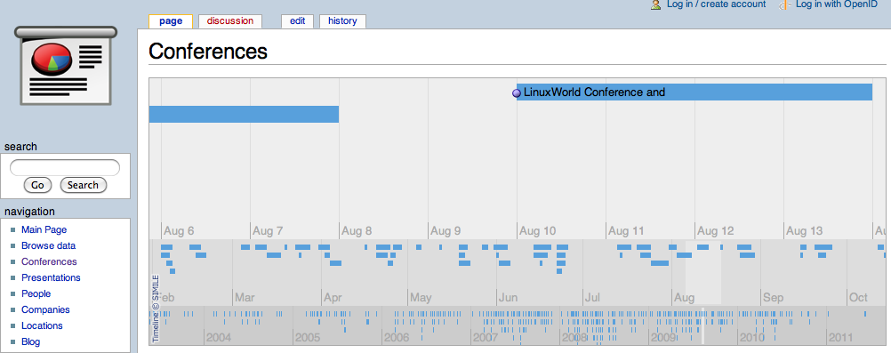
Timeline
{{#ask: [[Category:Conference]]
|?Start date
|?End date
|?Location
|sort=Start date
|order=desc
|format=timeline
|timelineposition=today
|timelinebands=DAY,MONTH, YEAR
|limit=5000
}}
http://www.techpresentations.org/Conferences

Slide 65
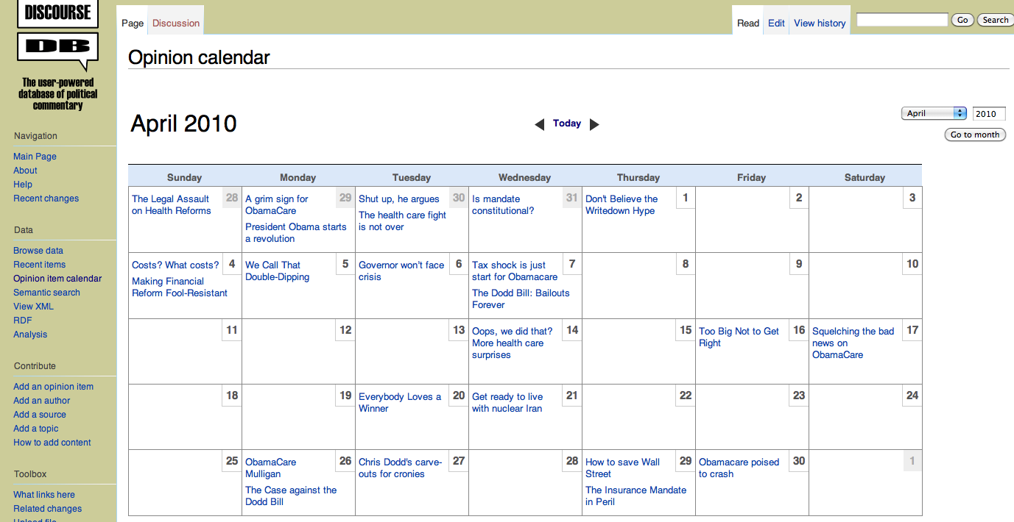
Calendar format
{{#ask: [[Category:Items]]
[[Was published on::>{{#calendarstartdate:}}]]
[[Was published on::<{{#calendarenddate:}}]]
|? Was published on
|limit=200
|format=calendar
}}
http://discoursedb.org/wiki/Opinion_calendar

Slide 66
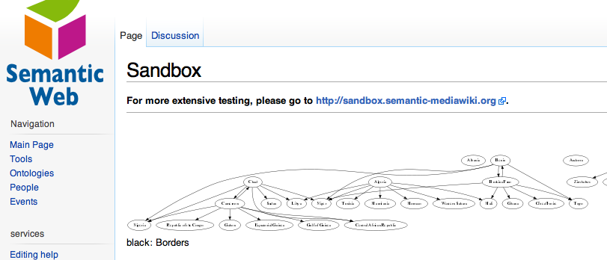
Graph
{{#ask: [[Category:Person]]
| ?has child
| ?knows
| format=graph
| graphcolor=Yes
| graphlink=Yes
| graphlegend=Yes
| graphlabel=No
| graphsize=10,10
| rankdir=TB
}}

Slide 67
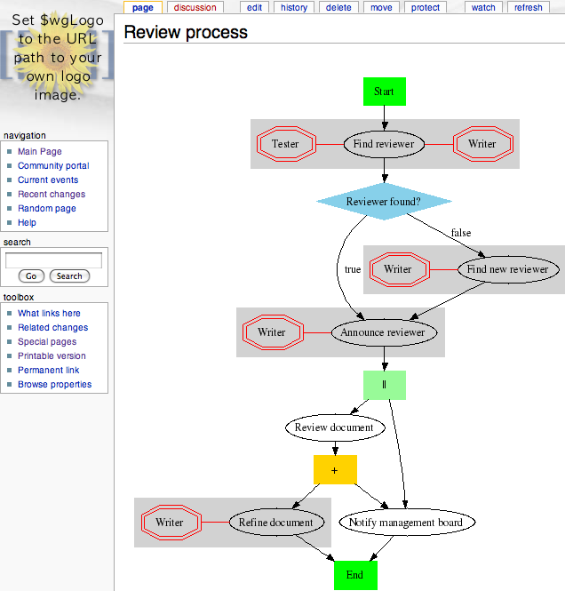

Process diagram
{{#ask: [[Category:Process Step]]
[[Category:{{PAGENAME}}]]
| ?has OrSuccessor=hasorsuccessor
| ?has Successor=hassuccessor
| ?hascontruesuccessor
| ?hasconfalsesuccessor
| ?has Condition=hascondition
| ?has Role=hasrole
| ?uses Resource=usesresource
| ?has Status=hasstatus
| format=process
| graphsize=12,12
| graphvalidation=no
| showroles=yes
| showstatus=yes
| showresources=yes
}}

Slide 69
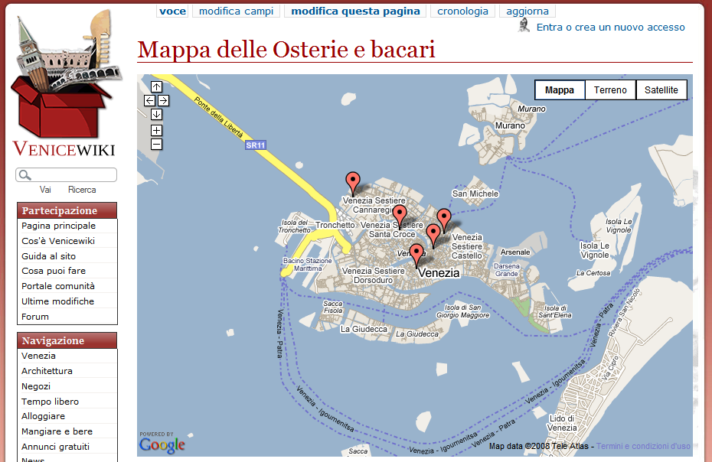
Google Maps
Notes:
69
Or on a map. This example is the Venice city wiki, displaying the bakeries in downtown Venice.
And yes, the example is in Italian.

Slide 70
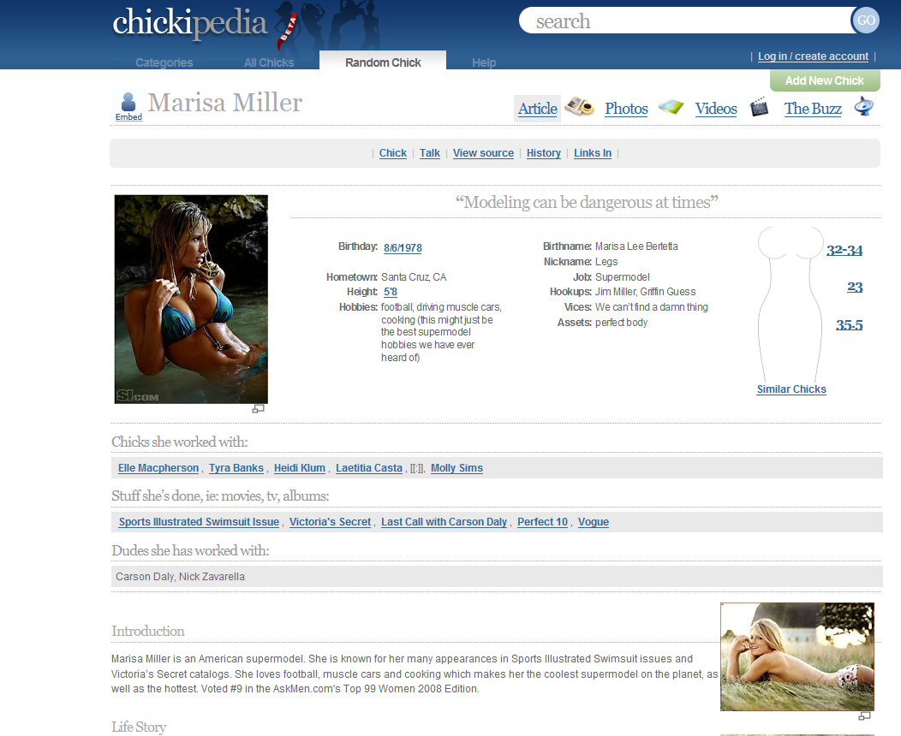
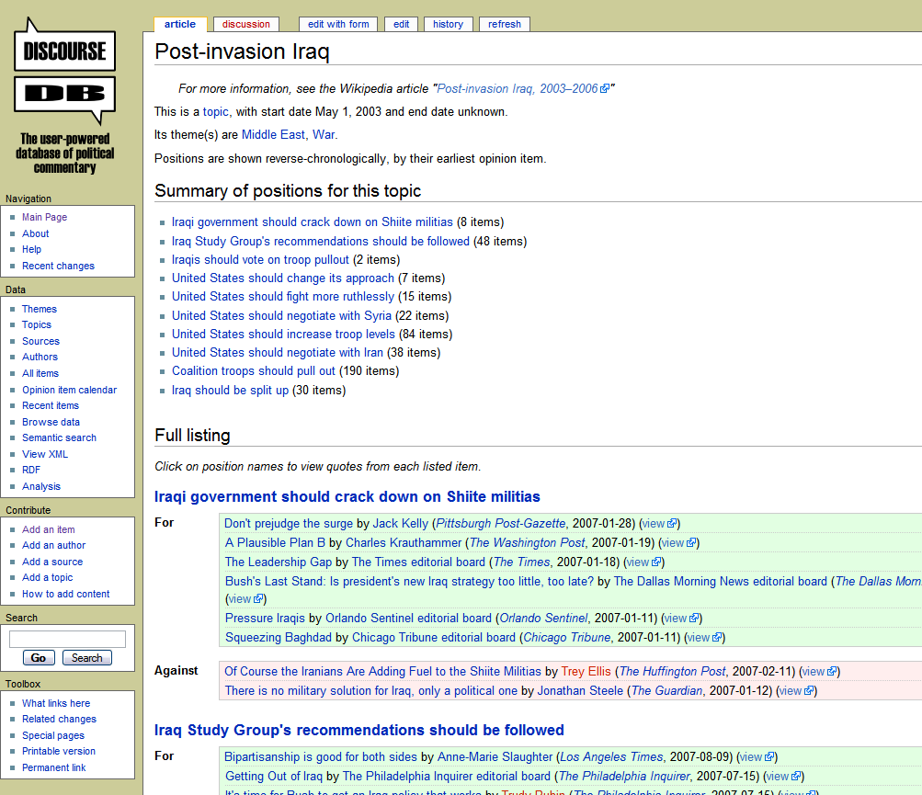

Slide 71
External data reuse
Computer understands wiki content
Knowledge based applications
A number of export formats
RDF/XML, SPARQL, RDFa, CSV, JSON, iCal, vCard, Bibtex, ...
RDF APIs in programming languages
Java, JavaScript, C/C++, Python, Ruby, Haskell, .Net, PHP, Common Lisp, Prolog, …
Standards based
URIs, XML, RDF, OWL, SPARQL, …

Slide 72
Questions?
Thank you for your attention!
http://semantic-mediawiki.org

