Slide 1

Exploring Windows Phone 7 Application Development
Jeff Wilcox
Senior Software Development Engineer
Microsoft Corporation
http://www.jeff.wilcox.name/
Notes:
Thanks for attending my presentation at JAOO 2010!
There are additional hidden slides covering some topics that couldn’t be covered in the one hour session.
Enjoy, and feel free to contact me with any feedback. Thanks, Jeff Wilcox

Slide 2
Agenda
Introduction to Windows Phone 7 & Silverlight
Controls
Threading
Navigation & Pages
Phone controls
Performance
Limitations
Application Lifetime, Launchers & Choosers, etc.
Questions

Slide 3
IT’S A NEW PLATFORM!
New OS
Modern UX & modern UI framework
Multi-touch devices
Emphasis on design
Excellent for developers
Integrated free toolset
One download… Visual Studio, Blend, Emulator, Controls
Quickly build professional apps
… and stop worrying about pointers and raw OS messaging

Slide 4
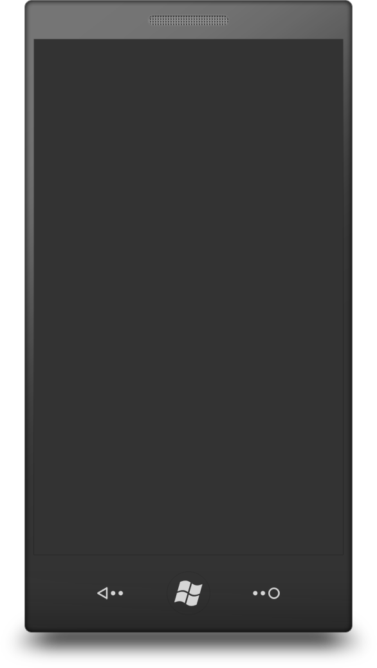
Hardware
Display
480x800 QVGA
Other resolutions in the future
Multimedia
Codec acceleration
Capacitive touch
4+ contact points
Memory
256MB RAM or more
8GB Flash or more
Sensors
A-GPS, Accelerometer, Compass, Light
GPU
DirectX 9 acceleration
Camera
5+ megapixels
CPU
ARMv7
Hardware buttons
Start, Search, Back

Slide 5
Framework Choices
Silverlight for Windows Phone
Write code in C#, VB
Powerful client platform
Leverage a decade of .NET libraries
XNA
Powerful 2D and 3D game experiences
Raw game loop and libraries
Native code is not a choice today

Slide 6

Silverlight for Windows Phone

Slide 7
What is Silverlight?
Modern user interface platform
.NET Managed Code
C#, VB
Leverage a decade of .NET libraries
Microsoft tools
Visual Studio
Expression Blend: Developer + Designer Surface

Slide 8
Silverlight for Windows Phone
Silverlight “3++”
Optimized for the phone GPU & ARM, input
Phone OS and sensor integration
Relaxed sandbox security compared to the plugin
Silverlight plugin apps (in IE) are not supported
Interested in advanced Silverlight?
Tomorrow there is a session on Silverlight and view model by Nikhil Kotari at 10:15
Purchase a WP7 book or a SL3 book

Slide 9
Silverlight
Input
Keyboard, Mouse
Touch
Ink
Modern App Framework
Data binding
Model – ViewModel (MVVM)
Data
LINQ, LINQ to XML, XML
Isolated Storage
Base Class Library (BCL)
Generics
Collections
Cryptography
Threading
UI Core
Vector Shapes
Layout
Animation
Text
Images
XAML
Media Stack
VC1, WMA, MP3
H.264, AAC
Communication & WCF
REST
JSON
RSS/ATOM
SOAP

Slide 10
XAML
Declarative XML markup for UI trees
Resources
Brushes, gradients, helper code and converters
Vector graphics, layout containers, text
Controls
Set properties, bindings, hook up event handlers
Enables the rich design surfaces in Visual Studio and Expression Blend 4
<Grid>
<TextBox Text=“Hello World" TextChanged=“MyMessageChangedHandler"/>
</Grid>

Slide 11
Layout
Flexible Layout System
Core Panels
StackPanel: Vertical or horizontal stacks
VirtualizingStackPanel: Fast item lists when fixed height
Grid: Rows, columns, very flexible
Other Panels include Canvas and WrapPanel
TIP: Avoid using Canvas

Slide 12
Other visual concepts
Transforms
Apply to any element
Scale, skew, translate, matrix, etc.
Projections – apply 3D to a 2D element
Animations
Built from keyframes in storyboards
Blend is what you want to use instead of hand-coding!

Slide 13
Styling
Phone styles are built in
Normal text, large text, etc.
Aware of phone themes (accent color, light & dark, …)
Can also create your own styles
Per-app, per-page, or per-element
<Style TargetType="TextBlock"
x:Key="SubHeadingText">
<Setter Property="FontSize” Value="42" />
<Setter Property="Foreground“ Value="Blue" />
</Style>
<TextBlock Text=“What’s up?“
Style=“{StaticResource SubHeadingText}“/>

Slide 14
Touch Events
Events exposed by UI elements
Raw Touch Points
Silverlight Toolkit GestureService
Tap, DoubleTap, Hold, Flick, Drag & Pinch events
XNA offers a ‘TouchPanel’ for gestures

Slide 15
Data Binding
Decouples apps and views when using MVVM
Two types of binding
Property binding (i.e. Foreground color)
List binding (List of people)
Set DataContext on an element tree
Based on a change notification system
<TextBlock Text=“{Binding Name}”
Foreground=“{Binding Name, Converter={StaticResource MyPersonForegroundBrushSelector}}” />

Slide 16
Property Change Notifications
Data objects implement INotifyPropertyChanged
TIP: Don’t use Reflection here
TIP: Store a single event argument instance (link)
TIP: Constant strings offer a simple level of static checking
Collections have INotifyCollectionChanged
// Bad for performance
NotifyPropertyChanged(()=> FullName);
// Good
NotifyPropertyChanged(“FullName”);
// Great
NotifyPropertyChanged(PropertyFullName);

Slide 17
Code and Design Reuse
User interface
Pages and user controls
Custom controls
Code
Class and control library projects
Across the .NET platform
Silverlight plugin (Mac, Windows)
Other platforms (Mono)
TIP: Carefully evaluate UserControl use in your application, they can have performance problems from XAML parsing.

Slide 18
Standard Controls

Slide 19
Controls
Built-in controls “just work”
Theme-aware
Manipulation events
Create event connections in XAML or in code
Basic controls
Button ‘clicks’
ScrollViewer pans and flicks
TextBox handles the cursor and works with software & hardware keyboard

Slide 20
Standard Controls
Border
Button
Canvas
CheckBox
Grid
HyperlinkButton
Image
ListBox
MediaElement
PasswordBox
ProgressBar
RadioButton
ScrollViewer
Slider
StackPanel
TextBlock
TextBox

Slide 21
SDK
Toolkit
Map
Panorama
Pivot
WebBrowser
ContextMenu
DatePicker
Gesture service
TimePicker
ToggleSwitch
WrapPanel

Slide 22
TextBox Input
TextBox
Integrates with the SIP (software keyboard)
Input Scopes
Optimized key layouts
Email, web address, numeric, etc.
Enables auto-correction
PasswordBox
Standard phone experience, no special code

Slide 23
Getting Started Building Apps
Demo
Notes:
Calculate the currency conversion, use a Button to update the value
Then remove the button by using TextChanged event for real-time change
Demonstrates InputScope, etc.

Slide 24
Lists

Slide 25
ListBox
Chose over ItemsControl if you can
Supports data and UI virtualization
Uses VirtualizingStackPanel by default
The native runtime optimizes performance for ListBox
Data virtualization is not standard, your collection must inherit from Ilist and provide a Count parameter (link)

Slide 26
ListBox Item Tips
Virtualized items should have a fixed height to prevent stutter
Keep items as simple as possible!
Get creative with a Grid instead of 20 panels
Avoid custom controls inside data templates
There’ve been strategies blogged
wait to load images until after scrolling is complete
perform decoding on a background thread

Slide 27
Bad ListBox DataTemplate
<ListBox.ItemTemplate> <DataTemplate> <StackPanel> <StackPanel Orientation="Horizontal"> <Image Source="{Binding PicSource}" Width="{Binding ApproxWidth}"/> <controls:MyPresenceControl User="{Binding}" OnlineText="{Binding ElementName=Resources, Path=UserOnline, Converter={StaticResource CurrentCultureConverter}}"/> <TextBlock Text="{Binding Name}" Foreground="{Binding Name, Converter={StaticResource MyNameForegroundConverter}, ConverterParameter='Red,Blue'}"/> </StackPanel> </StackPanel> </DataTemplate> </ListBox.ItemTemplate>
Notes:
Some of the problems in this template:
StackPanel with a horizontal orientation will have expensive layout
Multiple panels – stackpanel within a stackpanel, although there are no other children of the first panel
Binding to width may force an additional layout pass
A custom presence control which might contain other composite controls or complex visuals, making it hard to diagnose
An element name binding which looks in the visual tree for an item, a very expensive operation
Use of converters and converter parameters, relatively expensive in terms of performance
Using a converter for selecting between parameters like blue and red – indicates that the routine likely does parsing of those strings and real-time creation of a solid color brush (or similar) for those selected colors depending on the data binding. Not a cheap operation!

Slide 28
Good ListBox Data Template
Fixed Grid height (eliminates stutter) and exact image sizing
Raw & direct binding to a model object
Expose visibility, brushes, image sources as properties
Avoid using converters, converter parameters
No element name binding
Avoids custom controls and user controls
Model should avoid custom logic in getters
<ListBox.ItemTemplate> <DataTemplate> <Grid Height="180"> <Grid.ColumnDefinitions> <ColumnDefinition Width="120"/> <ColumnDefinition Width="80"/> <ColumnDefinition/> </Grid.ColumnDefinitions> <Image Source="{Binding PicSource}" Width="110" Height="110"/> <Image Source="{Binding PresencePic}" Width="70" Height="30" Grid.Column="1" Visibility="{Binding PresenceVisible}"/> <!-- clipped for space -->

Slide 29
ListBox without Virtualization
Slower startup time (full layout pass on all items)
For grouping scenarios, accordions, etc.
<ListBox> <ListBox.ItemsPanel> <ItemsPanelTemplate> <StackPanel/> </ItemsPanelTemplate> </ListBox.ItemsPanel> </ListBox>

Slide 30
ListBox Performance
Demo
Notes:
Calculate the currency conversion, use a Button to update the value
Then remove the button by using TextChanged event for real-time change
Demonstrates InputScope, etc.

Slide 31
Threading

Slide 32
Threading
Core Threads
Compositor Thread
User Interface (UI) Thread
Background Threads

Slide 33
Compositor Thread
Interacts with the GPU
Enables Independent Animations
Opacity
Translation
Scaling
Perspective transform
TIPS:
Elements need to be in a list (items are auto-cached) or have CacheMode=“BitmapCache”
Avoid OpacityMask on items, it cannot be accelerated

Slide 34
User Interface Thread
Primary thread for Silverlight
Handles important events
Input and touch
OS messages
Layout
System for arranging and sizing elements
Directly related to how complex pages are
All UI properties must be set on this thread
TIP: Keep this thread free and clear!

Slide 35
Dispatching to the UI Thread
Must set UI properties on the UI thread
If you don’t…
UnauthorizedAccessException: “Invalid cross-thread access”
Use a Dispatcher or other cross-thread communication technique to make the call
Dispatcher.BeginInvoke(()=>TextBox1.Text=“Hi.”);
Beware property change calls from model and data objects on your background threads

Slide 36
TIP: Be smart when dispatching
A dispatch typically costs at least 16ms (1 tick)
Group off-thread property change notifications
Use a smart dispatcher
private void Dispatch(Action action) { // No need for a dispatcher invoke, this will be quicker. if (Dispatcher.CheckAccess()) { action(); } else { Dispatcher.BeginInvoke(action); } }

Slide 37
Background Threads
BackgroundWorker
.NET thread queue
Important for performance
Help keep the UI thread available for input & events
Use for XML, JSON, serialization processing
Complex calculations, logic, server communication
TIP: Use the background thread often to keep the UI thread as responsive as possible

Slide 38
BackgroundWorker
BackgroundWorker bw = new BackgroundWorker(); bw.DoWork += BackgroundWork; bw.RunWorkerCompleted += (x, xe) => {
// This is called on the UI thread
}; bw.RunWorkerAsync();
private void BackgroundWork(object sender, DoWorkEventArgs e) { // This is where your background magic happens. }

Slide 39
Media

Slide 40
MediaElement
Media element plays audio or video
Proper visual element – place it inside your app, overlay with controls and visuals
<Grid> <Grid.RowDefinitions> <RowDefinition /> <RowDefinition Height="180"/> </Grid.RowDefinitions> <MediaElement Grid.RowSpan="2" Source="/Intro.wmv" AutoPlay="True" Stretch="UniformToFill"/> <Grid Grid.Row="1" Background="Black" Opacity=".6"> <!-- Put playback controls here --> </Grid> </Grid>

Slide 41
MediaPlayerLauncher
Opens the OS media player with content of your choice
You select the playback controls (pause, etc.)
MediaPlayerLauncher mediaPlayerLauncher = new MediaPlayerLauncher(); mediaPlayerLauncher.Media = new Uri(“Intro.wmv”, UriKind.Relative); mediaPlayerLauncher.Location = MediaLocationType.Data;
mediaPlayerLauncher.Controls =
MediaPlaybackControls.Pause | MediaPlaybackControls.Stop;
mediaPlayerLauncher.Show();

Slide 42
Media Tips
Only one MediaElement can be used at a time
XNA sound effect API can play multiple sounds
No VideoBrush on the phone
Emulation & Debugging…
Media playback in the emulator may not be supported (see documentation)
With an attached debugger, media may not playback on the device

Slide 43
Navigation & Pages

Slide 44
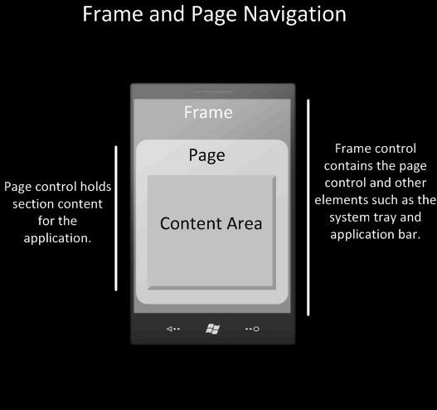
Frame and Page
All apps must have a root phone frame
Can derive from it to customize
Frame and pages handle back button navigation automatically
Back stack is managed by the app platform

Slide 45
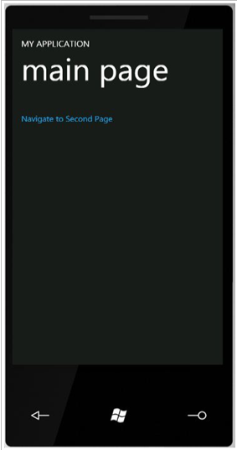
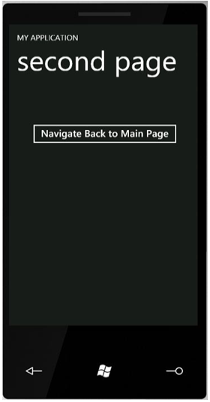
Page Navigation
Page-based navigation model
Similar to web page model
Each page identified by a URI
Each page is essentially stateless
private void hyperlinkButton1_Click( object sender, RoutedEventArgs e)
{
NavigationService.Navigate( new Uri("/SecondPage.xaml", UriKind.RelativeOrAbsolute) );
}

Slide 46
Navigating Back
Application can provide controls to navigate back to preceding page
The hardware Back key will also navigate back to preceding page
No code required – built-in behavior
Can override as needed to maintain logical experience in controls & app
private void button1_Click( object sender, RoutedEventArgs e)
{
NavigationService.GoBack();
}

Slide 47
Navigation Events
OnNavigatedTo
System.Windows.Navigation.NavigationEventArgs
Fired each time you navigate to the page
OnNavigatedFrom
System.Windows.Navigation.NavigationEventArgs
Fired each time you navigate from the page

Slide 48
Passing Data Between Pages
Can pass string data between pages using query strings
private void passParam_Click(object sender, RoutedEventArgs e)
{
NavigationService.Navigate(new Uri("/SecondPage.xaml?msg=" + textBox1.Text, UriKind.Relative));
}
On destination page
protected override void OnNavigatedTo( System.Windows.Navigation.NavigationEventArgs e)
{
base.OnNavigatedTo(e);
string msg = string.Empty;
if (NavigationContext.QueryString.TryGetValue("msg", out msg))
textBlock1.Text = msg;
}

Slide 49
Passing Objects Between Pages
Often, you will need to pass a data object from one page to another
For example, the user selects an item in a list and navigates to a Details page
One solution is to store your ViewModel (that is, data) in your App class
Global to whole application
Pass the selected item index in query string
NavigationService.Navigate(
new Uri("/SecondPage.xaml+?Param=value" ,
UriKind.RelativeOrAbsolute

Slide 50
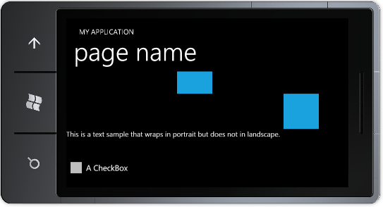
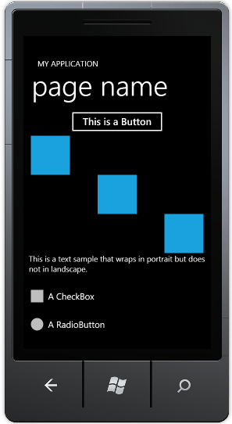
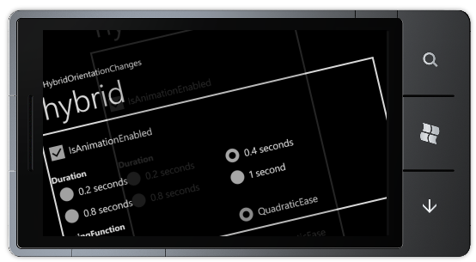
Orientation-aware Forms

Slide 51
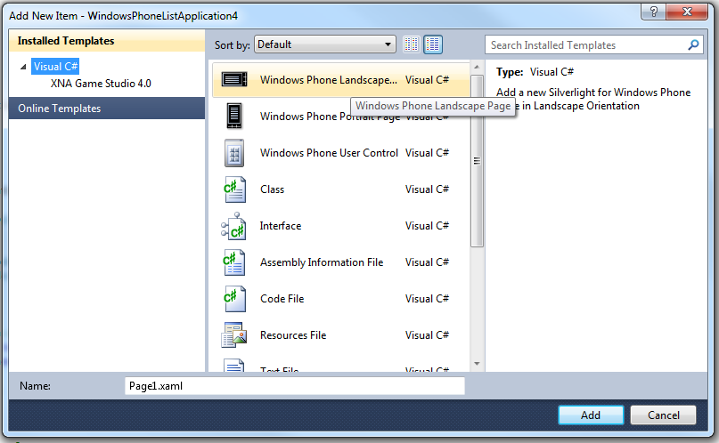
Orientation Support
In Visual Studio ‘Add New Item’ , you can add a Landscape Page or a Portrait Page
In fact, any page can be either – or both
The PhoneApplicationPage.SupportedOrientations property states what orientations the page supports
Portrait
Landscape
PortraitOrLandscape
If set to PortraitOrLandscape, page will re-orientate itself automatically when the user rotates the phone
You cannot force a page to re-orientate in code
You can force a page to always use a specific orientation by setting the SupportedOrientations property to the value you require

Slide 52
Orientation-aware Pages
<phone:PhoneApplicationPage
x:Class="OrientationSample.MainPage“
…
SupportedOrientations="PortraitOrLandscape" Orientation="Portrait"
mc:Ignorable="d" d:DesignWidth="480" d:DesignHeight="768“>
TIPS
Can use a ScrollViewer to scroll content when in landscape
Use Grid and StackPanel over Canvas, since they respect layout
Can provide MinWidth, MaxWidth, etc. property values
Avoid hard-coding widths
Provide a smooth transition animation automatically (link)

Slide 53
Phone Controls

Slide 54
Phone Controls
Application Bar
System Tray
Web Browser Control
Pivot
Panorama
Map

Slide 55
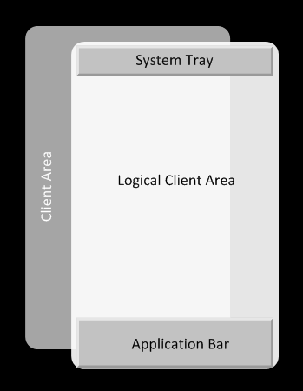
Application Chrome System Tray and Application Bar
System Tray
System owned indicator area that displays system-level status information
Apps can show/hide the Sys Tray
Application Bar
Area where applications can display buttons for the most common tasks
Can display pop-up menu for less common tasks
Microsoft.Phone.Shell.SystemTray.IsVisible = false;

Slide 56
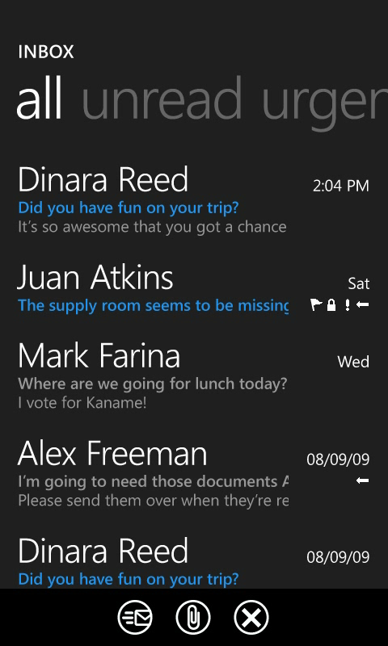
Application Bar
Use the Application Bar instead of creating your own menu system
Up to 4 buttons plus optional menu
Unfortunately data binding does not work with app bar! ☹

Slide 57
Application Bar in XAML
<phone:PhoneApplicationPage
x:Class=“MyApp.MainPage” … >
<phone:PhoneApplicationPage.ApplicationBar>
<shell:ApplicationBar x:Name="AppBar" IsMenuEnabled="True">
<shell:ApplicationBar.Buttons>
<shell:ApplicationBarIconButton x:Name="NewContactButton" IconUri="Images/appbar.new.rest.png" Text="New" Click="NewContactButton_Click"/>
<shell:ApplicationBarIconButton x:Name="SearchButton" IconUri="Images/appbar.feature.search.rest.png" Text="Find" Click="SearchButton_Click"/>
</shell:ApplicationBar.Buttons>
<shell:ApplicationBar.MenuItems>
<shell:ApplicationBarMenuItem x:Name="GenerateMenuItem" Text="Generate Data" Click="GenerateMenuItem_Click" />
<shell:ApplicationBarMenuItem x:Name="ClearMenuItem" Text="Clear Data" Click="ClearMenuItem_Click" />
</shell:ApplicationBar.MenuItems>
</shell:ApplicationBar>
</phone:PhoneApplicationPage.ApplicationBar>

Slide 58
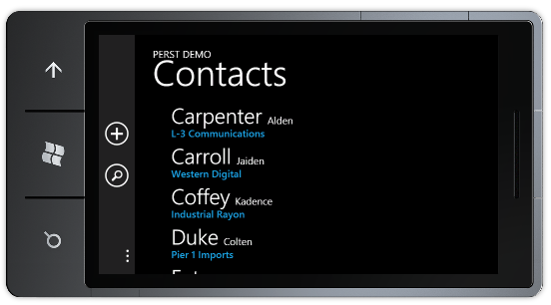
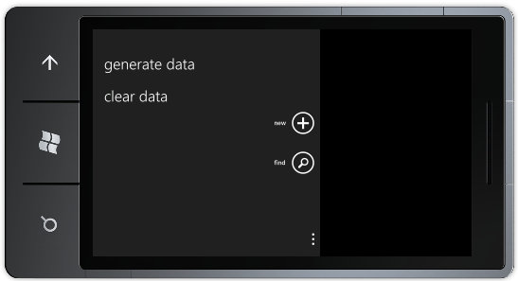
Application Bar & Landscape
Application Bar paints on side of screen in Landscape
Has built-in animation when page switches orientation

Slide 59
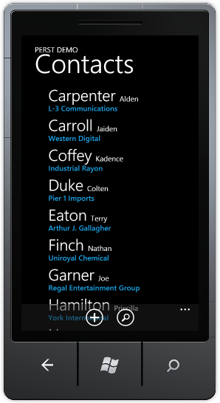
Application Bar Opacity
If Application Bar opacity is less than 1, displayed page will be the size of the screen Application Bar overlays screen content.
Try set Opacity values of 1, 0.5 or 0.
If Opacity is 1, displayed page is resized to the area of the screen not covered by the Application Bar
App Bar opacity impact performance

Slide 60
WebBrowser Control
Embeds a browser window into your app
No back/forward/URL chrome
Can navigate to a URI or you can send it HTML
Alternatively can open pages in IE with a chooser.
webBrowser1.Navigate(new Uri("http://www.bing.com/"));
webBrowser1.NavigateToString(
"<b>Hello JAOO Conference!</b>");

Slide 61
WebBrowser Control
TIP: Minimize the number of browser controls to 1
Best illusion of performance:
Use a single web browser control throughout the app
Translate the control off-screen or set Opacity to 0
When the control has loaded, navigate to the HTML string or page
Consider not showing the control until after the LoadCompleted event has fired

Slide 62
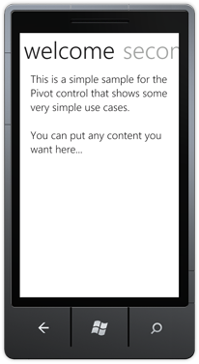
Pivot
Like a tab control
Optimized for quick startup time
Used for filtering data and views
I recommend over Panorama for most apps

Slide 63

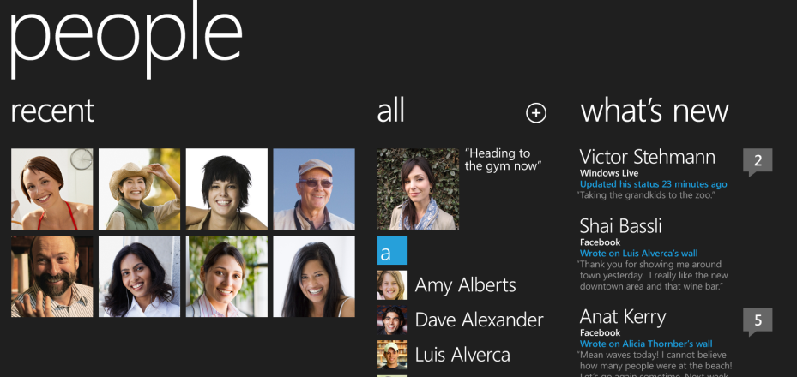

Slide 64
Panorama
UX: “Rich magazine-like experience”
Parallax background image is optional
Allows the user to explore a larger canvas area than traditional phone pages
Items with Orientation=“Horizontal” extend beyond a typical phone page’s size
A full layout pass happens on all items at startup!

Slide 65
Simple Pivot App
Demo

Slide 66
Pivots Vs. Panoramas
Pivot
Panorama
Supports a larger number of “items” because the layout is simpler
Supports programmatic selection for rich code-behind scenarios
LoadingPivotItem and UnloadingPivotItem events make it easy to defer content creation
More efficient use of screen space
Tends to create more visually stunning experiences
DefaultItem property makes matching operating system restore behavior easy
Background images of any size automatically wrap properly
Horizontally-oriented PanoramaItems allow variably-sized content to flow smoothly

Slide 67
Performance

Slide 68
Performance
Phone hardware is very different than your quad core desktop PC
Minimize complex visuals
Offload animations to the compositor thread
Make list item templates as simple as can be
Use BackgroundWorker & async coding throughout

Slide 69
Emulator
Windows Phone Emulator is great for developing applications
Contains an actual X86 build of the WP7 OS
Emulates the OS but does not have hardware capability limiting
May not see performance ‘issues’ until you use a real Windows Phone 7

Slide 70
Startup
Splash Screen
A JPEG image shown at startup
Optional
Some apps use the Startup + Startup Overlay concept
Minimize the startup DLL size
After 10 seconds your app is closed if not responsive

Slide 71
Layout Performance
Layout happens on the UI thread
Very expensive but necessary computations
Fast startup time, slow to display when toggled:
Visibility=“Collapsed”
Slower page startup time, ready to display anytime:
Opacity=“0”

Slide 72
Vectors vs. Images
Avoid complex vector paths that could be images
JPEGs are decoded quicker than PNGs
Mark images as Content instead of Resource when possible (places them outside the DLL and in the XAP instead)
Image code paths are optimized to load Content and isolated storage streams over memory streams
Use Resource for Panorama backgrounds to avoid a flicker or glitch

Slide 73
Loading Data
Consider smart caching of web service data
A Dictionary cache in memory
FIFO Queue in Isolated Storage
Web service requests
Parse data on the background thread
Beware serialization/deserialization costs
JSON is great

Slide 74
Progress Bar Control
“Indeterminate” progress bars are used throughout the UX on the phone
Control in the framework is sub-optimal as its animations are not offloaded to the compositor thread
Please use my PerformanceProgressBar (link)
Always set/bind IsIndeterminate to False when the effect is no longer needed to stop the storyboards

Slide 75
Memory
90MB peak memory use limit for marketplace apps on devices with 256 MB RAM
Panorama and Pivot pages often have many views and can add up in size
Compressed JPEG images may be small in file size, but are still uncompressed at runtime
var deviceMem=(long)DeviceExtendedProperties.GetValue("DeviceTotalMemory"); var app=(long)DeviceExtendedProperties.GetValue("ApplicationCurrentMemoryUsage"); var appPeak=(long)DeviceExtendedProperties.GetValue("ApplicationPeakMemoryUsage"); var managedMemory = GC.GetTotalMemory(false);

Slide 76
Frame Rate Counters
Default projects enable the counters when a debugger is attached
Find out more about the counters (link)
Left to right:
Compositor Thread frames per second (fps)
UI Thread fps
Texture memory use
Surface counter
Intermediate overlay texture count
Screen Fill Rate (TIP: < 2.50)

Slide 77
Limitations

Slide 78
It’s a new platform!
This is a first version named 7
We’re committed to providing platform updates
What the OS doesn’t do today
Multitasking
Copy & paste

Slide 79
Silverlight limitations on the phone
Shaders and effects
No ellipsis/text trimming built into the framework
No 24-bit color in Silverlight
TIP: Avoid defining gradients that may exhibit banding
TIP: Use image dithering for gradients if required for your brand

Slide 80
App platform limitations today
No Sockets
No built-in relational database
No platform invoke (p/invoke)
No native code development option
Cannot access live video feed from the camera

Slide 81
Application Lifetime

Slide 82
“A world of interruptions”
Phone calls
Texts
Reminders
Low battery!
Changing apps
Lock screen

Slide 83

One app at a time
WP7 maximizes app performance & resource use
Only one app in the foreground at a time
OS terminates your app when the user navigates away
OS may terminate your app if something else takes over the screen
Your app is Tombstoned when user hits Start
Save state information
When the user comes back, new app instance is started and provided the state info

Slide 84

Basic Lifecycle
Running
Not running
Launching
Closing
User exits the application (press back from the first page) – Closing event
User Starts the application – Launching Event

Slide 85
“Tombstone” Lifecycle
Running
Deactivated
Tombstoned (in most cases)
Activated
Load state to continue where she left off
Press Start
Open toast
Lock screen
User is back where she left off
The application’s process is killed (in most cases)*
Save state for later use

Slide 86
Lifecycle Events
Application_Launching
Not fired when the application is reactivated
Application_Activated
When the application is activated (brought to foreground)
Not fired when started the first time
Application_Deactivated
When the application is deactivated (sent to background)
Application_Closing
When the user presses Back on the first Page
Not fired when the application is deactivated / tombstoned

Slide 87
Launching Event Handler
Code to execute when the application is launching (for example, from Start)
This code will not execute when the application is reactivated
Application should load persisted data from isolated storage and display the application’s initial state
void Application_Launching(object sender, LaunchingEventArgs e)
{
using (IsolatedStorageFile isf = IsolatedStorageFile.GetUserStoreForApplication())
{
if (isf.FileExists(“MyPersistenceFile.dat"))
{
// Read persisted data from Storage
}
else
// No existing persisted data – create new data objects…
}
}

Slide 88
Closing Event Handler
Code to execute when the app is closing (for example, user presses Back)
This code will not execute when the application is deactivated
Application can save persisted data to isolated storage
TIP: You have only 10 sec to save and exit!
void Application_Closing(object sender, ClosingEventArgs e)
{
using (IsolatedStorageFile isf = IsolatedStorageFile.GetUserStoreForApplication())
{
//Create a new file and serialize data
using (IsolatedStorageFileStream fs = isf.CreateFile(“MyPersistenceFile.dat”))
{
XmlSerializer ser = new XmlSerializer(typeof(MyDataObject));
ser.Serialize(fs, mydataobject);
}
}
}

Slide 89
Deactivated Event Handler
Code to execute when the application is deactivated (sent to background)
This code will not execute when the application is closing
Application should save transient application data to the PhoneApplicationService.State or to PhoneApplicationPage.State dictionary so that if your application is resumed, you can quickly restore state info
void Application_Deactivated(object sender, DeactivatedEventArgs e)
{
// Add data that is “work in progress” (transient) to Application state
PhoneApplicationService.Current.State.Add(“MyUnsavedDataObject", myDataObject);
// Optionally, save any data that needs to be persisted – your app may // never be reactivated!
… persist some data …
}

Slide 90
Activated Event Handler
Code to execute when the application is activated (brought to foreground)
This code will not execute when the application is first launched
Application should load app state from PhoneApplicationService.State
Present the user with the experience they had before your application was suspended.
void Application_Activated(object sender, ActivatedEventArgs e)
{
MyDataObject mydataobject = null; //Create new data object variable
//Try to locate previous data in transient state of the application
if (PhoneApplicationService.Current.State.ContainsKey("MyUnsavedDataObject"))
{
//If found, initialize data variable & remove from application's state
mydataobject = PhoneApplicationService.Current.State["MyUnsavedDataObject"] as MyDataObject;
PhoneApplicationService.Current.State.Remove("MyUnsavedDataObject");
}
}

Slide 91
Page State
Restore the visual state of the page when the app is reactivated
User should see the page exactly as it was
Include things such as scroll position of a ScrollViewer control and the contents of TextBox controls
Use the State property of the PhoneApplicationPage class to store transient page state
Save state in OnNavigatedFrom event handler
Restore state in OnNavigatedTo event handler

Slide 92
Launchers & Choosers

Slide 93
Launchers and Choosers
The Windows Phone execution model isolates every application in its own sandbox
Apps cannot directly access information stores, such as contacts
Apps cannot directly invoke other applications, such as phone or messaging
Launchers and Choosers allow applications indirect access to these phone features
Launcher and Chooser APIs invoke distinct built-in applications that replace the currently running application
See Tombstoning

Slide 94
What Are Launchers and Choosers?
Launcher
Launches one of the built-in applications through which a user completes a task
No data is returned to calling application
Example: PhoneCallTask
Chooser
Launches one of the built-in applications through which a user completes a task
Returns some data to calling application
When caller completes, calling application is reactivated and supplied with the Chooser result
Note, user can cancel the launcher, resulting in an empty return value
Example: PhotoChooserTask

Slide 95
Launchers & Choosers
Launchers
Choosers
PhoneCallTask
SearchTask
SMSComposeTask
WebBrowserTask
EmailComposeTask
MarketplaceDetailTask
MarketplaceHubTask
MarketplaceReviewTask
MarketplaceSearchTask
MediaPlayerLauncher
CameraCaptureTask
EmailAddressChooserTask
PhoneNumberChooserTask
PhotoChooserTask
SaveEmailAddressTask
SavePhoneNumberTask

Slide 96
Programming Launchers
// Launches the Email application: displays a new email message
EmailComposeTask emailComposeTask = new EmailComposeTask();
emailComposeTask.To = "user@example.com";
emailComposeTask.Body = "Email message body";
emailComposeTask.Cc = "user2@example.com";
emailComposeTask.Subject = "Email subject";
emailComposeTask.Show();
// Launches the Windows Phone Marketplace client application // which then shows the search results based on search terms
MarketplaceSearchTask marketplaceSearchTask = new MarketplaceSearchTask();
marketplaceSearchTask.SearchTerms = "accelerometer xna";
marketplaceSearchTask.Show();

Slide 97
Choosers and the Execution Model
Important! When you launch a Launcher or Chooser, your app is terminated (most of the times)
When the task completes, your app may be reactivated and a new app instance created (see Tombstoning)
To use a Chooser
Chooser object must be declared with class scope within the PhoneApplicationPage
In the PhoneApplicationPage constructor, create an instance of the Chooser class you wish to use
Also in the PhoneApplicationPage constructor, assign a delegate for the Chooser’s Completed event
Implement the event handler for the Completed event
Call the Chooser’s Show method to invoke the Chooser

Slide 98
Programming Choosers
public partial class MainPage : PhoneApplicationPage {
// Declare the PhotoChooserTask object with page scope.
PhotoChooserTask photoChooserTask;
public MainPage() {
InitializeComponent();
// Initialize the PhotoChooserTask and assign the Completed handler
photoChooserTask = new PhotoChooserTask();
photoChooserTask.Completed += new EventHandler<PhotoResult>(photoChooserTask_Completed);
}
private void button1_Click(object sender, RoutedEventArgs e) {
photoChooserTask.Show();
}
void photoChooserTask_Completed(object sender, PhotoResult e) {
if (e.TaskResult == TaskResult.OK)
{
BitmapImage bmp = new BitmapImage();
bmp.SetSource(e.ChosenPhoto);
}
}
}

Slide 99
Using the Camera
CameraCaptureTask cameraCaptureTask;
// Declare the CameraCaptureTask object with page scope.
CameraCaptureTask cameraCaptureTask;
public MainPage() {
InitializeComponent();
// Initialize the CameraCaptureTask and assign the Completed handler
cameraCaptureTask = new CameraCaptureTask();
cameraCaptureTask.Completed += new EventHandler<PhotoResult>(cameraCaptureTask_Completed);
}
private void button1_Click(object sender, RoutedEventArgs e) {
cameraCaptureTask.Show();
}
void cameraCaptureTask_Completed(object sender, PhotoResult e) {
if (e.TaskResult == TaskResult.OK) {
BitmapImage bmp = new BitmapImage();
bmp.SetSource(e.ChosenPhoto);
myImage.Source = bmp;
}
}

Slide 100
Chooser and the Execution Model
Upon its return from Chooser, your application will be reactivated (see Tombstoning)
Method invocation order is
Application CTOR - (App.xmal.cs)
Application_Activated (returning from Tombstone)
Page Constructor (the page you return is created as a new instance)
Chooser delegate
Page OnNavigatedTo (if used – usually where you retrieve the state back from Tombstone …)

Slide 101
Chooser, Launcher Execution Model Disclaimer
Not all Choosers or Launchers trigger an automatic tombstone
Native experiences that feels, to the user, like an extension of the original application will not tombstone immediately
PhotoChooserTask
CameraCaptureTask
MediaPlayerLauncher
EmailAddressChooserTask
PhoneNumberChooserTask
Multiplayer Game Invite [games]
Gamer You Card [games]

Slide 102
Other Topics

Slide 103
Hardware APIs
Accelerometer
High-frequency event
TIP: Events fire on a background thread, remember to dispatch to the UI
TIP: Consider writing a simple band pass filter
Vibration
Just like Beep in classic apps
Microsoft.Devices.VibrateController.Default.Start(
TimeSpan.FromSeconds(0.25));

Slide 104
Communication Services
Push Notifications
Location Service
3 sources of information
WiFi
GPS
Cell Towers

Slide 105
QUESTIONS? And some answers…

Slide 106
Thank You!
Please evaluate (comments too!)
Download the tools
http://developer.windowsphone.com/
http://silverlight.codeplex.com/
MSFT loves feedback: what’s good, bad, painful?
Jeff Wilcox
http://www.jeff.wilcox.name/
jwilcox@microsoft.com

Slide 107
FYI: Silverlight Training
Nikhil Kotari
Browser as a Platform Track
Tues 10:15
Store Sal, Musikhuset
Learn about View Model (MVVM)
Deep dive into behaviors and binding
Notes:
FYI this training is available on Tuesday 10/5

Slide 108

© 2010 Microsoft Corporation. All rights reserved. Microsoft, Windows, Windows Vista and other product names are or may be registered trademarks and/or trademarks in the U.S. and/or other countries.
The information herein is for informational purposes only and represents the current view of Microsoft Corporation as of the date of this presentation. Because Microsoft must respond to changing market conditions, it should not be interpreted to be a commitment on the part of Microsoft, and Microsoft cannot guarantee the accuracy of any information provided after the date of this presentation.
MICROSOFT MAKES NO WARRANTIES, EXPRESS, IMPLIED OR STATUTORY, AS TO THE INFORMATION IN THIS PRESENTATION.

