Slide 1
V-DAY
Kelsey Barringham
Resident Assistant
University of Connecticut

Slide 2
{
}
V-DAY

Slide 3
{
}
The 'V' in V-Day stands for Victory, Valentine and Vagina.

Slide 4
{
}
What is V-DAY?
V-Day is a global activist movement to end violence against women and girls. V-Day is a catalyst that promotes creative events to increase awareness, raise money, and revitalize the spirit of existing anti-violence organizations. V-Day generates broader attention for the fight to stop violence against women and girls, including rape, battery, incest, female genital mutilation (FGM), and sex slavery.

Slide 5
{
}
Mission
V-Day is an organized response against violence toward women.
V-Day is a vision: We see a world where women live safely and freely.
V-Day is a demand: Rape, incest, battery, genital mutilation and sexual slavery must end now.
V-Day is a spirit: We believe women should spend their lives creating and thriving rather than surviving or recovering from terrible atrocities.
V-Day is a catalyst: By raising money and consciousness, it will unify and strengthen existing anti-violence efforts. Triggering far-reaching awareness, it will lay the groundwork for new educational, protective, and legislative endeavors throughout the world.
V-Day is a process: We will work as long as it takes. We will not stop until the violence stops.
V-Day is a day. We proclaim Valentine's Day as V-Day, to celebrate women and end the violence.
V-Day is a fierce, wild, unstoppable movement and community. Join us!

Slide 6
{
}
How It Started…
In 1994, a play called The Vagina Monologues, written by playwright and activist Eve Ensler, broke ground, offering to the world a piece of art like nothing it had seen before. Based on dozens of interviews Ensler conducted with women, the play addressed women's sexuality and the social stigma surrounding rape and abuse, creating a new conversation about and with women. The Vagina Monologues ran Off-Broadway for five years in New York and then toured the United States. After every performance, Ensler found women waiting to share their own stories of survival, leading her to see that The Vagina Monologues could be more than a moving work of art on violence; she divined that the performances could be a mechanism for moving people to act to end violence.
On Valentines Day, 1998, Eve, with a group of women in New York City, established V-Day. Set up as a 501(c)(3) and originally staffed by volunteers, the organization's seed money came from a star-studded, sold out benefit performance at the Hammerstein Ballroom in New York, a show that raised $250,000 in a single evening.

Slide 7
{
}
Four Core Beliefs
Art has the power to transform thinking and inspire people to act
Lasting social and cultural change is spread by ordinary people doing extraordinary things
Local women best know what their communities need and can become unstoppable leaders
One must look at the intersection of race, class, and gender to understand violence against women

Slide 8
{
}
V-Day dreams of a world in which women and girls
will be free to thrive,
rather than merely
survive. With
your
help, we can make it happen.

Slide 9
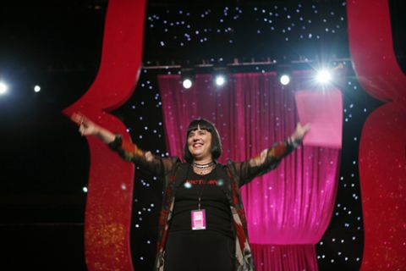
{
}

Slide 10
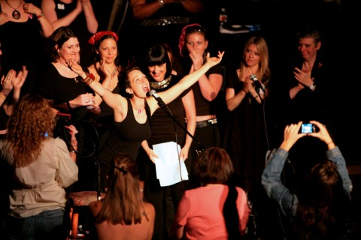
{
}

Slide 11
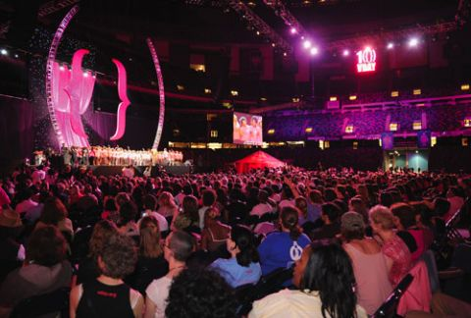
{
}

Slide 12
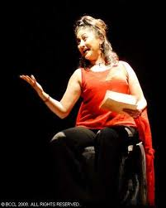
{
}

Slide 13
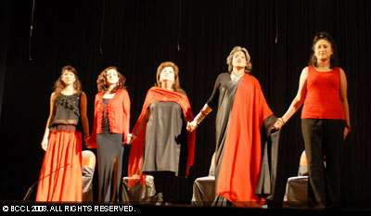
{
}

Slide 14


Slide 15
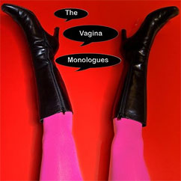

Slide 16


Slide 17


Slide 18


Slide 19


