Slide 1
Goal Lines for Monitoring
Gary Shenk
TMAW/NTWG
8/15/2012

Slide 2
Cannot Assign TMDL loads to Monitoring Stations
Spatial Mismatch
TMDL is defined on the 92 tidal monitoring segments
Chain Bridge is almost perfect match to POTTF_MD
Conowingo is about 95% of CB1TF
Fredericksburg is about 80% of RPPTF
Others are much worse
Model Mismatch - P5.3.2 vs Estimator or WRTDS
Confidence intervals
Different flow normalization techniques
Implementation vs water quality

Slide 3
Cannot assign WIP Target Loads to Monitoring Station
Spatial Mismatch
Target Loads are defined by state and basin
Patuxent - Maryland
Susquehanna - New York
Model Mismatch
Same reasoning as for TMDL loads

Slide 4
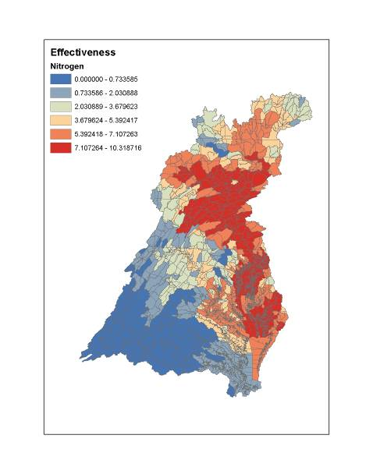
What is the TMDL? (my perspective)
4.5 mg/l
Wastewater Loads
All other sources
8 mg/l
20 percent slope
Agreement to do 55% to 90% of all possible actions, depending on PS/NPS split and position in the watershed

Slide 5
What are the WIPs? (my perspective)
Plans to restore water quality that are consistent with the TMDL
Illustrative only

Slide 6
What can we say?
We may compare flow normalized load trends to reductions estimated from implementation of WIPs.
Caveats:
WIPs are defined on different scale; some BMP spatial distribution is assumed
WIPs are implementation goals. Lag times are not factored in.

Slide 8
Confidence intervals
Different flow normalization methods
Different models

Slide 9
Consistent with TMDL decision of
“Percent of possible reductions”

Slide 10
Consistent with necessary WQ improvements
Estuarine model calibrated to 1990s
Critical period 1993-1995

Slide 11
Consistent with WIPs and Milestones
Starting now, What are we going to do?
Benefit for any method: Chance to examine WSM predictions to determine where and when it works best

Slide 12
Suggested Next Steps
Gather WSM, WRTDS, and ESTIMATOR output at all available locations
IMO, method must be
Flow-normalized
Expressed as a percent reduction
Explained clearly
Need to determine
Appropriate baseline
Display methods
Work toward indicators and possible role in 2017 mid-point evaluation

