Slide 1
APNIC RPKI Report
George Michaelson
ggm@apnic.net

Slide 2
Current Status
In service since Jan 2009
Two level service accessed via myAPNIC
APNIC certifies members holdings
Members can certify their allocations through hosted service interface

Slide 3
Current APNIC RPKI Service
Generate CA Certificates covering allocated resources
Manage resource pools and datasets
Generate Routing Authority Attestations (ROA)

Slide 4
Current Activity
Trust Anchor management
ROA management
General Signer
Public Up-Down Protocol interface

Slide 5
1. Trust Anchor Management
Split single APNIC TA to multi-component TA
Reflect IANA and ERX resource origin
Compatible with ongoing work on Global TA
Disruption to existing deployed service will be minimal due to sparse ERX holdings in APNIC region
TA transition in place by Q4

Slide 6
2. ROA Management
User defined MaxLength parameter for ROA
Previously fixed-length in UI
No back-end changes

Slide 7
3. General Signer
“Resource Tagged Attestations”
Ability to sign files with RPKI digital signatures
Useful for Resource Transfers, Customer Provisioning, general attestations about addresses
CMS based objects
multiple key signing supported
Validity dates

Slide 8
General Signer Motivation
RFC3779 encodes Internet Number Resources as critical extensions into public-key certificates
This is a (cryptographically) strong mechanism
We now have a mechanism to make strong, testable attestations about Internet Number Resources.

Slide 9
Examples
“please can you add a static route for 192.0.200.0/24 to my service,
signed, owner of 192.0.200.0/24”
ISP can now verify request comes from delegate for the prefix
“Dear broker, as the current holder of 192.0.200.0/24 please list this block as available for transfer,
signed, the soon-to-be ex-owner of 192.0.200.0/24”
Broker can now validate this listing request

Slide 10
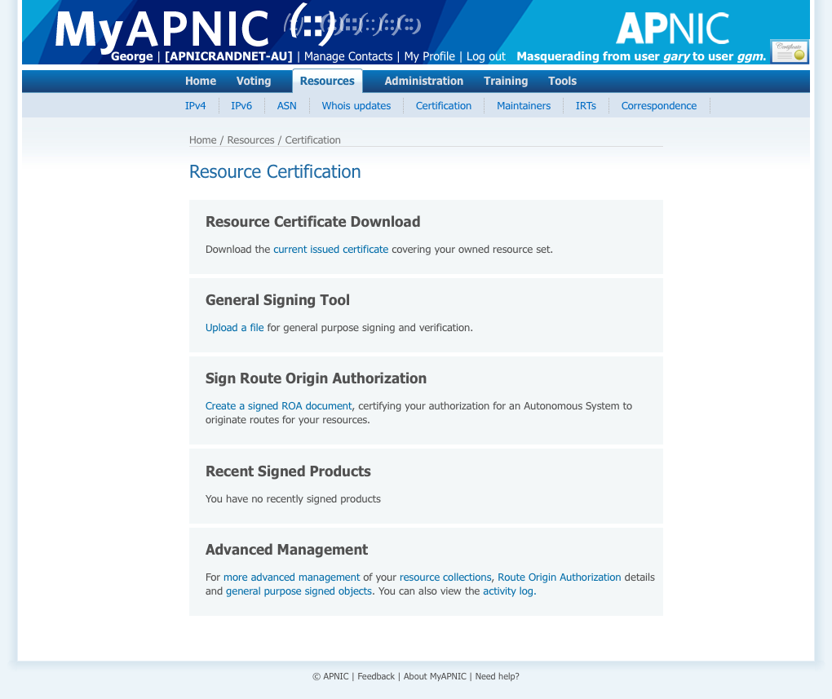

Slide 11
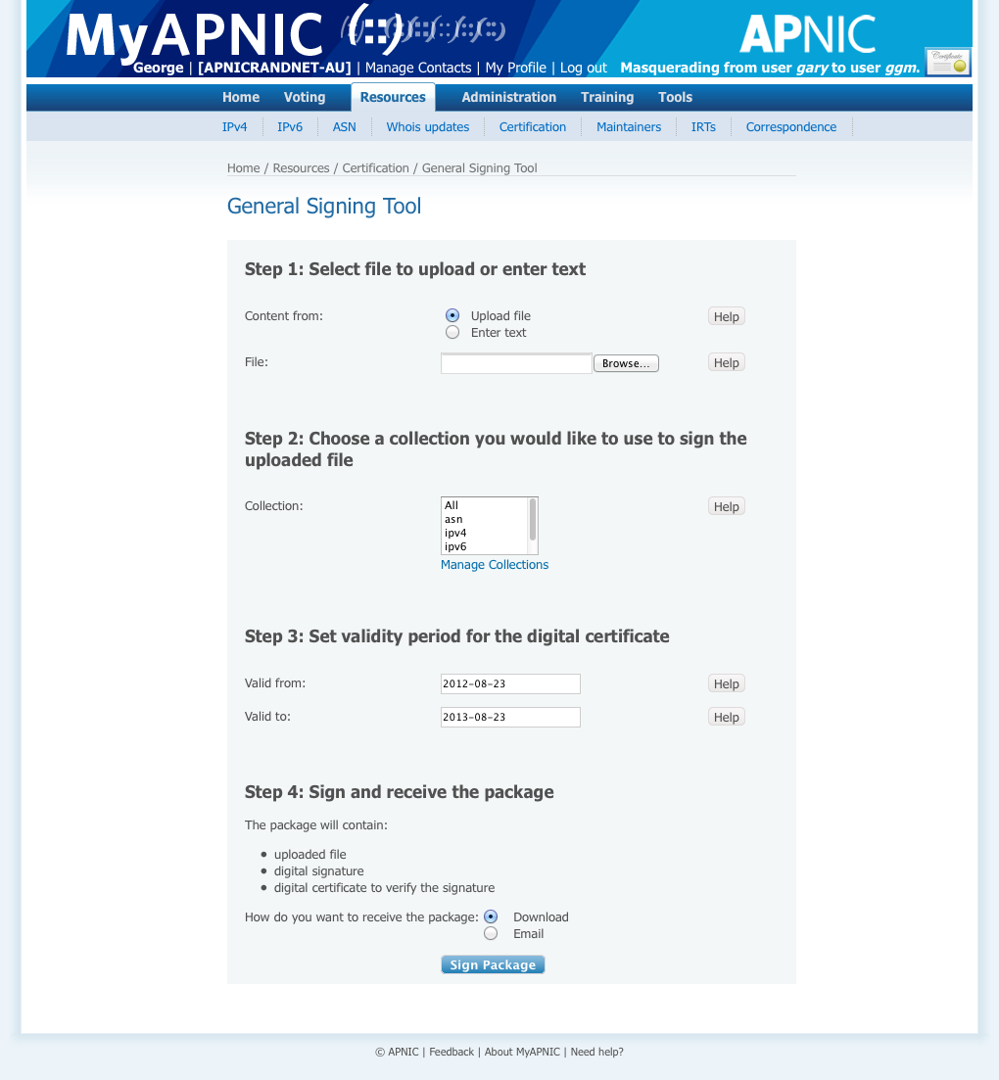

Slide 12
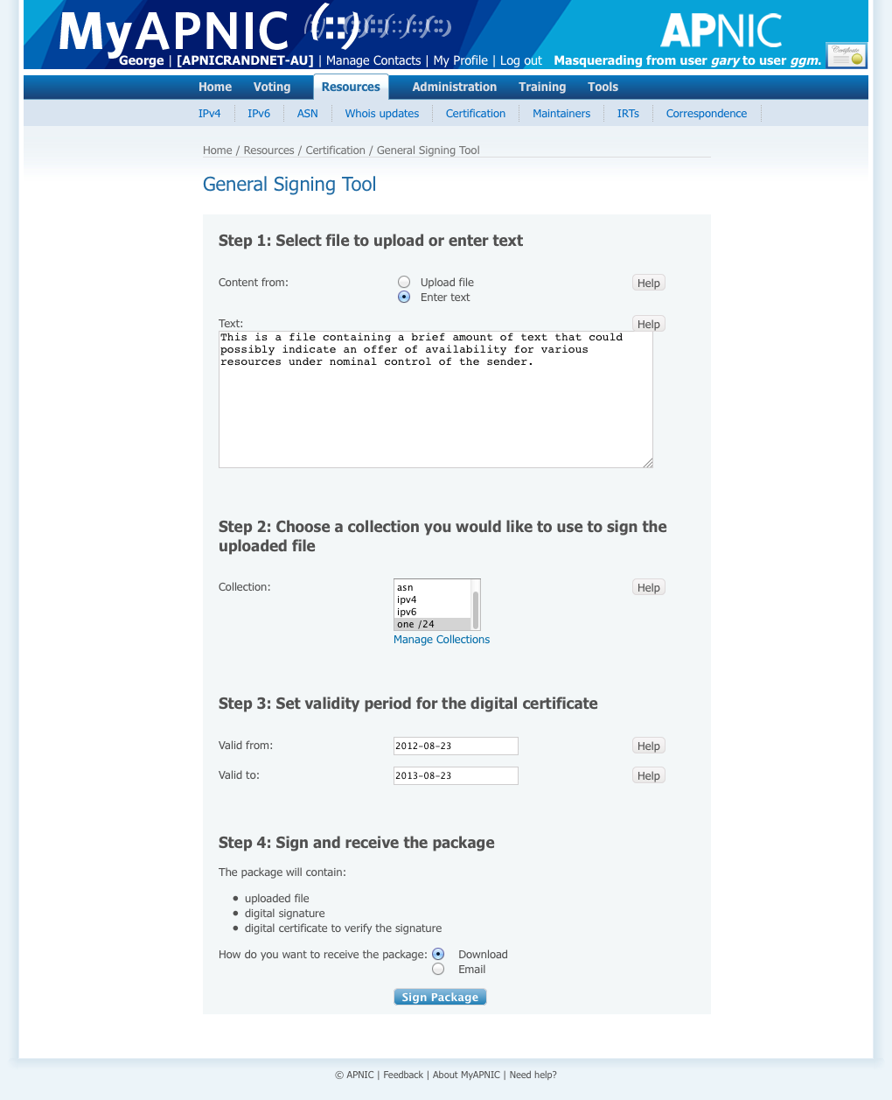

Slide 13
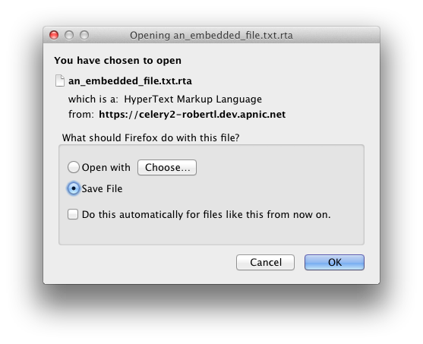

Slide 14
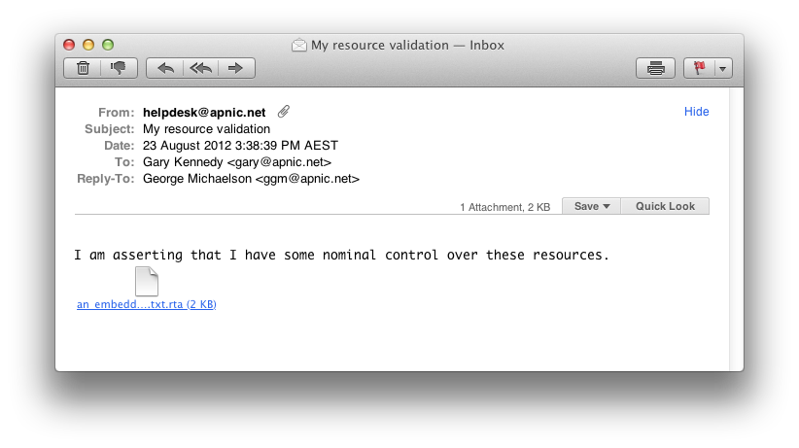

Slide 15
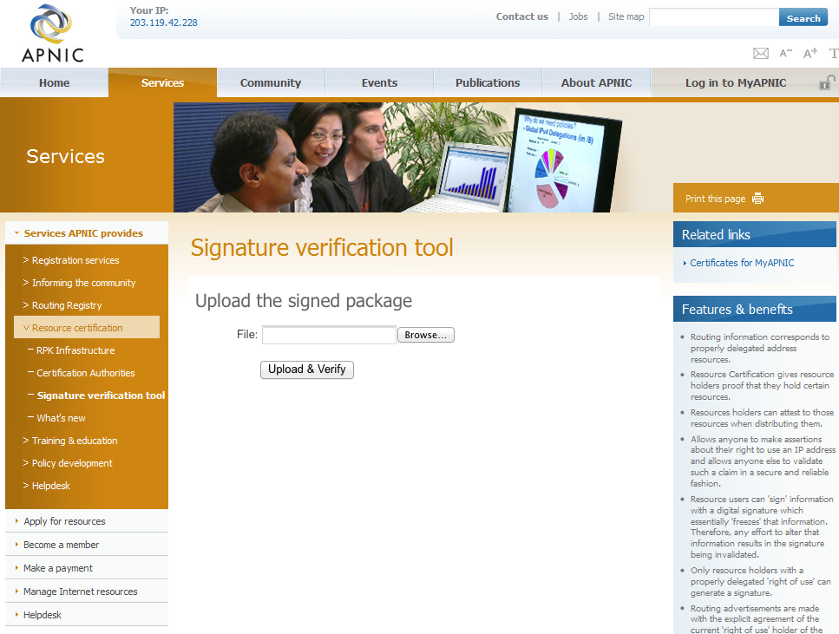

Slide 16


Slide 17


Slide 18


Slide 19


Slide 20


Slide 21
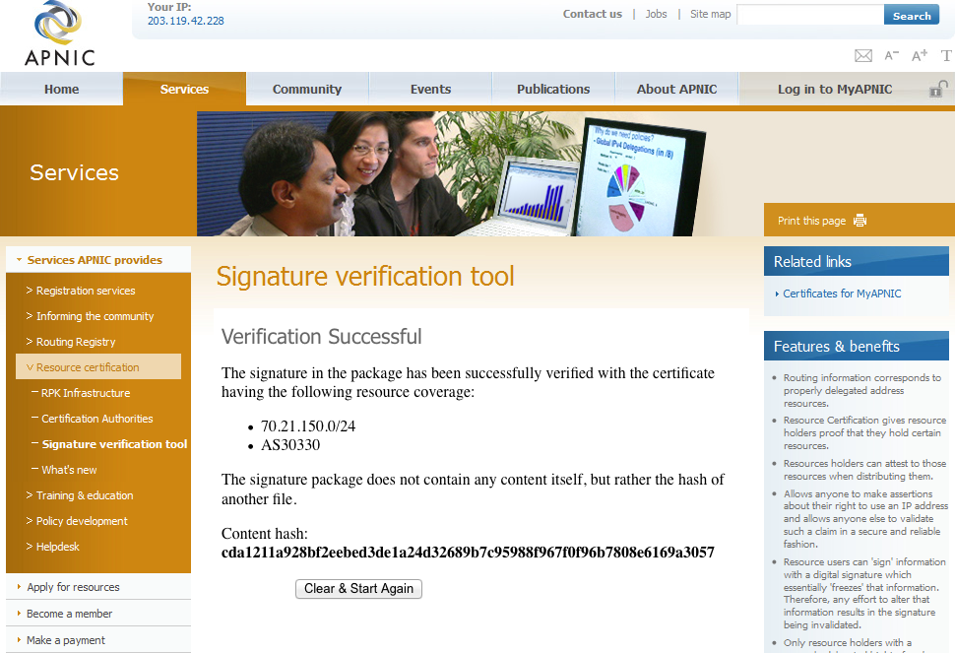

Slide 22
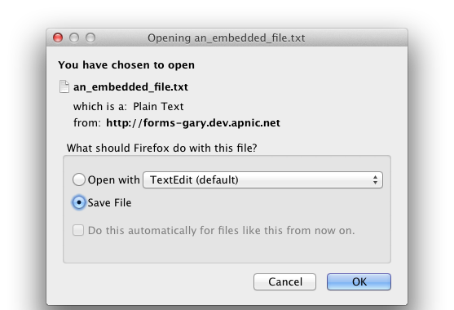

Slide 23
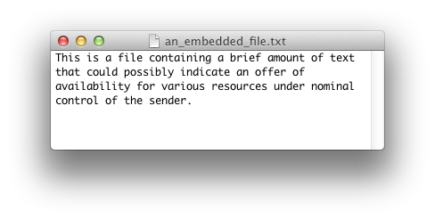

Slide 24
4. Public Up-Down Protocol interface
Complements existing myAPNIC hosted services
Allows for NIR and LIR sub-delegated RPKI services
Currently designing Up-Down enrollment procedures and credential exchange
End Q4 deliverable

Slide 25
Interfacing to NIR Resource CA
RPKI reflects resource allocation hierarchy
Support for NIR Resource CA therefore follows allocation hierarchy
APNIC cannot sign what it doesn’t know
APNIC RPKI CA signs the state of registry
APNIC supplies RPKI services over Up-Down Protocol
Certification Practice requires APNIC issue RPKI certificates to NIR
NIR operates RPKI services reflecting NIR registry state

Slide 26
NIR Operational Model
NIR operates an RPKI engine instance
Interface with APNIC via public Up-Down port
NIR issued RPKI certificates align to NIR resource registry state

