Slide 1


C.O.R.E. FLOOD ⁺ SMART
National, Community Based
Flood Mitigation Project

Slide 2
Agenda
What is C.O.R.E?
C.O.R.E. Partners
C.O.R.E Launch & Community Events

Slide 3
Hyogo Framework for Action
“Use knowledge, innovation and education to build a culture of safety and resilience at all levels”
Notes:
Promote community-based training initiatives, considering the role of volunteers, as appropriate, to enhance local capacities to mitigate and cope with disasters
Promote the engagement of the media in order to stimulate a culture of disaster resilience and strong community involvement in sustained public education campaigns and public consultations at all levels of society.

Slide 4
CDEMA CDM Strategy
“Enhanced Community Resilience in CDERA states /territories to mitigate and respond to the adverse effects climate change and disasters”

Slide 5
What is C.O.R.E?
CORE is Communities Organised and Ready for Emergencies.
A new ODPM initiative geared toward educating and preparing communities across Trinidad to help minimise the damage, risk and potential threat to life and property that result from disasters

Slide 6
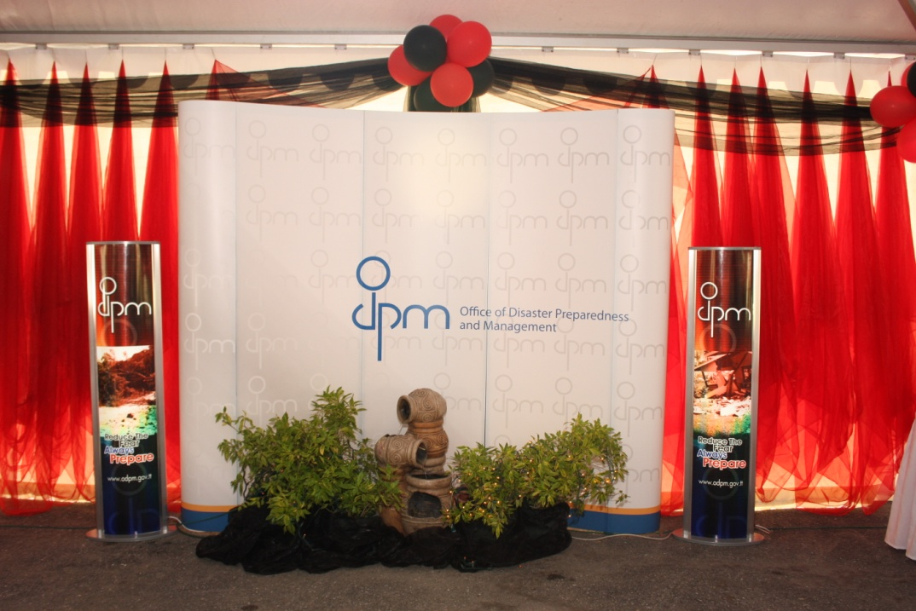



C.O.R.E Objectives
Flood Mitigation through awareness programme
PR & Visibility on the ground in communities
Strengthen relationships between ODPM and partners
⁺ many others

Slide 7
Our partners
Trinidad and Tobago Red Cross
Rotary Club
Adventist Development and Relief Agency
Habitat for Humanity
Ministry of Community Development
Ministry of the People and Social Development
Ministry of Health
Ministry of Local Government
Trinbago Emergency Network Team
Church of Jesus Christ of Latter Day Saints
Federation For Canine Registration Of Trinidad and Tobago
The Foundation for the Enhancement and Enrichment of Life
Kiwanis Club of Trinidad
Lions Club
Ministry of National Security
Trinidad and Tobago Fire Service
Trinidad and Tobago Defence Force
Trinidad and Tobago Police Service
Ministry of Works and Transport
Water Resource Agency
WASA
T&TEC
Trinidad & Tobago Meteorological Office

Slide 8

By working together with our partners,
we will aim to
educate, prevent and mitigate

Slide 9
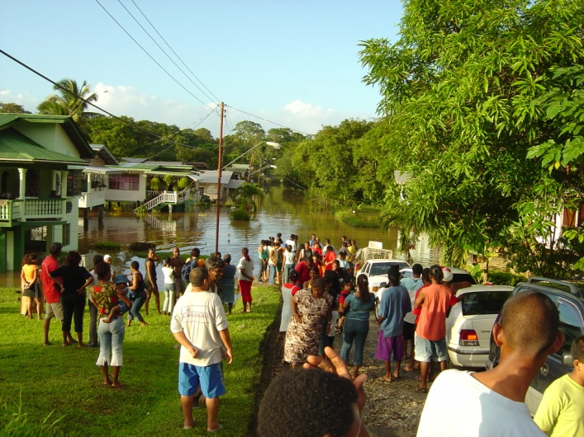
C.O.R.E Project
Community Walks
Visit the areas most affected
Listen
Learn and teach
Give-aways
disaster kits
flashlights

Slide 10
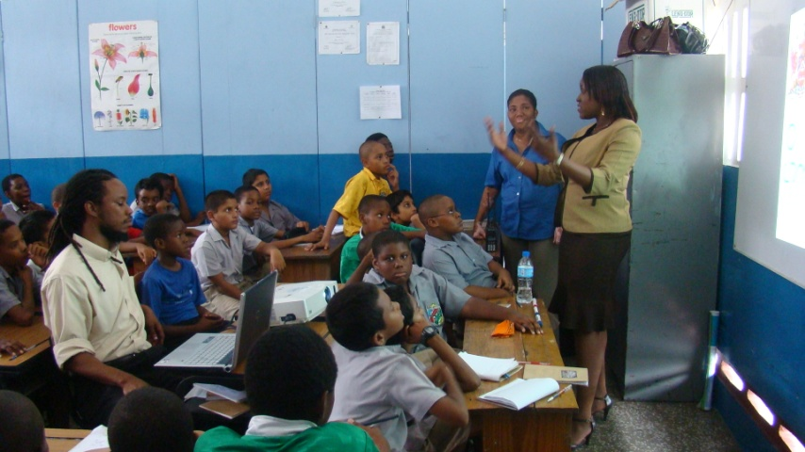
C.O.R.E Project
Big Events
Major events with half or full day agenda
Discussion facilitation
Combine with bigger calendar events during the year

Slide 11
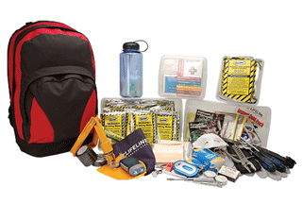
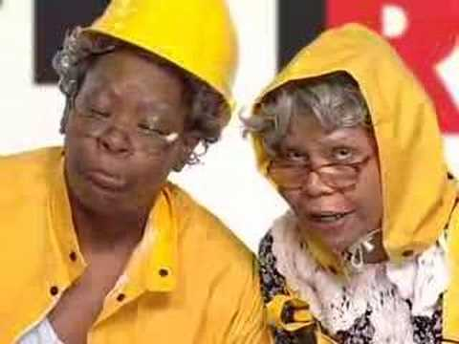

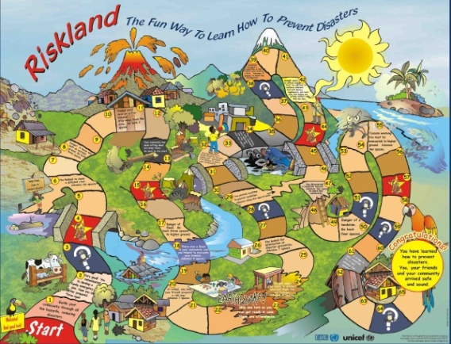
BIG EVENTS
Posters
Maps
Video Presentations
Disaster Kit
Flyers & Brochures
Audience
Riskland Game
Oral Presentations/Discussions
Food
Sponsors

Slide 12
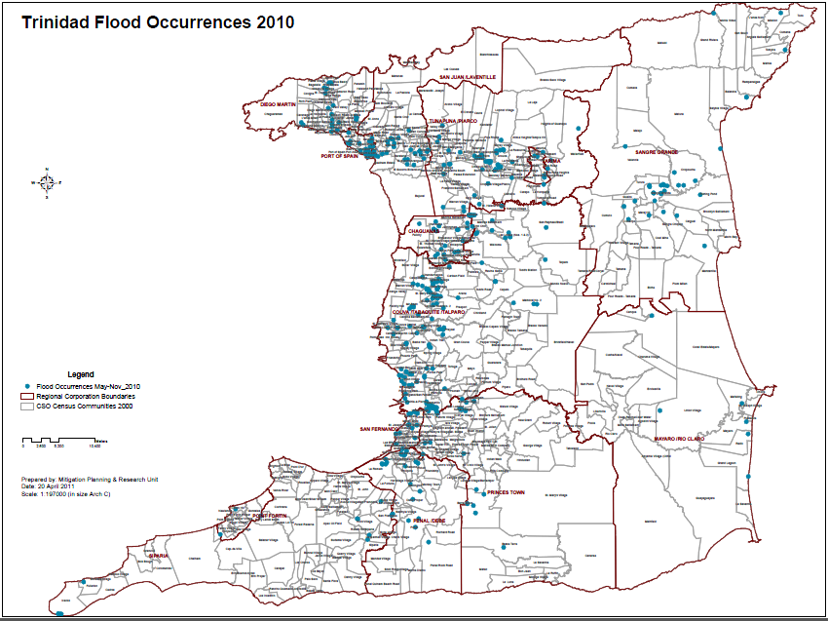
Flood Areas – 2010

Slide 13
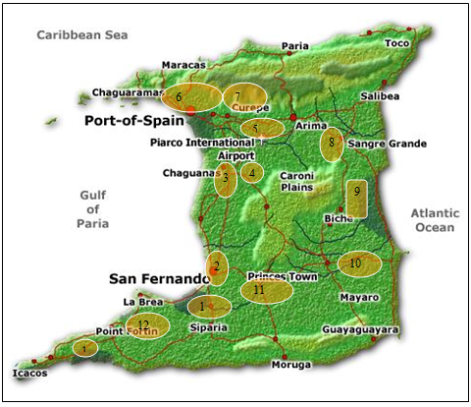
C.O.R.E. Communities
Gasparillo
Sangre Grande
Montrose Village/Lange Park
Diego Martin
Mc Bean / Chase Village
Trincity
Claxton Bay/Union Village
San Juan/Barataria
Port of Spain
Mayaro
Santa Cruz
Point Fortin
San Fernando

Slide 14
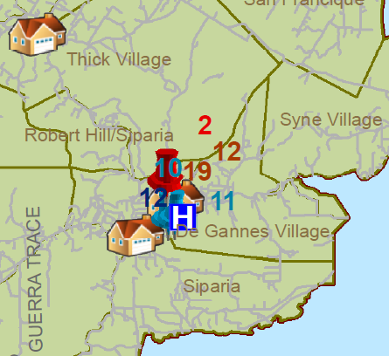
C.O.R.E LAUNCH 2011
Siparia
Saturday, 30th April 2011

Slide 15
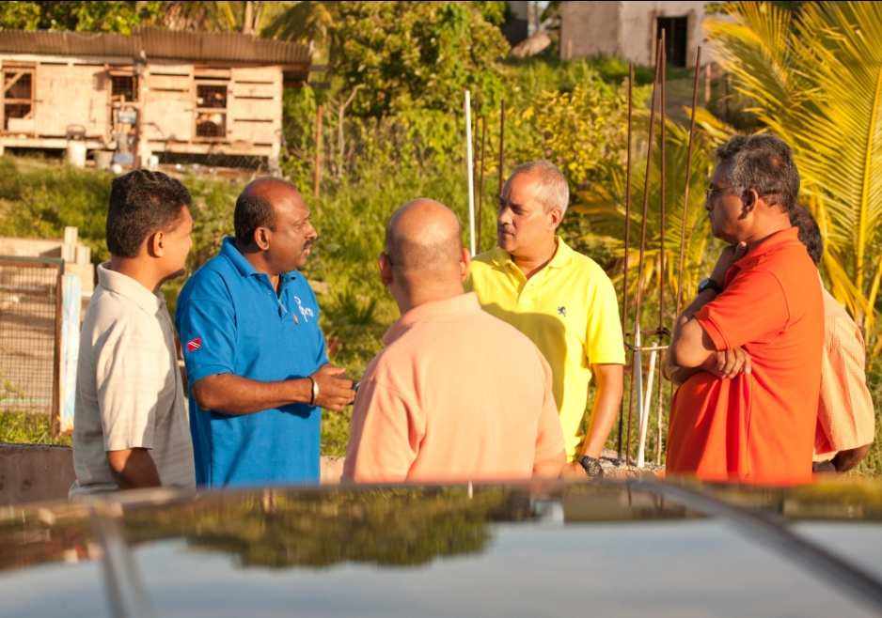
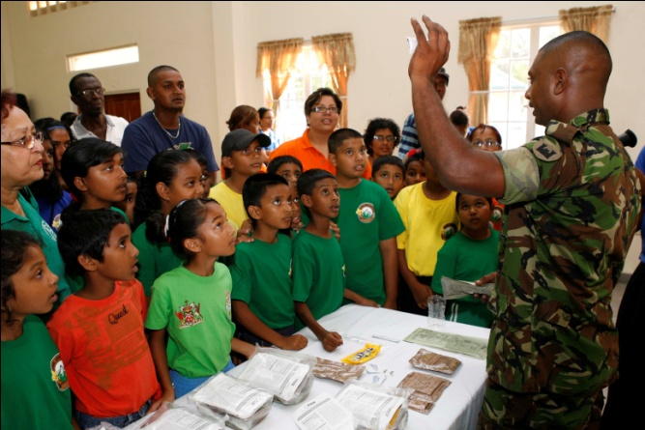
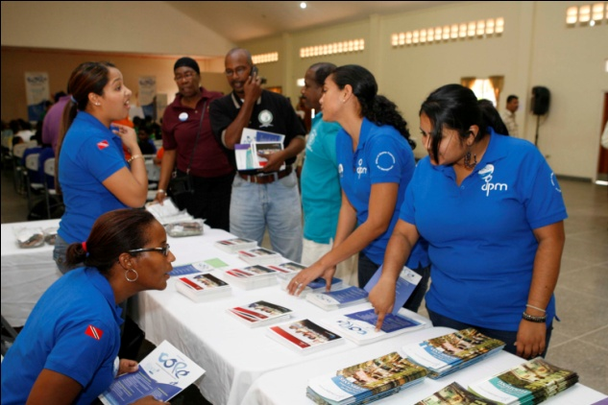

Slide 16
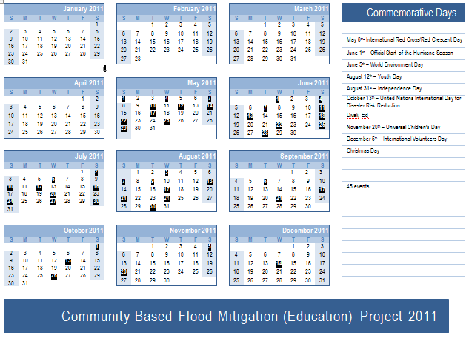
C.O.R.E events 2011

Slide 17


