Slide 1
Lessons Learnt from Major Housing Reconstruction Programs
Abhas K. Jha,
Regional Disaster Risk Management Coordinator,
East Asia and the Pacific,
The World Bank.

Slide 2
Two Main Objectives Today
Discuss lessons learnt from recent major housing reconstruction programs:
Ten plus One Meta Lesson
Make you aware of the Housing and Community Reconstruction Handbook project and solicit feedback.
Notes:
Tsunami-Aceh, Sri Lanka, Tamil Nadu, Bam, Pakistan

Slide 3
Why the Need?
Housing typically accounts for a large part (30 percent or more) of damage and losses after disasters.

Slide 4
Lesson # 1: Do a good damage assessment ….ONCE!
Simple , transparent criteria
Effective training a key to success
Community-led assessments a good complement to traditional methods
Swift and transparent grievance redressal
Notes:
Pakistan-photos of family in front of damaged house. Effective training.
Maharashtra-Pre-disaster landholding basis for assistance
Orissa cyclone-poverty line
Sri Lanka 5 category Maharashtra moved to 3
Grievance rederssal major issue in Latur.
Level one: At village level one can appeal to village grievance removal committee, if not satisfied you can always go to
Level 2: Appeal to tehsil grievance removal committee if not satisfied you can always go to
Level 3: District grievance removal committee, headed by DC/DDRO
In any case the decision of the district grievance removal committee will be

Slide 5
Lesson # 2: Put your reconstruction policy into place very early
Damage assessment feeds into policy
How much can you afford?
Key Questions:
What is a house?
Who gets a house?
What about non-damaged housing?
Technical guidelines
Environmental and social regulations
Broad, participatory and consultative process a must
Essential for managing expectations and resisting political pressures
Decisions in the relief and recovery phase set the context for reconstruction.

Slide 6
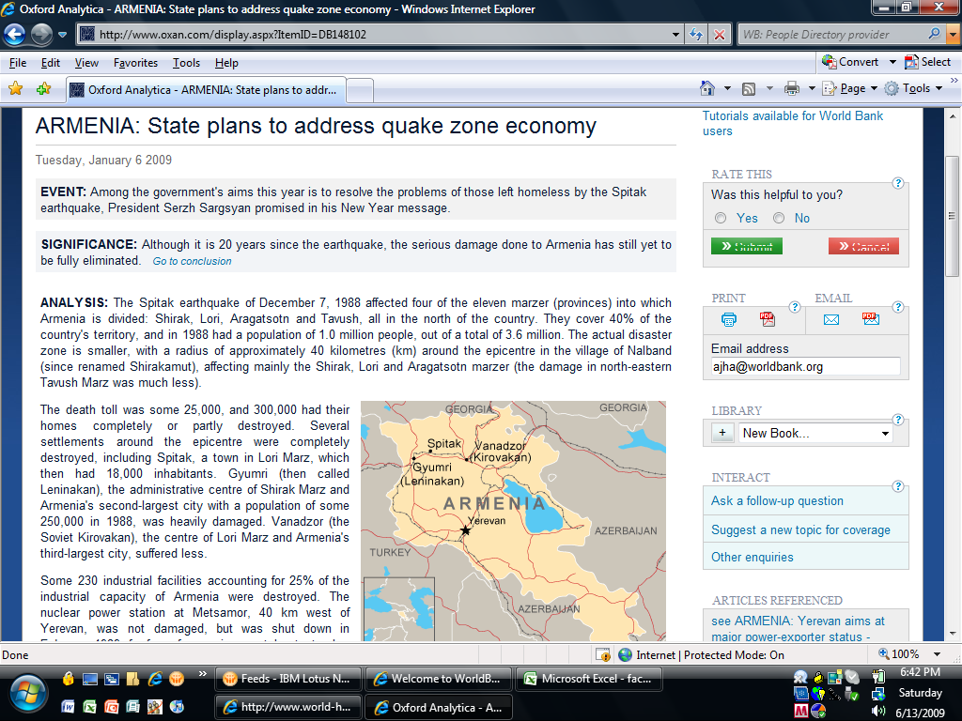

Slide 7
Lesson # 3: It’s about rebuilding communities
Not just physical spaces
Rebuild and restore
Livelihoods
Environment
Social fabric
Institutions and Community Capacity
Focus on the vulnerable

Slide 8
Lesson # 4 : Put Owners and the Community in Charge
Owner-driven reconstruction is the most empowering and dignified approach
Training and TA
Updating codes
Mechanisms to regulate prices
Financial assistance in installments
Does Not Work For Urban Condominiums!
Notes:
Gujarat 2001, Jogjakarta 2005, Thailand 2004, Sri Lanka 2004, Pakistan 2005
Tenants and Squatters
Gujarat NGOs-level of satisfaction high but lower than ODR.
High-levels of beneficiary satisfaction
ERRA has established 11 housing reconstruction centers and mobile training teams in the affected area for the training for local people and develop a capacity of building earthquake resistance house in the affected areas.

Slide 9
Lesson # 5: Institutions Matter
Authority
Autonomy
Political Support
Mandate, Policy and Plan
Effective Relationships
Military
Local authorities
NGOs
Donors
Notes:
Rule of thumb-more than a year or 1000 homes.
Pakistan ERRA in PMO-Military, Local Authorities, NGOs, Donors
Tamil Nadu-No execution

Slide 10
Lesson # 6: Use monitoring and assessments to improve outcomes
Technical Audits
Financial Audits
Social Audits
Use community and civil society for monitoring and trouble-shooting
Notes:
49 sq. km IKONOS, Bam, Pakistan, Thailand
Stereo images for DEM
Gujarat, Maharashtra-VLC, Charities, NGOs
Gujarat compliance pushed up from below 20 percent to almost 100 percent

Slide 11
Lesson # 7: Avoid Resettlement
Resettlement is usually unsuccessful
Livelihoods
Socially and culturally inappropriate
Sometimes unavoidable
Environmentally vulnerable
Successful resettlement
Takes into account livelihoods
Partners with the community
Fully serviced plots
Socially and culturally appropriate

Slide 12
Lesson # 8: Use Reconstruction to Mainstream DRM
Build back better!
Environmental and social sustainability
Cultural heritage preservation
Land tenure
Land-use planning
Anti-corruption
Notes:
Asbestos, Rubble-China, Turkey
Gujarat Urban Development Corporation-holistic town plans for 14 towns, 20 year horizon, building codes etc
Typhoon Tokage-2004 produced 1.5 times annual waste
UN-Bank protocol-October 2008
Effective anti-corruption plan-Fiduciary arrangements, TAP and corruption mapping matrix
BRR anti-corruption unit
Technical guidelines not designs
Coastal regulatory zoning

Slide 13
Lesson # 9: Training Makes a Vital Difference
Detailed damage assessment
Data collection and information management
Technical advisors and supervisors
Owners and builders in the field

Slide 14
Lesson # 10: Partner with Civil Society and the Private Sector
Constituency, capacity, outreach and skills
Align with government objectives
Formalize
Establish oversight mechanisms
Manage expectations
Notes:
Kutch Nav Nirman Abhiyan-14 grassroots NGOs
DHL-IFRC, FedEx-Red Cross

Slide 15
Lesson 0: It all depends!
Nature and magnitude of the disaster
Country context
Urban vs. rural
Special vs. regular procurement Regimes
Speed vs. quality
On vs. off-Budget

Slide 16
What is the Handbook?
1. A toolkit being prepared by the World Bank for use in large-scale, public housing reconstruction programs.
2. Printed version, downloadable handbook and parallel website

Slide 17
Website (Operational June 2009)
www.housingreconstruction.org
Wiki-type platform-Community of practitioners
Operational content-ToRs, Roster of experts

Slide 18
Why the Need?
Systematize knowledge and experience(Bank and non-Bank), consolidate the range of issues reconstruction entails
Primary audience is World Bank staff and their counterparts in the public sector managing large-scale public housing reconstruction programs.
Guide on how to get the job done-by providing a detailed, concise set of guidance, caveats and cautions for the entire housing reconstruction process.
Notes:
The World Bank has accumulated experience in large-scale housing reconstruction over the past several years.

Slide 19






Partners

Slide 20
The Process Timeline
Field Review-April 10-June 30:
Internal Bank review-QC Group plus Housing and Disaster Practice Groups.
Parallel external review-Bilateral partners, NGOs, GFDRR Results Council.
Presentation of Draft Handbook and website at Global Disaster Platform Meetings- June 17.
Final launch- Fall 2009

Slide 21
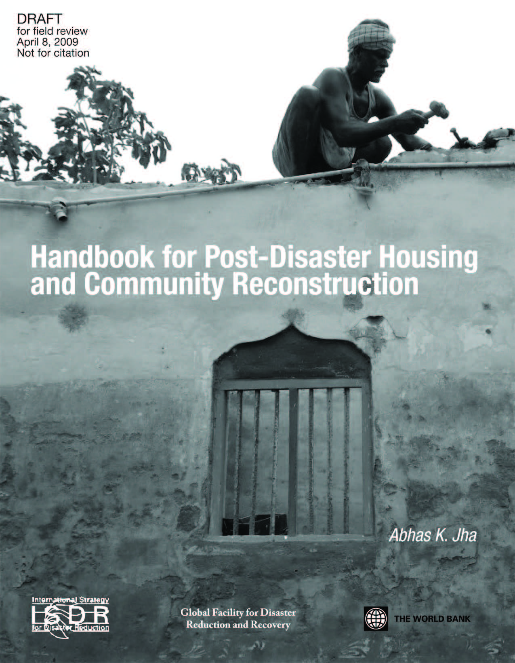
Please send us your feedback
http://www.tcgillc.com/pdhh.html
ajha(at)worldbank.org

