Slide 1

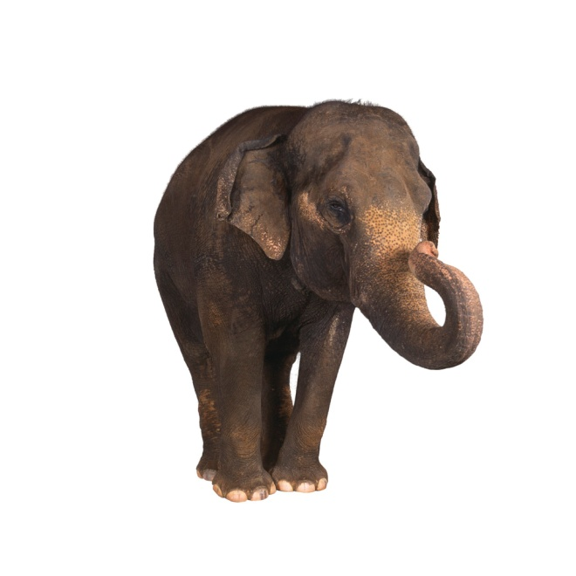
Scientific Root Words,
Suffixes, and Prefixes
#1
Created by B. Bowlby 2012

Slide 2

Match the root word, suffix or prefix with its meaning.
a. -ology
1. life, living.
b. bio-
2. one who studies.
c. zo-
3. Study of.
d. -logist
4. primitive, ancient.
e. -archaeo
5. animal.

Slide 3
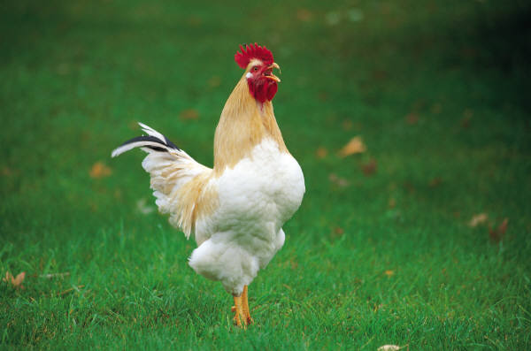
The answers are …
b. Bio-
1. Life, living.
d. -logist
2. one who studies.
a. -logy
3. study of.
e. Archaeo-
4. primitive, ancient.
c. Zo-
5. animal.

