Slide 1


Slide 2
Measuring IPv6 with advertisements for fun and profit
George Michaelson & Geoff Huston, APNIC

Slide 3
how to measure “the Internet”
What do we mean when we say
“we’re measuring the Internet?”

Slide 4

how to measure “the Internet”
What do we mean when we say
“we’re measuring the Internet?”

Slide 5

how to measure “the Internet”
What do we mean when we say
“we’re measuring the Internet?”

Slide 6
how to measure “the Internet”
What do we mean when we say
“we’re measuring the Internet?”
Number of hosts
Number of routes
Number of active routing entities
Number of application-events
Number of voip calls
Number of voice-over-IP in the carrier calls
Number of streaming TV watchers
….

Slide 7
Clearly a multi-dimensional problem
We’re well beyond single measure
Routing scaling for routing professionals
Traffic volumes for peering/settlement
Voice/data mix for telephony nuts
Finding datasets to suit the context
DiTL has root-DNS traffic covered
IX captures get local traffic mix, indicative volumes
ISPs track their own customer
Websites track their own users
Much of this is too valuable to be shared widely

Slide 8
Who is measuring the end user?

Slide 9
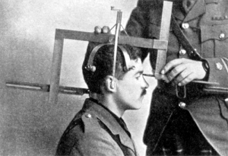
Who is measuring the end user?

Slide 10
Measuring the end user for IPv6 readiness
Need a technique which is ubiquitous
“Hop over” missing IPv6 enabled CPE
Reflect real-world end-user behaviour
Avoid systemic bias ‘my own web is typical’
Demonstrably not true for technical community
Access by tech end-user is ‘near the core’
bypassing CPE
Often has ‘special’ access
(new/novel/experimental & pre-service release)

Slide 11
JavaScript
Small community of researchers using JavaScript to ‘tickle’ web users via undisplayed fetches
Additions to website, not rendered into DOM, using unique DNS names, traceable
*.test.domain wildcards sub-classed to provide unique per-client test names
JavaScript driven client-side view of delay
Summary sent to web by ‘fetch’ of DNS name
Data in the name fetched, not in the content sent
Not substantially different to normal website tracking methodologies
Third party site, or alternate DNS names to main site

Slide 12
Anatomy of a web page fetch (1990s)

Slide 13
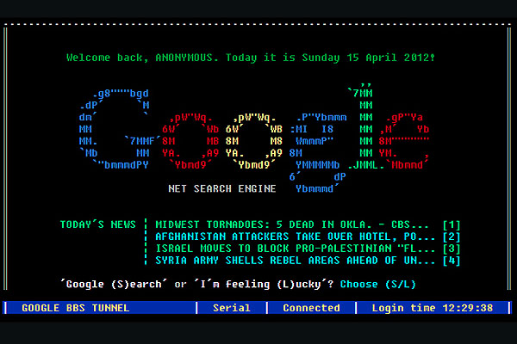
Anatomy of a web page fetch (1990s)

Slide 14
Anatomy of a web page fetch (1990s)
Client issues HTTP connect
:
Client issues “GET”
:
Client receives HTML stream in HTTP
Client disconnects
Server listens
Server accepts
responds 200 ok
Server receives, finds URL on disk, sends contents
:
:
Server exits and back to listen()

Slide 15
Anatomy of a web page fetch (2010s)

Slide 16

Anatomy of a web page fetch (2010s)

Slide 17
Anatomy of a web page fetch (2010s)
CAT
User visits URL in browser
Cached content pre-displayed
Cookies, JavaScript, Flash runs, decides what to display to user
Web page viewable
:
:
:
Maybe never Complete
Client issues several HTTP connects in parallel
:
Client does handshake over capabilities, header checks, tries to find cached content
:
Client receives HTML stream in HTTP
Client disconnects
Server listens
Server accepts
responds 200 ok
Server receives, finds URL on disk, sends contents
:
:
Server exits and back to listen()
CAT IZ NATZ OH NOES
CAT IZ GON

Slide 18
HTTP/HTML ain’t what it used to be
A huge amount of parallelism/asynchrony has been introduced.
Intermediate processing takes place on the stream of data, deciding what to display and what not to display
Adblock, flashblock, cache-optimizations
Document Object Model (DOM) includes material not displayed, material not added to DOM by scripts &c
JavaScript provides rich language including timers, async fetches, string/number processing

Slide 19
Anatomy of a JavaScript measurement

Slide 20

Anatomy of a JavaScript measurement

Slide 21
Anatomy of a JavaScript measurement
Website markup includes .js fetch, or inline <script>…</script> block
JavaScript engine in browser runs asynchronously to page render
Web page drawn unaffected/in-parallel with fetches
Spin random, to identify test. All fetches include unique id in wildcard DNS name
test314159.<test>.labs.apnic.net
Series of test images fetched in sequence (or random)
Dual-stack test314159.rdtd.labs.apnic.net A and AAAA record
IPv6 only test314159.rdt6.labs.apnic.net AAAA only
IPv6 literal [2401:2000:6660::2] no DNS involved
Each fetch has its own ‘sprite’ like timer
On completion, client-side delay (ms) measured from base clock
“Fail” timer, to send results at hang time if tests don’t complete (10s)
Results returned with same unique test id
test314159.zrdtd44.zrdt6101.zv6litnull.results.labs.apnic.net
Timer values embedded in the DNS name.

Slide 22
What do we get

Slide 23

What do we get

Slide 24
What do we get
Configure DNS to have a single NS, host that NS, and turn on query logging:
DNS logs of clients resolver to start test now captured
TCPdump of packetflows to webserver, dns, tunnel endpoint
Can detect partial connect failures, ICMP/ICMPv6 & SYN flows, TCP mss.
Also detailed inter-packet timings
Web logs
Successful fetch logging, order not guaranteed in logfile but has server-side timing information as backup

Slide 25
Cross-collating the data
Initial .js fetch on IPv4.
Confirms IPv4 address under test
Final results.labs.apnic.net posting on IPv4
Confirms test sequence ran to completion
If received, also has client-side delay times
All tests from same host carry same random ID
Where logged, can then cross-correlate IPv4 and IPv6
IPv4 and IPv6 can be seen in TCPdumps
Cross index to DNS resolver IP in DNS query also possible

Slide 26
Post-test processing
Oddities
results line received before tests complete
results line never received, but individual tests run to completion
tests lag by extreme periods, minutes after test
(so contradict results line which says null for that test)
Post-process heuristics manage this to produce ‘unified’ log of test combining data from web logs.
If any source said we saw the test, its included, even if results say test wasn’t run (!)
If results line provide times, then these times are used, otherwise server-side times are used.

Slide 27
What do we get?
Outcome: measurements at the 50,000 -100,000 hits/day level across 20-30 participating websites
large hits from specific economies/websites, skewing data capture
Still valid, but not yet ‘global’
A site like wikipedia, or an international newspaper would be EXTREMELY INTERESTING as a collection source
JavaScript can be used to perform 1-in-1000 type sub-rate filters to sample highly popular sites

Slide 28
Solutions
Need a way to get global coverage
We want to leverage the JavaScript investment, use the same data collection methodology (combine datasets)
Looking for a vehicle similar to JavaScript, but not limited to websites we can persuade to include our code.

Slide 29
…buy the impressions

Slide 30

…buy the impressions

Slide 31

…buy the impressions

Slide 32
…buy the impressions
Daily investment of $20 buys 50,000 impressions/day
Web advertising networks now fundamental to ‘making the web pay’
Lots of websites willing to have adverts placed for $
Well designed framework for distribution of content to websites en masse
Submit once, placement as widely as possible worldwide
Simple payment model based on impressions/clicks price point: CPM (clicks per mille)
Low CPM translates to high impression count
Remember: the advertising network wants your money, so if you bid too low for clicks, you get sold placements, to justify the payment

Slide 33
From JavaScript to flash
Advertising using flash encoded ‘dynamic’ content
Flash authoring tools widely available, ubiquitous for dynamic website content
Advertisement presents as an ‘image’ but can use flash to download active elements, movie clips, &c
The advertising economy is now almost completely based on flash
Turn off flash, or run an adblocker and visit your normal daily diet of websites…
JavaScript and actionscript near-cousins
Simple to translate working JavaScript into flash

Slide 34
Minor Problems

Slide 35

Minor Problems

Slide 36
Minor Problems
It’s a Morris Minor …..

Slide 37
Minor Problems
Advertising networks limit which flash primitives you can use (they reverse-compile the code and check)
Luckily, fetchURL() is basic to the flash-ad economy
Exclude random() library calls from code
the ad network has to provide information into the flash advert which is functionally highly random, which we reduce via hand-coded crc32() hash (which the reverse-compiler doesn’t complain about)
Cross site scripting demand use of crossdomain.xml fetch
Twice the volume of fetches required for same measurement
Could almost base method on this fetch alone (!)
Flash not on all platforms (cannot measure iOS)

Slide 38
Placement
At low CPM, the advertising network needs to present unique, new eyeballs to harvest impressions and take your money.
Therefore, a ‘good’ advertising network provides fresh crop of unique clients per day
Language-specific selections can tune placement
Evidence suggests that of 250 iso3166 economies, we have secured placement into 200, with 150+ at significant volume

Slide 39
Unique IPS?
Collect list of unique IP addresses seen
Per day
Since inception
Plot to see behaviours of system
Do we see ‘same eyeballs’ all the time?

Slide 40
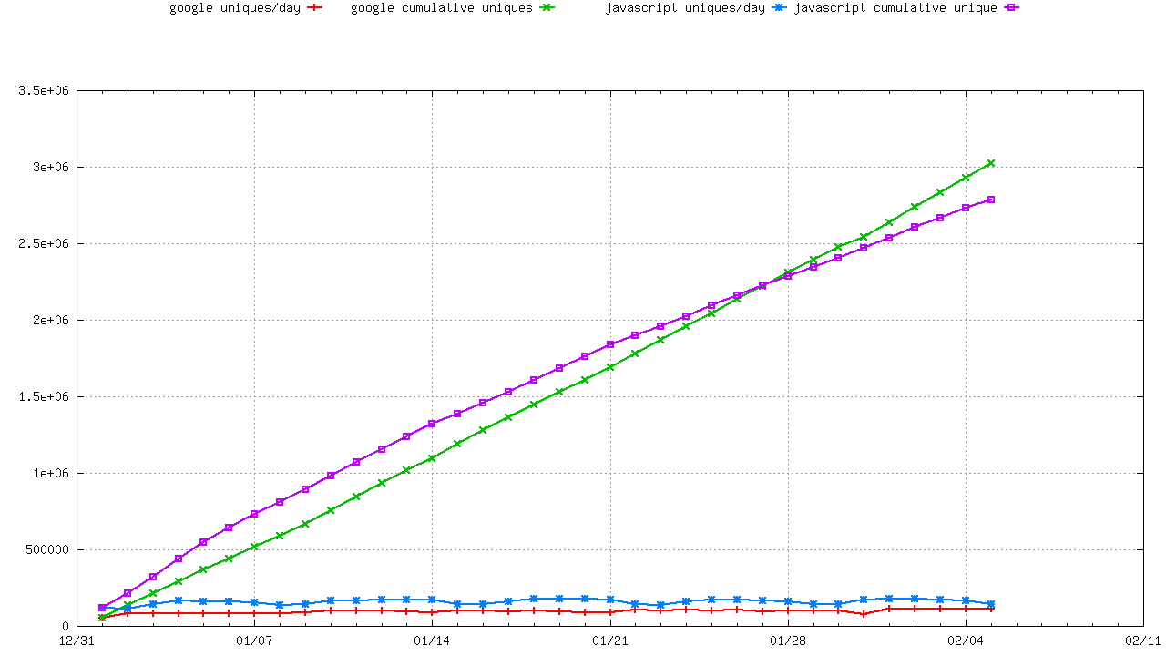
Lots of Unique IP’S

Slide 41
Lots of Unique IP’S
$20/day….

Slide 42
Lots of Unique IP’S
That’s a pretty straight line…
$20/day….

Slide 43
Lots of Unique IP’S
Both JavaScript and Flash delivering consistent, variant IP address sources every day
(Variances now coming in with higher volumes, changes to the experiment)
Slight sign of bias in JavaScript (same users coming back to same website)
Google Ads placement demands ‘fresh eyeballs’ to justify charge of placement based on impressions

Slide 44
How do the adwords people know we haven’t seen the IP addresses before?

Slide 45
THEY ASK GOOGLE

Slide 46
ASN Coverage
Collect list of unique AS for both IPv4 and IPv6 seen each day
Collate since Inception
Plot to see behaviours

Slide 47
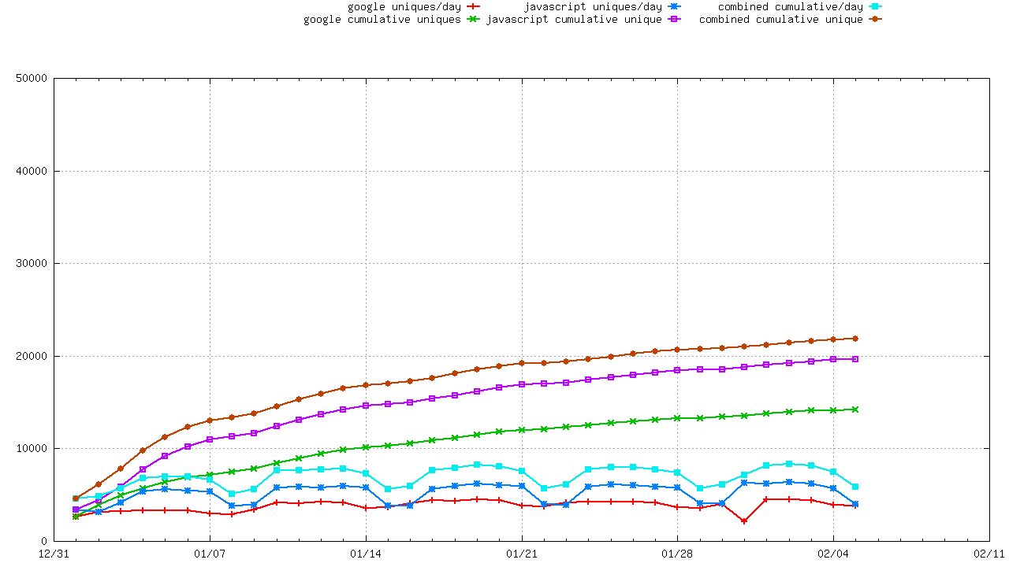
IPv4 ASN Coverage by time

Slide 48
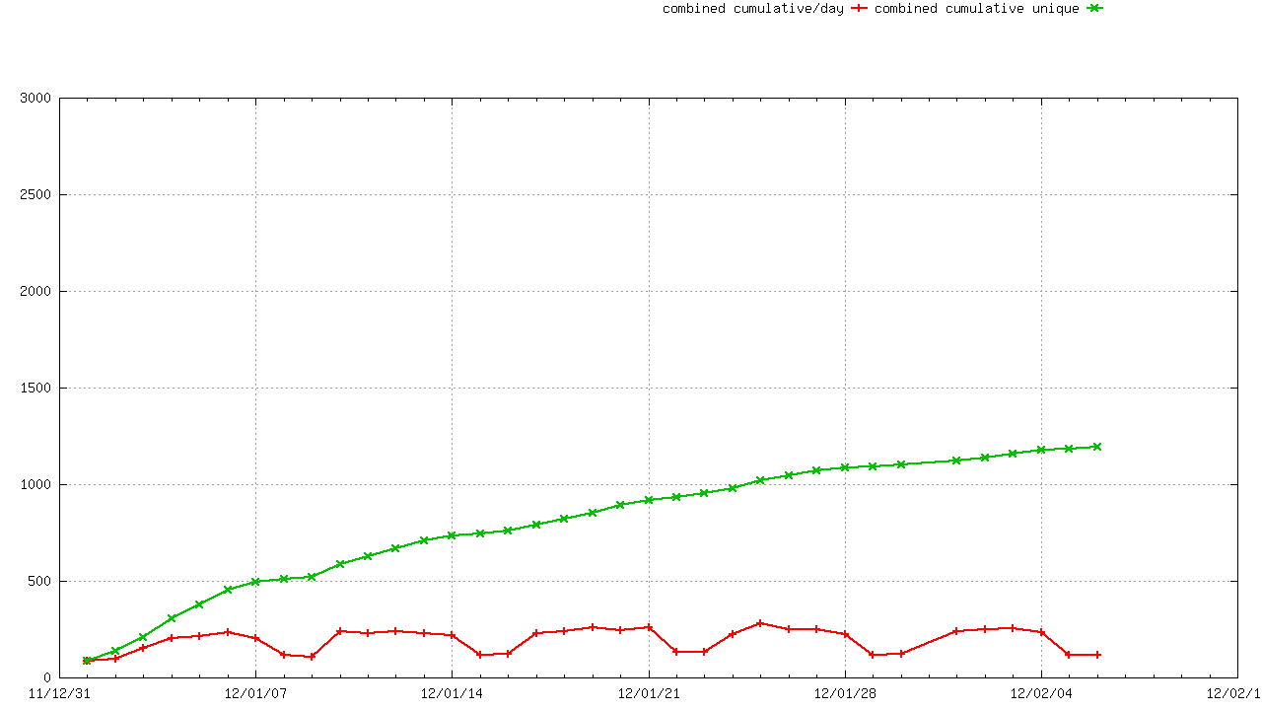
IPv6 ASN Coverage by time

Slide 49
AS Range by time
JavaScript shows more signs of ‘weekend droop’
Google aim to supply consistent load over time so artificially ‘inflate’ traffic against normal usage
Remember we’re 1/nth for a very small n of total advertising, so they can make us ‘constant’ when the JavaScript reflects real-world load per website and so can’t mask the ‘drop-off’ of weekend load
Trending to 25,000+ AS seen in IPv4
vs 1400 in IPv6
Few AS unique to either collection method (js/flash)

Slide 50
AS Range is Representative
25,000 ASN in IPv4 is a SIGNIFICANT amount of the global DFZ routed address space
We believe there is a lot of headroom yet to tap in the unique IP being served to us by the advertising network
We believe that we can use this data to make observations about global/internet-wide behaviours, as seen at the end-user.
Worldwide reach (thin at the margins)
We’ve already applied this method to ‘debogon’ checks on returned v4, found bogon filter matches.

Slide 51
RTT
One HTTP fetch of a 1x1.png is around 7 packets
Candidates for syn-ack matches in tcpdump
Each 1x1 fetch requires a crossdomain.xml
more syn-ack matches
Results line requires a crossdomain/1x1
At least 4, rising 10+ RTT measurements available off-the-wire, per tested IP
From 500,000+ distributed points in the network per day
High variances being seen in some parts of the network (c/f Geoff's presentation)
Complements ATLAS and other measures

Slide 52
Dealing with the data
Per-day, unified web, dns, tcp dumps
Separate per collection head-end .bz2
Reduce to Single-line per IPv4/IPv6 instance
(client being tested)
Add times of dual-stack, IPv6 literal, relative to IPv4 fetches
Approx 10Mb per day, 800,000 experiments/day
As of April 2012
Post-process to add
Economy of registration (RIR delegated stats)
Covering prefix and origin-AS (bgp logs for that day)
Combine into weekly, monthly datasets (<10Mb)
Map to publicly visible dataset forms (JSON/CSV)

Slide 53
What are we finding?

Slide 54

What are we finding?

Slide 55
What are we finding?
That’s just wrong..

Slide 56
What are we finding?
That’s just wrong..
MY EYEBALLS ARE MELTING…
IS THAT GEOFF OR GEORGE?

Slide 57
What are we finding?
This slide never happened OK?
What happens in MAT stays in MAT

Slide 58
What are we finding?
This slide never happened OK?
What happens in MAT stays in MAT

Slide 59
What are we finding?
http://labs.apnic.net/ipv6_measurement
Breakdowns by ASN, Economy, Region, Organisation
JSON and CSV datasets for every graph produced, on a stable URL
Coming soon: single fetch of the dataset for bigtable map/reduce
125+ economies provide >200 samples/interval consistently in weeklies, 150+ at monthlies.
Law of diminishing returns as more data collected
200 is somewhat arbitrary, but provides for 0.005 level measure if we get one-in-200 hit.
Beyond this, data is insufficient to measure lowside IPv6 preference
It doesn’t match google!
Yes, we differ significantly from the published google IPv6 statistics
This is interesting! Different measures tell us different things?

Slide 60
Google visualization API

Slide 61

Google visualization API

Slide 62
Google visualization API
G
GLE

Slide 63
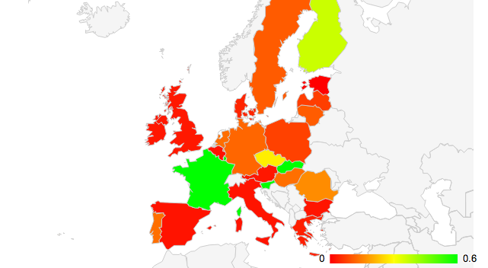
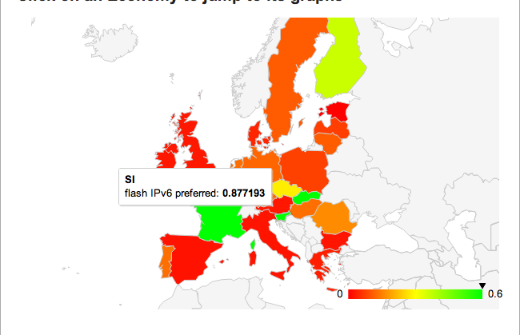
Google visualization API

Slide 64
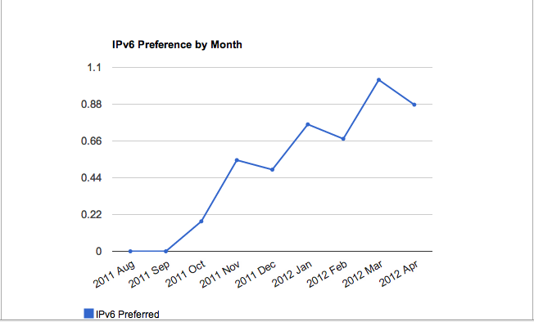
Google visualization API

Slide 65
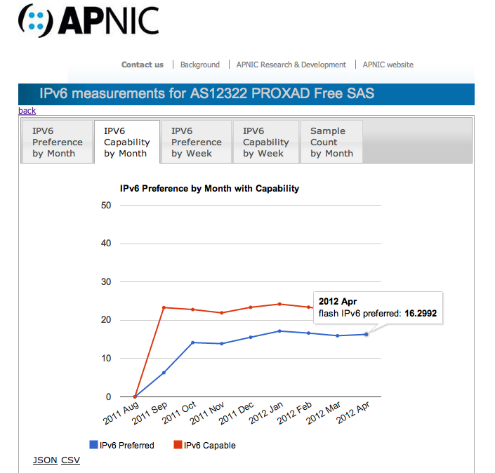
Google visualization API

Slide 66
Observations
The world is ‘lumpy’ for IPv6 preference
We can detect regional/economy-specific variances against world 0.3%
France up at 4%, Japan at 1.6%, US at 0.56
Sample sizes for OECD economies, UN regions are high enough to be statistically useful
Emerging Internet economies more marginal
Increased uptake would help extend coverage for iso3166, observing we’re already at 229/250 for some data, and over 100 economies for ‘good’ data volumes

Slide 67
AS views
Take per-day BGP views (AS4608)
Process IP stream by longest-match covering prefix, emit prefix and Origin AS
Side benefit: (cleanroom strip end-user IPs)
Result: per Origin-AS views of IPv6 preference
~1500 pass the 200-minimum samples test
Out of a population of ~5000 ASN in the IPv6 DFZ
More data not raising more V6 ASN significantly
Law of diminishing returns on who provides V6 to end-users at this time.
Interesting trend in hop-overs, and which ASN used
Signs we are detecting CGN/NAT/Economy-border filters?

Slide 68
IPv6 measurement
Penetration rate of IPv6 into the global AS economy is slow
No signs of ‘game changer’ flip to IPv6 at the end-user yet
Widely distributed hop-over for IPv6 being seen.
due to the CPE gap ?
Even IPv6 enabled ISPs have customers tunnelling over the air-gap
Much more information about IPv6, global internet behaviour is in the data
“watch this space” –long-term investment in measurement, ongoing.
Better datasets, BigTable map/reduce
Collaborations with “the usual suspects” to extend the experiment

Slide 69
Conclusions
JavaScript on web pages, and Flash in advertising networks are viable tools for a broad-range, high volume data collection of simple construction
Low cost of entry, high return on investment for measurement activity
Many Internet-wide, unique IP Addresses are visible. 33,000 ASN (v4) to 1600 ASN (v6) visible (April 2012)
75%+ coverage of V4, 25%+ of IPv6 ASN In DFZ
We have a LOT more information to get out of this investment. RTT, MTU/MSS, pMTU &c &c

Slide 70
Acknowledgements
Thanks to RIPE NCC, Google and ISC

Slide 71

Acknowledgements
Thanks to RIPE NCC, Google and ISC

Slide 72

Acknowledgements
Thanks to RIPE NCC, Google and ISC

Slide 73

Acknowledgements
Thanks to RIPE NCC, Google and ISC

Slide 74
Acknowledgements
Thanks to RIPE NCC, Google and ISC
More info, JSON/CSV data (daily updates)
http://labs.apnic.net/ipv6-measurement/

Slide 75


?

