Slide 1

Measuring IPv6 Users
George Michaelson,
Geoff Huston
APNIC
Notes:
I

Slide 2
How to measure the end user
Notes:
So, this is the question.

Slide 3
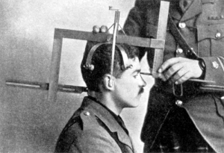
How to measure the end user
Notes:
We love to measure.
There are lots of things that can be measured on the Internet, and people are out there doing it.
We measure the amount of IPv4 and IPv6 address which has been assigned.
We measure how much IPv6 is being routed
We measure how many hits our webserver takes, or how many prefixes are in BGP, or how much traffic we see at exchange points.
So a question which arose for us, was, how can we measure what real people, ordinary users are doing?

Slide 4
How to measure a million end users
Notes:
We’re not really measuring one user.
What we want to do, is measure as many end users as possible, so we can start to understand how IPv6 is being deployed to the edge, and how its going to work.
The goal is to get good data, and that means getting as much data as possible, about as many different users as possible, worldwide.

Slide 5

How to measure a million end users
be www.google.net
G
GLE
Notes:
Well.. If you have the luxury of taking almost all search worldwide, you know everything about the user.
So, this is clearly one of the ways to do this: be big, and be a web service everyone worldwide goes to.
But we don’t have the luxury of being google.

Slide 6
How to measure a million end users
be www.google.net
or
Notes:
So we have to look for another way to get lots and lots of users to measure

Slide 7
How to measure a million end users
be www.google.net
or
Get your code run on millions of machines
Notes:
And the answer seems to be, to get users to measure themselves for you.
Now, I don’t mean ‘be a virus’ or ‘be a botnet’

Slide 8
Approaches to Measurement
A case study: APNIC’s approach
we wanted to measure IPv6 deployment as seen by end users
We wanted to say something about ALL users
Our website isn’t that popular
…So we were looking at a way to sample end users in a random but statistically significant fashion
We stumbled across the advertising networks...
Notes:
What we have done, is look into how we were able to characterize user behavuour from our own website measurements,
And then find a way to apply the technique to more people.
Our website isn’t that popular. And, it’s a very specific population of users who want to come and look at a Regional Internet Registry web page: its you. People who are very likely to have IPv6
So we tend to overcount the IPv6 capability from our own web, because the users who come there, are close to the core of their network, where IPv6 is easier to deploy.
This is where we stumbled across the advertizing networks

Slide 9


…buy the measurement
Notes:
Advertising networks are designed to show something to as many people as possible.
They are designed to get fresh eyes, to look at somebodys adverts.
They don’t just put adverts in front of your customers coming to your web, they put adverts in front of anyone they can make look at the advert.
The primary channel for web advertizing right now is flash. Adverts which have some dynamic behaviour like image swapping, presented to the user via flash. The mechanism permits the advertizing network to ask websites to embed logic in their webpage which fires off flash, which fetches the web adverts.
Flash, is a fully functional, network aware programming environment, Its perfect for what w need to do, conducting IPv6 tests.
And, what we’ve done, is embed a series of fetches of tiny, undisplayed 1x1 pixel images, each one backed by a DNS name which is unique and each one testing a different kind of transport over the Internet: Ipv4, dual stack, Ipv6 only.
We are then able to collate these fetches, and summarize what that user can do in each case, from their host.

Slide 10
Placement
At low CPM, the advertising network needs to present unique, new eyeballs to harvest impressions and take your money.
Therefore, a ‘good’ advertising network provides a fresh crop of unique clients per day
Pay for placement of ads, embed the measurement in flashcode.
Result is lots of Unique IP addresses to measure.
Notes:
There is a basic metric in web advertizing called the CPM or clicks-per-mille, how many people can be converted from viewing an advert, to clicking on an advert, which drives the pricing model.
Normally, people pay higher CPM if their advert is placed somewhere which achieves a high click-rate. That’s normally what advertizers want: they want people to follow the advert to your website, and buy something, and so complete a profitable sell.
But the advertizing network REALLY wants to take your money. So, if you deliberately bid LOW on the CPM model, they agree to show your ad widely, and take a different level of revenue from you, based on impressions not clicks.
And this drives a need to supply fresh new IP addreses, with fresh new eyeballs behind them, to justify charging for impressions.

Slide 11
Unique IPS?
Collect list of unique IP addresses seen
Per day
Since inception
Plot to see behaviours of system
Do we see ‘same eyeballs’ all the time?
Notes:
So a reasonable question to ask now is “how unique are these Ips”
And it turns out, they are really very unique.
We did some basic statistics on this, by comparing the flash advert to another mechanism we have on our own, and some other web pages, using javascript.
We’re checking the IP addresses we see each day, and seeing if they are unique in the day, and how many we see, and then also compiing a cumulative list of all the IP addresses we have ever seen.

Slide 12
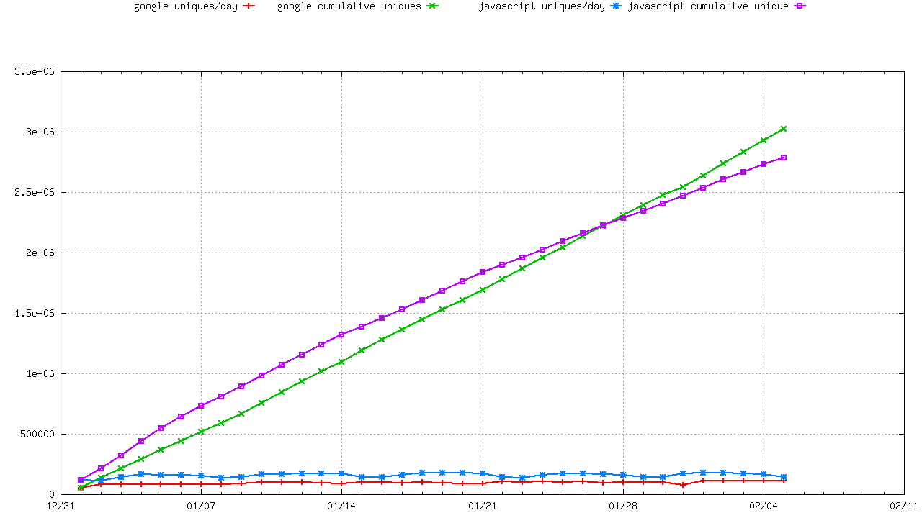
Lots of Unique IP’S
Cumulative Unique IPs
Daily Unique IPs
Notes:
So this graph shows the data as two sets of lines. Each set shows both javascript and flash.
Down the bottom, is the unique daily totals. And you can see that each method is sending broadly similar amounts of IP addresses, per day, unique counts.
Up the top, is the cumulative plot. And one line is very gentely curving down: this is the list of javascript Ips because it tends to collect all the addresses website visitors are using to come to the website: there isnt quite as much uniqueness over time, in this measure. –Its still pretty good, but it does tend to re-visit some of the same Ips.
The other line, the blue line, shows the uniqueness of the Ips presented by the advertizing network. And its substantially a straight line: they have a worldwide supply of clean, new, unseen eyes, and they are trying very hard to ensure we see these new IP addresses behind them.
This is because for us, a million users is a large measure, but the global network is now covering 2 billion people, so we are able to be supplied with constantly changing Ips from the world.

Slide 13
What are we finding?
http://labs.apnic.net/ipv6_measurement
Breakdowns by ASN, Economy, Region, Organisation
125+ economies provide >200 samples/interval consistently in weeklies
150+ at monthlies.
2400 ASN provide graphable data
Over 35,000 ASN seen during the last year.
Notes:
If you want to see the kinds to result we’ve collected, this is being presented from the labs.apnic.net website.
We’re archiving all our reduced data and making it available for view, and doing some post processing to compile comparative measurement by economy, region and organization. We think this is helping inform us about how each state and region in the world is doing with its IPv6 deployment, and can be used outside of the Internet technical community for strategic planning.
Whats interesting is that we’re seeing into a significant number of the individual networks worldwide: 35,000 ASN have been seen in the test, and that’s over 75% of the global AS network. Far fewer than this present enough data to graph, but its still a significant percentage of the 8 to 10,000 AS which are currently believed to be doing IPv6.
And at the national level we can plot about half of the worlds economies with some data, although in a few cases it’s a bit spotty.
At one presentation, I mentioned we’d seen the vatican, with about 16 adverts and I joked that I couldn’t confirm who was using the browser and hadn’t seen IPv6. Afterward I was told by somebody they knew that the Vatican City had been testing IPv6. I think we need a few more cardinals to get on the web so we can confirm that

Slide 14
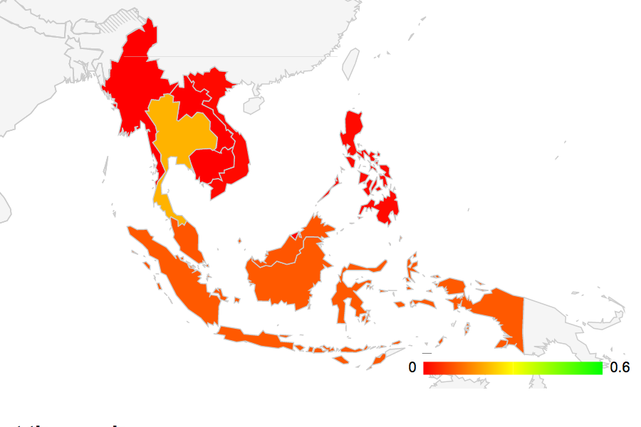

Google visualization API
Notes:
To display the data, we’re using the google visualization API.
This provides a really simple, rich set of javascript chart and graph models, and includes a good worldwide map model for colour graphing economies.
Here you can see it showing the UN economic region of ‘south east asian’ and you can see that Thailand and Indonesia are showing more IPv6 than other economies in the region, Thailand with 0.2% of users having IPv6.

Slide 15
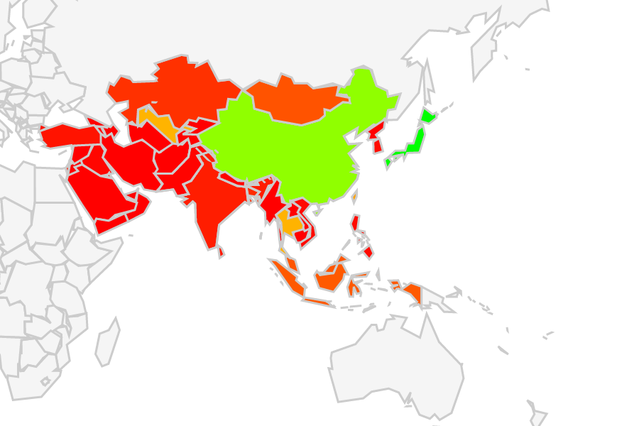
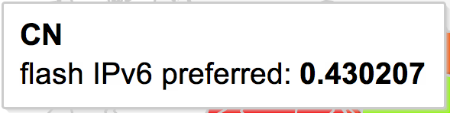
Google visualization API
Notes:
This is the google chart for Asia, and shows the penetration of IPv6 in China and Japan is significantly higher. China has double the Thai population, and Japan is already up at around 2%.

Slide 16
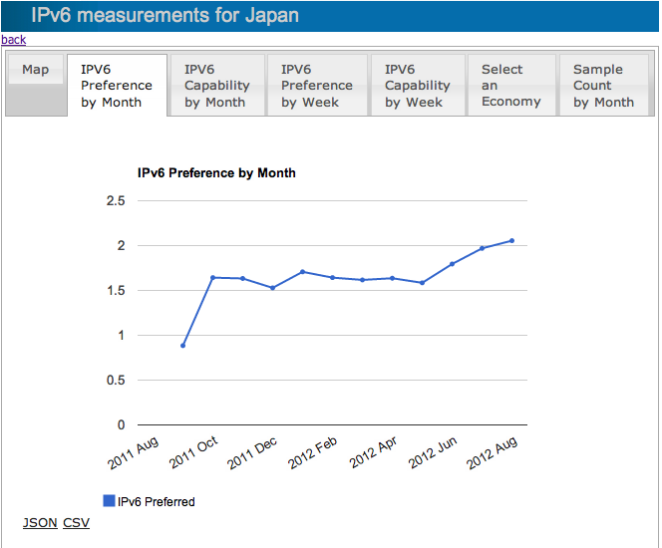
Google visualization API
Notes:
We also provide per-economy charts with monthy and weekly totals, this is the monthly chart for Japan and it shows that after a flat period in 2011/2012 there looks to have been quite rapid deployment of IPv6, around the time of world IPv6 launch.

Slide 17
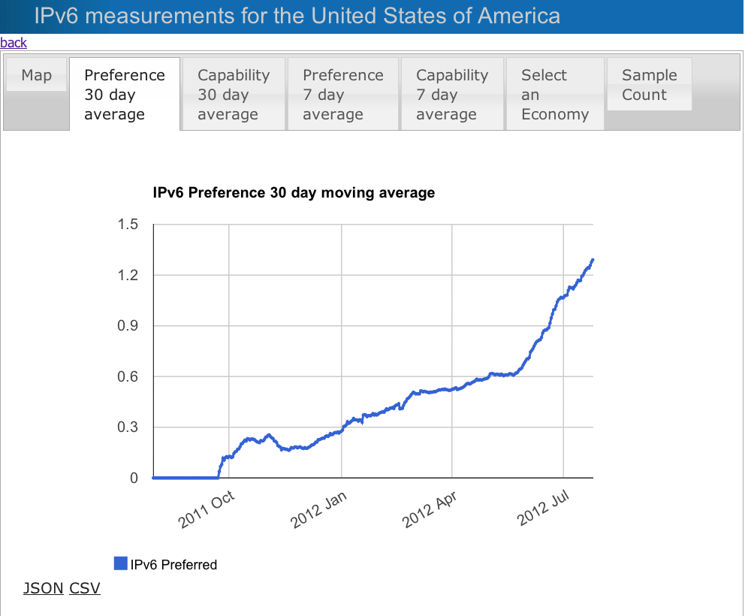
Google visualization API
Notes:
By comparison, this is a graph of the IPv6 uptake for the USA, using a moving 30 day model, whch smooths out a lot of the measurement variances.
It shows a really strong uptake of IPv6 during and after World IPv6 Launch and reflects the kind of capital and operating investment people in Verizon, AT&T, and Comcast have made, getting IPv6 deployed to the CPE.

Slide 18
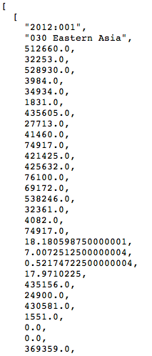
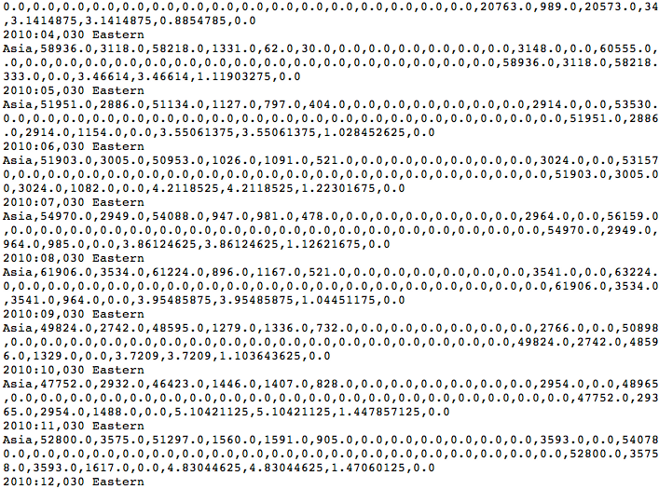
Draw your own graphs
http://labs.apnic.net/ipv6-measurement/datafields.html
Notes:
As well as charts, we’re making all the data available as JSON and CSV files, so you can post process it yourself. The URLs are described on the website, and are stable paths to fetch data in each context
This has been used by the New Zealand Internet community in their IPv6 deployment activity to show details on their national take up in their own web charts.
There is considerably more data than I can show here, we are currently charting the flash adverts, but we also collate and hold our javascript measurements, and if you want to view per-AS number, this is possibly a better dataset for you, because it covers far more AS with plottable data.
JSON is really easy to use, and has been useful sharing information with the RIPE NCC in our ongoing collaboration in IPv6 measurement.

Slide 19
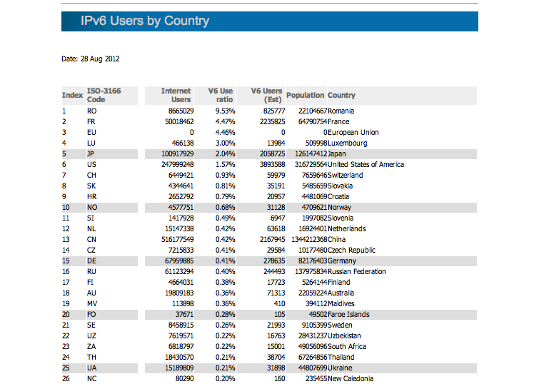
http://labs.apnic.net/dists/v6dcc.html
Notes:
One of the more interesting derived datasets we have is a table of the combination of the IPv6 capability with the GDP, population, and inferred internet usercount.
This is permitting us to show the indicative Ipv6 population by economy.
So, here it is presented in IPv6 preference order, and ranks economies by the apparent penetration of IPv6 with two standouts: Romania, where a single ISP has deployed a managed rollout to their CPE of IPv6, and achieved a huge nationwide success story, with over 22% of the userbase now IPv6 enabled (they have about half of the national footprint, so this drops back to a national measure of 9%)
The other is France, where Proxad/FreeNet has deployed 6rd, with a similarly massive effect to the customer. This demonstrates that sensible use of transition technology can work, and immediately boost IPv6 coverage.
Proxad is on 17% but with lower market share, the effect on the French IPv6 figure dilutes to 4% -which is still significantly ahead of current world average.

Slide 20
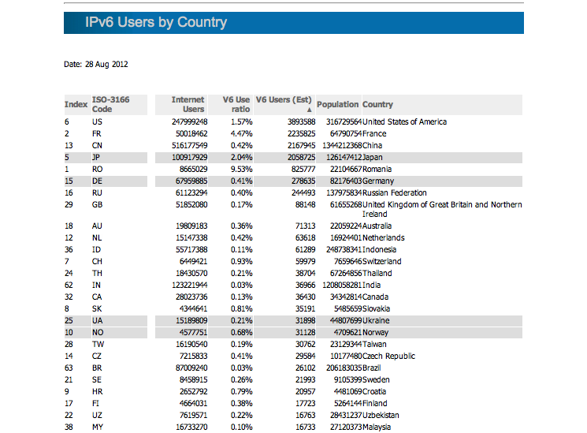
http://labs.apnic.net/dists/v6dcc.html
Notes:
We’ve made this a sortable table. If you resort by the inferred IPv6 population you see a slightly different story.
The top 5 economies are covering around 10 million users already. That’s a huge number in absolute terms, while being a very small percentage of the global internet userbase in relative terms. 10 million is a significant population of IPv6 usage.
China appears to have about one-quarter the penetration of IPv6 compared to the USA, but in population terms the difference is closer to half: it is clear that as China continues to deploy IPv6 it will move to the top of this table very rapidly.
And you can see further down the table there is visible signs the Asia-Pacific population from China, Japan, Indonesia, Thailand, India and Malaysia are visible.

Slide 21
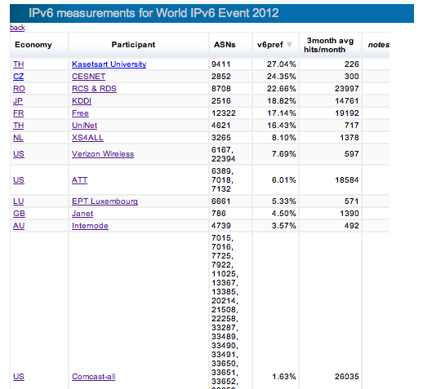
http://labs.apnic.net/ipv6-measurement/W6L
Notes:
We also have views based on the ASN, this one is the compilation of registered participants in the World IPv6 Launch. It helps to show that research and academic networks continue to dominate the deployment figures, because they are early adopters of new technology and have less issues in the CPE deployment problem space.
You’ll notice a Thai research net has pushed to the top of the table here.
But it shows some domestic ISP providers like XSforALL and KDDI do have IPv6 deploying to their customer base in volume, and it shows the emerging penetration of IPv6 into the large national carriers like comcast and AT&T

Slide 22
IPv6 measurement
Penetration rate of IPv6 into the global AS economy is slowly rising.
Signs Global-Unicast IPv6 will shortly overtake Teredo
Widely distributed hop-over for IPv6 being seen.
due to the CPE gap ?
Even IPv6 enabled ISPs have customers tunnelling over the air-gap
Much more information about IPv6, global internet behaviour is in the data
“watch this space” –long-term investment in measurement, ongoing.
Better datasets, BigTable map/reduce
Collaborations with “the usual suspects” to extend the experiment
Notes:
So, this data is what is driving my personal sense that IPv6 has arrived, its here, and we have a good news story on our hands right now.
Trends are up. They are variable, and the world is not flat: rates of IPv6 adoption vary by economy, and by region, by ISP, and they reflect sometimes the global economic conditions, and sometimes the capital investment regime in a specific place and time.
While in general tunnels are bad, transition technology like 6rd done right, can make IPv6 deployment to the user reasonably good. The CPE gap is the real problem.
APNIC is making a long term investment in data analysis, and hopes to continue to inform the industry, and strategic planners with this kind of information.

Slide 23
IPv6 measurement
If you see the advert

Slide 24
IPv6 measurement
If you see the advert
PLEASE DON’T CLICK ON IT
(it costs us more)

Slide 25
A word for our sponsors
Thanks to
the Internet Society
Google
ISC
RIPE NCC
For funding, platform support, collaboration

