Slide 1
Elections Matter: The Importance of Voting
Julietta Teresa Martinez-Landeros Resident Advisor University of Colorado at Boulder

Slide 2
Note from the Author
My floor has an Avengers theme, and because this creates a sense of unity on the floor, residents asked for interesting ways to keep the theme going throughout the year. Thus, as the first Avenger is Captain America and as this is a presidential election year, I thought it would be a cool idea to educate residents on the importance of voting, especially as college students make up a very powerful voting block. This powerpoint uses non-partisan facts as statistics that simply demonstrate the power of their vote, and how voting affects their lives in ways they may not be aware of. Residents responded very well to this bulletin board, and in fact began to discuss if they were voting and why it is important to vote. They were especially responsive to thought provoking information they may not have otherwise known. Best, Julietta Teresa Martinez-Landeros Resident Advisor, University of Colorado at Boulder

Slide 3
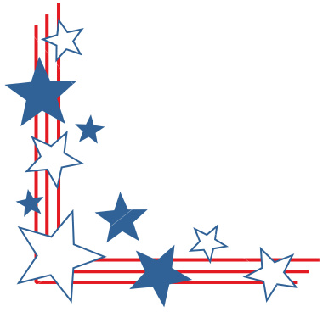
Did You Know?
The Millennial generation already makes up 1/5 of the electorate. By 2015, they will account for 1/3.
Compared to 2000, young voters have more than doubled their turnout in the 2008 primaries and caucuses.
In both the 2006 and the 2008 primaries, young voters made the difference in several tight races. Senator Obama owes his caucus win in Iowa to 18-29 year olds, and a winning margin among the youth vote helped Senator McCain win in California.
The 2008 presidential election was the first in decades where candidates were actively and aggressively courting the youth vote. In the primaries, four candidates from both parties had full-time, national youth outreach directors.
Young Latinos are the largest, and fastest-growing ethnic subset of young adults; 50,000 young Latinos turn 18 each month, and Latinos make up 17% of the youth electorate.
Since 2004, young women have led the turnout increase witnessed among young adults overall. In both 2004 and 2006, young women voted at rates seven and three points higher than young men.
Research shows that young voters with college experience are much more likely to vote than their non-college counterparts. Although ½ of young Americans ages 18-29 have never enrolled in college, 79% of the young voters on Super Tuesday attended college.

Slide 4
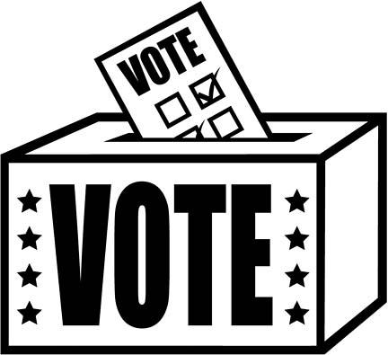
Your Vote Matters!
Top 10 Reasons You Should Vote

Slide 5
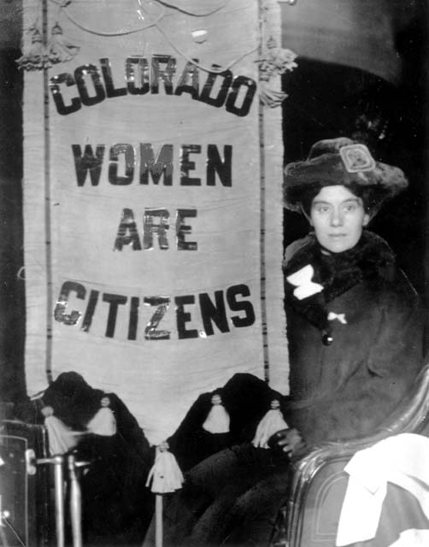
10. Honor past sacrifices
Voting is a way to honor those who have helped to secure our rights. Military members who have fought for this country, suffrage activists and Civil Rights leaders are only a few examples of those to whom we owe our respect and appreciation. Voting gives you the opportunity to help pay that debt.

Slide 6
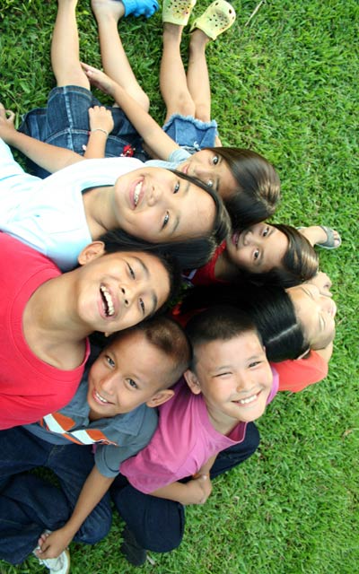
9. the next generation
By voting you are not only doing your part to influence the present, you are also affecting the future. Demonstrating this point well is the fact that the president selects U.S. Supreme Court Justices for lifetime appointments. These judicial officials may exert powerful influence for decades to come.

Slide 7
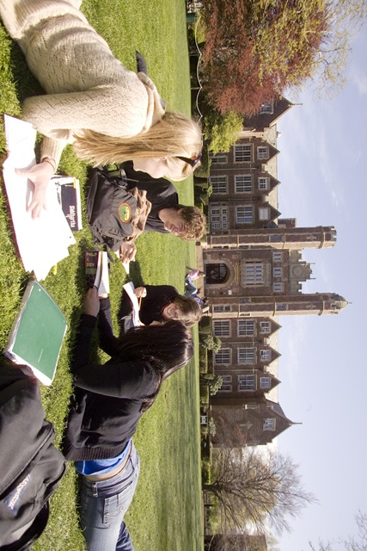
8. address student needs
Politicians know who votes each election, and they are more likely to support initiatives that are popular among groups with the highest voter turnout. For college students to have significant political influence, they must turn out in greater numbers than is traditionally seen. You have a part to play in that.

Slide 8

7. important voting bloc
The college vote can swing elections. There are more than 75 million Millennials, a number that rivals the number of baby boomers - another important voting bloc. The problem is that college students typically vote in much smaller numbers than older citizens. Mobilized, Millennials represent a powerful political force.

Slide 9

6. Address environmental issues
The environment stands to be among the biggest political topics of this generation. Many climate experts warn of serious, potentially irreversible weather changes that may drastically alter life on our planet. Whether you agree with this assessment or have other views, your vote is a way to express your convictions.

Slide 10
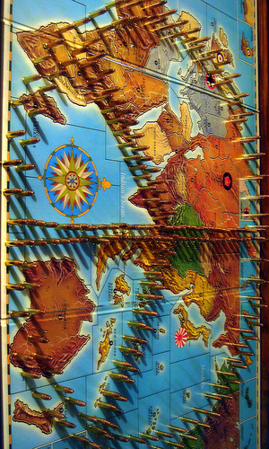
5. shape foreign policy
National leaders in Washington, D.C., are continually making foreign policy decisions, including when to intervene militarily in world affairs. It isn't the president or Congressional members who deploy to other countries to risk their lives - it's young people. Use your vote to support foreign policies you believe in.

Slide 11
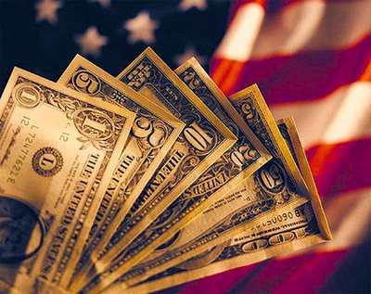
4. Shape Economic future
Most expect social security benefits to be gone or greatly diminished by the time college-aged individuals reach retirement age - which will be higher than it is now. Politicians continually make decisions about higher ed costs and student loan policies. These and other issues prove you have an important economic interest in every election.

Slide 12

3. Shape social agenda
Are you passionate about a particular social issue? Gay marriage, the economy, the environment, military spending, immigration and foreign policy are only a few of many contentious topics that dominate the political discourse. Learn about candidates' views on issues that are important to you, and vote in support of your beliefs.

Slide 13
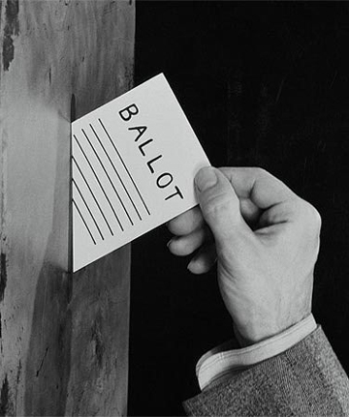
2. Your voice matters
Many students don't believe their vote will make any difference, but recent history has shown that elections can be decided by a handful of votes. In fact, many local contests end in ties each election year with winners being determined by a coin flip. Taking the initiative to vote can help prevent elections from being left to chance.

Slide 14
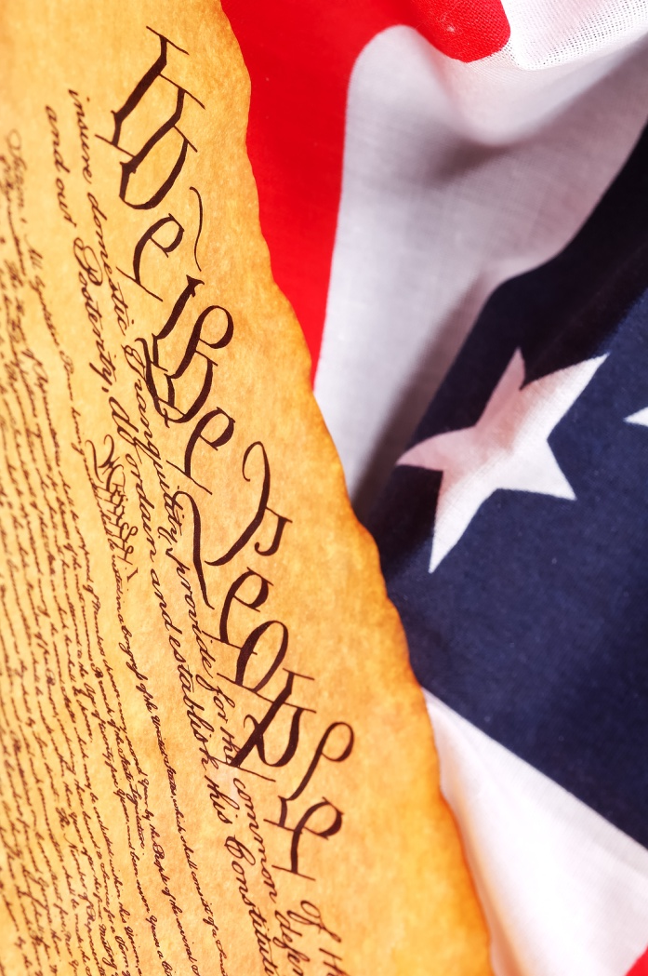
1. It's your right
Just as you've been told since elementary school, voting is an important right we have a duty to exercise. Many governments around the world allow citizens no part in electing officials. You do have the opportunity to help select government leaders, and the health of our democracy relies on your participation.

Slide 15
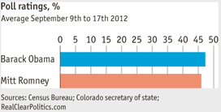
Battlefield: Colorado
Swing State: A state in which no single candidate or party has overwhelming support in securing that state's votes. These states are also referred to as a Battleground state.
Colorado is the target of both major political parties in presidential elections, since winning this swing state is the best opportunity for a party to gain votes. With such a close race in 2012, your vote really does make all the difference!

Slide 16
Out-Of-State
Worry not, out-of-state students! The Supreme Court has ruled that college students who go to school out-of-state enjoy certain protections allowing them to register to vote in either their “home state” or “school state.”
Visit Countmore.org for more details.

Slide 17
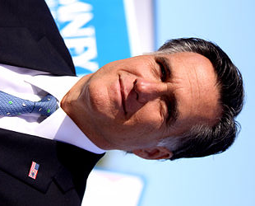
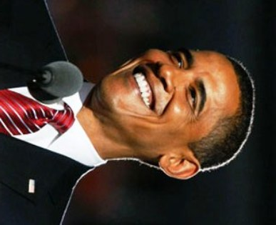

Now Get Involved!
Barack Obama (D)
Website: barackobama.com/
Facebook: facebook.com/barackobama
Twitter: twitter.com/BarackObama
or @barackobama
Learn more about the leading candidates by visiting their website, liking them on Facebook, and following them on Twitter!
Mitt Romney (R)
Website: mittromney.com
Facebook: facebook.com/mittromney
Twitter: twitter.com/mittromney
or @mittromney

Slide 18
