Slide 1
SANDRA WILLARD

Slide 2


Slide 3
Both nature and people inspire me, which is evident in the subjects that I choose to draw. I love the beauty of this planet and can never find enough time to put down on paper everything that excites me. Having deep respect for the work of such artists as Seurat, Wyeth, and Escher, provides inspiration for many of my pieces.

Slide 4
As a self-taught artist, I began my professional career at a very early age. I sold my first artwork in the fourth grade to a classmate. I find myself constantly viewing other artists work and frequently refer to the masters as a means to improve my skills. My personal belief is that artists learn best by observation, practice and developing a style unique to themselves. When I create a piece of art, I look for a particular quality or emotion of my subject that fascinates me. My art is a success to me if it slows a viewer down and they get lost in the moment. Although not every piece tells a story, when there is meaning behind a particular work that I’ve created, I enjoy relating it because it adds so much more to the art.
http://www.ebsqart.com/Artist/Sandra-Willard/10151/

Slide 5
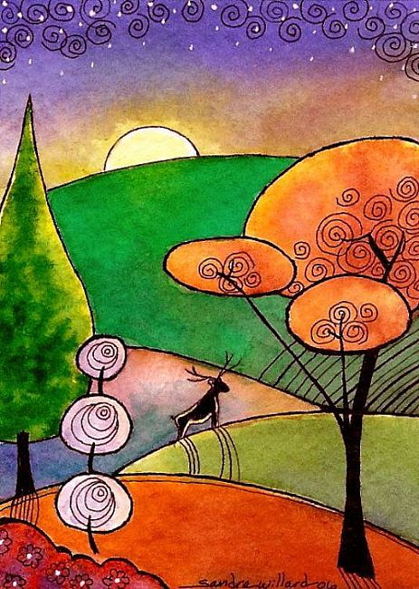

Slide 6
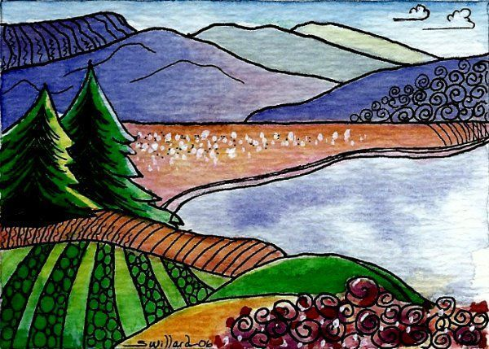

Slide 7
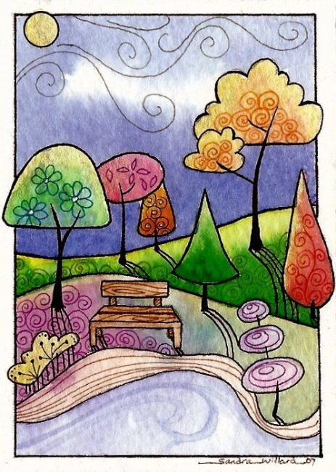

Slide 8
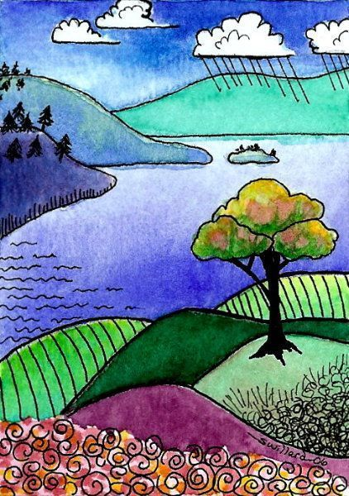

Slide 9
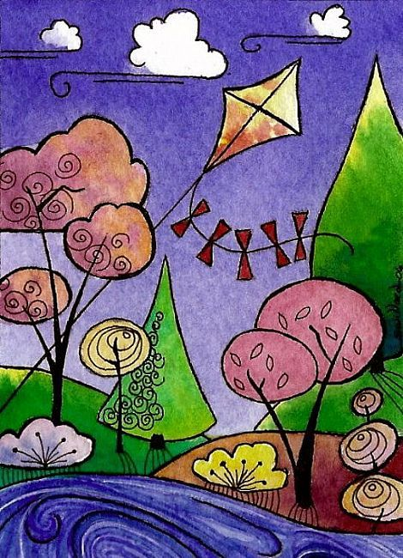

Slide 10
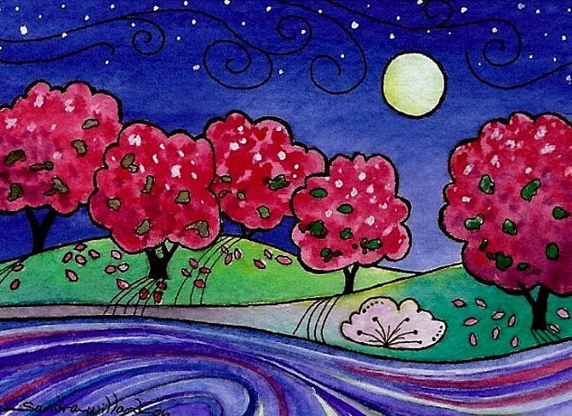

Slide 11
