Slide 1

Moving Beyond the Walls
Gail Desler Kathleen Watt

Slide 2
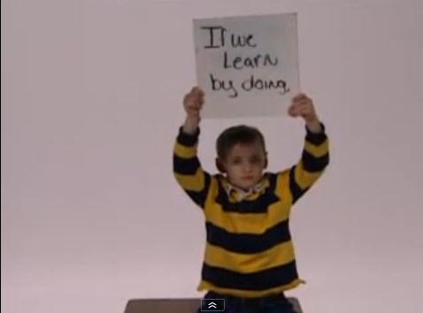
Vision of K12 students today

Slide 3
Defining 21st century literacy
21st century readers and writers need to:
Develop proficiency with the tools of technology
Build relationships with others to pose and solve problems collaboratively and cross-culturally
Design and share information for global communities to meet a variety of purposes

Slide 4
21st century literacies (Cont.)
Manage, analyze and synthesize multiple streams of simultaneous information
Create, critique, analyze, and evaluate multi-media texts
Attend to the ethical responsibilities required by these complex environments
National Council of Teachers of English 2008

Slide 5
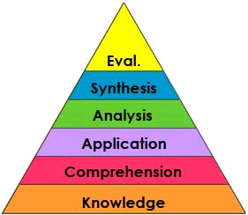
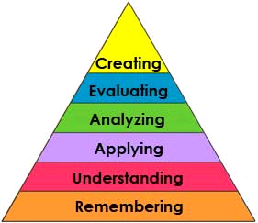
What are 21st century skills?
20th century Blooms
21st century Blooms

Slide 6
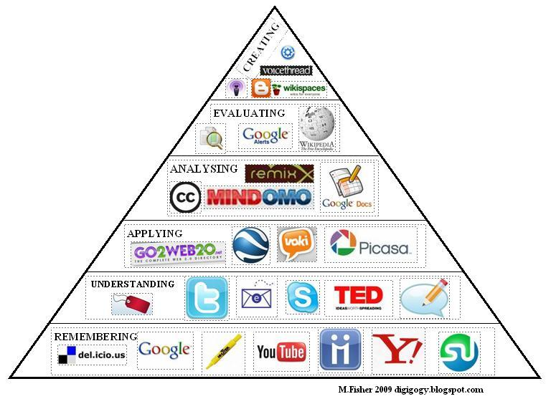
Web 2.0 = two-way learning

Slide 7
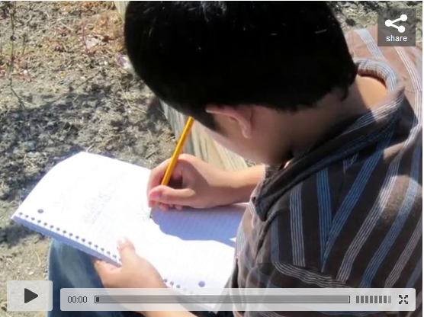
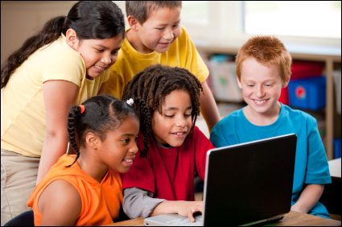
What do 21st century classrooms look like?

Slide 8
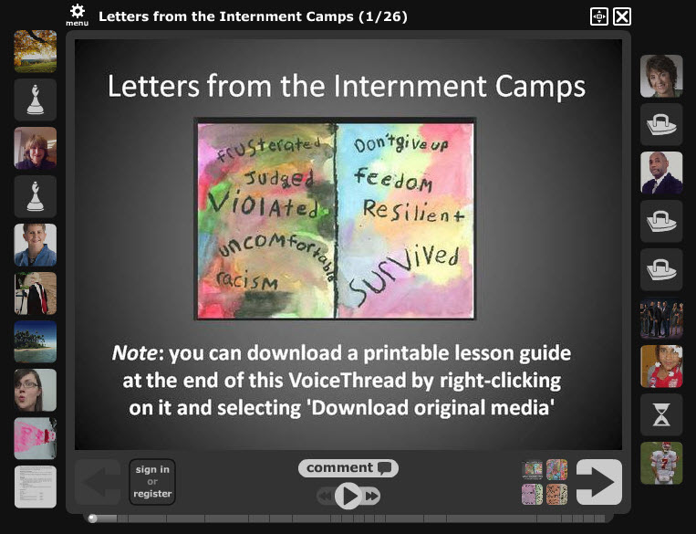
Producing information

Slide 9
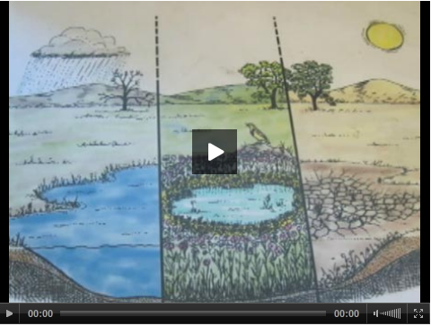
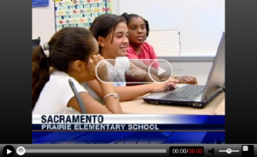
Making a difference

Slide 10
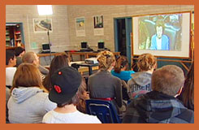

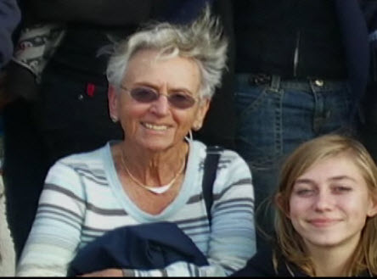
Doing history vs. studying history

Slide 11
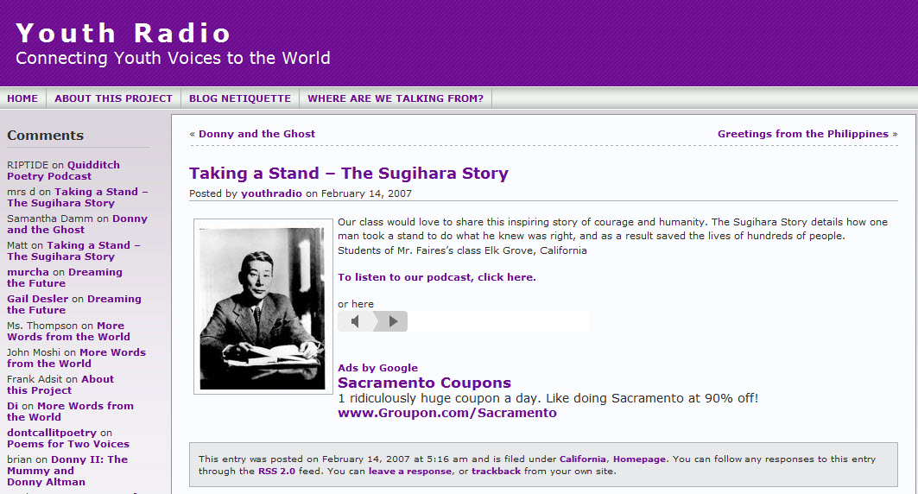
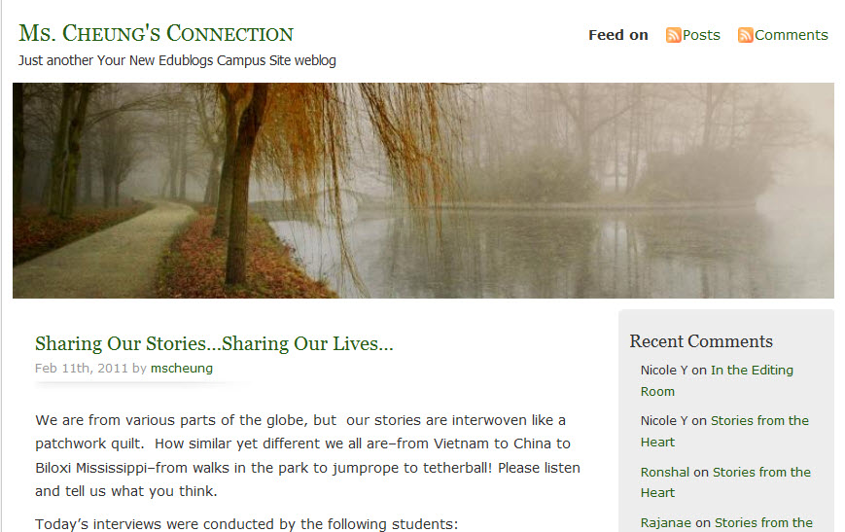
Recognizing the power of the human voice

Slide 12

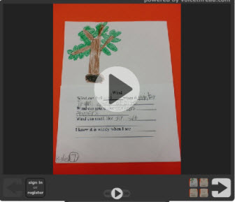
Extending science lessons

Slide 13
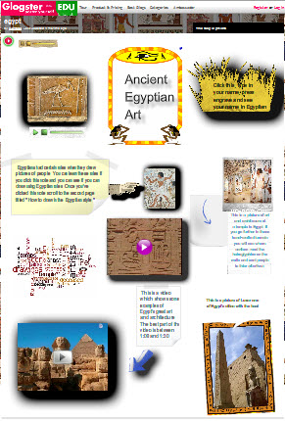
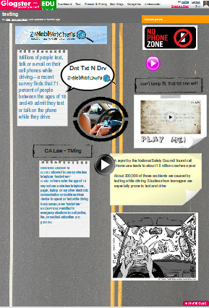
Going green

Slide 14

Making global connections

Slide 15

A 21st century vision – “where study leads to action”

