Slide 1

Notes:
Debbie Adams

Slide 2
DEBBIE ADAMS
My Biography as an Artist: I am primarily a self-taught artist. I began drawing at an early age but later my career took a different path. Through the years my love of art has always remained an important part of my life. It was nearly 35 years later that I decided to pursue my dream of becoming an artist. But, it was a rough start for I didn’t know where to begin so I just doodled mostly, stick people as I recall. Pretty bad I know. It got better over time as I searched for help online and found websites and blogs that explained how to draw. So with the best of my understanding I would apply the principles taught the best I could. To my surprise I realized over time that not only was I drawing, I had actually developed my own technique. I finally gave into the notion that I actually was an artist after all.
Notes:
Debbie Adams Biography

Slide 3
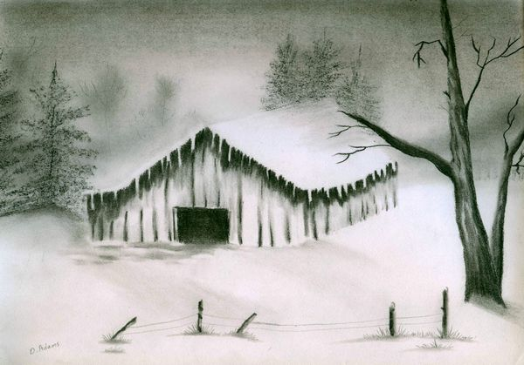
Notes:
Old Barn

Slide 4
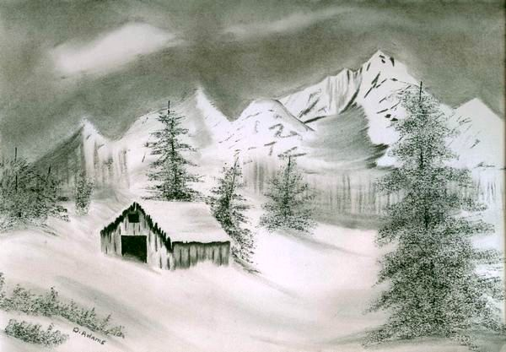
Notes:
Winterly Foothills

Slide 5
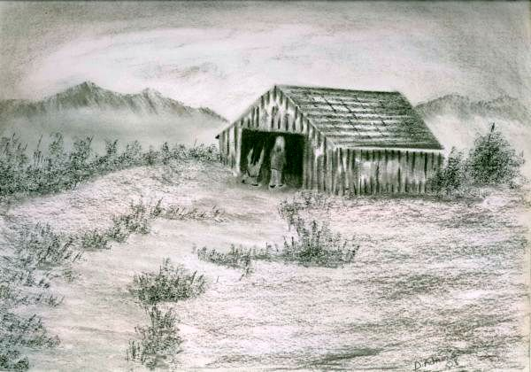
Notes:
Curious

Slide 6
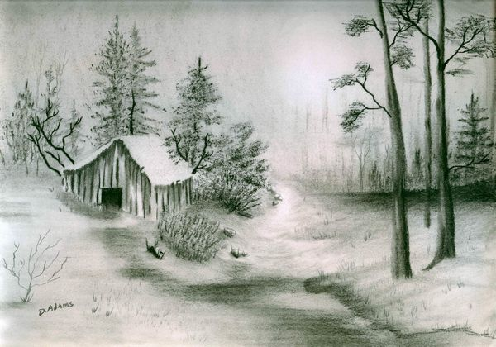
Notes:
Hidden Shack

Slide 7
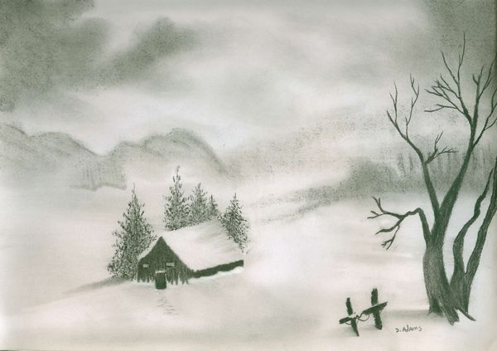
Notes:
Another Frosty Morning

Slide 8
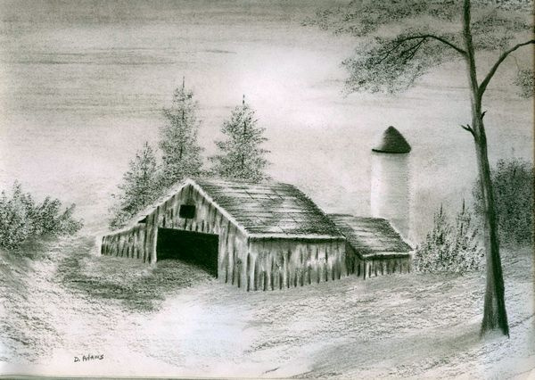
Notes:
Barn and Silo

Slide 9
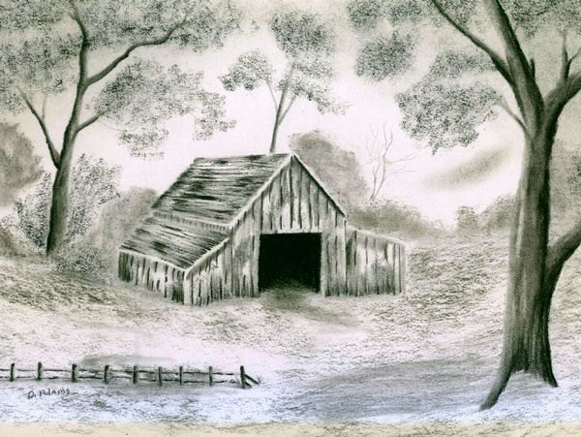
Notes:
Grandpa’s Barn

Slide 10
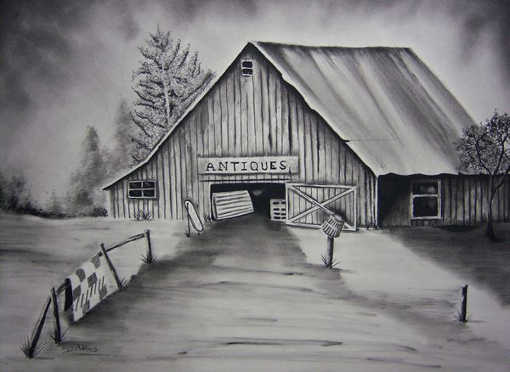
Notes:
Antiques

Slide 11
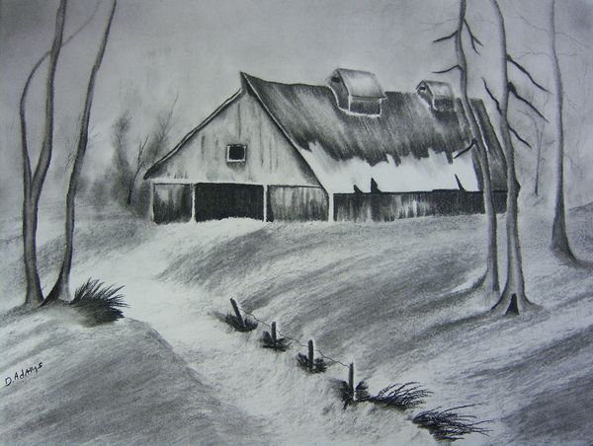
Notes:
The Old Haybarn

Slide 12
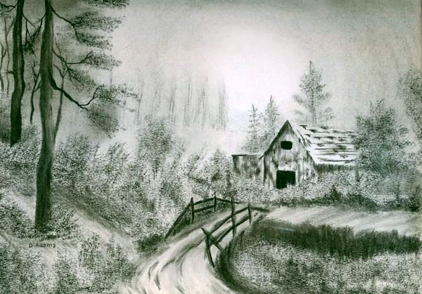
Notes:
Days Gone By

Slide 13
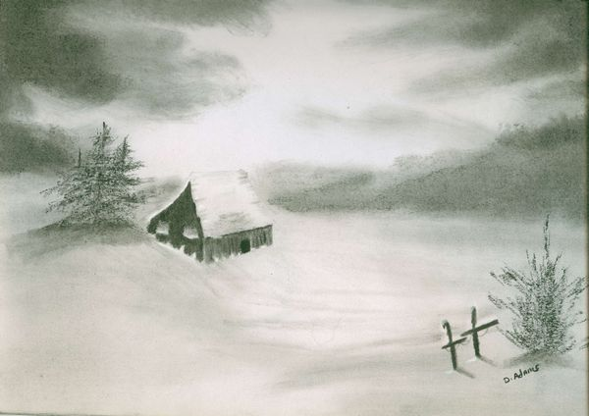
Notes:
Frosty Winter Morn

Slide 14
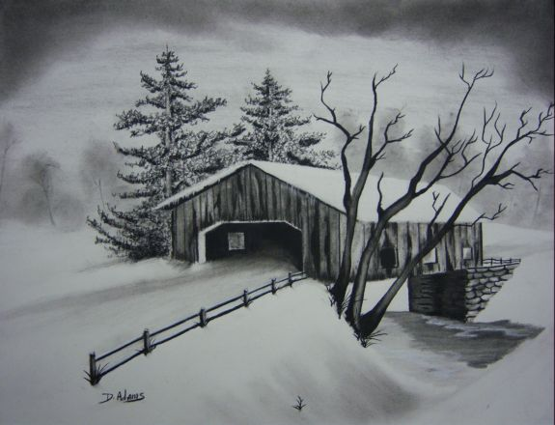
Notes:
Country Charm

