Slide 1
The Control Plane
Nick Feamster CS 6250: Computer Networks Fall 2011

Slide 2
What is the Control Plane?
Essentially the “brain” of the network
Responsible for computing and implementing
End-to-end paths (Routing)
Permissions (Access Control Lists)
Today: The “Internet control plane” as we know it
Layer 2 Path Computation: Spanning Tree
Intradomain routing: OSPF/ISIS
Interdomain routing: BGP
Question: Where should the control plane reside?

Slide 3
Layer 2 Route Computation

Slide 4
Life of a Packet: On a Subnet
Packet destined for outgoing IP address arrives at network interface
Packet must be encapsulated into a frame with the destination MAC address
Frame is sent on LAN segment to all hosts
Hosts check destination MAC address against MAC address that was destination IP address of the packet

Slide 5
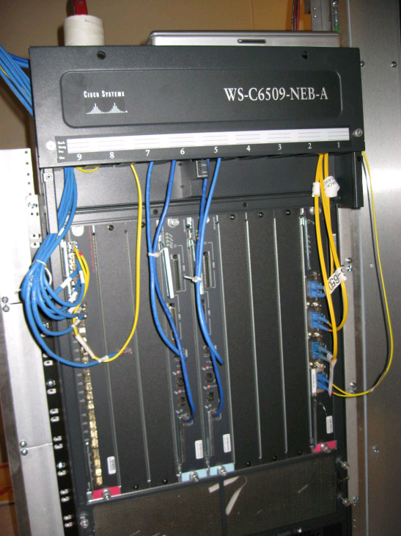
Interconnecting LANs
Receive & broadcast (“hub”)
Learning switches
Spanning tree (RSTP, MSTP, etc.) protocols

Slide 6
Interconnecting LANs with Hubs
All packets seen everywhere
Lots of flooding, chances for collision
Can’t interconnect LANs with heterogeneous media (e.g., Ethernets of different speeds)
hub
hub
hub
hub

Slide 7
Problems with Hubs: No Isolation
Scalability
Latency
Avoiding collisions requires backoff
Possible for a single host to hog the medium
Failures
One misconfigured device can cause problems for every other device on the LAN

Slide 8
Improving on Hubs: Switches
Link-layer
Stores and forwards Ethernet frames
Examines frame header and selectively forwards frame based on MAC dest address
When frame is to be forwarded on segment, uses CSMA/CD to access segment
Transparent
Hosts are unaware of presence of switches
Plug-and-play, self-learning
Switches do not need to be configured

Slide 9
Switch: Traffic Isolation
Switch breaks subnet into LAN segments
Switch filters packets
Same-LAN-segment frames not usually forwarded onto other LAN segments
Segments become separate collision domains
switch
collision domain
hub
hub
hub
collision domain
collision domain

Slide 10
Filtering and Forwarding
Occurs through switch table
Suppose a packet arrives destined for node with MAC address x from interface A
If MAC address not in table, flood (act like a hub)
If MAC address maps to A, do nothing (packet destined for same LAN segment)
If MAC address maps to another interface, forward
How does this table get configured?
LAN B
A
B
C
LAN A
LAN C

Slide 11
Advantages vs. Hubs
Better scaling
Separate collision domains allow longer distances
Better privacy
Hosts can “snoop” the traffic traversing their segment
… but not all the rest of the traffic
Heterogeneity
Joins segments using different technologies

Slide 12
Disadvantages vs. Hubs
Delay in forwarding frames
Bridge/switch must receive and parse the frame
… and perform a look-up to decide where to forward
Storing and forwarding the packet introduces delay
Solution: cut-through switching
Need to learn where to forward frames
Bridge/switch needs to construct a forwarding table
Ideally, without intervention from network administrators
Solution: self-learning

Slide 13
Motivation For Self-Learning
Switches forward frames selectively
Forward frames only on segments that need them
Switch table
Maps destination MAC address to outgoing interface
Goal: construct the switch table automatically
B
A
C
switch
D

Slide 14
(Self)-Learning Bridges
Switch is initially empty
For each incoming frame, store
The incoming interface from which the frame arrived
The time at which that frame arrived
Delete the entry if no frames with a particular source address arrive within a certain time
B
Switch learns how to reach A.
A
C
D

Slide 15
Cut-Through Switching
Buffering a frame takes time
Suppose L is the length of the frame
And R is the transmission rate of the links
Then, receiving the frame takes L/R time units
Buffering delay can be a high fraction of total delay, especially over short distances
A
B
switches

Slide 16
Cut-Through Switching
Start transmitting as soon as possible
Inspect the frame header and do the look-up
If outgoing link is idle, start forwarding the frame
Overlapping transmissions
Transmit the head of the packet via the outgoing link
… while still receiving the tail via the incoming link
Analogy: different folks crossing different intersections
A
B
switches

Slide 17
Limitations on Topology
Switches sometimes need to broadcast frames
Unfamiliar destination: Act like a hub
Sending to broadcast
Flooding can lead to forwarding loops and broadcast storms
E.g., if the network contains a cycle of switches
Either accidentally, or by design for higher reliability
Worse yet, packets can be duplicated and proliferated!

Slide 18
Solution: Spanning Trees
Ensure the topology has no loops
Avoid using some of the links when flooding
… to avoid forming a loop
Spanning tree
Sub-graph that covers all vertices but contains no cycles
Links not in the spanning tree do not forward frames

Slide 19
Constructing a Spanning Tree
Elect a root
The switch with the smallest identifier
Each switch identifies if its interface is on the shortest path from the root
And it exclude from the tree if not
Also exclude from tree if same distance, but higher identifier
Message Format: (Y, d, X)
From node X
Claiming Y as root
Distance is d
root
One hop
Three hops

Slide 20
Steps in Spanning Tree Algorithm
Initially, every switch announces itself as the root
Example: switch X announces (X, 0, X)
Switches update their view of the root
Upon receiving a message, check the root id
If the new id is smaller, start viewing that switch as root
Switches compute their distance from the root
Add 1 to the distance received from a neighbor
Identify interfaces not on a shortest path to the root and exclude those ports from the spanning tree

Slide 21
Example From Switch #4’s Viewpoint
Switch #4 thinks it is the root
Sends (4, 0, 4) message to 2 and 7
Switch #4 hears from #2
Receives (2, 0, 2) message from 2
… and thinks that #2 is the root
And realizes it is just one hop away
Switch #4 hears from #7
Receives (2, 1, 7) from 7
And realizes this is a longer path
So, prefers its own one-hop path
And removes 4-7 link from the tree
1
3
5
2
4
6
7

Slide 22
Switches vs. Routers
Switches
Switches are automatically configuring
Forwarding tends to be quite fast, since packets only need to be processed through layer 2
Routers
Router-level topologies are not restricted to a spanning tree
Can even have multipath routing

Slide 23
Scaling Ethernet
Main limitation: Broadcast
Spanning tree protocol messages
ARP queries
High-level proposal: Distributed directory service
Each switch implements a directory service
Hosts register at each bridge
Directory is replicated
Queries answered locally
…are there other ways to do this?

Slide 24
Intradomain Routing

Slide 25
Routing Inside an AS
Intra-AS topology
Nodes and edges
Example: Abilene
Intradomain routing protocols
Distance Vector
Split-horizon/Poison-reverse
Example: RIP
Link State
Example: OSPF, ISIS

Slide 26
Topology Design
Where to place “nodes”?
Typically in dense population centers
Close to other providers (easier interconnection)
Close to other customers (cheaper backhaul)
Note: A “node” may in fact be a group of routers, located in a single city. Called a “Point-of-Presence” (PoP)
Where to place “edges”?
Often constrained by location of fiber

Slide 27
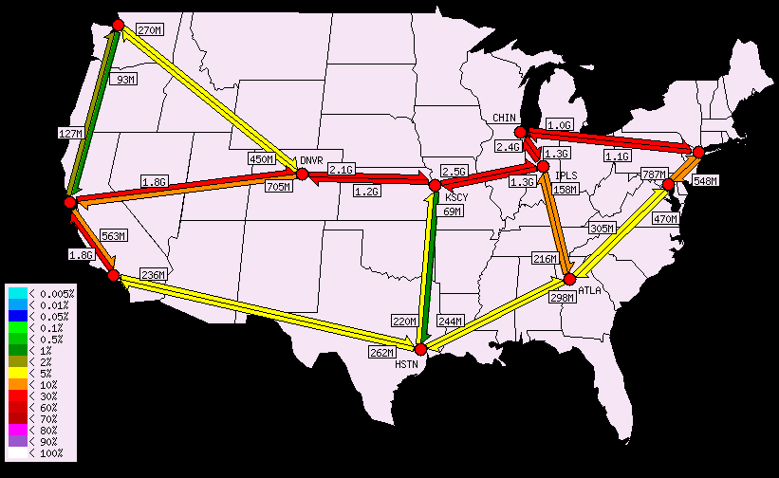
Example: Abilene Network Topology

Slide 28
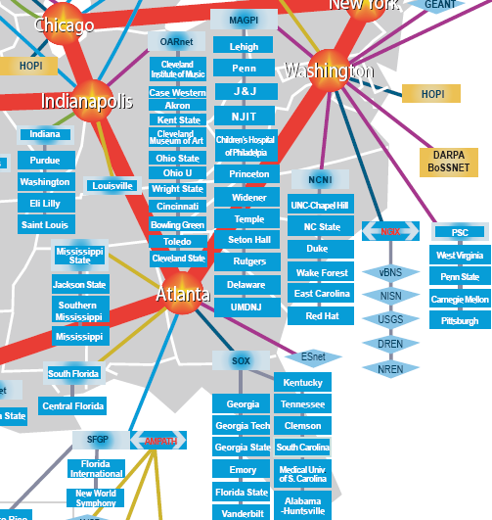
Where’s Georgia Tech?
10GigE (10GbpS uplink) Southeast Exchange
(SOX) is at 56 Marietta Street

Slide 29
Intradomain Routing: Two Approaches
Routing: the process by which nodes discover where to forward traffic so that it reaches a certain node
Within an AS: there are two “styles”
Distance vector: iterative, asynchronous, distributed
Link State: global information, centralized algorithm

Slide 30
Forwarding vs. Routing
Forwarding: data plane
Directing a data packet to an outgoing link
Individual router using a forwarding table
Routing: control plane
Computing paths the packets will follow
Routers talking amongst themselves
Individual router creating a forwarding table

Slide 31
Distance Vector Algorithm
Iterative, asynchronous: each local iteration caused by:
Local link cost change
Distance vector update message from neighbor
Distributed:
Each node notifies neighbors only when its DV changes
Neighbors then notify their neighbors if necessary
Each node:
wait for (change in local link cost or message from neighbor)
recompute estimates
if DV to any destination has changed, notify neighbors

Slide 32
Link-State Routing
Keep track of the state of incident links
Whether the link is up or down
The cost on the link
Broadcast the link state
Every router has a complete view of the graph
Compute Dijkstra’s algorithm
Examples:
Open Shortest Path First (OSPF)
Intermediate System – Intermediate System (IS-IS)

Slide 33
Link-State Routing
Idea: distribute a network map
Each node performs shortest path (SPF) computation between itself and all other nodes
Initialization step
Add costs of immediate neighbors, D(v), else infinite
Flood costs c(u,v) to neighbors, N
For some D(w) that is not in N
D(v) = min( c(u,w) + D(w), D(v) )

Slide 34
Detecting Topology Changes
Beaconing
Periodic “hello” messages in both directions
Detect a failure after a few missed “hellos”
Performance trade-offs
Detection speed
Overhead on link bandwidth and CPU
Likelihood of false detection
“hello”

Slide 35
Broadcasting the Link State
Flooding
Node sends link-state information out its links
The next node sends out all of its links except the one where the information arrived
X
A
X
A
C
B
D
C
B
D
(a)
(b)
X
A
X
A
C
B
D
C
B
D
(c)
(d)

Slide 36
Broadcasting the Link State
Reliable flooding
Ensure all nodes receive the latestlink-state information
Challenges
Packet loss
Out-of-order arrival
Solutions
Acknowledgments and retransmissions
Sequence numbers
Time-to-live for each packet

Slide 37
When to Initiate Flooding
Topology change
Link or node failure
Link or node recovery
Configuration change
Link cost change
Periodically
Refresh the link-state information
Typically (say) 30 minutes
Corrects for possible corruption of the data

Slide 38
Scaling Link-State Routing
Message overhead
Suppose a link fails. How many LSAs will be flooded to each router in the network?
Two routers send LSA to A adjacent routers
Each of A routers sends to A adjacent routers
…
Suppose a router fails. How many LSAs will be generated?
Each of A adjacent routers originates an LSA …

Slide 39
Scaling Link-State Routing
Two scaling problems
Message overhead: Flooding link-state packets
Computation: Running Dijkstra’s shortest-path algorithm
Introducing hierarchy through “areas”
Area 0
area
border
router

Slide 40
Link-State vs. Distance-Vector
Convergence
DV has count-to-infinity
DV often converges slowly (minutes)
DV has timing dependences
Link-state: O(n²) algorithm requires O(nE) messages
Robustness
Route calculations a bit more robust under link-state
DV algorithms can advertise incorrect least-cost paths
In DV, errors can propagate (nodes use each others tables)
Bandwidth Consumption for Messages
Messages flooded in link state

Slide 41
Open Shortest Paths First (OSPF)
Area 0
Key Feature: hierarchy
Network’s routers divided into areas
Backbone area is area 0
Area 0 routers perform SPF computation
All inter-area traffic travles through Area 0 routers (“border routers”)

Slide 42
Another Example: IS-IS
Originally: ISO Connectionless Network Protocol
CLNP: ISO equivalent to IP for datagram delivery services
ISO 10589 or RFC 1142
Later: Integrated or Dual IS-IS (RFC 1195)
IS-IS adapted for IP
Doesn’t use IP to carry routing messages
OSPF more widely used in enterprise, IS-IS in large service providers

Slide 43
Hierarchical Routing in IS-IS
Backbone
Area 49.001
Area 49.0002
Level-1
Routing
Level-2
Routing
Level-1
Routing
Like OSPF, 2-level routing hierarchy
Within an area: level-1
Between areas: level-2
Level 1-2 Routers: Level-2 routers may also participate in L1 routing

Slide 44
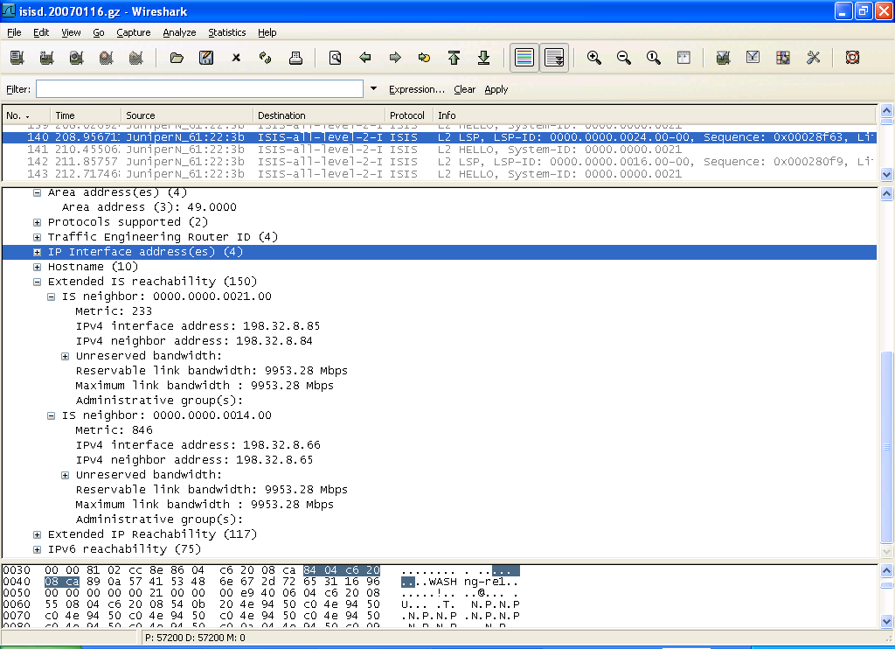
ISIS on the Wire…

Slide 45
Interdomain Routing
See http://nms.lcs.mit.edu/~feamster/papers/dissertation.pdf (Chapter 2.1-2.3) for good coverage of today’s topics.

Slide 46
Internet Routing
Abilene
Georgia
Tech
Comcast
The Internet
AT&T
Cogent
Large-scale: Thousands of autonomous networks
Self-interest: Independent economic and performance objectives
But, must cooperate for global connectivity

Slide 47
Internet Routing Protocol: BGP
Autonomous Systems (ASes)
Route Advertisement
Destination Next-hop AS Path
130.207.0.0/16
Traffic
192.5.89.89
10578..2637
130.207.0.0/16
66.250.252.44
174… 2637
Session
Notes:
Diagram of routing table is very confusing because it’s not pointing to anything
Green arrow shorter, and too thick… green is a msg
More intuition about how the system actually works.
Don’t say “interdomain”
DESTINATION-BASED Routing
Tables look like a set of possible routes and a rankings over these routes
(pop up a simplified table fragment)

Slide 48
Two Flavors of BGP
iBGP
eBGP
External BGP (eBGP): exchanging routes between ASes
Internal BGP (iBGP): disseminating routes to external destinations among the routers within an AS
Question: What’s the difference between IGP and iBGP?

Slide 49
Example BGP Routing Table
The full routing table
> show ip bgp
Network Next Hop Metric LocPrf Weight Path
*>i3.0.0.0 4.79.2.1 0 110 0 3356 701 703 80 i
*>i4.0.0.0 4.79.2.1 0 110 0 3356 i
*>i4.21.254.0/23 208.30.223.5 49 110 0 1239 1299 10355 10355 i
* i4.23.84.0/22 208.30.223.5 112 110 0 1239 6461 20171 i
Specific entry. Can do longest prefix lookup:
> show ip bgp 130.207.7.237
BGP routing table entry for 130.207.0.0/16
Paths: (1 available, best #1, table Default-IP-Routing-Table)
Not advertised to any peer
10578 11537 10490 2637
192.5.89.89 from 18.168.0.27 (66.250.252.45)
Origin IGP, metric 0, localpref 150, valid, internal, best
Community: 10578:700 11537:950
Last update: Sat Jan 14 04:45:09 2006
Prefix
AS path
Next-hop

Slide 50
Routing Attributes and Route Selection
BGP routes have the following attributes, on which the route selection process is based:
Local preference: numerical value assigned by routing policy. Higher values are more preferred.
AS path length: number of AS-level hops in the path
Multiple exit discriminator (“MED”): allows one AS to specify that one exit point is more preferred than another. Lower values are more preferred.
eBGP over iBGP
Shortest IGP path cost to next hop: implements “hot potato” routing
Router ID tiebreak: arbitrary tiebreak, since only a single “best” route can be selected

Slide 51
Other BGP Attributes
Next-hop: 192.5.89.89
iBGP
Next-hop: 4.79.2.1
4.79.2.2
4.79.2.1
Next-hop: IP address to send packets en route to destination. (Question: How to ensure that the next-hop IP address is reachable?)
Community value: Semantically meaningless. Used for passing around “signals” and labelling routes. More in a bit.

Slide 52
Local Preference
Higher local pref
Primary
Destination
Backup
Lower local pref
Control over outbound traffic
Not transitive across ASes
Coarse hammer to implement route preference
Useful for preferring routes from one AS over another (e.g., primary-backup semantics)

Slide 53
Communities and Local Preference
Primary
Destination
Backup
“Backup” Community
Customer expresses provider that a link is a backup
Affords some control over inbound traffic
More on multihoming, traffic engineering in Lecture 7

Slide 54
AS Path Length
Traffic
Destination
Among routes with highest local preference, select route with shortest AS path length
Shortest AS path != shortest path, for any interpretation of “shortest path”

Slide 55
Hot-Potato Routing
Prefer route with shorter IGP path cost to next-hop
Idea: traffic leaves AS as quickly as possible
Dest.
New York
Atlanta
Traffic
Common practice: Set IGP weights in accordance with propagation delay (e.g., miles, etc.)
5
10
I
Washington, DC

Slide 56
Problems with Hot-Potato Routing
Small changes in IGP weights can cause large traffic shifts
Dest.
San Fran
New York
Traffic
Question: Cost of sub-optimal exit vs. cost of large traffic shifts
11
5
10
I
LA

Slide 57
Internet Business Model (Simplified)
Preferences implemented with local preference manipulation
Provider
Pay to use
Free to use
Peer
Get paid to use
Destination
Customer
Customer/Provider: One AS pays another for reachability to some set of destinations
“Settlement-free” Peering: Bartering. Two ASes exchange routes with one another.

Slide 58
A Clean Slate 4D Approach to Internet Control and Management

Slide 59
Layers of the 4D Architecture
Network-level objectives
Decision
Network-wide views
Dissemination
Direct control
Discovery
Data
Data Plane:
Spatially distributed routers/switches
Can deploy with today’s technology
Looking at ways to unify forwarding paradigms across technologies

Slide 60
Advantages of 4D
Separate network logic from distributed systems issues
enables the use of existing distributed systems techniques and protocols to solve non-networking issues
Higher robustness
raises level of abstraction for managing the network
allows operators to focus on specific network-level objectives
Better security
reduces likelihood of configuration mistakes
Accommodating heterogeneity
Enable Innovations
only decision plane needs to be changed

Slide 61
Challenges of 4D
Reducing complexity
Dramatically simplifying overall system? Or is it just moving complexity?
Unavoidable delays to have network-wide view.
Is it possible to have a network-wide view sufficiently accurate and stable to manage the network?
The logic is centralized in Decision Element (DE)
Is it possible to respond to network failures and restore data flow within an acceptable time?
DE can be a single point of failure.
Attackers can compromise the whole network by controlling DE

Slide 62
Research Agenda: Decision Plane
Algorithms to satisfy Network-level objectives
Traffic Engineering: beyond intractable problems?
Reachability Policies
Planned Maintenance
Specification of network-level objectives: new language?
Coordination between Decision Elements
To avoid a single point of failure, multiple DE’s
1) only elected leader sends instructions to all
2) independent DE’s without coordination: network elements resolves commands from different DE’s
Hierarchy in Decision Plane

Slide 63
Research Agenda: Dissemination Plane
Separate control from data “logically”
supervisory channel in SONET, optical links
no separation channel for control and data in the Internet
How to achieve robust, efficient connection of DE with routers and switches?
flooding
spanning-tree protocols
source routing
When to apply the new logic in data plane
each router applies update ASAP
coordinate update at a pre-specified time: need time synch

Slide 64
Research Agenda: Discovery Plane
Today
consistency between management logic, configuration files, and physical reality is maintained manually!
4D
Bootstrapping with zero pre-configuration
Automatically discovering the identities of devices and the logical/physical relationships between them
Supporting cross-layer auto-discovery

Slide 65
Research Agenda: Data Plane
Data plane handles data packets under direct control of the decision plane
Decision plane algorithms should vary depending on the forwarding paradigms in data plane
Packet-forwarding paradigms
Longest-prefix matching (IPv4, IPv6)
Exact-match forwarding (Ethernet)
Label switching (MPLS, ATM, Frame Relay)
Weighted splitting over multiple outgoing links or single out-going link?

Slide 66
End-to-End Routing Behavior on the Internet

Slide 67
End-to-End Routing Behavior
Importance of paper
Revitalized field of network measurement
Use of statistical techniques to capture new types of measurements
Empirical findings of routing behavior (motivation for future work)
Various routing pathologies
Routing loops
Erroneous
Connectivity altered mid-stream
Fluttering…

Slide 68
End-to-End Routing Behavior
Pathology
type
Prevalence
in 1995
Prevalence
in 1996
Long-lived
Routing loops
0.14%
same
~
Short-lived
Routing loops
~
0.065%
same
Outage>30s
0.96%
2.2%
Total
1.5%
3.4%

Slide 69
Routing Loops
Persistent Routing Loops
10 persistent routing loops in D1
50 persistent routing loops in D2
Temporary Routing Loops
2 loops in D1
21 in D2
Location of Routing Loops: All in one AS

Slide 70
Erroneous and Transient Routing
Transatlantic route to London via Israel!
Connectivity altered mid-stream
10 cases in D1
155 cases in D2
Fluttering: Packets to the same flow changing mid-stream

Slide 71
Routing Prevalence and Persistence
Prevalence: How often is the route present in the routing tables?
Internet paths are strongly dominated by a single route
Persistence: How long do routes endure before changing?
Routing changes occur over a variety of time scales

