Slide 1
VO-URP: on data modeling, UTYPEs and more
Gerard Lemson
Laurent Bourges

Slide 2
Aim 1: overview of VO-URP
Request Omar
VO-URP = Virtual Observatory UML Representation Pipeline
Used in SimDM to facilitate DMing effort
Defines a syntax for UTYPE-s that is used in UTYPE doc (Mireille)

Slide 3
Aim 2: discuss UTYPE-s
Not: What are they and what are they for?
See also Norman‘s questions http://nxg.me.uk/note/2009/utype-questions/
Yes: Producing UTYPE-s
Not much: Using UTYPE-s
Tiger team

Slide 4
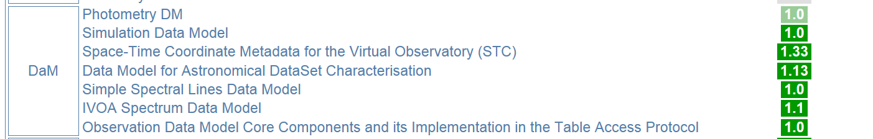
Context: data modeling in IVOA
Some in pipe-line
Also: VOResource family of models
How do we make them interoperable?
Standard answer seems to be: "UTYPE-s !!”
Mechanism is still missing.
Very incomplete interoperability.

Slide 5
Instantiation
What does one do with models?
Create instances
Needs a serialisation/representation mechanism
What we do with instances depends on representation
XML: write them, send them, upload them, transform them (XSLT)
RDB: insert them in DB, query DB

Slide 6
Transformation
Potentially we want to do more with a model:
Mapping: Create alternative representations of the model, as faithfully as possible (Java, C#,…)
Transformation: in queries or views, produces ad hoc model
Use: import in other model, either original of transformed version
Generally:
Produce a view which is a partial representation of a transformed alternative version of some ad hoc model that used part of original model in some representation.

Slide 7
Problem
How do we keep track of source and meaning of information

Slide 8
Questions on UTYPE-s
How can UTYPE-s help interoperability between models/representations/views?
In what contexts?
How far can one use them; fields only, classes, relations?
Meaning of query results can not be represented by simple mappings in general.
Usefulness of UTYPEs depends very much on the model
E.g. in SimDM UFIs would be more useful.

Slide 9
Data models in IVOA
MUST/SHOULD provide
UML
XSD
UTYPE-s
Documentation
No formal constraints on any of these representations!

Slide 10
IVOA models rather non-uniform.
Some UML
mainly as illustration, not rigorous
Most XSD (incl. VOResource etc)
but with different “style”
in general not equivalent to UML
Some RDB (ObsCore, SimDM)
Some(most?) UTYPE-s
Separately defined

Slide 11
Interoperability of data models
Non-uniformity of modeling language makes this a technically and conceptually non-trivial process
Queries, implying transformations of models, complicate matters even more.
Idea seems to be that UTYPE-s will help
I doubt that very much, unless for trivial use cases.
It is not a natural solution in any case.
Natural would be if different data models would be expressed in common language
Using common meta-model

Slide 12
An example what this could look like:
VO-URP
http://vo-urp.googlecode.com

Slide 13
Spin-off from Simulation Database (SimDB)
Use UML for complete data model
Including documentation text
Do NOT write other representations by hand
Automate generation using XSLT
From XMI ⇨
XSD + template XML docs
HTML+UTYPE
DDL+TAP_SCHEMA
Java +JAXB/JPA

Slide 14
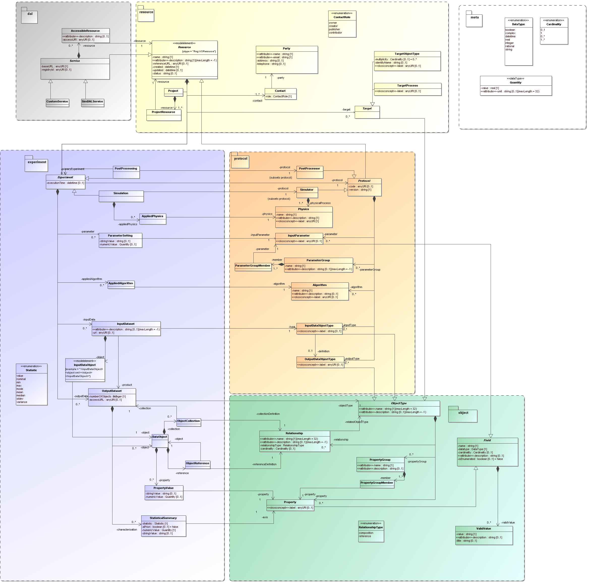

Slide 15
SimDB, Trieste 2008
MagicDraw CE 12.1
UML2.0 (with profile)
Generally lossy transformation (XSLT)
RDB
schema
XML
schema
UTYPES
HTML
doc
Java w.
JAXB, JPA
Physical representation

Slide 16
VO-URP representation: .vo-urp
Many different XMI dialects
XMI complex for XSLT
Need for simpler representation, also for use in web app (Laurent)
Representation of UML Profile in XML Schema
vo-urp.xsd (intermediateModel.xsd)
Domain Specific Language in sense of MOF
A MOF level 2 meta-model

Slide 17
VO-URP Data model representations
MagicDraw CE 12.1
UML2.0 (with profile)
MagicDraw CE 16.5
UML 2.2 (with profile)
Modelio
UML2.1.1
SimDM/Protocol
UML Tools
& custom
Lossless transformation (XSLT)
Custom transformation (XSLT)
VO-URP Representation
(XML, vo-urp.xsd)
Domain Specific
Language
for IVOA.
Generally lossy transformation (XSLT)
RDB:
DDL + TAP
schema
XML
schema
UTYPES
HTML
doc
Java w.
JAXB, JPA
Physical representation

Slide 18
.vo-urp as domain specific language
XSD schema representing UML2 profile
Profile
subset of modeling elements, extension through stereotypes/tags, predefined types
See Appendix B SimDM REC
Used explicitly in VO-URP browser web application
TBD
Make conventions/rules explicit
Expand types
Add mapping configuration

Slide 19
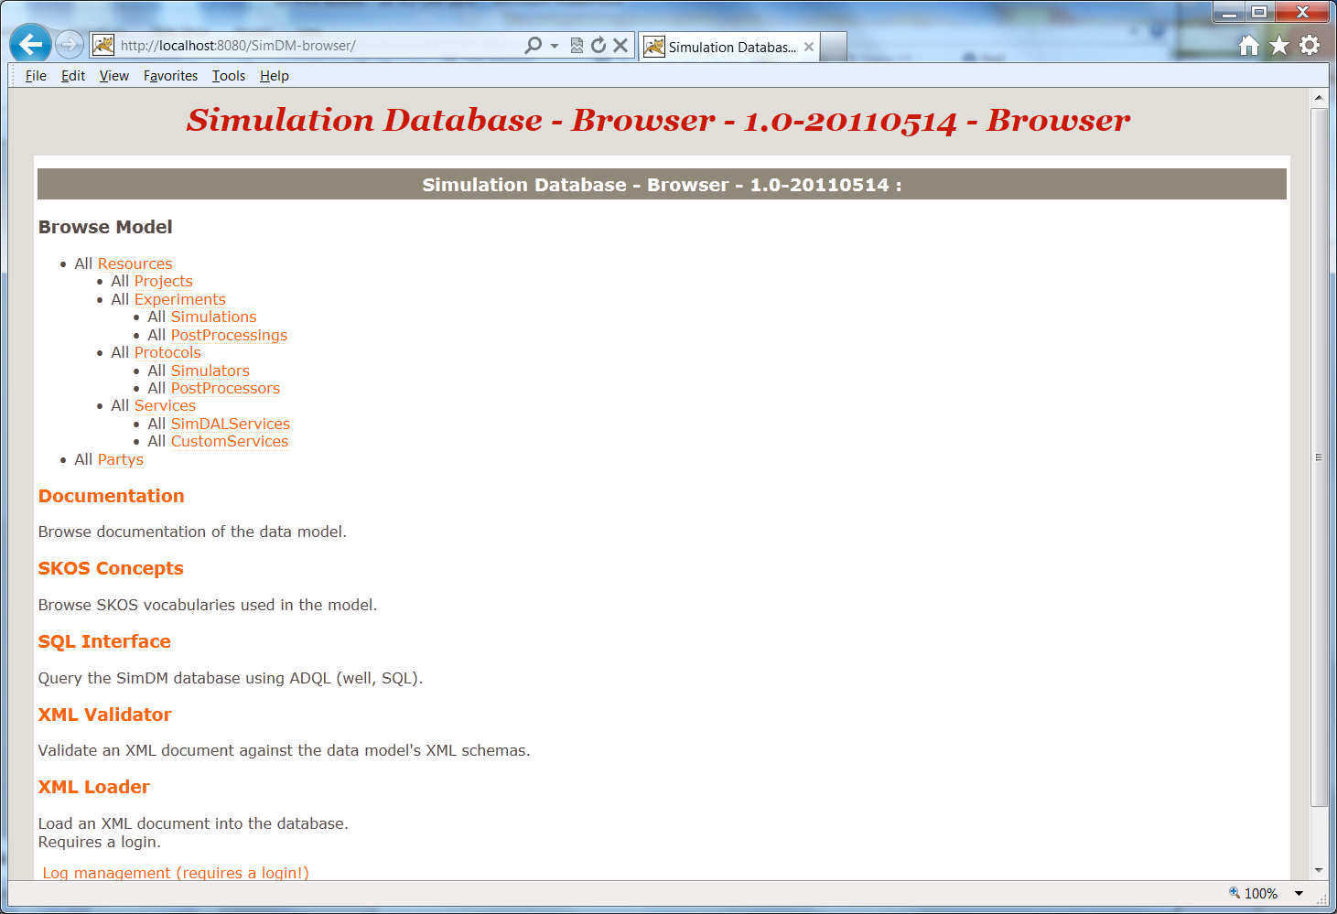
VO-URP: Reference Web Application
VO-URP
representation
RDB
XSD
UTYPES
HTML
Java
http://galformod.mpa-garching.mpg.de/dev/SimDM-browser

Slide 20
VO-URP and UTYPE-s
Our assumptions
A UTYPE is a term that in the context of a data model identifies an element of that data model uniquely.
To ensure uniqueness following syntax sufficient.
NB based on concepts in .vo-urp representation!!

Slide 21
VO-URP’s UTYPE BNF
utype := [model-utype | package-utype | class-utype |
attribute-utype | collection-utype |
reference-utype | container-utype
model-utype := <model-name>
package-utype := model-utype “:/” package-hierch
package-hierch := <package-name> [“/” <package-name>]*
class-utype := package-utype “/” <class-name>
attribute-utype := class-utype “.” attribute
attribute := [primitive-attr | struct-attr]
primitive-attr := <attribute-name>
struct-attr := <attribute-name> “.” attribute
collection-utype := class-utype “.” <collection-name>
reference-utype := class-utype “.” <reference-name>
container-utype := class-utype “.” “CONTAINER”a
identifier-utype := class-utype “.” “ID”

Slide 22
Use of UTYPE-s in VO-URP/SimDM
For identification of model elements
a HTML document (part of spec) has anchors at each position where a definition of an element is made. <base-url>#<utype> will bring you to that element.
The .vo-urp representation has for each modeling element a <utype> giving explicitly the UTYPE for that element, plus full definition.
Less essential: utypes can be parsed and one could walk from the root of the .vo-urp representation down to the element.
Precise syntax somewhat arbitrary

Slide 23
Our suggestion (possibly) independent of UTYPE discussion
Data modeling is not easy. Especially not in a distributed world.
It would be useful if the DM WG were to define a common meta-model for data modeling efforts in IVOA
Allows compliance rules and validation
Mappings can also be standardised
Best practices can be enforced easily
VO-URP has a reference implementation for this and we’re happy to provide it as start for further development.

