Slide 1
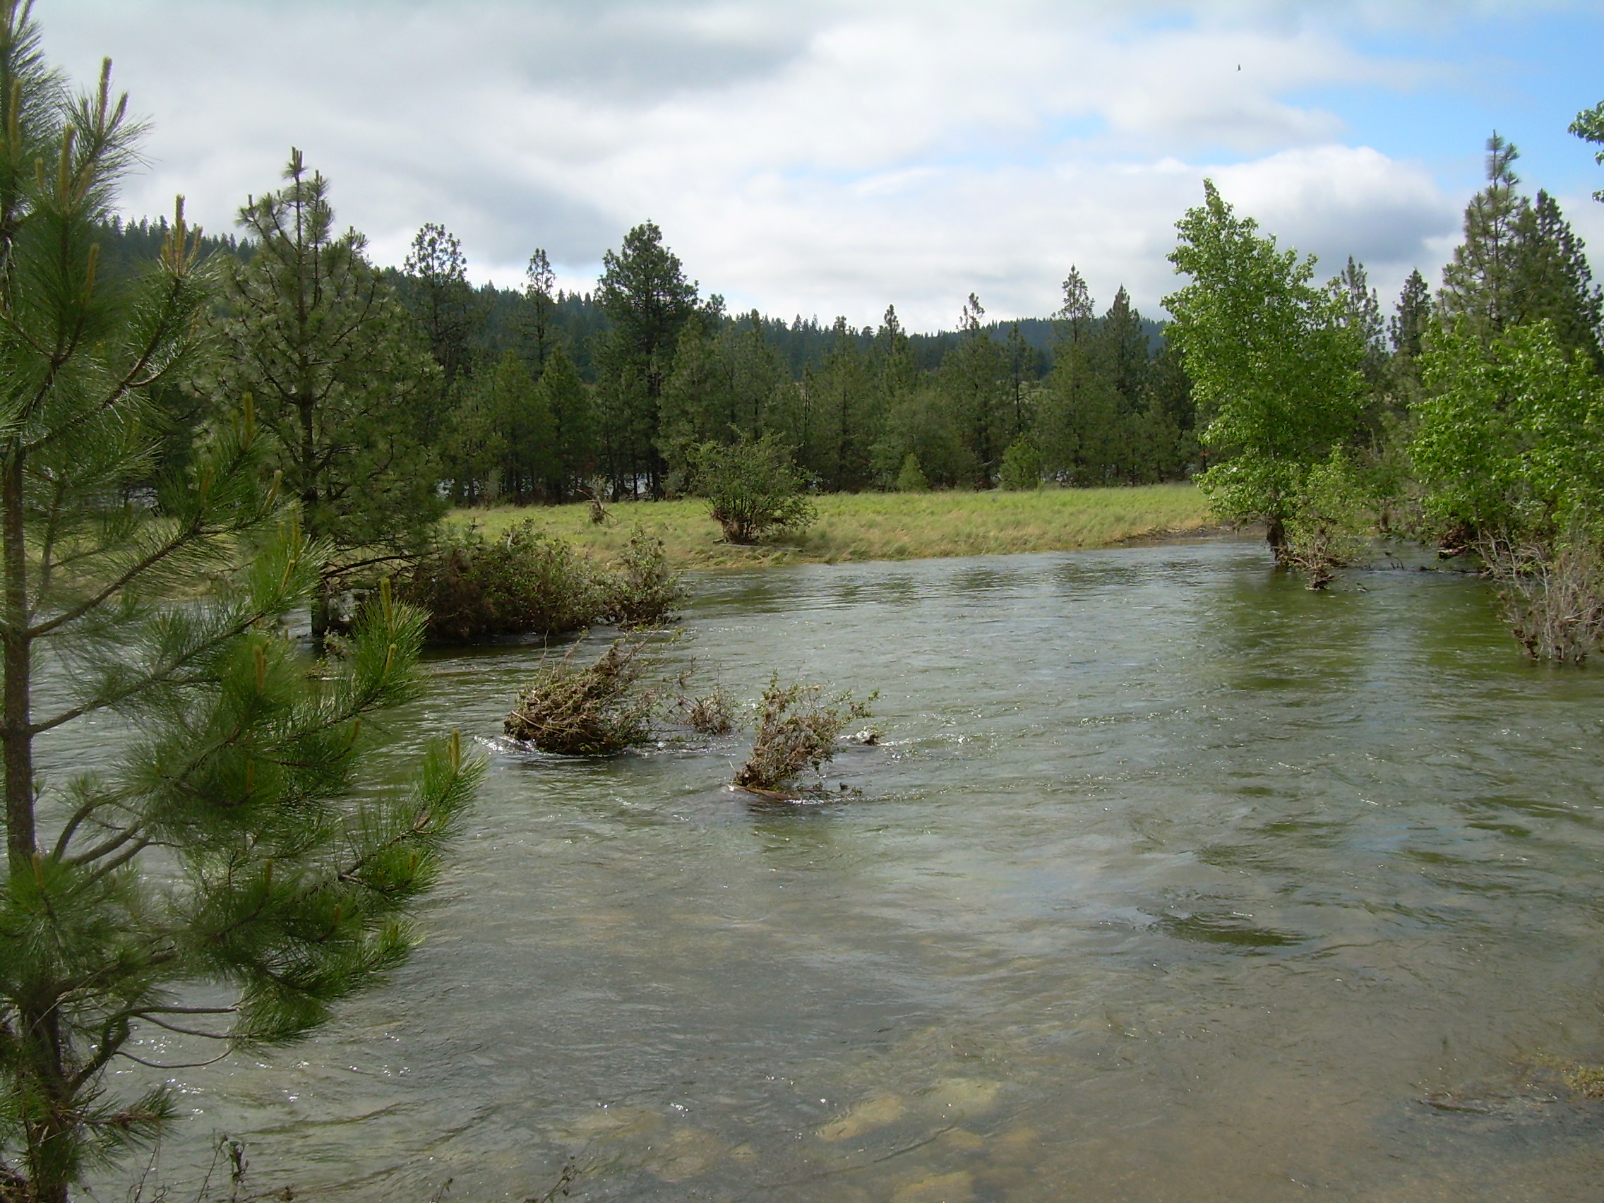
Update: Spokane River DO TMDL Implementation ________________________ David Moore Washington State Department of Ecology Eastern Regional Office

Slide 2
Timeline
TMDL approved May 2010
Advisory Committee
Met 9 times starting August 2010
Initial focus on NPS trading
Identified several more promising paths to compliance
Plan to issue WA NPDES permits June 1, 2011
Notes:
What TMDLs used to look like (Liberty Lake and Spokane)
“attorney stimulus plan”
~1400 TMDLs have been approved since 1996

Slide 3
Tools for compliance
Alternate season limits
Ortho phosphate
Bioavailable phosphorus
Bubble permit
NPS Trading – stormwater best bet
Nutrient equivalency
Modeling / Validation necessary for all

Slide 4
June | July | August | September | October
Issue Permits – Kaiser Liberty Lake City of Spokane (June 1st)
IEP Public comment period (June 1 – July 1) | Revise / issue final IEP permit (July 15th)
Spokane County public comment period (June 1 – August 1) |  | Develop responses / revise Spokane County permit (August 1 – September 30) |  | Issue Spokane County permit (October 1)

Slide 5
Advisory Committee
Avista Utilities
Center for Justice / Riverkeeper
City of Coeur d’ Alene
City of Post Falls
City of Spokane
Coeur d’ Alene Tribe
EPA Region 10
Hayden Area Regional Sewer Board
Idaho Department of Environmental Quality
Inland Empire Paper Company
Kaiser Aluminum
Kootenai Environmental Alliance
Lake Spokane Association
Lands Council
Liberty Lake Sewer and Water District
Spokane County
Spokane County Conservation District
Spokane Tribe of Indians
Stevens County

