Slide 1


Last News of and
http://saada.unistra.fr
http://saada.unistra.fr/taphandle
laurent.michel@astro.unistra.fr

Slide 2
Saada Key-points
Saada builds databases from data files
No Code to write
Storage of heterogeneous dataset
Can host multiple data collections
Support persistent links between data
Meta-data tagging (ucd, units…) « by hand »
Acces by Web interface or VO protocols
A Java layer on the top of an RDBMS
PostgresQL, MySQL or SQLite

Slide 3


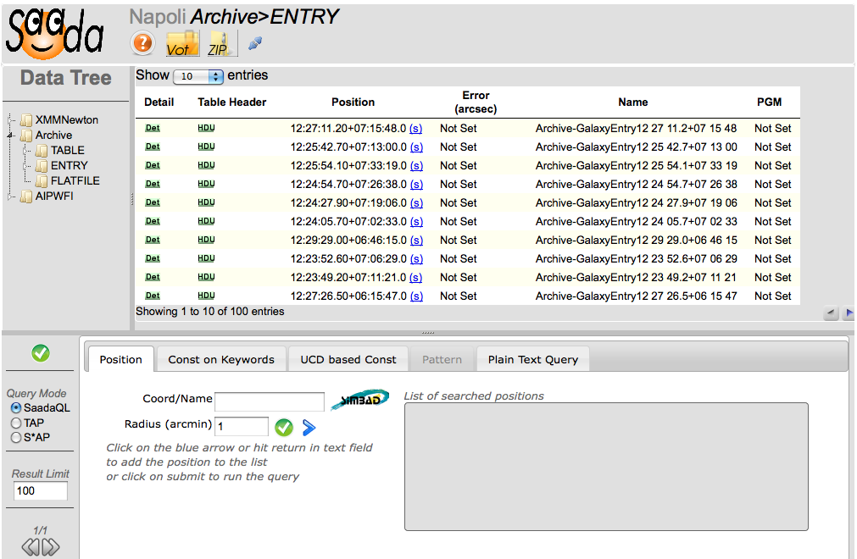
1.6.0 Presented in 05/2011
Embedded database (simple file)
Data storage in one simple file
No client/server infrastructure to deploy
But real limitations (tables < 1e6 rows)
TAP access
Asynchronous TAP queries
New Web interface
Ajax based
Samp (WebSampConnector OBSPM)

Slide 4
Videos
Data base creation: Loading 3 catalogues with their Readme files and linking them each to other
Set metada: Setting UCDs in some table column and using them to run a query on several tables

Slide 5
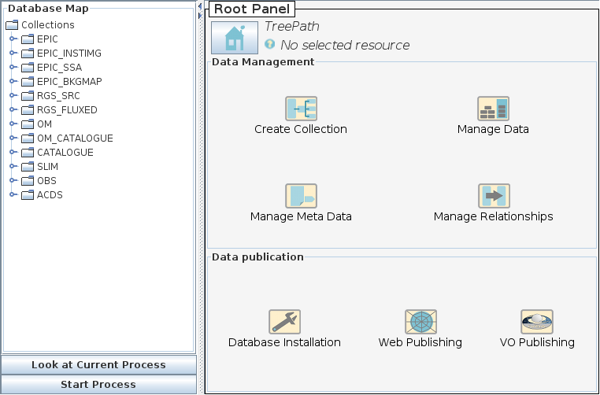
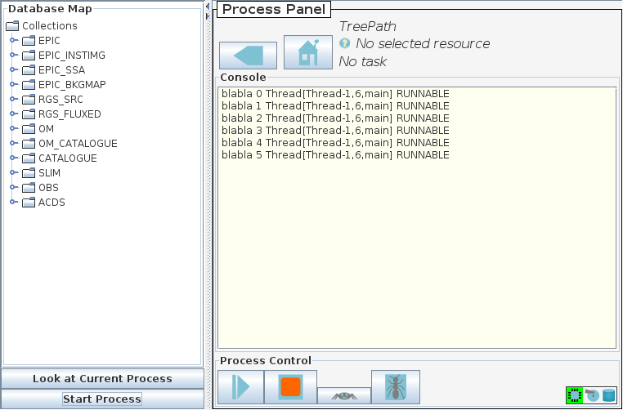
Saada1.7.0 (beta online)
New administration tool
Better look and feel
Advanced tool for VO publishing (TAP, ObsCore…)

Slide 6
Saada 1.7: Videos
Data base upgrade: Saada 1.7 comes with an upgrade tool.
Shopping cart: The web interface provides a shopping cart facility alllowing to download a selection of product files with their associated data.
Delegate the shopping cart processing The shpoong cart content can be sent to a third party (an UWS client)
Third party UWS client
Ask for the cart
content
(UWS protocol)
Send the cart
content
(Json message)
SaadaDB
server
Web browser

Slide 7

Saada 1.7: VO Publication
SaadaDB
TAP tables
VO Registry
Saada Data
Admin tool
No registry
Connection yet
Capabilities Database
Authority setup Set authority/curation/pubisher parameters for VO services attached to this database.
SAP service declaration Publish Saada data collections in Simple DAL protocols
TAP service setup Publish SQL table of the SaadaDB data colletion in a TAPservice
ObsCore mapping tool Map SaadaDB data collection in a ObsCore view

Slide 8
Browsing TAP services with TapHandle
http://saada.u-strasbg.fr/taphandle
Laurent.michel@astro.unistra.fr

Slide 9
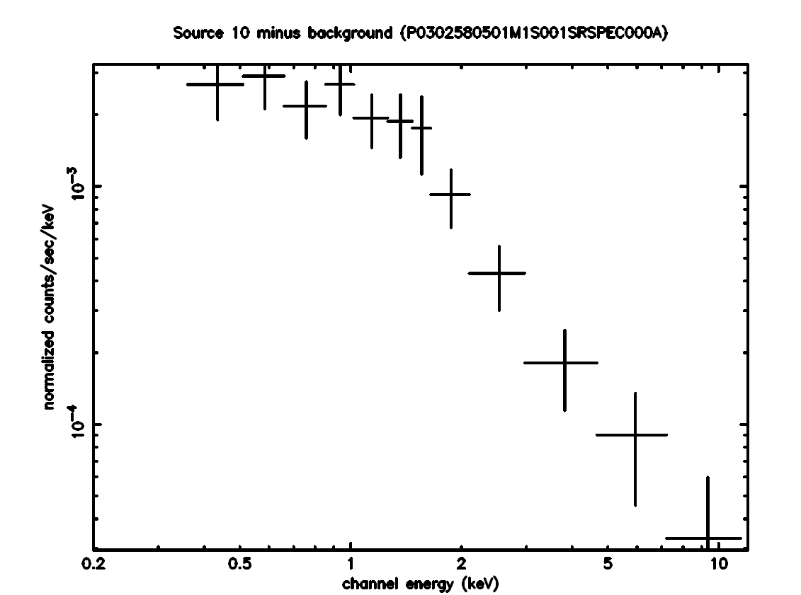
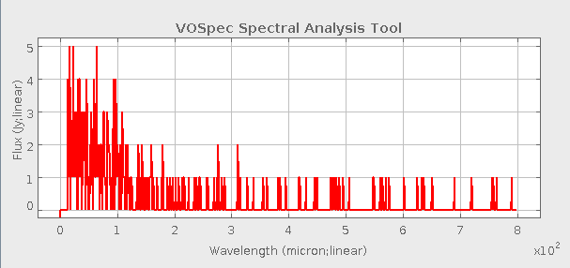
User Request
Having VO services providing many kind of data about regions of interest.
Structured data (FITS or VOTables)
Any categories (images, spectra …)
Flat data (preview, text…)
Using this data to select candidate regions for the searched.
XMM FITS spectrum visualized with VOSPec
JPEG preview of this spectrum

Slide 10
Key-Points
Browsing TAP services from a WEB browser in order to visualize any data format.
Structured files (FITS, VOTables) displayed through a SAMP connection
Others files (pdf …) displayed with the built-in browser features
Multiple TAP services presented on a single WEB page.
Possibility of “naked eye” data selection

Slide 11



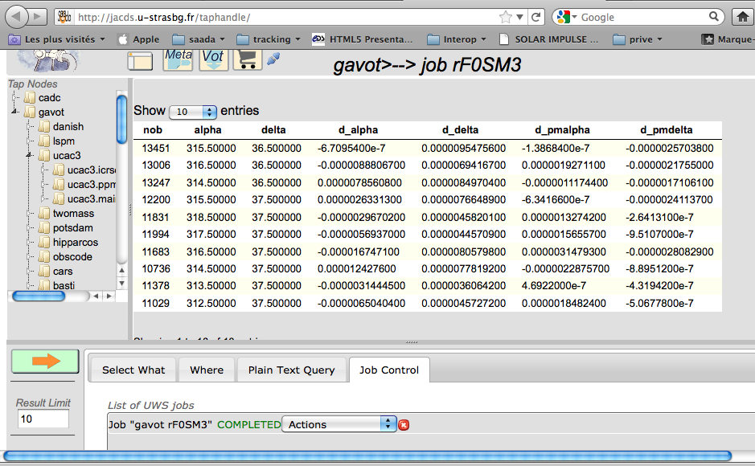


Taphandle Architecture
TAP service
TAP service
UWS/TAP/XML
TAP service
TAP service
Proxy Server
JSON
Browser Features
SAMP
AJAX/JQuery
….
….
Taphandle

Slide 12
Futur de TapHandle
Improvement
Look and Feel improvement
ADQL Upload
Open Project
Contributors are welcome on http://code.google.com/p/tap-handles/

