Slide 1


Urbana Interop Closing Plenary 21/May/2012
Christophe Arviset
For the TCG

Slide 2
Coming Soon
TAPRegExt 1.0 sent to Exec for approval
RFC for VOSpace 2.0, SimpleDALRegExt 1.0, PhotDM 1.0
Soon RFC for VOUnits 1.0
Later DALI 1.0, VOTable 1.3

Slide 3
Upcoming TCG challenges
IVOA Publication Tools for Data Centres
http://www.ivoa.net/cgi-bin/twiki/bin/view/IVOA/PublishingInTheVONew
Please send your inputs !
Registry monitoring of services compliancy and availability
Utypes !
New Science cases
Potential revision of existing standard to “retrofit” the recent new core standards (VOUnits, Utypes, …)

Slide 4
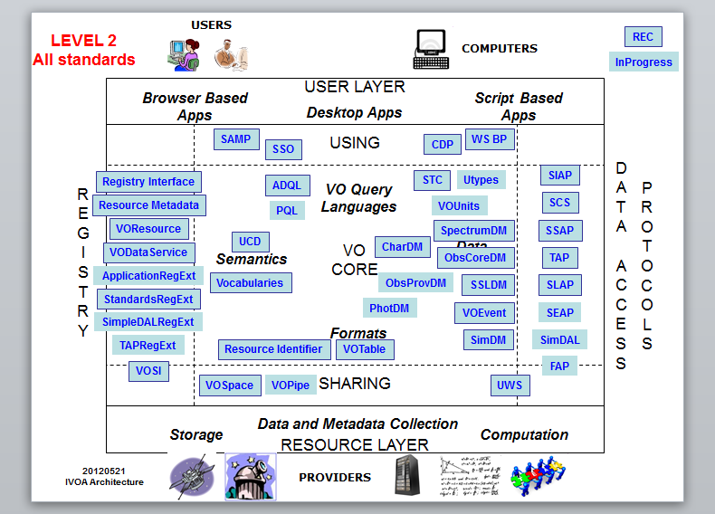
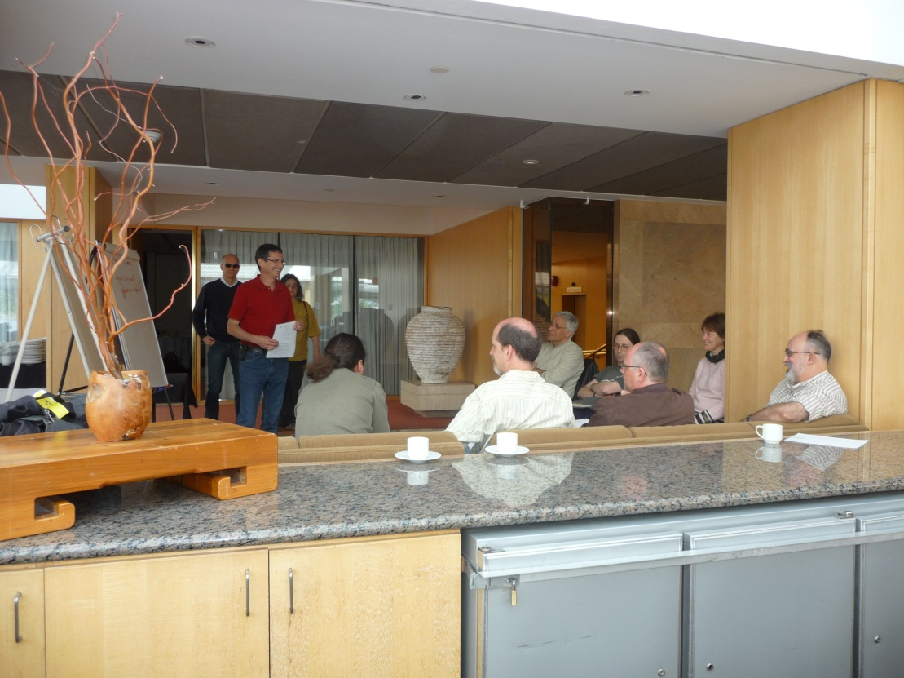
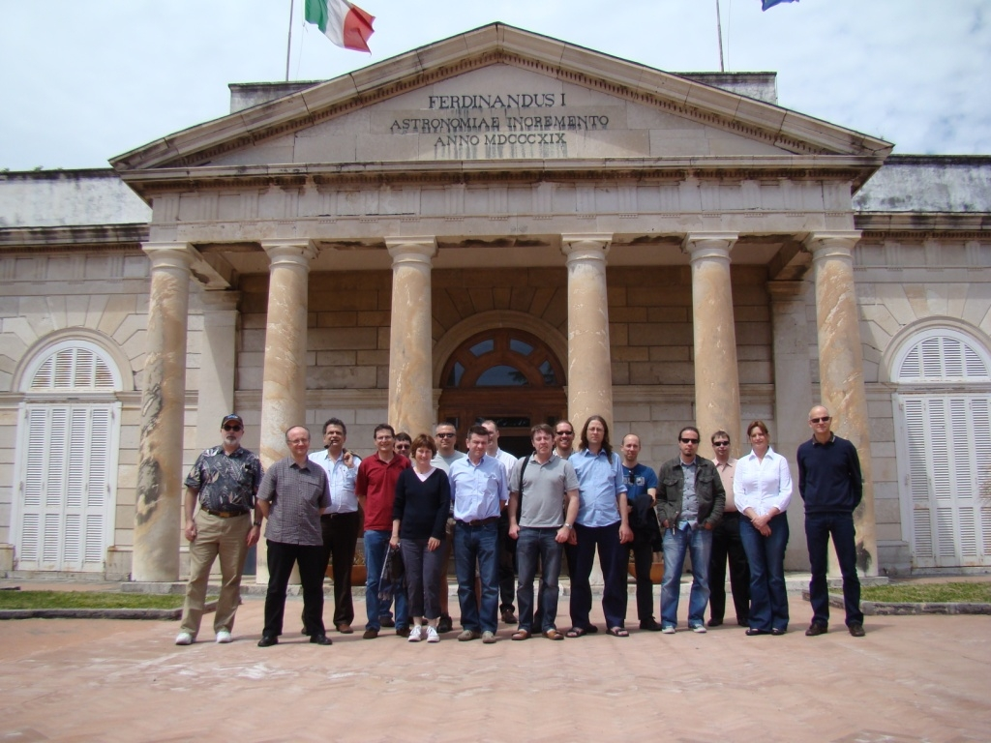
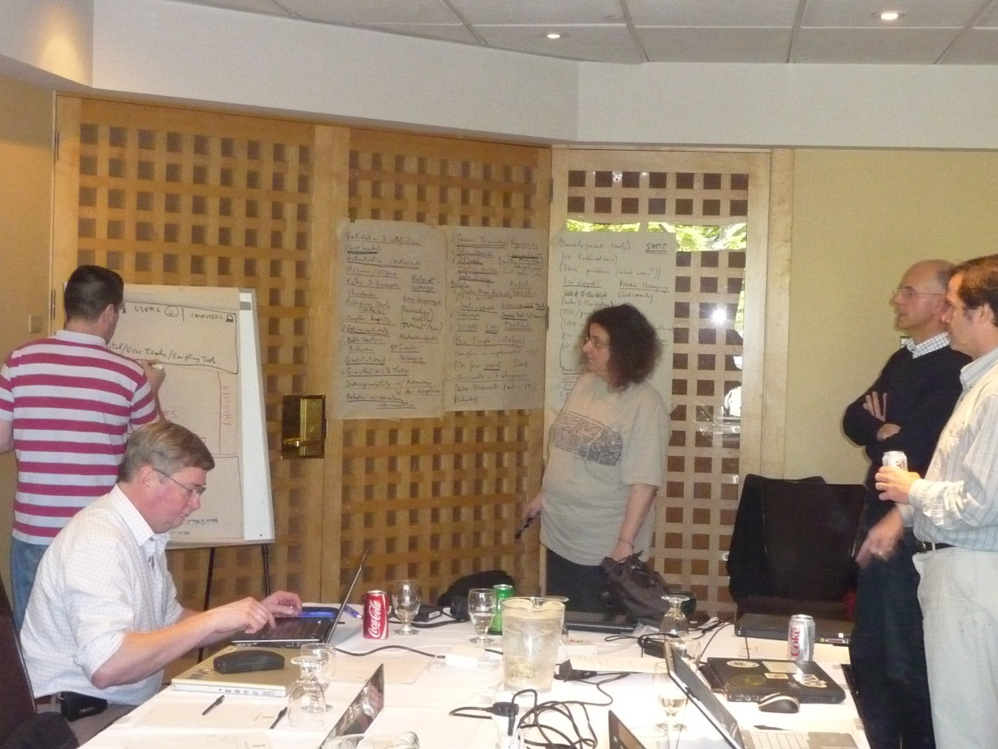
TCG in action

Slide 5
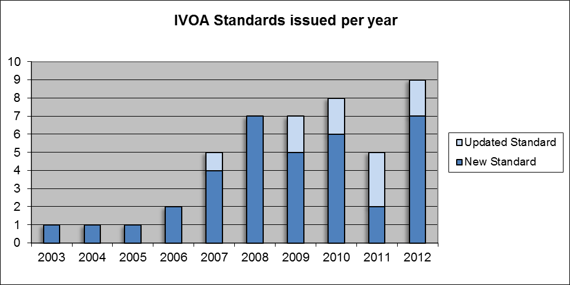
IVOA Standards per year
Planned

