Slide 1
The High power proton accelerator for the European Spallation Source (ESS)
S. Gammino
Milano, 9 Marzo 2012

Slide 2
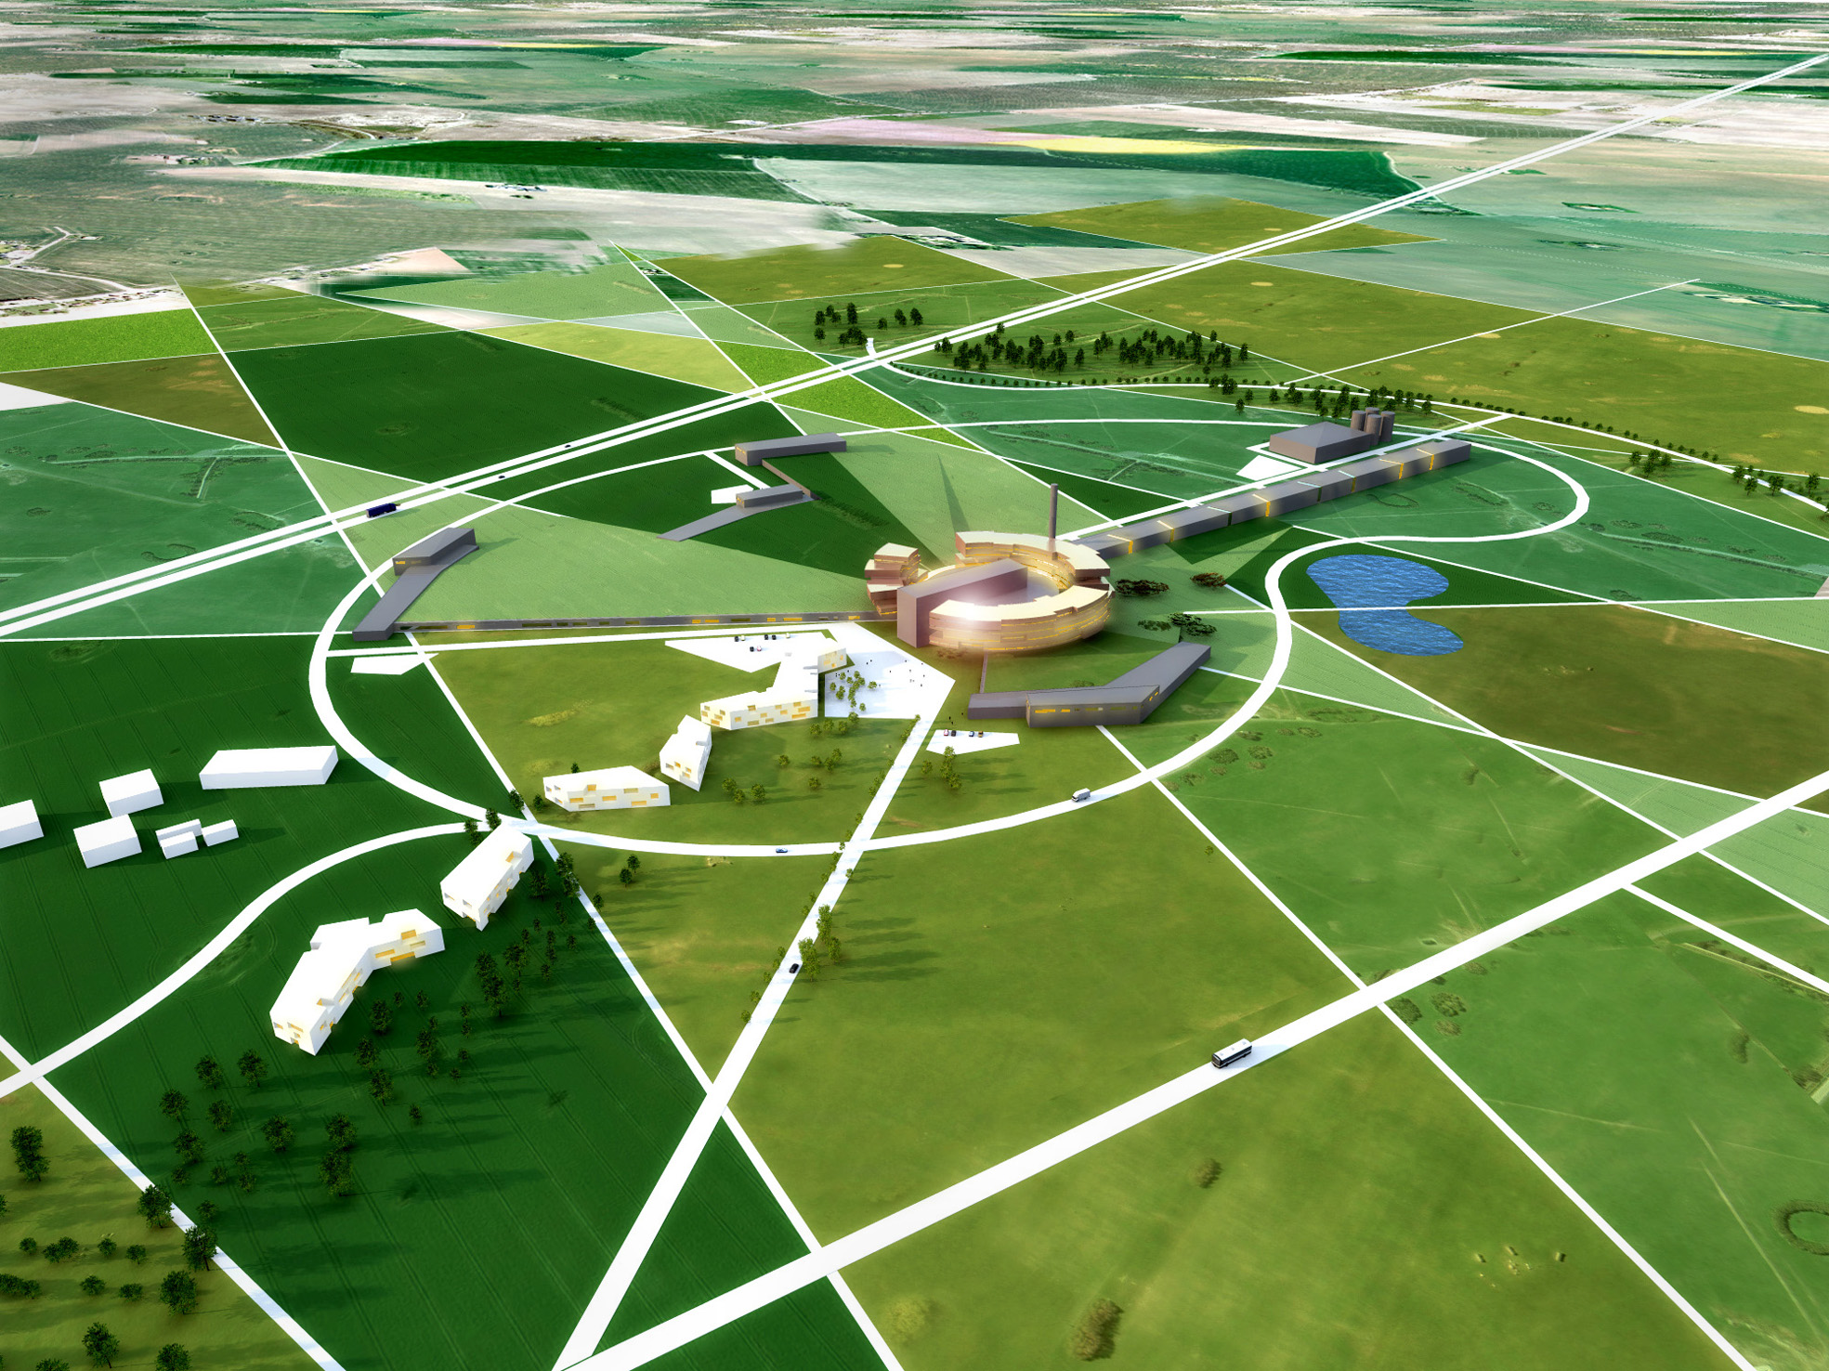

Slide 3
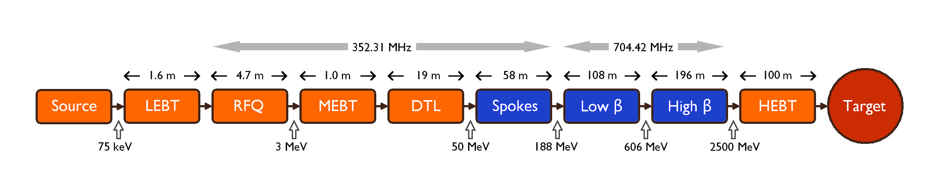
Present Geometry and Top-Level Parameters
Energy 2.5 GeV
Current 50 mA
Average power 5 MW
Pulse length 2.86 ms (new value since April 2011, equal to 2×20/14)
Rep rate 14 Hz (new value since April 2011)
Length 482 m, plus HEBT
Max cavity field 40 MV/m
Reliability > 95%
Longer than previously because of ”hybrid design”, smoother longitudinal phase advance, lower field gradients, ...

Slide 4
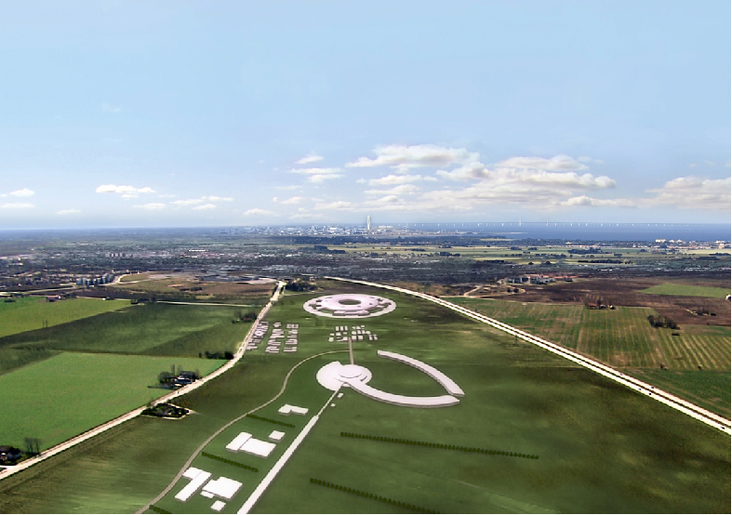
ACCELERATORS
High power, highly reliable Front Ends
High intensity light ions Linacs : systems design, beam dynamics, performance and current projects, reliability issues,
Synergies with ongoing and planned projects on accelerator driven systems, transmutation, neutrino factories, HEP injectors, materials science
Beam loss handling and diagnostics systems for high brightness hadron accelerators (≪1 W/m with localized exceptions)
Current state of theory and simulation tools, confronting predictions with experiment,
Low-energy superconducting structures, to be checked: how competitive they are for energies below 100 MeV…
 | Nominal | Upgrade
Average beam power | 5.0 MW | 7.5 MW
Macropulse length | 2.86 ms | 2.86 ms
Repetition rate | 14 Hz | 14 Hz
Proton energy | 2.5 GeV | 2.5 GeV
Beam current | 50 mA | 75 mA
Duty factor | 4% | 4%
Beam loss rate | < 1 W/m | < 1 W/m

Slide 5
ACCELERATORS
Radio frequency issues: where are we on high-gradient cavities and high power couplers, and current expectancies; current problems with the operation of high power, high duty cycle klystron/modulator systems,
Compatibility of the proposed ESS design with future upgrades
Energy usage, how to minimize electricity consumption without seriously compromising the performance

Slide 6
Parameters for the ESS linac
In comparison to the originally proposed design (5 MW, 1 GeV, 150 mA) the parameters have been modified in 2009 in order to simplify the linac design and to increase its reliability. The current has been decreased and the final energy increased, keeping the footprint of the accelerator the same.
Decrease in current – With increased energy the average pulse current is reduced
Increase of the cavity gradient – By decreasing the current, the gradient can be raised to 15 MV/m, keeping the coupler power constant.
Increase of beam energy.
Repetition rate - The originally proposed repetition rate of 16.67 Hz has been changed to 20 and then to 14 Hz.
Pulse length –2.86 ms

Slide 7
Cavities and Cryomodules
Power Couplers
Transition Energy from Warm to Cold Sections
Higher Order Modes
Cryomodules
Cryogenics
The linac parameters that were used are consistent with the SRF technology available today or that is expected to be in a 2 year period. No fundamental issue was identified. However there is still a large amount of work that remains to be done towards
the engineering various components.
High-power RF architecture
1 klystron per cavity
1 klystron to power several cavities

Slide 8
Main topics addressed: modelling codes, radiation issues, longitudinal and transverse measuring techniques
Main message: more diagnostic equipment than envisaged
Beam Diagnostics
Linac Front-Ends
Beam Dynamics
Beam Diagnostics
The primary linac diagnostic needs include beam position, beam arrival time (or phase), beam bunch length, beam transverse profiles, and beam loss.
Especially important for high power operation are sensitive beam loss measurement and profile resolution over a wide dynamic range.
Techniques for halo measurement in a superconducting environment need to be developed.

Slide 9
Accelerator Clear elements: main requirements, items that deserve additional R&D. “Obscure” elements: transition elements between different sections, partnership definition complicated by the workloads of involved research teams. Strength points: for most of the components (e.g. Front-End until the warm-cold transition, elliptical cavities) there is a sufficient/remarkable experience within the Institutions involved in ESS. INFN is recognized to own a remarkable expertise in the design of HPPA accelerators. Italian contribution to the Accelerator DU: Ion Source, LEBT, DTL, elliptical cavities, know-how about RFQ and superconductivity → useful know-how for ESS design and construction.

Slide 10
Collaboration model for linac design update (ADU)
Work Packages
1. Management Coordination – ESS (Mats Lindroos)
2. Accelerator Science – ESS (Steve Peggs)
3. Infrastructure Services – Tekniker, Bilbao, now ESS Lund
4. SCRF Spoke cavities – IPN, Orsay (Sebastien Bousson)
5. SCRF Elliptical cavities – CEA, IRFU-Saclay (Guillaume Devanz)
with contribution by INFN
6. Front End and NC linac – INFN (Santo Gammino)
7. Beam transport, NC magnets and Power Supplies – Århus University (Søren Pape-Møller)
8. RF Systems – ESS (Dave Mc.Ginnis)
19. Test stand – Uppsala university (Roger Ruber)

Slide 11
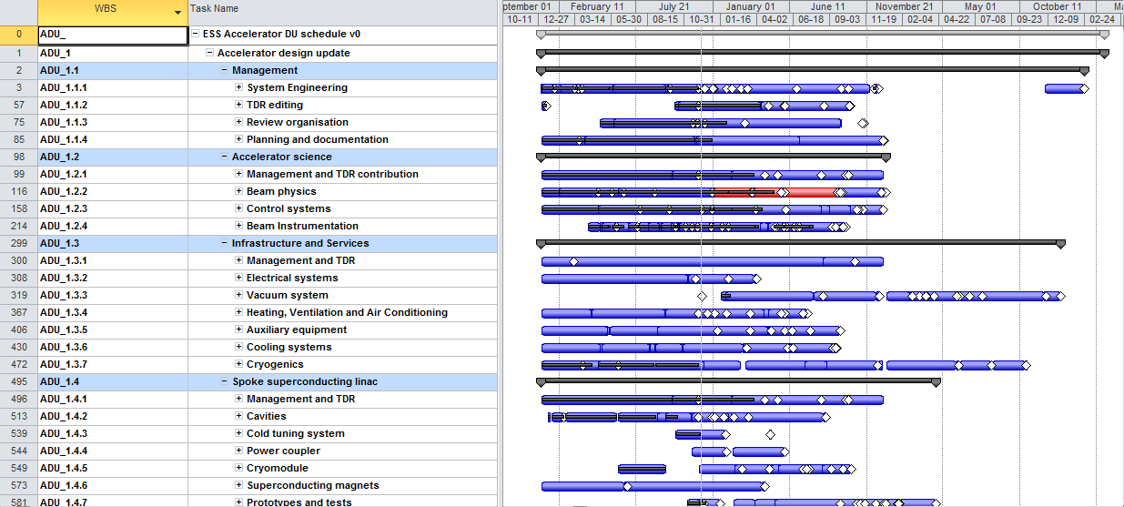
ADU Project Plan
900 tasks/milestones,
294 deliverables
189 968 hours

Slide 12
 | Proposed review schedule for ADU Work Units
WBS | Name | Review Schedule | Column1 | Column2
ADU_1.4.2 | Cavities | 2012-04-30 | S. Bousson | D. McGinnis
ADU_1.4.3 | Cold tuning system | 2012-04-30 | S. Bousson | D. McGinnis
ADU_1.4.4 | Power coupler | 2012-04-30 | S. Bousson | D. McGinnis
ADU_1.5.4 | High beta cavities | 2012-04-30 | S. Bousson | D. McGinnis
ADU_1.1.1 | System Engineering | 2012-05-30 | R. Duperrier | M. Landroos
ADU_1.1.2 | TDR editing | 2012-05-30 | R. Duperrier | M. Landroos
ADU_1.1.3 | Review organisation | 2012-05-30 | R. Duperrier | M. Landroos
ADU_1.1.4 | Planning and documentation | 2012-05-30 | R. Duperrier | M. Landroos
ADU_1.2.3 | Control systems | 2012-06-30 | G.Trahern | R. Ruber
ADU_1.2.4 | Beam Instrumentation | 2012-06-30 | A.Jansson | R. Ruber
ADU_1.6.2 | Proton source and Low Energy Beam Transport | 2012-06-30 | S.Gammino | H.Danared
ADU_1.6.3 | Radio Frequency Quadrupole | 2012-06-30 | S.Gammino | H.Danared
ADU_1.6.4 | Medium Energy Beam Transport | 2012-06-30 | S.Gammino | H.Danared
ADU_1.6.7 | Prototypes and tests | 2012-06-30 | S.Gammino | H.Danared
ADU_1.2.2 | Beam physics | 2012-06-30 | H.Danared | G.Trahern
ADU_1.8.2 | RF modelling | 2012-08-30 | D.McGinnis | R.Ruber
ADU_1.8.3 | Low level RF system | 2012-08-30 | D.McGinnis | R.Ruber
ADU_1.8.4 | RF power generation | 2012-08-30 | D.McGinnis | R.Ruber
ADU_1.8.5 | RF power distribution | 2012-08-30 | D.McGinnis | R.Ruber
ADU_1.4.5 | Cryomodule | 2012-09-30 | G. Devanz | W.Hees
ADU_1.4.6 | Superconducting magnets | 2012-09-30 | G. Devanz | W.Hees
ADU_1.5.2 | Medium beta cavities | 2012-09-30 | G. Devanz | W.Hees
ADU_1.5.3 | Cold tuning system | 2012-09-30 | G. Devanz | W.Hees
ADU_1.5.5 | Power coupler | 2012-09-30 | G. Devanz | W.Hees
ADU_1.5.7 | High beta Cryomodule | 2012-09-30 | W.Hees | G. Devanz
ADU_1.5.8 | Superconducting Magnets | 2012-09-30 | W.Hees | G. Devanz
ADU_1.6.5 | Drift Tube Linac | 2012-09-30 | S.Gammino | W.Hees
ADU_1.7.2 | High Energy Beam Transport | 2012-09-30 | S. Pape Møller | H.Danared
ADU_1.7.3 | Normal conducting magnets | 2012-09-30 | S. Pape Møller | H.Danared
ADU_1.7.4 | Power supplies | 2012-09-30 | S. Pape Møller | H.Danared
ADU_1.7.5 | Warm magnet/diagnostics prototype | 2012-09-30 | S. Pape Møller | H.Danared

Slide 13
WP 8 and WP 19
The complexity of the RF system, the high cost and the close integration needs with the conventional facilities has made it necessary to move WP 8 (RF systems) to Lund.
New planning has been submitted and EPG have decided to appoint David McGinnis as WP leader
Uppsala is proposed to lead a new WP 19 on Test stands. The WP is a P2B WP and we propose to launch it ASAP to avoid any issues with the UU contract.
The addenda will have the same total budget as the present UU WP
The new WP at UU: Uppsala will build a test stand with a complete 352 MHz RF source including the low level RF system which is designed and built at LU
Test of complete RF system
Test of LLRF (control of phase, frequency and amplitude) with test cavity from Orsay
System test of RF system and test at full power of complete spoke cavity Cryo Module from Orsay
Test of recombination of RF sources for future upgrades
Survey of existing European test stands for ESS construction phase

Slide 14
Comments from TAC-4 (Feb.16th,2012)
Good progress with ADU project…
…goal is to have requirement specifications, interface control documents, cost and schedule for construction for the end of 2012 (together with TDR)
Responsibilities and organization adapted to new situation with project office at ESS and a stronger accelerator division at ESS
Evolving baseline and the CDR is a snapshot of the status in November 2011
However, baseline is converging – many decisions taken since last TAC!
14

Slide 15
P2B and Construction
15

Slide 16
ESS Project Strategy
P2B
assures a stringent project framework for prototyping the design choices in the technical design
a continuous transition from design to construction and keeps the collaborations intact through the construction decision process
P2B projects
Design Updates
Construction projects
2011 | 2012 | 2013 | 2014 | 2015 | 2016 | 2017 | 2018 | 2019
International convention signed
First
neutrons
TDRs with cost and Schedule
Cryomodule production starts
Const.
First protons
P2B
Const.
P2B
DU
DU
P2B
16
P2B

Slide 17
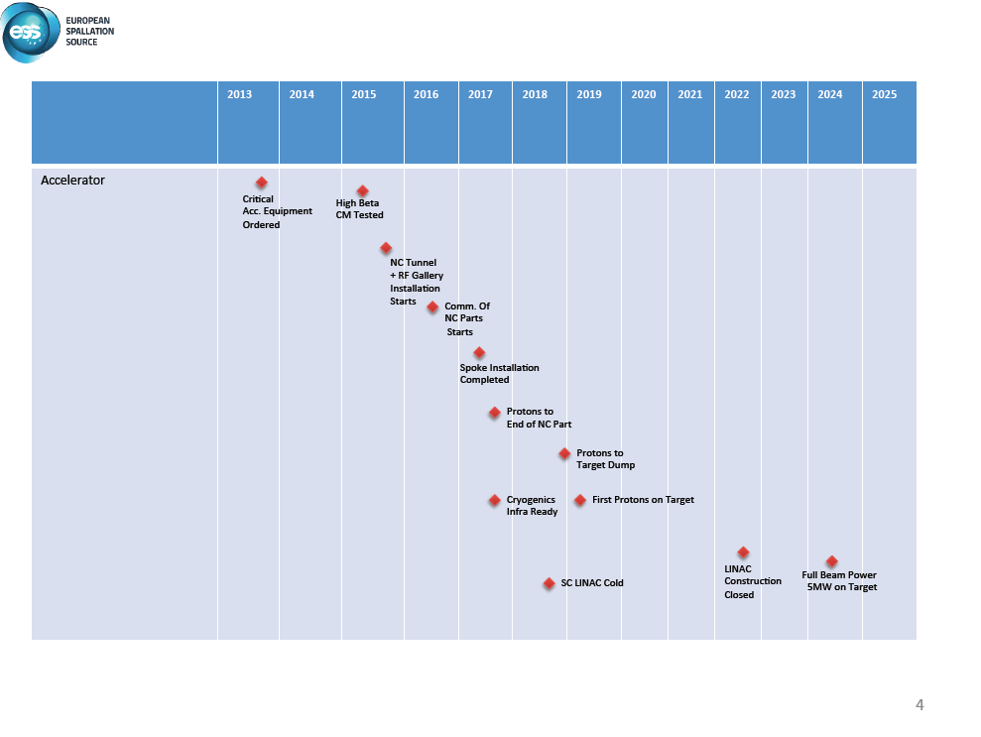

Slide 18

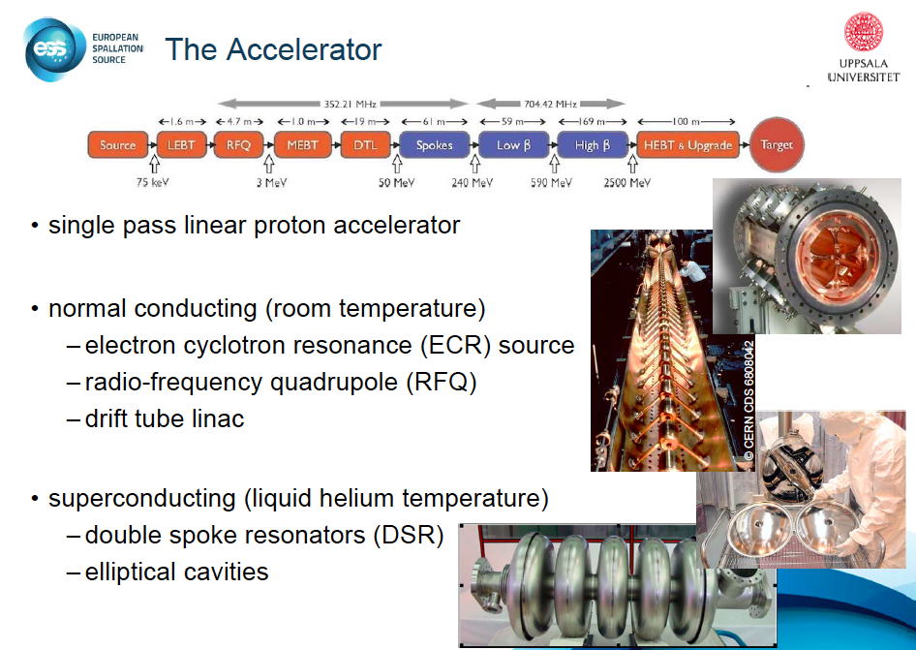

Slide 19
Project plan for the linac design update and prototyping
Design Report for the end of 2012, 20% precision in costing
Readiness to construct by the end of 2012 -- the design will be a safe baseline design with technical choices made for which the writing of specifications, detailed drawings and completion of late prototypes could be launched without any further delay after 2012
Energy budget and sustainability should be taken into account in each work package

Slide 20
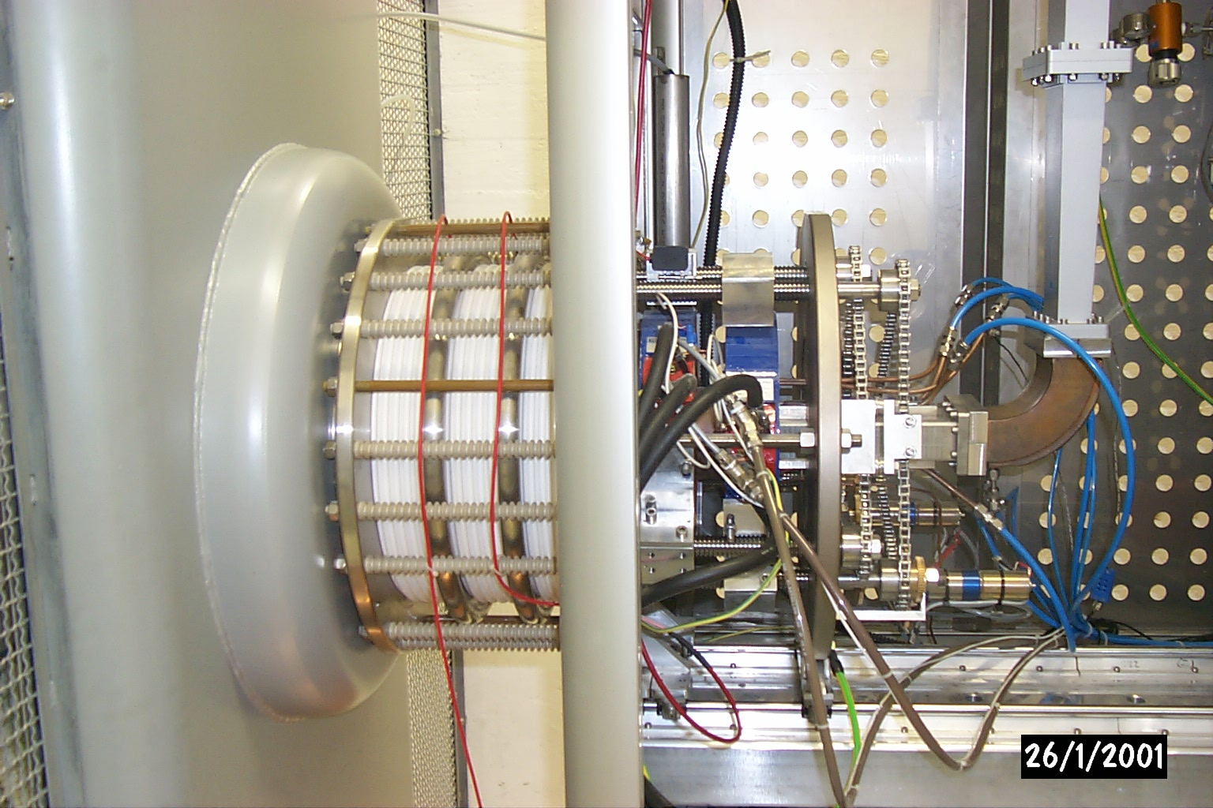
The high current proton source will be based on the know-how acquired during the design phase and the construction phase and commissioning of the sources named TRIPS and VIS at INFN-LNS and of the SILHI source at CEA-Saclay.
TRASCO INTENSE PROTON SOURCE (TRIPS)
Beam energy 80 keV
Current up to 60 mA
Proton fraction > 80%
RF power < 1 kW @ 2.45 GHz
CW mode
Reliability 99.8% over 142 h (35 mA)
Emittance 0.07 π mm mrad (32 mA), 0.15 to 0.25 at max current
Test benches available at INFN-LNS and at CEA-IRFU

Slide 21
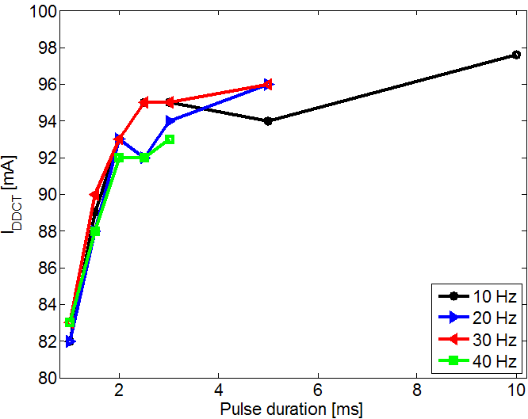
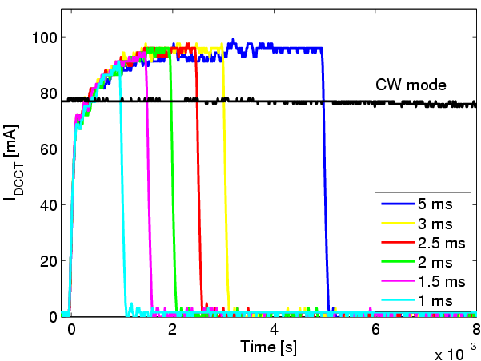
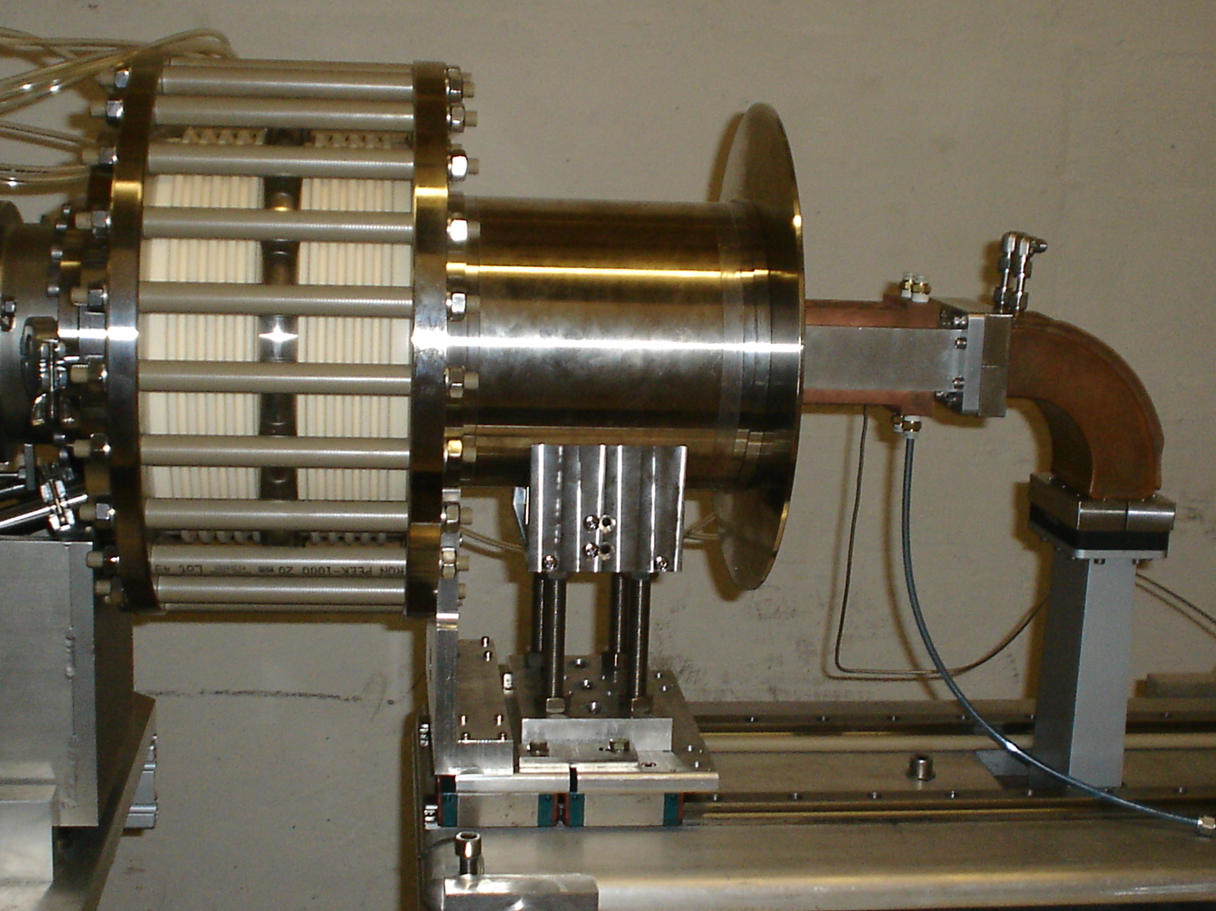
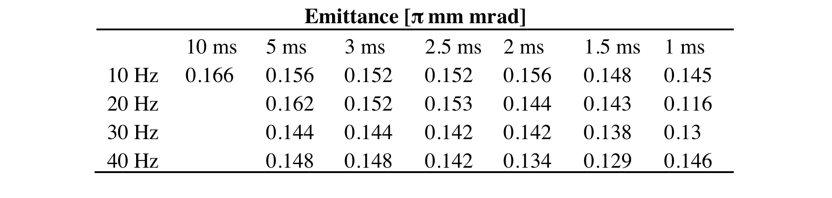
Proton source & Tests
SILHI
90mA
φ=9mm
VIS-Versatile Ion Source

Slide 22
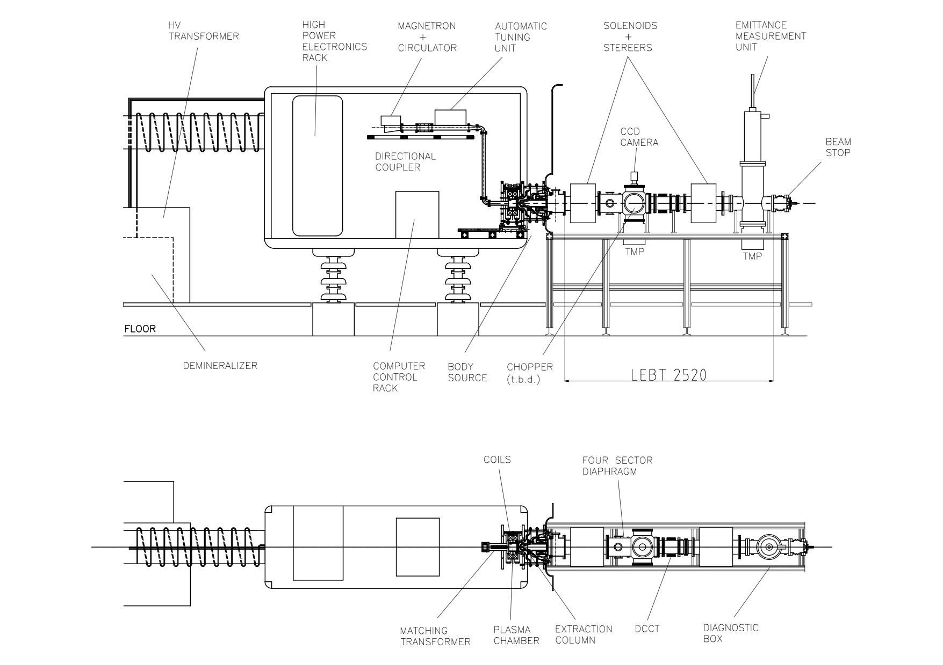
WU2 – Proton source & LEBT

Slide 23
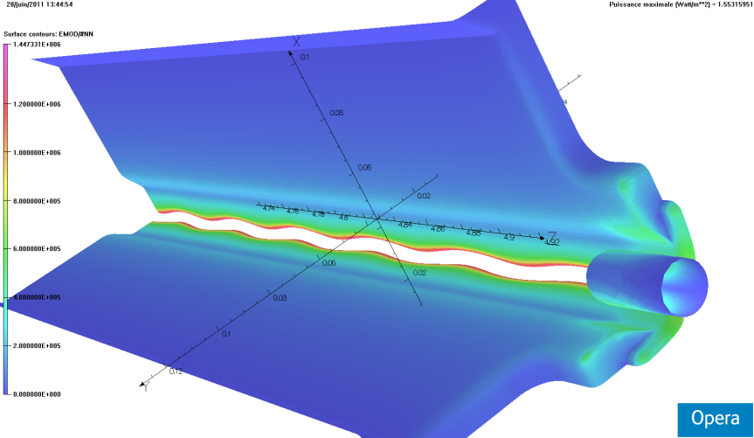
RFQ ANALYSIS
• sensitivity to dipole-like perturbations: the RFQ can be made naturally stable with proper choice of vane undercuts: 23 mm at RFQ input, 25 mm at RFQ output.
• sensitivity to quadrupole-like perturbations: RFQ ends are tuned with adjustable-length rods.
• quadrupole mode closer to accelerating mode Q₀ is Q₁: 1.47 MHz frequency shift, +31.9 MHz quadratic frequency shift
• dipole modes closer to accelerating mode Q₀ are
D₂ : -5.5 MHz shift, -61.3 MHz QFS
D₃ : +2.3 MHz shift, +40.3 MHz QFS

Slide 24
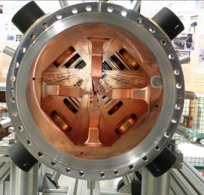
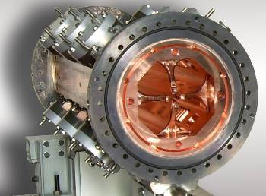
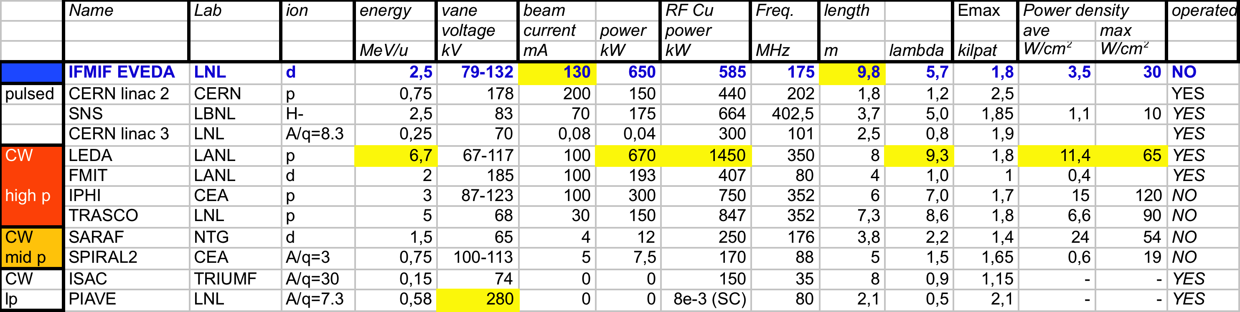
Research Programs in Europe related to ADS studies
IPHI@Saclay.CEA
TRASCO@LegnaroINFN

Slide 25
Technical Results-WU3

Slide 26
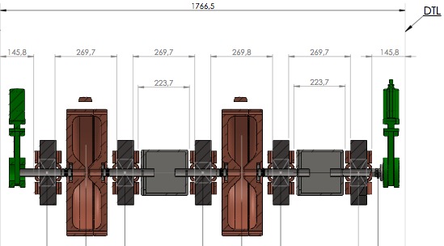
MEBT
Room for diagnostics & Vacuum elements

Slide 27
Drift tube Linac
As for this part, INFN-LNL team has already designed an accelerator with similar performances and has prototyped with Italian industry, together with CERN Linac4 team, a common prototype tank approximately 1 m long (prototype for Linac4 and SPES driver).
The collaboration with CERN team could continue and the DTL may be built on the basis of this R&D. If we look in details to the different parameters of the Linac4 and ESS DTL, there is an evident similarity concerning pulse current, gradient, injection energy, and some difference exists for output energy and duty cycle only.
For this reason, there is no need of prototyping for NC Linac, but a careful analysis of the optimum design, adapted to the ESS parameters, is under way, to put in evidence possible criticalities and maximize the reliability .

Slide 28
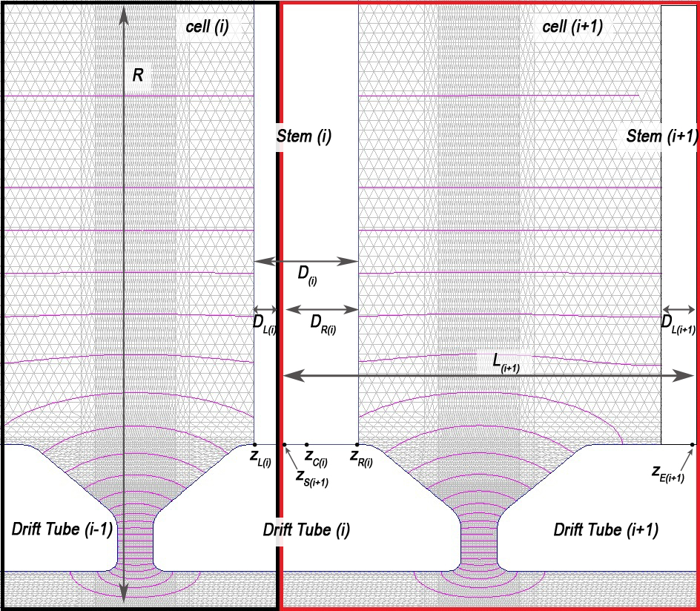
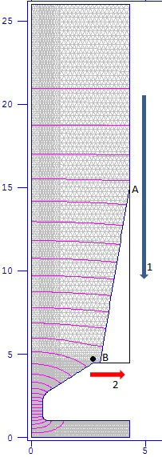
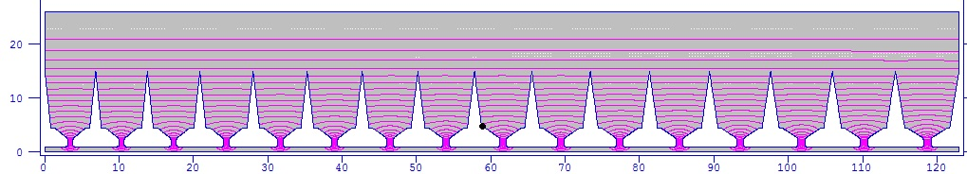
Analisys of RF Stem Effect on fields shape
Stem volume that perturbs first cell is less than that which perturbs second one.
We decrease triangle height until cell resonant frequency is less than that corrected for stem (moving A point from top to bottom);
we decrease triangle base until cell resonant frequency is equal to that corrected for stem (moving B point from left to right).

Slide 29
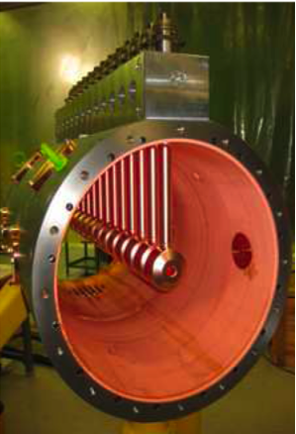
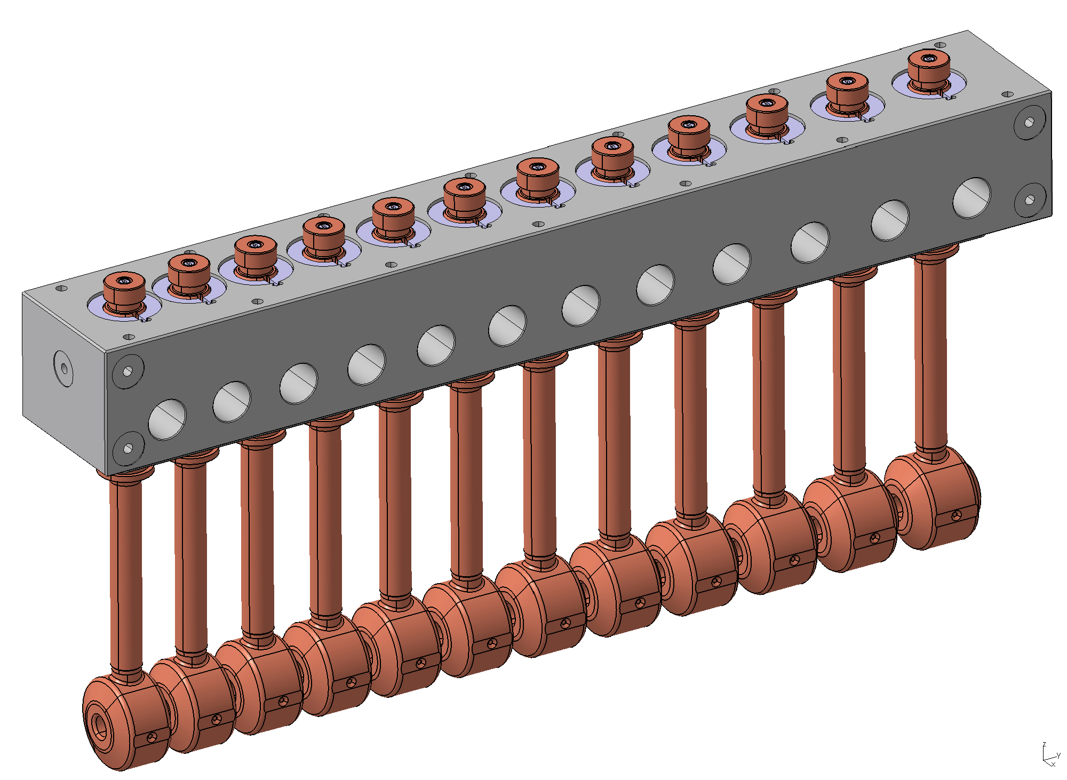
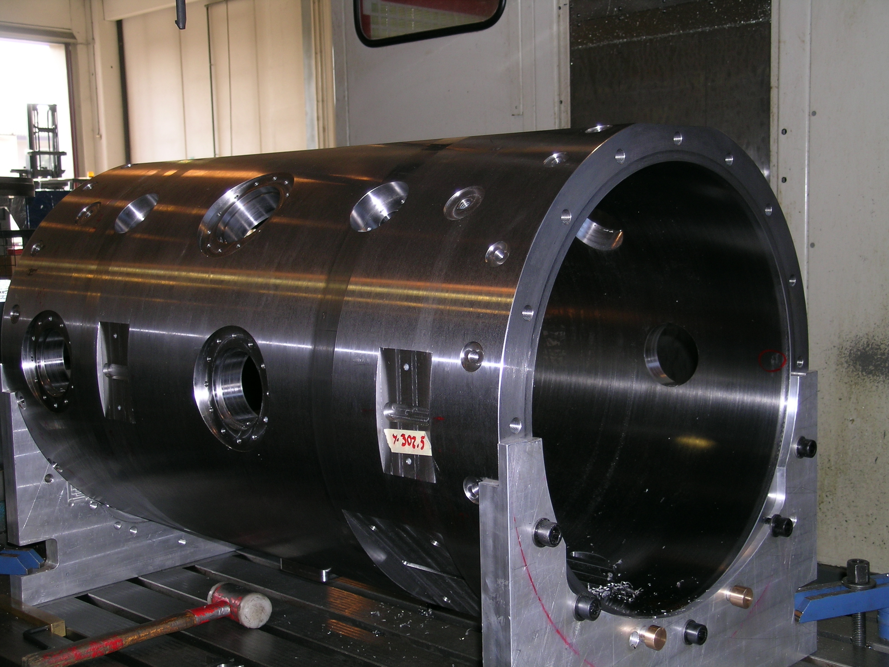
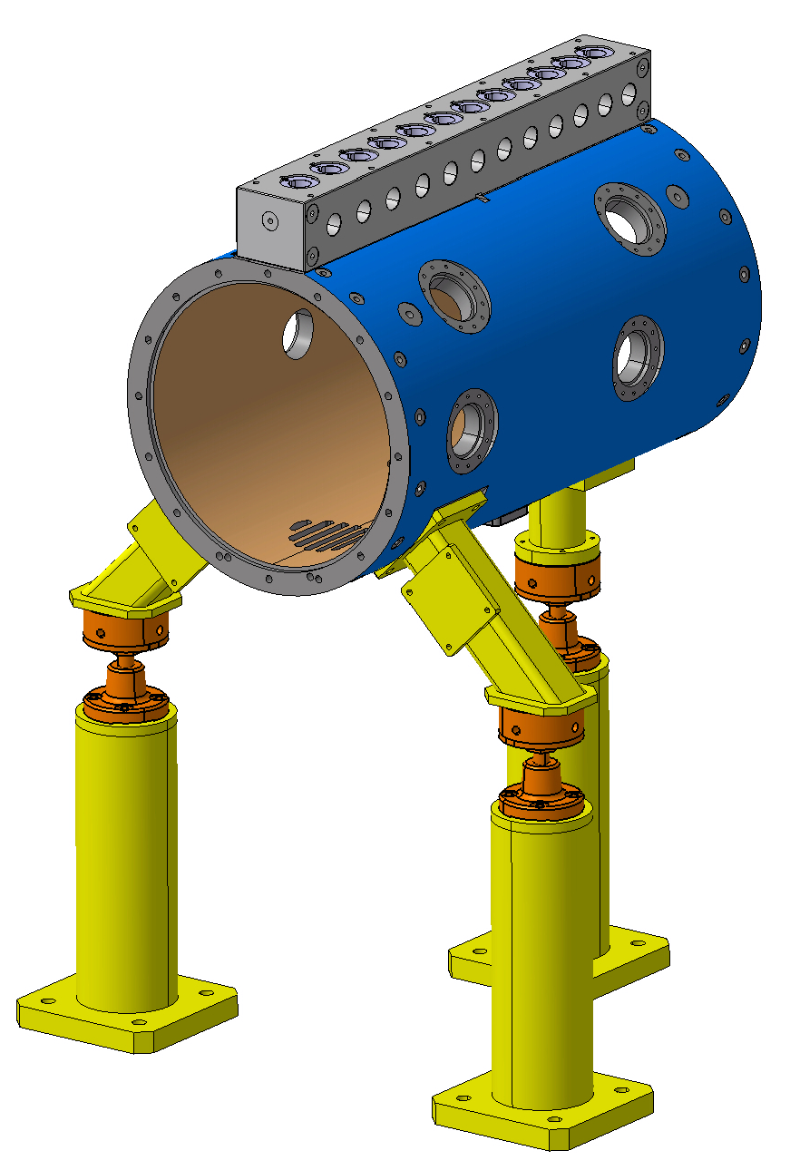
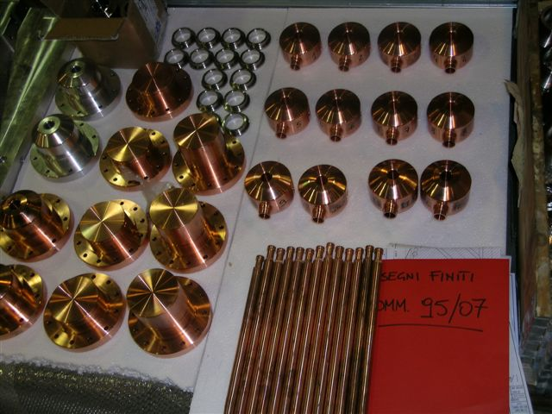
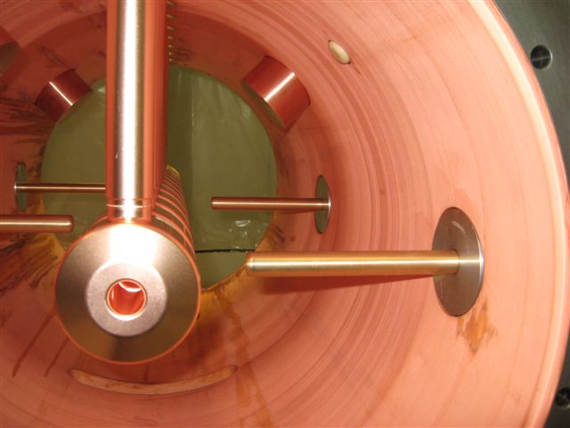
CERN-INFN DTL prototype, based on CERN design
Tank machining at Cinel (Vigonza-Italy)

Slide 30
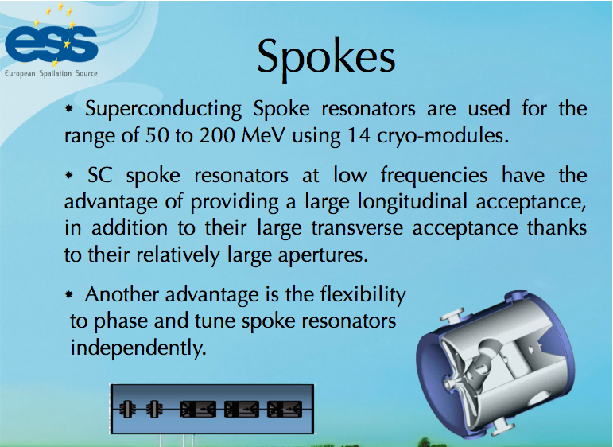
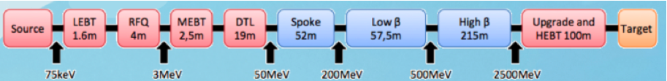

Slide 31
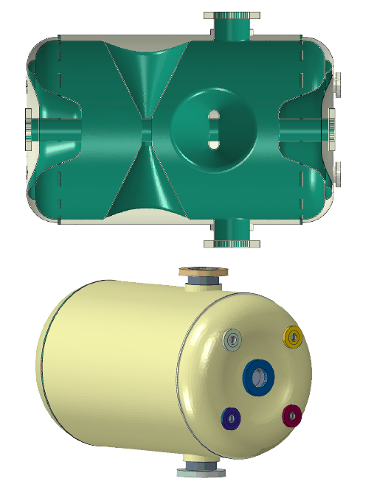
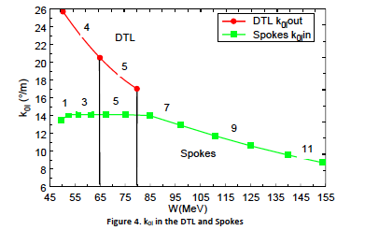
Disadvantages
Matching, cost, length (not compensated by cryogenics’ savings

Slide 32
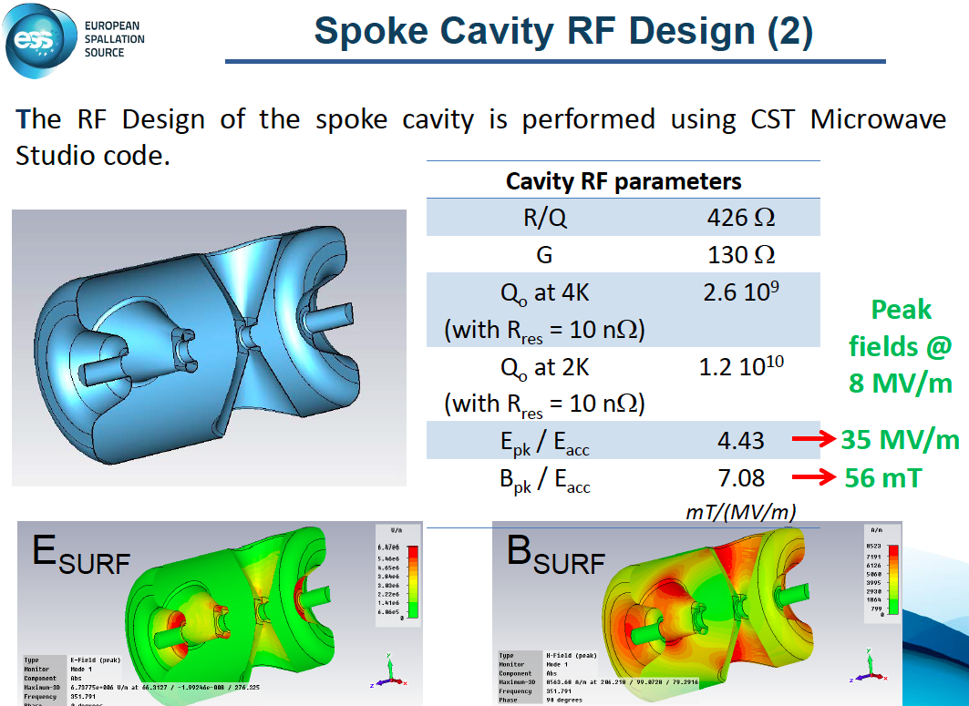

Slide 33
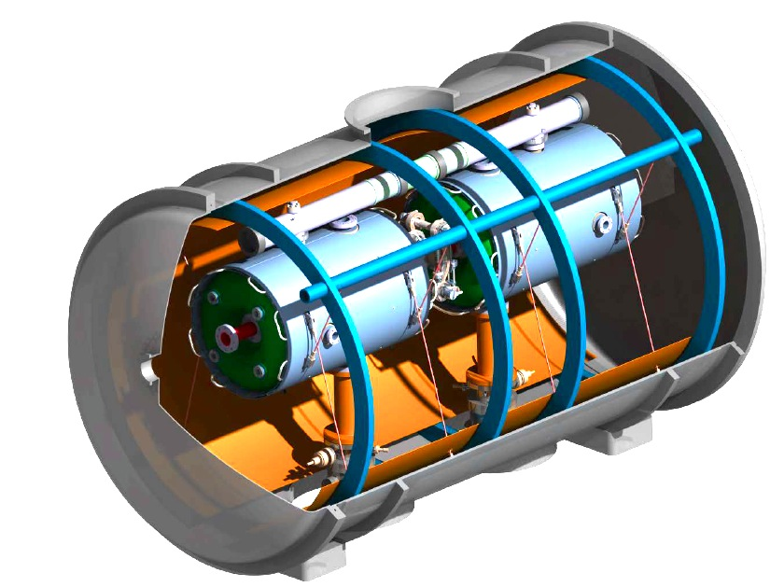
First prototype in 2013
at IPN-Orsay

Slide 34
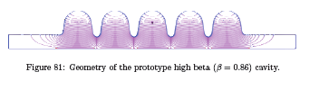
Elliptical cavities design at CEA-IRFU, Saclay
The elliptical superconducting linac consists of two types of cavities – medium beta and high beta – to accelerate the beam from the spoke superconducting linac energy (191 MeV) up to full energy (653 MeV in the medium beta, 2500 MeV the high beta).
The profile of a 5-cell high beta cavity is shown in Figure.

Slide 35
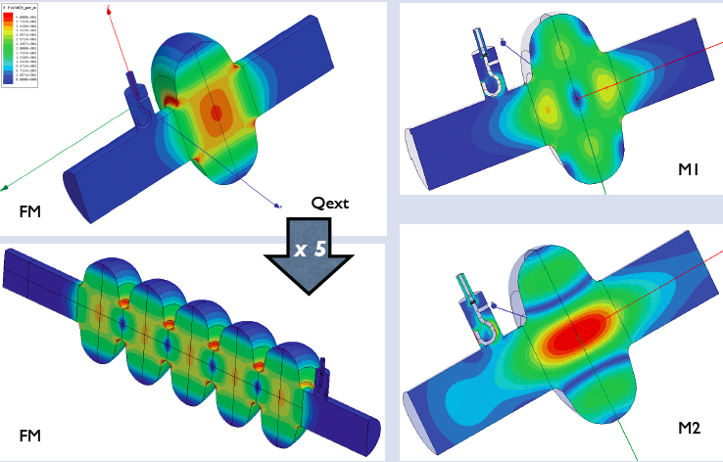
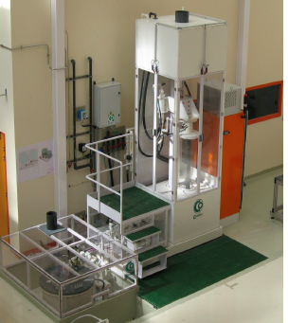
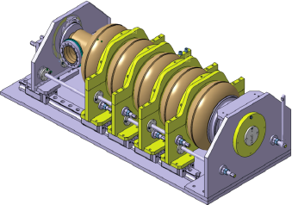

Slide 36
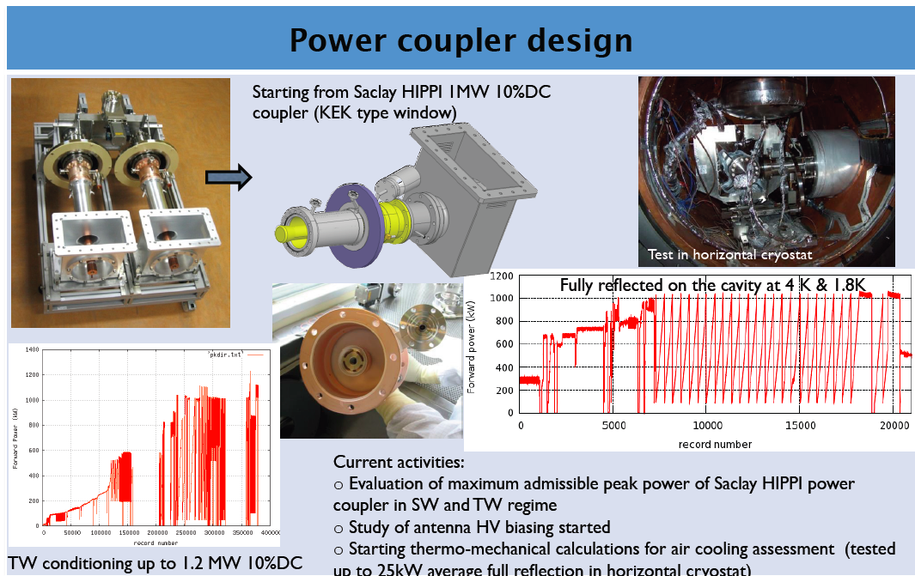
Prototype design at CEA-IRFU, Saclay

Slide 37
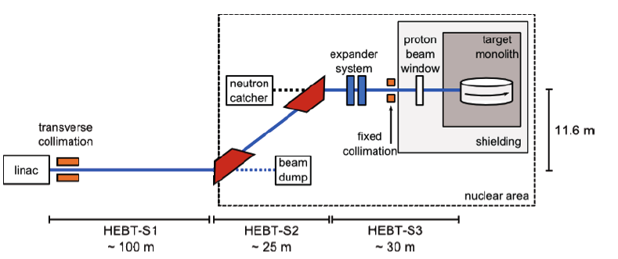
HEBT

Slide 38
Perspectives
A clear path towards the definition of each component of the accelerator is tracked.
Reliability issues and possibility to upgrade have driven the efforts of ADU WPs.
Some open questions are still on the table with the aim to reduce costs and increase beam availability.
Team building is well placed.
Links between accelerator’s designers and infrastructure are established.
Second half 2012: TDR and costing
Ready to build ESS since 2013!

Slide 39
Thanks for your attention.

Slide 40
