Slide 1
Results of a National Assessment of Information Literacy Skills

Slide 2

Project SAILS
Standardized Assessment of Information Literacy Skills
Originated at Kent State University
Knowledge test

Slide 3
SAILS Test
ACRL standards (1, 2, 3, 5)
168 items, multiple-choice
Scoring
Each student answers 45 items; the students are grouped together to achieve cohort scores
Item response theory (item difficulty and student performance)
Cohort scores placed on a scale from 0 to 1000
Breakouts for class standing and major
Validity and reliability
Correlation with JMU information literacy test
Correlation with ACT / SAT scores
Item reliability estimates .80 and higher
Item difficulty assessed through inter-rater reliability
Notes:
Individual test also available
Items written for outcomes and objectives from the 2 ACRL documents.

Slide 4
Administration
Three-year rolling benchmark
173 administrations at 105 institutions (U.S. & Canada)
51,364 undergraduate students

Slide 5
Profile of the Benchmark
Type of Institution | Number of Institutions | Total Number of Students | Fresh. | Soph. | Juniors | Seniors
Associates | 17 | 4,600 | 2,289 | 1,556 | 300 | 76
Bachelors – General | 15 | 3,530 | 2,581 | 427 | 164 | 264
Bachelors – Liberal Arts | 17 | 6,566 | 3,533 | 1,002 | 860 | 1,131
Masters | 34 | 19,209 | 9,638 | 3,660 | 2,692 | 2,880
Doctorate | 22 | 17,459 | 14,010 | 1,114 | 714 | 1,437

Slide 6
SAILS Skill Sets
Developing a research strategy
Selecting finding tools
Searching
Using finding tool features
Retrieving sources
Evaluating sources
Documenting sources
Understanding economic, legal, and social issues

Slide 7
Scores for Skill Set 1: Developing a Research Strategy
 | Associates | Bach – General | Bach – Liberal Arts | Masters | Doctorate
Freshman | 460 ± 5 | 469 ± 5 | 483 ± 4 | 485 ± 2 | 492 ± 2
Sophomore | 491 ± 6 | 500 ± 12 | 505 ± 7 | 506 ± 4 | 506 ± 8
Junior |  | 503 ± 18 | 512 ± 8 | 513 ± 4 | 516 ± 9
Senior |  | 511 ± 15 | 529 ± 7 | 525 ± 5 | 539 ± 7

Slide 8
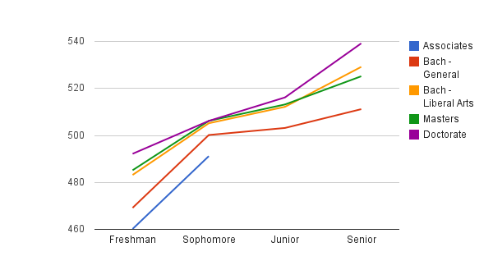
Scores for Skill Set 1: Developing a Research Strategy

Slide 9
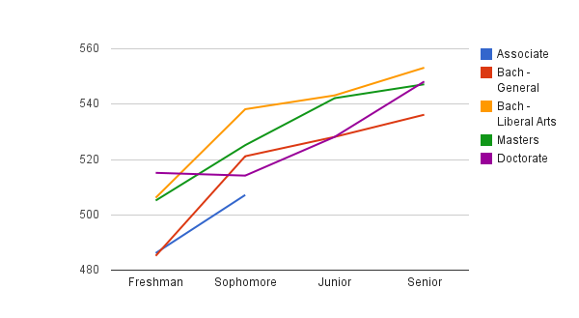
Skill Set 2: Selecting Finding Tools

Slide 10
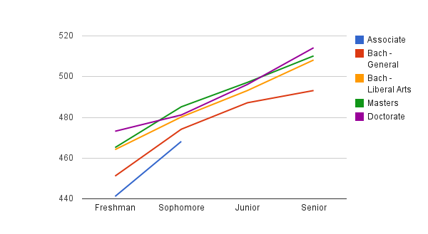
Skill Set 3: Searching

Slide 11
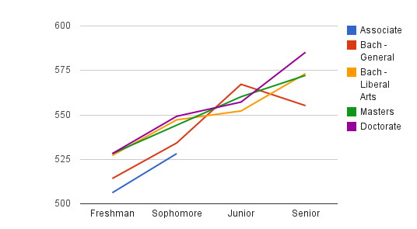
Skill Set 4: Using Finding Tool Features

Slide 12
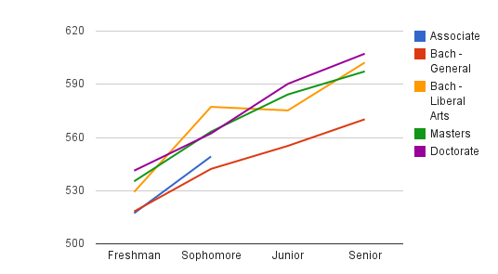
Skill Set 5: Retrieving Sources

Slide 13
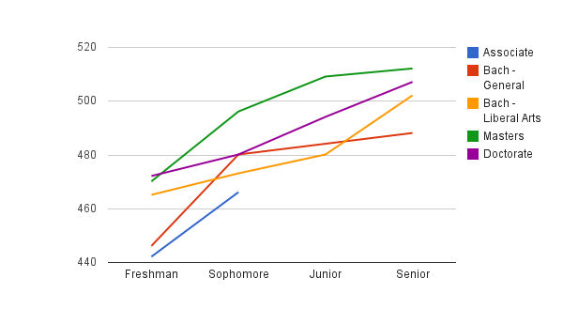
Skill Set 6: Evaluating Sources

Slide 14
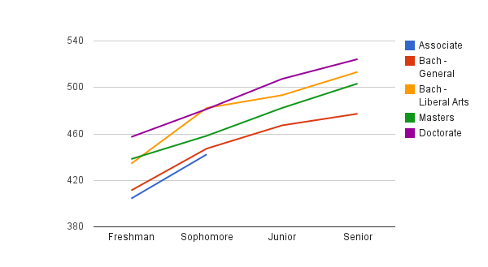
Skill Set 7: Documenting Sources

Slide 15
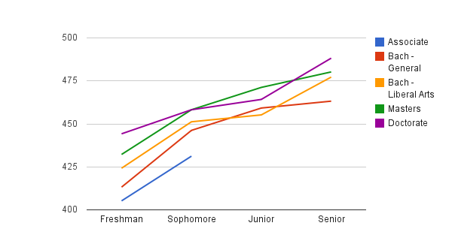
Skill Set 8: Understanding Economic, Legal, and Social Issues

Slide 16
Trends for Class Standing
Seniors do better on the test than freshmen. This is true for every skill set and for all four types of schools that have seniors.
For associates schools, sophomores do better than freshmen on every skill set.
The biggest gains are mostly in two skill sets, Retrieving Sources and Documenting Sources.
Notes:
Differences range from an increase of 33 points to an increase of 79 points.
with increases ranging from 21 to 38 points

Slide 17
Trends for Institution Type
Doctorate, masters, and bachelors–liberal arts schools score higher than bachelor–general and associates schools on nearly all skill sets at nearly all levels.
Students at doctorate institutions achieve more of the highest scores than any other institution type.
Doctorate institution students score consistently higher in the skill sets of Developing a Research Strategy; Searching; Using Finding Tool Features; Retrieving Sources; Documenting Sources; and Understanding Economic, Legal, and Social Issues.
Students at masters institutions scored highest across more classes for the skill set Evaluating Resources.

Slide 18
Interpretation
How are students learning these skills? What are factors that led to increased information literacy?
Expected student development and maturation?
Is it library instruction?
Learning from classroom faculty?
Assignments?
Parents? Friends?

Slide 19
Limitations
Sample may not be representative.
Institutions are self-selecting.
Institutions choose students to test.
Low-stakes test.
Cannot compare skill sets.
No mastery and proficiency levels.
Notes:
Institutions that participate in SAILS are self-selecting. In addition, each institution selects students to take the SAILS test and those students may not represent the institution’s student body.
The tests measure knowledge, which does not always correspond to demonstration of information literacy skills. The tests are based on the very broad construct of information literacy as operationalized by four of the five ACRL standards.

Slide 20
Future Research
Majors
Crosstabs – class standing by major
Individual scores
Proficiency and mastery
Pre- and post-test

Slide 21


Slide 22
Thank you!
www.ProjectSAILS.org

