Slide 1
Relativistic Heavy Ions ALICE/CERN
Kristjan Gulbrandsen
Niels Bohr Institute - Discovery

Slide 2
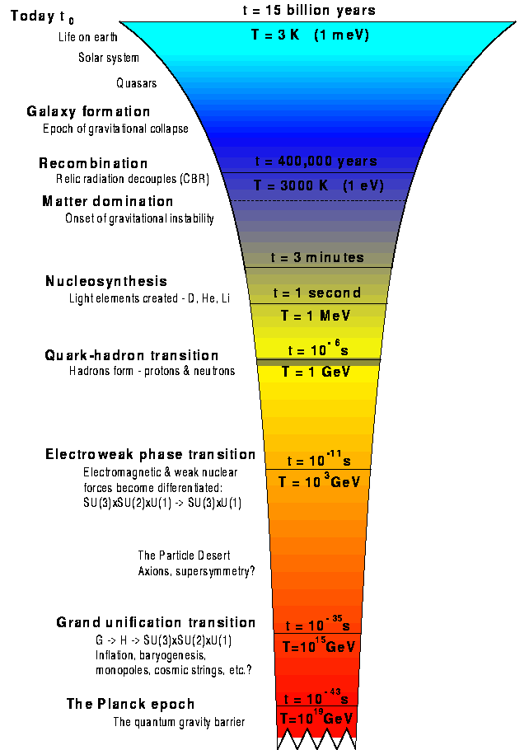
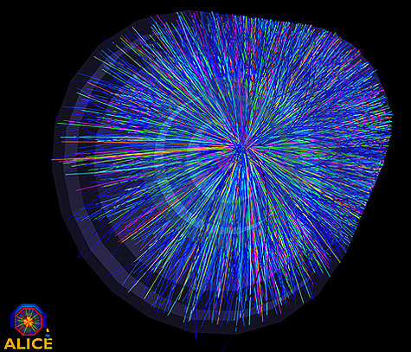

Slide 3
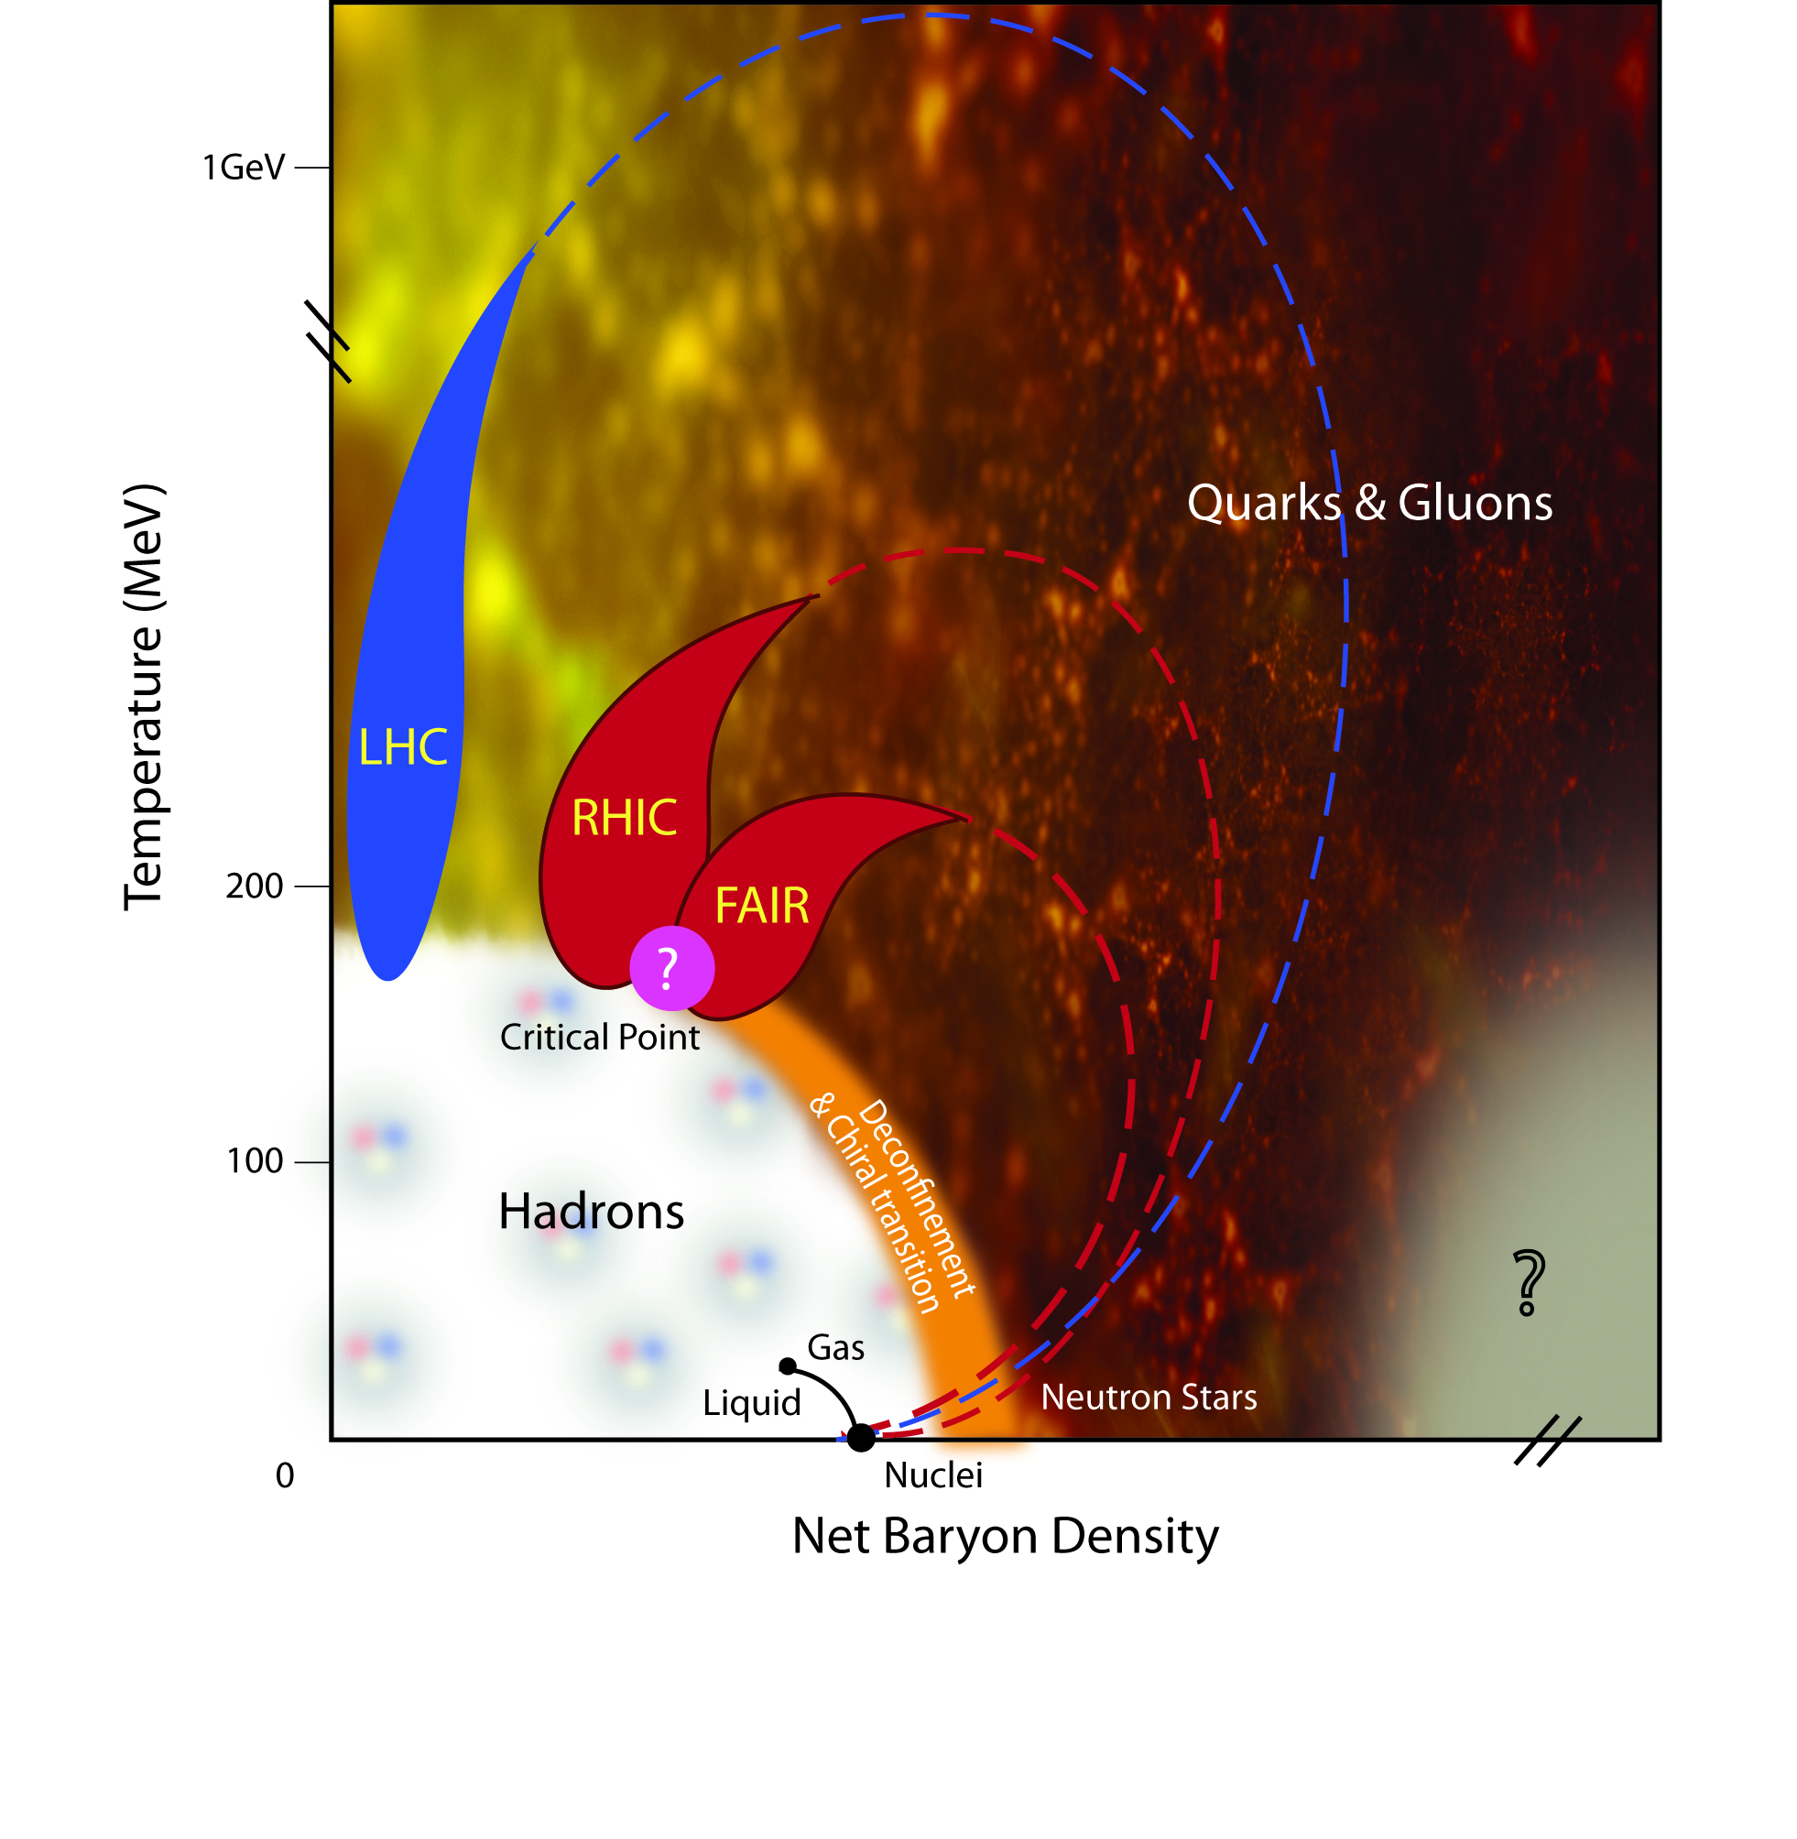
QCD Phase Diagram

Slide 4
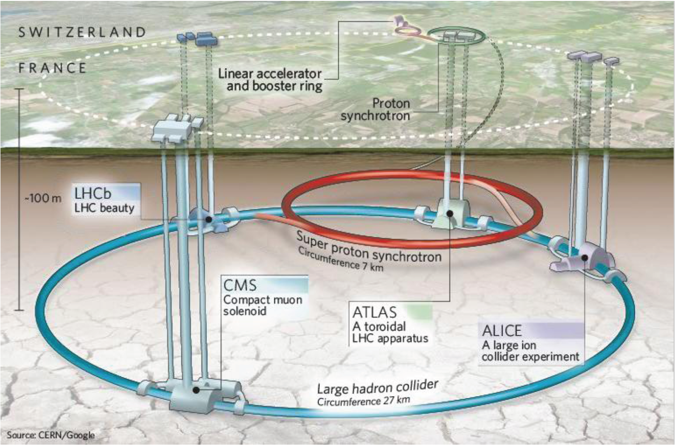
CERN – The Large Hadron Collider
Notes:
Collided protons (since late 2009) and lead ions (in November – ending a week ago)
Delivered to 4 experiments
ALICE built to study collisions of these ions
proton-proton collisions are still important

Slide 5
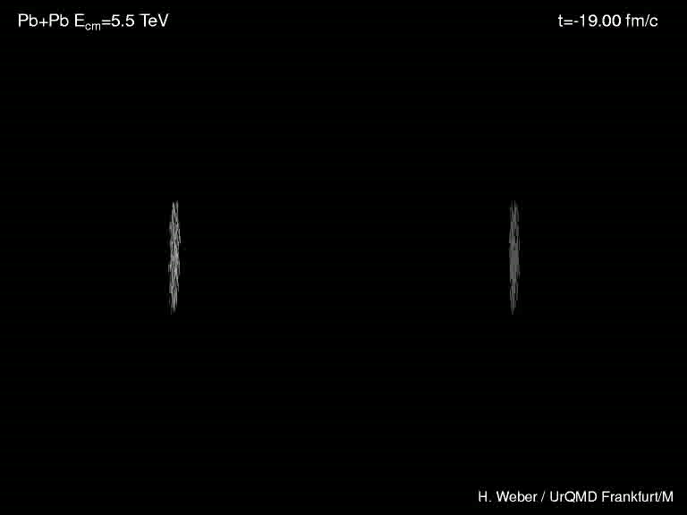
Creating the Early Universe

Slide 6
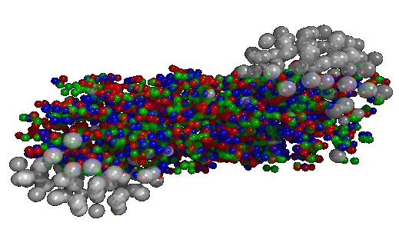
Nucleus Collisions

Slide 7
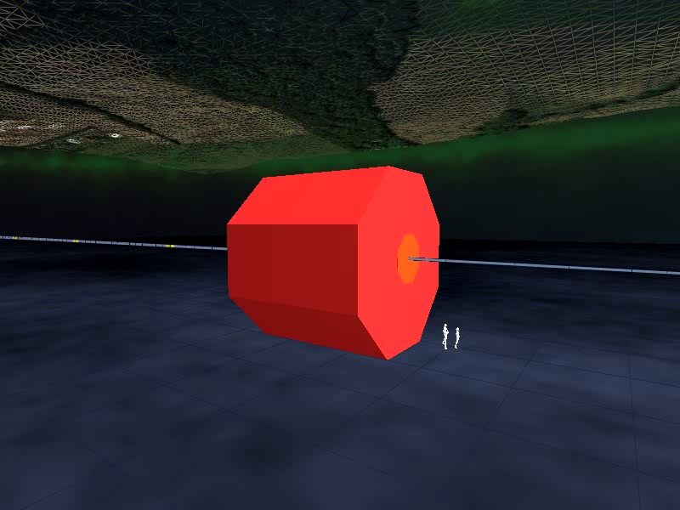
Detecting a Collision

Slide 8
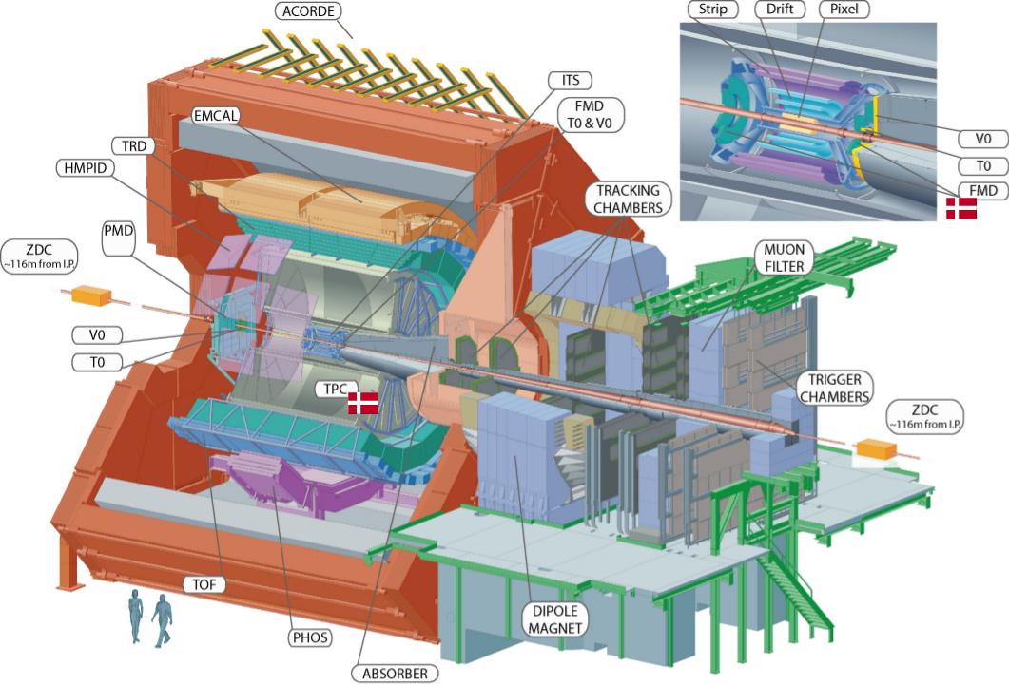
A Large Ion Collider Experiment

Slide 9
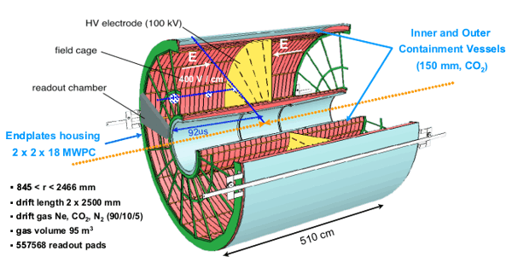
Time Projection Chamber (TPC)
Measure position and momentum
Particle Identification

Slide 10
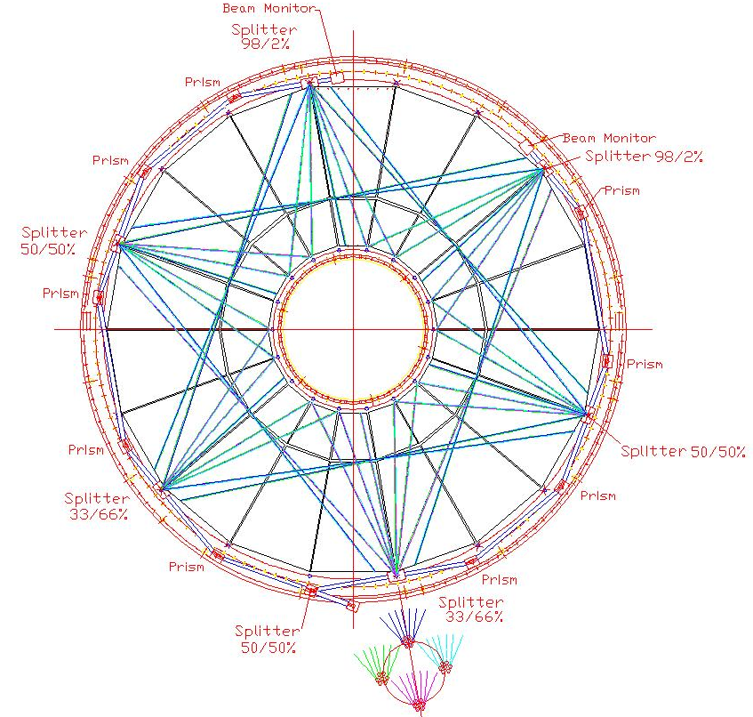
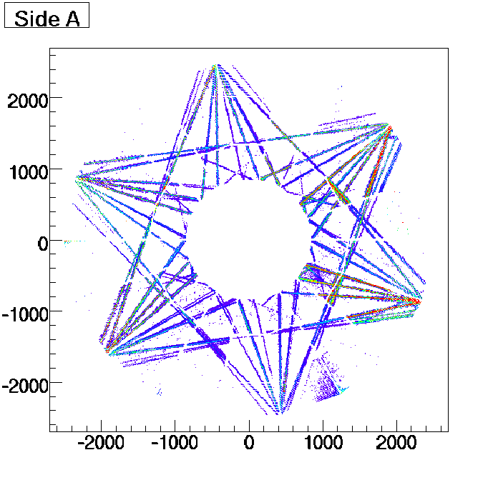
TPC Laser
Beam split into 336 laser tracks
Unaffected by magnetic field
Crucial for knowledge of drift time
Exact positions known

Slide 11
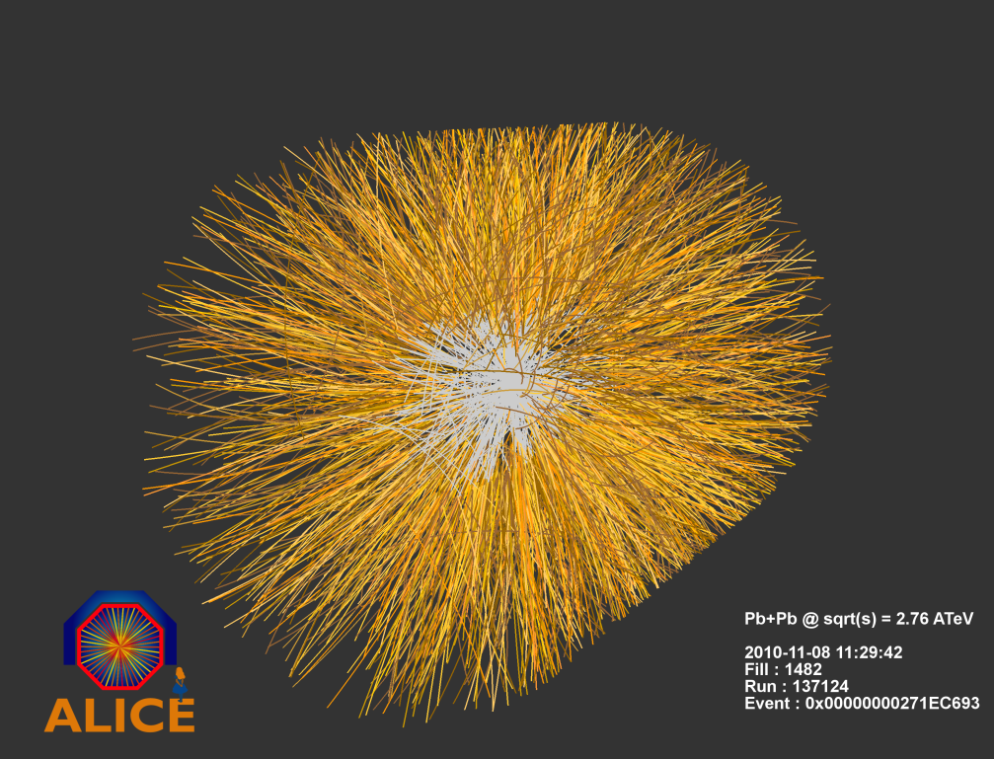
TPC PbPb Event

Slide 12
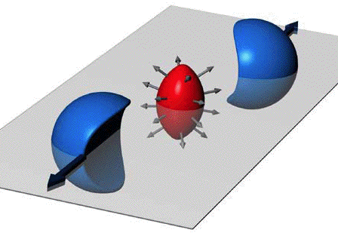
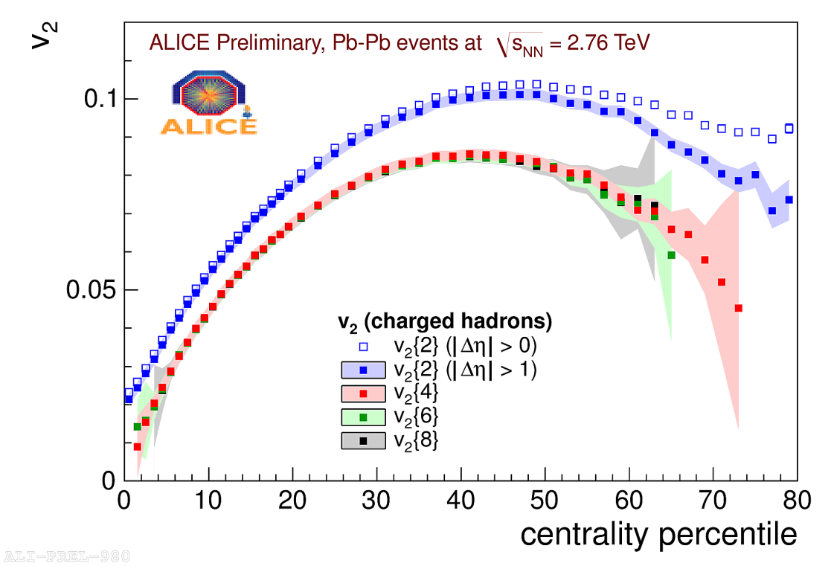
Strong Hydrodynamics
Asymmetry region of interaction
Produces asymmetric distribution of particles
Requires interactions
Can measure this final asymmetry (v₂)
Related to viscosity of the medium
Higher order correlations indicate hydrodynamical behavior
Duke – Jetlab – Cold Atoms
http://www.phy.duke.edu/research/photon/qoptics/news/stronginter/index.html
Notes:
Unlike our universe, the created universes can be asymmetric
Initial shape is related to number of produced particles

Slide 13
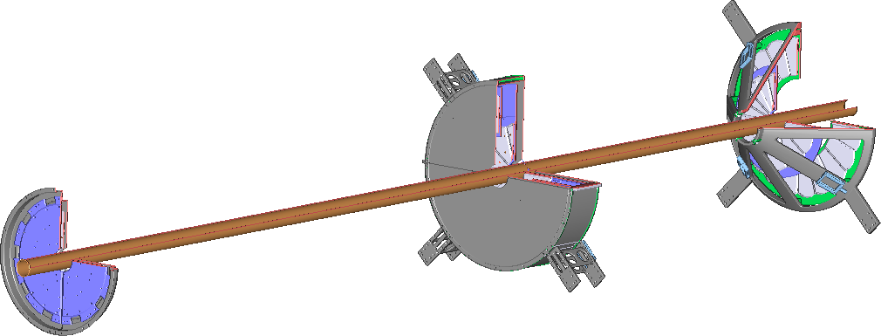
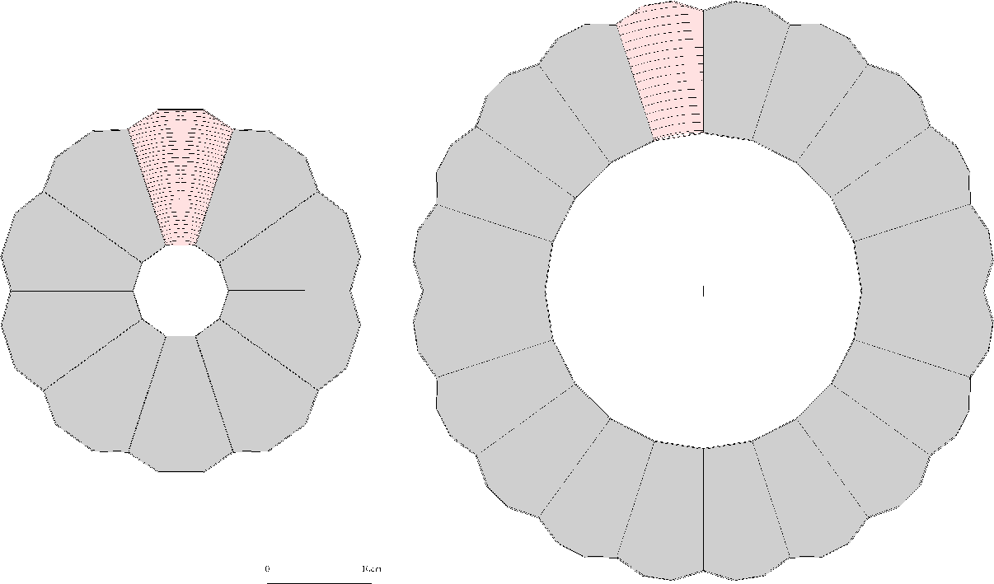
Forward Multiplicity Detector
Interaction Point
Only detector in ALICE with high segmentation at high |η|
51200 silicon strips - radial and azimuthal segmentation
position and energy information
Hit information can be used in p+p for particles detection
Energy information used in Pb+Pb (high occupancy)

Slide 14
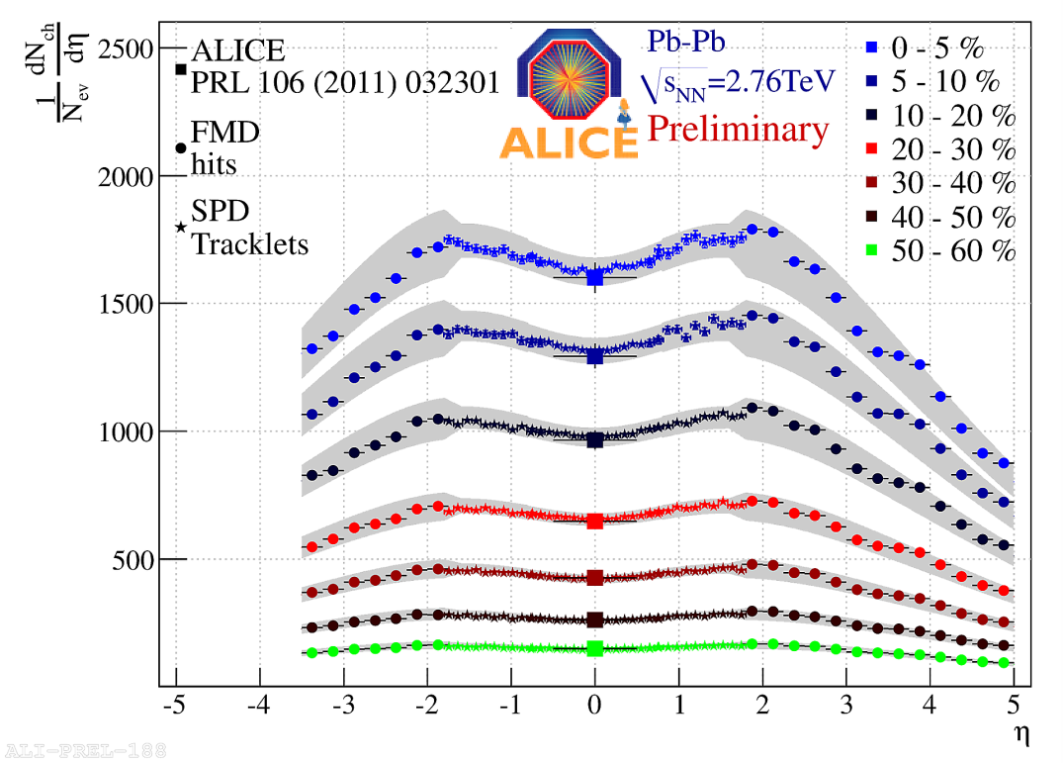
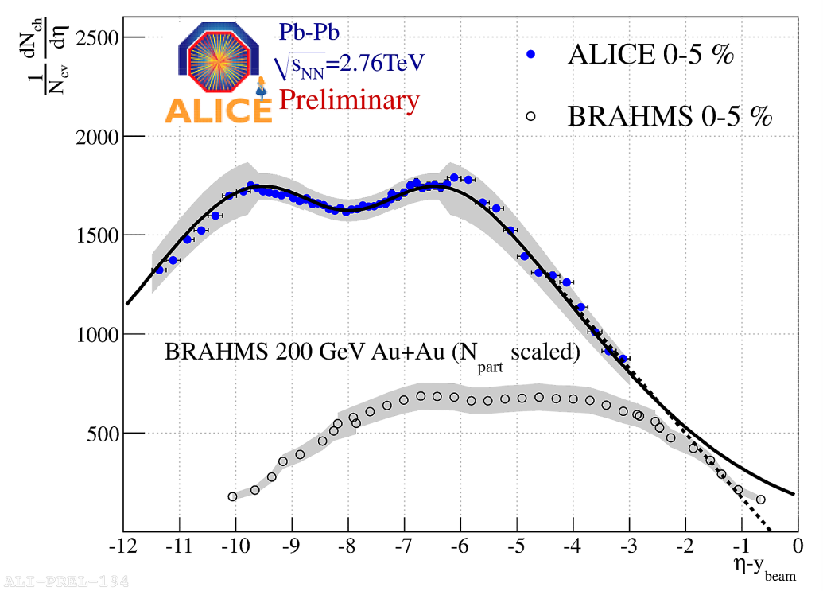
dN/dη versus η
Can measure distribution of produced particles
High η appears to show universal behavior
Most energy goes into production of particles at midrapidity
~ 18000 particles produced in central collision, 15 GeV/fm³ energy density
First order measurement
higher orders can give more information

Slide 15
Long Range Correlations (LRC)
How much does each side of the interaction communicate?
Not calculable from theory
Much information contained about the internal dynamics

Slide 16
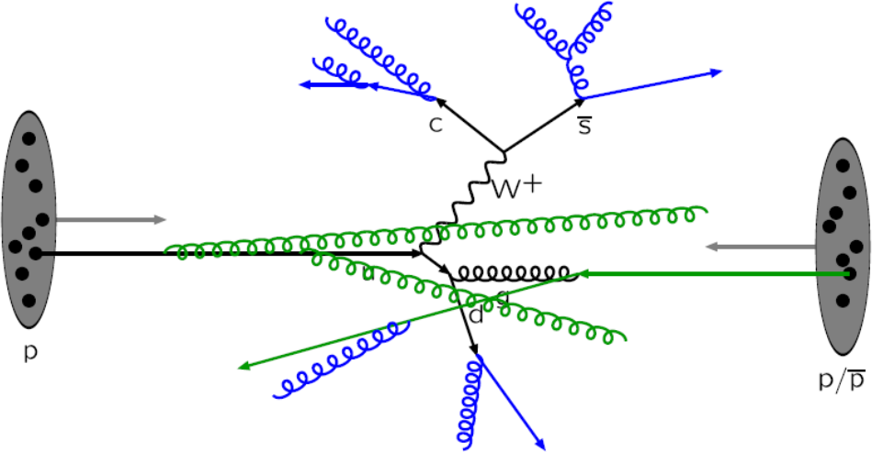
Proton Collision Processes

Slide 17
Summary
Active analysis crucial to understanding the QGP
Bulk properties and correlations are key topics
p-p data analyzed to gain deeper understanding of baseline interactions
Analyses will feed back into models
Gives understanding of initial state of Pb-Pb collisions
Divide out
initial state
Do we understand
the initial state?

Slide 18
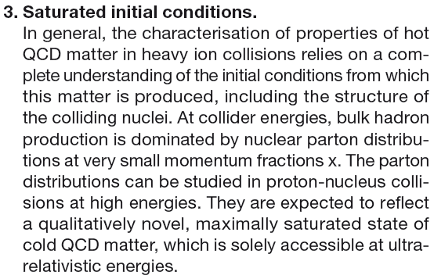
Future
p-Pb run November this year!
New opportunities to study nuclear matter in novel state (gluon saturation)
Shed light on possible complication to understanding the initial state of these collisions
Current measurement methods ready to be applied to p-Pb

Slide 19
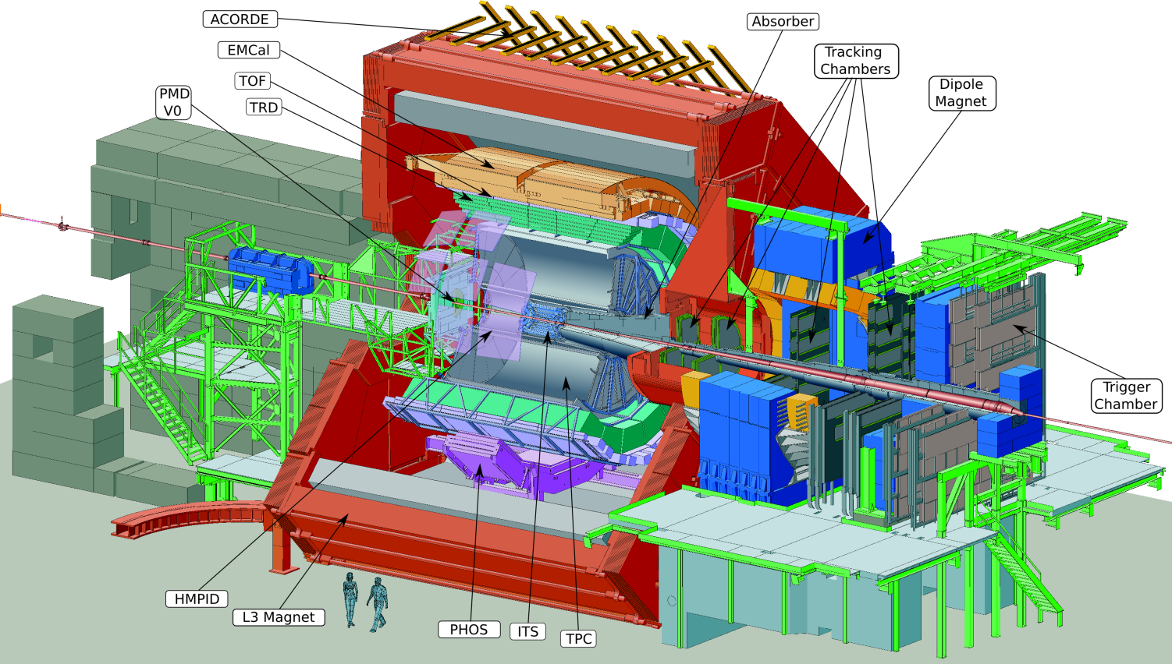
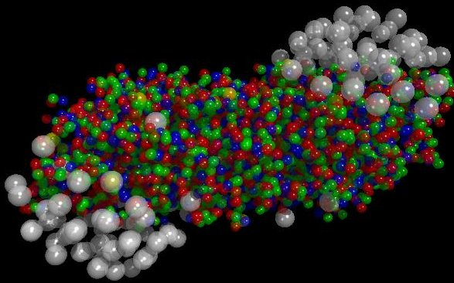
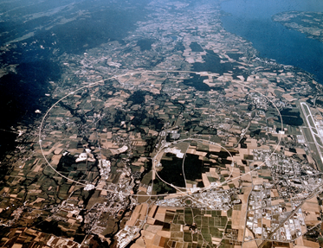
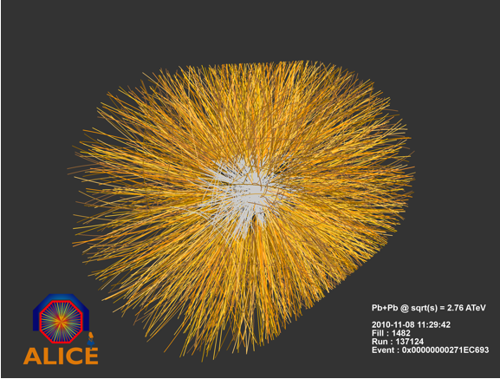
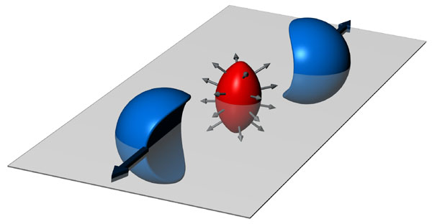
HEHI Group in 2012
Perm. Staff:
Ian Bearden
Hans Bøggild
Jens Jørgen Gaardhøje
Børge Svane Nielsen
Temp. Staff:
Christian Holm Christensen
Kris Gulbrandsen
PostDocs:
Ante Bilandzic (from 2/2)
Marek Chojnacki (from 7/5)
Hans Hjersing Dalsgaard
Casper Nygaard (to 30/6)
Ph. D. students:
Alexander Hansen
Carsten Søgaard (to 30/6)
Valentina Zaccolo
Undergradstudents:
Leire Arriola
Peter Jochumzsen
Bastian Poulsen
Thomas Schwanberger
Techn.& Eng.:
Henrik Bertelsen
Aksel Boiesen
Jimmy K. Hansen
Jørn Westergaard
Funded By:
-Danish Natural Science
Research Council(FNU)
-Danish Basic Research
Foundation (GF)
-Carlsberg Foundation

Slide 20
Backup Slides

Slide 21
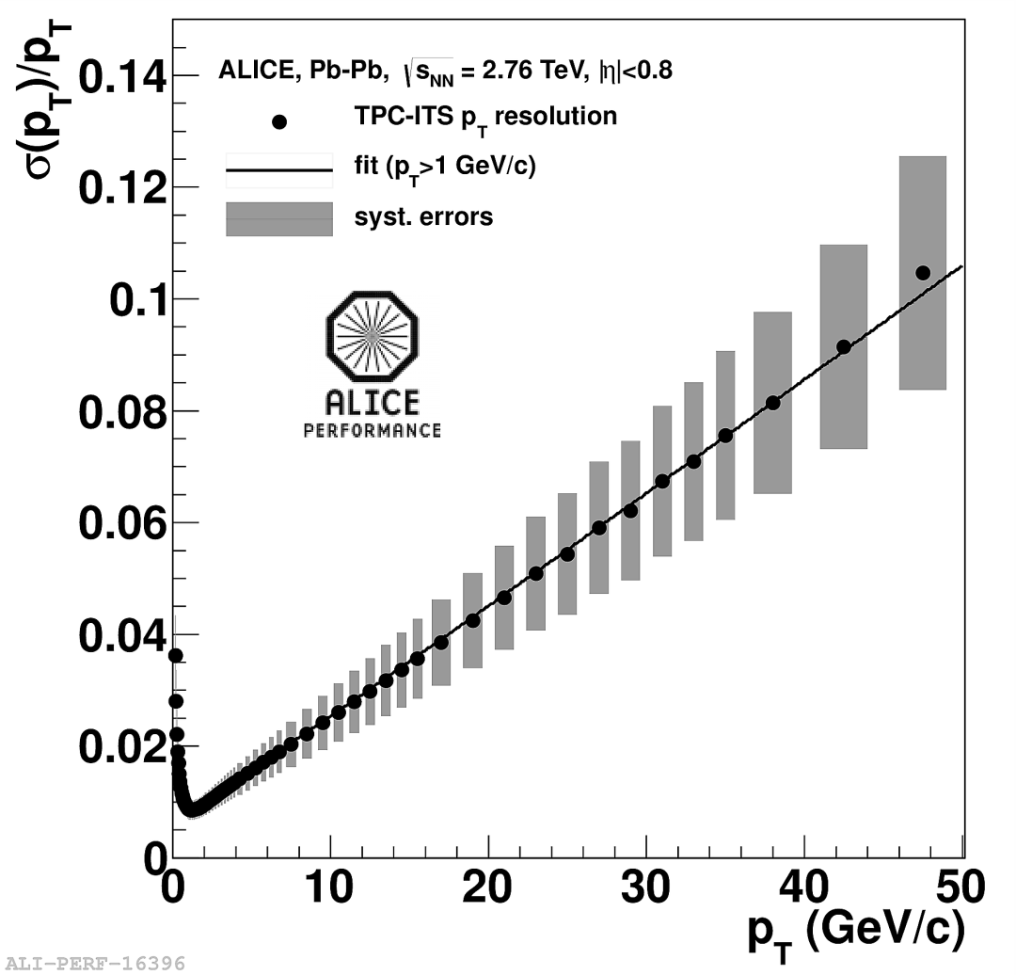
TPC Momentum Resolution

